Slide 1
Simple.Web
Developing RESTful web sites
and services, made easy

Slide 2
MVH
Model – View - Handler

Slide 3
Handlers
One Class per URI
(Single Responsibility Principle)

Slide 4
The Single
Responsibility
Principle:
a class should have one, and only one, reason to change
namespace MvcApplication1.Controllers
{
public class MoviesController : Controller
{
public ActionResult Index()
{
return View();
}
public ActionResult Details(int id)
{
// TODO: Add select logic here
return View();
}
public ActionResult Create()
{
return View();
}
[HttpPost]
public ActionResult Create(Movie movie)
{
try
{
// TODO: Add insert logic here
return RedirectToAction("Index");
}
catch
{
return View();
}
}
public ActionResult Edit()

Slide 5
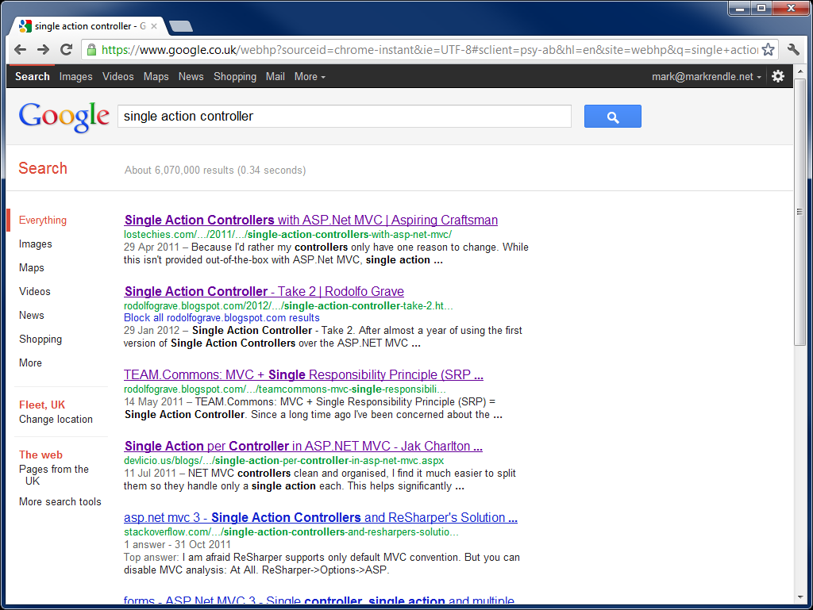

Slide 6
Handlers
One Class per URI
(Single Responsibility Principle)
Interfaces define behaviour
(Interface Segregation Principle)
Composable applications
(Open/Closed Principle)

Slide 7
Views
For HTML Content-Type
View renderer is simply a ContentTypeHandler
Automatically resolved
Using @model or @handler directives in Razor
Access to Handler variables
No @ViewBag required

Slide 8
Demo
Hello, Simple.Web

Slide 9
HTTP Interfaces
Synchronous
Asynchronous
IGet
IPost<T>
IPut<T>
IDelete
IPatch<T>
IHead
IGetAsync
IPostAsync<T>
IPutAsync<T>
IDeleteAsync
IPatchAsync<T>
IHeadAsync
OPTIONS handled automatically by framework

Slide 10
Other Interfaces
Request
Response
IUploadFiles
IRequireAuthentication
ILoginPage
ILogin
IOutput<T>
IOutputStream
ICacheability
IETag & IModified

Slide 11
OOWP
Inheritance
Handlers can derive from other Handlers
Encapsulation
Handler holds state and logic for operation

Slide 12
REST HATEOAS
Hypermedia
State transitions as Links
Automatic link generation
Content-Type negotiation
Handlers return data as POCOs
Data formatted as requested by client
Rich type descriptiveness

Slide 13
RESTy Attributes
Canonical(Type model)
To generate rel=“self”
LinksFrom(Type model)
To generate all other links
RespondsTo & RespondsWith
When different code is needed for different types

