Slide 1
LOG IN

Slide 2



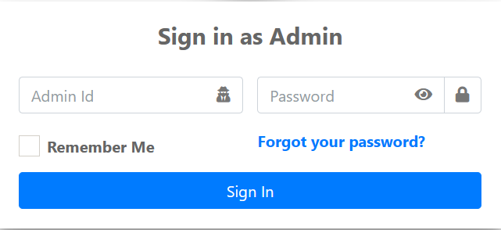
/
SLSU TO Department of Elementary Education

Slide 3
ADMIN
(Ikaw na balaha sa design marte, guide rani)

Slide 4
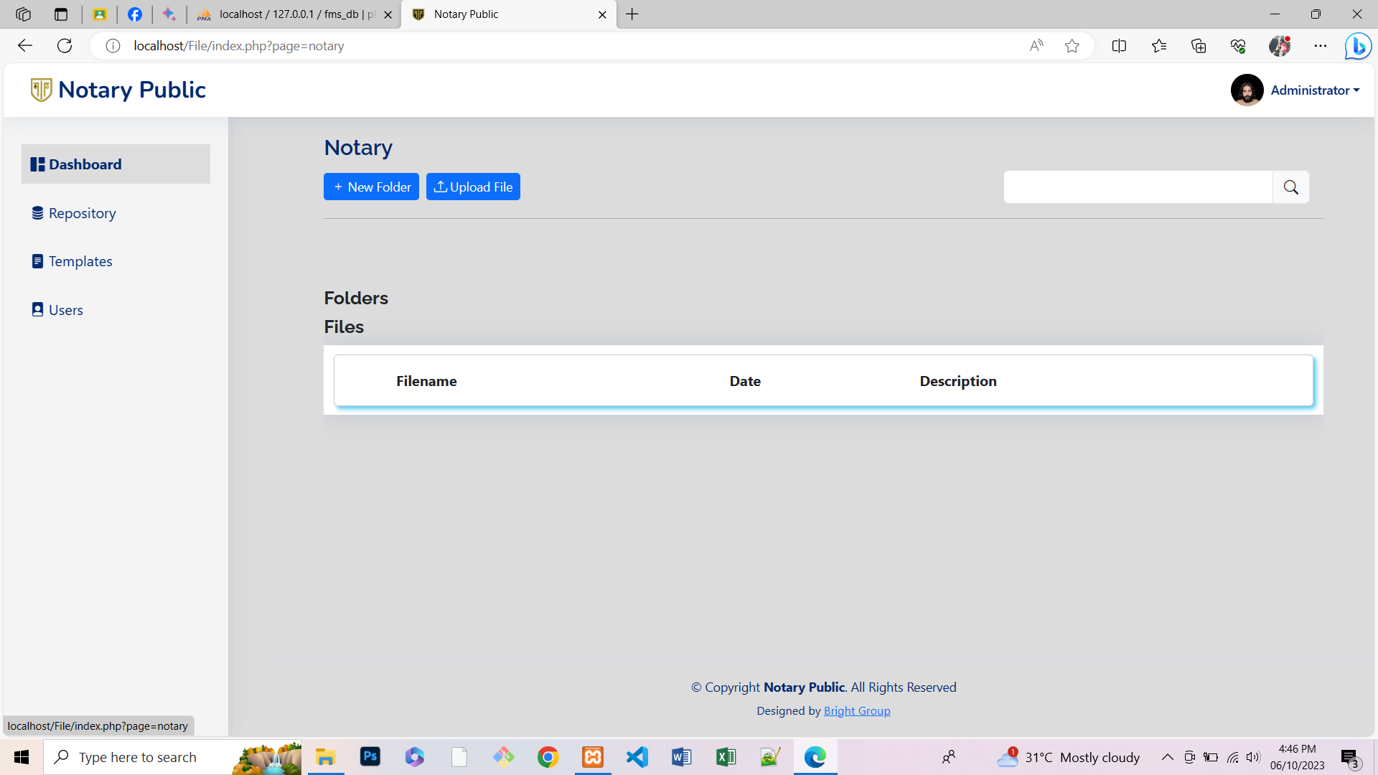


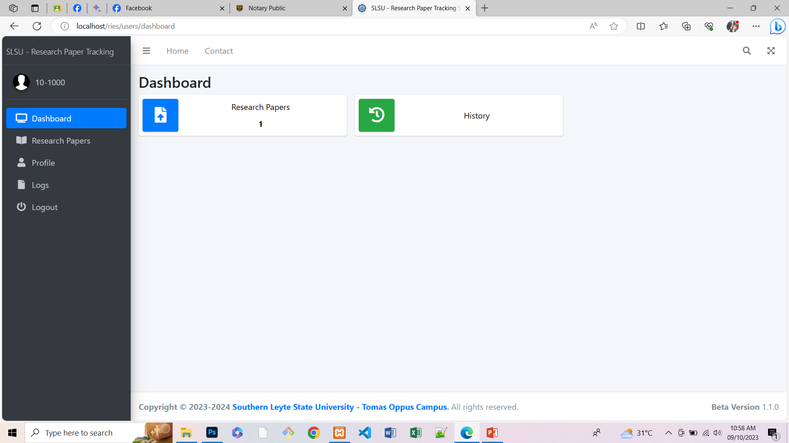



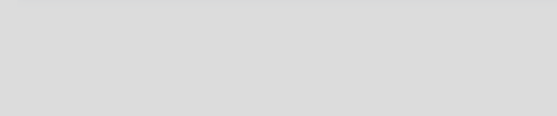
SLSU TO Department of Elementary Education
Notification ni dire marte sa mga ni send og file sa admin.
Hi Administrator!
Dashboard
My Files
Faculty
Number of Faculties
All Files Uploaded
Personal Files
?
Announcement
User
Ang dire pud marte is ang Number of Faculty nga na register sa system, ja tanan files nga na upload og personal files sa admin nga na upload. INDICATOR RANI MARTE.
Recently Uploaded Files
File Name | Uploaded by | Date | Description
Ang dire marte is ang mga recent files nga gi share nga file sa user dire sa admin.
Limit laman marte og 10 files kada page. Butangi laman og pagination.

Slide 5
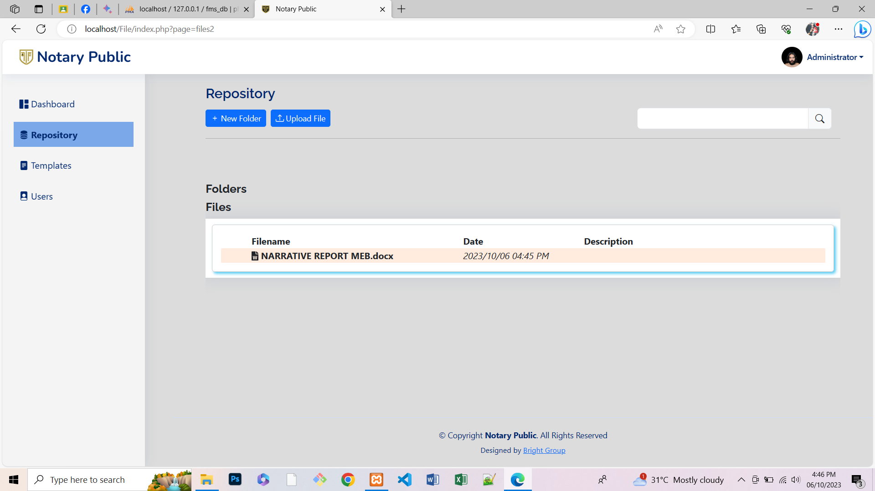

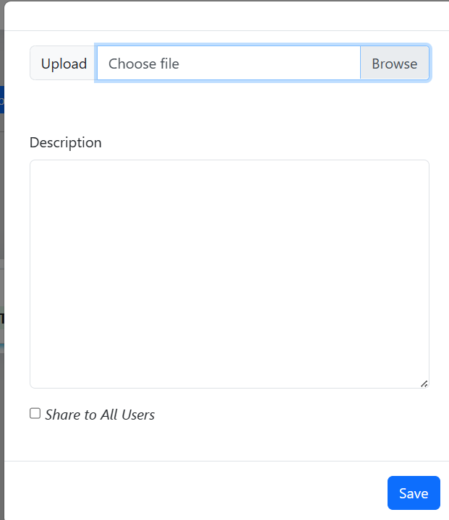
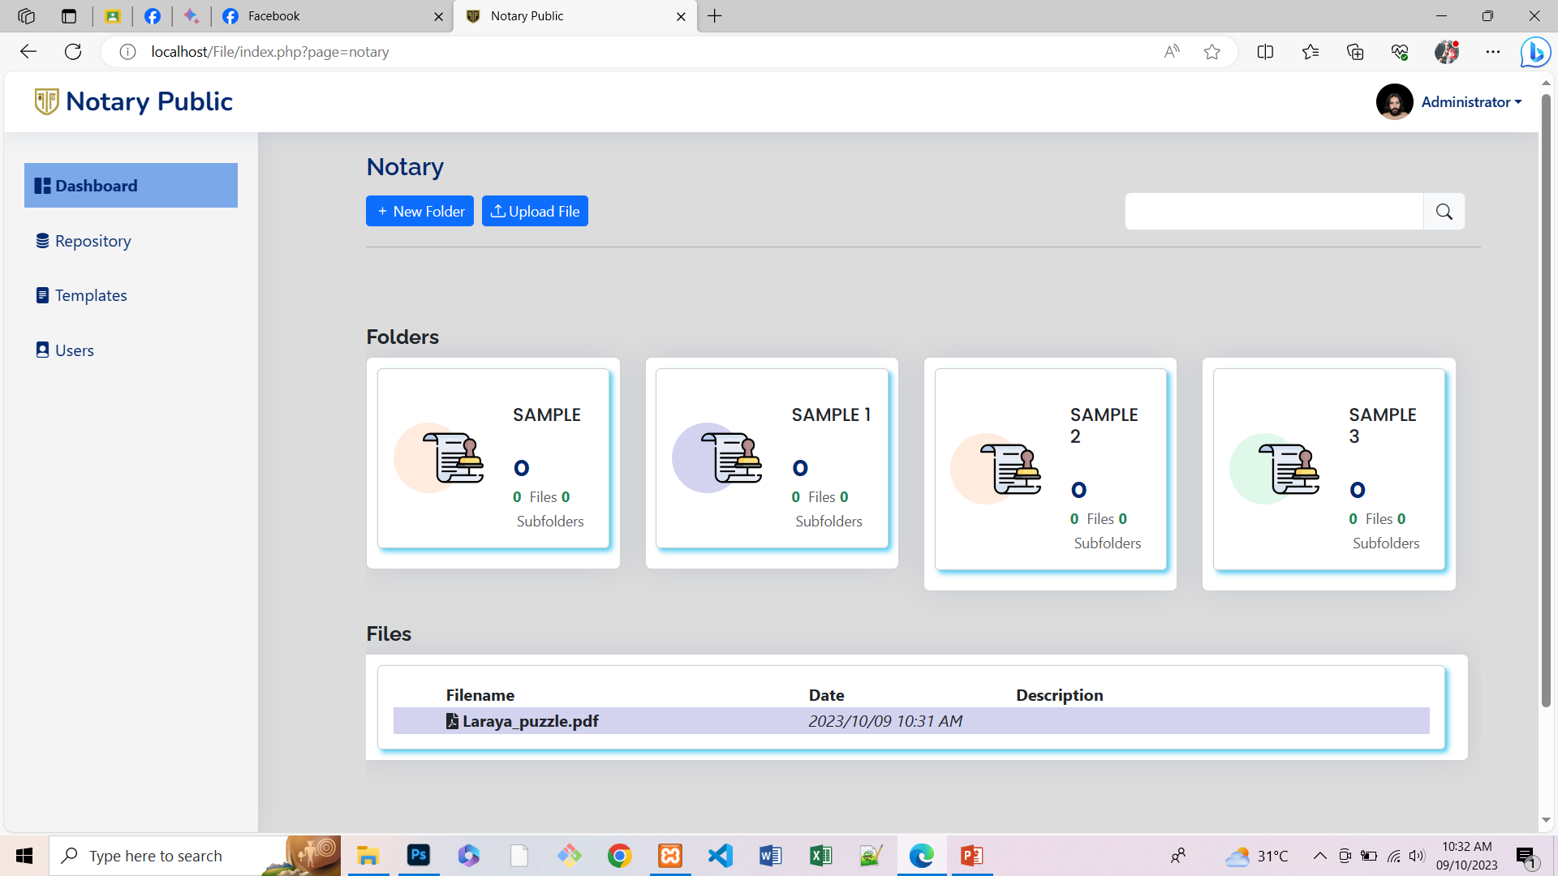
/
SLSU TO Department of Elementary Education
My Files
All Files
Faculty
Drop down ni sija dire nga makapili raka kinsa ang sendan nimu og files, pwede pud tanan nimu sendan dire mag check sa share to all faculty.
Faculty
?
List of Faculty
?
Share to all Faculty
Send
User
Mao ra ni sud sa My Files marte, guide ra ni marte sa purma ikaw nay bahala marte. Palihog laman kug utro sa logo anang kada files

Slide 6


SLSU TO Department of Elementary Education
Dashboard
All Faculty
My Files
Faculty
Announcement
File Name | Date | Description
User
Balansay, Aldrin
Ikaw nalaman bahala sa purma ani marte, basta dire is ang list sa mga faculty nga na register.
Ineg add sa new user automatic sija ma add dire sa faculty nga list.
Ig click sa box Makita ang mga files or folder nga ge share ni aldrin sa admin.

Slide 7

SLSU TO Department of Elementary Education
Dashboard
Button ni sija marte, ineg click ani and purma is pareha ra sa pag upload of file.
Ineg send sa announcement ma notify ang user nga nay announcement ang admin.
Announcements
Announcement
My Files
Faculty
Announcement
Create Announcement
Share to Faculty
Send
User
Announcement | Date
Dire ma save ang mga announcement.

Slide 8

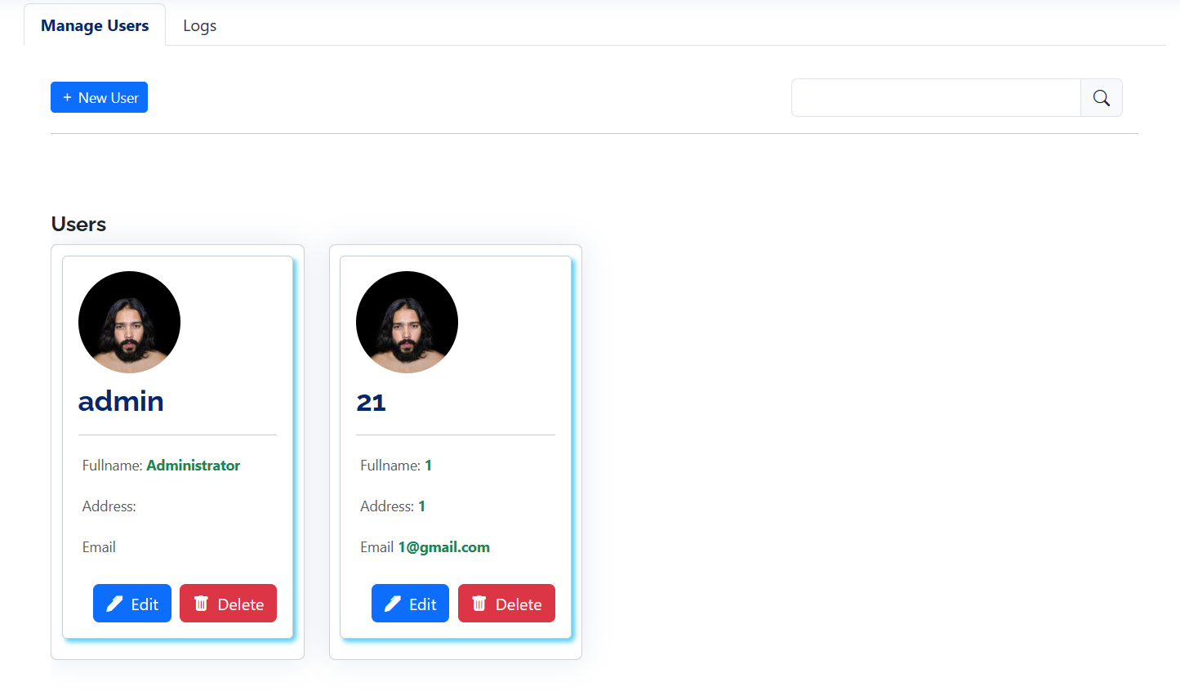
SLSU TO Department of Elementary Education
Dashboard
LOGS
Pun.e laman ang logs marte.
My Files
+ New Faculty
Faculty
Announcement
User

Slide 9
USER
(Ikaw na balaha sa design marte, guide rani)

Slide 10
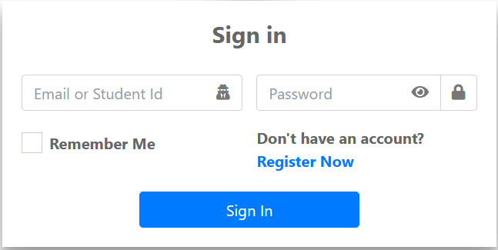
/
SLSU TO Department of Elementary Education

Slide 11

SLSU TO Department of Elementary Education
Dashboard
Hi (name of user)
My Files
Announcements
Announcements
Profile
Logs
Marte ikaw nay bahala unsa pay angay e butang sa dashboard sa user please man

Slide 12
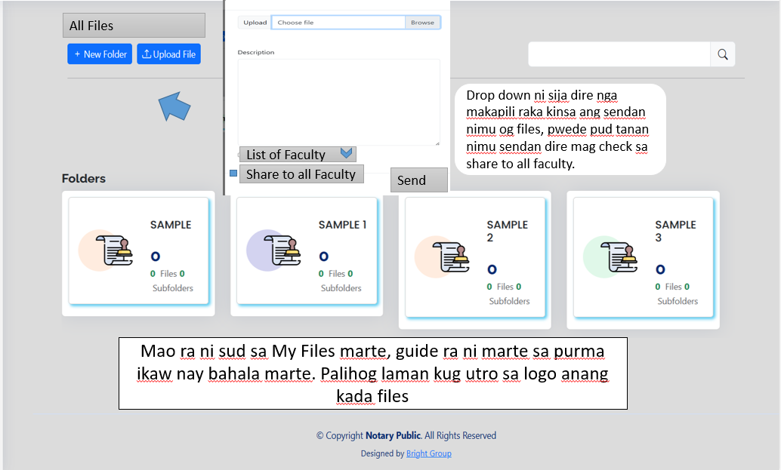
SLSU TO Department of Elementary Education
Dashboard
My Files
Announcements
Profile
Logs

Slide 13
SLSU TO Department of Elementary Education
Dashboard
All the Announcement
My Files
Announcement
Announcements
Announcements
Profile
Announcement | Date
Logs
Marte ikaw nay bahala unsa pay angay e butang sa dashboard sa user please man
Kung pwede marte inig click nimu sa announcement, nay modal nga ipakita ang full announcement.

Slide 14
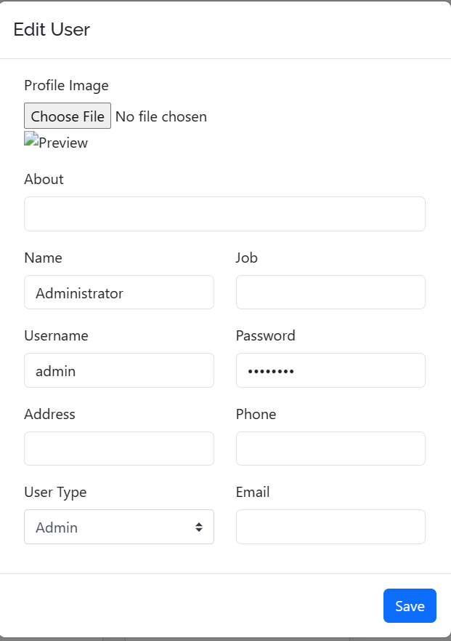
SLSU TO Department of Elementary Education
Dashboard
My Profile
My Files
Announcement
Announcements
Announcements
Profile
Profile
Logs
Ing.ani ra laman marte. Peru kung imung panindoton okay kaajo HAHAHAA
Marte ikaw nay bahala unsa pay angay e butang sa dashboard sa user please man

Slide 15
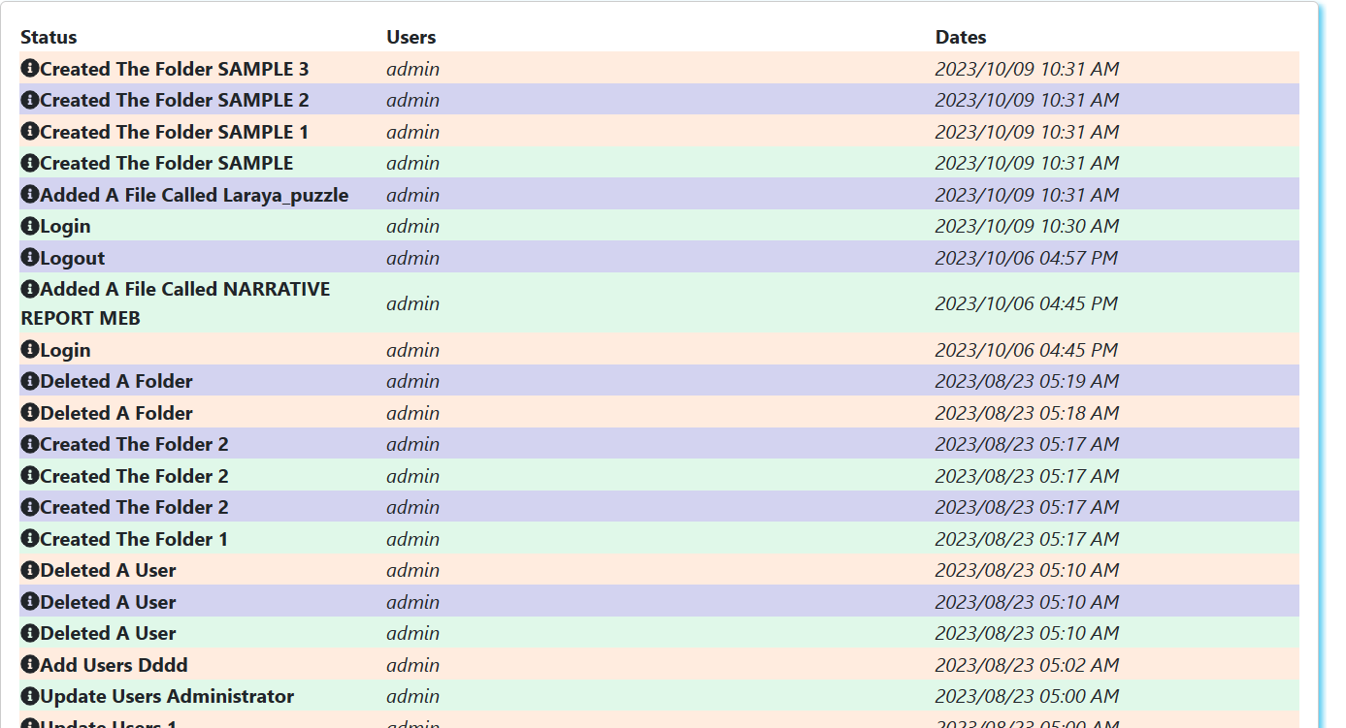
SLSU TO Department of Elementary Education
Dashboard
My Files
Announcement
Announcements
Announcements
Profile
Logs
Logs
Marte ikaw nay bahala unsa pay angay e butang sa dashboard sa user please man

Slide 16
SLSU TO Department of Elementary Education
MARTE GUIDE RA NI IKAW NAY BALAHA SA DESIGN OG PORMA,
UNTAG MASABTAN RA THANKSSSSSSSSSSSSSSSS
My Files
Announcement
Announcements
Announcements
Profile
Logs
Logs
Marte ikaw nay bahala unsa pay angay e butang sa dashboard sa user please man

