Slide 1
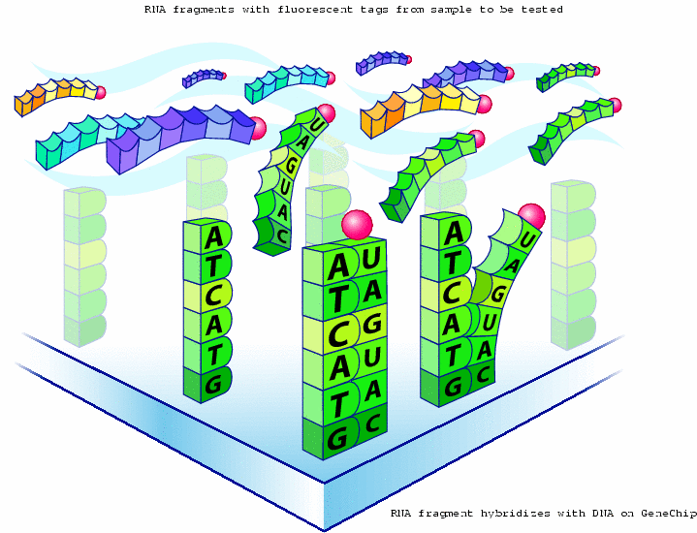
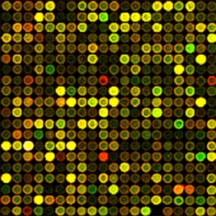
DNA microarray: arrays of northern blots
Abundance (of complementary DNA species) measured by flouresence intensity
probe
target

Slide 2


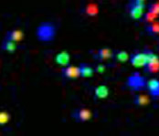
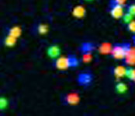
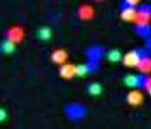
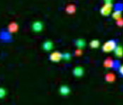
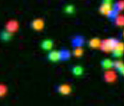

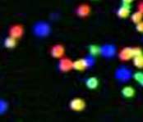
Illumina Sequencing Technology
3’
5’
DNA (0.1-1.0 ug)
A
G
C
T
A
G
C
T
T
C
A
C
G
G
A
T
A
A
T
C
C
C
G
C
G
A
T
T
Sample preparation
C
G
Single molecule array
A
Cluster growth
T
5’
Sequencing
1
2
3
4
5
6
7
8
9
T G C T A C G A T …
Image acquisition
Base calling
This slide courtesy of Gary Schroth, Illumina
Notes:
2

Slide 3
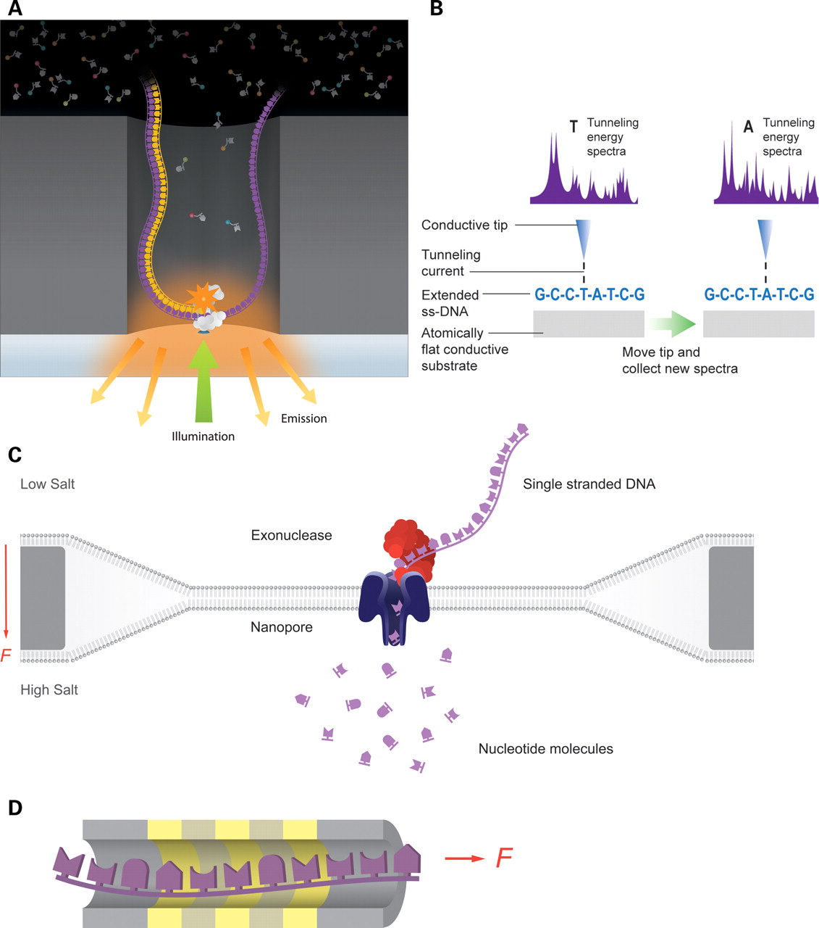

How third-generation DNA-sequencing technologies work.
How third-generation DNA-sequencing technologies work. Third-generation DNA-sequencing technologies are distinguished by direct inspection of single molecules with methods that do not require wash steps during DNA synthesis. (A) Pacific Biosciences technology for direct observation of DNA synthesis on single DNA molecules in real time. A DNA polymerase is confined in a zero-mode waveguide and base additions measured with florescence detection of gamma-labeled phosphonucleotides. (B) Several companies seek to sequence DNA by direct inspection using electron microscopy similar to the Reveo technology pictured here, in which an ssDNA molecule is first stretched and then examined by STM. (C) Oxford Nanopore technology for measuring translocation of nucleotides cleaved from a DNA molecule across a pore, driven by the force of differential ion concentrations across the membrane. (D) IBM's DNA transistor technology reads individual bases of ssDNA molecules as they pass through a narrow aperture based on the unique electronic signature of each individual nucleotide. Gold bands represent metal and gray bands dielectric layers of the transistor.
Eric E. Schadt et al. Hum. Mol. Genet. 2010;19:R227-R240
© The Author 2010. Published by Oxford University Press
Notes:
How third-generation DNA-sequencing technologies work. Third-generation DNA-sequencing technologies are distinguished by direct inspection of single molecules with methods that do not require wash steps during DNA synthesis. (A) Pacific Biosciences technology for direct observation of DNA synthesis on single DNA molecules in real time. A DNA polymerase is confined in a zero-mode waveguide and base additions measured with florescence detection of gamma-labeled phosphonucleotides. (B) Several companies seek to sequence DNA by direct inspection using electron microscopy similar to the Reveo technology pictured here, in which an ssDNA molecule is first stretched and then examined by STM. (C) Oxford Nanopore technology for measuring translocation of nucleotides cleaved from a DNA molecule across a pore, driven by the force of differential ion concentrations across the membrane. (D) IBM's DNA transistor technology reads individual bases of ssDNA molecules as they pass through a narrow aperture based on the unique electronic signature of each individual nucleotide. Gold bands represent metal and gray bands dielectric layers of the transistor.

