Slide 1
Introduction to Machine Learning: R/keras
Tensors, MNIST classification
Methods Seminar, SS20
Lead: Prof. Mark Robinson
Responsible: Ashley Polhemus and Sona Hunanyan

Slide 2
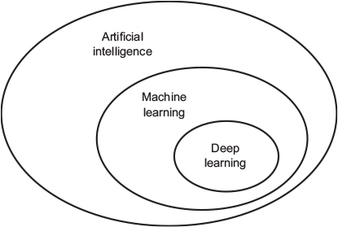
Artificial intelligence, machine learning, and deep learning
AI (born in 1950s): the effort to automate intellectual tasks normally performed by humans
ML (born in 1990s): could a computer go beyond “whatever we know how to order it to perform” and learn on its own how to perform a specified task?
DL (became prominent in early 2010s): define it after we know what machine-learning algorithms do…
Notes:
Chapter 1.1: What are artificial intelligence, machine learning, and deep learning? How do they relate to each other?
AI is a general field that encompasses machine learning and deep learning, but that also includes many more approaches that don’t involve any learning. Early chess programs, for instance, only involved hardcoded rules crafted by programmers.

Slide 3
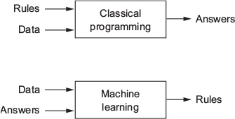
More on machine learning
ML system is trained rather than explicitly programmed
ML finds statistical structure in data that eventually allows the system to come up with rules for automating the task
ML is tightly related to mathematical statistics, but
tends to deal with large, complex datasets
exhibits comparatively little mathematical theory
ideas are proven empirically more often than theoretically
Notes:
In classical programming, the paradigm of symbolic AI, humans input rules (a program) and data to be processed according to these rules, and out come answers (see figure 1.2). With machine learning, humans input data as well as the answers expected from the data, and out come the rules. These rules can then be applied to new data to produce original answers.
Large, complex datasets (such as a dataset of millions of images, each consisting of tens of thousands of pixels)

Slide 4
What do we need to do machine learning?
Input data points
Speech recognition task – files of people speaking
Image tagging task – pictures
Examples of the expected output
Speech recognition task – human-generated transcripts of sound files
Image tagging task - tags such as “dog,” “cat,” and so on.
A way to measure whether the algorithm is doing a good job - to determine the distance between the algorithm’s current output and its expected output. This measurement is used to adjust the way the algorithm works. This adjustment step is called learning.
Notes:
1.1.2

Slide 5
Learning representations from data
Meaningfully transform data
meaningful outputs to learn useful representations of the data
What’s a representation?
RGB format
select all red pixels in the image
A color image
HSV format
make the image less saturated
Notes:
The central problem in ML and DL is to meaningfully transform data to get meaningful outputs , in other words to learn useful representations of the input data

Slide 6
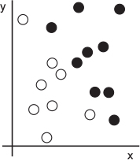
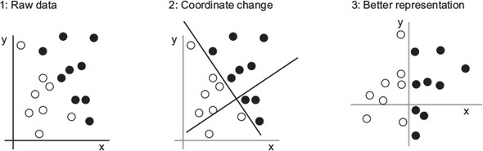
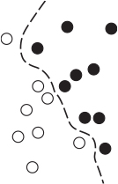
Learning representations from data: an example
Task: Take (x, y) coordinates of the points and output whether that point is likely to be black or white.
Alternative: Decision Boundary
Notes:
As you can see, we have a few white points and a few black points. Let’s say we want to develop an algorithm that can take the coordinates (x, y) of a point and output whether that point is likely to be black or to be white. In this case,
. The inputs are the coordinates of our points.
. The expected outputs are the colors of our points.
. A way to measure whether our algorithm is doing a good job could be, for instance, the percentage of points that are being correctly classified.

Slide 7
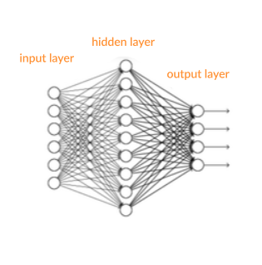
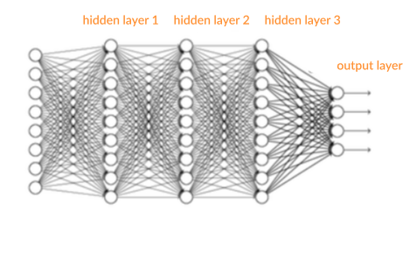
The ”deep” in deep learning
- Stands for the idea of successive layers of representations
How many layers contribute to a model of the data is called the depth of the model.
“Shallow” Model
“Deep” Model
Notes:
Deep learning is a specific subfield of machine learning: a new take on learning representations from data that puts an emphasis on learning successive layers of increasingly meaningful representations. Other appropriate names for the field could have been layered representations learning and hierarchical representations learning.

Slide 8
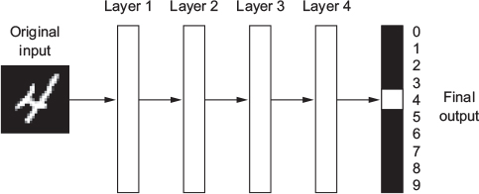
Basics of a neural network
The layered representations are learned via models called neural networks
The term neural network is a reference to neurobiology, however, DL models are NOT models of the brain, only that some concepts in DL were developed by drawing inspiration from our understanding of the brain.
Notes:
Let’s examine how a network several layers deep transforms an image of a digit in order to recognize what digit it is.

Slide 9
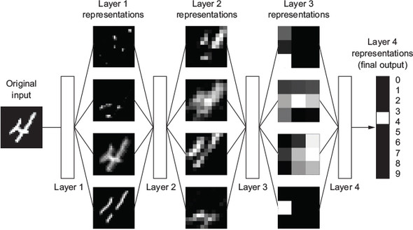
Deep representations learned by a digit-classification model
Notes:
As you can see in Figure, the network transforms the digit image into representations that are increasingly different from the original image and increasingly informative about the final result. You can think of a deep network as a multistage information-distillation operation, where information goes through successive filters and comes out increasingly purified (that is, useful with regard to some task).

Slide 10
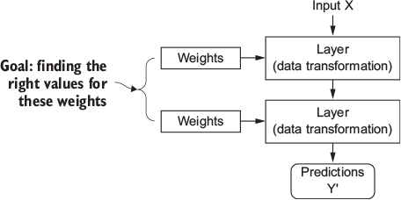
How deep learning works? Step 1
The specification of what a layer does to its input data is stored in the layer’s weights (parameters), equivalently, the transformation implemented by a layer is parameterized by its weights.
Learning means finding a set of values for the weights of all layers in a network, such that the network will correctly map example inputs to their associated targets.
Notes:
At this point, you know that machine learning is about mapping inputs (such as images) to targets (such as the label “cat”), which is done by observing many examples of inputs and targets. You also know that deep neural networks do this input-to-target mapping via a deep sequence of simple data transformations (layers) and that these data transformations are learned by exposure to examples.

Slide 11
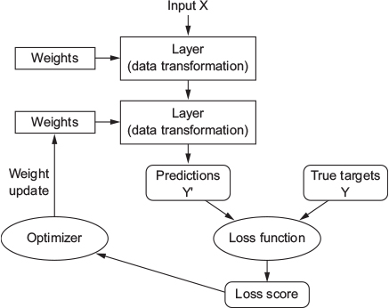
Building blocks: Tensors, weights, and activation functions

Slide 12
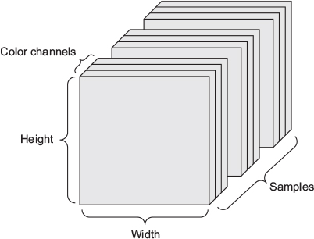
What is a tensor?
Multidimensional array of integers upon which you can perform simple calculations to transform input data in a layer of a neural network
Defined by
Number of axes (Rank)
Shape
Data type

Slide 13
Common tensor shapes:
2D – Vector data (samples, features)
3D – Timeseries data (samples, time, features)
4D – Images (samples, height, width, channels)
5D – Videos (samples, frames, height, width, channels)
Notes:
Tensor - Notation

Slide 14
What Rank and Shape would the following tensors have?
An actuarial dataset of 1 million people, including each person’s age, area code, and income
2D, (1000000, 3)
A batch of 128 grayscale images of size 256 × 256
4D, (128, 256, 256, 1)
A dataset of tweets, where we encode each tweet as a sequence of 140 characters out of an alphabet of 128 unique characters
3D, (# samples, 140, 128)

Slide 15
Tensor Operations
Simple operations applied to tensors to manipulate data in a layer
Element- wise operations (addition, subtraction, multiplication)
Relu() Same as max(x, 0)
Dot product
Notes:
Tensor operations – element-wise vs. dot product

Slide 16
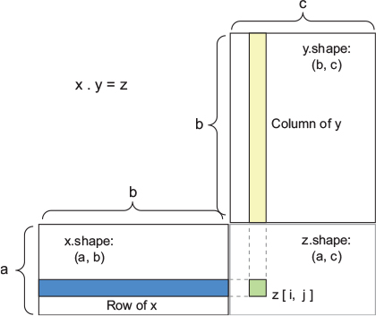
Dot Product
Vector - Vector Dot Product
- For all indices in vector x, sum the products of x[[i]] and y[[i]]
- For each row in matrix X and each column in matrix Y, compute the vector dot product of each row of X and column of Y
Properties
- asymmetric
- relies on shape compatibility
Outputs
(a, b, c, d) . (d) -> (a, b, c)
(a, b, c, d) . (d, e) -> (a, b, c, e)

Slide 17
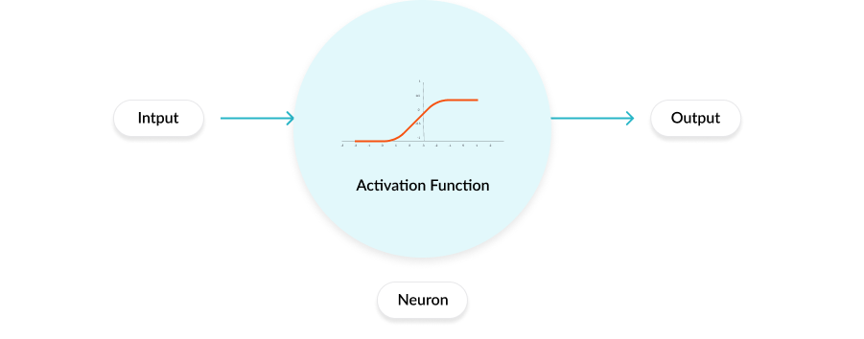
Activation Functions
In a neural network each neuron has a weight and multiplying the input number with the weight gives the output of the neuron, which is transferred to the next layer.
The activation function is a mathematical “gate” in between the input feeding the current neuron and its output going to the next layer.
Notes:
For more details refer to https://missinglink.ai/guides/neural-network-concepts/7-types-neural-network-activation-functions-right/

Slide 18
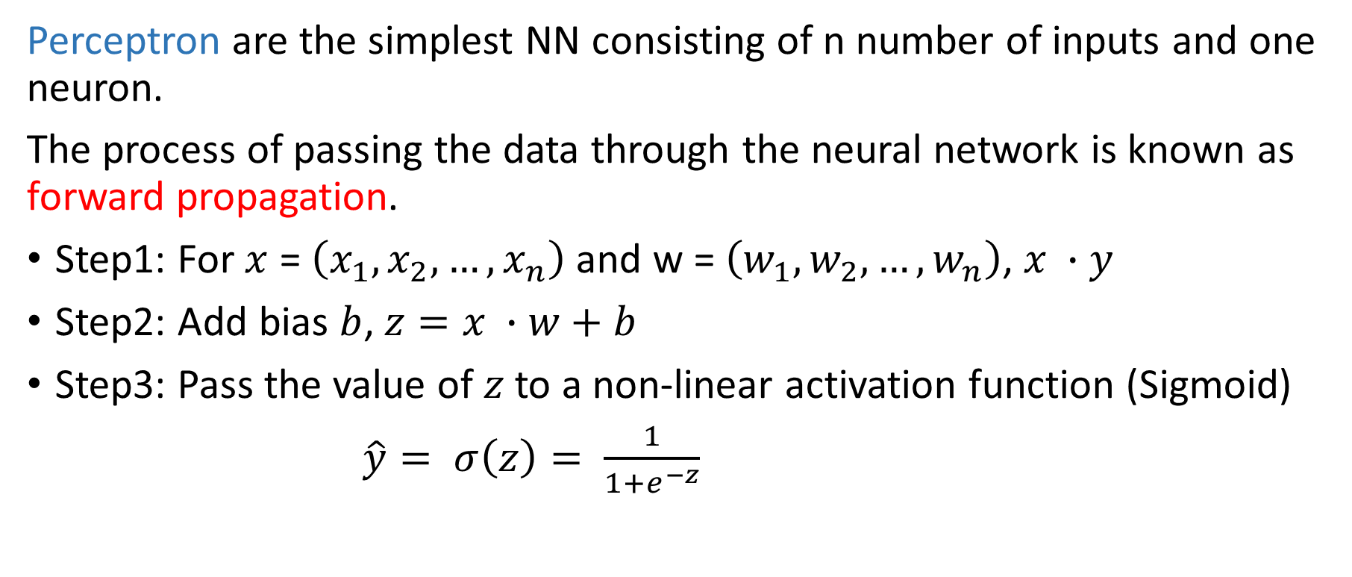
Mathematical representation of an activation function
Perceptron are the simplest NN consisting of n number of inputs and one neuron.
The process of passing the data through the neural network is known as forward propagation.
Step1: For $x$ = $\left(x_{1}, x_{2},…, x_{n}\right)$and w = $\left(w_{1}, w_{2},…, w_{n}\right)$, $x ∙y$
Step2: Add bias $b$, $z=x ∙w+b$
Step3: Pass the value of $z$ to a non-linear activation function (Sigmoid)
$\hat{y}= σ\left(z\right)= \frac{1}{1+e^{−z}}$
Notes:
Pass the value of z to a non-linear activation function. Activation functions — are used to introduce non-linearity into the output of the neurons, without which the neural network will just be a linear function. Moreover, they have a significant impact on the learning speed of the neural network.
See detail in https://hackernoon.com/a-6ur13zzx

Slide 19
Three types of activation functions
Binary step function
Linear activation functions
Non-linear activation functions
Sigmoid/Logistic
TanH / Hyperbolic Tangent
ReLU (Rectified Linear Unit)
Leaky ReLU
Parametric ReLU
Softmax
Swish

Slide 20



Desirable Properties of an activation function
Non-linear
Range – Balance between stability and efficiency
Continuously differentiable – Enables gradient-based optimization and backpropogation
Approximates f(x) = x near the origin – Enables efficient learning when weights are initialized with small random values
Binary Step Function
ReLU
TanH

Slide 21
Unpacking Deep Learning ‘Layers’

Slide 22
Unpacking Deep Learning ‘Layers’
Input tensor
Activation Function
Simple tensor operation
+, -, *, dot, etc.
Weight tensor
(modifiable or ‘trainable’ transformation factors)
Output tensor

Slide 23
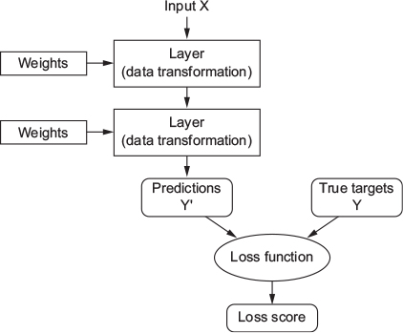
How deep learning works? Step 2
To control the output of a neural network,
you need to be able to measure how far
this output is from what you expected.
This is done by a loss function
(objective function) that takes the
predictions of the network and the
true target and computes a distance score,
capturing how well the network has done.
Notes:
the true target - what you wanted the network to output

Slide 24
What is a loss function?
Prediction: The model’s output (i.e., a classification)
Loss Function: Function calculating chosen metrics of the model’s performance (i.e., accuracy).
Loss Score: Quantifies the difference between the desired/true values and those generated by the model
Lower loss score –> better prediction

Slide 25

How deep learning works? Step 3
The fundamental trick in deep
learning is to use this score to
adjust the value of the weights in
a direction that will lower the
loss score.
This adjustment is the job of the
optimizer, which implements the
Backpropagation algorithm
Notes:
The next chapter explains in more detail how backpropagation works.
Initially, the weights of the network are assigned random values, so the network merely implements a series of random transformations. Naturally, its output is far from what it should ideally be, and the loss score is accordingly very high. But with every example the network processes, the weights are adjusted a little in the correct direction, and the loss score decreases. This is the training loop, which, repeated a sufficient number of times (typically tens of iterations over thousands of examples), yields weight values that minimize the loss function. A network with a minimal loss is one for which the outputs are as close as they can be to the targets: a trained network. Once again, it’s a simple mechanism that, once scaled, ends up looking like magic.

Slide 26
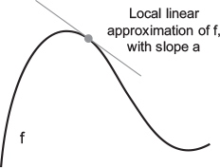
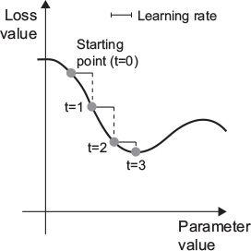
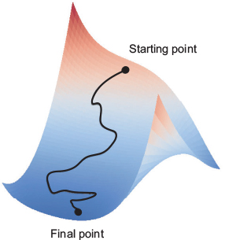
What is gradient descent?
Goal: Minimize loss function
To do this, the optimizer adjusts the weights a little in the direction of the gradient of the loss function
1. Find the derivative (‘gradient’) of the loss function
2. Adjust weights in the direction of the gradient (backpropagation, via chain rule)
3. Appropriate adjustments and batch sizes allow you to find global min of loss()
Notes:
Optimizing objective & loss functions – Gradient descent

Slide 27
Summing it all up…
A deep learning model contains successive layers of data representations which are trained to transform input data based on an original set of inputs and outputs
A tensor is a multi-dimensional array which can be used to transform data, or itself be transformed via simple tensor operations
A deep learning model’s input and output are tensors containing data, while weights are tensors to used to transform input and output tensors. Tensor operations are performed sequentially in (many) layers.
An activation function determines whether and which neurons are fired given the inputs and outputs of the layers
An optimizer adjusts the model’s weights according to the gradient of a loss function to minimize the loss score
Weights are adjusted through backpropagation, applying the chain rule to adapt weights according to the loss function’s derivative.

Slide 28
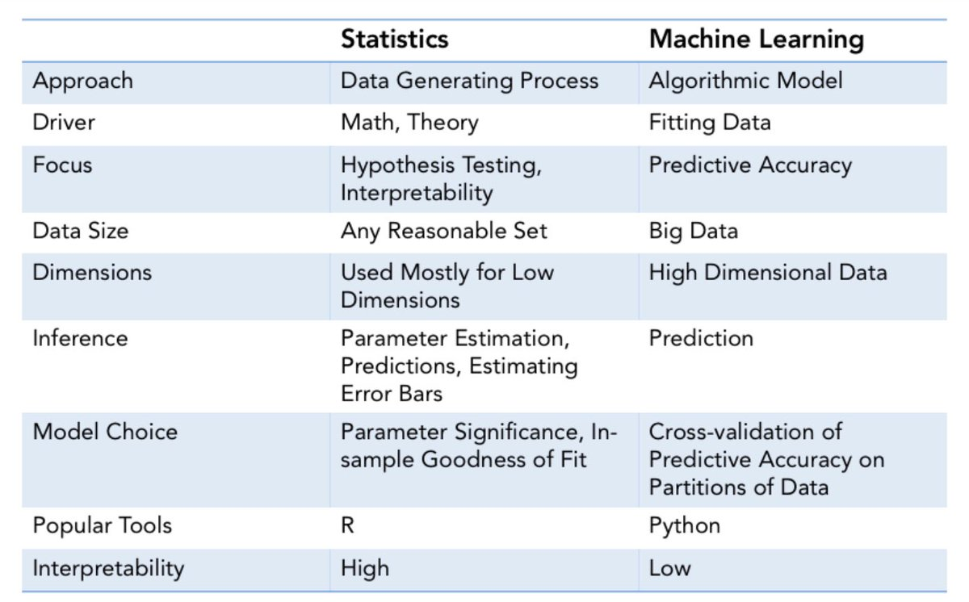
Translating between Statistics and Machine Learning
https://pbs.twimg.com/media/ENNEGGhX0AEWNYO.jpg

Slide 29
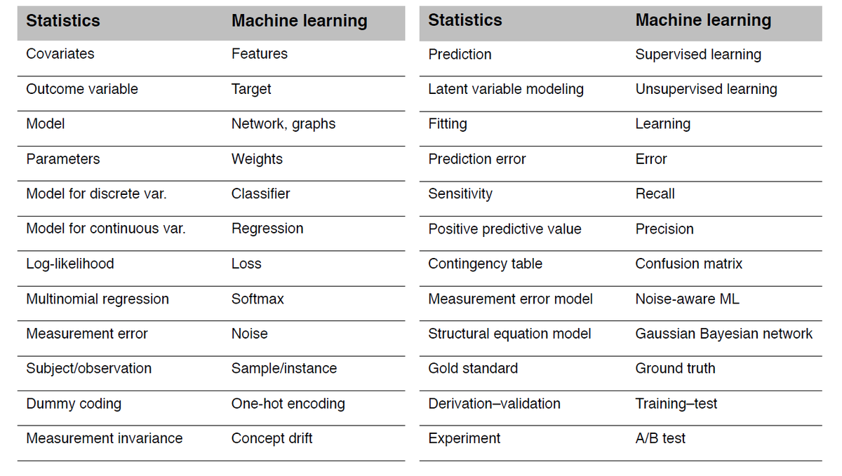
Translating between Statistics and Machine Learning
https://pbs.twimg.com/media/EQBFqE1U8AEVh0i.png

Slide 30
Helpful Resources
Deep Learning with R
https://livebook.manning.com/book/deep-learning-with-r/chapter-1/101
An introduction to the math behind neural networks:
https://hackernoon.com/a-6ur13zzx
How to choose Activation Functions:
https://missinglink.ai/guides/neural-network-concepts/7-types-neural-network-activation-functions-right/
A tutorial for comparing Optimizers:
https://medium.com/@onlytojay/mnist-cnn-optimizer-comparison-with-tensorflow-keras-163735862ecd

Slide 31
In-Class Exercise
Keras Setup
MNIST example

Slide 32
What is Keras?
Keras (https://keras.rstudio.com) is a deep-learning framework that provides a convenient way to define and train almost any kind of deep-learning model.
Keras has the following key features:
It allows the same code to run seamlessly on CPU or GPU.
It has a user-friendly API that makes it easy to quickly prototype deep-learning models.
It has built-in support for convolutional networks (for computer vision), recurrent networks (for sequence processing), and any combination of both.
It supports arbitrary network architectures: multi-input or multi-output models, layer sharing, model sharing, and so on. This means Keras is appropriate for building essentially any deep-learning model, from a generative adversarial network to a neural Turing machine.

Slide 33
Installation instructions
The Keras R package is compatible with R versions 3.2 and higher, to check which version do you have installed, type
+ version #in Rstudio
The documentation for the R interface is available at https://keras.rstudio.com
The main Keras project website can be found at https://keras.io.
Notes:
1. How to check the R version from Rstudio?

Slide 34
Install Anaconda for Python
For Windows users:
Install Anaconda for Python 3.x
(https://www.anaconda.com/download/#windows) before installing Keras.
Linux and macOS users can install Anaconda from the same web page by choosing the corresponding tab.

Slide 35
Install Keras
# install the keras R package from GitHub as follow
+ devtools::install_github("rstudio/keras")
#The Keras R interface uses the TensorFlow backend engine by default.
# To install both the core Keras library as well as the TensorFlow backend use the
+ library(keras)
+ install_keras() #linux and macOS users can choose method = "virtualenv“ or "conda"
Notes:
“virtualenc doesn’t work for windows”

Slide 36

MNIST Example

Slide 37
Exercise – Optimizers & Activation Functions
Optimizers
Activation Functions
'Adadelta', 'Adagrad', 'Adam', 'Adamax', 'Nadam', 'RMSprop', 'SGD’
https://medium.com/@onlytojay/mnist-cnn-optimizer-comparison-with-tensorflow-keras-163735862ecd
‘sigmoid’
‘softmax’
‘tanh’
‘relu’
https://towardsdatascience.com/exploring-activation-functions-for-neural-networks-73498da59b02

