Slide 1
Pitch Prediction Can we predict the next pitch?
Springboard Data Science Career Track
Mark Rojas

Slide 2
Concerns
Major League Baseball (MLB) attendance dropped more than 6% this year, continuing a steady decline.
“It’s the lowest league-wide attendance since 2003 and the largest single-season drop in a decade.”
While some clubs saw a jump in attendance, 17 of the 30 franchises sold fewer tickets than they did last year.
Using average ticket prices from Team Marketing Report, that comes to about $93.7 million in lost ticket revenue in 2018.
- money.com

Slide 3
But why?
High Ticket Prices
Poor Weather Conditions
Off-season Inactivity
In-game Action! ( or lack of )
Possible Reasons:

Slide 4
So what can we do?
Increased player salaries makes lowering ticket prices unsustainable.
As of today, we are still unable to control the weather.
Not every team can acquire the ‘big’ name free-agent during the off-season or win the World Series like the Houston Astros did in 2017 who recorded a $23.7 million boost in sales in 2018.
Let’s improve the in-game action!
But how?

Slide 5
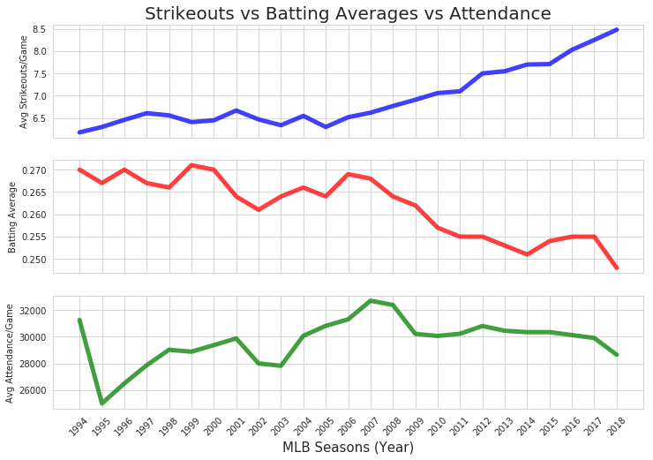
Impact on Attendance
Strikeouts | Batting Average
Average
Strikeouts per Game
Batting Averages
(Hits / At Bats)
Partial Season Lockout
Average
Attendance per Game
Down
~6.5%

Slide 6
Goal
By increasing the mean Batting Average (BA) for hitters, we:
Increase number of base runners
Increase chances for stolen bases
Increase opportunities to pick-off runners
Increase potential runs
Deliver an action-packed game!
Putting butts in the seats!

Slide 7
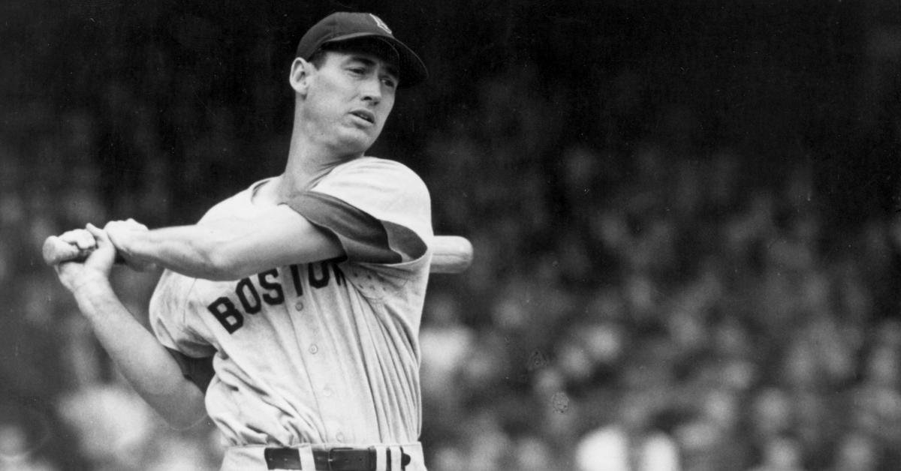
Just get more hits!
"Hitting is the single most difficult thing to do in a sport"
– Ted Williams

Slide 8
Throw Hitters a Life Line
Many pitchers these days are taking steps to avoid ‘tipping’ their pitches, so it’s harder to tell what pitch is coming.
Teams found in violation of ‘sign stealing’ could be punished with forfeited draft picks and international spending money.
We propose the use of Machine Learning to predict the next-pitch and in turn improve a hitters overall Batting Average.

Slide 9
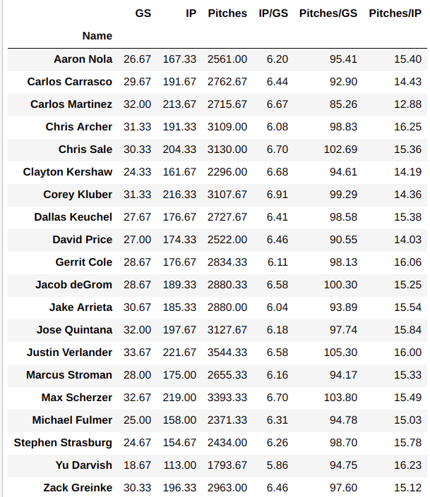
Pitchers of Interest (POI)
‘Top’ 20 pitchers of interest selected from the 2016, 2017, and 2018 seasons.
GS – Games started / season
IP – Innings pitched / season
Pitches - Pitches thrown / season
IP/GS – Innings pitched / game
Pitches/GS – Pitches thrown / game
Pitches/IP – Pitches thrown / inning
Note: The averages for these pitchers of interest are in-line with the rest of the starting pitchers in MLB.

Slide 10
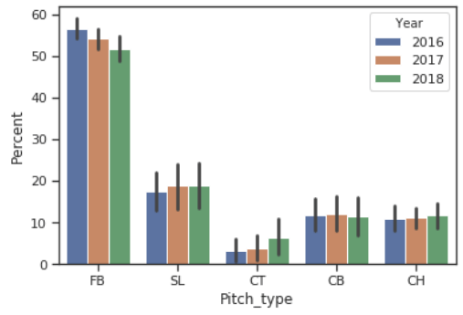
Pitch Type Consistency
Percent of Pitch Types Thrown from 2016 - 2018
We continue to see roughly the same ratios of Fastballs, Sliders, Cutters, Curveballs, and Change-ups thrown from year-to-year.
From 2016-2018, the percent of Fastballs has decreased slightly while Cutters have increased.

Slide 11
The Dataset – Sportradar API
Past Events:
Pitch Type
Pitch Velocity
Pitch Location*
Pitch Outcome*
Pitch Sequences*
Hit Type*
Hit Zone*
Is_Bunt_Shown*
Is_Strike_Zone*
167,427 observations | 41 features for all 20 POI’s
Past Events – are those that describe the previous pitch or a result of the previous pitch.
Current Situations – are those that describe the current in-game condition.
Our Target (labeled pitch types), will be used to train our model and attempt to predict the Next Pitch Type.
Target Pitch Types:
FB = Fastball
SL = Slider
CT = Cutter
CB = Curveball
CH = Change-up
SP = Splitter
KN = Knuckleball
Current Situations:
Inning
Top / Bottom Inning*
Pitch Count
Hitter Count
Hitter Handedness*
At-Bat Count*
Number of Outs
Cumulative Pitch Type Sums
Cumulative Pitch Type %
* categorical features

Slide 12
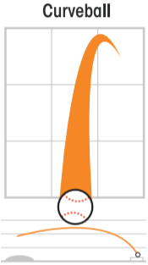
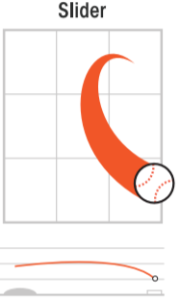
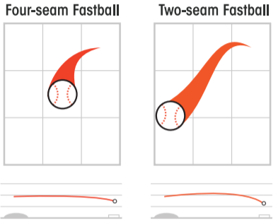
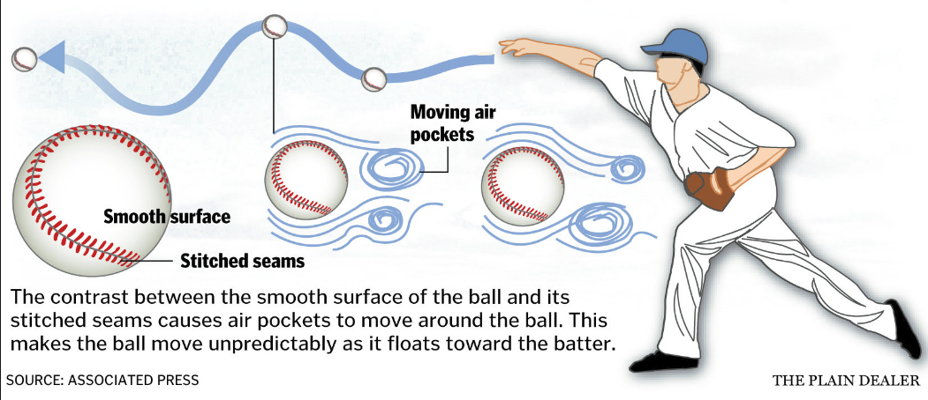
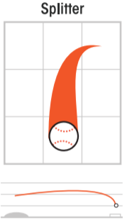
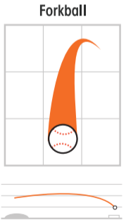
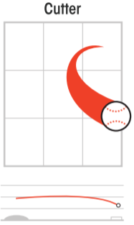
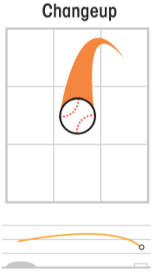
Common Pitch-Types
Breakers:
Curveball (70-80 mph)
Breaks from top to bottom
Slider (80-90 mph)
Breaks down and away from Right Handed Hitters
It is between a fastball and curve
Knuckleball
(60-70 mph)
Unpredictable pitch, movement will vary
Change-ups:
Change-up (70-85 mph)
Slower than a fastball, but thrown with the same arm motion
Fastballs:
Four-seam (85-100 mph) - Fastest, straightest pitch, little movement
Two-seam / Sinker (80-90 mph) - Moves downward
Splitter (80-90 mph) – Breaks down suddenly before reaching plate
Forkball (75-85 mph) – Like splitter but gradual downward movement
Cutter (85-95 mph) – Faster than slider, more movement than fastball

Slide 13
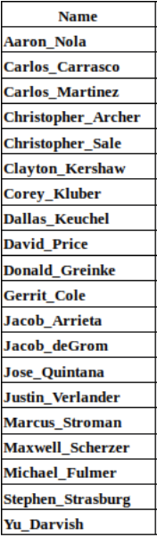
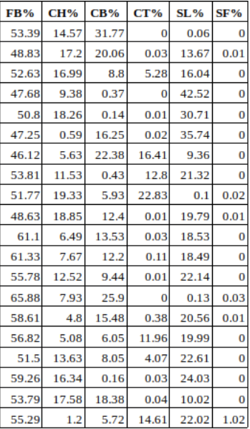
Pitchers Arsenal of Pitch Types
Percent of pitch-types each pitcher throws as part of their arsenal (2016-2018)
Class Imbalance!

Slide 14
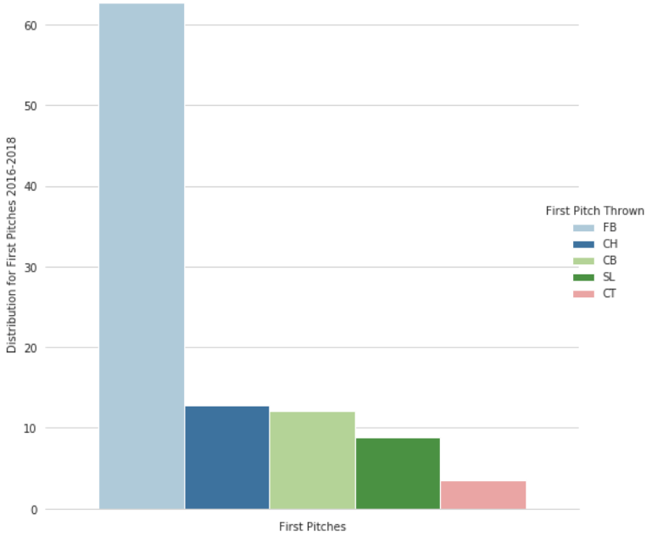
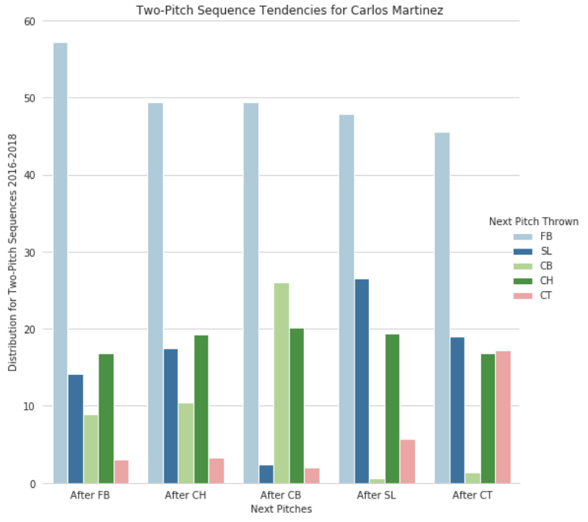
Naive Approach
First, let’s consider only the previous pitch when predicting the next pitch. There are two ways to apply the naive approach.
First pitches
Start of every inning, there is a first pitch, when there is not a previous pitch
Two-pitch sequences
Sequence of pitches consisting of previous pitch followed by the next pitch
Distribution of First Pitch and Two-Pitch Sequences for Carlos Martinez (2016-2018)

Slide 15
Naive Approach
Measure Performance Examples - Accuracy
In the case for Carlos Martinez, we see that we have exactly 5 classes, requiring multi-class classification.
Pitch Type | Percent Thrown
Fastball (FB) | 0.538
Cutter (CT) | 0.039
Curveball (CB) | 0.095
Slider (SL) | 0.154
Change-up (CH) | 0.174
Pitch Types and Percentage Thrown for Carlos Martinez (2016-2018)
When considering accuracy as a performance metric, the majority class is the Fastball (FB) at 0.538.
So, if we assign Fastball to all of the instances, our model would have a majority class baseline of 53.8% on this training set and our target to beat when comparing other models.
Accuracy Not Ideal!!!

Slide 16
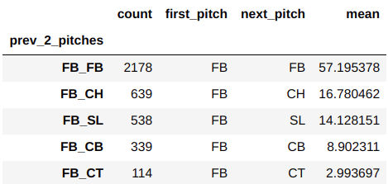
Naive Approach
Measure Performance Examples – Multi-class Log Loss
In addition to using accuracy to measure a models performance, we can also compute the multi-class logarithmic loss (cross entropy).
When considering the previous pitch as a way to predict the next pitch for Carlos Martinez, we see that after he throws a Fastball, the next pitch can be either another Fastball, Change-up, Slider, Curveball, or Cutter.
Based on Carlos’ two-sequence pitch data where the first pitch was a Fastball, we calculate the following mean values as predicted probabilities.
Computed
Log Loss
61.8%

Slide 17
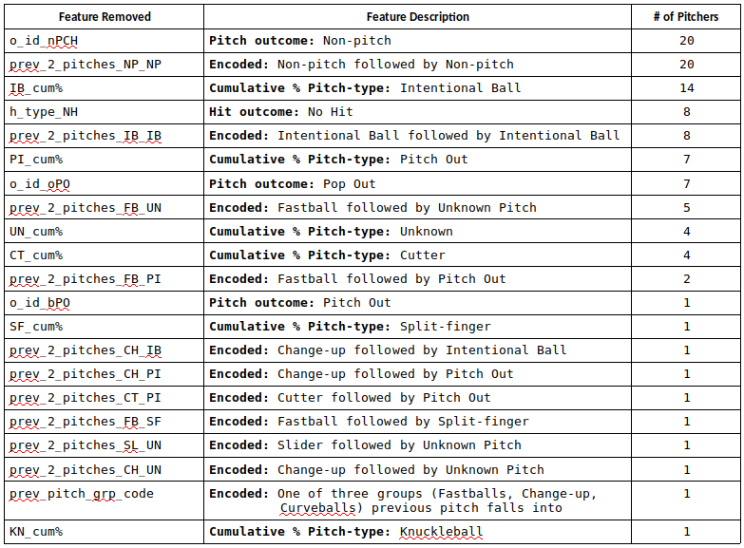
Correlated Features
Identified and removed features with a 95% or greater correlation.
Removed a total of 21 unique features for one or more pitchers.

Slide 18
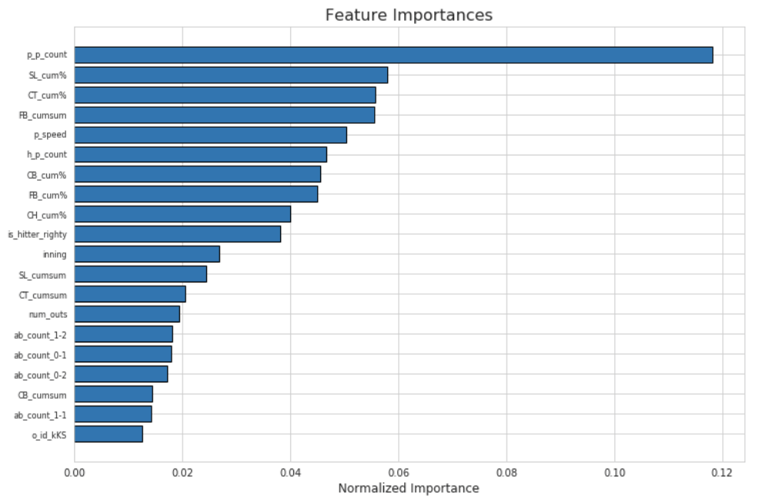
Feature Importance
Estimated Feature Importance using Gradient Boosting.
Features with zero-to-low importance were removed.
Top Feature for each Pitcher
Number of pitches thrown in the game (p_p_count)
Other top Features
Cumulative sums and %’s for varying pitch types
Previous pitch speed
Inning
At-bat count (balls - strikes)
Top 20 Important Features for Marcus Stroman

Slide 19
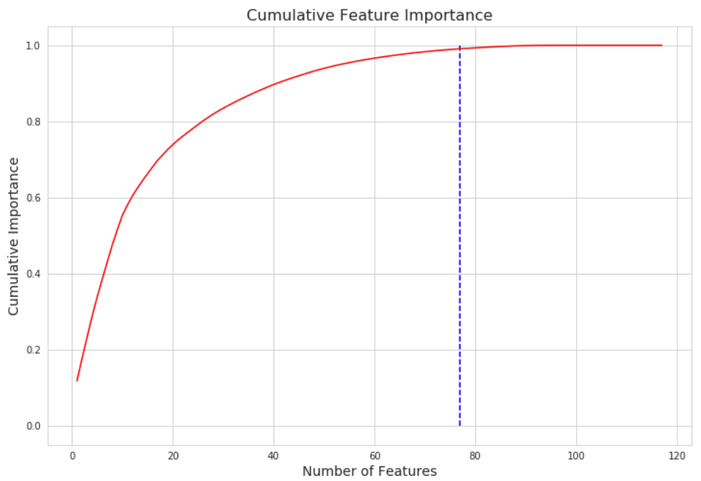
Feature Importance
Top features contributing to 99% of cumulative importance.
In this example
77 features required for 99% cumulative importance
41 zero-to-low importance features removed from data set
Cumulative Feature Importance Curve for Marcus Stroman

Slide 20
Predictive Model Selection
Now that we know more about the data, we can select a predictive model to assess the data in a way that helps make predictions about what might happen in the future.
Labeled Data
Multiple Classes
Imbalanced Targets
Supervised Learning
Multi-class Classification
Commonly used Machine Learning Algorithms:
Logistic Regression can perform multinomial classification, applying a non-linear function (sigmoid).
Support Vector Machine maximizes the margin between the classes and the hyperplane using a loss function. However, training time can be higher than other models and less effective with noisier data.
Decision Trees are easily interpretable and non-parametric (distribution-free), managing outliers but susceptible to overfitting.

Slide 21
Predictive Model Selection
Ensemble Methods
Random Forest is an ensemble of randomized decision trees. Each decision tree gets a random sample of training data and a subset of features to base a decision on.
Gradient Tree Boosting essentially converts weak learners (i.e., decision trees) into strong learners. Not easily interpretable and sensitive to small changes in the set of features.
Ensemble Voting Classifier combines machine learning base estimators for classification via plurality voting to achieve improved generalization and robustness over a single estimator.

Slide 22
Ensemble Voting Approach
Decision: use an ensemble approach, combining multiple models with varying predictions in hopes of creating a stronger final prediction.
Performed cross-validation to pre-evaluate ‘out-of-the-box’ models.
Selected the following classifiers to use as estimators:
Logistic Regression
Support Vector Machine (with Radial Basis Function kernel)
Decision Trees
Random Forest
Gradient Boosting
Performed Grid SearchCV on each classifier for hyper-parameter tuning.
Scaled and centered numerical features based on quantile ranges.
‘Best Estimators’ used for each classifier in ensemble voting classifier.

Slide 23
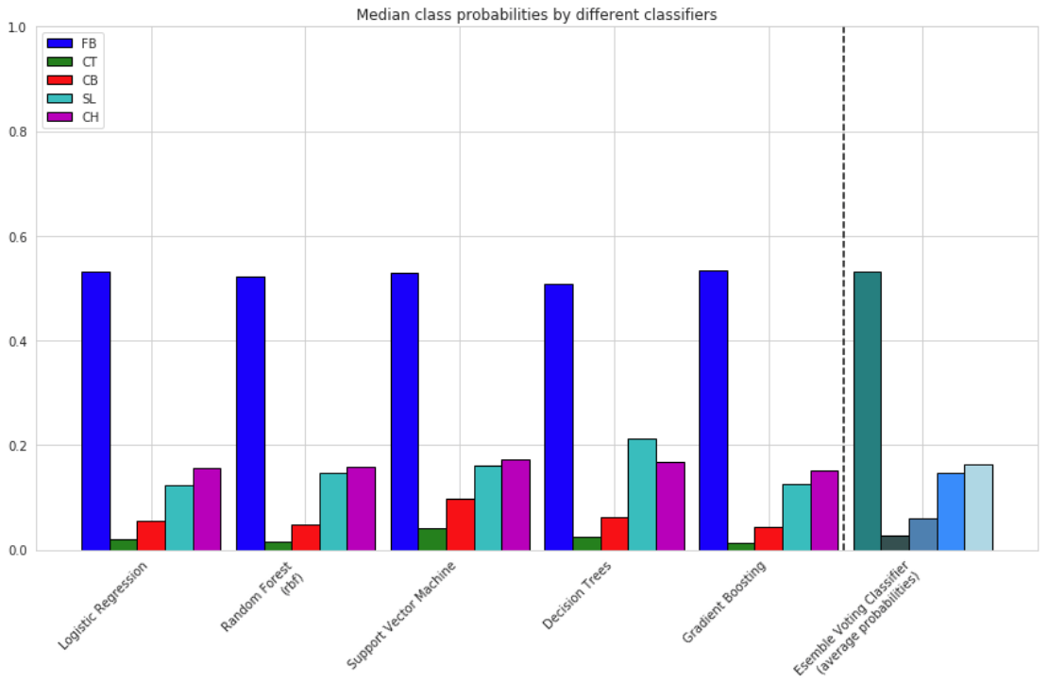
Comparing Class Probabilities
Individual Classifiers vs. Ensemble of Classifiers
Observations:
Similar median values for Fastballs and Cutters
SVM predicts slightly more Curveballs
Decision Trees predict more Sliders than Change-ups
Median Class Probabilities for each Classifier for Carlos Martinez

Slide 24
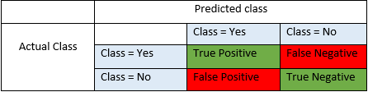
Interpretation of Confusion Metrics
Example: Predicting if pitch-type is a Fastball or Not a Fastball
True Positives (TP) – Correctly predicted positive pitch-type
e.g., Predicted: Fastball | Actual: Fastball
True Negatives (TN) – Correctly predicted negative pitch-type
e.g., Predicted: Not a Fastball | Actual: Not a Fastball
False Positives (FP) – Incorrectly predicted positive pitch-type
e.g., Predicted: Fastball | Actual: Not a Fastball
False Negatives (FN) – Incorrectly predicted negative pitch-type
e.g., Predicted: Not a Fastball | Actual: Fastball

Slide 25
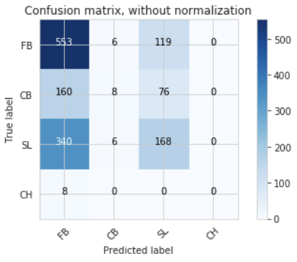
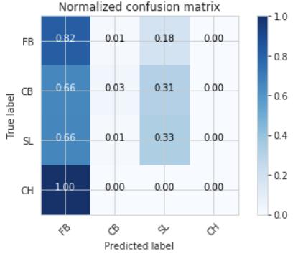
Multi-class Confusion Matrix
Confusion Matrix for Clayton Kershaw
Most pitch-types were predicted to be Fastballs (FB)
Second-most predicted were Sliders (SL)
As a result, the model is unable to effectively distinguish between FB’s and SL’s.

Slide 26
Interpretation of Performance Measures
Accuracy
Ratio of correctly predicted observation to total observations
(TP + TN) / (TP + FP + FN + TN)
Precision
Ratio of correctly predicted ‘positive’ observations to total predicted positive observations
TP / (TP + FP)
Recall
Ratio of correctly predicted ‘positive’ observations to all observations in actual ‘yes’ class
TP / (TP + FN)
F1 Score
Weighted average of Precision and Recall, considers False Positives and False Negatives
2*(Recall * Precision) / (Recall + Precision)

Slide 27
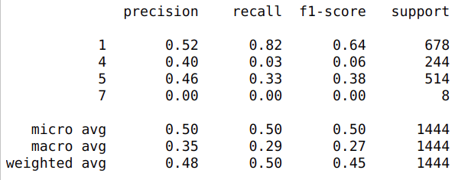
Problem with Accuracy
Classification Report for Clayton Kershaw
Accuracy = (TP+TN) / (TP+FP+FN+TN)
Pitch-type | TP | TN | FP | FN | Accuracy
Fastball (FB) | 553 | 258 | 508 | 125 | 0.562
Curveball (CB) | 8 | 1188 | 12 | 236 | 0.828
Slider (SL) | 168 | 735 | 195 | 346 | 0.625
Change-up (CH) | 0 | 1436 | 0 | 8 | 0.994
Average Accuracy
0.75

Slide 28
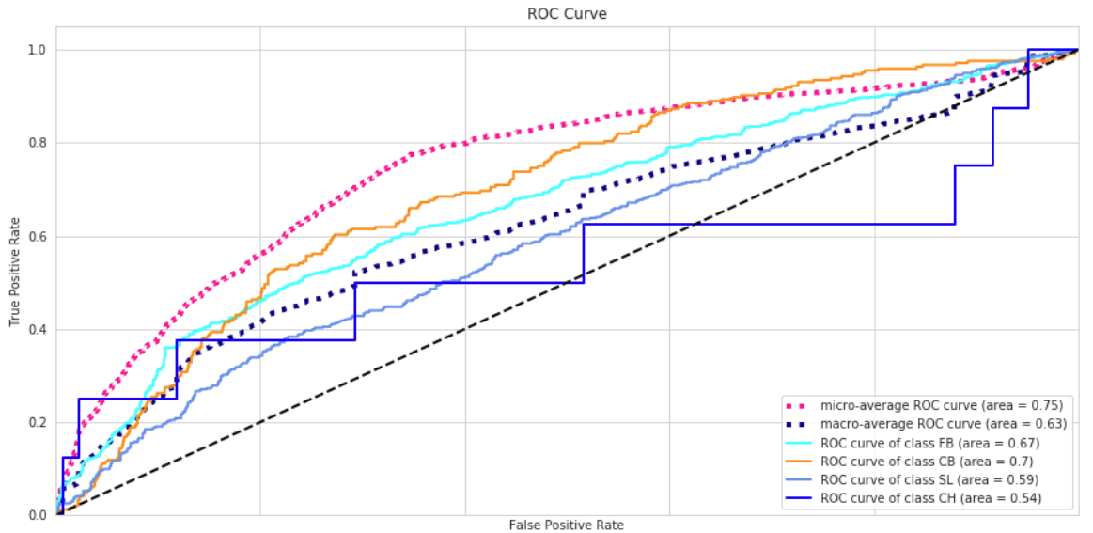
Receiver Operating Characteristic (ROC) Curve
While most classification machine learning models can be validated by accuracy estimation techniques, this is not the case for this project.
ROC curves are good for summarizing the trade-off between the True Positive Rate and False Positive Rate at different probability thresholds.
Indicates difficulty distinguishing between classes
Not appropriate when working with imbalanced classes.

Slide 29
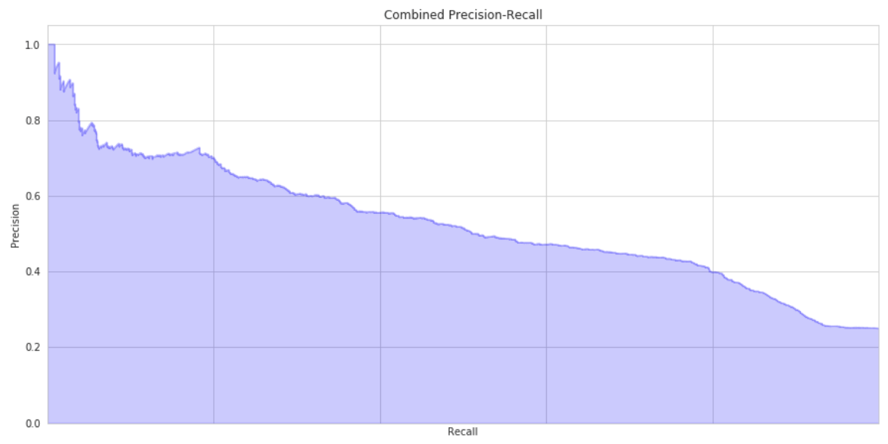
Precision-Recall
Average Precision Score
Is this the Best Trade-off of Precision-Recall?
Depends
Precision-Recall is a useful measure of success of prediction when the classes are very imbalanced.
High AUC represents High Recall (low False Negative rate) and High Precision (low False Positive rate).
High Recall + Low Precision = Many results with many incorrect predictions
Low Recall + High Precision = Few results but with many correct predictions

Slide 30
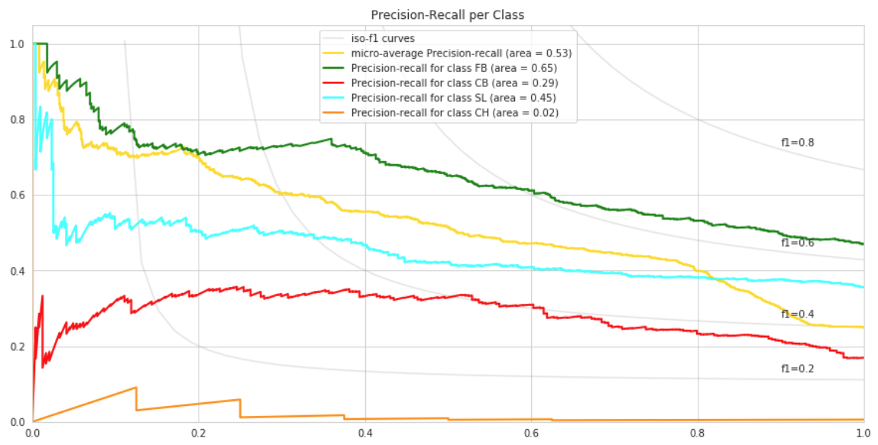
Precision-Recall
Per Class
Breakdown of Precision-Recall Curves for each Class

Slide 31
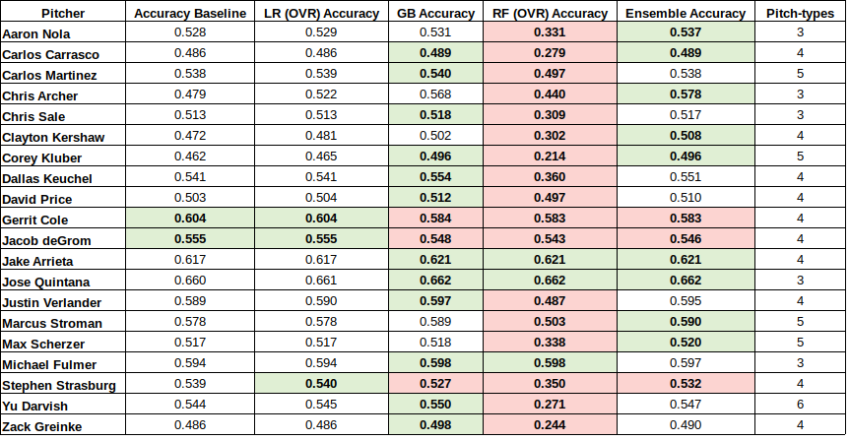
Model Performance Comparison
Accuracy Scores
Predictive Models vs. Majority Class Baseline
Best Accuracy = 1
Cells in Green
Top Accuracy Score
Cells in Red
Worst Accuracy Score
Gradient Boosting and Ensemble approach showed best results.
Random Forests (ensemble of randomized decision trees) performed poorly.
Accuracy results inconsistent.

Slide 32
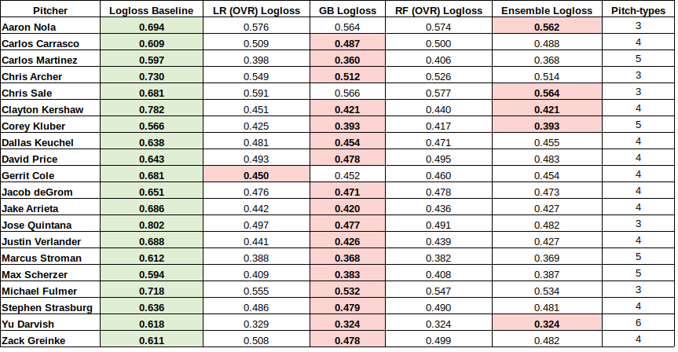
Model Performance Comparison
Multi-class Logarithmic Loss
Predictive Models vs. Mean Baseline
Best Logloss = 0
Cells in Green
Worst Logloss Error
Cells in Red
Top Logloss Error
Imbalanced classes, Logloss a better performance measure than Accuracy.
All predictive models outperformed the mean Logloss Baseline.
For most pitchers, Gradient Boosting outperformed all other models.
Logloss errors were best for Pitchers who throw >=5 different pitch-types.

Slide 33
Conclusion
On average, more than 50% of all pitches thrown are Fastballs.
Due to imbalanced classes, we should not use Accuracy and ROC curves to measure a models performance.
When comparing Logarithmic Log Loss (cross-entropy) for predictive models against the mean baseline, it is possible to minimize errors by as much as 10% - 40%.
Pitcher’s pitch count provides greatest importance to predicting the next pitch.
Similarity in pitch speed and location between pitch-types from same pitch group make it difficult to distinguish.

Slide 34
Recommendations
Compare in-game pitches to predicted pitches to monitor success rate.
Select a subset of hitters to essentially perform a randomized controlled trial to estimate the effect size (ROI).
Monitor before and after batting averages for selected hitters.
Increased attendance and a boost in revenue will be biggest measure of success.

Slide 35
Future Work
Increase data to include all starting and relief pitchers for more than just three seasons. (decrease variance)
Extend feature data to include weather conditions, pitch movement, fielders position, score differential, batting averages, and team record, just to name a few. (decrease bias)
Consider multi-label, multi-class classification problem by attempting to predict:
Pitch-type + Pitch Group + Pitch Speed + Pitch Location
Apply a combination of Supervised and Unsupervised Learning to address and include unlabeled pitch data.

Slide 36
Questions?
Mark Rojas
Cell: (832) 330-2870
Email: rojas.mm@gmail.com
Skype: markrojas
Linkedin: https://www.linkedin.com/in/mark-rojas/
Github: https://github.com/markrojas
Pitch Prediction Repository:
https://github.com/markrojas/Springboard_DSCT/tree/master/capstone_projects/capstone_I

