Slide 1
Dengue AI: Predicting Disease Spread
CS4622: Machine Learning Project
140108C - M.E.I. De Silva 140457T - M.A.A.D. Perera 140137M - D.E. Dulshan 140287V - K.M.L.R. Karunanayake

Slide 2
Introduction
Project was done for the “DengAI : Predicting disease spread” challenge hosted on Driven-data platform which based on prediction of total victims of a given month when time series data of weather and vegetation of a given regions.
Vector of the dengue fever is mosquito, which enforces the fact that transmission dynamics of dengue are directly related to the climatic variables.
Therefore, by analyzing the number of previous cases against the respected climate conditions, there is a possibility of coming up with an accurate enough predicting machine learning algorithm to predict number of dengue patients in a given week.

Slide 3
Objective
To analyze the number of previous cases against the respected climate conditions of given regions of iquitos and san juan, and coming up with an accurate enough predicting algorithm to predict number of dengue patients in a given week.

Slide 4
Methodology
The problem “DengAI” falls into the category of regression under supervised learning, since challenge is to predict values given time series data. Methodology is consisted of 4 key steps.
Preprocessing Data
Choosing a Machine learning Model
Iteratively testing with the preprocessed data and Choosing the best Model

Slide 5
Preprocessing Data
Sparse distribution of data had been given under too many dimensions.
Missing values and Outliers present.
There is a true necessity of data preprocessing.
Different approaches were used in preprocessing data.
Features were reduced looking at the correlation with each other and total cases.
Missing values are were filled using the front fil and outliers were removed.

Slide 6
Choosing a machine learning model
Machine learning Models tested,
Negative Binomial
Random forest
Linear Regression
Ensemble model created using 3 Linear regression Models (The Best Model chosen)

Slide 7
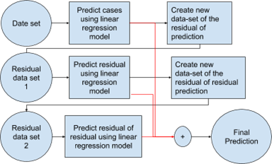
Ensemble Model using 3 linear regression Models (Best Model)
In this methodology residuals of the training set (Difference between predicted cases and true cases) were used to train model again and again.

Slide 8
Testing and Choosing the best Model
Outcome of the model was evaluated by submitting prediction for test data given by driven-data platform. (using MAE is calculated for a given set of test sample)

Slide 9
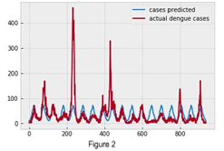
Results and Analysis
First prediction using months
Linear model can not grasp the sudden changes of the first predictions done using months as the feature.
To accommodate these changes, another linear regression model was created to predict residuals of the training data.

Slide 10
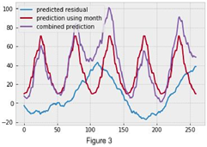
Prediction of the residuals of the data...
Figure shows how predictions with residuals became more accurate on peak months. Residual prediction gave artificial boost on sudden rises of actual dengue cases.
Found that Sudden peaks in the total cases make the biggest errors.
overfitted over model using another cycle of residual prediction

Slide 11
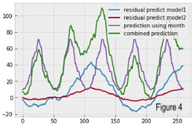
Combination of the two residual prediction cycles(final result)
Increase in the peak area minimizing the error of the prediction.
Model with 2 residual prediction iterations was the best model with 19.9808 MAE and ranked 98.

Slide 12
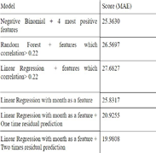
Comparison of the MAE(Mean absolute error) of different models experimented
Table shows MAE (Mean Absolute Error) gathered after submitting predicted value of tests data to driven-data platform using the different models.

Slide 13
Conclusion
Different machine learning algorithms were tested in a practical Scenario.
Learnt how a practical problem is solved using machine learning and data-mining techniques.
DengAI was competition that forced us to dig deeper in machine learning techniques.
We managed to rank at 98 using an ensemble method of 3 linear regression models

Slide 14
References
DengAI competition : https://www.drivendata.org/competitions/44/dengai-predicting-disease-spread/
GitHub repository: https://github.com/ErangaD/DengueAI

Slide 15
Thank You !

