Slide 1

Disease Spread Predicting the Spread of Dengue
Springboard Data Science Career Track
– Mark Rojas

Slide 2
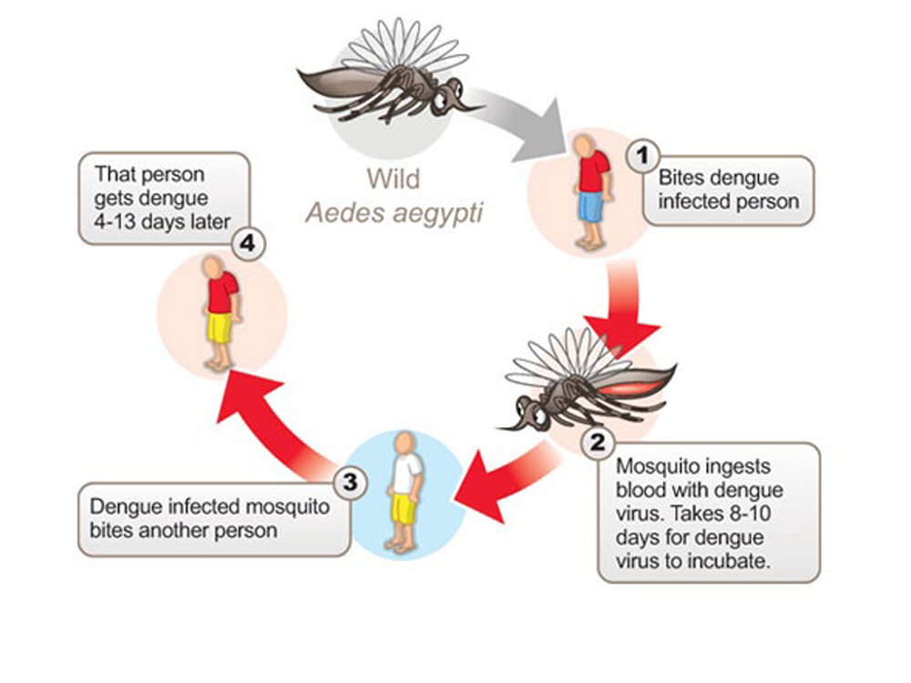
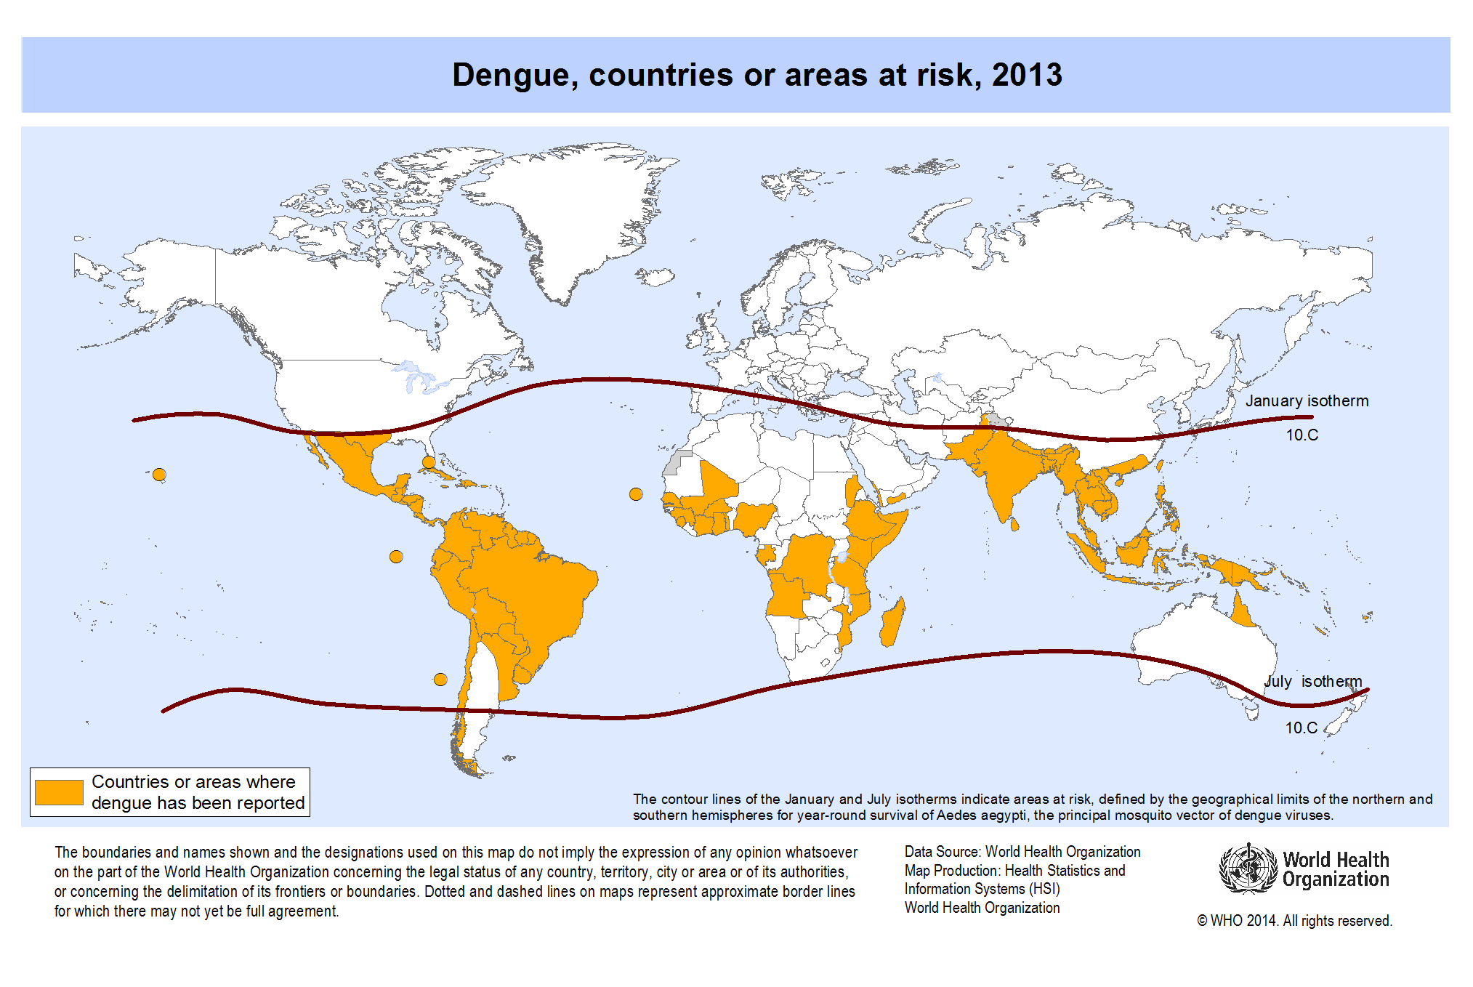
Problem Statement
Dengue is a mosquito-borne disease
400 million infected yearly
Symptoms similar to flu, however,
severe cases, including dengue fever, can result in death!
500,000 hospitalized with severe dengue
3.9 Billion People at Risk!!!
In tropical and sub-tropical parts of the world
Believed to be related to climate variables:
Temperature | Precipitation | Humidity

Slide 3
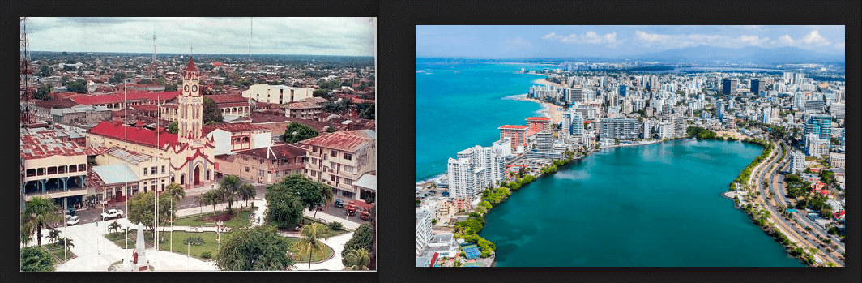
Goal
Using climatological data, predict the number of dengue fever cases reported each week in:
Iquitos, Peru
San Juan, Puerto Rico

Slide 4
Data Collection
The data for this competition comes from multiple sources aimed at supporting the Predict the Next Pandemic Initiative.
Dengue Surveillance Data:
Centers for Disease Control and Prevention
Department of Defense's Naval Medical Research Unit 6
Armed Forces Health Surveillance Center
Peruvian government and US universities
Environmental and Climate Data:
National Oceanic and Atmospheric Administration in the US Department of Commerce
File | Description | Format
Training Data Features | The features for the training data set | CSV
Training Data Labels | The number of dengue cases for each row in the training data set | CSV
Test Data Features | The features for the testing data set | CSV

Slide 5
Data Cleaning and Wrangling
The data includes 1,456 observations with 24 features consisting of 2-object and 22-numerical features. 936 observations are from San Juan data set while the other 520 observations come from the Iquitos data.
Missing and Null Data:
For San Juan, 20 of the 24 features contained between 6 – 191 null values
For Iquitos, 20 of the 24 features contained between 3 – 37 null values
Null values were imputed with median values for each ‘month’ and ‘year’. Median values were used rather than means because of outliers (described in the exploratory data analysis).
Unit Conversion:
For both San Juan and Iquitos, NOAA's GHCN temperatures are in Celsius (degree) while NOAA's NCEP temperatures are in Kelvin (non-degree) measurements. To avoid potential issues with scaling, NOAA’s NCEP temperature Kelvin units were converted to Celsius using the formula: 0K − 273.15 = -273.1°C. Columns were renamed accordingly to reflect unit change.

Slide 6
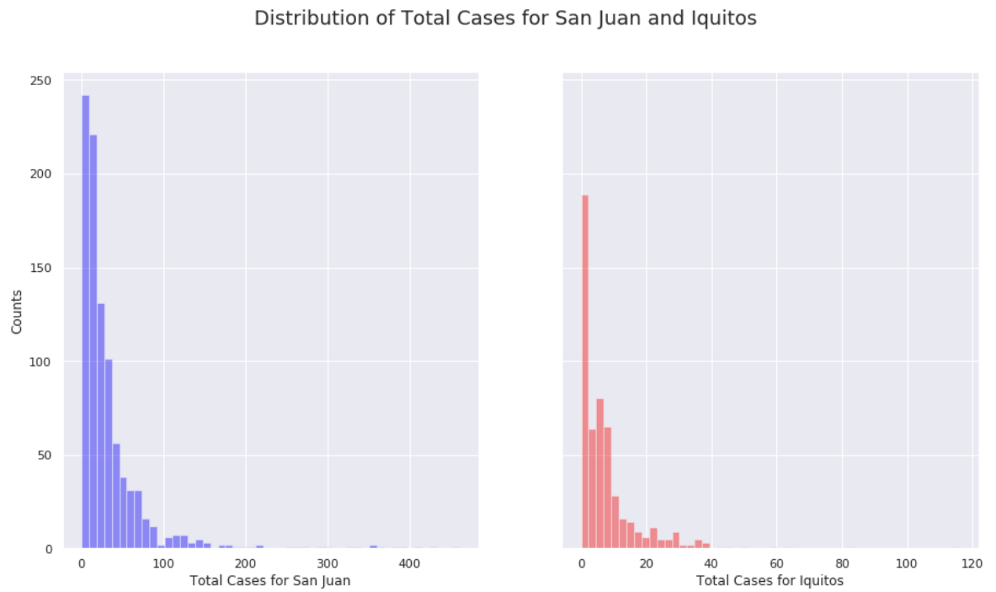
Exploratory Data Analysis Training Labels (Total Cases)
Positively Skewed distributions
Predictive model will need to be optimized for outliers
Labeled data will need to be normalized
One approach to normalize the labeled data will be to apply Logarithmic Transformation.

Slide 7
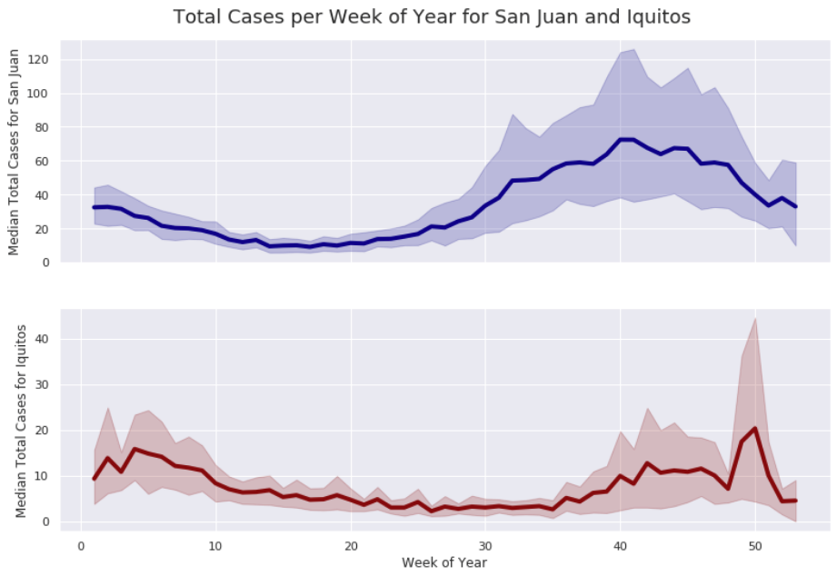
Exploratory Data Analysis Total Cases over 53-week Period
More cases reported at the end of the year in San Juan than in beginning of year
Similar trend in number of cases reported in Iquitos as for San Juan
To illustrate further, apply Decomposition Time Series to Total Cases for both cities.

Slide 8
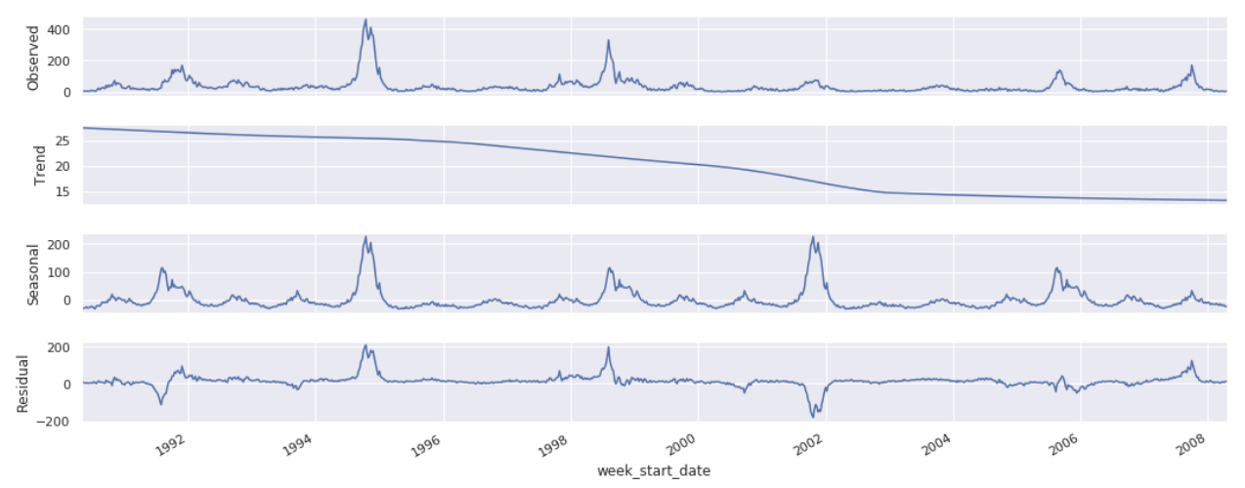
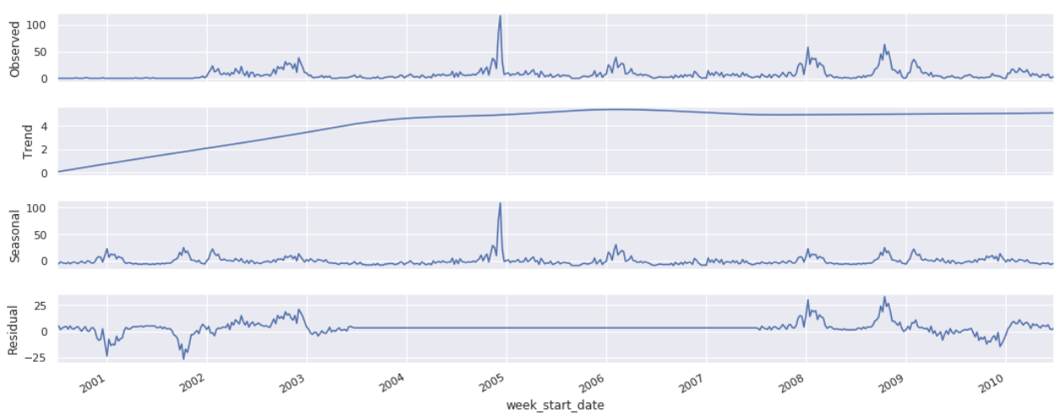
Exploratory Data Analysis Time Series Decomposition
San Juan
Iquitos
Strong Seasonality
Downward Trend
Cyclic Behavior
Residual shows seasonality with cyclic behavior
Strong Seasonality
Upward Trend
Cyclic Behavior
Residual shows seasonality with cyclic behavior

Slide 9
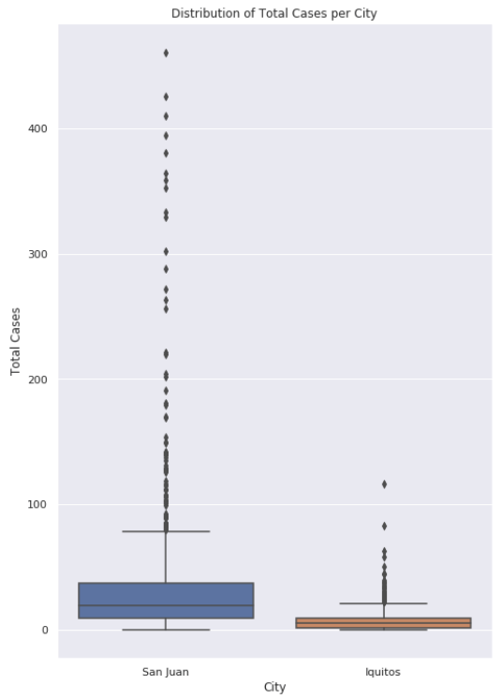
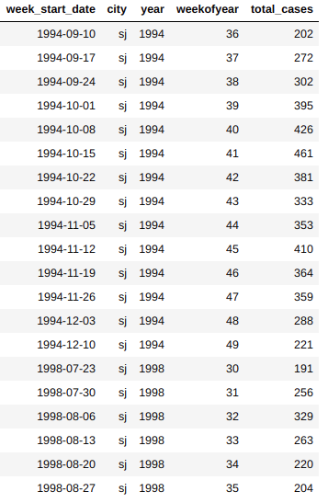
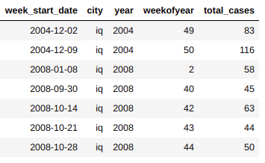
Exploratory Data Analysis Outliers for Training Labels
Z-scores with a threshold > 3 used to detect outliers.
20 outliers in the San Juan label data
7 outliers in the Iquitos label data
San Juan
Iquitos

Slide 10
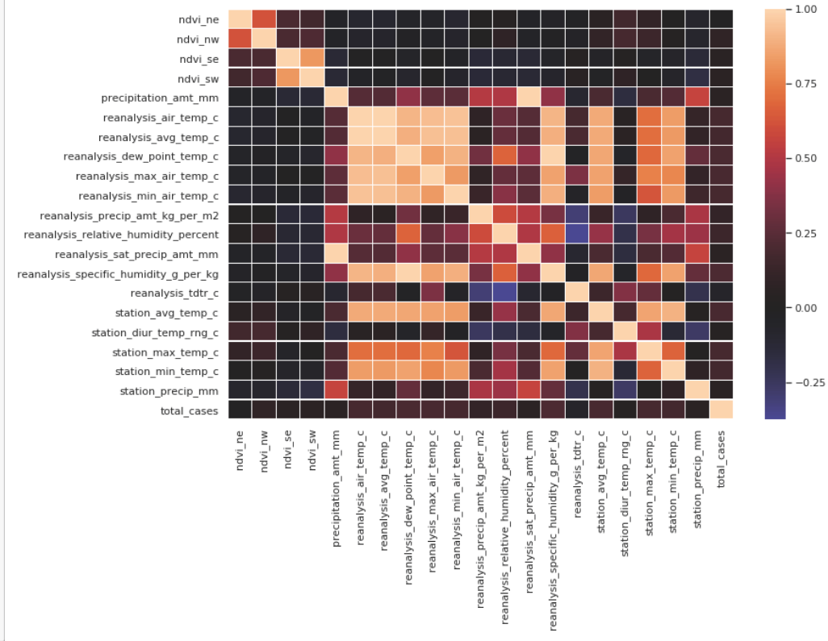
Exploratory Data Analysis Correlation: Features vs. Total Cases
San Juan
Correlation Matrix

Slide 11
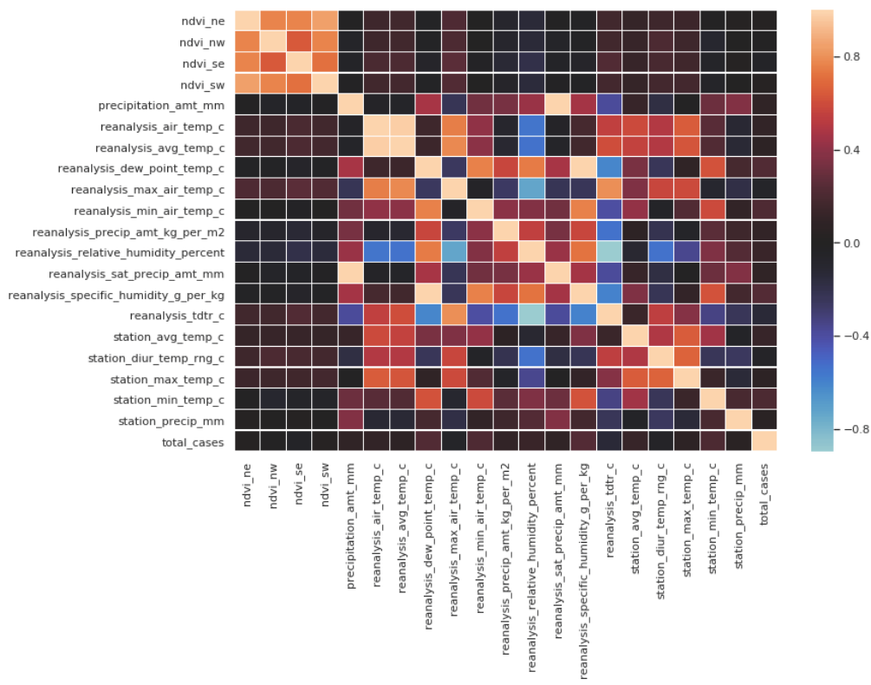
Exploratory Data Analysis Correlation: Features vs. Total Cases
Iquitos
Correlation Matrix

Slide 12
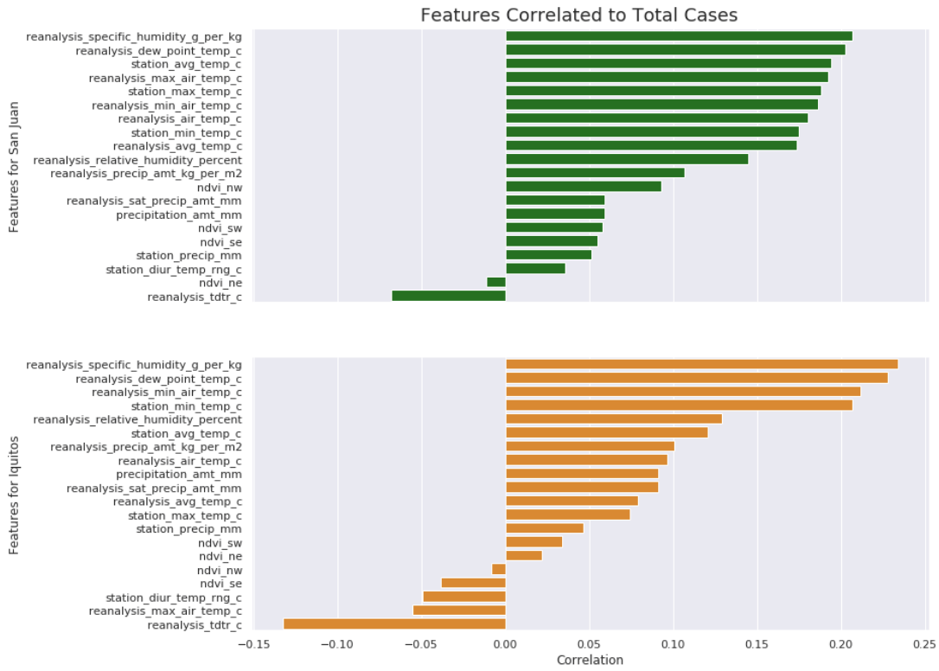
Exploratory Data Analysis Features Correlated to Total Cases
Moisture in the Air!!
Reanalysis Specific Humidity
Reanalysis Dew Point Temp

Slide 13
Summary
For the most part, the 24 features data and labeled data for both San Juan and Iquitos are fairly clean.
• Split feature data and labeled data into two groups (San Juan, Iquitos)
• Imputed missing and null values using median values
• Used fillna(…) with forward-fill method where medians could not be computed
• Approximately a 9 year overlap in observation between San Juan
• Positively skewed Distributions for Total Cases
• Seasonality for Time Series data
• Outliers Detected
• Features are not ‘highly’ correlated to the labeled data (total_cases)
◦ Highest correlated features to total_cases were:
▪ reanalysis_specific_humidity_g_per_kg
▪ reanalysis_dew_point_temp_c
◦ Moisture in the air!
• We see some correlation in features vs. features that may provide some insights

Slide 14
Next Steps
Moving forward, we need to consider Demographics and Climate conditions for the two cities. This information may provide more insight into why we see opposite levels of reported cases during the year.
2 and 3 week lag between features and labels required for incubation and symptom periods.
A predictive model will need to be selected.
Driven Data used Negative Binomial Regression to establish the benchmark score: 25.8173
Perform Feature Engineering
Train model
Tune parameters
Test performance
We will beat this score!

