Slide 1
EMS-GT2: An Improved Exact Solution for the
(l, d)-Planted Motif Problem
Mark Joseph D. Ronquillo
Proceso L. Fernandez

Slide 2
Context of the Study
Definition of Terms
EMS-GT
Additional Speedup Techniques
Methods
Results
Conclusion

Slide 3
Context of the Study

Slide 4
Context
Motif Finding
Given a set of DNA sequences, find common substrings in each sequence considering a number of allowed mutations

Slide 5
Context
(l, d)-planted motif search problem
Given a set of n sequences with length of m each, find the planted motif of length l considering up to d mutations:

Slide 6
(l, d)-planted motif problem:
Ex:
n = 4
m = 30
l = 5
d = 2
S1
taagctgctattctacggatagatactaca
S2
acacttgactatataggatctaggatacat
S3
actagatatacctataggcacattgctgga
S4
tagagcacatagacctgacacatagtactt
Find the planted motif M:
?

Slide 7
(l, d)-planted motif problem:
Ex:
n = 4
m = 30
l = 5
d = 2
S1
taagctgctattctacggatagatactaca
S2
acacttgactatataggatctaggatacat
S3
actagatatacctataggcacattgctgga
S4
tagagcacatagacctgacacatagtactt
Find the planted motif M:
tactg

Slide 8
Definition of terms

Slide 9
Definition of Terms
l-mer:
- a string of length l in the alphabet Σ
in this context we use Σ = {a, c, g, t}

Slide 10
Definition of Terms
motif:
- l-mer that occurs across different sequences
(but with subject to mutations)

Slide 11
Definition of Terms
dH(x,y): hamming distance
- the number of mismatch positions between two l-mers.
ex: dH(actg, gcta) = 2

Slide 12
Definition of Terms
d-neighbor of an l-mer x:
- is another l-mer y whose hamming distance with x is at most d.

Slide 13
Definition of Terms
N(x, d): d-neighborhood of an l-mer x:
- is the set of all l-mers with at most d hamming distance value from x.

Slide 14
Definition of Terms
N(x, d): d-neighborhood of an l-mer x:
Example:
l = 4, d = 2
gatc
aaac, aacc, aagc, aata, aatc, aatg, aatt, actc, agtc, attc, caac, cacc, cagc, cata, catc, catg, catt, cctc, cgtc, cttc, gaaa, gaac, gaag, gaat, gaca, gacc, gacg, gact, gaga, gagc, gagg, gagt, gata, gatc, gatg, gatt, gcac, gccc, gcgc, gcta, gctc, gctg, gctt, ggac, ggcc, gggc, ggta, ggtc, ggtg, ggtt, gtac, gtcc, gtgc, gtta, gttc, gttg, gttt, taac, tacc, tagc, tata, tatc, tatg, tatt, tctc, tgtc, tttc
{
}

Slide 15
Definition of Terms
N(S, d): d-neighborhood of a sequence S
- is the set of all d-neighbors of all l-mers in sequence S.
- there are exactly (m - l +1) l-mers in sequence S of length m.

Slide 16
Definition of Terms
N(S, d): d-neighborhood of a sequence S
l = 5
S:
taagctg

Slide 17
Definition of Terms
N(S, d): d-neighborhood of a sequence S
l = 5
S:
taagctg

Slide 18
Definition of Terms
N(S, d): d-neighborhood of a sequence S
l = 5
S:
taagctg

Slide 19
Definition of Terms
N(S, d): d-neighborhood of a sequence S
l = 5
S:
taagctg

Slide 20
Definition of Terms
N(S, d): d-neighborhood of a sequence S
N(x1, d)
N(x2, d)
N(x3, d)
N(x4, d)
N(x5, d)
N(S, d) =
...
N(xm-l+1, d)

Slide 21
EMS-GT Algorithm

Slide 22
First Approach:
It checks every possible combination of positions in different sequences and tests if it is the correct position where the motif is planted.

Slide 23
First Approach:
It checks every possible combination of positions in different sequences and tests if it is the correct position where the motif is planted.

Slide 24
First Approach:
It checks every possible combination of positions in different sequences and tests if it is the correct position where the motif is planted.

Slide 25
Second Approach:
Exhaustively searches all possible 4^{l} l-mers if it a motif.
Sequences
4^{l} possible l-mers

Slide 26
Exact Motif Search - Generate and Test (EMS-GT)
EMS-GT is composed of 2 phases.
Generate Phase: quickly filters the search space by doing a set intersection between the d-neighborhood of the first n' sequences. Resulting set is the candidate motif set.
Test Phase: evaluates each candidate motif if it has at least one d-neighbor in the remaining (n - n') sequences.

Slide 27
EMS-GT: Demonstration:
Parameters
n = 5
m = 30
l = 5
d = 2
n' = 3
Dataset
S1
S2
S3
S4
S5

Slide 28
EMS-GT: Demonstration:
Parameters
n = 5
m = 30
l = 5
d = 2
n' = 3
Dataset
S1
S2
S3
S4
S5
Generate
S2
S1
S3

Slide 29
EMS-GT: Demonstration:
Parameters
n = 5
m = 30
l = 5
d = 2
n' = 3
Dataset
S1
S2
S3
S4
S5
Generate
Test
S2
S1
S4
S5
S3
candidate motifs

Slide 30
EMS-GT: Demonstration:
Parameters
n = 5
m = 30
l = 5
d = 2
n' = 3
Dataset
S1
S2
S3
S4
S5
Generate
Test
S2
S1
S4
S5
S3
motifs
candidate motifs

Slide 31
Generate Phase
n = 5
m = 30
l = 5
d = 2
n' = 3
S1
taagctgctattctacggatagatactaca
S2
acacttgactatataggatctaggatacat

Slide 32
Generate Phase
n = 5
m = 30
l = 5
d = 2
n' = 3
S1
taagctgctattctacggatagatactaca
...
...
S2
acacttgactatataggatctaggatacat

Slide 33
Generate Phase
n = 5
m = 30
l = 5
d = 2
n' = 3
S1
taagctgctattctacggatagatactaca
...
...
S2
acacttgactatataggatctaggatacat
...
...

Slide 34
Generate Phase
n = 5
m = 30
l = 5
d = 2
n' = 3
S1
taagctgctattctacggatagatactaca
...
...
S2
acacttgactatataggatctaggatacat
...
...
S1
∩
S2

Slide 35
Generate Phase
n = 5
m = 30
l = 5
d = 2
n' = 3
S3
actagatatacctataggcacattgctgga
...
...

Slide 36
Generate Phase
n = 5
m = 30
l = 5
d = 2
n' = 3
S3
actagatatacctataggcacattgctgga
...
...
S1
∩
S2
∩
S3
candidate motifs

Slide 37
EMS-GT: Demonstration:
n = 5
m = 30
l = 5
d = 2
n' = 2
Test Phase:
candidate motifs = {tagac, ccatg, tagtt}
...
S4
tagagcacatagacctgacacatagtactt
S5
cagatagactataggccatataccgtagaa

Slide 38
EMS-GT: Demonstration:
n = 5
m = 30
l = 5
d = 2
n' = 2
Test Phase:
candidate motifs = {tagac, ccatg, tagtt}
...
S4
tagagcacatagacctgacacatagtactt
...
S5
cagatagactataggccatataccgtagaa

Slide 39
Implementation

Slide 40
Implementation: Speedup Techniques
1. Integer Mapping of an l-mer
a = 00 | c = 01 | g = 10 | t =11
example:
tacgt
is mapped to
1100011011
integer value = 795

Slide 41
Implementation: Speedup Techniques
2. Bit-based set representation and
l-mer enumeration
Set Representation
0
0
We know that there are 4^{l} number of possible l-mers given the DNA bases.
1
1
2
1
3
0
A value of 1 means it is in the set while 0 means otherwise
...
4^{l}
0

Slide 42
Implementation: Speedup Techniques
2. Bit-based set representation and
l-mer enumeration
Set Representation
0
0
In this example we know that l-mers with value of 1 and 2 belong to the set.
1
1
2
1
3
0
1 = AAAAC and 2 = AAAAG, if l = 5
...
4^{l}
0

Slide 43
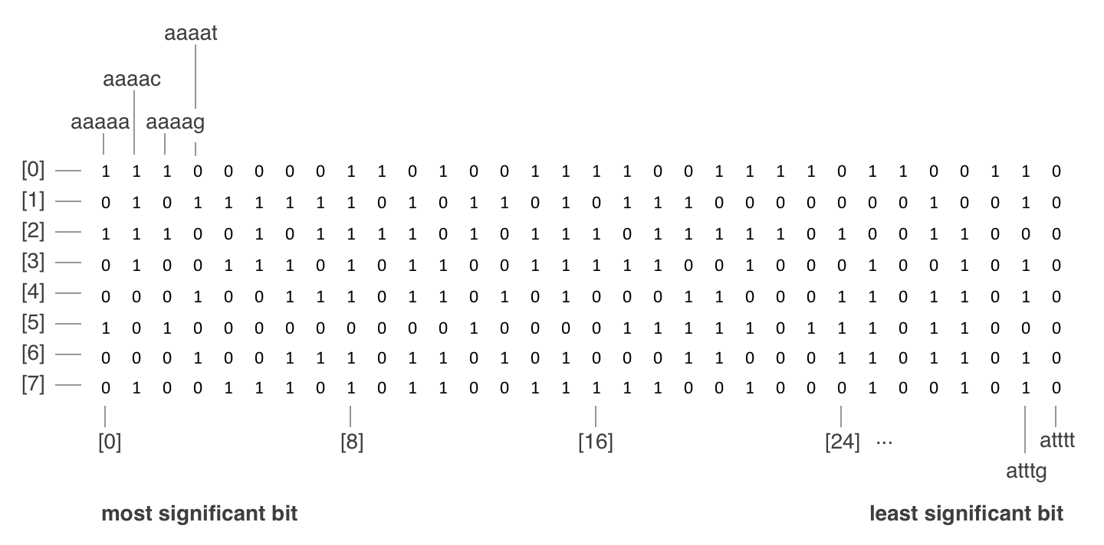
Implementation: Speedup Techniques
3. Bit-array compression

Slide 44
Implementation: Speedup Techniques
3. Bit-array compression
* each element contains a 32-bit integer for bit flags instead of one.

Slide 45
Implementation: Speedup Techniques
3. Bit-array compression
* the process of setting and checking the value:
gacgt = 1000011011 = 539 in decimal
bit position = 539 mod 32 = 27;
array index = 539 / 32 = 16;
The bit flag for gacgt is in the 27th least significant bit of the integer at array index 16.

Slide 46
Implementation: Speedup Techniques
4. XOR-based Hamming
distance computation
Example:
aacgt maps to 0000011011
tacgc maps to 1100011001
XOR produces
1100000010
= 2 mismatches

Slide 47
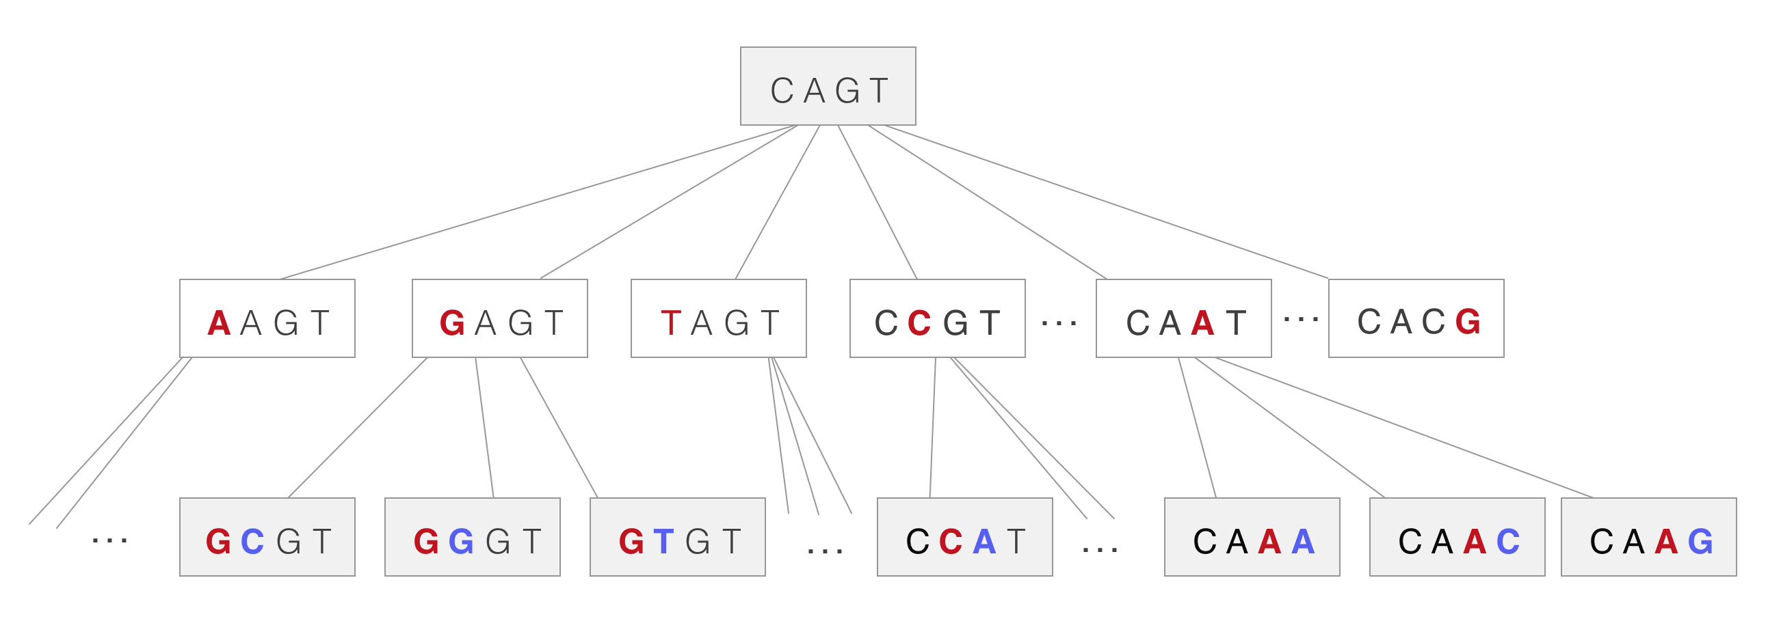
Implementation: Speedup Techniques
5. Recursive neighborhood generation

Slide 48
Implementation: Speedup Techniques
6. Block-based optimization for
neighborhood generation
- instead of setting one bit at a time in the neighborhood generation, we generate the neighborhood by blocks

Slide 49
Implementation: Speedup Techniques
6. Block-based optimization for
neighborhood generation
- instead of setting one bit at a time in the neighborhood generation, we generate the neighborhood by blocks
- if we partition the bit-array N into 4^{k} of bits, where k < l, each block will conform to one of (k + 2) patterns.

Slide 50
Implementation: Speedup Techniques
6. Block-based optimization for
neighborhood generation
- instead of setting one bit at a time in the neighborhood generation, we generate the neighborhood by blocks
- if we partition the bit-array N into 4^{k} of bits, where k < l, each block will conform to one of (k + 2) patterns.
- we pre-computed these block patterns and use it to set the bits in the bit-array by blocks.

Slide 51
Implementation: Speedup Techniques
6. Block-based optimization for
neighborhood generation
Lets say we want to generate the d-neighborhood of 15-mer
acgtgagttactaga

Slide 52
Implementation: Speedup Techniques
6. Block-based optimization for
neighborhood generation
Lets say we want to generate the d-neighborhood of 15-mer
acgtgagttactaga
Prefix
Suffix

Slide 53
Implementation: Speedup Techniques
6. Block-based optimization for
neighborhood generation
Now instead of recursively generating all d-neighbor of length l, we only consider up to (l-k) prefix of l. For each prefix, we apply the corresponding block pattern based on the remaining allowed mutations.

Slide 54
Additional Speedup Techniques

Slide 55
1. Faster Candidate Motif Elimination through Block Processing.

Slide 56
1. Faster Candidate Motif Elimination through Block Processing.
Observations:
- The bit array that stores the candidate motifs is enumerated alphabetically.

Slide 57
1. Faster Candidate Motif Elimination through Block Processing.
Observations:
- The bit array that stores the candidate motifs is enumerated alphabetically.
- Given the alphabetical enumeration, l-mers near other do not differ that much.

Slide 58
1. Faster Candidate Motif Elimination through Block Processing.
Observations:
- The bit array that stores the candidate motifs is enumerated alphabetically.
- Given the alphabetical enumeration, l-mers near other do not differ that much.
- In EMS-GT, each candidate motif testing is independent of other.

Slide 59
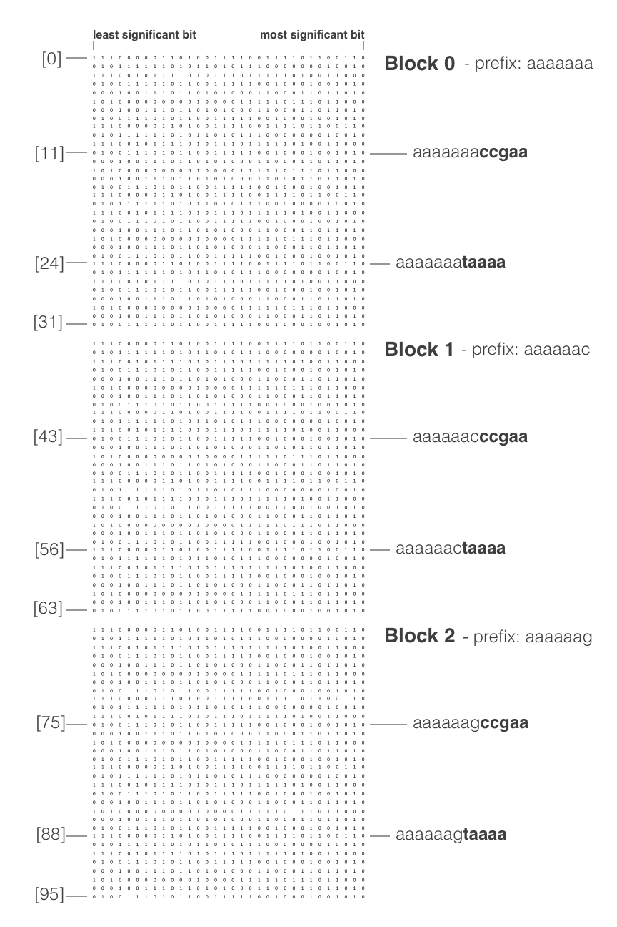
Faster Candidate Motif Elimination through Block Processing.
By grouping every 4^{k} bits into blocks, we can exploit some of the blocks' properties.

Slide 60
Faster Candidate Motif Elimination through Block Processing.
By grouping every 4^{k} bits into blocks, we can derive these properties:
- Each l-mer in a block shares the same prefix string.
- For every block, the hamming distance of any two l-mers is at most k.

Slide 61
Faster Candidate Motif Elimination through Block Processing.
Theorem. Let x and y be l-mers in a block in the search space containing 4^{k} l-mers. Let d be the number of allowed mutations in the problem instance. Let z be another l-mer. If dH (x, z) > (k + d) then dH (y, z) > d, and therefore z is not in N(y, d)

Slide 62
Faster Candidate Motif Elimination through Block Processing.
x
y
...

Slide 63
Faster Candidate Motif Elimination through Block Processing.
x
less than or equal to k
y
...

Slide 64
Faster Candidate Motif Elimination through Block Processing.
x
less than or equal to k
y
...
z

Slide 65
Faster Candidate Motif Elimination through Block Processing.
x
less than or equal to k
y
...
the distance is greater than d + k
z

Slide 66
Faster Candidate Motif Elimination through Block Processing.
x
less than or equal to k
y
...
the distance is greater than d + k
the dH(y, z) is greater than d
z

Slide 67
Faster Candidate Motif Elimination through Block Processing.
We used this theorem in the Test Phase by filtering some of the l-mers in a sequence S.

Slide 68

Faster Candidate Motif Elimination through Block Processing.
Improved Test Phase:
Test the candidate motifs the normal way, until one is eliminated.
{
}
Sn'
Sn'+1
...
Sn

Slide 69
Faster Candidate Motif Elimination through Block Processing.
Improved Test Phase:
gagct
Sn''
tagagcacatagacctgacacatagtactt

Slide 70
Faster Candidate Motif Elimination through Block Processing.
Improved Test Phase:
gagct
Sn''
tagagcacatagacctgacacatagtactt
l-mers in sequence Sn''
{
}
tagag, agagc, gagca, agcac
...
tactt

Slide 71
Faster Candidate Motif Elimination through Block Processing.
Improved Test Phase:
gagct
Sn''
tagagcacatagacctgacacatagtactt
l-mers in sequence Sn''
{
}
tagag, agagc, gagca, agcac
...
tactt
we can filter some l-mers in the set of (m-l+1) l-mers of Sn'' where the candidate motif got eliminated

Slide 72
Faster Candidate Motif Elimination through Block Processing.
We now use this filtered set of l-mers over the original sequence for testing the remaining candidate motifs in the block.

Slide 73
2. Pre-computation of Mismatch values for Hamming distance Computation

Slide 74
2. Pre-computation of Mismatch values for Hamming distance Computation
Example:
aacgt maps to 0000011011
tacgc maps to 1100011001
XOR produces
1100000010
= 2 mismatches

Slide 75
2. Pre-computation of Mismatch values for Hamming distance Computation
Originally, EMS-GT counts each pairs of bits in the XOR result for the Hamming distance computation.

Slide 76
2. Pre-computation of Mismatch values for Hamming distance Computation
We can improve this by referring to a pre-computed mismatch count values instead of counting the pair of bits every Hamming distance computation.

Slide 77
Pre-computation of Mismatch values
The pre-computed array of mismatch values lookup
...
1010010111010000
6
42448
1010010111010001
7
42449
1010010111010010
7
42450
1010010111010100
7
42451
...

Slide 78
Pre-computation of Mismatch values
Improved Hamming distance computation:
Example: Given a pre-computed values up to 16-bits and an XOR result:
1010010111010000
1010010111010011

Slide 79
Pre-computation of Mismatch values
Improved Hamming distance computation:
Example: Given a pre-computed values up to 16-bits and an XOR result:
1010010111010000
1010010111010011
1010010111010000
1010010111010011

Slide 80
Pre-computation of Mismatch values
Improved Hamming distance computation:
Example: Given a pre-computed values up to 16-bits and an XOR result:
1010010111010000
1010010111010011
1010010111010000
1010010111010011
7

Slide 81
Pre-computation of Mismatch values
Improved Hamming distance computation:
Example: Given a pre-computed values up to 16-bits and an XOR result:
1010010111010000
1010010111010011
1010010111010000
1010010111010011
6
7
6 + 7 = 13
the hamming distance is 13

Slide 82
Methods

Slide 83
Methods
Dataset
20 DNA sequences (n)
each sequence is 600 characters long (m)
used (l, d)-challenge instances, where l < 18.

Slide 84
Methods
Evaluation
Runtime evaluation of EMS-GT, qPMS9 and EMS-GT2 using (9, 2), (11, 3), (13, 4), (15, 5) and (17, 6) challenge instances over 20 iterations each.

Slide 85
Performance

Slide 86
Performance:
Experimentation Results:
 | qPMS9 | EMS-GT | EMS-GT2
(9, 2) | 0.60 s | 0.04 s | 0.05 s
(11, 3) | 1.26 s | 0.17 s | 0.26 s
(13, 4) | 4.58 s | 1.03 s | 0.82 s
(15, 5) | 25.73 s | 12.39 s | 10.43 s
(17, 6) | 123.17 s | 143.87 s | 111.22 s

Slide 87
Conclusions:
EMS-GT2 is efficient in finding short motifs
where l < 18
EMS-GT2 proved its competitiveness by beating qPMS9 in all (l, d)-challenge instances
where l < 18.
In practice, motifs are typically 10 base pairs.

