Slide 1
Agile
SNHU Travel Web Development Team

Slide 2
Agile Jobs

Slide 3

Product Owner
Meets regularly with the clients and potential users of the software product, then issues user stories into the product backlog describing the needs of the users.

Slide 4

Scrum Master
Organizes the daily scrum and meets regularly with the Product Owner and the clients. Keeps the developers motivated, but from a distance, in order to give space for creativity and innovation to flourish. Also manages the product backlog.

Slide 5
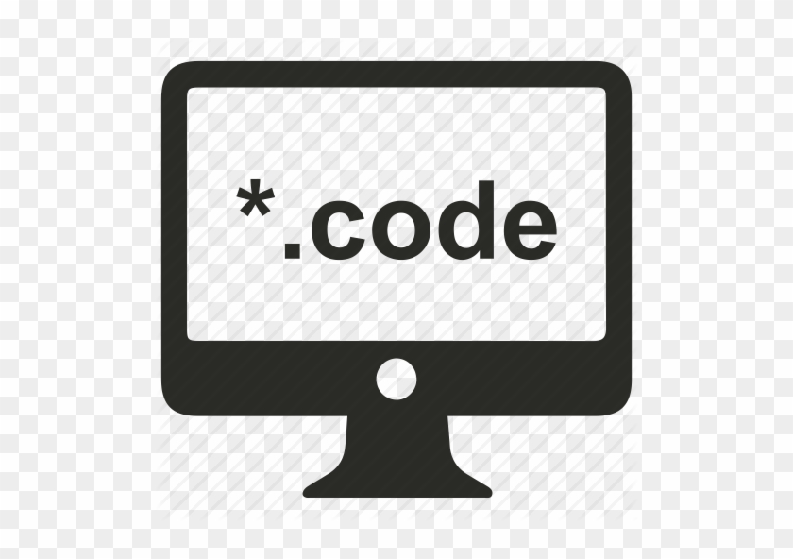
Developer
Pulls user stories off the product backlog and writes the code prescribed by the Product Owner in accordance with the needs of the users and the clients. Works in tandem with the Testers.

Slide 6

Tester
Writes code to test the validity of the code being written by the Developers. Testers work in tandem with Developers in order to find bugs early and get the issues refactored swiftly by the Developers.

Slide 7
Agile Phases
Requirements
Development
Testing
Delivery
Feedback

Slide 8

Requirements
During this phase, the Product Owner, Scrum Master, and the client work to identify the needs of the end user and create a series of user stories for the Developers to work from.

Slide 9

Development
During development, the Developers take user stories off the product backlog and begin writing code that satisfies the requirements of the story.

Slide 10

Testing
Testing is done in tandem with development, and it is here that the Testers work to identify bugs in the working code being developed so they can get feedback swiftly to the Developers.

Slide 11

Delivery
The working code is handed over to the client for inspection.

Slide 12

Feedback
The client and potential users meet with the Product Owner and discuss what work needs to be done to satisfy the client’s needs.

Slide 13
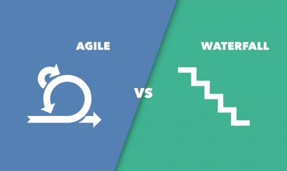
Waterfall vs. Agile
Waterfall and Agile are two very different development ideologies, each with their own unique methods for getting work done on a development team.

Slide 14
Waterfall
Waterfall is a more traditional style with a top-down approach where planning is done in the management tier, then work is handed down the chain of command until it reaches the eyes of the developer, who then puts himself to getting the code written in accordance with rigid guidelines.

Slide 15
Agile
In opposition with Waterfall, Agile demands the power be placed in the hands of the developer, who only uses the user stories given him/her by the Product Owner as a rough guideline for creating work based on the needs of the client.

Slide 16
When to use Waterfall
Waterfall is better used at the management level, where the need for organized command-and-control structure helps to keep the company in order.

Slide 17
When to use Agile
Agile works best at the bottom rungs of the command chain, where the developers may be left in charge of exploring code creatively and using their own inspirations design and innovate in accordance with the needs of the client.

Slide 18
Citations
Rigby, D., Elk, S., & Berez, S. (2020). Doing Agile Right: Transformation Without Chaos (Illustrated ed.). Harvard Business Review Press.
Layton, M. C., Ostermiller, S. J., & Kynaston, D. J. (2020). Agile Project Management For Dummies, 3rd Edition (3rd ed.). For Dummies.
Cobb, C. G. (2015). The Project Manager’s Guide to Mastering Agile: Principles and Practices for an Adaptive Approach (1st ed.). Wiley.

