Slide 1
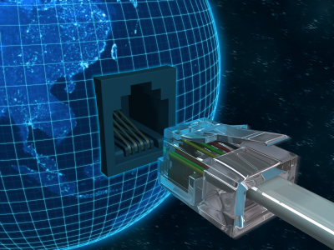
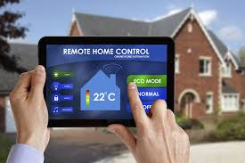
Home
Automation

Slide 2
Practical Applications
Of
Home Automation
Using home Automation to turn your House
into a SMART House

Slide 3
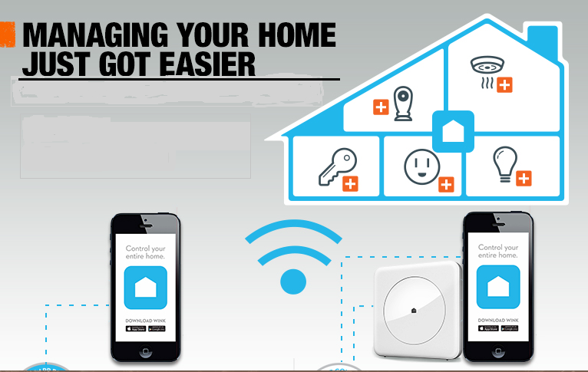
Managing your home just got Easier

Slide 4






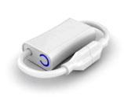

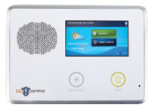
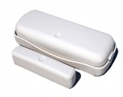
Connected devices for the home
Inexpensive
Need “no new wires”
Use regular voltage or batteries
Wireless communication
Use maturing, reliable standards
Z-Wave, ZigBee, Powerline

Slide 5

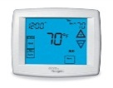

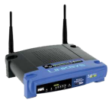
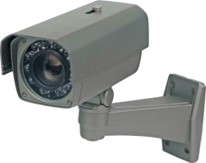
Existing abstractions for home tech
Network of devices
Interoperability protocols
DLNA, Z-Wave, Speakeasy, …
Open, low-level device access
Appliance
Monolithic systems
Crestron, Control4, EasyLiving, …
Fixed tasks over fixed devices
Management is still hard
Users must manage each device/task
Developers must deal directly w/ h/w
Remote monitoring
Climate control
Extensibility is still hard
Closed set of tasks
Closed set of devices
Notes:
Making extensibility and manageability easy is about finding the right abstractions. So, what are the main abstractions around which home technology is organized today? There are two.
The first abstraction is a network of devices. This viewpoint leads one to develop protocols by which devices can talk to each other, that is, interoperability protocols. It does not worry so much about how tasks are implemented on top of this network.
The second abstraction is of an appliance. This views technology as complete, closed systems. It leads to software that is coupled directly with the hardware and works only with the specific devices: vertical integration.

Slide 6
Our abstraction
View the home as a computer
Networked devices =~ peripherals
Tasks over these devices =~ applications
Adding devices =~ adding a peripheral
Adding tasks =~ installing an application
Managing networked devices =~ managing files
[The home needs an operating system (and an app store), HotNets 2010]
Notes:
A different paradigm for organizing technology in the home

Slide 7
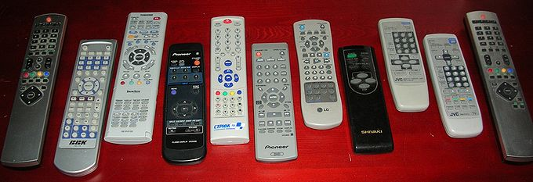
The 3C’s
Convenience
Accessibility from anywhere with internet connection
Laziness factor
Nikola Tesla – 1898 – first patented remote control
First used for military

Slide 8
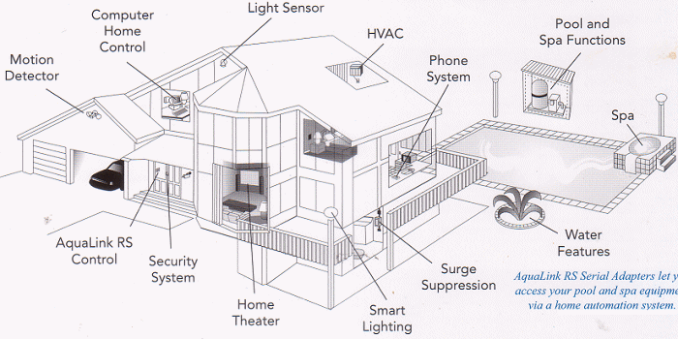
The concept of home automation is to automate/semi-automate certain tasks that are performed several times a day. It is no limited to just lights and fans. It can be further expanded to everything in the house.

Slide 9
Common 2009 Uses:
HVAC
Temperature and humidity control
Lighting
Mood lighting
Whole home control
Audio/Video
Whole home entertainment systems
One location for hardware
Intercom Systems

Slide 10
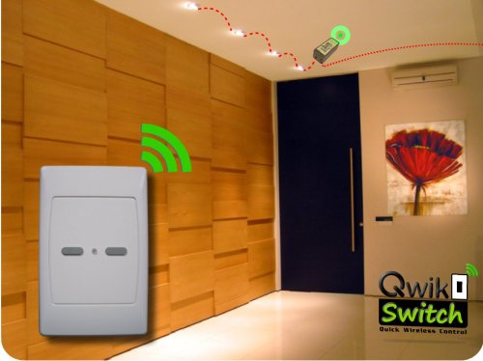
RF (Radio Frequency) Systems
Primary Use?
Remodel
Problems?
Interference
Slower

Slide 11
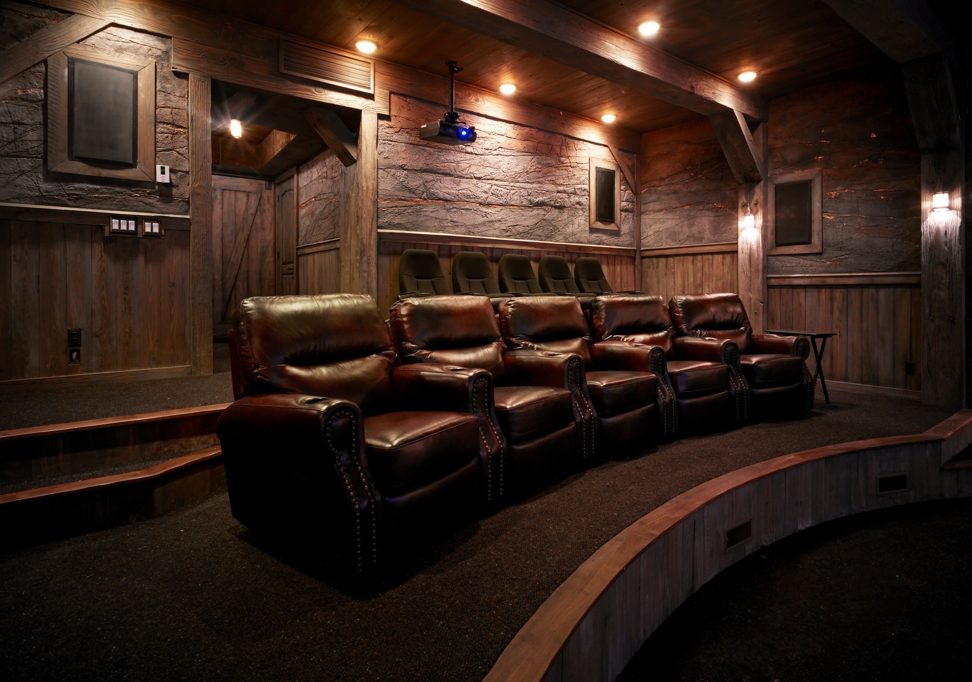
Automated intelligent
Lights
Which switch on/off
By itself depending
On the situation

Slide 12
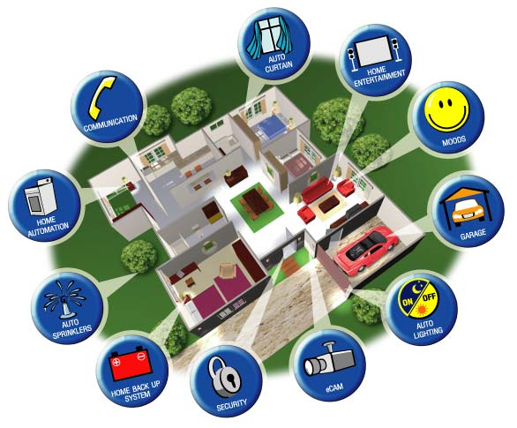
Where is Home Automation going?

Slide 13
Green Building and Safe Building
HVAC Control
Electricity consumption management
Lighting control
Regulated according to ambient light
Natural Light
Shades/Curtain control
Security
Connections to cameras, alarms
Example: Flashing all lights if alarm goes off.
Flood warning

Slide 14
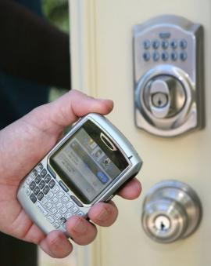
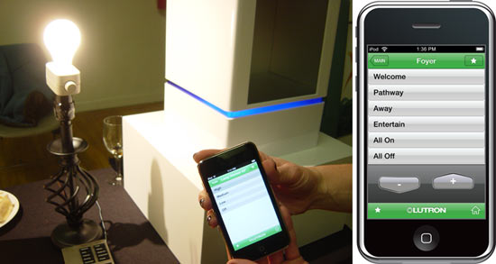
Where are We going?
Deadbolt Control
I-phone Apps/Controller
Control TV, Garage Door,Security systems anything you want!!

Slide 15


BIOMETRICS

Slide 16
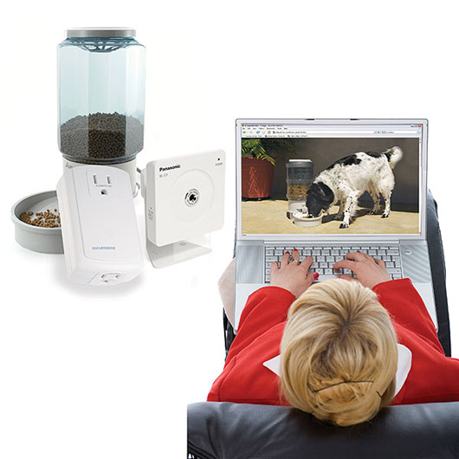
Vacant Home Capabilities:
Feed and watch pets
Water plants
Interior and Exterior
Presence Simulation
Lighting, TV, anything – pre-programmed schedule

Slide 17
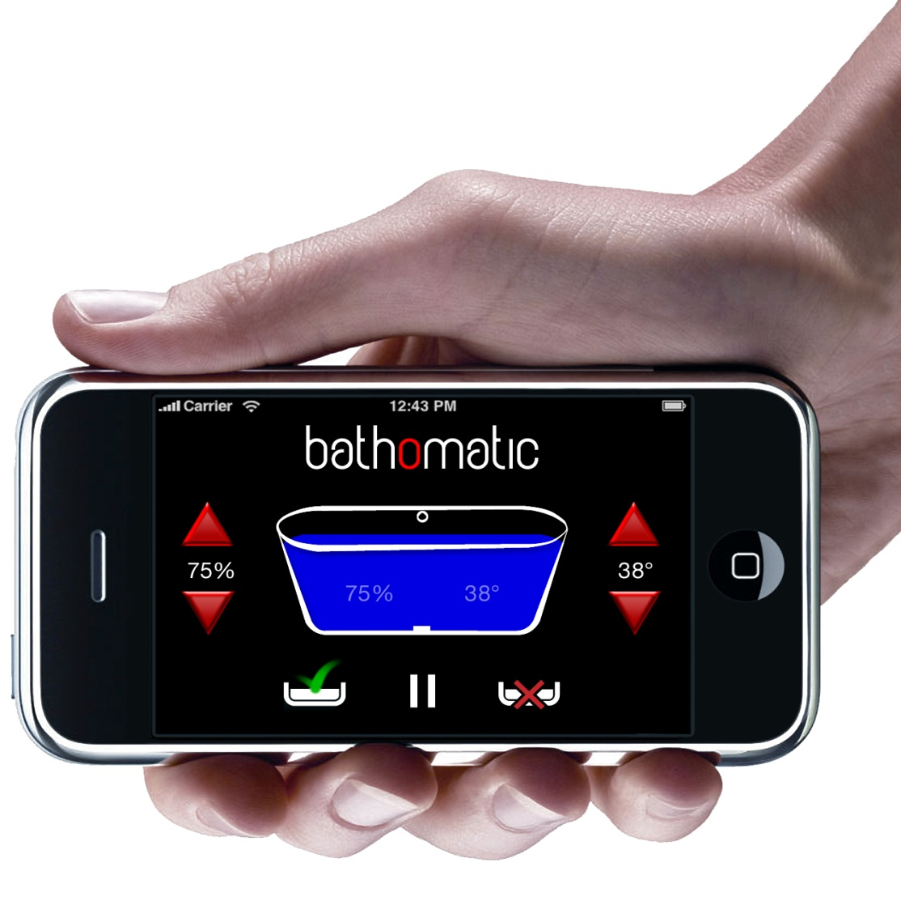
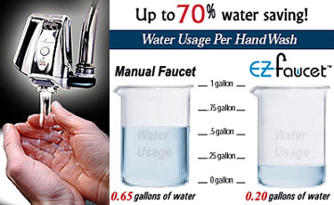
Water Management
Programmed bath cycles
Bathomatic DEMO
Sensor Faucet

Slide 18
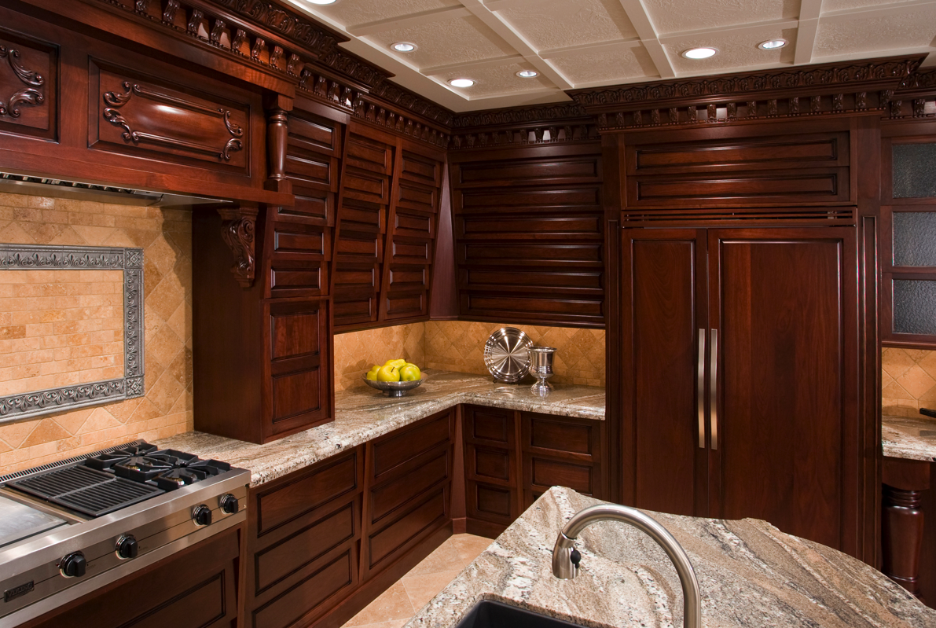
Automated Cabinets

