Slide 1
Feature Store Requirements
Mark Rumore

Slide 2
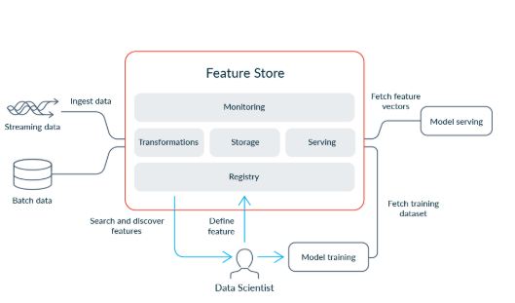
Scope
Purpose:
sharing features across teams, ensuring feature consistency, improving model reproducibility
Users:
Developer and Citizen Developers
Access Control:
Defined by department

Slide 3
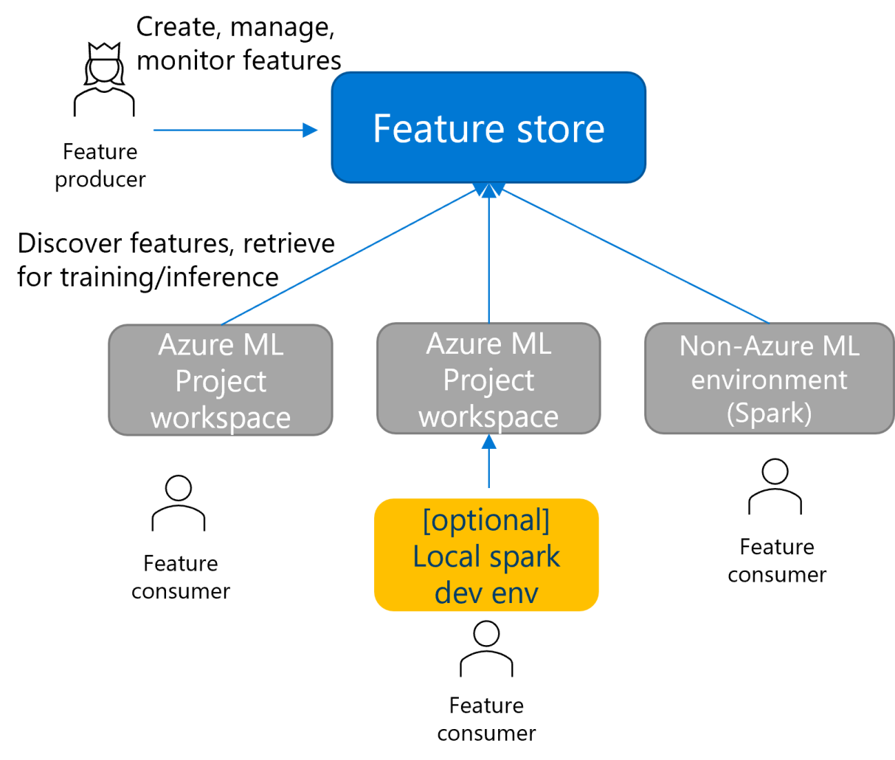
Infrastructure
Resources:
Use Azure Data Lake or Azure Blob Storage (probably) to store raw and processed feature data.
Snowflake?? (potentially) for metadata management.
Use Azure Machine Learning Datastores to connect your feature store to Azure ML Studio.
Compute Resources:
Use some vm? or Azure Synapse Analytics for feature engineering and batch processing.
Use Azure Kubernetes Service (AKS) for real-time feature serving.
Notes:
Live feature store: will have to have a vm set up to run
- Will just be an enhancement in the future
Non-live feature store: can use feasts interface

Slide 4
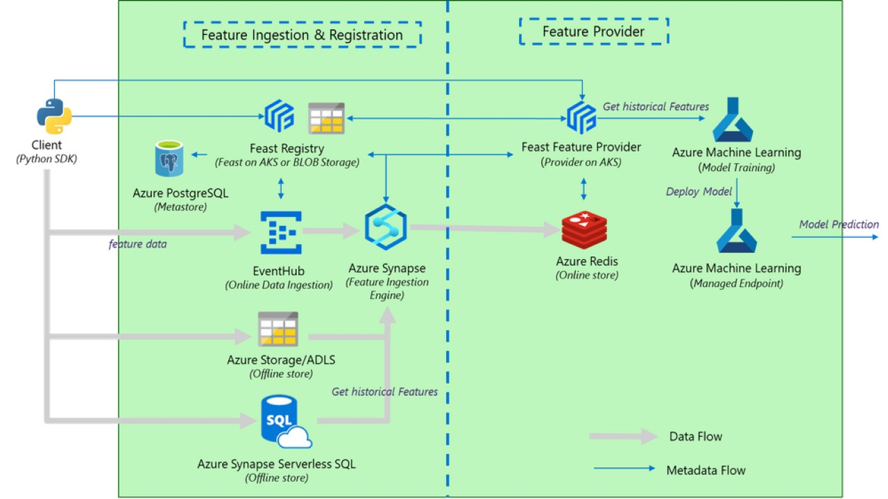


Slide 5
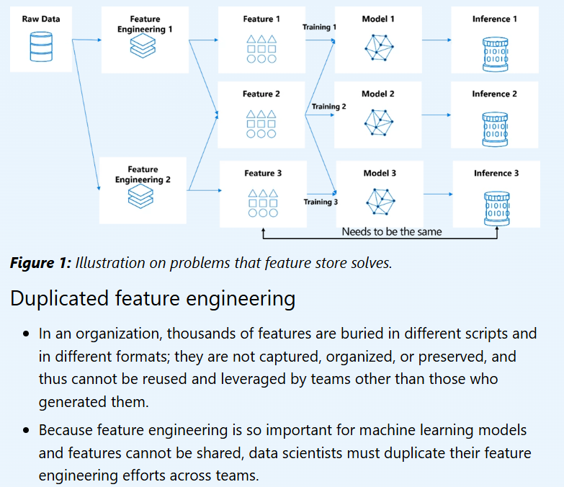
Design
Feature Registry:
Maintain metadata about features (e.g., feature name, description, data type, source, update frequency).
Azure Purview for data cataloging and lineage tracking. (won’t need)
Data.world can be used instead
Feature Storage:
Store features in a format optimized for retrieval (e.g., Parquet, Delta Lake).
Organize features into namespaces or groups (e.g., sales_features, customer_features).
Feature Serving:
Implement APIs for real-time feature retrieval.
Use batch pipelines for offline feature generation.
Notes:
Feature store format storage:
Parquet
Snowflake – likely will be the choice

Slide 6
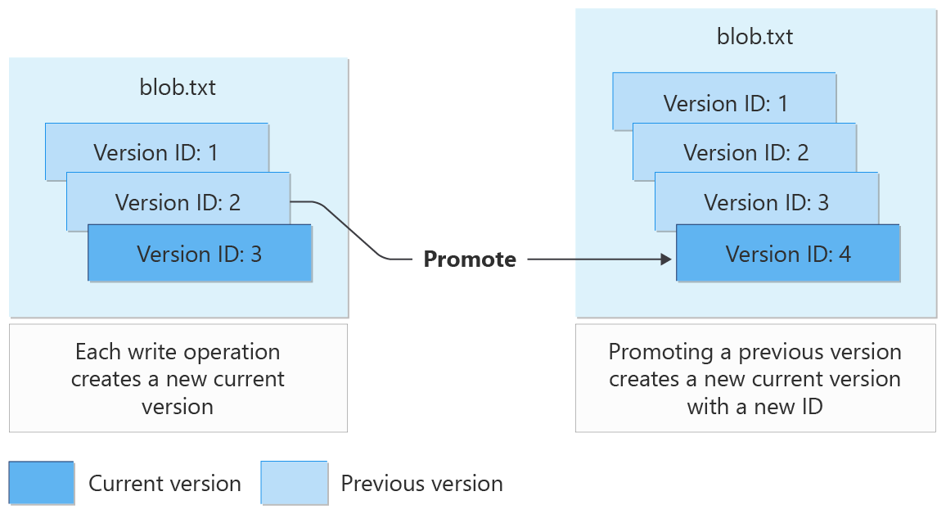
Feature Engineering Pipeline
Reusable Pipelines:
Create reusable feature engineering pipelines using Azure Machine Learning Pipelines Versioning:
Version features to ensure reproducibility of models.
Use tools like MLflow for tracking feature versions.
Won’t use Mlflow for data versioning
Feast can handle versioning within library
Monitoring:
Monitor feature drift and data quality using tools like Azure Monitor or custom scripts.
Custom scripts to track drift will likely be what we use
Feast profiling could assist

Slide 7
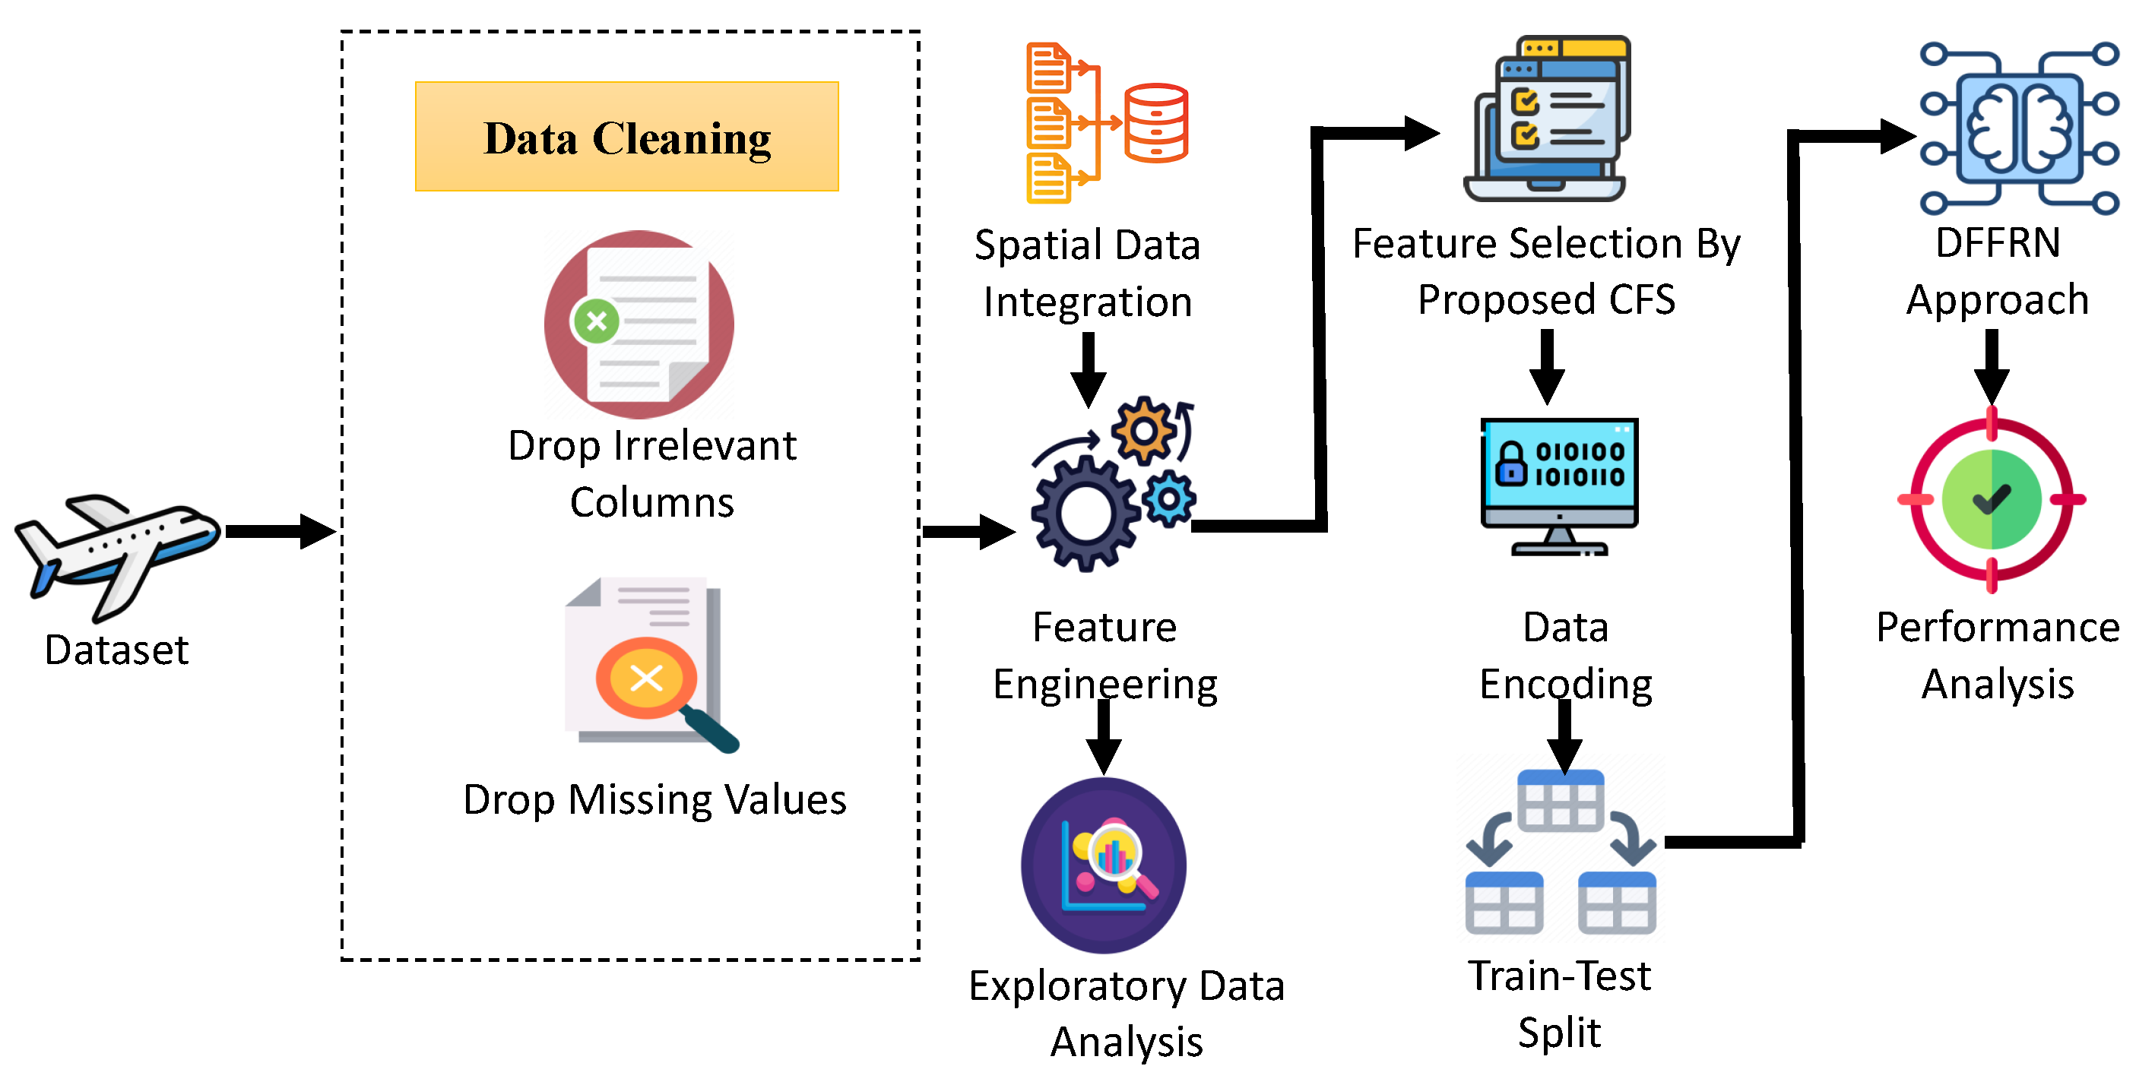
Integration
Datastores:
Register your feature store as a datastore in Azure ML Studio.
We won’t need to do this
Datasets:
Create datasets in Azure ML Studio that point to your feature store.
Feature Consumption:
Use the feature store in training pipelines and inference workflows.
All the above is replaced with the feature store, mitigating citizen developer risk of creating incorrect features during engineering process.

Slide 8
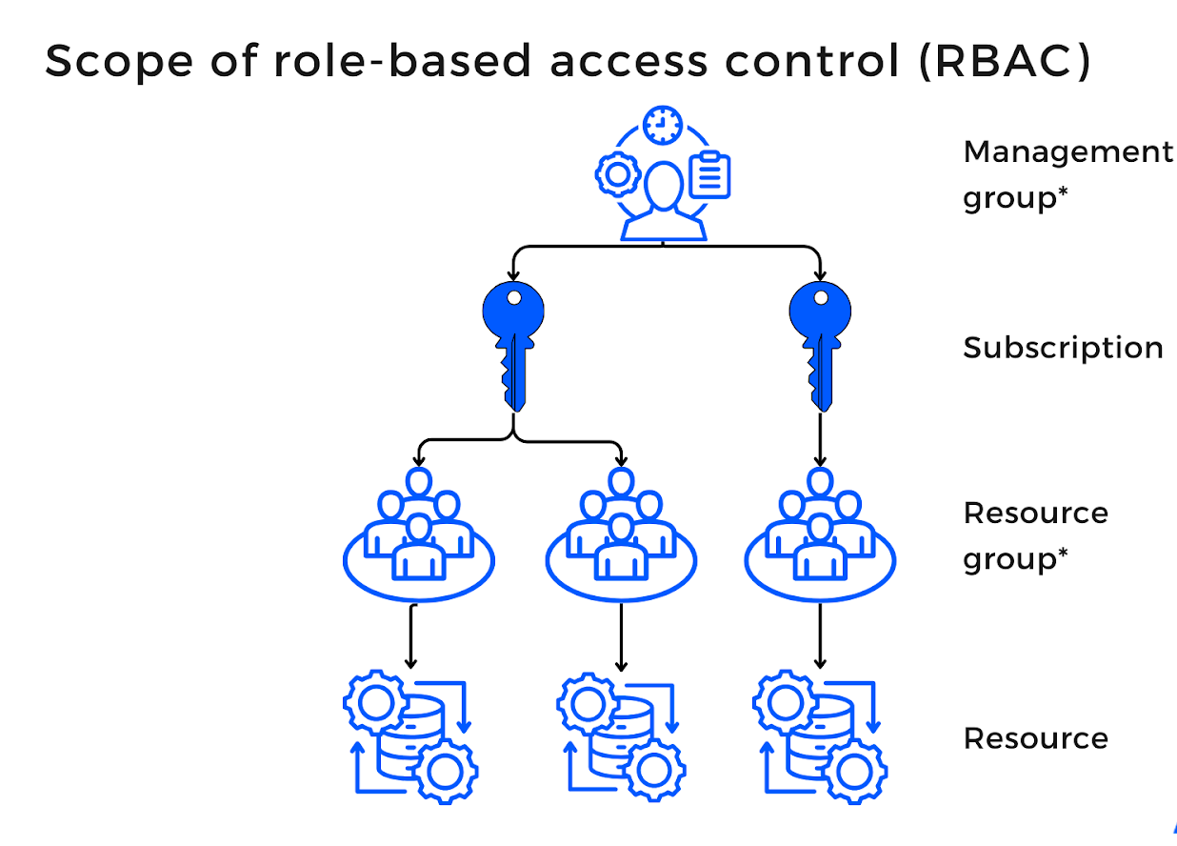
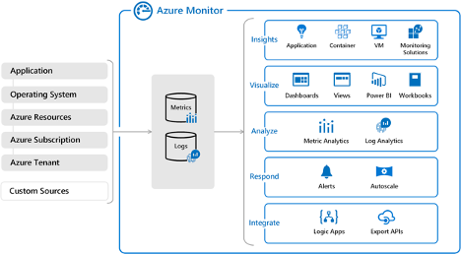
Governance
Access Control:
We won’t necessarily need to use azure we can use whatever RBAC feast offers and map back to OKTA.
Use Azure Role-Based Access Control (RBAC) to manage access to the feature store.
AD Group
Data Encryption:
Encrypt data at rest and in transit using Azure's built-in encryption features.
Auditing:
Track feature usage and modifications using Azure's logging and auditing tools.

Slide 9
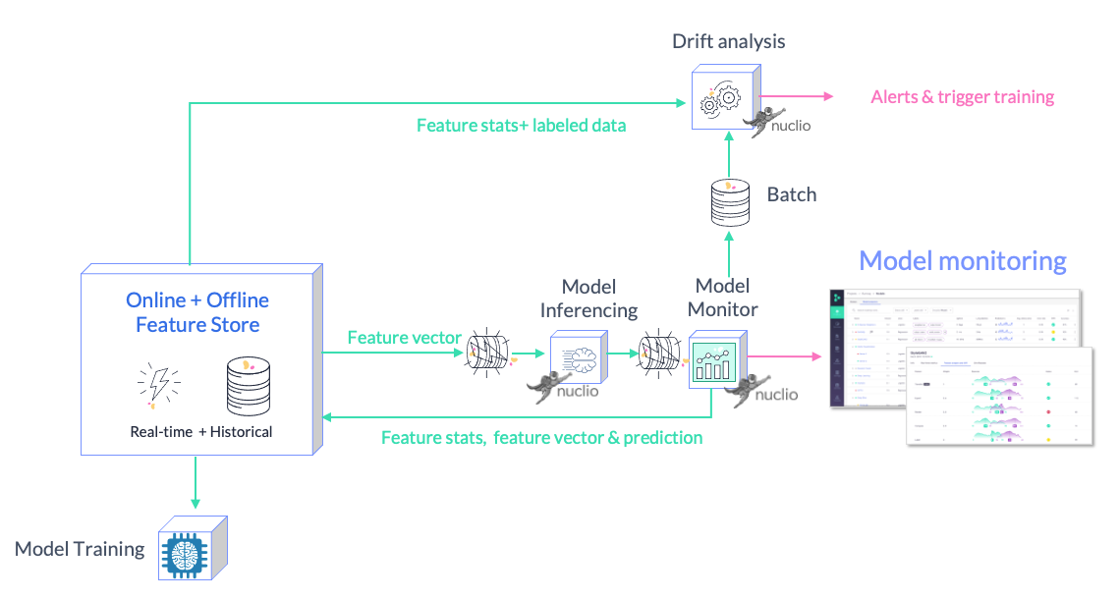
Scaling
Automate and Scale:
Automate feature extraction and updates using Azure Data Factory.
Scaling:
Use Azure Autoscale to handle varying workloads for feature engineering and serving.
Notes:
Avoid using azure synapse, ADF directly is better

Slide 10
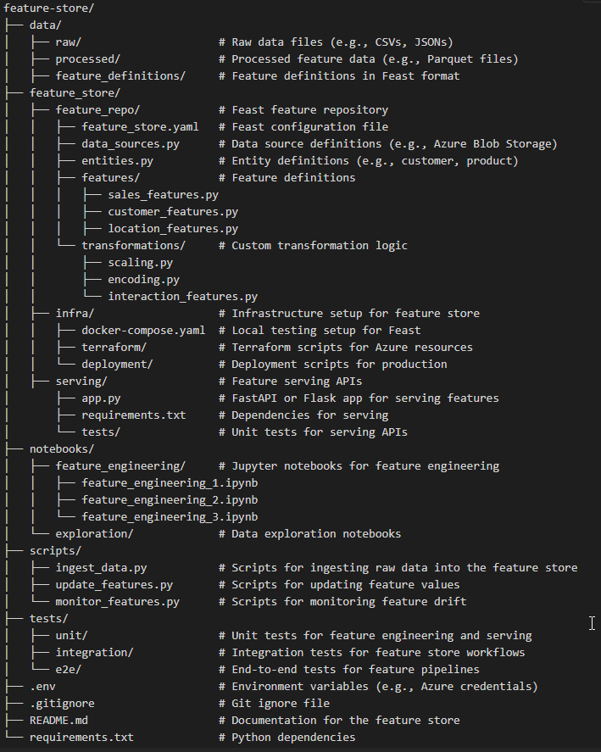
Code Repository
1. Data Directory (data/)
Purpose: Store raw and processed data.
Subfolders:
raw/: Raw data ingested from external sources.
processed/: Processed feature data stored in formats like Parquet.
feature_definitions/: Feature definitions exported from Feast.
2. Feature Store Directory (feature_store/)
Purpose: Centralized location for Feast configurations and feature definitions.
feature_store.yaml: Configuration file for Feast (e.g., Azure Blob Storage as the offline store).
data_sources.py: Define data sources (e.g., Azure Blob Storage paths).
entities.py: Define entities (e.g., customer, product).
features/: Python files defining features using Feast's FeatureView.
transformations/: Custom transformation logic for feature engineering.
3. Infrastructure Directory (infra/)
docker-compose.yaml: Local setup for testing Feast.
terraform/: Terraform scripts to provision Azure Blob Storage and compute resources.
deployment/: Scripts for deploying the feature store to production.
4. Serving Directory (serving/)
app.py: REST API for serving features (e.g., using FastAPI or Flask).
requirements.txt: Dependencies for the serving application.
tests/: Unit tests for the serving APIs.
5. Scripts Directory (scripts/)
ingest_data.py: Script to ingest raw data into the feature store.
update_features.py: Script to update feature values in the store.
monitor_features.py: Script to monitor feature drift and quality.
6. Tests Directory (tests/)
Subfolders:
unit/: Unit tests for feature engineering and serving.
integration/: Integration tests for feature pipelines.
e2e/: End-to-end tests for the entire feature store workflow.

Slide 11
Timeline Phase 1 (2025)
POC Initially stand-up non live Feast:
Add Feast library
Data references
Can be done within a Sprint
Design
2 sprints
Caveats: setting up Feast is different than actually creating the features

