Slide 1
Affirm Business Recommendations
Mark Sadowski

Slide 2
Improve Music Segment Conversion
2nd largest segment at the top of the funnel, but consistently the lowest in approval rate and 2nd lowest in application rate.
Customer loan segment for music skews slightly towards younger individuals. Likely HS and college students who play an instrument in school and would like to buy instead of renting an instrument.
Great opportunity to convert individuals who are just starting to enter adulthood and the financial services ecosystem. Although a relatively low $55 ARPU for the Music segment, give them a great experience here and the likelihood of them coming back for loans on things like furniture and apparel after they graduate and land their first job increases.

Slide 3
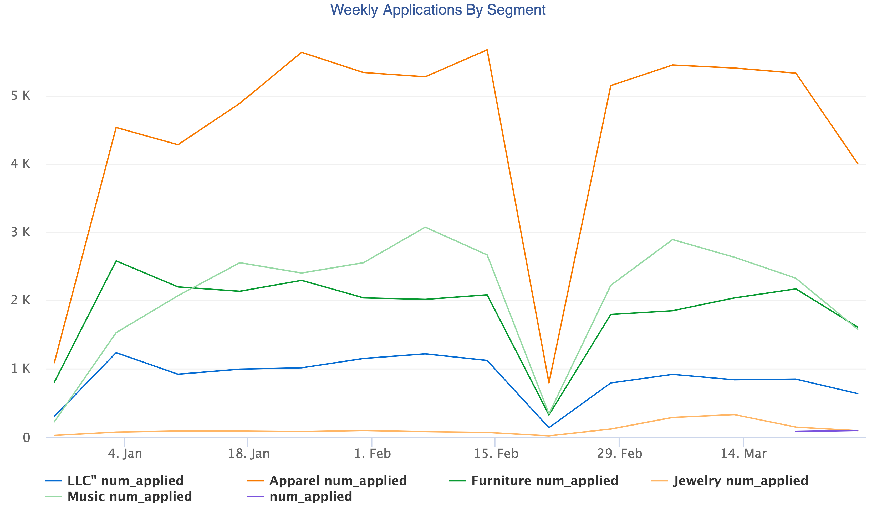
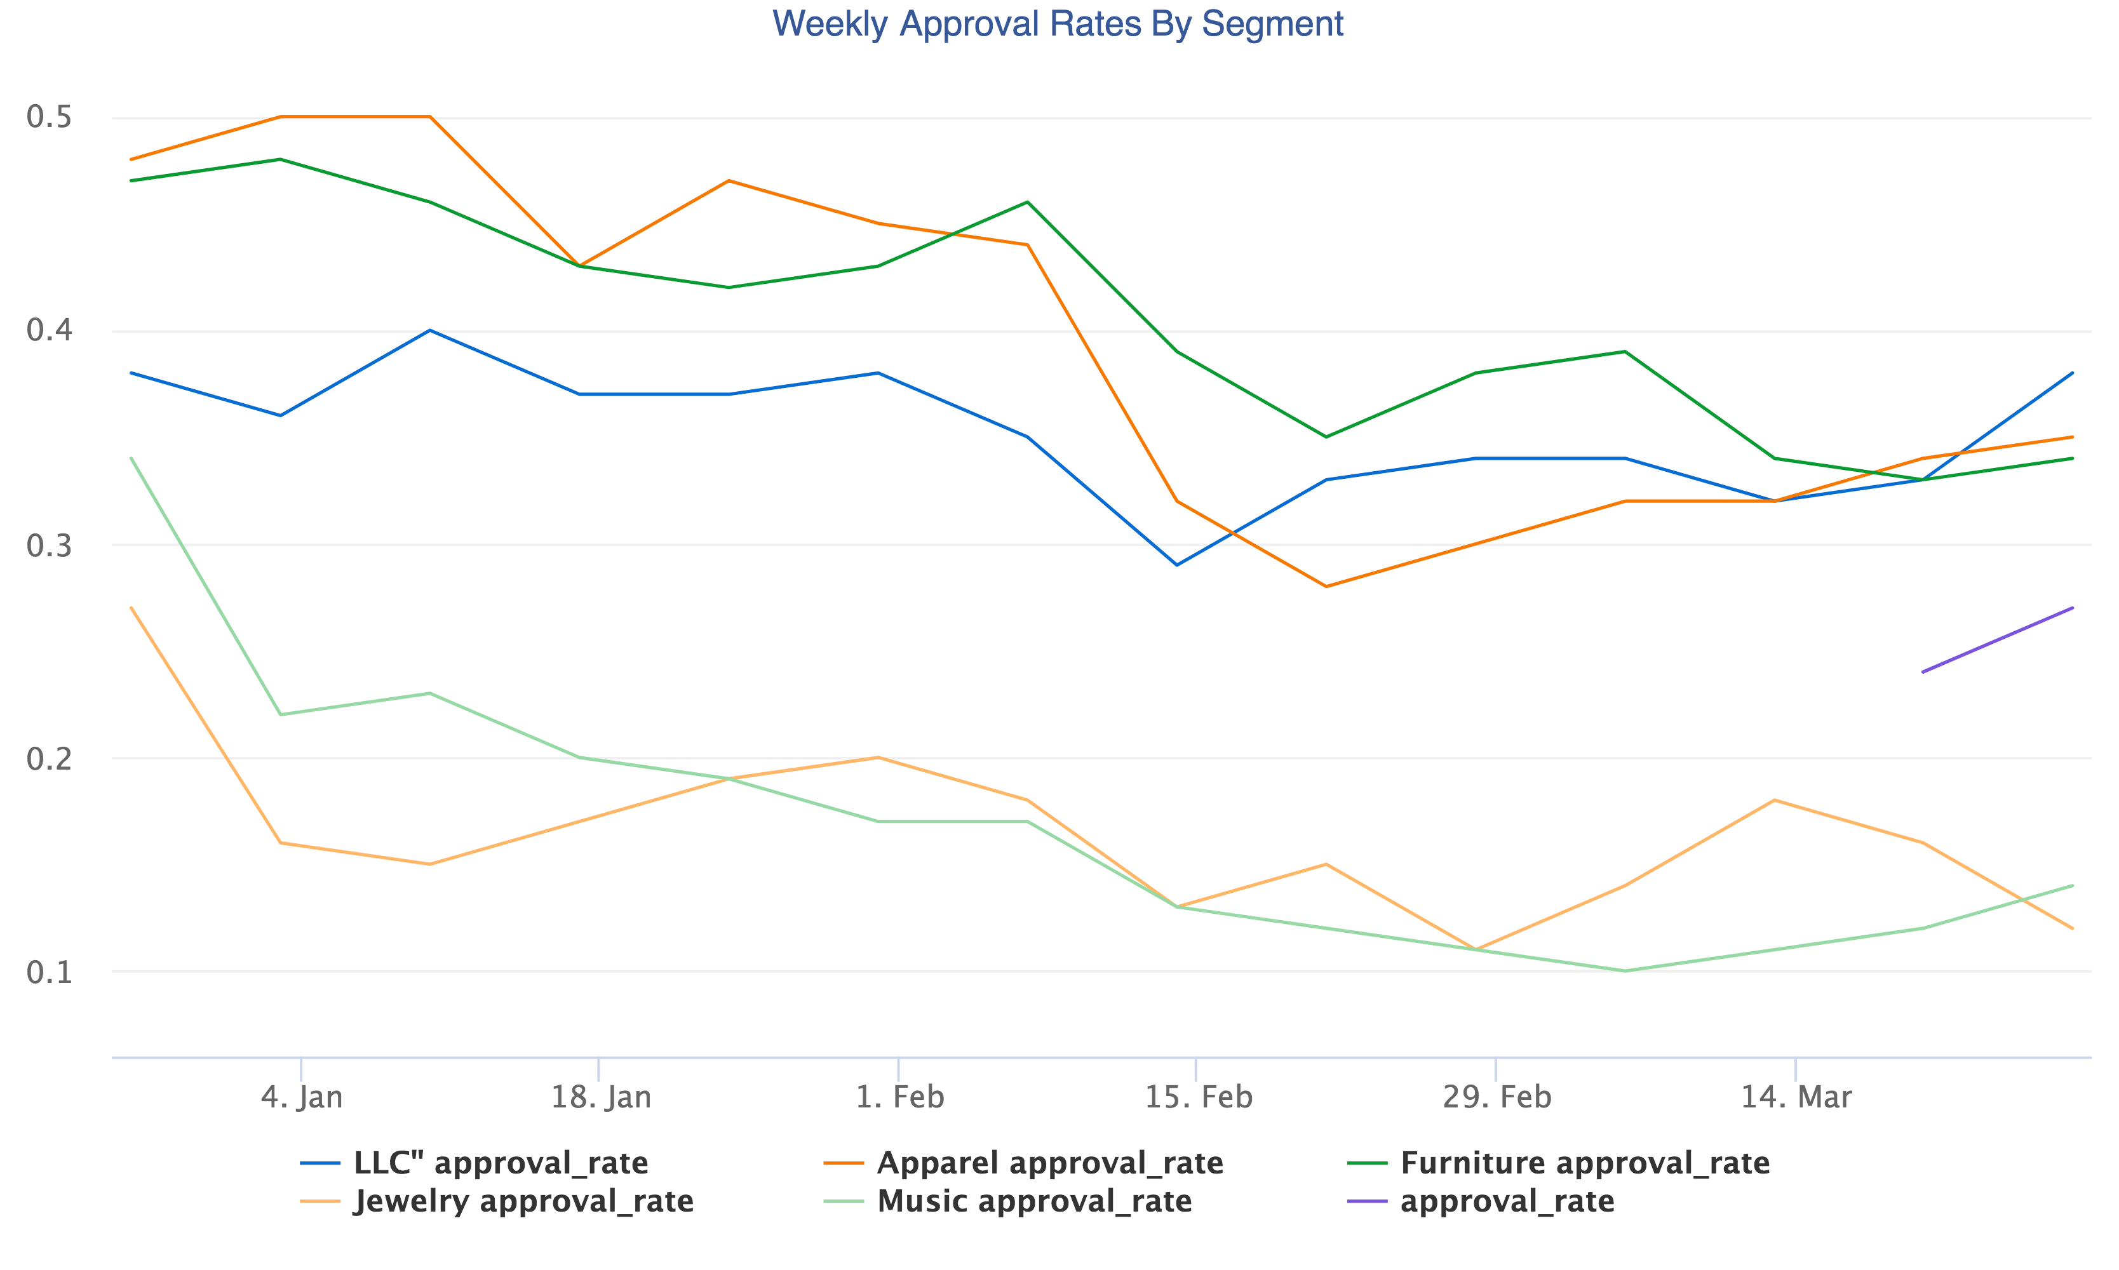
Music – High Applications and Low Approval Rates

Slide 4
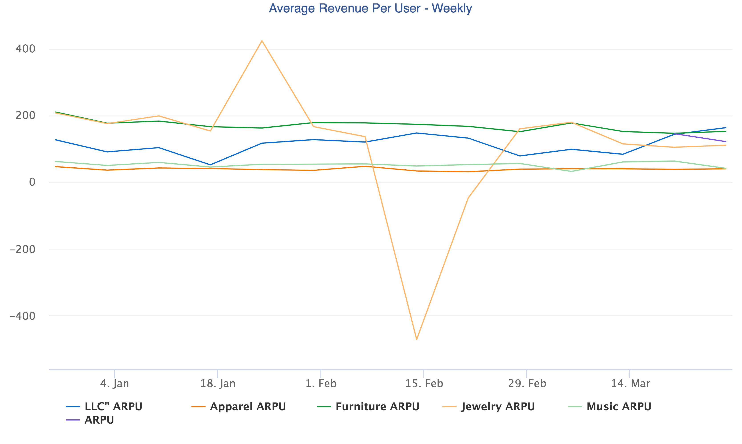
Improve jewelry Loads
If the markets are equally saturated then we should spend some time in understanding why the number of checkout loads are so close to zero in this segment.
ARPU is among the highest in the $175-200 range for Q1 2016.
Jewelry may also be purchased in higher frequency than musical instruments and furniture.

Slide 5
Next Steps
How to improve NUX Sign-ups
We want to give people more financial freedom, but some segments like Music, tend to convert worse
Want to try out different flows for customers who are younger and/or may have little-to-no credit history.
What non-financial questions could we ask the user in order for us to get a better signal on their ability to pay back a loan
Understand the approval drop off in March.
Our funnel loads improved after the week of missing data, but our approval and completed points in the funnel have not fully recovered.
Need more data around the session flow: device, browser, IP, etc. to diagnose if a technical problem.
Would also be useful to know if we had any technical changes or launched in any new markets during this time.

