Slide 1
The Observer Pattern
February 7th, 2011
Mark Sands
CS 425
1/12
Intro - Pattern – Problem – Solution - Consequences

Slide 2
The Four Elements of a Design Patterns
Pattern Name
A handle used to describe the design problem, its solution, and consequences in a word or two
Problem
When to apply the pattern
Solution
The elements that make up the design, their relationships, responsibilities, and collaborations
Consequences
The results and trade-offs of applying the pattern
2/12
Intro - Pattern – Problem – Solution - Consequences

Slide 3
A Decoupling Pattern
According to the Gang of Four, the Observer pattern intends to define a one-to-many dependency between objects so that when one object changes state, all its dependents are notified and updated automatically.¹
The Observer Pattern is a behavioral pattern, which are concerned with algorithms and the assignment of responsibilities between objects. Its primary purpose is to decouple objects from each other, which makes this an example of a “decoupling” pattern.²
3/12
Intro - Pattern – Problem – Solution - Consequences

Slide 4
Automatic Notification Handling
The Observer pattern is used when you have a set of objects that need to be notified whenever an event occurs.
This is a common pattern, also known as Dependents and Publish-Subscribe.
Many graphical user interface toolkits use this approach to separate the presentational aspects of the user interface from the underlying application data.
4/12
Intro - Pattern – Problem – Solution - Consequences

Slide 5
Requirements Always Change
In the process of writing your application, evaluate your requirements. If you are certain of the requirements, then you can solve this problem by hard coding the solution. The hard coding approach works fine, but requirements always change.
A large design does not scale well when new graphical or monitoring requirements are added so it is important to maintain consistency between related objects through decoupling.
5/12
Intro - Pattern – Problem – Solution - Consequences

Slide 6
Common Motivation
Graphical user interface toolkits separate much of the UI from the underlying application data. Classes defining application data and presentations can be reused independently.
A spreadsheet and a bar chart can depict information in the same data object using different presentations without the spreadsheet and bar chart knowing about each other. When the user changes the information in the spreadsheet, the bar chart reflects changes immediately, vice versa.
6/12
Intro - Pattern – Problem – Solution - Consequences

Slide 7
Four Participants of the Observer
Subject
Provides an interface for attaching and detaching Observer objects
Knows its observers
Observer
An interface for objects that are notified of changes in a subject
Concrete Subject
Sends a notification to its observers when its state changes
Concrete Observer
Implements the updating interface
7/12
Intro - Pattern – Problem – Solution - Consequences

Slide 8
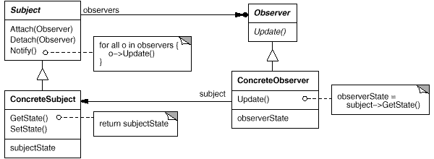
The Observer Pattern Implementation
Subject represents the independent abstraction. Observer represents the dependent abstraction. The Subject notifies the Observer objects to update their state.
8/12
Intro - Pattern – Problem – Solution - Consequences

Slide 9
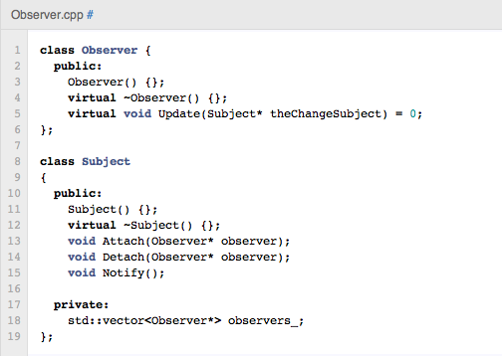
Code Demonstration
9/12
Intro - Pattern – Problem – Solution - Consequences

Slide 10
Benefits and Liabilities
Abstract coupling between Subject and Observer so each can be extended and reused individually
Dynamic relationship provides more flexibility
Broadcast communication, notifications are broadcast automatically to all objects that subscribe to it
Observers have no knowledge of each other and are blind to the cost of changing the subject.
The update dependency can be hard to track down with the dynamic relationship
10/12
Intro - Pattern – Problem – Solution - Consequences

Slide 11
Alternatives to the Observer Pattern
The Compound Pattern on the Chain of Responsibility and Observer
The Observer Pattern is embedded in the Chain of Responsibility pattern to become a compound pattern. Each handler in the Chain of Responsibility is an object of the Observer Pattern. When there is not an observer, the handler delivers the request of the customer to the next handler in the responsibility chain.³
Mediator Pattern
Weak Reference Pattern
Delegation Pattern
Inversion of Responsibility/Inversion of Control
Post-Object Programming
11/12
Intro - Pattern – Problem – Solution - Consequences

Slide 12
Bibliography
¹ Gamma, Eric, Richard Helm, Ralph Johnson, and John Vlissides. Design Patterns: elements of reusable object-oriented software. Reading, Mass.: Addison-Wesley, 1995. Print.
² Shalloway, Alan, and James Trott. Design Patterns explained: a new perspective on object-oriented design. Boston, Ma.: Addison-Wesley, 2002. Print.
³ Zhang Yueping; Li Yuefan; Xu Kesheng;, "The Compound Pattern on the Chain of Responsibility and Observer," Computer Science-Technology and Applications, 2009. IFCSTA '09. International Forum on , vol.3, no., pp.420-422, 25-27 Dec. 2009
12/12
Intro - Pattern – Problem – Solution - Consequences

