Slide 1
A Universal Law of Robustness via Isoperimetry
Mark Sellke (Stanford)
Joint work with Sébastien Bubeck (MSR)
https://arxiv.org/pdf/2105.12806.pdf

Slide 2
Adversarial Examples
Neural networks memorize training data, are vulnerable to small perturbations.
[GSS 15], [CW 17], [MMSTV 18], [ISTETM 19],…
What is going on?
Some hypotheses:
1. Robust memorization is computationally hard
2. Neural networks cannot memorize robustly
3. Robust memorization needs more data
4. Robust memorization requires large models

Slide 3
Adversarial Examples
Neural networks memorize training data, are vulnerable to small perturbations.
[GSS 15], [CW 17], [MMSTV 18], [ISTETM 19],…
What is going on?
Some hypotheses:
1. Robust memorization is computationally hard
2. Neural networks cannot memorize robustly
3. Robust memorization needs more data
4. Robust memorization requires large models
Law of Robustness

Slide 4
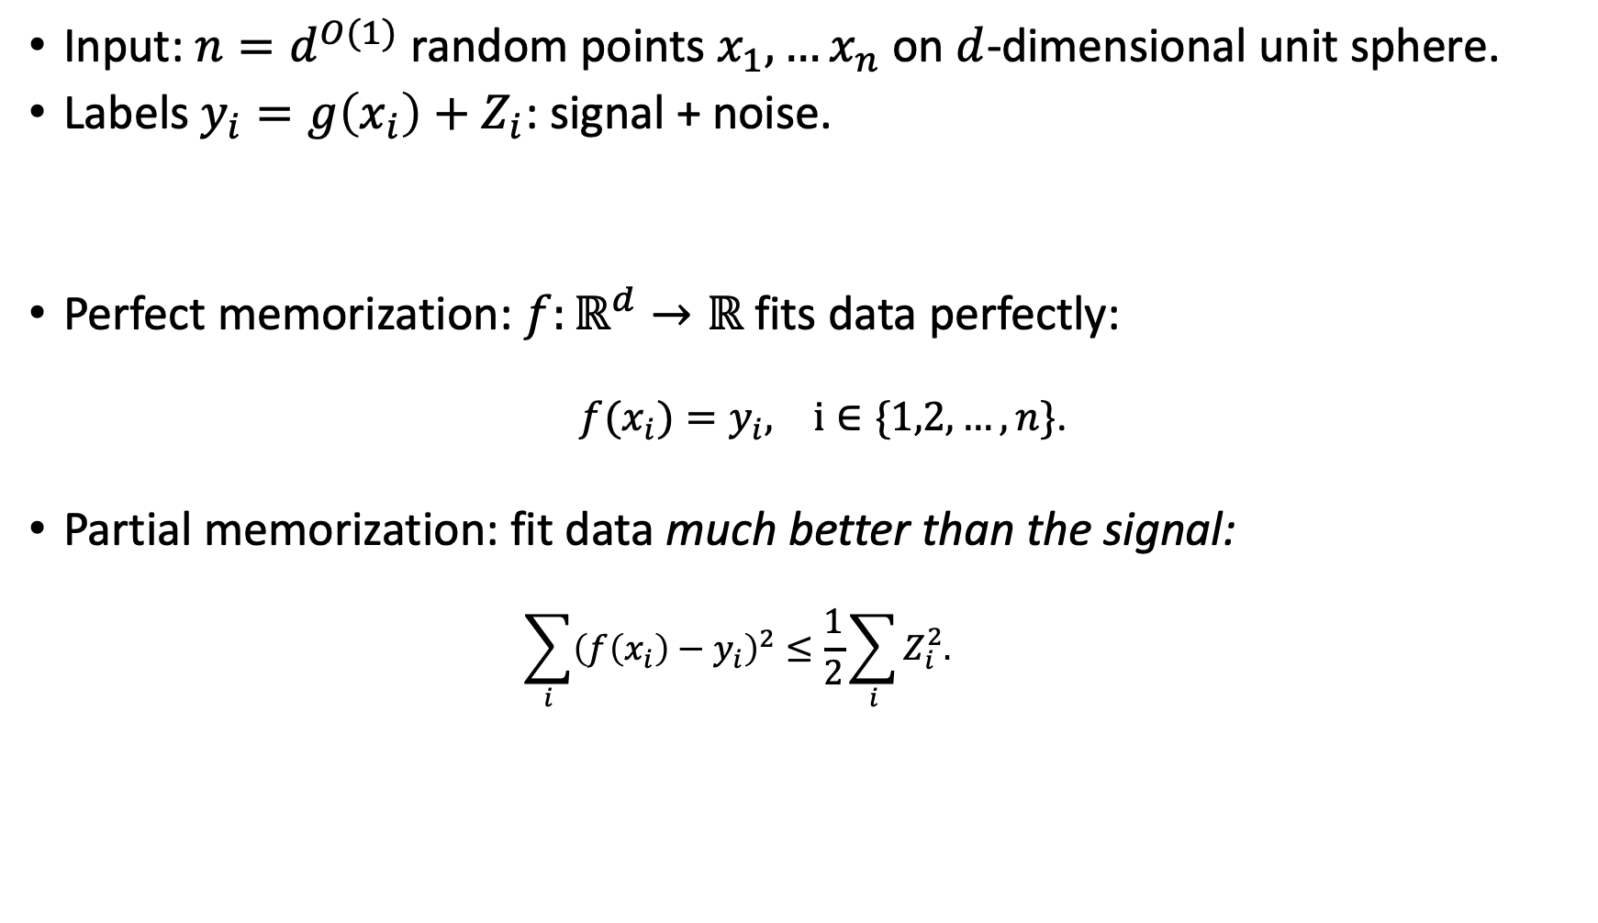
The Model of Memorization
Input: $n=d^{O(1)}$ random points $x_{1},…x_{n}$ on $d$-dimensional unit sphere.
Labels $y_{i}=g\left(x_{i}\right)+Z_{i}$: signal + noise.
Perfect memorization: $f:ℝ^{d}→ℝ$ fits data perfectly:
${f(x}_{i})=y_{i}, i∈\{1,2,…, n\}$.
Partial memorization: fit data much better than the signal:
$$\sum_{i}{{\left(f\left(x_{i}\right)−y_{i}\right)}^{2}}≤\frac{1}{2}\sum_{i}{Z_{i}^{2}.}$$

Slide 5
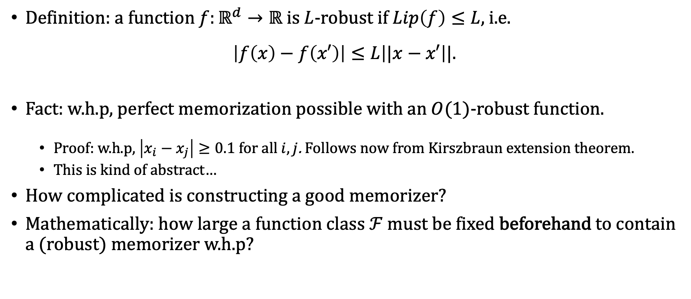
Robustness and Memorization
Definition: a function $f:ℝ^{d}→ℝ$ is $L$-robust if $Lip\left(f\right)≤L$, i.e.
$$\left|f\left(x\right)−f\left(x′\right)\right|≤L\left||x−x′\right||.$$
Fact: w.h.p, perfect memorization possible with an $O(1)$-robust function.
Proof: w.h.p, $\left|x_{i}−x_{j}\right|≥0.1$ for all $i,j$. Follows now from Kirszbraun extension theorem.
This is kind of abstract…
How complicated is constructing a good memorizer?
Mathematically: how large a function class $ℱ$ must be fixed beforehand to contain a (robust) memorizer w.h.p?

Slide 6
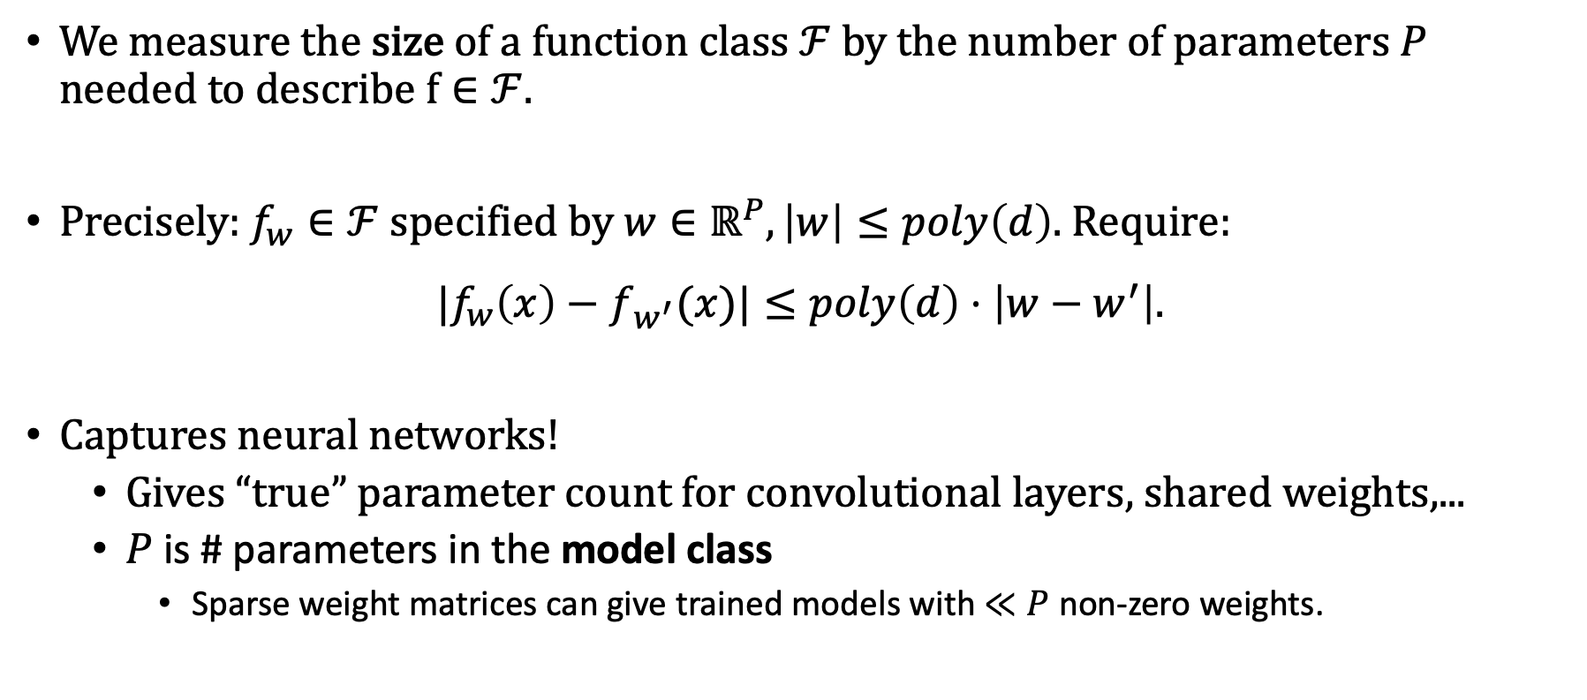
Parameter Counting
We measure the size of a function class $ℱ$ by the number of parameters $P$ needed to describe $f∈ℱ$.
Precisely: $f_{w}∈ℱ$ specified by $w∈ℝ^{P}, \left|w\right|≤poly\left(d\right).$ Require:
$${|f}_{w}\left(x\right)−f_{w^{′}}(x)|≤poly\left(d\right)⋅\left|w−w^{′}\right|.$$
Captures neural networks!
Gives “true” parameter count for convolutional layers, shared weights,...
$P$ is # parameters in the model class
Sparse weight matrices can give trained models with $≪P$ non-zero weights.

Slide 7
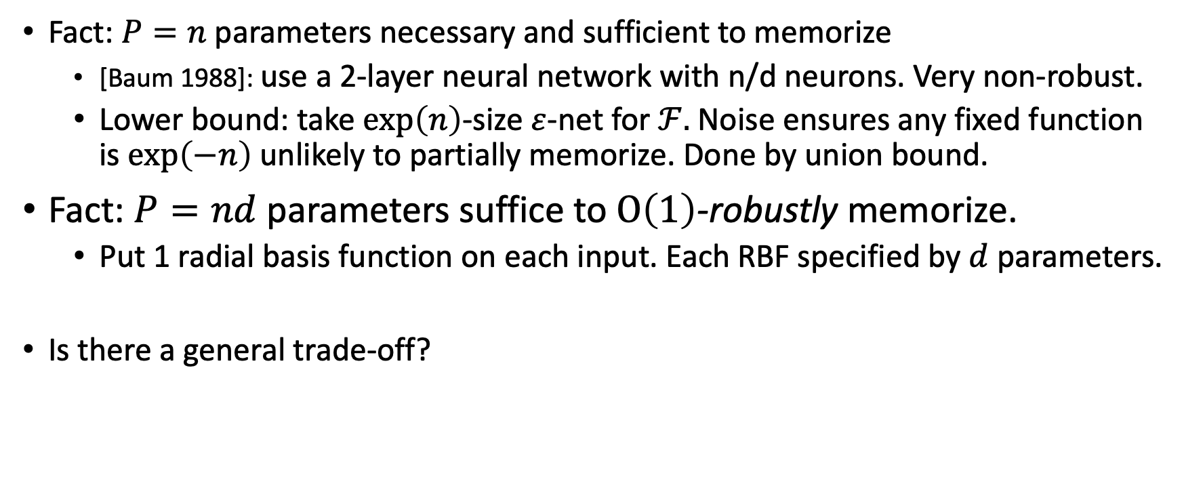
A Size vs Robustness Tradeoff?
Fact: $P=n$ parameters necessary and sufficient to memorize
[Baum 1988]: use a 2-layer neural network with n/d neurons. Very non-robust.
Lower bound: take $exp\left(n\right)$-size $ε$-net for $ℱ.$ Noise ensures any fixed function is $exp\left(−n\right)$ unlikely to partially memorize. Done by union bound.
Fact: $P=nd$ parameters suffice to $O\left(1\right)$-robustly memorize.
Put 1 radial basis function on each input. Each RBF specified by $d$ parameters.
Is there a general trade-off?

Slide 8
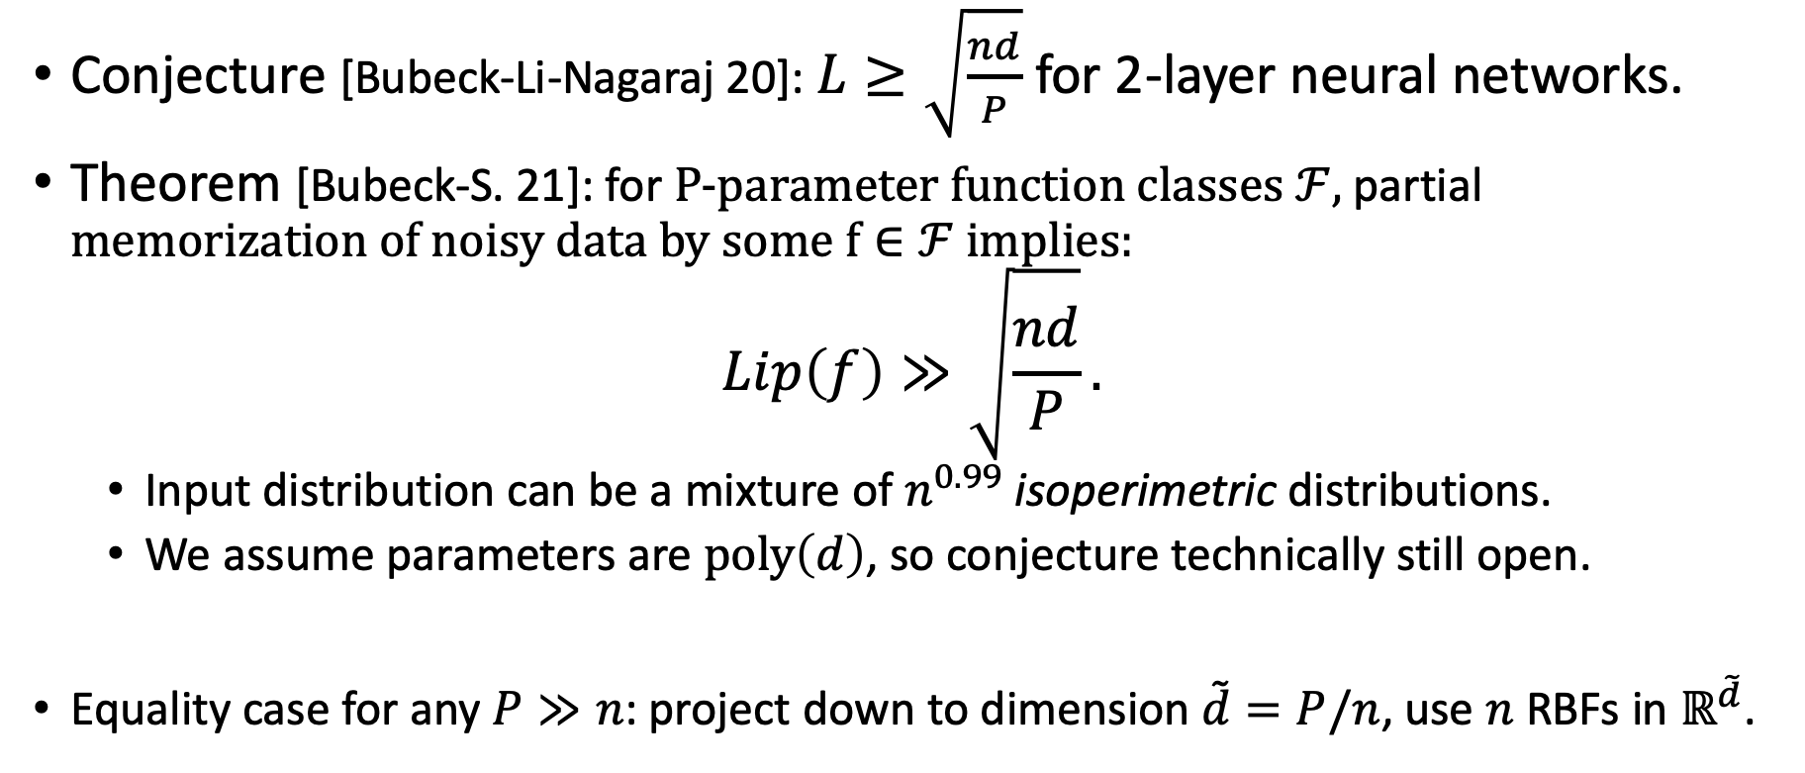
A Universal Law of Robustness
Conjecture [Bubeck-Li-Nagaraj 20]: $L≥\sqrt{\frac{nd}{P}}$ for 2-layer neural networks.
Theorem [Bubeck-S. 21]: for P-parameter function classes $ℱ$, partial memorization of noisy data by some $f∈ℱ$ implies:
$$Lip\left(f\right)≫\sqrt{\frac{nd}{P}}.$$
Input distribution can be a mixture of $n^{0.99}$ isoperimetric distributions.
We assume parameters are $poly\left(d\right)$, so conjecture technically still open.
Equality case for any $P≫n$: project down to dimension $\tilde{d}=P/n$, use $n$ RBFs in $ℝ^{\tilde{d}}$.

Slide 9
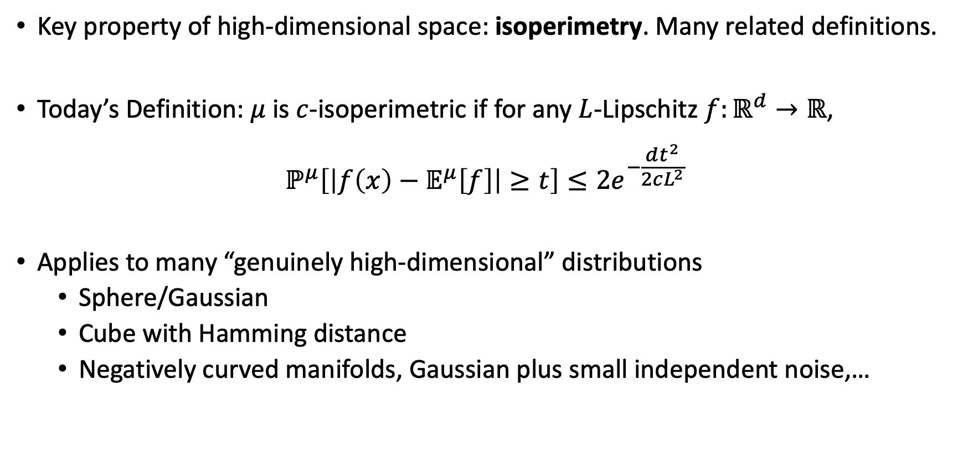
Isoperimetry
Key property of high-dimensional space: isoperimetry. Many related definitions.
Today’s Definition: $μ$ is $c$-isoperimetric if for any $L$-Lipschitz $f:ℝ^{d}→ℝ$,
$$ℙ^{μ}\left[\left|f\left(x\right)−𝔼^{μ}\left[f\right]\right|≥t\right]≤2e^{−\frac{dt^{2}}{2cL^{2}}}$$
Applies to many “genuinely high-dimensional” distributions
Sphere/Gaussian
Cube with Hamming distance
Negatively curved manifolds, Gaussian plus small independent noise,…

Slide 10
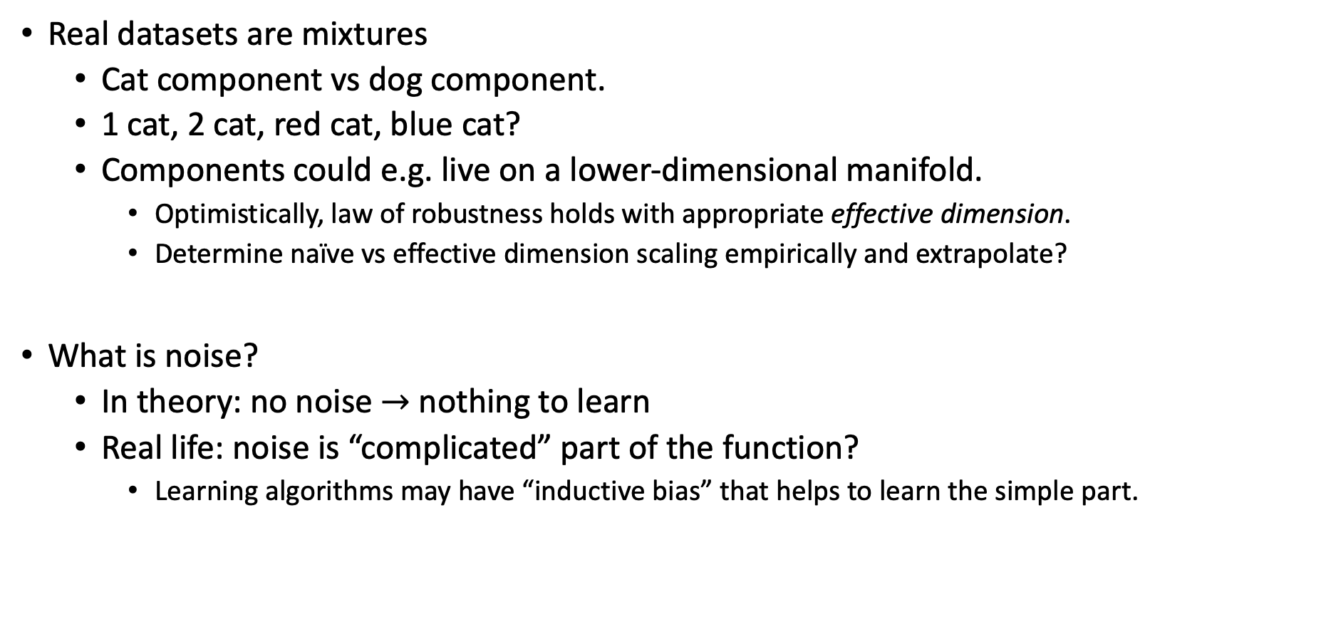
Interpretation
Real datasets are mixtures
Cat component vs dog component.
1 cat, 2 cat, red cat, blue cat?
Components could e.g. live on a lower-dimensional manifold.
Optimistically, law of robustness holds with appropriate effective dimension.
Determine naïve vs effective dimension scaling empirically and extrapolate?
What is noise?
In theory: no noise $→$ nothing to learn
Real life: noise is “complicated” part of the function?
Learning algorithms may have “inductive bias” that helps to learn the simple part.

Slide 11
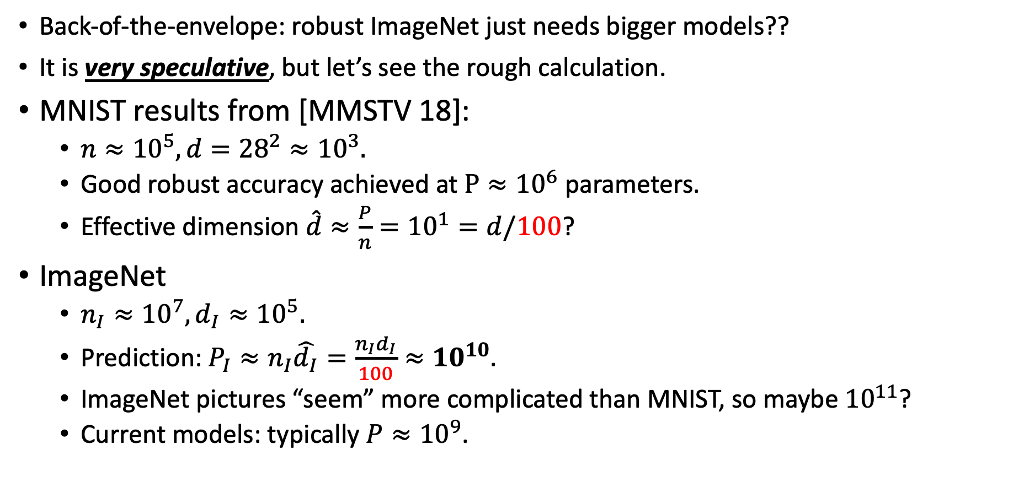
MNIST and ImageNet
Back-of-the-envelope: robust ImageNet just needs bigger models??
It is very speculative, but let’s see the rough calculation.
MNIST results from [MMSTV 18]:
$n≈{10}^{5}, d={28}^{2}≈{10}^{3}.$
Good robust accuracy achieved at $P≈{10}^{6}$ parameters.
Effective dimension $\hat{d}≈{\frac{P}{n}=10}^{1}=d/100$?
ImageNet
$n_{I}≈{10}^{7}, d_{I}≈{10}^{5}.$
Prediction: $P_{I}≈n_{I}\hat{d_{I}}=\frac{n_{I}d_{I}}{100}≈{10}^{10}.$
ImageNet pictures “seem” more complicated than MNIST, so maybe ${10}^{11}$?
Current models: typically ${P≈10}^{9}$.
Proportionality constant for image effective dimension?

Slide 12
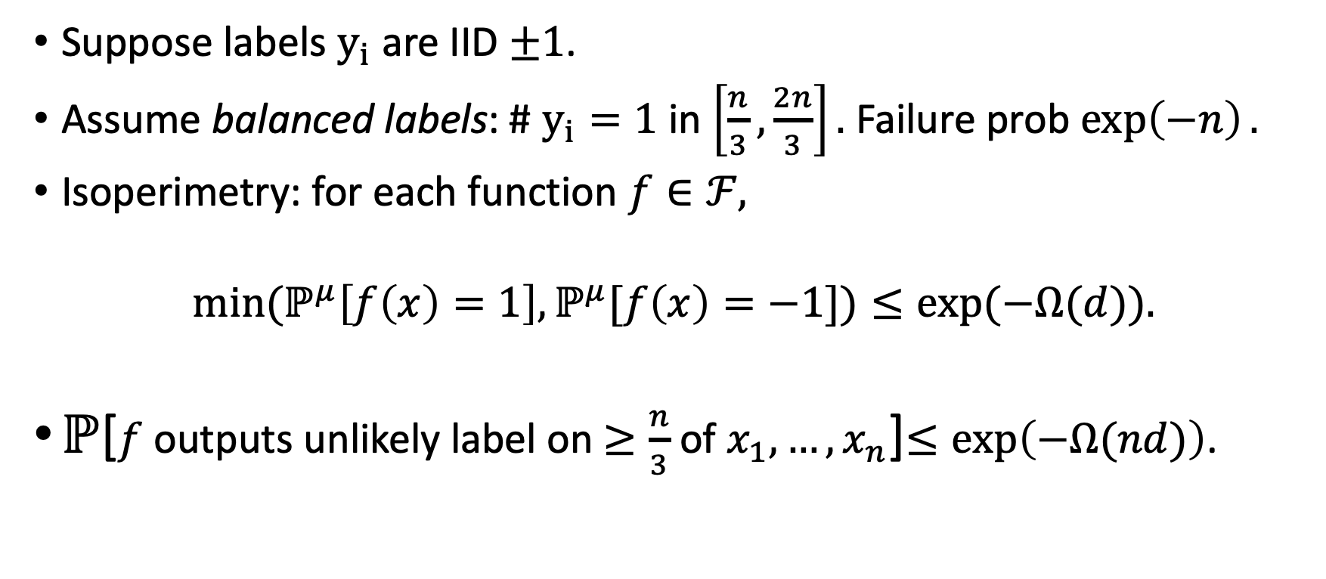
Proof for Perfect Memorization
Suppose labels$y_{i}$ are IID $±1$.
Assume balanced labels: # $y_{i}=1$ in $\left[\frac{n}{3},\frac{2n}{3}\right].$ Failure prob $\exp\left(−n\right).$
Isoperimetry: for each function $f∈ℱ,$
$$\min{{(ℙ}^{μ}\left[f\left(x\right)=1\right],ℙ^{μ}[f\left(x\right)=−1])≤exp⁡(−Ω(d)).}$$
$ℙ$[$f$ outputs unlikely label on $≥\frac{n}{3}$ of $x_{1},…,x_{n}$]$≤\exp\left(−Ω(nd)\right)$.

Slide 13
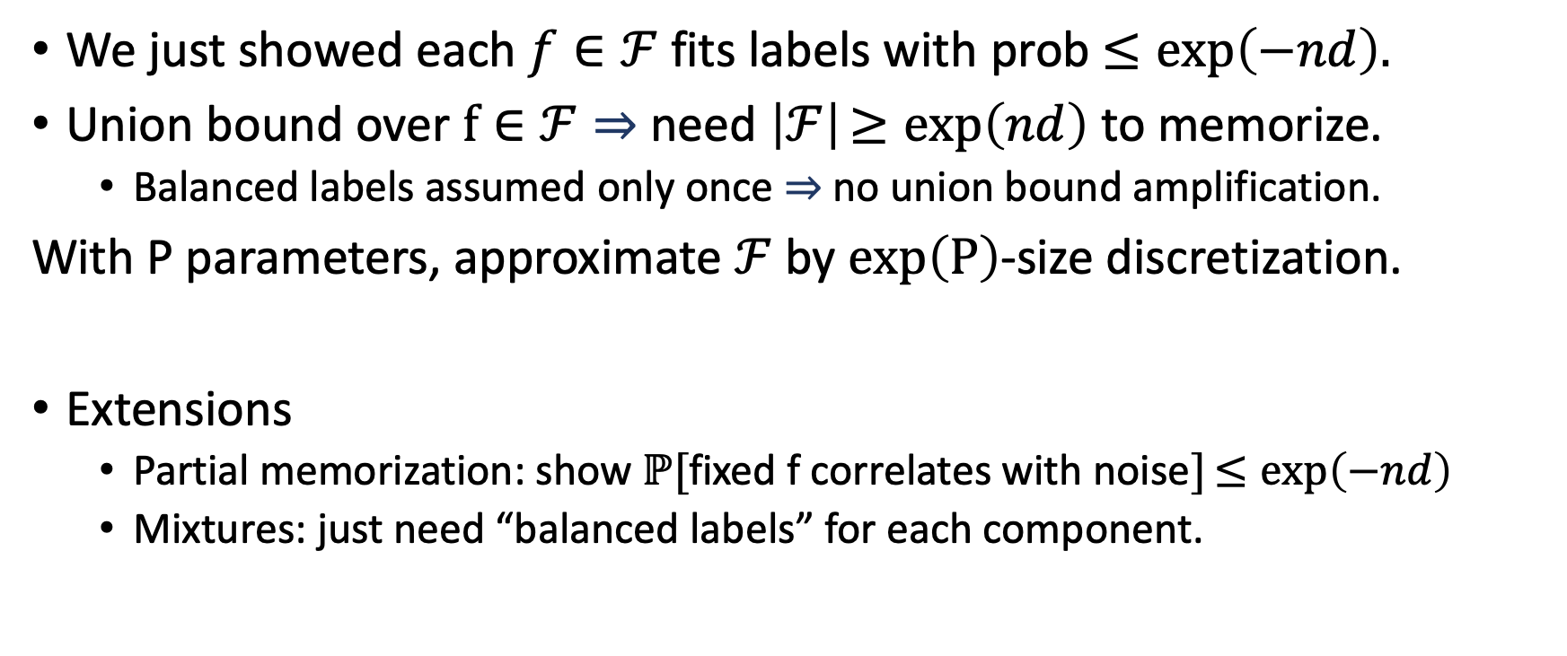
Proof for Perfect Memorization
We just showed each $f∈ℱ$ fits labels with prob $≤exp\left(−nd\right).$
Union bound over $f∈ℱ⇒$ need $\left|ℱ\right|≥exp\left(nd\right)$ to memorize.
Balanced labels assumed only once $⇒$no union bound amplification.
With P parameters, approximate $ℱ$ by $exp\left(P\right)$-size discretization.
Extensions
Partial memorization: show $ℙ[$fixed f correlates with noise$]≤exp\left(−nd\right)$
Mixtures: just need “balanced labels” for each component.

Slide 14
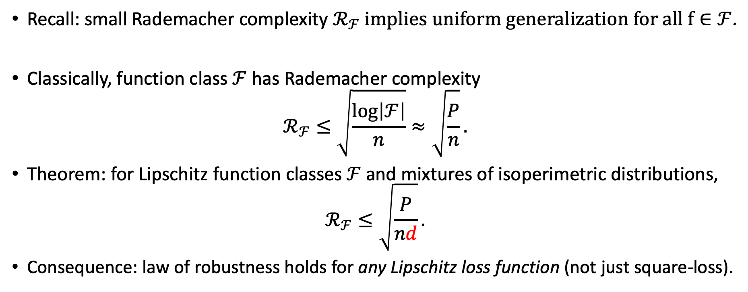
Generalization Perspective
Recall: small Rademacher complexity $ℛ_{ℱ}$ implies uniform generalization for all $f∈ℱ$.
Classically, function class $ℱ$ has Rademacher complexity
$$ℛ_{ℱ}≤\sqrt{\frac{\log\left|ℱ\right|}{n}}≈\sqrt{\frac{P}{n}}.$$
Theorem: for Lipschitz function classes $ℱ$ and mixtures of isoperimetric distributions,
$$ℛ_{ℱ}≤\sqrt{\frac{P}{nd}}.$$
Consequence: law of robustness holds for any Lipschitz loss function (not just square-loss).

Slide 15

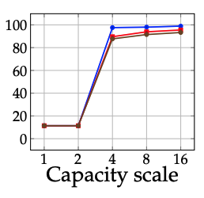
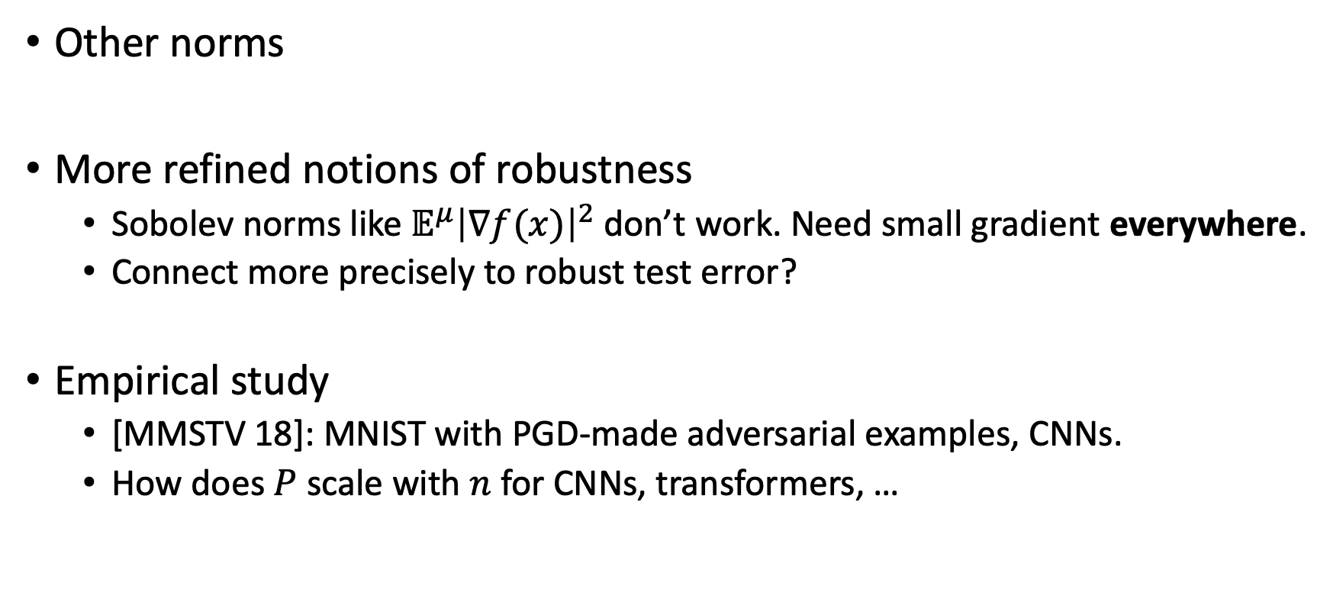
Open Directions
Other norms
More refined notions of robustness
Sobolev norms like ${𝔼^{μ}\left|∇f(x)\right|}_{ }^{2}$ don’t work. Need small gradient everywhere.
Connect more precisely to robust test error?
Empirical study
[MMSTV 18]: MNIST with PGD-made adversarial examples, CNNs.
How does $P$ scale with $n$ for CNNs, transformers, …

