Slide 1
Algorithmic Pure States for the Negative Spherical Perceptron
Mark Sellke (Stanford), joint with Ahmed El Alaoui (Cornell)

Slide 2
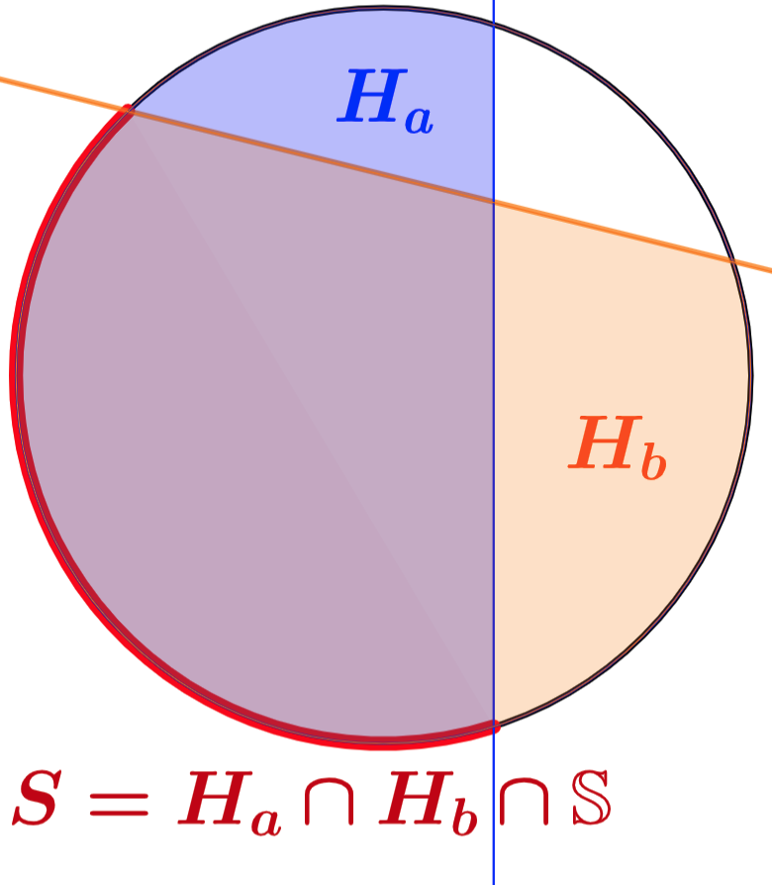
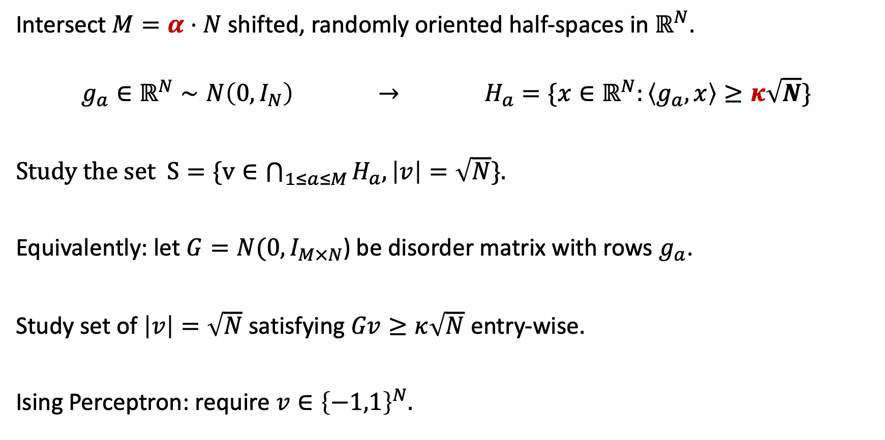
The Spherical Perceptron Problem
Intersect $M=α⋅N$ shifted, randomly oriented half-spaces in $ℝ^{N}$.
$$g_{a}∈ℝ^{N}∼N\left(0,I_{N}\right) → H_{a}=\{x∈ℝ^{N}:\left\langle g_{a},x\right\rangle ≥κ\sqrt{N}\}$$
Study the set$S=\{v∈\bigcap_{1≤a≤M}{H_{a},\left|v\right|=\sqrt{N}\}.}$
Equivalently: let $G=N(0,I_{M×N}$) be disorder matrix with rows $g_{a}$.
Study set of $\left|v\right|=\sqrt{N}$ satisfying $Gv≥κ\sqrt{N}$ entry-wise.
Ising Perceptron: require $v∈{\left\{−1,1\right\}}^{N}.$

Slide 3
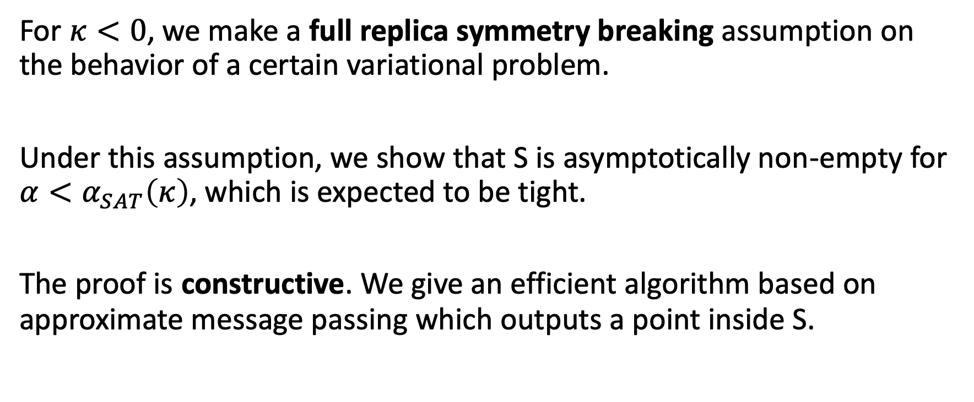
Main Result in Brief
For $κ<0$, we make a full replica symmetry breaking assumption on the behavior of a certain variational problem.
Under this assumption, we show that S is asymptotically non-empty for $α<α_{SAT}\left(κ\right)$, which is expected to be tight.
The proof is constructive. We give an efficient algorithm based on approximate message passing which outputs a point inside S.

Slide 4
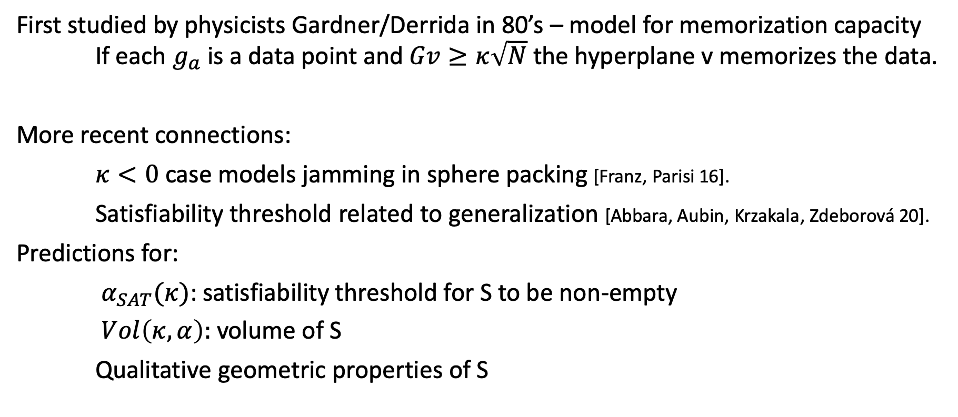
Historical Background
First studied by physicists Gardner/Derrida in 80’s – model for memorization capacity If each $g_{a}$ is a data point and $Gv≥κ\sqrt{N}$ the hyperplane v memorizes the data.
More recent connections:
$κ<0$ case models jamming in sphere packing [Franz, Parisi 16].
Satisfiability threshold related to generalization [Abbara, Aubin, Krzakala, Zdeborová 20].
Predictions for:
$α_{SAT}(κ)$: satisfiability threshold for S to be non-empty
$Vol\left(κ,α\right):$ volume of S
Qualitative geometric properties of S

Slide 5
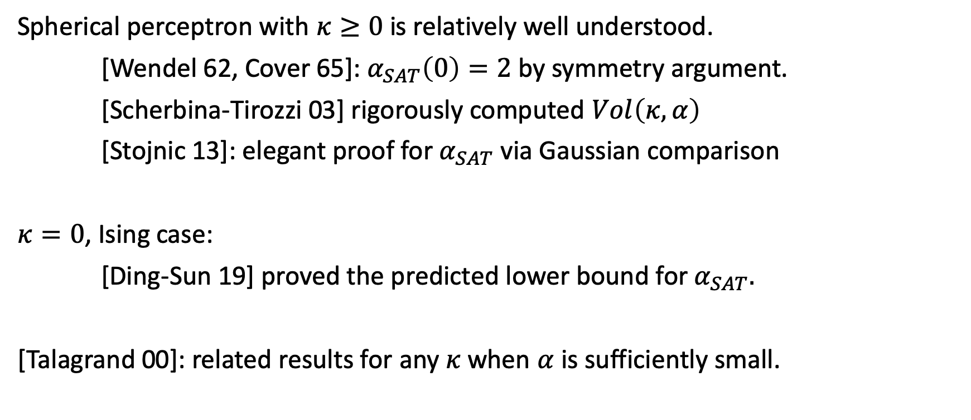
Mathematical Work
Spherical perceptron with $κ≥0$ is relatively well understood.
[Wendel 62, Cover 65]: $α_{SAT}\left(0\right)=2$ by symmetry argument.
[Scherbina-Tirozzi 03] rigorously computed $Vol\left(κ,α\right)$
[Stojnic 13]: elegant proof for $α_{SAT}$ via Gaussian comparison
$κ=0$, Ising case:
[Ding-Sun 19] proved the predicted lower bound for $α_{SAT}.$
[Talagrand 00]: related results for any $κ$ when $α$ is sufficiently small.

Slide 6
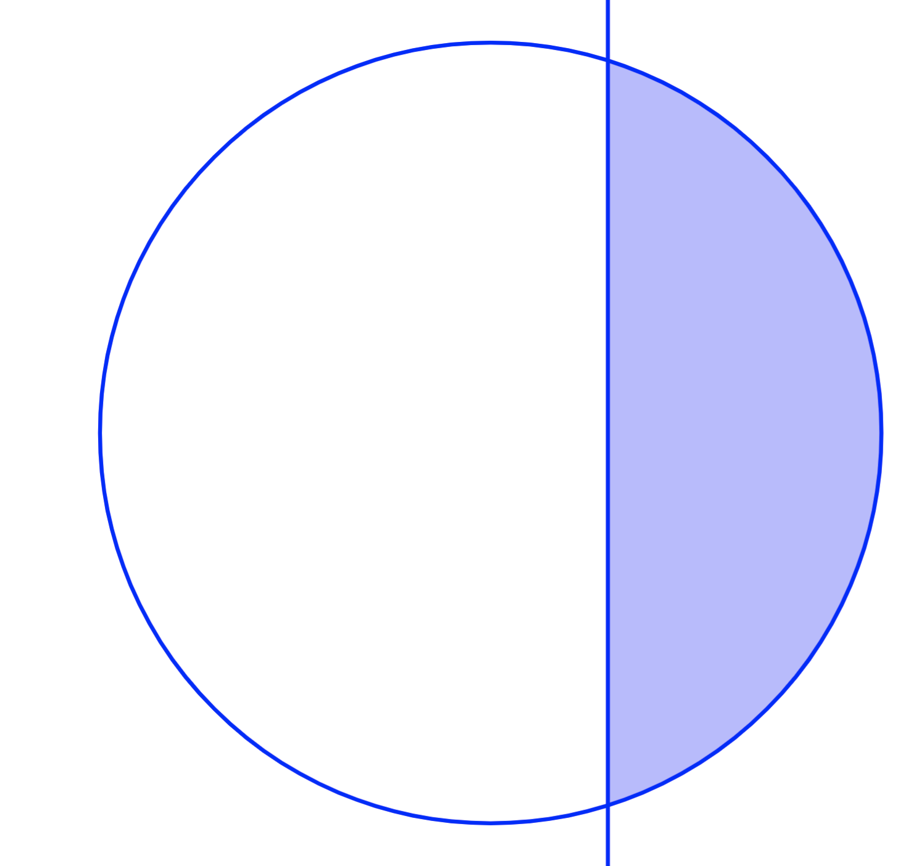


Convexity for $κ≥0$
If $κ≥0$, can replace sphere with ball to make things convex. Relatedly, the problem is replica-symmetric.
[Stojnic 13] used this observation and convex Gordon minimax theorem to compute $α_{SAT}$.
However when $κ<0$ (our focus) the problem is genuinely non-convex and harder.

Slide 7
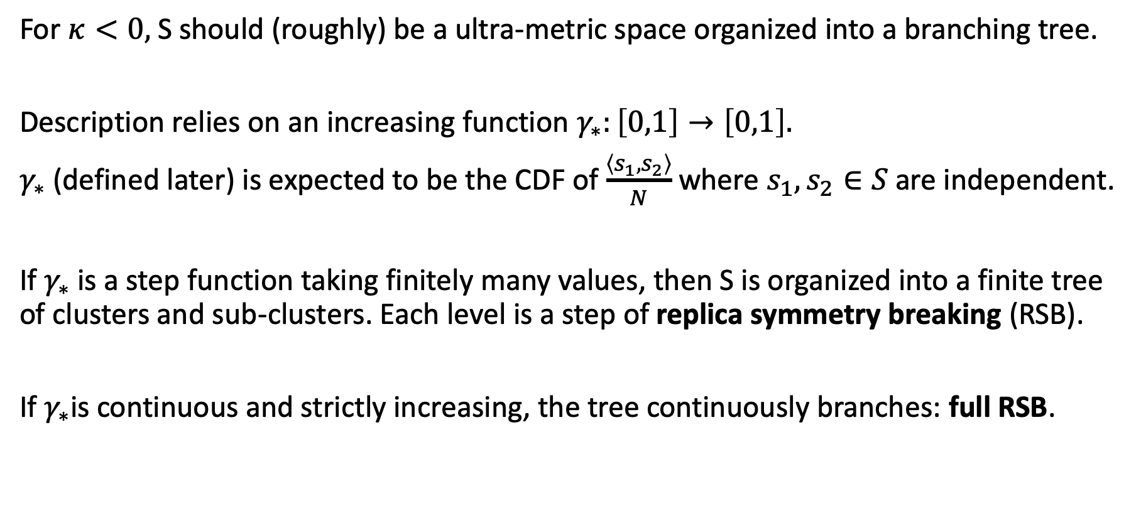
Replica Symmetry Breaking
For $κ<0,$ S should (roughly) be a ultra-metric space organized into a branching tree.
Description relies on an increasing function $γ_{∗}:\left[0,1\right]→\left[0,1\right].$
$γ_{∗}$ (defined later) is expected to be the CDF of $\frac{\left\langle s_{1},s_{2}\right\rangle }{N}$ where $s_{1},s_{2}∈S$ are independent.
If $γ_{∗}$ is a step function taking finitely many values, then S is organized into a finite tree of clusters and sub-clusters. Each level is a step of replica symmetry breaking (RSB).
If $γ_{∗}$is continuous and strictly increasing, the tree continuously branches: full RSB.

Slide 8

Conjecture:
For the negative spherical perceptron, full RSB holds for $α≈α_{SAT}$.

Slide 9
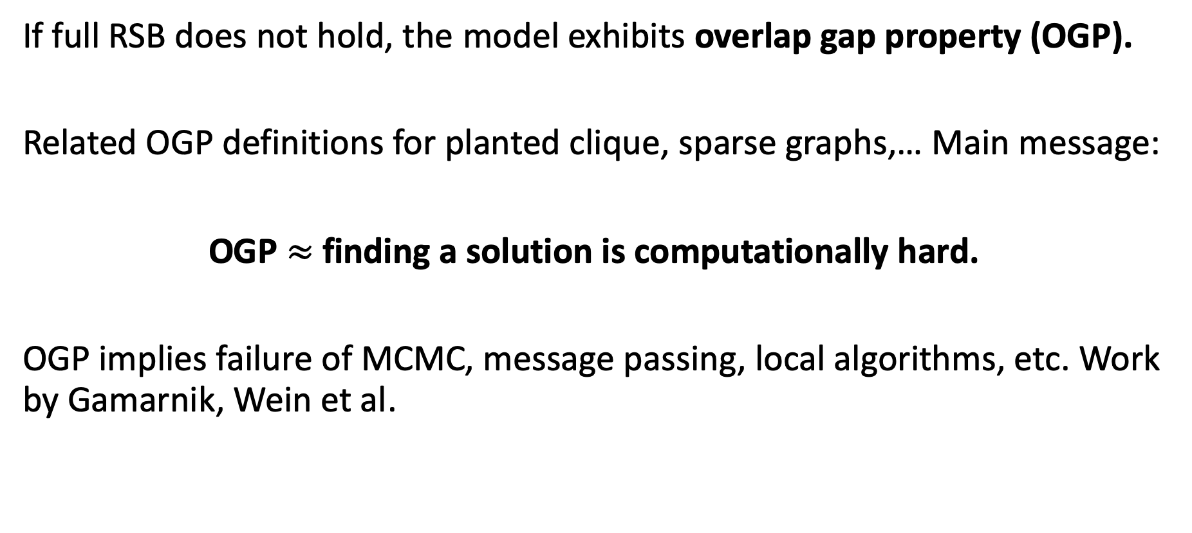
Algorithmic Obstructions From Overlap Gap
If full RSB does not hold, the model exhibits overlap gap property (OGP).
Related OGP definitions for planted clique, sparse graphs,… Main message:
OGP $≈$ finding a solution is computationally hard.
OGP implies failure of MCMC, message passing, local algorithms, etc. Work by Gamarnik, Wein et al.

Slide 10
Efficient Algorithms under Full RSB
[Subag 18, Montanari 18, El Alaoui-Montanari-S 20]: if full RSB, can optimize mean-field spin glass Hamiltonians via approximate message passing (AMP) algorithms.
[El Alaoui-S 20]: full RSB assumption yields AMP algorithm to find a point in S.
AMP algorithms are:
1. Efficient – running times are linear in the input size.
2. Convenient – exact high-dimensional limiting behavior is understood.
3. Flexible – can achieve very different things using one class of algorithms.

Slide 11
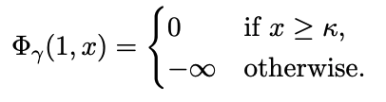
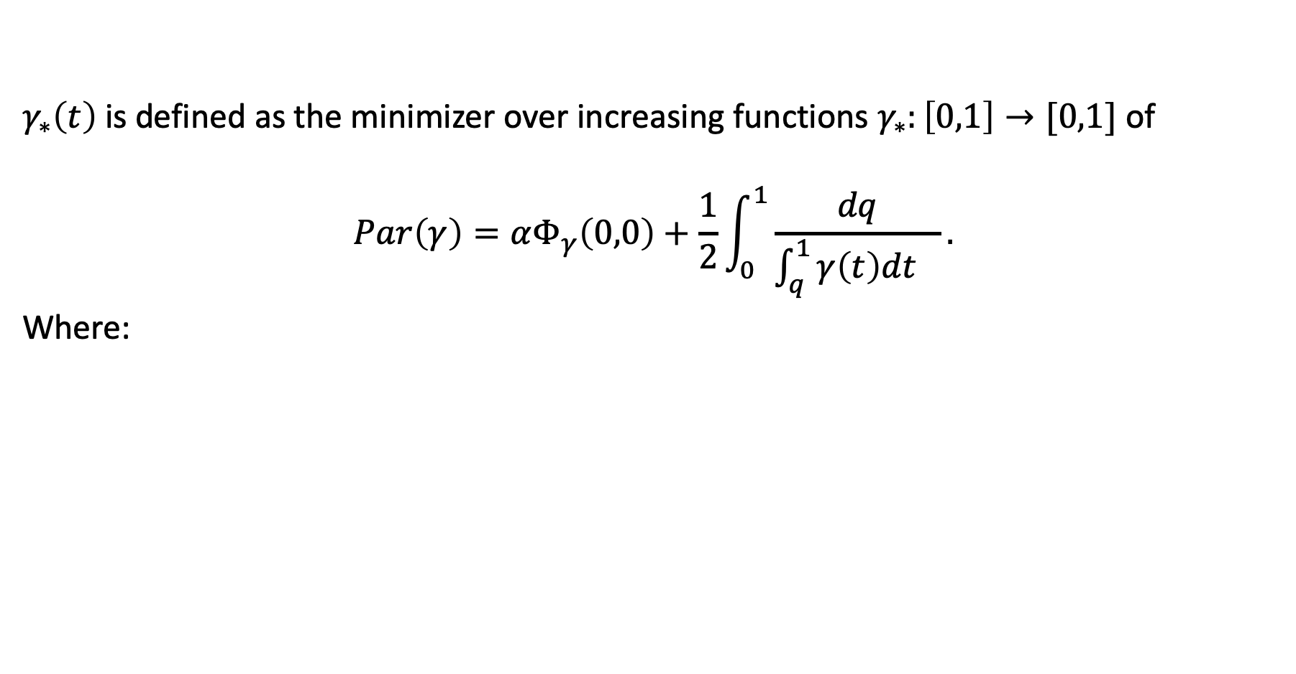
Parisi Variational Principle
$γ_{∗}\left(t\right)$is defined as the minimizer over increasing functions $γ_{∗}:\left[0,1\right]→[0,1]$ of
$$Par\left(γ\right)=αΦ_{γ}\left(0,0\right)+\frac{1}{2}\int_{0}^{1}{\frac{dq}{\int_{q}^{1}{γ\left(t\right)dt }}}.$$
Where:

Slide 12


Parisi PDE to SDE
$Φ_{γ}(t,x)$ represents how happy we are with $\left\langle u_{t},g_{a}\right\rangle =x$ if we search for a solution in the subsphere ${\{u:⟨u}_{t},u⟩=\left\langle u_{t},u_{t}\right\rangle =tN⟩$centered at $u_{t}$ with norm $\sqrt{tN}$.
Hence the terminal condition:
PDE:
Associated Parisi SDE:
Stochastic Optimal Control
Brownian Motion

Slide 13
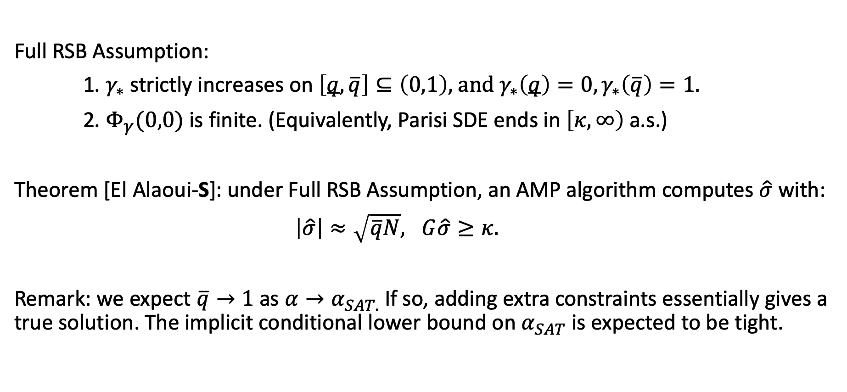
Main Result
Full RSB Assumption:
1. $γ_{∗}$ strictly increases on $\left[q,\overline{q}\right]⊆\left(0,1\right),$and $γ_{∗}\left(q\right)=0, γ_{∗}\left(\overline{q}\right)=1.$
2. $Φ_{γ}(0,0)$ is finite. (Equivalently, Parisi SDE ends in $\left[κ,∞\right)$ a.s.)
Theorem [El Alaoui-S]: under Full RSB Assumption, an AMP algorithm computes $\hat{σ}$ with:
$\left|\hat{σ}\right|≈\sqrt{\overline{q}N}, G\hat{σ}≥κ.$
Remark: we expect $\overline{q}→1$ as $α→α_{SAT.}$ If so, adding extra constraints essentially gives a true solution. The implicit conditional lower bound on $α_{SAT}$ is expected to be tight.

Slide 14
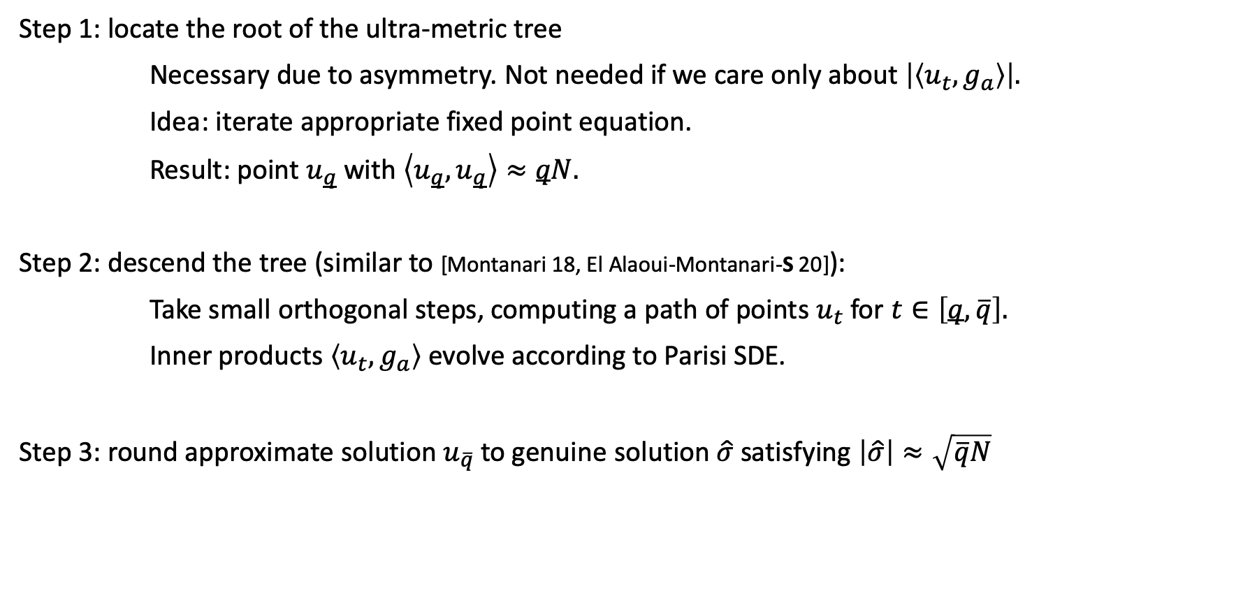
Algorithm Overview
Step 1: locate the root of the ultra-metric tree
Necessary due to asymmetry. Not needed if we care only about $\left|\left\langle u_{t},g_{a}\right\rangle \right|.$
Idea: iterate appropriate fixed point equation.
Result: point $u_{q}$ with $\left\langle u_{q},u_{q}\right\rangle ≈qN.$
Step 2: descend the tree (similar to [Montanari 18, El Alaoui-Montanari-S 20]):
Take small orthogonal steps, computing a path of points $u_{t}$ for $t∈\left[q,\overline{q}\right].$
Inner products $\left\langle u_{t},g_{a}\right\rangle$ evolve according to Parisi SDE.
Step 3: round approximate solution $u_{\overline{q}}$ to genuine solution$\hat{σ}$ satisfying $\left|\hat{σ}\right|≈\sqrt{\overline{q}N}$

Slide 15
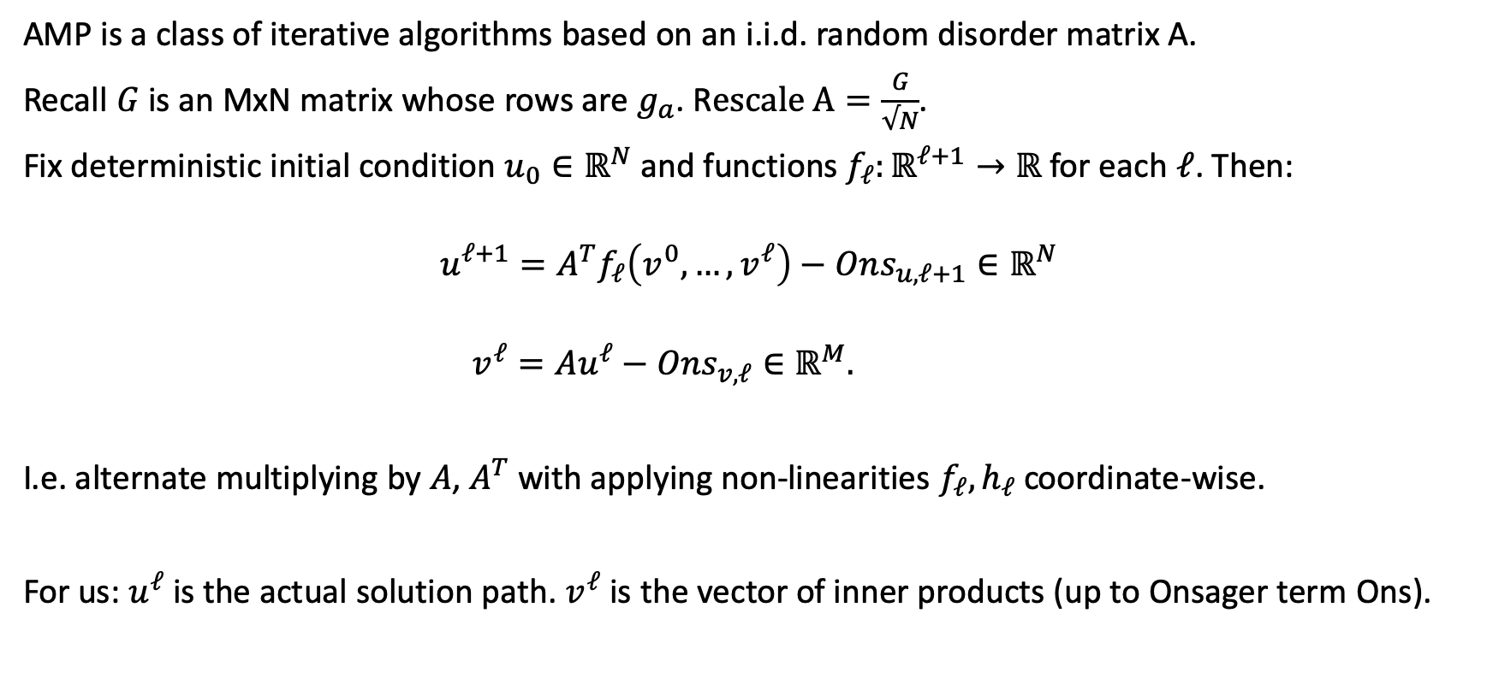
Approximate Message Passing (AMP)
AMP is a class of iterative algorithms based on an i.i.d. random disorder matrix A.
Recall $G$ is an MxN matrix whose rows are $g_{a}$. R$escale A=\frac{G}{√N}$.
Fix deterministic initial condition $u_{0}∈ℝ^{N}$ and functions $f_{ℓ}:ℝ^{ℓ+1}→ℝ$ for each $ℓ$. Then:
$$u^{ℓ+1}=A^{T}f_{ℓ}\left(v^{0},…,v^{ℓ}\right)−Ons_{u,ℓ+1}∈ℝ^{N}$$
$$v^{ℓ}=Au^{ℓ}−Ons_{v,ℓ}∈ℝ^{M}.$$
I.e. alternate multiplying by $A$, $A^{T}$ with applying non-linearities $f_{ℓ},h_{ℓ}$ coordinate-wise.
For us: $u^{ℓ}$ is the actual solution path. $v^{ℓ}$ is the vector of inner products (up to Onsager term Ons).

Slide 16
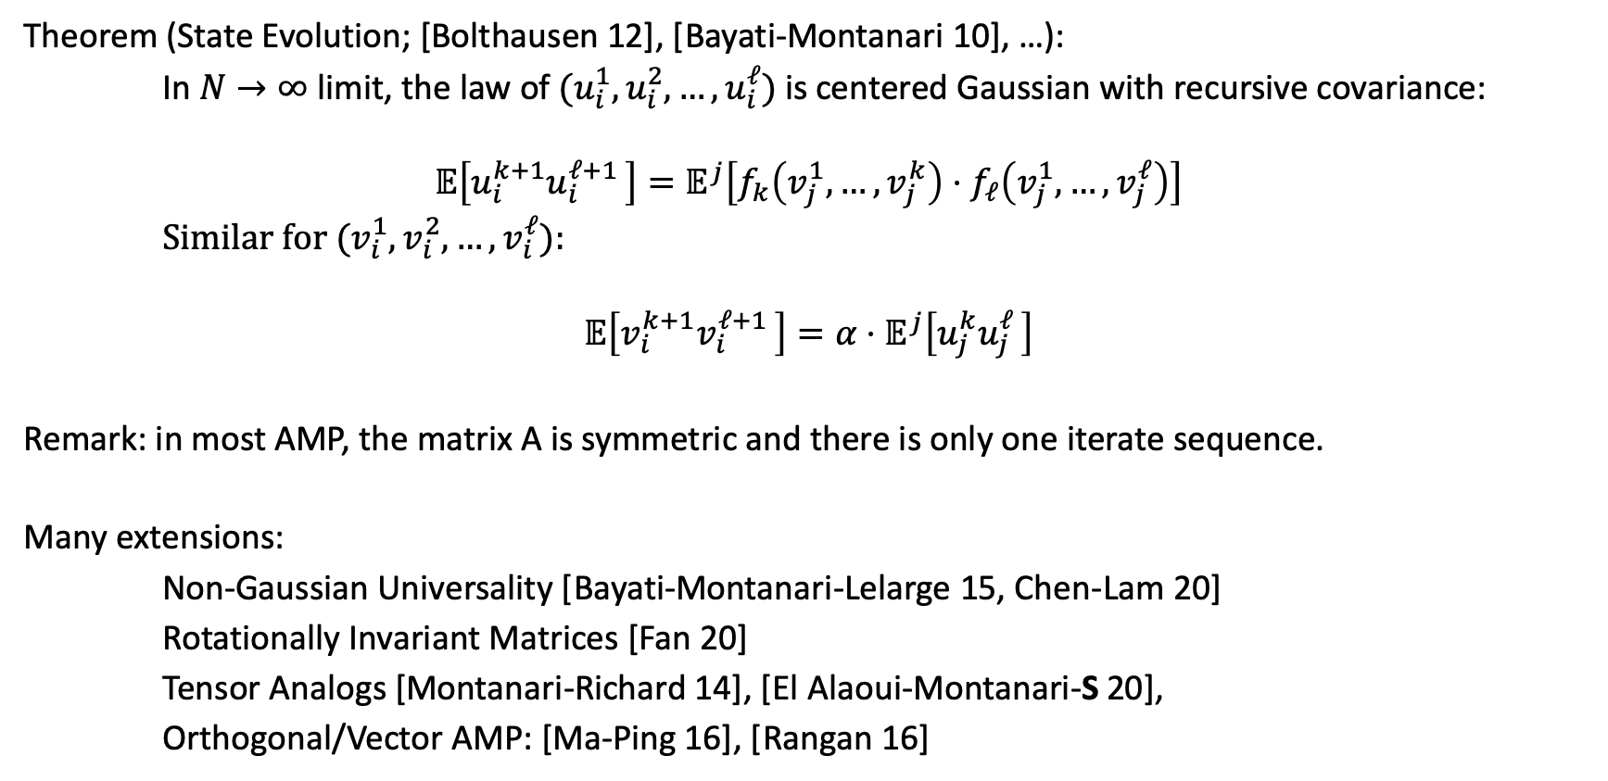
State Evolution for AMP
Theorem (State Evolution; [Bolthausen 12], [Bayati-Montanari 10], …):
In $N→∞$ limit, the law of ${(u_{i}^{1},u_{i}^{2},…,u}_{i}^{ℓ})$ is centered Gaussian with recursive covariance:
$$𝔼\left[u_{i}^{k+1}u_{i}^{ℓ+1 }\right]=𝔼^{j}\left[f_{k}\left(v_{j}^{1},…,v_{j}^{k}\right)⋅f_{ℓ}\left(v_{j}^{1},…,v_{j}^{ℓ}\right)\right]$$
Similar for ${(v_{i}^{1},v_{i}^{2},…,v}_{i}^{ℓ}):$
$$𝔼\left[v_{i}^{k+1}v_{i}^{ℓ+1 }\right]=α⋅𝔼^{j}\left[u_{j}^{k}u_{j}^{ℓ }\right]$$
Remark: in most AMP, the matrix A is symmetric and there is only one iterate sequence.
Many extensions:
Non-Gaussian Universality [Bayati-Montanari-Lelarge 15, Chen-Lam 20]
Rotationally Invariant Matrices [Fan 20]
Tensor Analogs [Montanari-Richard 14], [El Alaoui-Montanari-S 20],
Orthogonal/Vector AMP: [Ma-Ping 16], [Rangan 16]

Slide 17
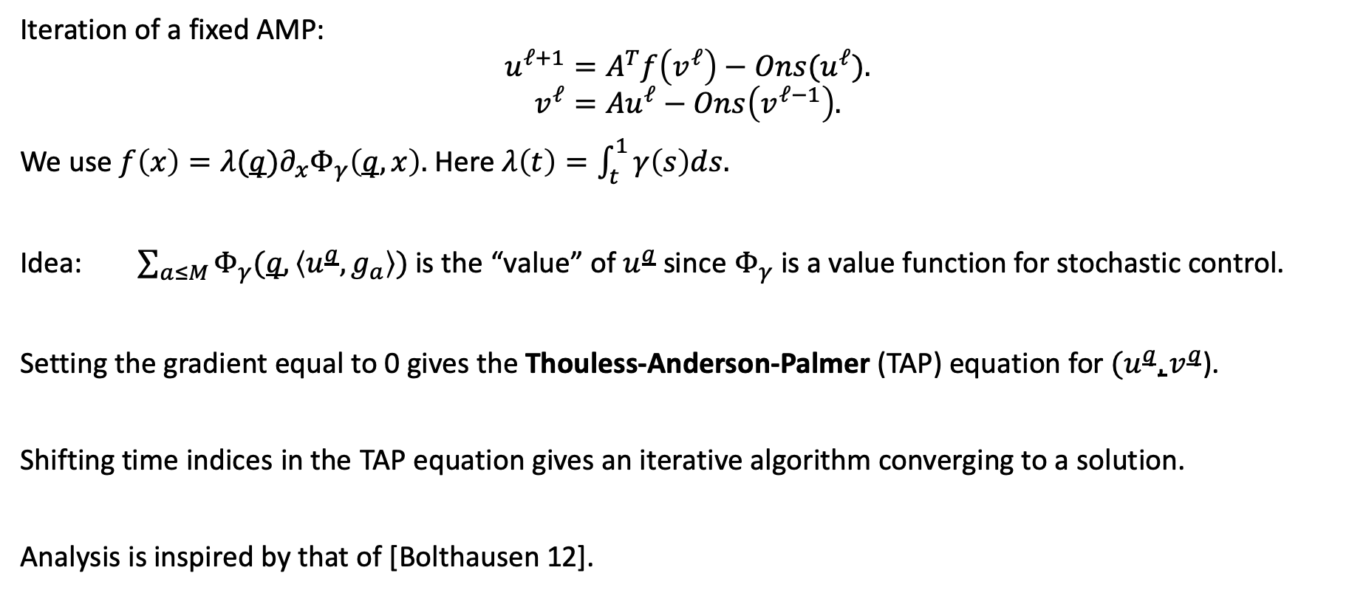
Step 1: Fixed Point Iteration
Iteration of a fixed AMP:
$$u^{ℓ+1}=A^{T}f_{ }\left(v^{ℓ}\right)−Ons(u^{ℓ}).$$
$$v^{ℓ}=Au^{ℓ}−Ons\left(v^{ℓ−1}\right).$$
We use $f_{ }\left(x\right)={λ(q)∂}_{x}Φ_{γ}\left(q,x\right).$ Here $λ\left(t\right)=\int_{t}^{1}{γ\left(s\right)ds.}$
Idea: $\sum_{a≤M}{Φ_{γ}(q,\left\langle u^{q},g_{a}\right\rangle )}$ is the “value” of $u^{q}$ since $Φ_{γ}$ is a value function for stochastic control.
Setting the gradient equal to 0 gives the Thouless-Anderson-Palmer (TAP) equation for ${(u}^{q},v^{q}$).
Shifting time indices in the TAP equation gives an iterative algorithm converging to a solution.
Analysis is inspired by that of [Bolthausen 12].

Slide 18
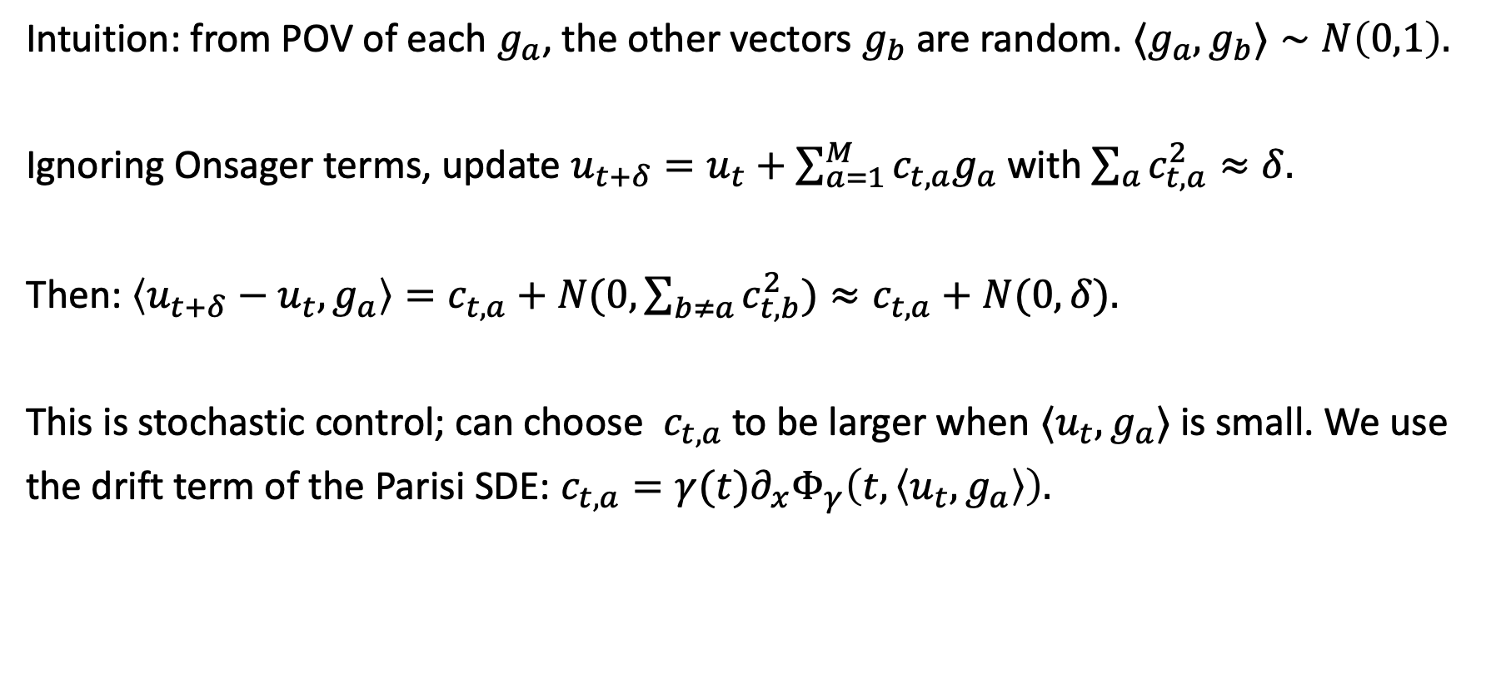
Step 2: Descending the Tree
Intuition: from POV of each $g_{a}$, the other vectors $g_{b}$ are random. ${⟨g}_{a},g_{b}⟩∼N\left(0,1\right).$
Ignoring Onsager terms, update $u_{t+δ}=u_{t}+\sum_{a=1}^{M}{c_{t,a}g_{a}}$ with $\sum_{a}{c_{t,a}^{2}≈δ. }$
Then: $\left\langle u_{t+δ}−u_{t},g_{a}\right\rangle =c_{t,a}+N(0,\sum_{b≠a}{c_{t,b}^{2})≈c_{t,a}+N(0,δ).}$
This is stochastic control; can choose $c_{t,a}$ to be larger when ${⟨u}_{t},g_{a}⟩$ is small. We use
the drift term of the Parisi SDE: $c_{t,a}=γ(t)∂_{x}^{ }Φ_{γ}\left(t,\left\langle u_{t},g_{a}\right\rangle \right).$

Slide 19
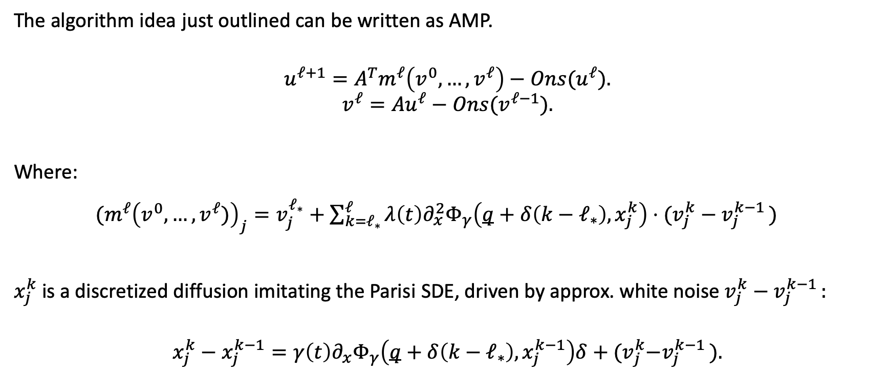
Incremental AMP Formulation
The algorithm idea just outlined can be written as AMP.
$$u^{ℓ+1}=A^{T}m^{ℓ}\left({v^{0},…,v}^{ℓ}\right)−Ons(u^{ℓ}).$$
$$v^{ℓ}=Au^{ℓ}−Ons(v^{ℓ−1}).$$
Where:
${(m}^{ℓ}{\left({v^{0},…,v}^{ℓ})\right)}_{j}=v_{j}^{ℓ_{∗}}+{\sum_{k=ℓ_{∗}}^{ℓ}{λ\left(t\right)∂_{x}^{2}Φ_{γ}\left(q+δ\left(k−ℓ_{∗}\right),x_{j}^{k}\right)⋅(v_{j}^{k}−v_{j}^{k−1 }) }}^{}$
$x_{j}^{k}$is a discretized diffusion imitating the Parisi SDE, driven by approx. white noise $v_{j}^{k}−v_{j}^{k−1 }:$
$$x_{j}^{k}−x_{j}^{k−1}=γ\left(t\right)∂_{x}Φ_{γ}\left(q+δ\left(k−ℓ_{∗}\right),x_{j}^{k−1}\right)δ+{(v}_{j}^{k}−v_{j}^{k−1 }).$$

Slide 20
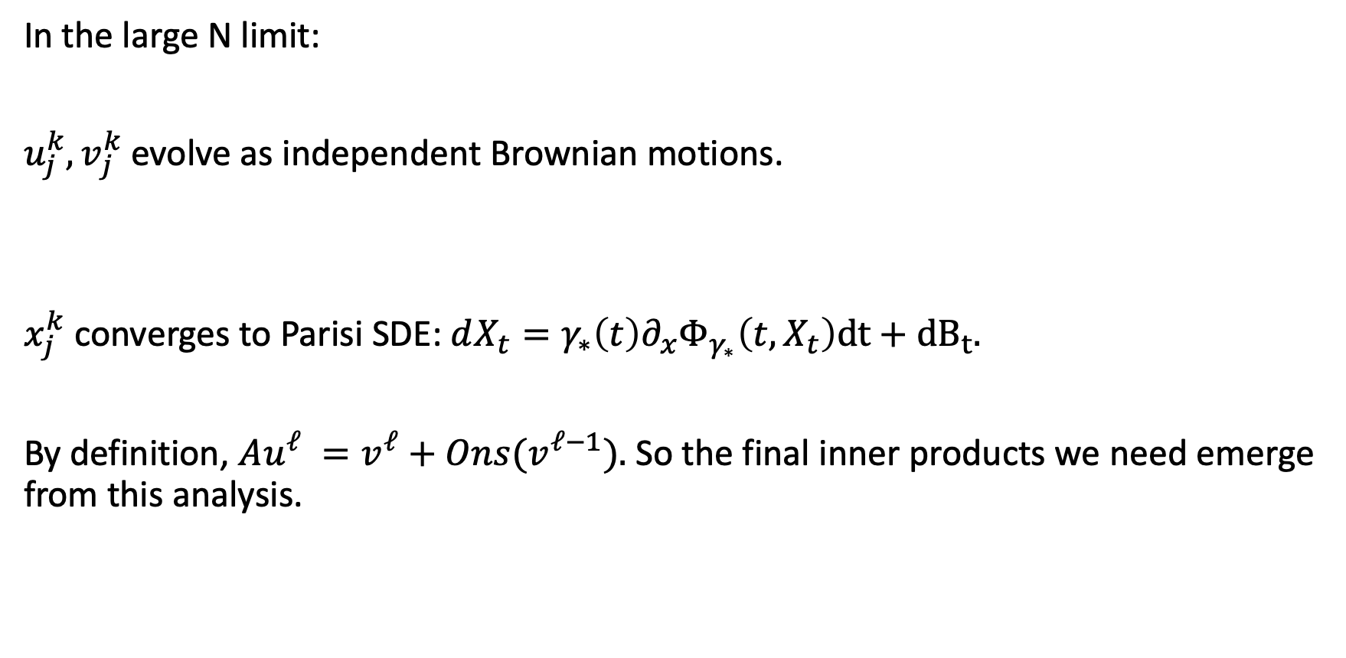
Limiting Dynamics
In the large N limit:
${u_{j}^{k},v}_{j}^{k}$ evolve as independent Brownian motions.
$x_{j}^{k}$ converges to Parisi SDE: $dX_{t}=γ_{∗}\left(t\right)∂_{x}Φ_{γ_{∗}}\left(t,X_{t}\right)dt+{dB}_{t}.$
By definition, $Au^{ℓ} =v^{ℓ}+Ons(v^{ℓ−1}).$ So the final inner products we need emerge from this analysis.

Slide 21
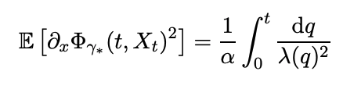



Under the Hood
Certain identities are needed to make everything work:
Derived as stationarity conditions for the variational problem.
Step 1 converges to norm $q$
Correct total variance in each diffusion step.

Slide 22
Recap
The spherical perceptron concerns an intersection of shifted half-spaces.
In the negative case, we give an algorithm to compute a point in this intersection, assuming a full RSB hypothesis on the optimal solution of an associated variational problem.
Main stages, both using AMP:
1. Locate the root of the ultrametric tree by iteratively
finding a stationary point for the TAP potential.
2. Descend the tree by mimicking the Parisi SDE.

