Slide 1
The Price of Incentivizing Exploration: A Characterization via Thompson Sampling and Sample Complexity
Mark Sellke
Joint work with (and several slides by) Alex Slivkins
1
2
1. Stanford University. 2. Microsoft Research
https://arxiv.org/abs/2002.00558

Slide 2






Motivation: recommender systems
Watch this movie
Dine in this restaurant
Vacation in this resort
Buy this product
Drive this route
See this doctor

Slide 3
Info flow in recommender system
user arrives, needs to choose a product
receives recommendation (& extra info)
chooses a product, leaves feedback
consumes info from prior users
produces info for future users
For common good, user population should balance
exploration: trying out various alternatives to gather info
exploitation: making best choices given current info
Example: coordinate via system’s recommendations.

Slide 4
Exploration and incentives
Problem: self-interested users (agents) favor exploitation
Under-exploration: some actions explored at sub-optimal rate
For common good, we want to induce some agents to explore.
“External” incentives:
monetary payments / discounts
promise of a higher social status
people’s desire to experiment
Ex: best action remains unexplored if it seems worse initially
prone to selection bias; not always feasible

Slide 5
Exploration and incentives
Problem: self-interested users (agents) favor exploitation
Under-exploration: some actions explored at sub-optimal rate
For common good, we want to induce some agents to explore.
“External” incentives:
monetary payments / discounts
promise of a higher social status
people’s desire to experiment
Ex: best action remains unexplored if it seems worse initially
prone to selection bias; not always feasible
Approach: create info asymmetry by not revealing full history

Slide 6
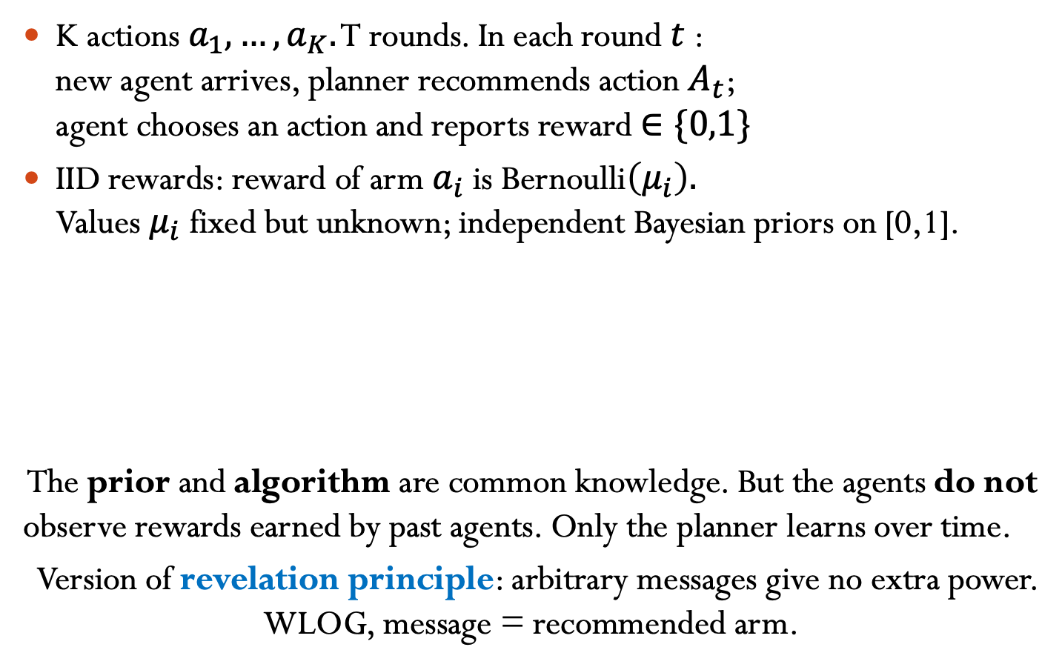
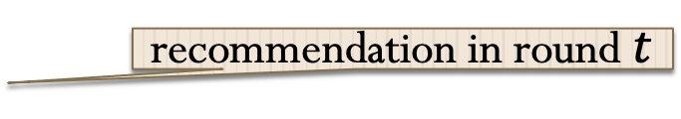
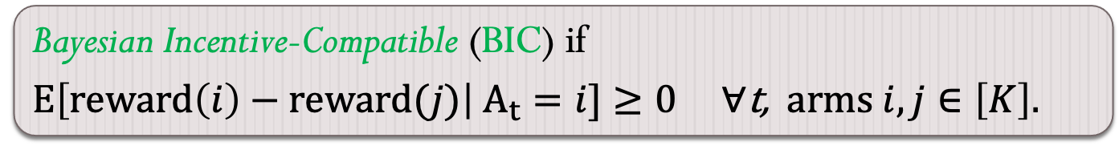
Model: incentivized exploration
K actions $a_{1},…,a_{K}.$ T rounds. In each round $t$ : new agent arrives, planner recommends action $A_{t}$; agent chooses an action and reports reward $∈\{0,1\}$
IID rewards: reward of arm $a_{i}$ is Bernoulli$\left(μ_{i}\right).$ Values $μ_{i}$ fixed but unknown; independent Bayesian priors on [0,1].
The prior and algorithm are common knowledge. But the agents do not observe rewards earned by past agents. Only the planner learns over time.
Version of revelation principle: arbitrary messages give no extra power. WLOG, message = recommended arm.
Agents follow recommendations ⇒ “multi-armed bandits”
Bayesian Incentive-Compatible (BIC) if
$\text{E}\left[reward\left(i\right)−reward(j)\right| A_{t}=i]≥0$ $∀\text{t}\text{,} \text{arm}s i,j∈\left[K\right].$
recommendation in round $t$

Slide 7
Prior work: IE via info asymmetry
Origins: Kremer, Mansour, Perry (EC13 & JPE’14): our model Che & Horner (`13 & QJE`18): (very) different model
Subsequent work: basic model and (many) extensions
Mansour, Syrgkanis, Slivkins (`15), Papanastasiou, Bimpikis, Savva (`15)
Mansour, Syrgkanis, Slivkins, Wu (`16), Bahar, Smorodinsky, Tennenholtz (`16; `19)
Immorlica, Mao, Slivkins, Wu (`19; `20), Cohen & Mansour (`19) Simchowitz & Slivkins (`21)

Slide 8
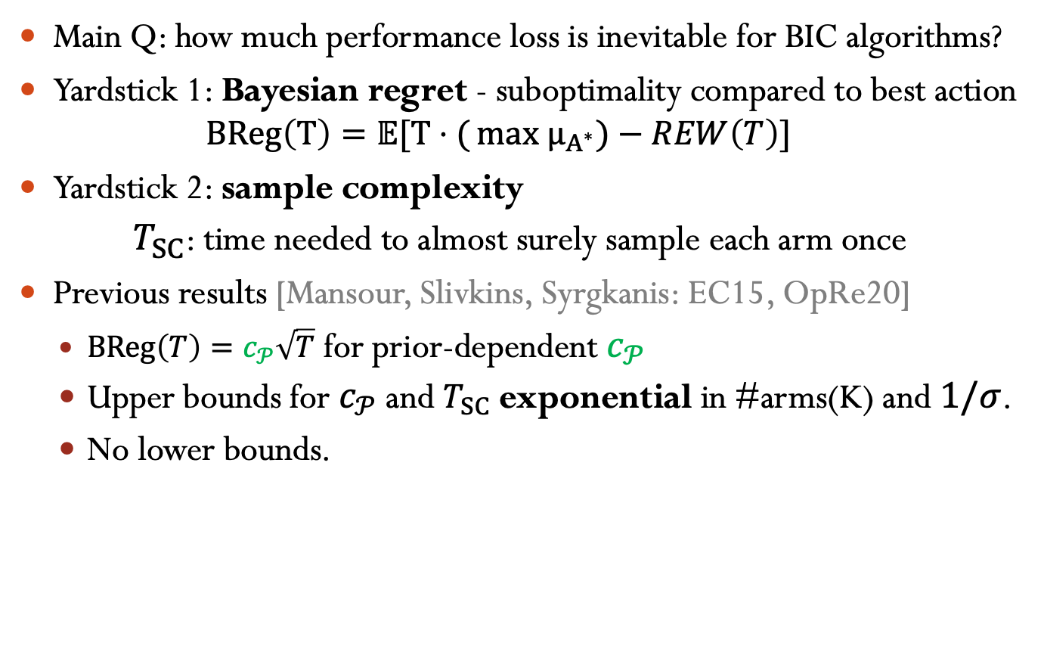
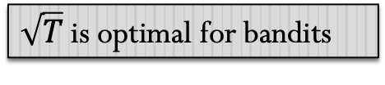
Our focus: Price Of Incentives (PoI)
Main Q: how much performance loss is inevitable for BIC algorithms?
Yardstick 1: Bayesian regret - suboptimality compared to best action
$$BReg\left(T\right)=𝔼[T⋅({max μ_{A^{∗}}})−REW\left(T\right)]$$
Yardstick 2: sample complexity
${ T}_{SC}$: time needed to almost surely sample each arm once
Previous results [Mansour, Slivkins, Syrgkanis: EC15, OpRe20]
$BReg\left(T\right)=c_{𝒫}\sqrt{T}$ for prior-dependent $c_{𝒫}$
Upper bounds for $c_{𝒫}$ and $T_{SC}$exponential in #arms(K) and $1/σ$.
No lower bounds.
$\sqrt{T}$is optimal for bandits
variance of the prior

Slide 9
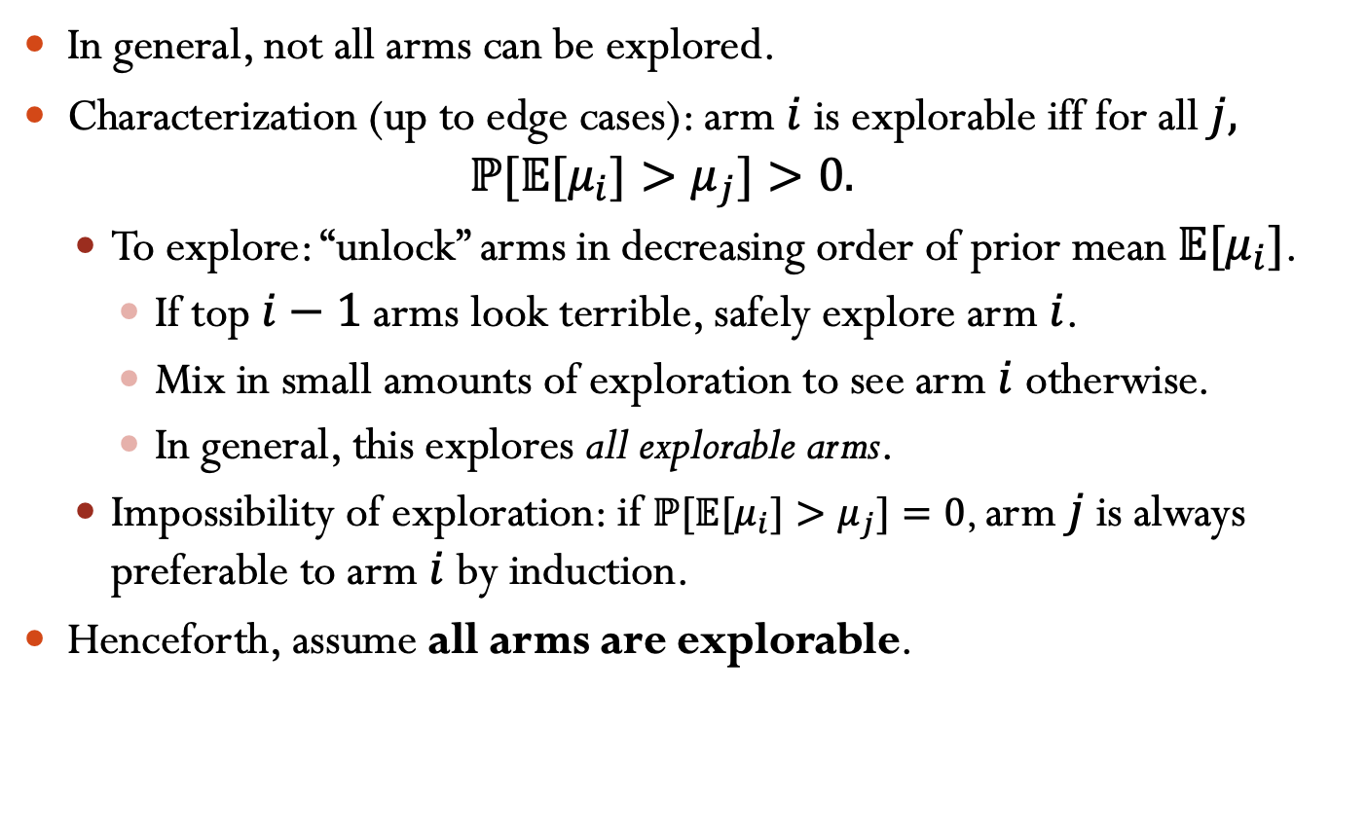
Which arms can be explored?
In general, not all arms can be explored.
Characterization (up to edge cases): arm $i$ is explorable iff for all $j,$
$${ℙ[𝔼[μ}_{i}]>μ_{j}]>0.$$
To explore: “unlock” arms in decreasing order of prior mean $𝔼[μ_{i}]$.
If top $i−1$ arms look terrible, safely explore arm $i$.
Mix in small amounts of exploration to see arm $i$ otherwise.
In general, this explores all explorable arms.
Impossibility of exploration: if ${ℙ[𝔼[μ}_{i}]>μ_{j}]=0$, arm $j$ is always preferable to arm $i$ by induction.
Henceforth, assume all arms are explorable.

Slide 10
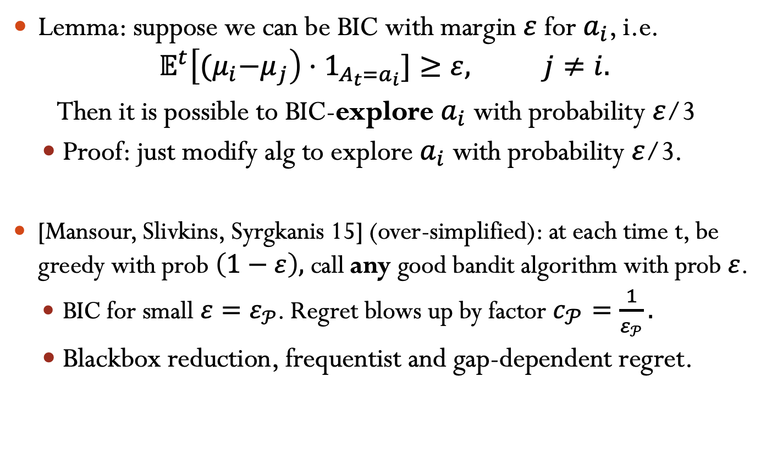
Basic Technique: Exploit to Explore
Lemma: suppose we can be BIC with margin $ε$ for $a_{i}$, i.e.
$$𝔼^{t}\left[{(μ}_{i}−μ_{j}\right)⋅1_{A_{t}=a_{i}}]≥ε, j≠i.$$
Then it is possible to BIC-explore $a_{i}$ with probability $ε$/3
Proof: just modify alg to explore $a_{i}$ with probability $ε$/3.
[Mansour, Slivkins, Syrgkanis 15] (over-simplified): at each time t, be greedy with prob $\left(1−ε\right),$ call any good bandit algorithm with prob $ε$.
BIC for small $ε=ε_{𝒫}$. Regret blows up by factor $c_{𝒫}=\frac{1}{ε_{𝒫}}.$
Blackbox reduction, frequentist and gap-dependent regret.

Slide 11
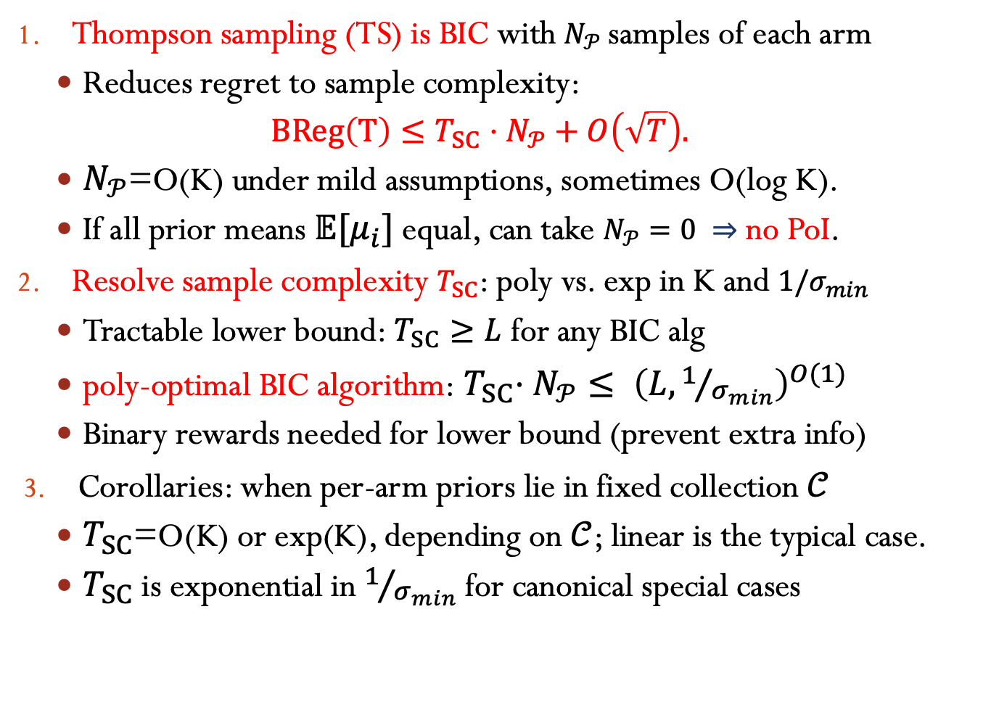
Our Results: characterize PoI
Thompson sampling (TS) is BIC with $N_{𝒫}$samples of each arm
Reduces regret to sample complexity:
$$BReg\left(T\right)≤T_{SC}⋅N_{𝒫}+O\left(\sqrt{T}\right).$$
$N_{𝒫}$=O(K) under mild assumptions, sometimes O(log K).
If all prior means $𝔼[μ_{i}]$ equal, can take $N_{𝒫}=0 ⇒$ no PoI.
Resolve sample complexity $T_{SC}$: poly vs. exp in K and $1/σ_{min}$
Tractable lower bound: $T_{SC}≥L$ for any BIC alg
poly-optimal BIC algorithm:${ T}_{SC}⋅N_{𝒫}≤ {\left(L,1/{σ_{min}}\right)}^{O(1)}$
Binary rewards needed for lower bound (prevent extra info)
Corollaries: when per-arm priors lie in fixed collection $𝒞$
$T_{SC}$=O(K) or exp(K), depending on $𝒞$; linear is the typical case.
$T_{SC}$ is exponential in $1/{σ_{min}}$ for canonical special cases
smallest std. dev

Slide 12
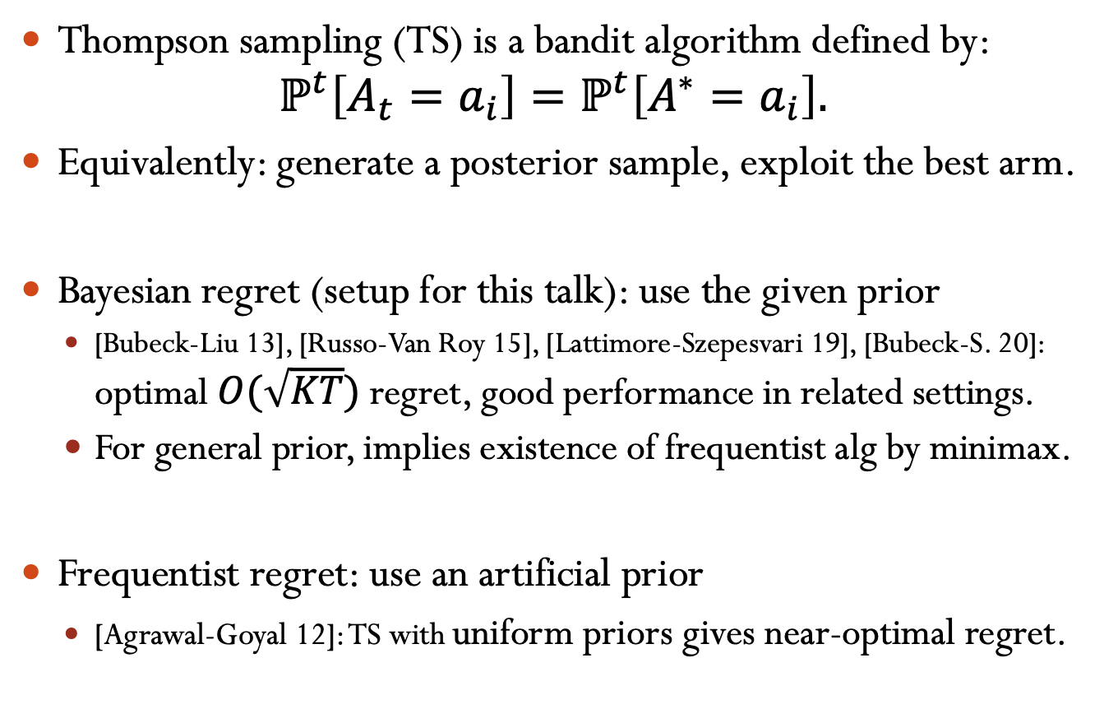
Thompson Sampling
Thompson sampling (TS) is a bandit algorithm defined by:
$$ℙ^{t}\left[A_{t}=a_{i}\right]=ℙ^{t}\left[A^{∗}=a_{i}\right].$$
Equivalently: generate a posterior sample, exploit the best arm.
Bayesian regret (setup for this talk): use the given prior
[Bubeck-Liu 13], [Russo-Van Roy 15], [Lattimore-Szepesvari 19], [Bubeck-S. 20]: optimal $O(\sqrt{KT})$ regret, good performance in related settings.
For general prior, implies existence of frequentist alg by minimax.
Frequentist regret: use an artificial prior
[Agrawal-Goyal 12]: TS with uniform priors gives near-optimal regret.

Slide 13
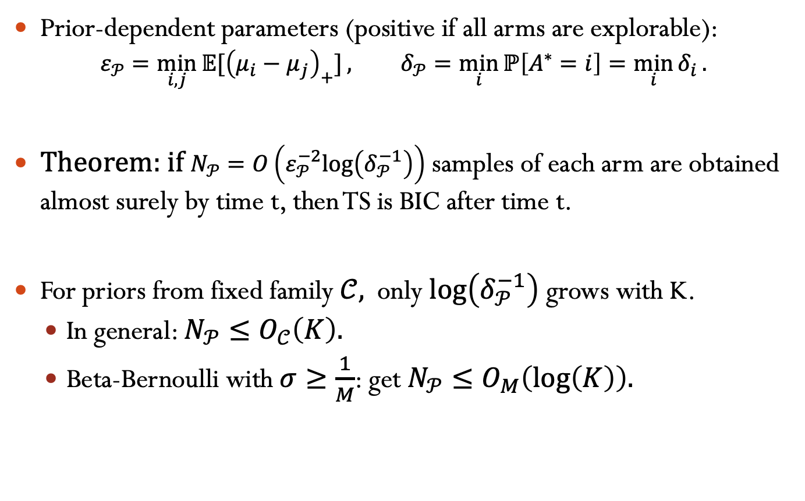
TS is BIC with Initial Samples
Prior-dependent parameters (positive if all arms are explorable):
$$ε_{𝒫}=\min_{i,j}{𝔼[{\left(μ_{i}−μ_{j}\right)}_{+}]}, δ_{𝒫}=\min_{i}{ℙ\left[A^{∗}=i\right]=\min_{i}{δ_{i}}.}$$
Theorem: if $N_{𝒫}=O\left(ε_{𝒫}^{−2}log\left(δ_{𝒫}^{−1}\right)\right)$ samples of each arm are obtained almost surely by time t, then TS is BIC after time t.
For priors from fixed family $𝒞,$ only $log\left(δ_{𝒫}^{−1}\right)$ grows with K.
In general: $N_{𝒫}≤O_{𝒞}\left(K\right).$
Beta-Bernoulli with $σ≥\frac{1}{M}$: get $N_{𝒫}≤O_{M}\left(\log\left(K\right)\right).$

Slide 14
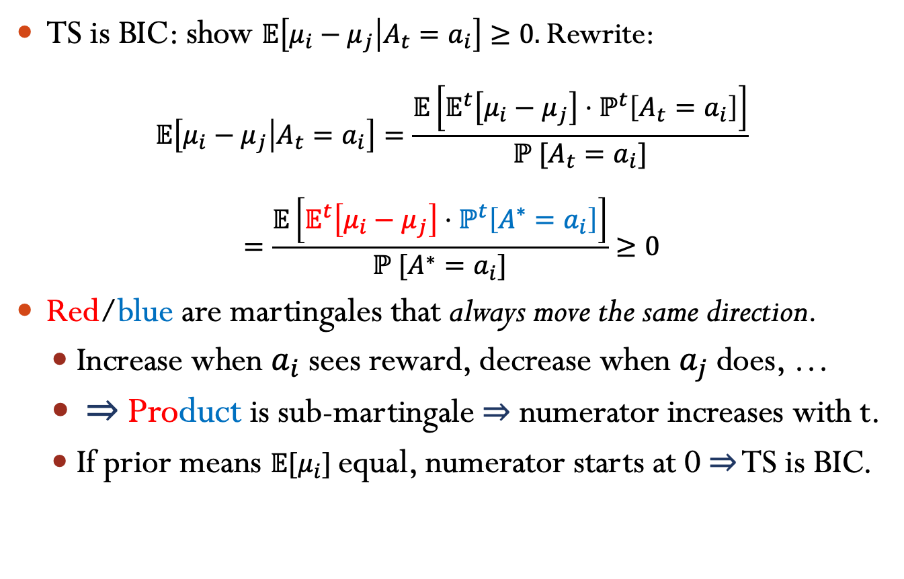

TS is BIC with equal prior means
TS is BIC: show $𝔼\left[μ_{i}−μ_{j} | A_{t}=a_{i}\right]≥0.$ Rewrite:
$$𝔼\left[μ_{i}−μ_{j} | A_{t}=a_{i}\right]=\frac{𝔼\left[𝔼^{t}\left[μ_{i}−μ_{j}\right]⋅ℙ^{t}\left[A_{t}=a_{i}\right]\right]}{ℙ^{ }[A_{t}=a_{i}]}$$
$$=\frac{𝔼\left[𝔼^{t}\left[μ_{i}−μ_{j}\right]⋅ℙ^{t}\left[A^{∗}=a_{i}\right]\right]}{ℙ^{ }[A^{∗}=a_{i}]}≥0$$
Red/blue are martingales that always move the same direction.
Increase when $a_{i}$ sees reward, decrease when $a_{j}$ does, …
$⇒$ Product is sub-martingale$⇒$ numerator increases with t.
If prior means $𝔼[μ_{i}]$ equal, numerator starts at 0$⇒$ TS is BIC.
$≈$Bayes Rule
?
Defn of TS

Slide 15
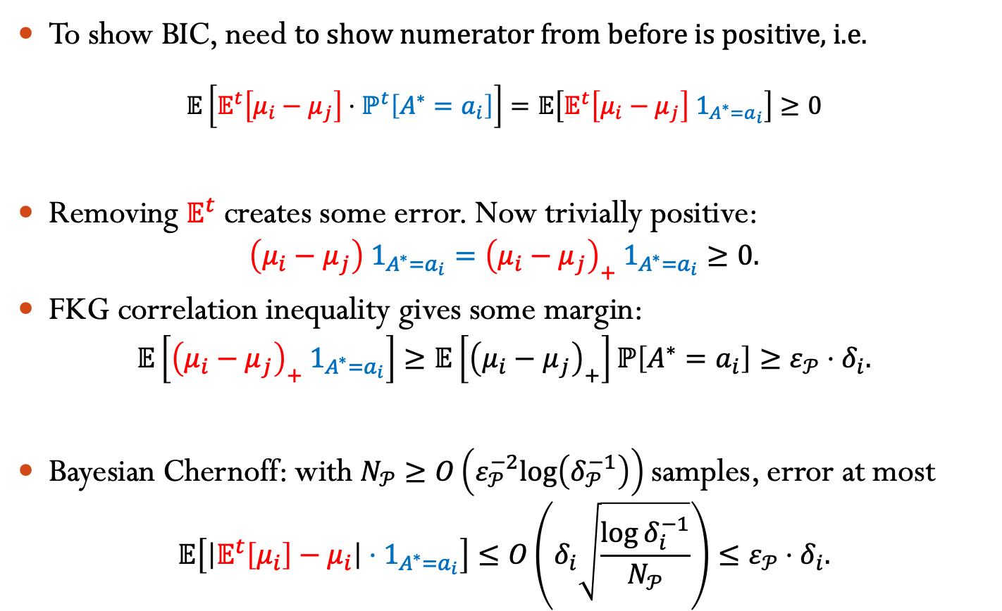
TS is BIC with Initial Samples
To show BIC, need to show numerator from before is positive, i.e.
$$𝔼\left[𝔼^{t}\left[μ_{i}−μ_{j}\right]⋅ℙ^{t}\left[A^{∗}=a_{i}\right]\right]=𝔼\left[𝔼^{t}\left[μ_{i}−μ_{j}\right] 1_{A^{∗}=a_{i}}\right]≥0$$
Removing $𝔼^{t}$ creates some error. Now trivially positive:
$$\left(μ_{i}−μ_{j}\right) 1_{A^{∗}=a_{i}}={\left(μ_{i}−μ_{j}\right)}_{+} 1_{A^{∗}=a_{i}}≥0.$$
FKG correlation inequality gives some margin:
$$𝔼\left[{\left(μ_{i}−μ_{j}\right)}_{+} 1_{A^{∗}=a_{i}}\right]≥𝔼\left[{\left(μ_{i}−μ_{j}\right)}_{+}\right]ℙ\left[A^{∗}=a_{i}\right]≥ε_{𝒫}⋅δ_{i}.$$
Bayesian Chernoff: with $N_{𝒫}≥O\left(ε_{𝒫}^{−2}log\left(δ_{𝒫}^{−1}\right)\right)$samples, error at most
$$𝔼\left[\left|𝔼^{t}\left[μ_{i}\right]−μ_{i}\right|{⋅1}_{A^{∗}=a_{i}}\right]≤O\left(δ_{i}\sqrt{\frac{\log{δ_{i}^{−1}}}{N_{𝒫}}}\right)≤ε_{𝒫}⋅δ_{i}.$$
?

Slide 16
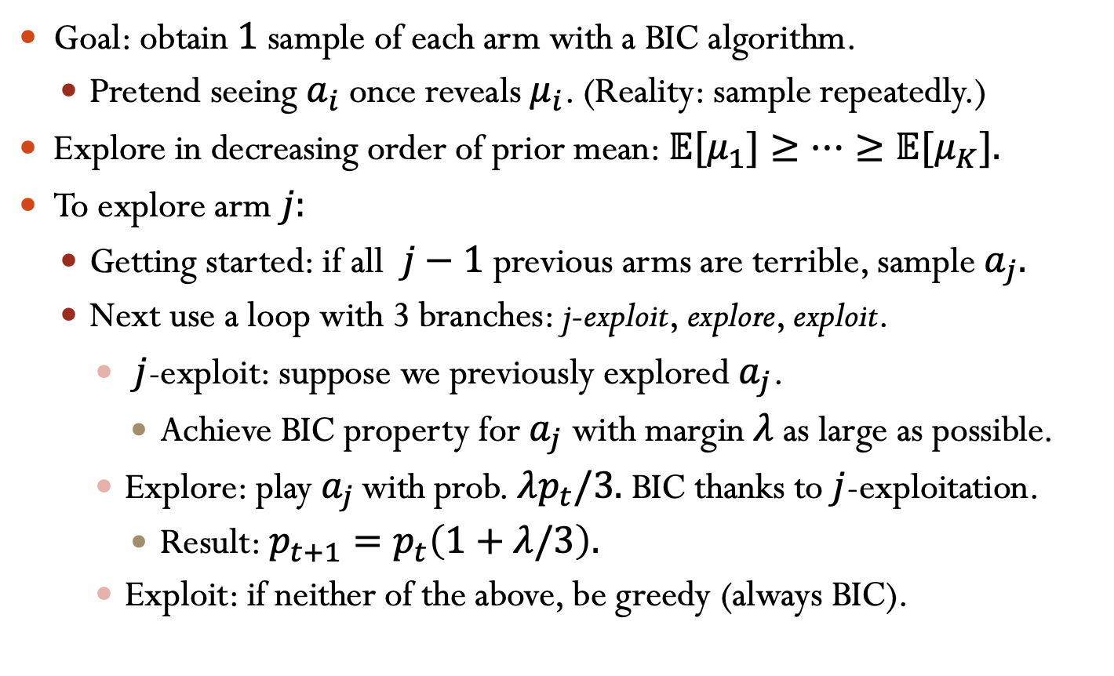
BIC Sampling Algorithm
Goal: obtain $1$ sample of each arm with a BIC algorithm.
Pretend seeing $a_{i}$ once reveals $μ_{i}$. (Reality: sample repeatedly.)
Explore in decreasing order of prior mean: $𝔼[μ_{1}]≥…≥𝔼[μ_{K}].$
To explore arm $j:$
Getting started: if all $j−1$ previous arms are terrible, sample $a_{j}.$
Next use a loop with 3 branches: j-exploit, explore, exploit.
$j$-exploit: suppose we previously explored $a_{j}$.
Achieve BIC property for $a_{j}$ with margin $λ$ as large as possible.
Explore: play $a_{j }$with prob. $λp_{t}/3.$ BIC thanks to $j$-exploitation.
Result: $p_{t+1}=p_{t}\left(1+λ/3\right).$
Exploit: if neither of the above, be greedy (always BIC).

Slide 17

Exponential Growth of Initial Sampling
Growth $p_{t+1}=p_{t}\left(1+λ/3\right)$ leads to $p_{t}∼p_{0}⋅\exp\left(λt\right).$
Hence $λ$ determines sample complexity $T_{SC}$. $How small is λ$?
Answer:
$$λ=\min_{j∈\left[K\right], q∈Δ_{j−1}}{𝔼\left[{\left(μ_{j}−μ_{q}\right)}_{+}\right], μ_{q}=\sum_{i}{q_{i}μ_{i}. }}$$
Reason: minimax theorem on related 2-player zero-sum game.

Slide 18
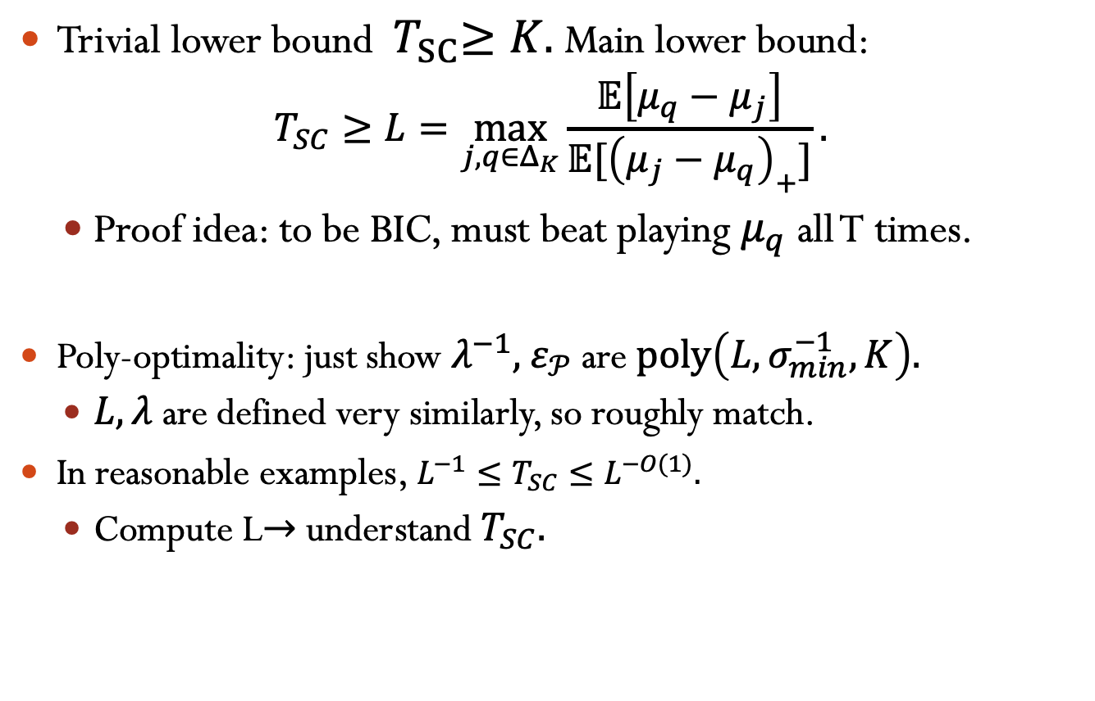
UB=poly(LB)
Trivial lower bound ${ T}_{SC}≥K.$ Main lower bound:
$$T_{SC}≥L=\max_{j,q∈Δ_{K}}{\frac{𝔼\left[μ_{q}−μ_{j}\right]}{𝔼[{\left(μ_{j}−μ_{q}\right)}_{+}]}}.$$
Proof idea: to be BIC, must beat playing $μ_{q}$ all T times.
Poly-optimality: just show $λ^{−1},$ $ε_{𝒫}$are $poly\left(L,σ_{min}^{−1},K\right).$
$L,λ$ are defined very similarly, so roughly match.
In reasonable examples, $L^{−1}≤T_{SC}≤L^{−O(1)}.$
Compute L$→$ understand $T_{SC}.$

Slide 19
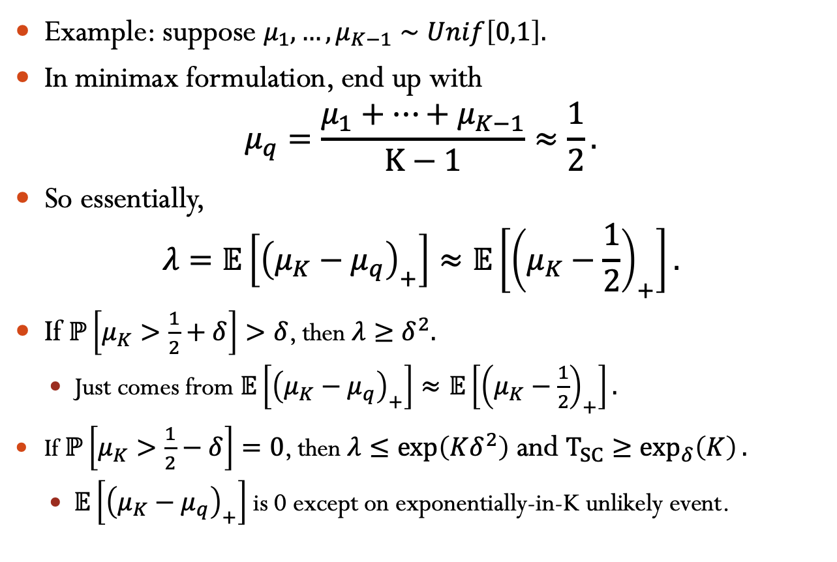
Linear/Exponential Dichotomy
Example: suppose $μ_{1},…,μ_{K−1}∼Unif\left[0,1\right].$
In minimax formulation, end up with
$$μ_{q}=\frac{μ_{1}+…+μ_{K−1}}{K−1}≈\frac{1}{2}.$$
So essentially,
$$λ=𝔼\left[{\left(μ_{K}−μ_{q}\right)}_{+}\right]≈𝔼\left[{\left(μ_{K}−\frac{1}{2}\right)}_{+}\right].$$
If $ℙ\left[μ_{K}>\frac{1}{2}+δ\right]>δ$, then $λ≥δ^{2}.$
Just comes from $𝔼\left[{\left(μ_{K}−μ_{q}\right)}_{+}\right]≈𝔼\left[{\left(μ_{K}−\frac{1}{2}\right)}_{+}\right].$
If $ℙ\left[μ_{K}>\frac{1}{2}−δ\right]=0$, then $λ≤\exp\left(Kδ^{2}\right)$ and $T_{SC}≥\exp_{δ}\left(K\right).$
$𝔼\left[{\left(μ_{K}−μ_{q}\right)}_{+}\right]$ is 0 except on exponentially-in-K unlikely event.

Slide 20
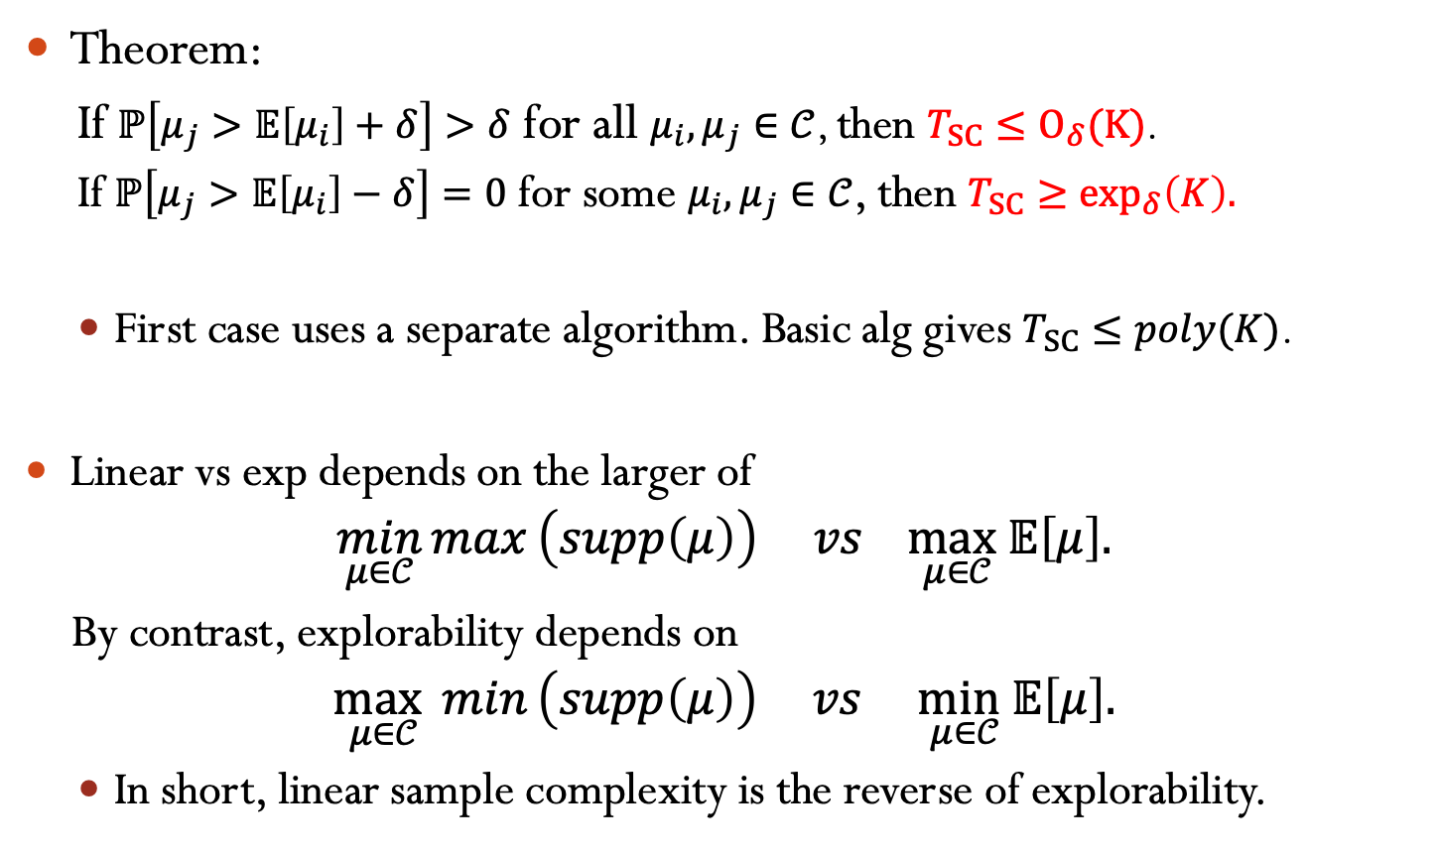
Linear/Exponential Dichotomy
Theorem:
If $ℙ\left[μ_{j}>𝔼\left[μ_{i}\right]+δ\right]>δ$ for all $μ_{i},μ_{j}∈𝒞$, then $T_{SC}≤O_{δ}(K)$.
If $ℙ\left[μ_{j}>𝔼\left[μ_{i}\right]−δ\right]=0$ for some $μ_{i},μ_{j}∈𝒞$, then $T_{SC}≥\exp_{δ}\left(K\right).$
First case uses a separate algorithm. Basic alg gives $T_{SC}≤poly(K)$.
Linear vs exp depends on the larger of
$$\min_{μ∈𝒞}{max}\left(supp\left(μ\right)\right) vs \max_{μ∈𝒞}𝔼\left[μ\right].$$
By contrast, explorability depends on
$$\max_{μ∈𝒞}{min}\left(supp\left(μ\right)\right) vs \min_{μ∈𝒞}𝔼\left[μ\right].$$
In short, linear sample complexity is the reverse of explorability.

Slide 21
Some Open Directions
Matching bounds for Bayesian regret
More refined analysis needed.
Quantitative results for correlated priors
We used FKG a lot, requires independence.
Long-lived agents, inevitable/random observations, heterogenous agents…

