Slide 1
The Saxl Conjecture for Fourth Powers via the Semigroup Property
Sammy Luo and Mark Sellke
JMM 2016

Slide 2

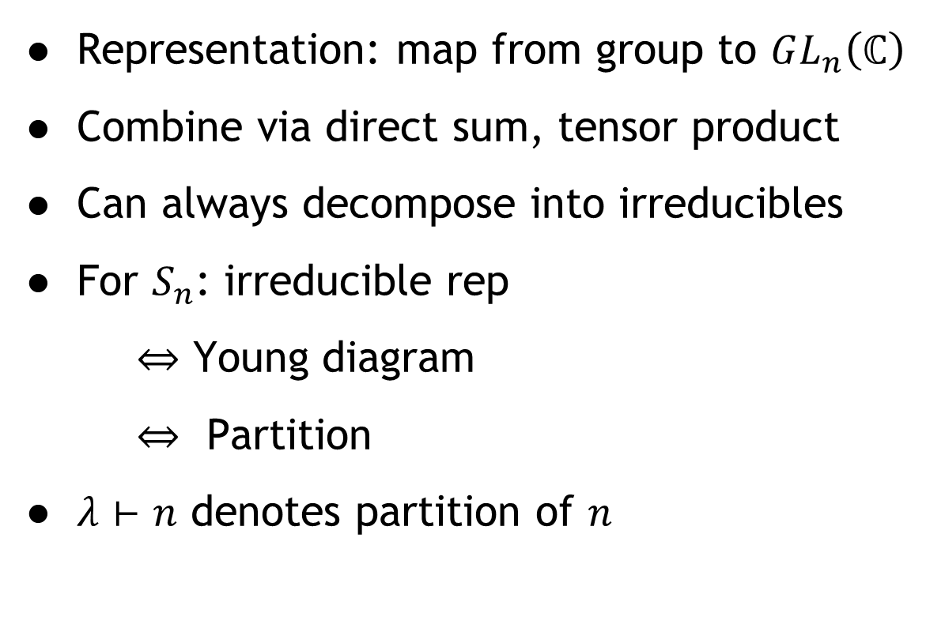
Finite Group Representations
Representation: map from group to $GL_{n}\left(ℂ\right)$
Combine via direct sum, tensor product
Can always decompose into irreducibles
For $S_{n}$: irreducible rep
$⇔$ Young diagram
$⇔$ Partition
$λ⊢n$ denotes partition of $n$
$⇔$ $\left[5,3,2\right]$

Slide 3
Examples of Representations
Trivial Representation
Alternating Representation
Conjugation: tensor with alternating rep

Slide 4
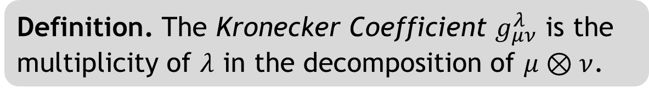
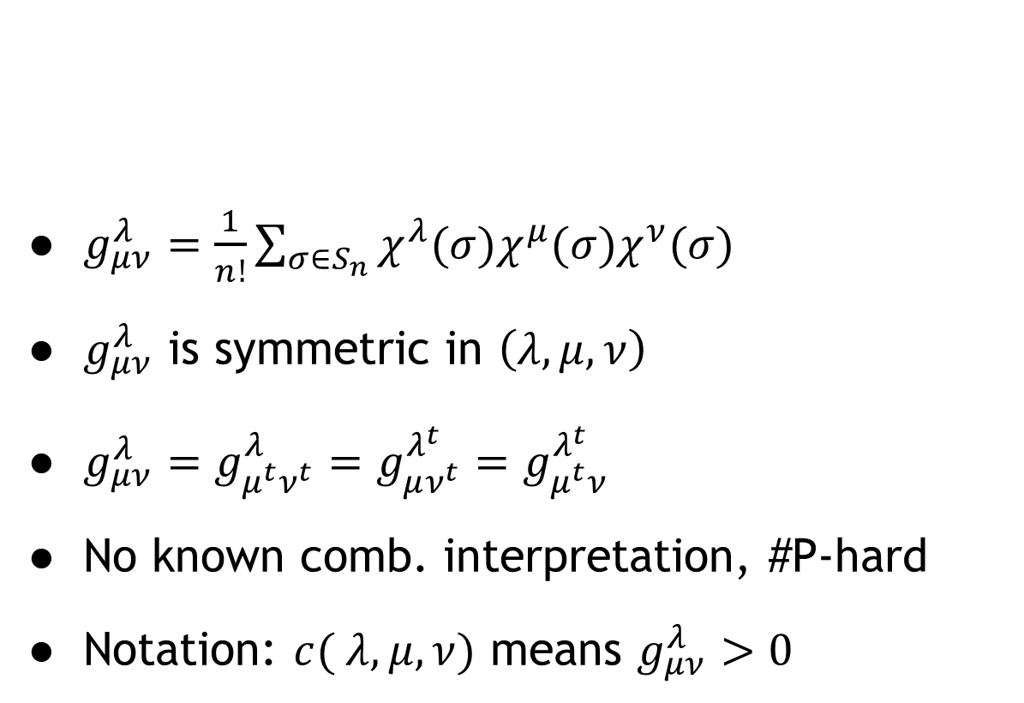
Kronecker Coefficients
$g_{μν}^{λ}=\frac{1}{n!}\sum_{σ∈S_{n}}{χ^{λ}(σ)χ^{μ}(σ)χ^{ν}(σ)}$
$g_{μν}^{λ}$ is symmetric in $\left(λ,μ,ν\right)$
$g_{μν}^{λ}=g_{μ^{t}ν^{t}}^{λ}=g_{μν^{t}}^{λ^{t}}=g_{μ^{t}ν}^{λ^{t}}$
No known comb. interpretation, #P-hard
Notation: $c( λ,μ,ν)$ means $g_{μν}^{λ}>0$
Definition. The Kronecker Coefficient $g_{μν}^{λ}$ is the multiplicity of $λ$ in the decomposition of $μ⊗ν$.
Notes:
formula sucks

Slide 5

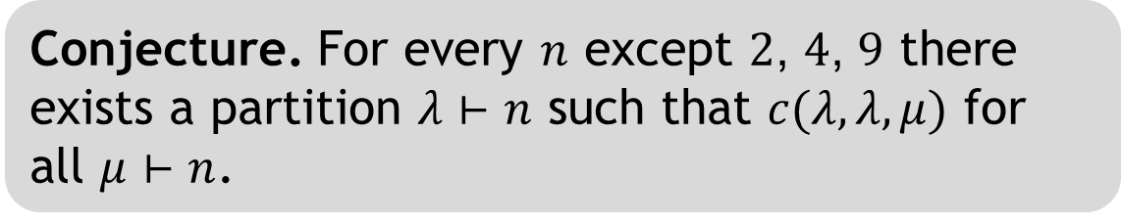

The Tensor Square Conjecture
Staircase case - Saxl conjecture
Convention: $n=\left(\begin{aligned}m+1 \\ 2\end{aligned}\right)$, so $ρ_{m}⊢n$
Conjecture. For every $n$ except $2$, $4$, $9$ there exists a partition $λ⊢n$ such that $c(λ,λ,μ)$ for all $μ⊢n$.
$$ρ_{5}=$$
Notes:
We’re going to focus on the saxl conjecture (but some of our results generalize to other things)

Slide 6
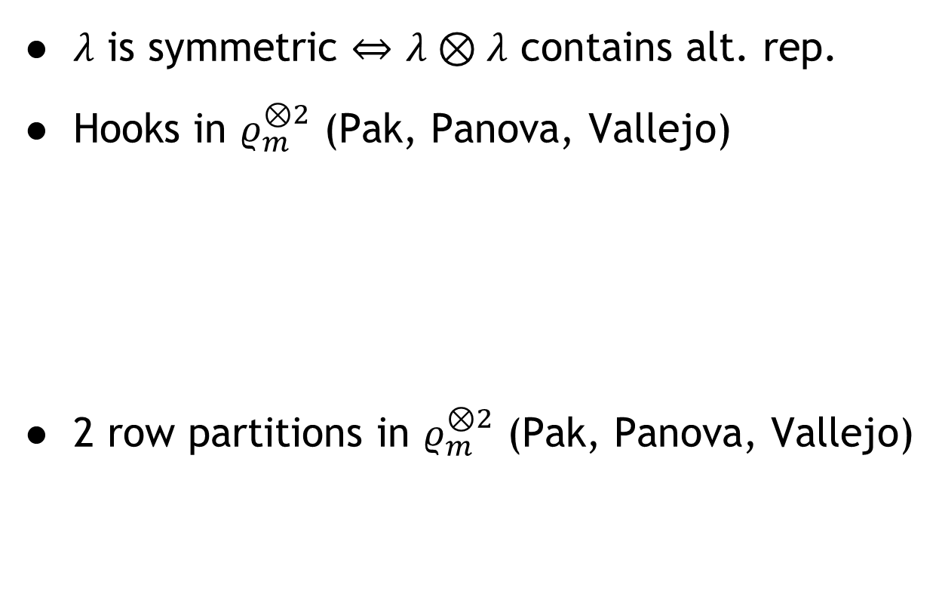
Some Prior Results
$λ$ is symmetric $⇔$ $λ⊗λ$ contains alt. rep.
Hooks in $ρ_{m}^{⊗2}$ (Pak, Panova, Vallejo)
2 row partitions in $ρ_{m}^{⊗2}$ (Pak, Panova, Vallejo)

Slide 7


The Semigroup Property
Horizontal and vertical sums
$$+_{H}$$
$$=$$

Slide 8


The Semigroup Property
$$+_{V}$$
$$=$$

Slide 9
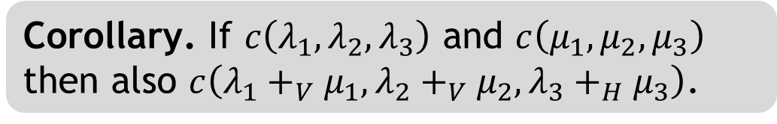
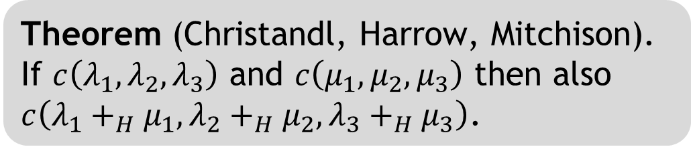
The Semigroup Property
Theorem (Christandl, Harrow, Mitchison). If $c\left(λ_{1}, λ_{2}, λ_{3}\right)$ and $c\left(μ_{1},μ_{2}, μ_{3}\right)$ then also $c\left(λ_{1}+_{H}μ_{1}, λ_{2}+_{H}μ_{2}, λ_{3}+_{H}μ_{3}\right)$.
Corollary. If $c\left(λ_{1}, λ_{2}, λ_{3}\right)$ and $c\left(μ_{1},μ_{2}, μ_{3}\right)$ then also $c\left(λ_{1}+_{V}μ_{1}, λ_{2}+_{V}μ_{2}, λ_{3}+_{H}μ_{3}\right)$.

Slide 10
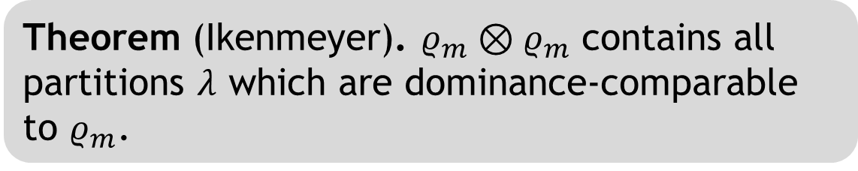
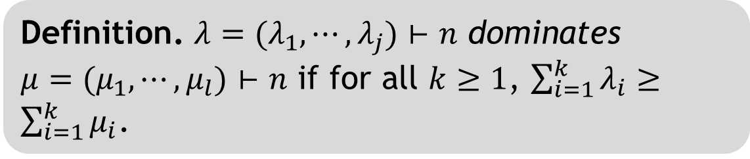
Dominance Order
Definition. $λ=(λ_{1},⋯,λ_{j})⊢n$ dominates $μ=(μ_{1},⋯,μ_{l})⊢n$ if for all $k≥1$, $\sum_{i=1}^{k}{λ_{i}}≥\sum_{i=1}^{k}{μ_{i}}$.
Theorem (Ikenmeyer). $ρ_{m}⊗ρ_{m}$ contains all partitions $λ$ which are dominance-comparable to $ρ_{m}$.
Notes:
Dominance is like how stretched / convexified you are

Slide 11
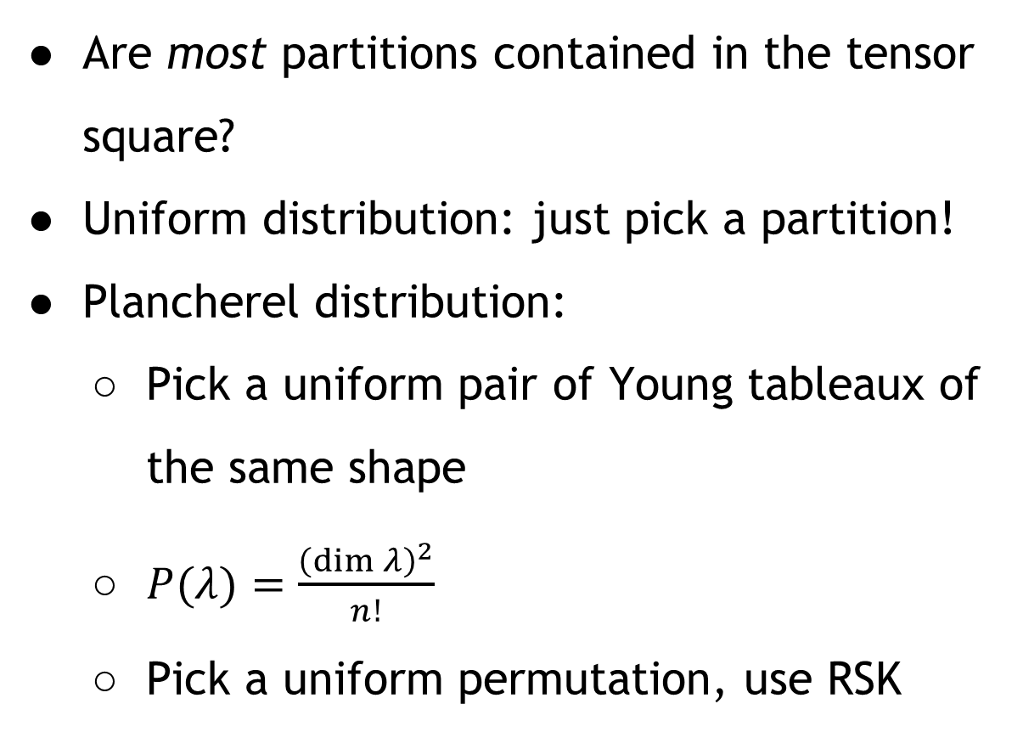
Probabilistic Approach
Are most partitions contained in the tensor square?
Uniform distribution: just pick a partition!
Plancherel distribution:
Pick a uniform pair of Young tableaux of the same shape
$P(λ)=\frac{{\left(\dim{λ}\right)}^{2}}{n!}$
Pick a uniform permutation, use RSK

Slide 12
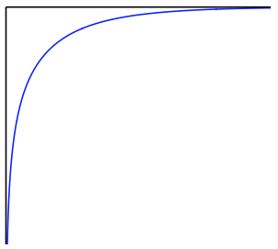
Uniform Limit Shape

Slide 13
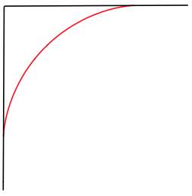
Plancherel Limit Shape

Slide 14
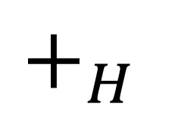

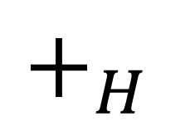


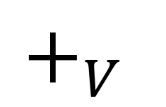

$$+_{H}$$
$$=$$
$$+_{V}$$
$$+_{H}$$
$$=$$
$$=$$
$$\left(ρ_{k}+_{H}ρ_{k+1}\right)+_{V}\left(ρ_{k}+_{H}ρ_{k}\right)=ρ_{2k+1}$$
$$\left(ρ_{k}+_{H}ρ_{k−1}\right)+_{V}\left(ρ_{k}+_{H}ρ_{k}\right)=ρ_{2k}$$

Slide 15
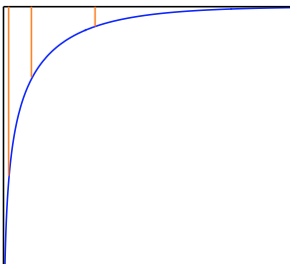
Chopping up the Uniform Shape

Slide 16
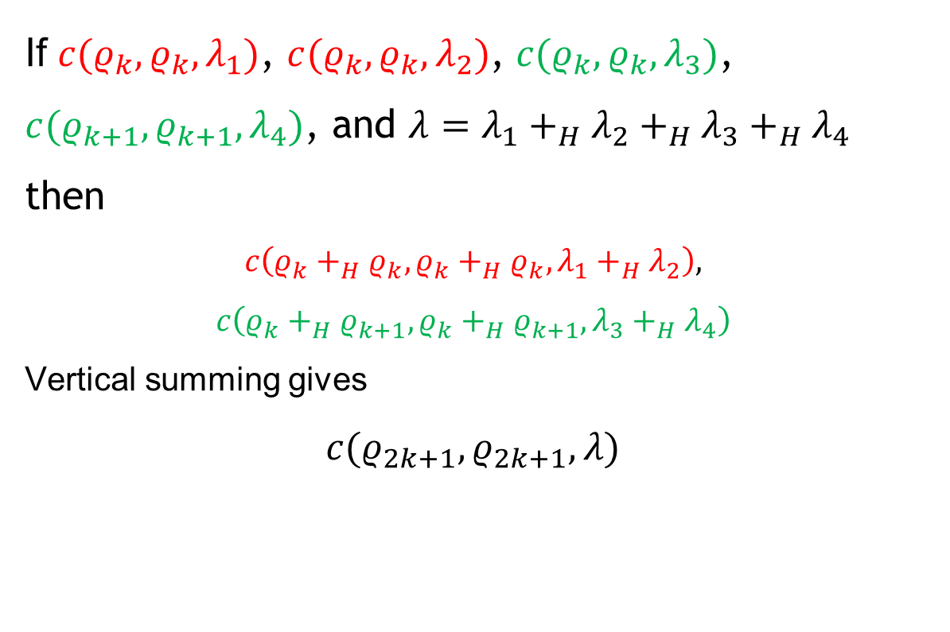
Idea for Probabilistic Results
If $c(ρ_{k},ρ_{k},λ_{1})$, $c(ρ_{k},ρ_{k},λ_{2})$, $c(ρ_{k},ρ_{k},λ_{3})$, $c(ρ_{k+1},ρ_{k+1},λ_{4})$, and $λ=λ_{1}+_{H}λ_{2}+_{H}λ_{3}+_{H}λ_{4}$ then
$$c\left(ρ_{k}+_{H}ρ_{k}, ρ_{k}+_{H}ρ_{k},λ_{1}+_{H}λ_{2}\right),$$
$$c\left(ρ_{k}+_{H}ρ_{k+1}, ρ_{k}+_{H}ρ_{k+1},λ_{3}+_{H}λ_{4}\right)$$
Vertical summing gives
$$c(ρ_{2k+1},ρ_{2k+1},λ)$$

Slide 17
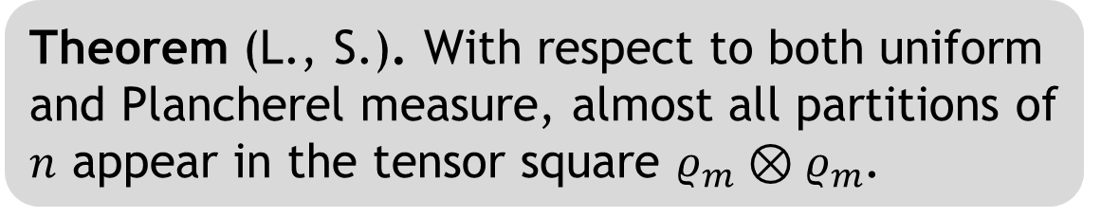
Probabilistic Results
Theorem (L., S.). With respect to both uniform and Plancherel measure, almost all partitions of $n$ appear in the tensor square $ρ_{m}⊗ρ_{m}$.

Slide 18

Deterministic Approach
Is every partition close to some partition contained in $ρ_{m}⊗ρ_{m}$?
Blockwise distance $Δ$: # of squares to move
Subadditive:
$$Δ\left(λ_{1},λ_{2}\right)+Δ\left(μ_{1},μ_{2}\right)≥Δ\left(λ_{1}+_{H}μ_{1},λ_{2}+_{H}μ_{2}\right)$$

Slide 19
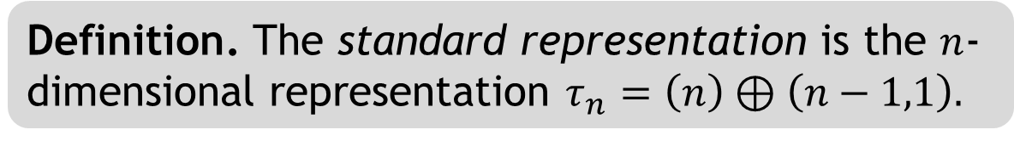
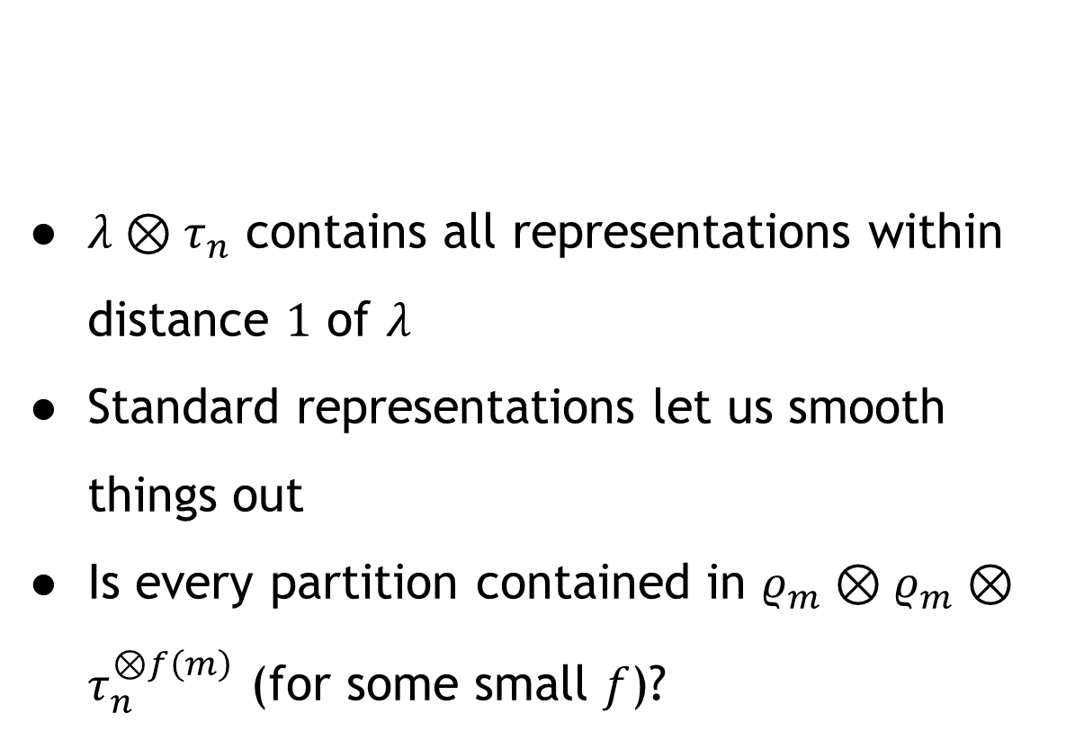
The Standard Representation
$λ⊗τ_{n}$ contains all representations within distance $1$ of $λ$
Standard representations let us smooth things out
Is every partition contained in $ρ_{m}⊗ρ_{m}⊗τ_{n}^{⊗f\left(m\right)}$ (for some small $f$)?
Definition. The standard representation is the $n$-dimensional representation $τ_{n}=\left(n\right)⊕\left(n−1,1\right).$

Slide 21










Staircase Identity Generalized
$$+_{H}$$
$$+_{H}$$
$$+_{H}$$
$$=$$
$$+_{V}$$
$$+_{V}$$
$$+_{H}$$
$$=$$
$$+_{V}$$
$$=$$
Notes:
(4x4 analog, combine 3x3 first)
Unlike in prob version, results are not immediately comparable to the corresponding staircases, and need to be resolved by breaking down further (via recursion). This is why it’s very important that staircases are breaking down into only more staircases.

Slide 22


Deterministic Approach
Split into pieces comparable to staircases
Let $M(m)$ be the number of $τ_{n}$’s we need for $ρ_{m}^{⊗2}$ to contain everything.
The recurrence:
$$M\left(m\right)≤M\left(\frac{3m}{4}\right)+M\left(\frac{m}{8}\right)+O\left(m\right).$$
Theorem (L., S.). $M\left(m\right)=O\left(m\right)$.

Slide 23
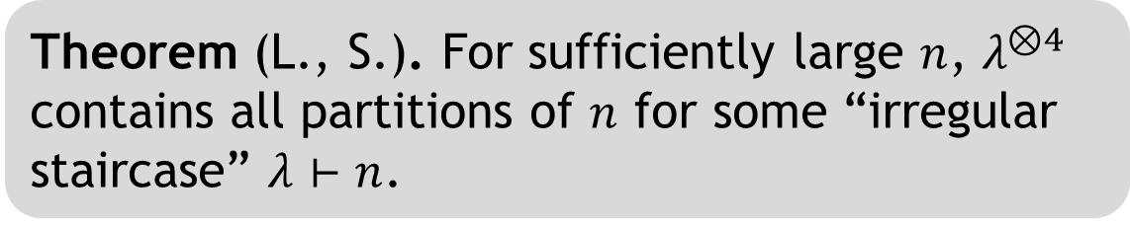
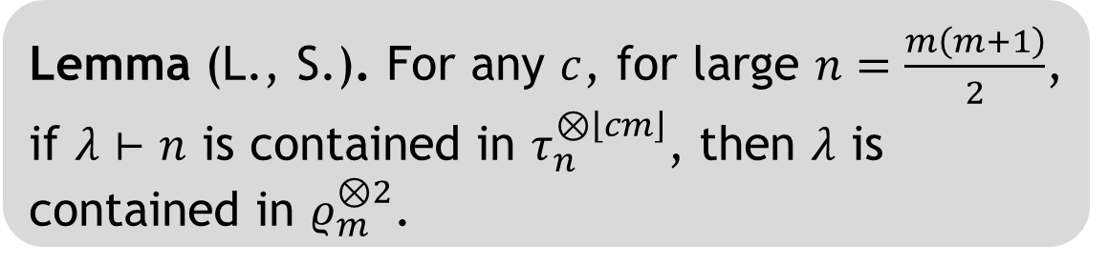
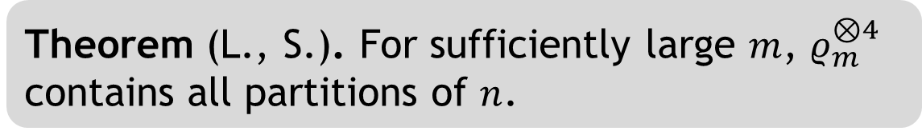
Results
Lemma (L., S.). For any $c$, for large $n=\frac{m\left(m+1\right)}{2}$, if $λ⊢n$ is contained in $τ_{n}^{⊗\left\lfloor cm\right\rfloor }$, then $λ$ is contained in $ρ_{m}^{⊗2}$.
Theorem (L., S.). For sufficiently large $m$, $ρ_{m}^{⊗4}$ contains all partitions of $n$.
Theorem (L., S.). For sufficiently large $n$, $λ^{⊗4}$ contains all partitions of $n$ for some “irregular staircase” $λ⊢n$.

Slide 24
Future Directions
Reducing 4 to 2: no smoothing allowed
Rectangles are the “hardest” case
Are these methods strong enough?

Slide 25
Questions?

Slide 26
Notes:
Ad-hoc solution showing a 6x6 square satisfies the Saxl conjecture. All other cases up to this size follow from the dominance result and semigroup property.

Slide 27



Notes:
Rectangles seem to be the hardest case for the Saxl conjecture.
This picture shows that tensor cubes of staircases contain rectangles.

