Slide 1
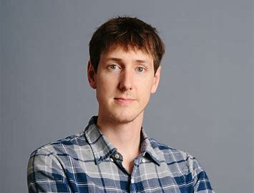
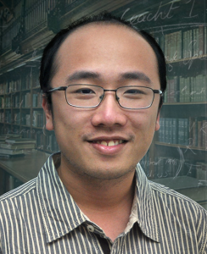
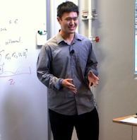
Competitively Chasing Convex Bodies
SÉbastien Bubeck, Yin Tat Lee, Yuanzhi Li, Mark Sellke
1
1, 2
3
3
1: MSR Redmond 2: University of Washington 3: Stanford University

Slide 2

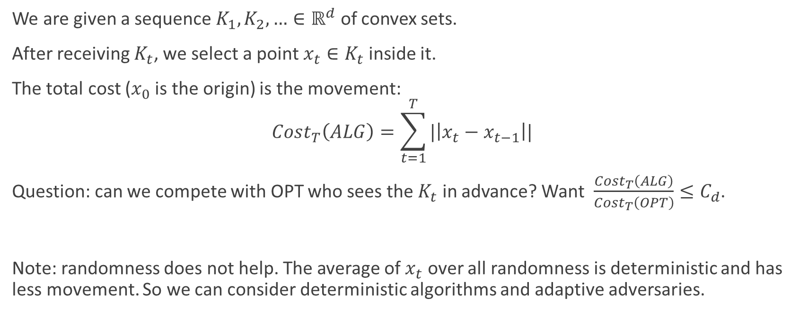


The Chasing Convex Bodies Problem
We are given a sequence $K_{1},K_{2},…∈ℝ^{d}$ of convex sets.
After receiving $K_{t}$, we select a point $x_{t}∈K_{t}$ inside it.
The total cost ($x_{0}$ is the origin) is the movement:
$$Cost_{T}\left(ALG\right)=\sum_{t=1}^{T}{|\left|x_{t}−x_{t−1}\right||}$$
Question: can we compete with OPT who sees the $K_{t}$ in advance? Want $\frac{Cost_{T}\left(ALG\right)}{Cost_{T}\left(OPT\right)}≤C_{d}$.
Note: randomness does not help. The average of $x_{t}$ over all randomness is deterministic and has less movement. So we can consider deterministic algorithms and adaptive adversaries.
$$K_{t}$$
$$x_{t−1}$$
$$x_{t}$$

Slide 3
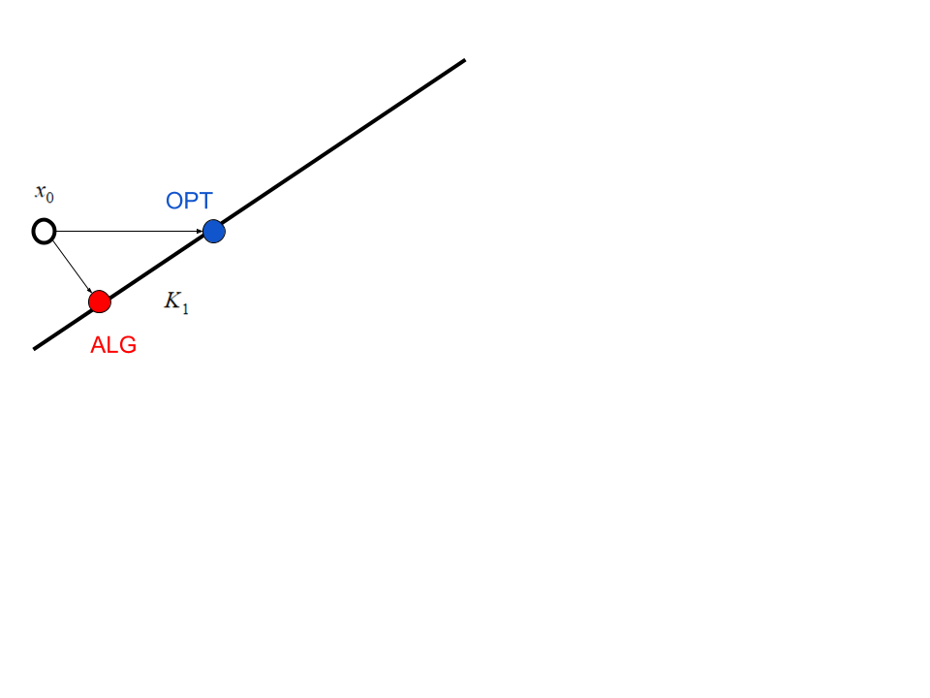
Example

Slide 4
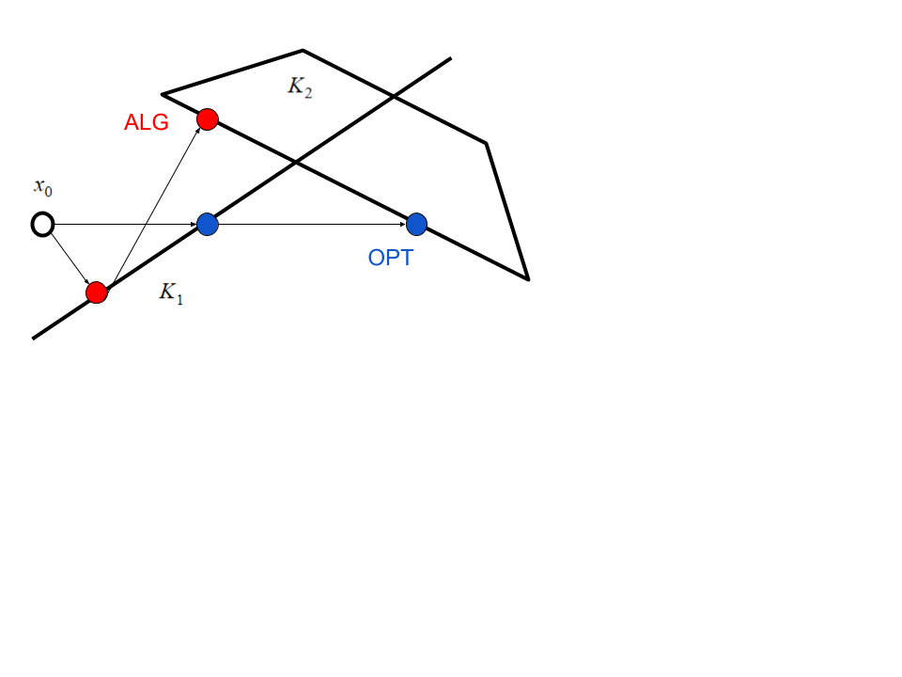
Example

Slide 5
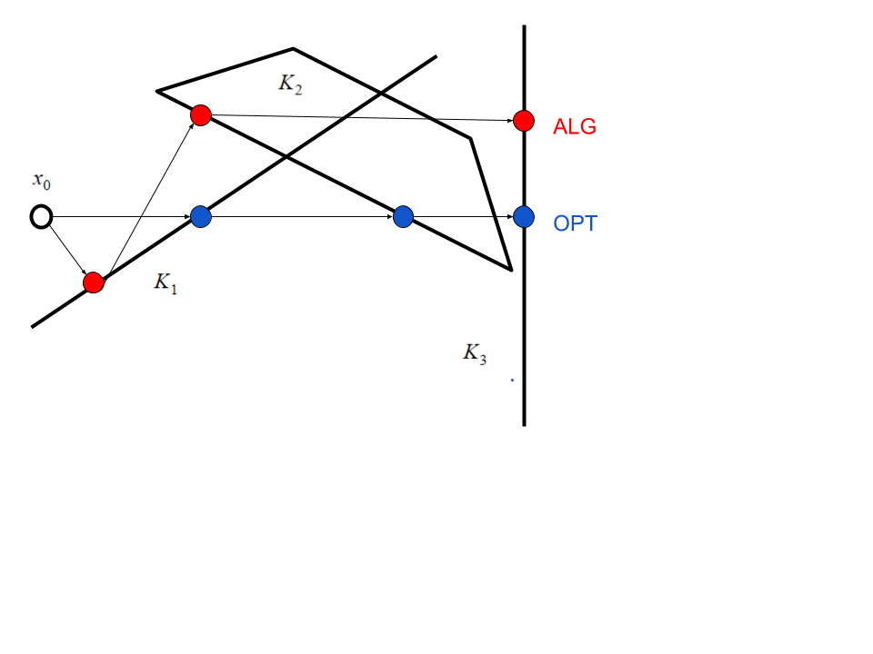
Example

Slide 6
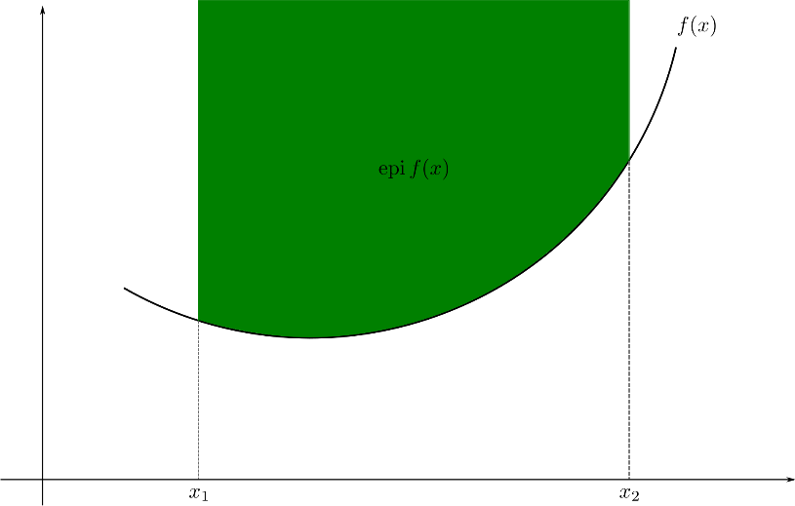
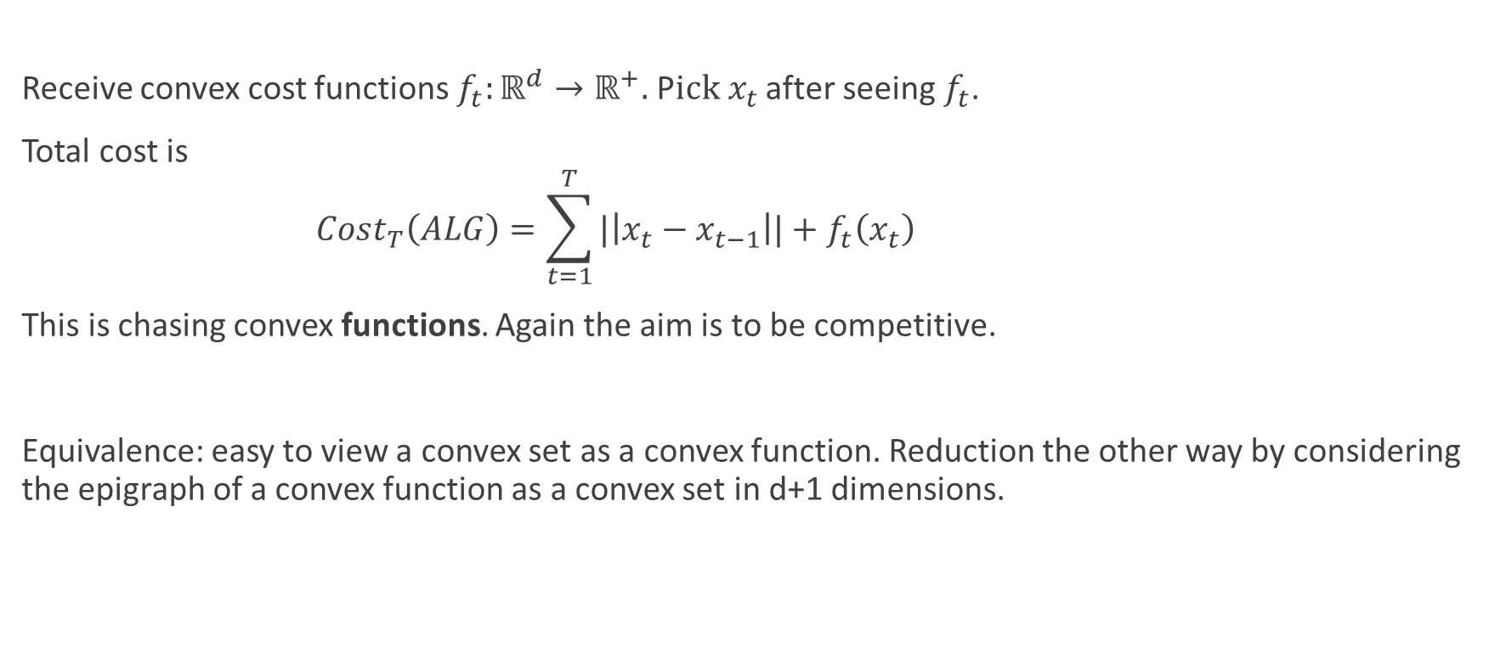
Motivation 0: an Equivalent Problem
Receive convex cost functions $f_{t}:ℝ^{d}→ℝ^{+}.$ P$ick x_{t}$ after seeing $f_{t}$.
Total cost is
$$Cost_{T}\left(ALG\right)=\sum_{t=1}^{T}{|\left|x_{t}−x_{t−1}\right||+f_{t}\left(x_{t}\right) }$$
This is chasing convex functions. Again the aim is to be competitive.
Equivalence: easy to view a convex set as a convex function. Reduction the other way by considering the epigraph of a convex function as a convex set in d+1 dimensions.

Slide 7
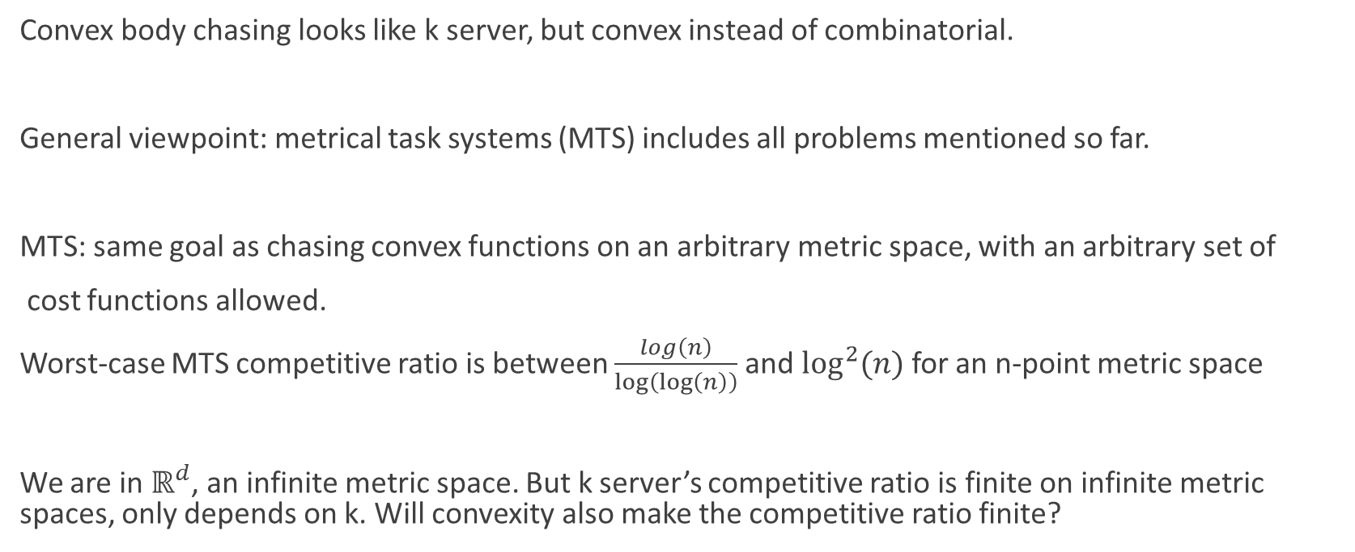
Motivation 1: Chasing General Functions
Convex body chasing looks like k server, but convex instead of combinatorial.
General viewpoint: metrical task systems (MTS) includes all problems mentioned so far.
MTS: same goal as chasing convex functions on an arbitrary metric space, with an arbitrary set of
cost functions allowed.
Worst-case MTS competitive ratio is between $\frac{log\left(n\right)}{\log\left(\log\left(n\right)\right)}$ and $\log^{2}⁡(n)$ for an n-point metric space
We are in $ℝ^{d}$, an infinite metric space. But k server’s competitive ratio is finite on infinite metric spaces, only depends on k. Will convexity also make the competitive ratio finite?

Slide 8
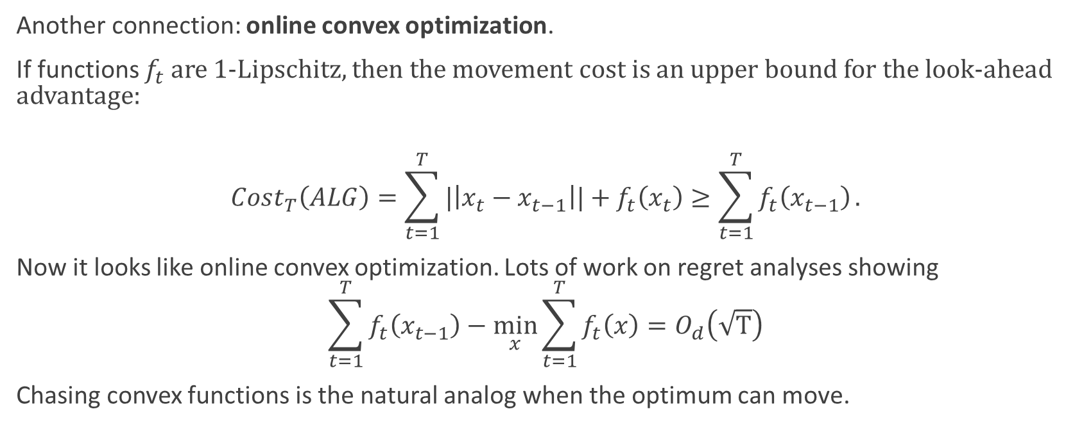
Motivation 2: Online Convex Optimization
Another connection: online convex optimization.
If functions $f_{t}$ are 1-Lipschitz, then the movement cost is an upper bound for the look-ahead advantage:
$$Cost_{T}\left(ALG\right)=\sum_{t=1}^{T}{|\left|x_{t}−x_{t−1}\right||+f_{t}\left(x_{t}\right)}≥\sum_{t=1}^{T}{f_{t}\left(x_{t−1}\right)}.$$
Now it looks like online convex optimization. Lots of work on regret analyses showing
$$\sum_{t=1}^{T}{f_{t}\left(x_{t−1}\right)}−\min_{x}\sum_{t=1}^{T}{f_{t}\left(x\right)=O_{d}\left(\sqrt{T}\right)}$$
Chasing convex functions is the natural analog when the optimum can move.

Slide 9
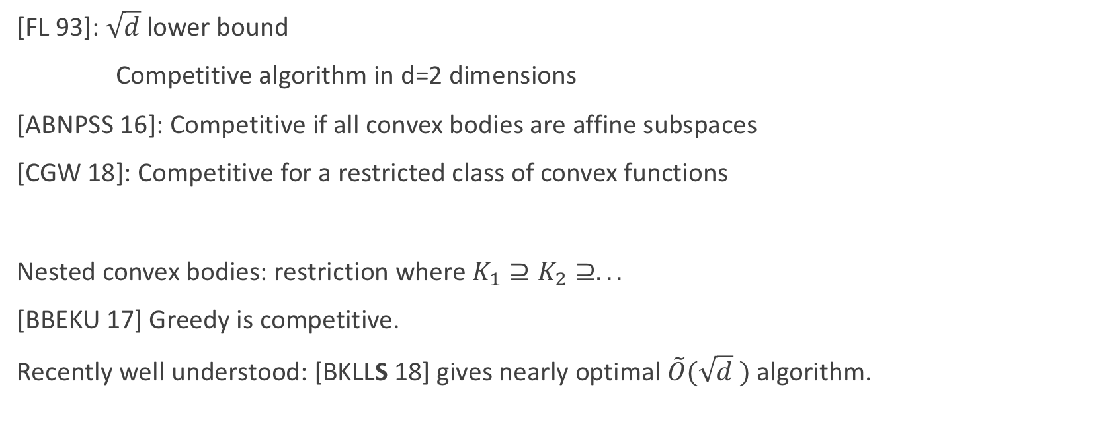
Previous Work
[FL 93]: $\sqrt{d}$lower bound
Competitive algorithm in d=2 dimensions
[ABNPSS 16]: Competitive if all convex bodies are affine subspaces
[CGW 18]: Competitive for a restricted class of convex functions
Nested convex bodies: restriction where $K_{1}⊇K_{2}⊇.. .$
[BBEKU 17] Greedy is competitive.
Recently well understood: [BKLLS 18] gives nearly optimal $\tilde{O}(\sqrt{d} )$ algorithm.

Slide 10

Our Result: First Finite Competitive Ratio
Theorem [BLLS 18]: there exists a $2^{O\left(d\right)}$competitive algorithm for chasing convex bodies.

Slide 11
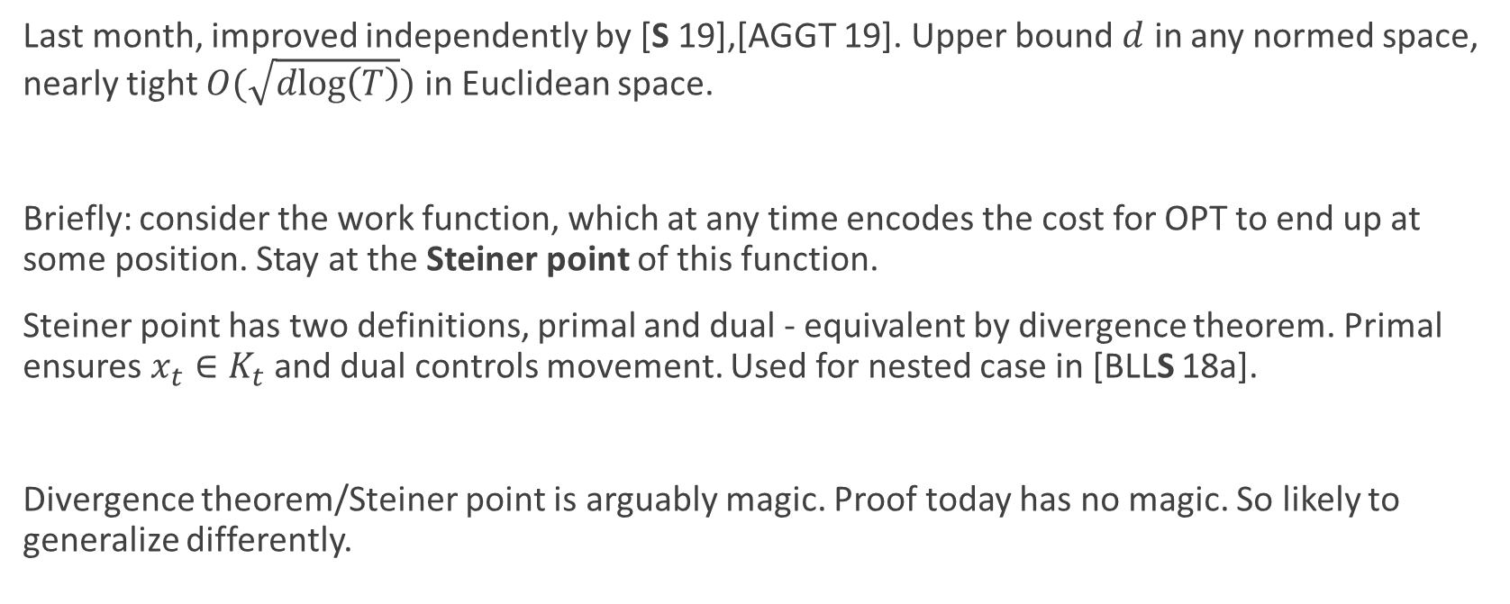
Last Month, An Improvement
Last month, improved independently by [S 19],[AGGT 19]. Upper bound $d$ in any normed space, nearly tight $O(\sqrt{dlog\left(T\right)})$ in Euclidean space.
Briefly: consider the work function, which at any time encodes the cost for OPT to end up at some position. Stay at the Steiner point of this function.
Steiner point has two definitions, primal and dual - equivalent by divergence theorem. Primal ensures $x_{t}∈K_{t}$ and dual controls movement. Used for nested case in [BLLS 18a].
Divergence theorem/Steiner point is arguably magic. Proof today has no magic. So likely to generalize differently.

Slide 12

Warm-Up: Greedy Fails
Suppose every convex set $K_{t}$ is a line in $ℝ^{2}$. Can we easily chase lines competitively?
Greedy algorithm (move to closest point) fails if $K_{t}$ rotates slowly around a center.
OPT just stays at the center, ALG moves forever!

Slide 13
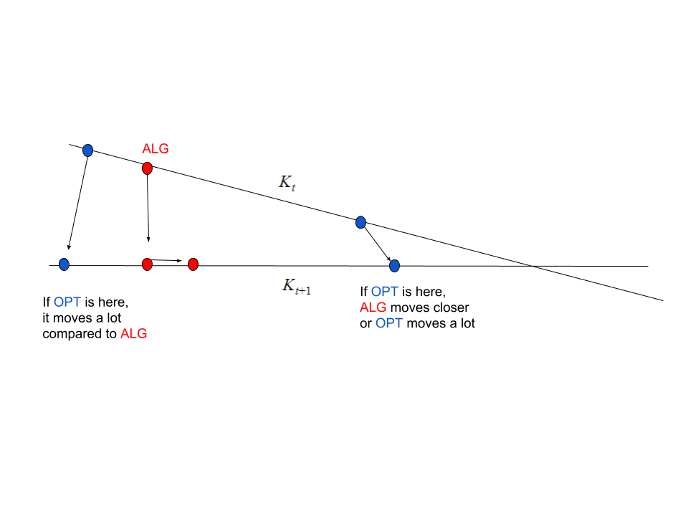

Chasing Lines: Move Towards OPT
Move to the closest point in $K_{t+1}$, then slightly towards $K_{t}∩K_{t+1}$!
Either OPT moves a comparable amount, or we move closer to OPT!
Easy to show this is competitive using distance to OPT as potential function.

Slide 14
Moving To OPTSET: High Level Intuition
General approach: group the time-steps into phases. In each phase, make progress with respect to appropriate potential.
Define OPTSET to be the set of possible current positions of OPT, requiring only that OPT have low movement in the current phase. OPTSET will shrink over time as the phase goes on.
Goal: in each phase, move closer to every point in OPTSET. Then finish with potential argument.
Observation: OPTSET is convex because an average of short paths remains short. So we can hope to move towards OPTSET in a meaningful way.

Slide 15
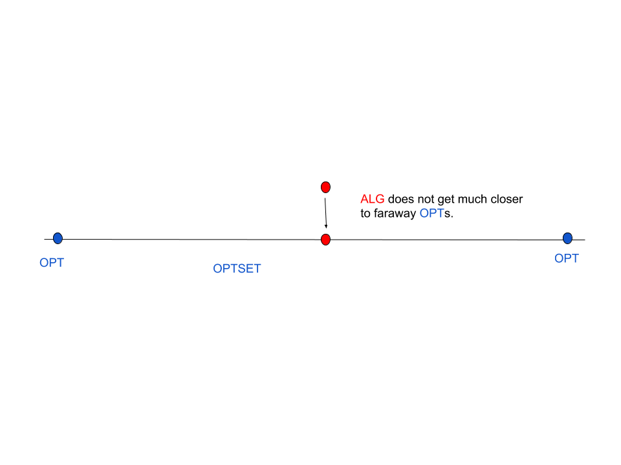
Moving To OPTSET: Preview of Difficulty
Suppose OPTSET is a line. We can move closer to OPTSET.
But for a potential argument, we must move closer to all points in OPTSET. And we cannot simultaneously move much closer to faraway points in opposite directions.
Procrastinate: try to avoid much movement until OPTSET really shrinks.

Slide 16
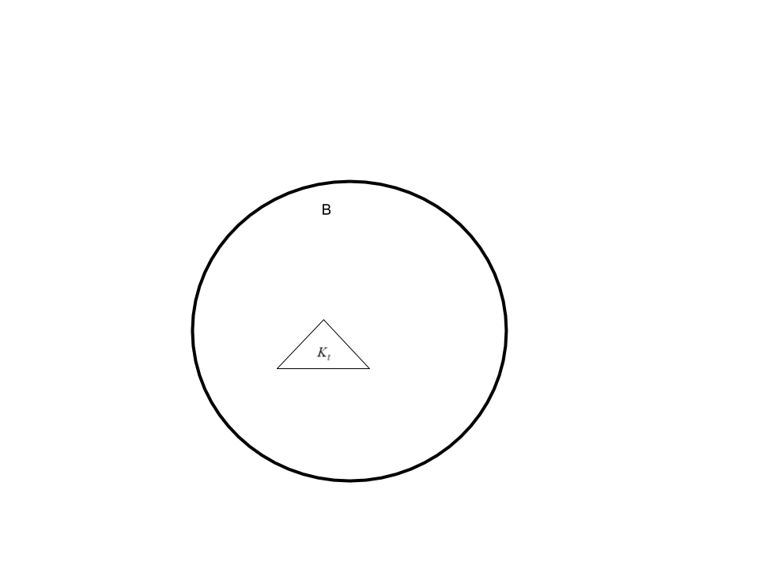

Getting Down to Business: Choosing a Scale
In each phase, we have a scale r for the problem.
We work inside a ball B with radius $R=α⋅r.$ Here $α=poly\left(d\right).$
OPTSET consists of paths with movement at most r
in the phase, and which stay inside B.
When OPTSET has small diameter, update (B,r) and begin new phase.

Slide 17
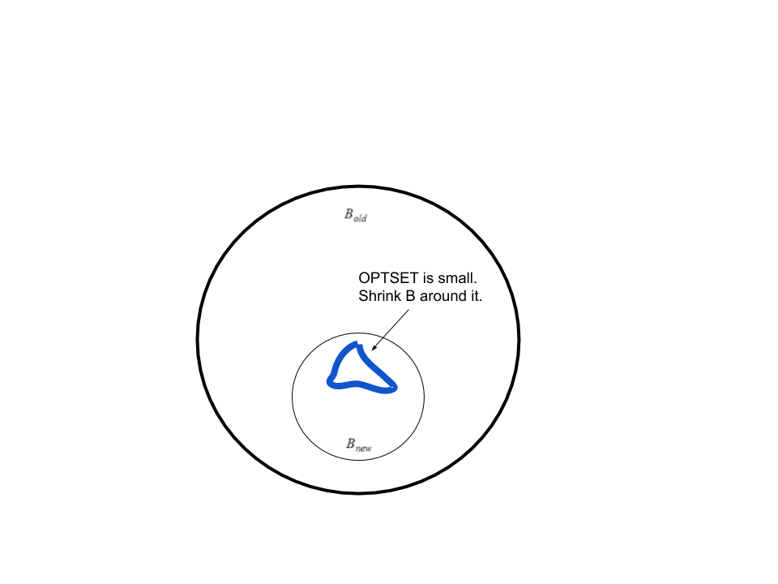
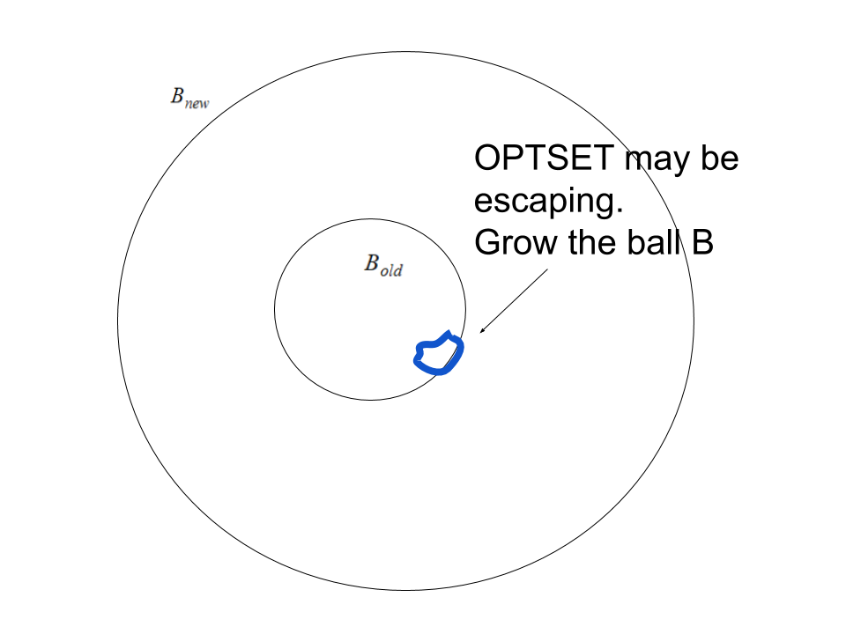

Moving to a New Phase
We use potential $Φ=max⁡(\left|x−OPT\right|−αr,αr)$. Constructed so both cases below are good.
When diam(OPTSET) shrinks:
If OPTSET is well inside B, shrinking B makes progress.
If OPTSET is near the outside of B, growing B makes progress.

Slide 18
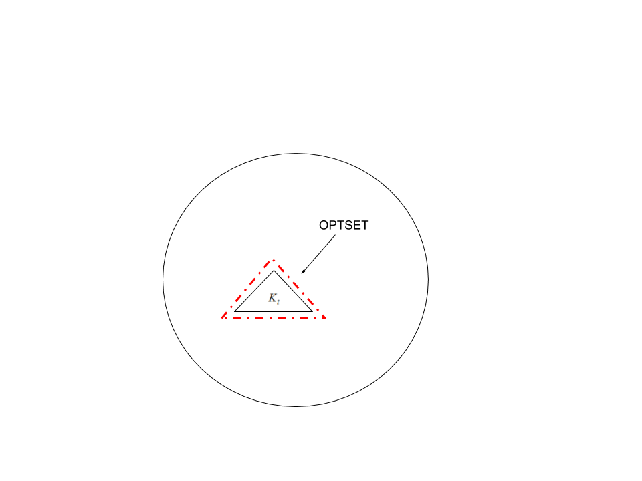
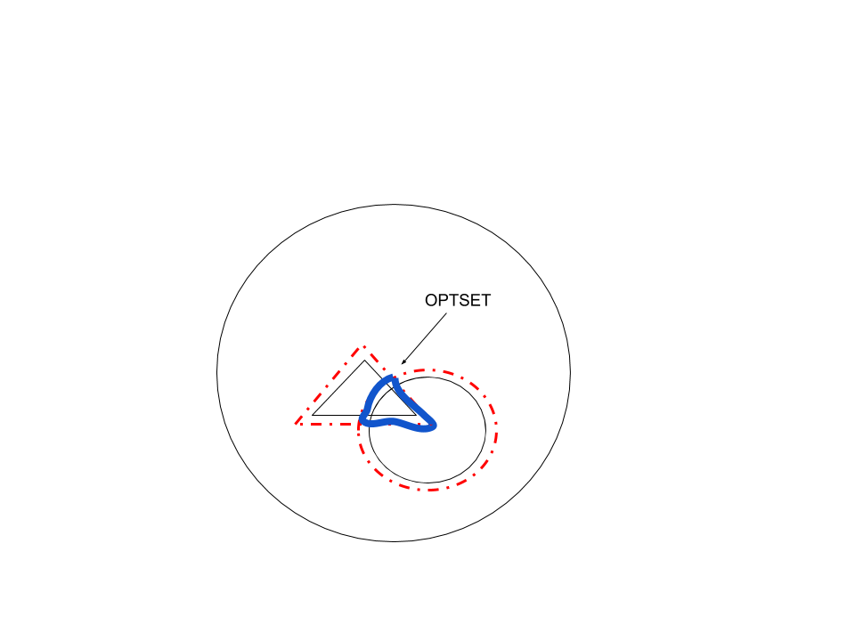

The Easy Case
The choice of potential ensures we make progress in each phase, as long as ALG has movement $O_{d}\left(r\right).$
Our only remaining goal is to ensure this.
We first observe that OPTSET is contained in the intersection of r-neighborhoods of the requests $K_{t}$.

Slide 19
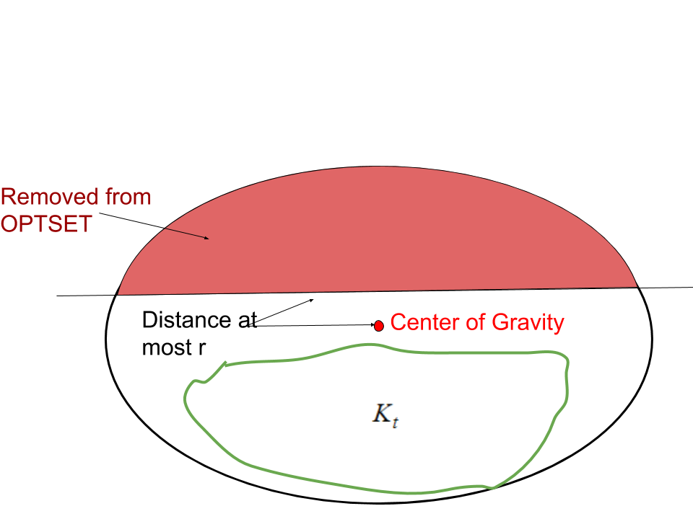

The Easy Case
We try to stay near the center of mass of OPTSET. Any request $K_{t}$ forcing an actual movement cuts along an r-neighborhood of the center of mass.
If OPTSET is long compared to r in all directions, this essentially cuts through the center of mass. Such cuts reduce the volume by a constant factor. In poly(d) iterations, OPTSET shrinks a lot. Eventually small diameter?

Slide 20
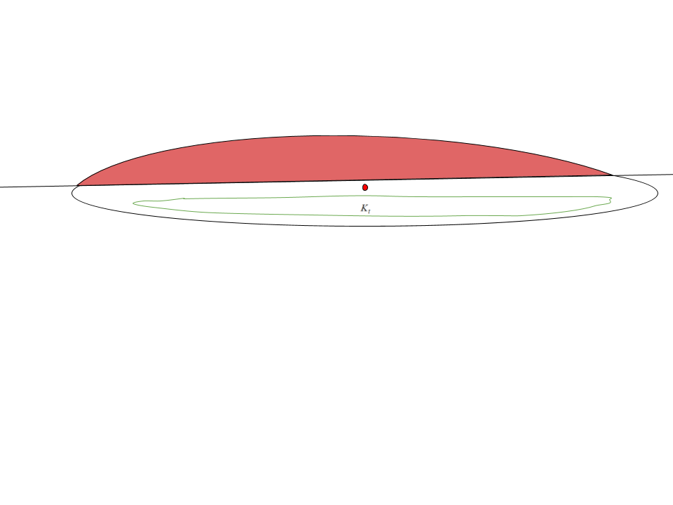
Moving to OPTSET: the Main Difficulty
OPTSET could be a line or pancake: some long directions, some short.
Then the preceding argument does not work. We could keep cutting short directions and never make real progress.

Slide 21
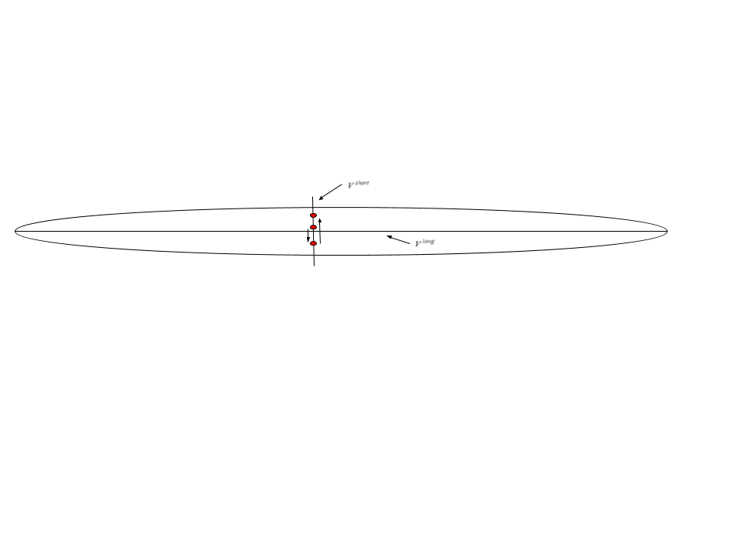

Long/Short Direction Decomposition
By convexity, we can write $OPTSET≈_{d}x_{center}⊕V^{short}⊕V^{long}$ where
$V^{short}, V^{long}$ are convex sets with dimensions $\left(m,d−m\right)$. They are respectively short and long in ALL directions.
Solution: stay at center of mass of $V^{long}$ and only move in $V^{short}$. Procrastinate until long directions shrink. But why is this competitive??

Slide 22
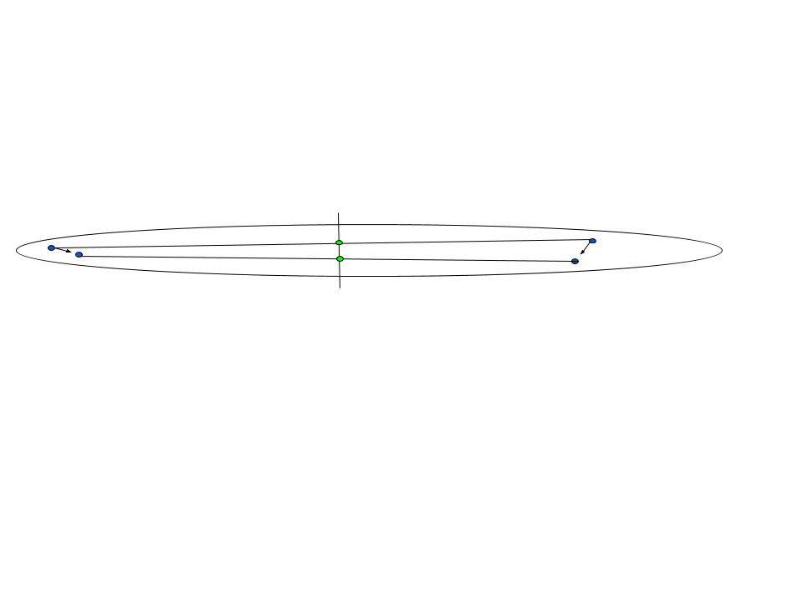
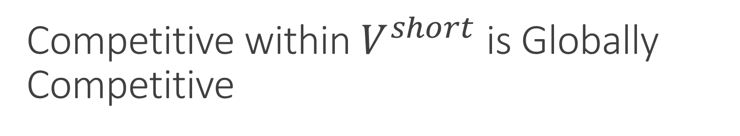

Competitive within $V^{short}$ is Globally Competitive
By inductive hypothesis on smaller dimension, we can stay competitive among algorithms that remain in the subspace $V^{short}$ of short directions.
Crucial step: averages of faraway OPTs with time-varying weights stay exactly in $V^{short}$. Therefore, if we stay competitive inside $V^{short}$ we are automatically globally competitive.
This is the main difficulty in the proof. Exponential d-dependence comes from this step.

Slide 23
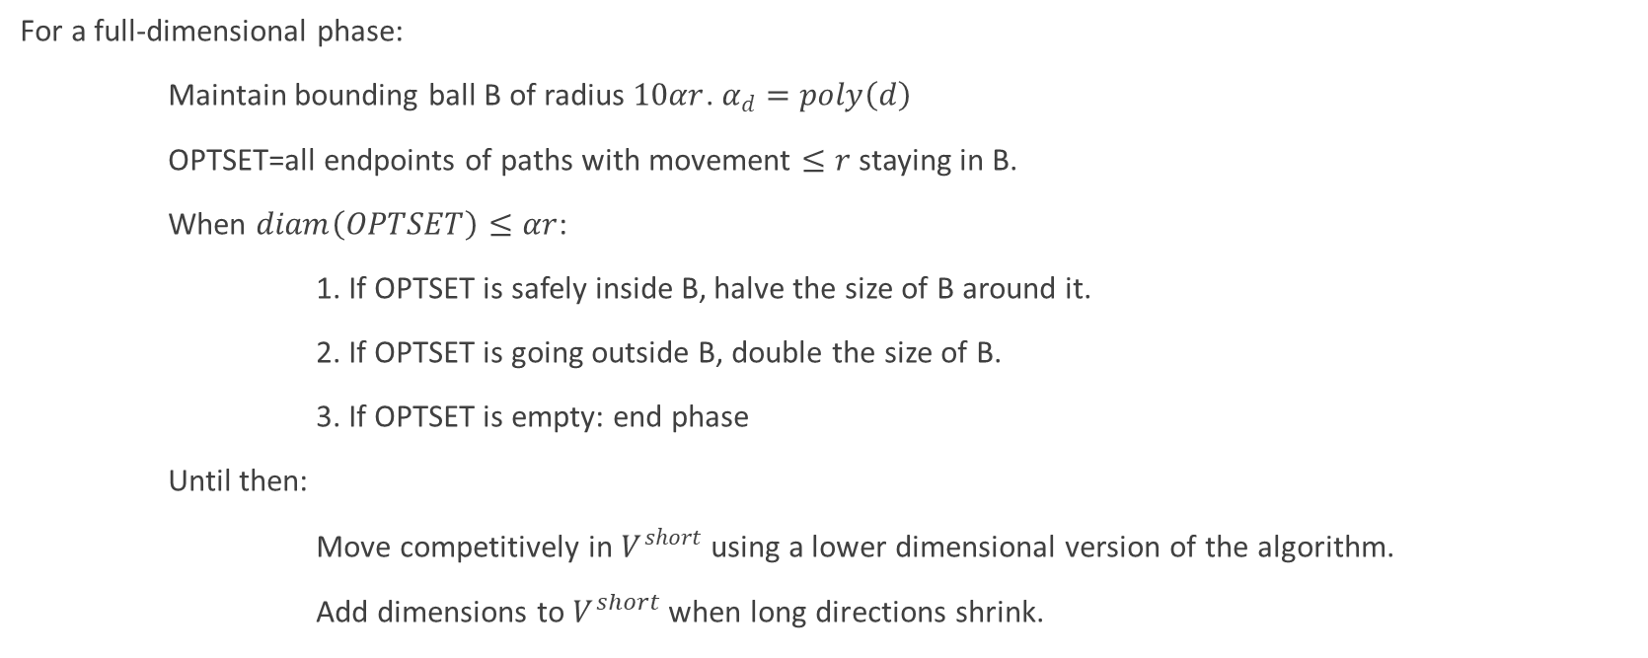
Final Algorithm (informally)
For a full-dimensional phase:
Maintain bounding ball B of radius $10αr$. $α_{d}=poly\left(d\right)$
OPTSET=all endpoints of paths with movement $≤r$ staying in B.
When $diam\left(OPTSET\right)≤αr$:
1. If OPTSET is safely inside B, halve the size of B around it.
2. If OPTSET is going outside B, double the size of B.
3. If OPTSET is empty: end phase
Until then:
Move competitively in $V^{short}$ using a lower dimensional version of the algorithm.
Add dimensions to $V^{short}$ when long directions shrink.

Slide 24
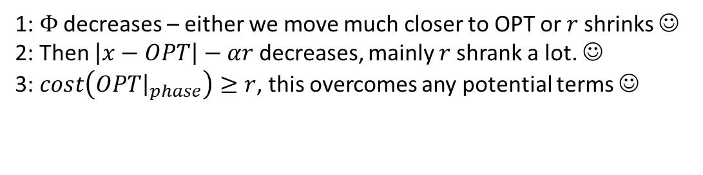

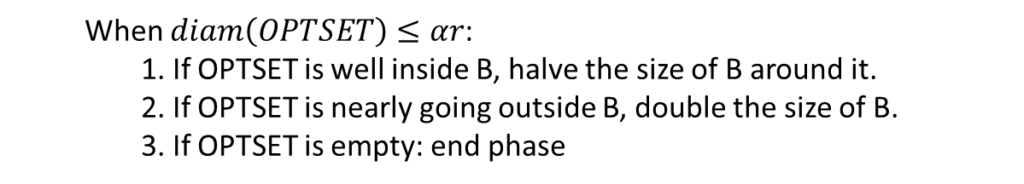
Potential Analysis
For a given OPT point, use potential $Φ=max⁡(\left|x−OPT\right|−αr,αr)$.
By construction, $cost\left(ALG{\left.​\right|}_{phase}\right)≤O_{d}\left(r\right).$
Potential Claim: $\left(1+50α\right)⋅\left(cost\left(OPT\right){\left.​\right|}_{phase}\right)+Φ_{old}−Φ_{new}≥\frac{αr}{2}$.
When $diam\left(OPTSET\right)≤αr$:
1. If OPTSET is well inside B, halve the size of B around it.
2. If OPTSET is nearly going outside B, double the size of B.
3. If OPTSET is empty: end phase
1: $Φ$ decreases – either we move much closer to OPT or $r$shrinks ☺
2: Then $\left|x−OPT\right|−αr$ decreases, mainly $r$shrank a lot. ☺
3: $cost\left(OPT{\left.​\right|}_{phase}\right)≥r$, this overcomes any potential terms ☺

Slide 25
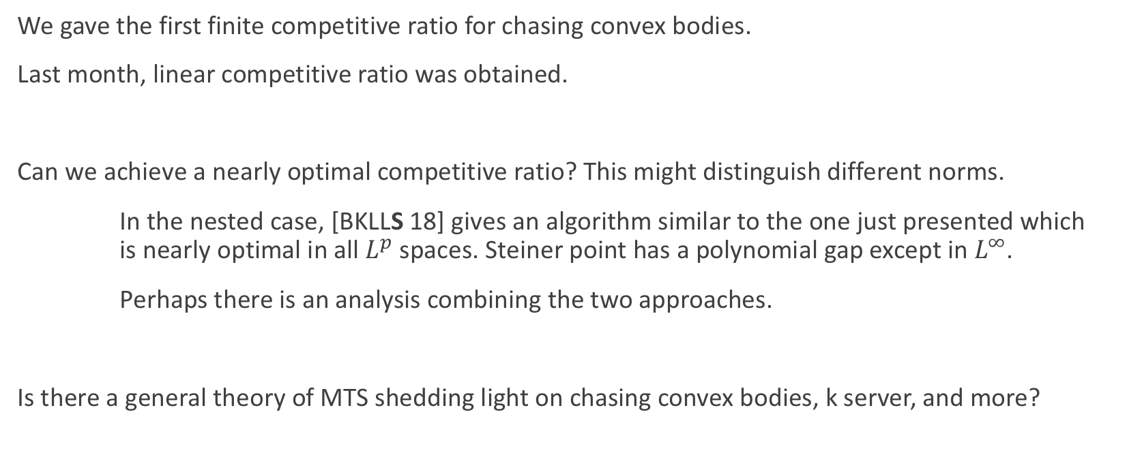
Conclusion
We gave the first finite competitive ratio for chasing convex bodies.
Last month, linear competitive ratio was obtained.
Can we achieve a nearly optimal competitive ratio? This might distinguish different norms.
In the nested case, [BKLLS 18] gives an algorithm similar to the one just presented which is nearly optimal in all $L^{p}$ spaces. Steiner point has a polynomial gap except in $L^{∞}$.
Perhaps there is an analysis combining the two approaches.
Is there a general theory of MTS shedding light on chasing convex bodies, k server, and more?

Slide 26
Thank you!

