Slide 1
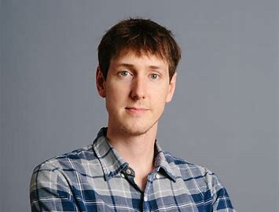
Chasing Nested Convex Bodies Nearly Optimally
1
2
1, 3
4
5
Sébastien Bubeck, Bo’az Klartag, Yin Tat Lee, Yuanzhi Li, Mark Sellke
1: MSR Redmond 2: Weizmann Institute 3: University of Washington 4: CMU 5: Stanford

Slide 2

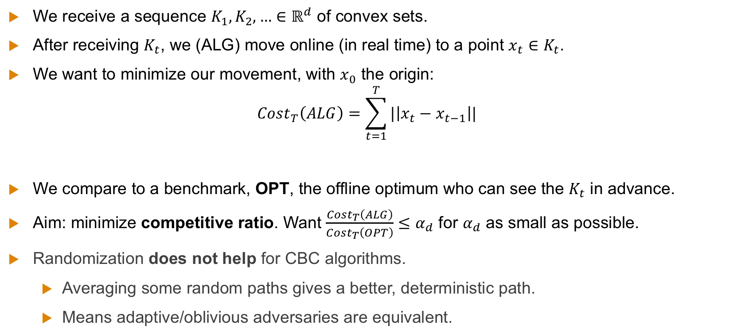


The Chasing Convex Bodies Problem
We receive a sequence $K_{1},K_{2},…∈ℝ^{d}$ of convex sets.
After receiving $K_{t}$, we (ALG) move online (in real time) to a point $x_{t}∈K_{t}$.
We want to minimize our movement, with $x_{0}$ the origin:
$$Cost_{T}\left(ALG\right)=\sum_{t=1}^{T}{|\left|x_{t}−x_{t−1}\right||}$$
We compare to a benchmark, OPT, the offline optimum who can see the $K_{t}$ in advance.
Aim: minimize competitive ratio. Want $\frac{Cost_{T}\left(ALG\right)}{Cost_{T}\left(OPT\right)}≤α_{d}$ for $α_{d}$ as small as possible.
Randomization does not help for CBC algorithms.
Averaging some random paths gives a better, deterministic path.
Means adaptive/oblivious adversaries are equivalent.
$$K_{t}$$
$$x_{t−1}$$
$$x_{t}$$

Slide 3
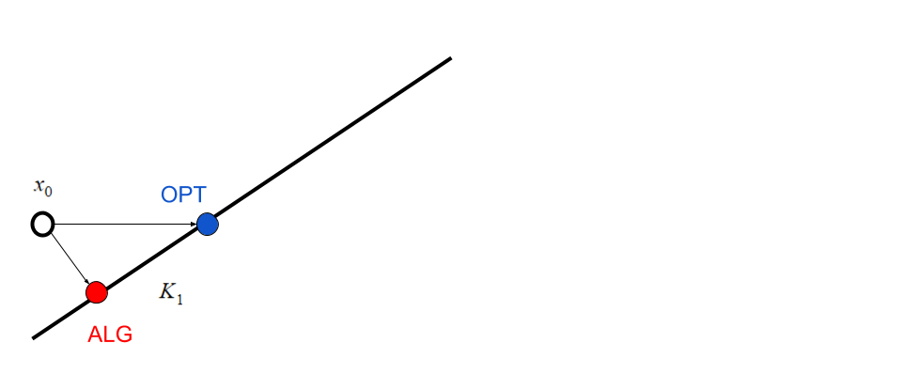
Example

Slide 4
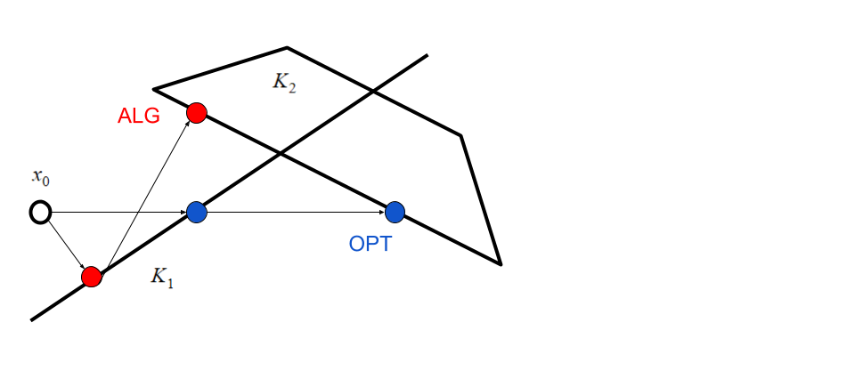
Example

Slide 5
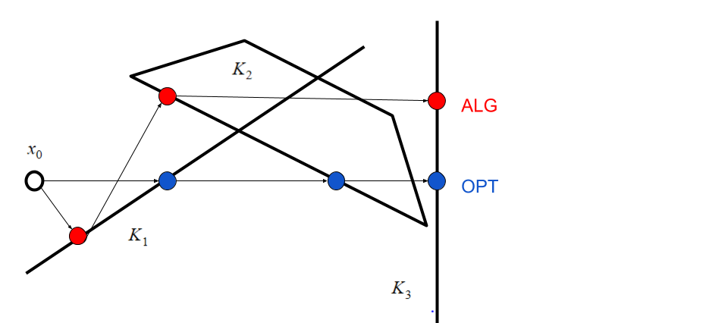
Example

Slide 6
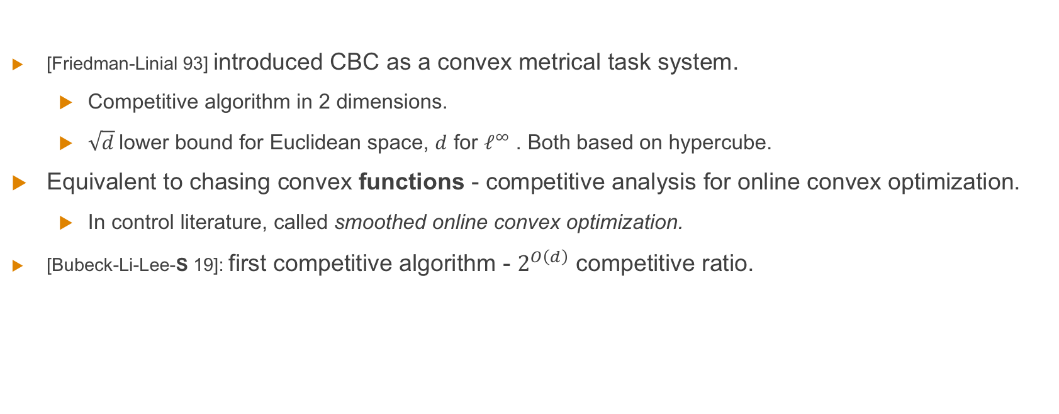
Background
[Friedman-Linial 93] introduced CBC as a convex metrical task system.
Competitive algorithm in 2 dimensions.
$\sqrt{d}$lower bound for Euclidean space, $d$ for $ℓ_{ }^{∞}$ . Both based on hypercube.
Equivalent to chasing convex functions - competitive analysis for online convex optimization.
In control literature, called smoothed online convex optimization.
[Bubeck-Li-Lee-S 19]: first competitive algorithm - $2^{O\left(d\right)}$ competitive ratio.

Slide 7
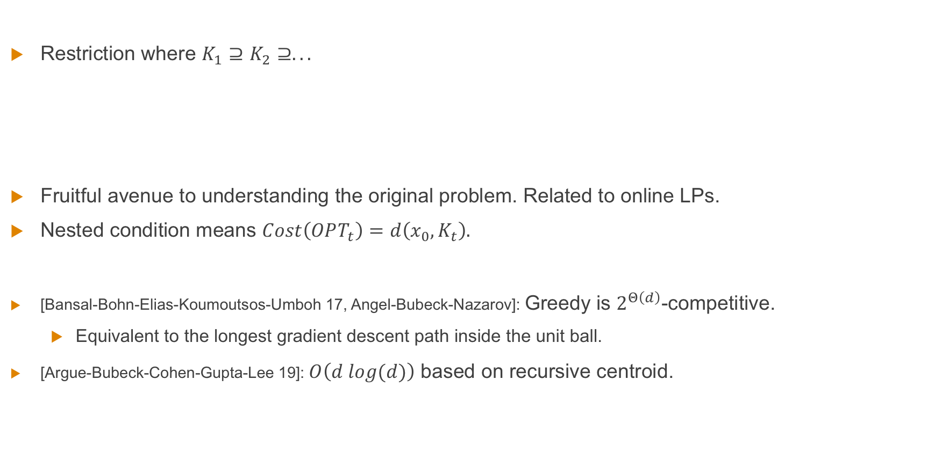
Chasing Nested Convex Bodies
Restriction where $K_{1}⊇K_{2}⊇.. .$
Fruitful avenue to understanding the original problem. Related to online LPs.
Nested condition means $Cost\left(OPT_{t}\right)=d\left(x_{0},K_{t}\right).$
[Bansal-Bohn-Elias-Koumoutsos-Umboh 17, Angel-Bubeck-Nazarov]: Greedy is $2^{Θ\left(d\right)}$-competitive.
Equivalent to the longest gradient descent path inside the unit ball.
[Argue-Bubeck-Cohen-Gupta-Lee 19]: $O\left(d log(d)\right)$ based on recursive centroid.

Slide 8






Simpler Formulation of Nested Chasing
Nested CBC v2:
Start with $K_{1}=B_{1}$ a unit ball.
Receive request sequence $K_{1}⊇K_{2}⊇.. .$ .
Move online to $x_{t}∈K_{t}$.
Aim: Ensure movement at most $α.$
Reduction (double and restart):
While $d\left(x_{0},K_{t}\right)∈[2^{n},2^{n+1}]$:
Replace $K_{t}$ with ${\tilde{K}}_{t}=K_{t}∩B_{2^{n+1}}\left(x_{0}\right).$
Use v2 on ${\tilde{K}}_{t}$ sequence to move $O\left(α2^{n}\right)$ in total.
At end: $Cost\left(OPT\right)=Ω(2^{n})$, $Cost\left(ALG\right)=O(α2^{n})$.
Hence any solution of v2 gets $O\left(α\right)$ for nested CBC via reduction.
$${\tilde{K}}_{t}$$
$$2^{n+1}$$
$$K_{t}$$
$$x_{0}$$
$$2^{n}$$

Slide 9
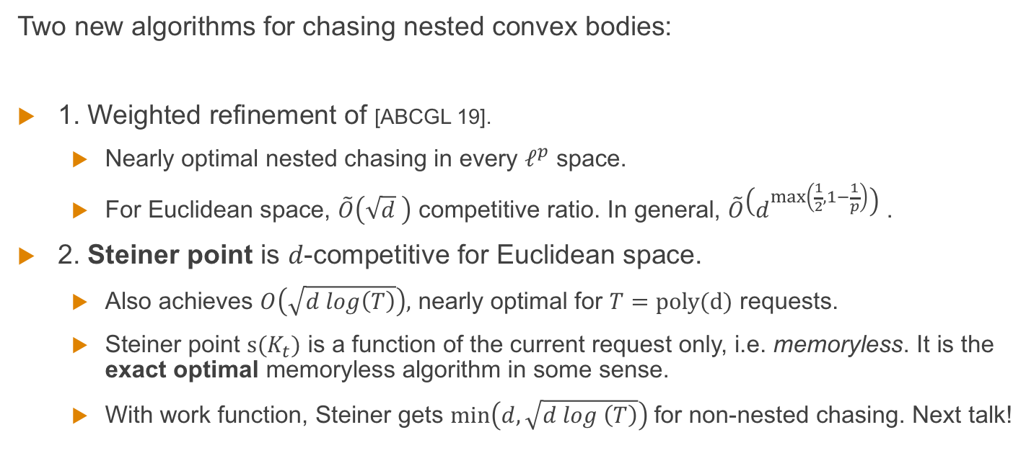
Our Results
Two new algorithms for chasing nested convex bodies:
1. Weighted refinement of [ABCGL 19].
Nearly optimal nested chasing in every $ℓ^{p}$ space.
For Euclidean space, $\tilde{O}\left(\sqrt{d} \right)$ competitive ratio. In general, $\tilde{O}\left(d^{\max\left(\frac{1}{2},1−\frac{1}{p}\right)}\right)$ .
2. Steiner point is $d$-competitive for Euclidean space.
Also achieves $O\left(\sqrt{d log\left(T\right)}\right),$ nearly optimal for $T=poly(d)$ requests.
Steiner point $s(K_{t})$ is a function of the current request only, i.e. memoryless. It is the exact optimal memoryless algorithm in some sense.
With work function, Steiner gets $min\left(d,\sqrt{d log \left(T\right)}\right)$for non-nested chasing. Next talk!

Slide 10

Centroid Approach of [ABCGL 19]
Idea: keep $x_{t}$ in the middle of $K_{t}.$ When we have to move, $K_{t}$shrinks a lot.
Precisely: If $x_{t}$ is the center of gravity $cg(K_{t})$, then every request forcing movement shrinks the volume by a constant factor (Grunbaum’s inequality).
Hope: every $O(d)$ steps the diameter halves, hence $O(d)$ movement. Not true!
Fix: long/short subspace decomposition. Only move in long directions when forced.
Short
Long

Slide 11
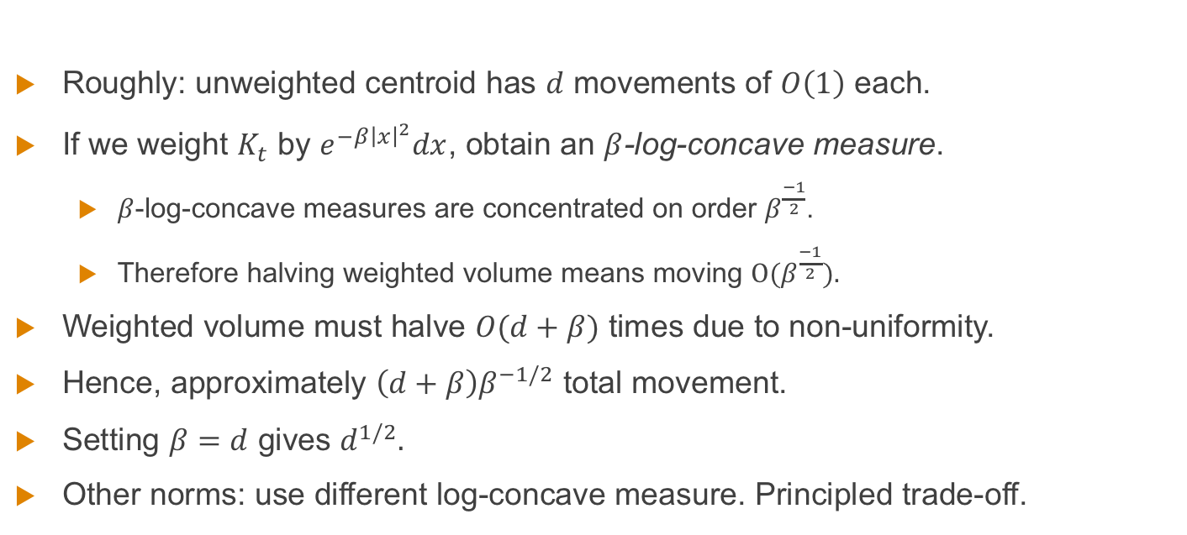
A Bit About Weighted Centroid
Roughly: unweighted centroid has $d$ movements of $O\left(1\right)$ each.
If we weight $K_{t}$ by $e^{−β{\left|x\right|}^{2}}dx$, obtain an $β$-log-concave measure.
$β$-log-concave measures are concentrated on order $β^{\frac{−1}{2}}$.
Therefore halving weighted volume means moving $O(β^{\frac{−1}{2}}).$
Weighted volume must halve $O(d+β)$ times due to non-uniformity.
Hence, approximately $\left(d+β\right)β^{−1/2}$ total movement.
Setting $β=d$ gives $d^{1/2}.$
Other norms: use different log-concave measure. Principled trade-off.

Slide 12
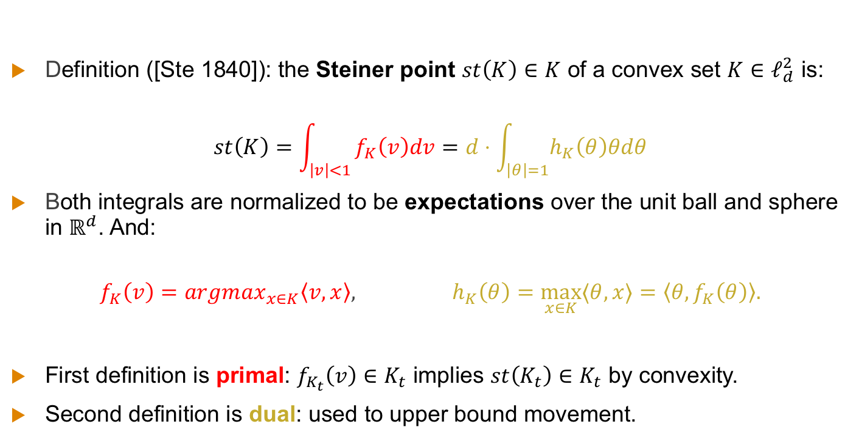
Steiner Point: Two Equivalent Definitions
Definition ([Ste 1840]): the Steiner point $st\left(K\right)∈K$ of a convex set $K∈ℓ_{d}^{2}$ is:
$$st\left(K\right)=\int_{\left|v\right|<1}{f_{K}\left(v\right)dv=d⋅\int_{\left|θ\right|=1}{h_{K}\left(θ\right)θdθ}}$$
Both integrals are normalized to be expectations over the unit ball and sphere in $ℝ^{d}$. And:
$$f_{K}\left(v\right)=argmax_{x∈K}\left\langle v,x\right\rangle , h_{K}\left(θ\right)=\max_{x∈K}{⟨θ,x⟩}=\left\langle {θ,f}_{K}\left(θ\right)\right\rangle .$$
First definition is primal: $f_{K_{t}}\left(v\right)∈K_{t}$ implies $st\left(K_{t}\right)∈K_{t}$ by convexity.
Second definition is dual: used to upper bound movement.
Support Function (Scalar)
Extreme Point (Vector)

Slide 13

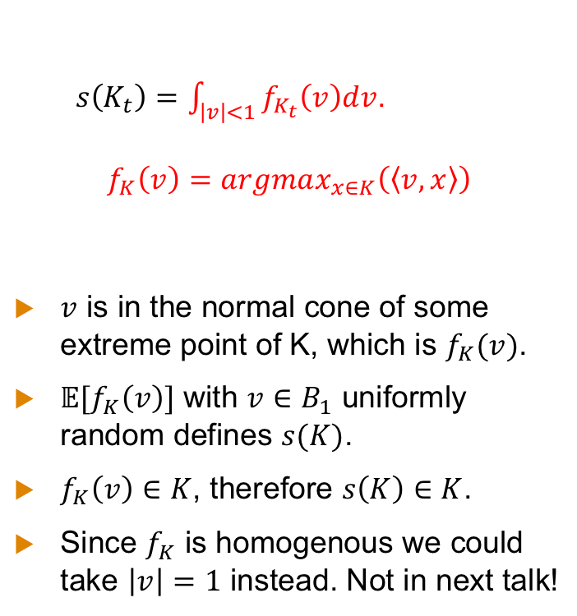


Understanding the Primal Definition
$s\left(K_{t}\right)=\int_{\left|v\right|<1}{f_{K_{t}}\left(v\right)dv}$.
$$f_{K}\left(v\right)=argmax_{x∈K}\left(\left\langle v,x\right\rangle \right)$$
$v$ is in the normal cone of some extreme point of K, which is $f_{K}(v)$.
$𝔼[f_{K}\left(v\right)]$ with $v∈B_{1}$ uniformly random defines $s(K)$.
$f_{K}\left(v\right)∈K$, therefore $s\left(K\right)∈K$.
Since $f_{K}$ is homogenous we could take $\left|v\right|=1$ instead. Not in next talk!
$$v$$
$$f_{K}\left(v\right)$$
$$s(K)$$

Slide 14
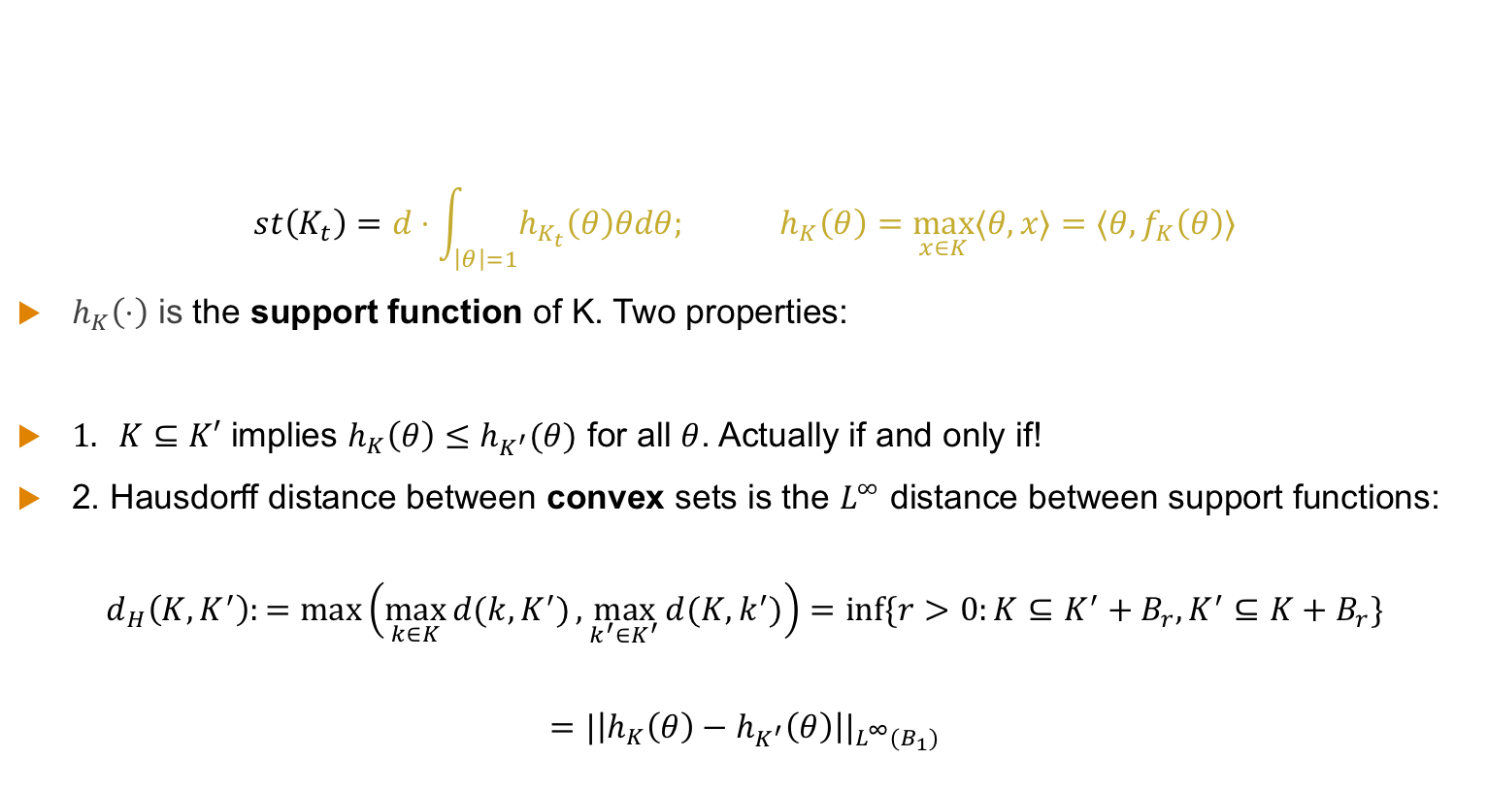
Understanding the Support Function
$$st\left(K_{t}\right)=d⋅\int_{\left|θ\right|=1}{h_{K_{t}}\left(θ\right)θdθ; }h_{K}\left(θ\right)=\max_{x∈K}{⟨θ,x⟩={⟨θ,f}_{K}\left(θ\right)⟩}$$
$h_{K}\left(⋅\right)$ is the support function of K. Two properties:
$1. K⊆K′$ implies $h_{K}\left(θ\right)≤h_{K^{′}}(θ)$ for all $θ$. Actually if and only if!
2. Hausdorff distance between convex sets is the $L^{∞}$ distance between support functions:
$$d_{H}\left(K,K^{′}\right):=max\left(\max_{k∈K}{d(k,K^{′})},\max_{k^{′}∈K^{′}}{d(K,k^{′})}\right){=\inf{\{r>0:K⊆K^{′}+B_{r},K^{′}⊆K+B_{r}\}}}$$
$$=|\left|h_{K}\left(θ\right)−h_{K^{′}}\left(θ\right)\right||_{L^{∞}(B_{1})}$$

Slide 15
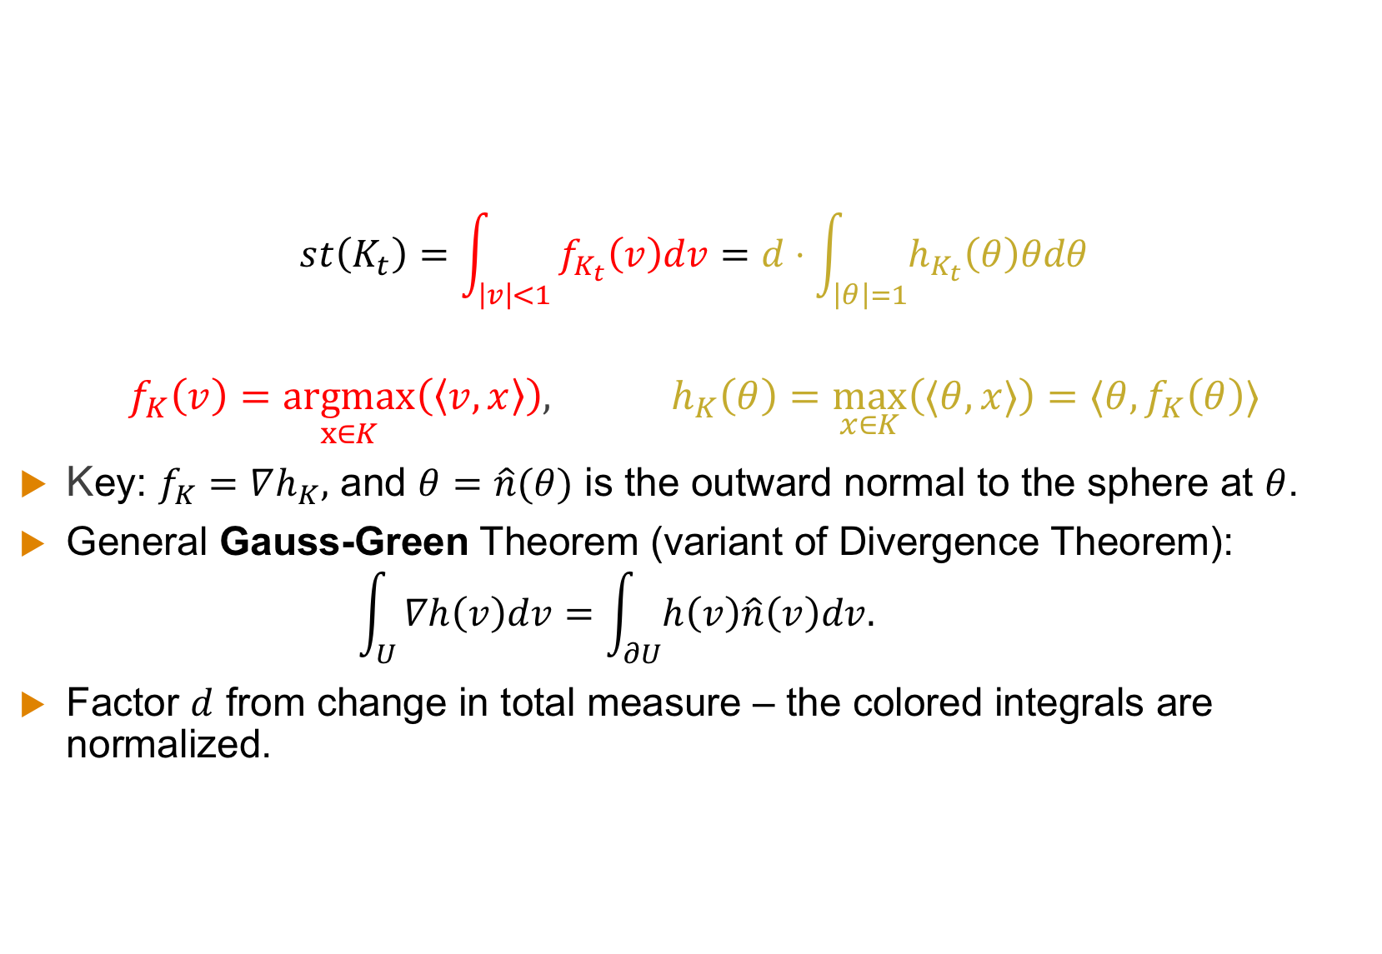
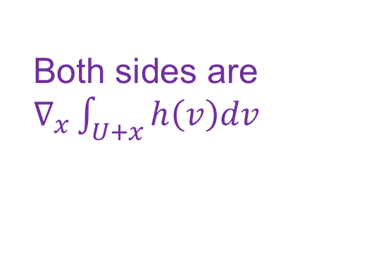
Why Do The Definitions Agree?
$$st\left(K_{t}\right)=\int_{\left|v\right|<1}{f_{K_{t}}\left(v\right)dv=d⋅\int_{\left|θ\right|=1}{h_{K_{t}}\left(θ\right)θdθ}}$$
$$f_{K}\left(v\right)=\underset{x∈K}{argmax}\left(\left\langle v,x\right\rangle \right), h_{K}\left(θ\right)=\max_{x∈K}\left(⟨θ,x⟩\right)={⟨θ,f}_{K}\left(θ\right)⟩$$
Key: $f_{K}=∇h_{K},$ and $θ=\hat{n}(θ)$ is the outward normal to the sphere at $θ$.
General Gauss-Green Theorem (variant of Divergence Theorem):
$$\int_{U}{∇h\left(v\right)dv=\int_{∂U}{h\left(v\right)\hat{n}\left(v\right)dv. }}$$
Factor $d$ from change in total measure – the colored integrals are normalized.
Both sides are $∇_{x}\int_{U+x}{h\left(v\right)dv}$

Slide 16
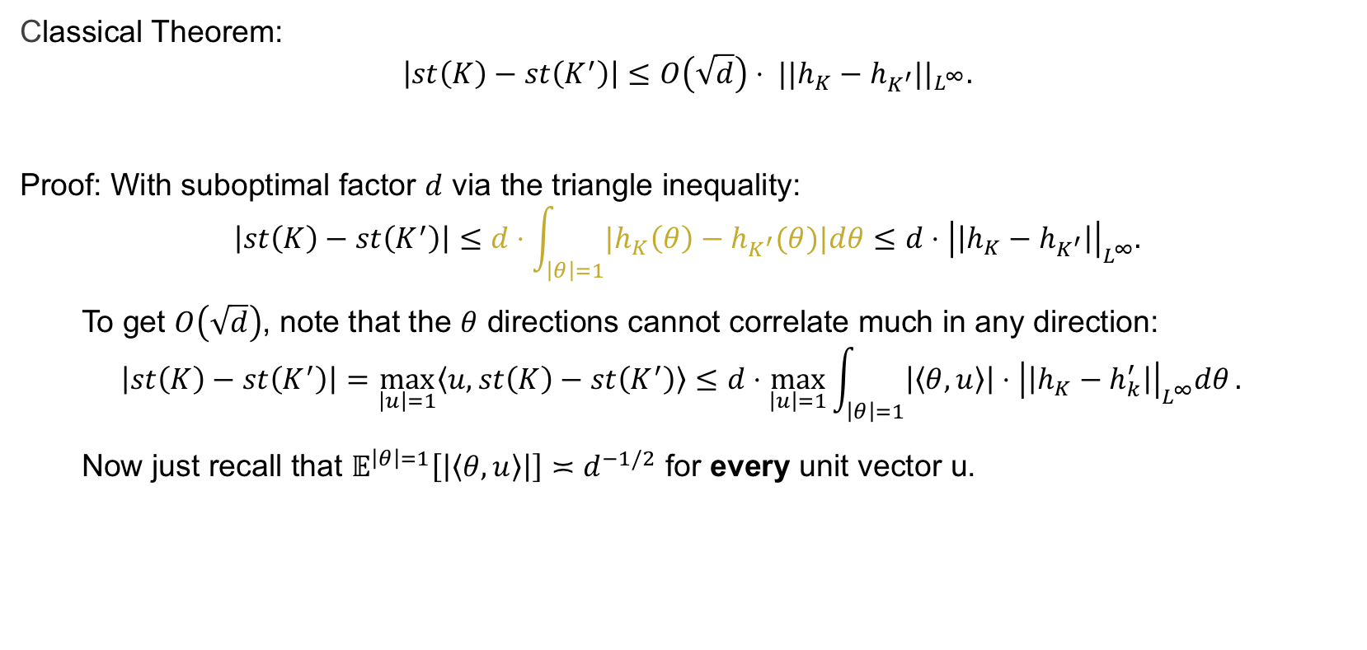
Warmup: Steiner is Hausdorff-Lipschitz
Classical Theorem:
$${\left|st\left(K\right)−st\left(K^{′}\right)\right|≤O\left(\sqrt{d}\right)⋅ ||h_{K}−h_{K^{′}}||}_{L^{∞}}.$$
Proof: With suboptimal factor $d$ via the triangle inequality:
$$\left|st\left(K\right)−st\left(K^{′}\right)\right|≤d⋅\int_{\left|θ\right|=1}{{|h}_{K}\left(θ\right)−h_{K^{′}}(θ)|dθ}≤d⋅{\left|\left|h_{K}−h_{K^{′}}\right|\right|}_{L^{∞}}.$$
To get $O\left(\sqrt{d}\right)$, note that the $θ$ directions cannot correlate much in any direction:
$${\left|st\left(K\right)−st\left(K^{′}\right)\right|=\max_{\left|u\right|=1}{〈u,st\left(K\right)−st\left(K^{′}\right)〉}≤d⋅{\max_{\left|u\right|=1}{\int_{\left|θ\right|=1}{\left|〈θ,u〉\right|}⋅{\left|\left|h_{K}−h_{k}^{′}\right|\right|}_{L^{∞}}^{ }dθ}.}_{ }}_{ }$$
Now just recall that $𝔼^{\left|θ\right|=1}\left[\left|〈θ,u〉\right|\right]≍d^{−1/2}$ for every unit vector u.

Slide 17
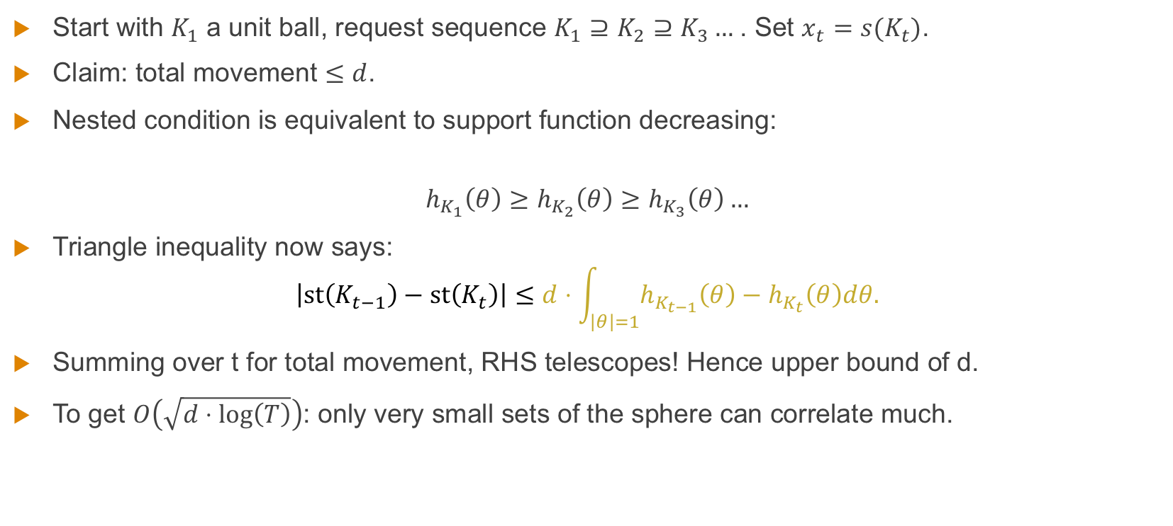
Nested Chasing with Steiner Point
Start with $K_{1}$ a unit ball, request sequence $K_{1}⊇K_{2}⊇K_{3}…$. Set $x_{t}=s(K_{t})$.
Claim: total movement $≤d$.
Nested condition is equivalent to support function decreasing:
$$h_{K_{1}}\left(θ\right)≥h_{K_{2}}\left(θ\right)≥h_{K_{3}}\left(θ\right)…$$
Triangle inequality now says:
$$\left|st\left(K_{t−1}\right)−st\left(K_{t}\right)\right|≤d⋅\int_{\left|θ\right|=1}{h_{K_{t−1}}\left(θ\right)−h_{K_{t}}\left(θ\right)dθ.}$$
Summing over t for total movement, RHS telescopes! Hence upper bound of d.
To get $O\left(\sqrt{d⋅\log\left(T\right)}\right)$: only very small sets of the sphere can correlate much.

Slide 18
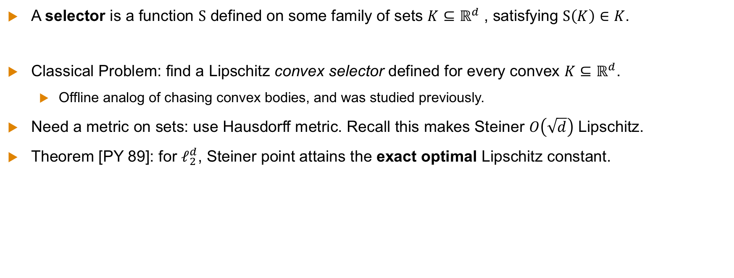
Optimal Memoryless Algorithm in Euclidean Space
A selector is a function $S$ defined on some family of sets $K⊆ℝ^{d}$ , satisfying $S\left(K\right)∈K$.
Classical Problem: find a Lipschitz convex selector defined for every convex $K⊆ℝ^{d}$.
Offline analog of chasing convex bodies, and was studied previously.
Need a metric on sets: use Hausdorff metric. Recall this makes Steiner $O\left(\sqrt{d}\right)$ Lipschitz.
Theorem [PY 89]: for $ℓ_{2}^{d}$, Steiner point attains the exact optimal Lipschitz constant.

Slide 19
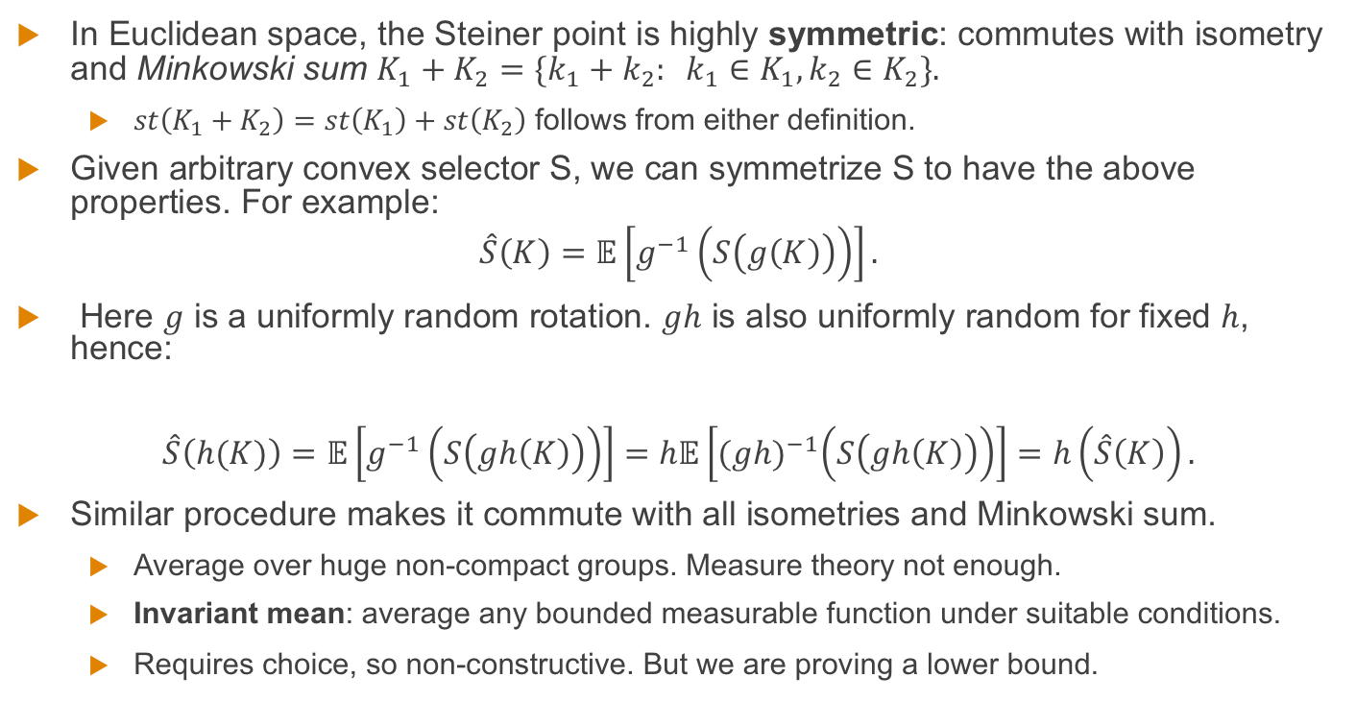
Optimal Memoryless Algorithm in Euclidean Space
In Euclidean space, the Steiner point is highly symmetric: commutes with isometry and Minkowski sum $K_{1}+K_{2}=\{k_{1}+k_{2}: k_{1}∈K_{1},k_{2}∈K_{2}\}.$
$st\left(K_{1}+K_{2}\right)=st\left(K_{1}\right)+st\left(K_{2}\right)$ follows from either definition.
Given arbitrary convex selector S, we can symmetrize S to have the above properties. For example:
$$\hat{S}\left(K\right)=𝔼\left[g^{−1}\left(S\left(g\left(K\right)\right)\right)\right].$$
Here $g$ is a uniformly random rotation. $gh$ is also uniformly random for fixed $h$, hence:
$$\hat{S}\left(h(K)\right)=𝔼\left[g^{−1}\left(S\left(gh\left(K\right)\right)\right)\right]=h𝔼\left[{(gh)}^{−1}\left(S\left(gh\left(K\right)\right)\right)\right]=h\left(\hat{S}\left(K\right)\right).$$
Similar procedure makes it commute with all isometries and Minkowski sum.
Average over huge non-compact groups. Measure theory not enough.
Invariant mean: average any bounded measurable function under suitable conditions.
Requires choice, so non-constructive. But we are proving a lower bound.

Slide 20
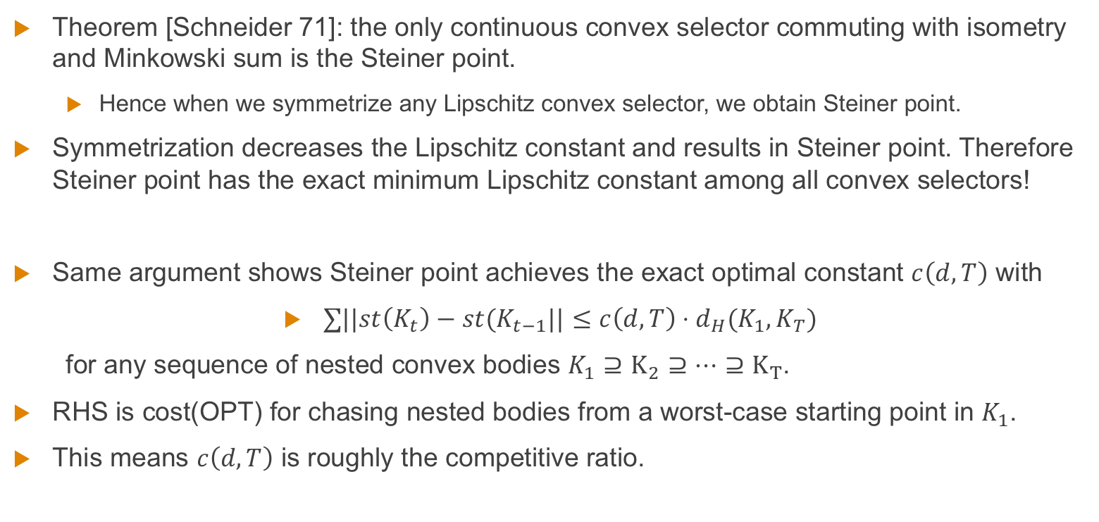
Optimal Memoryless Algorithm in Euclidean Space
Theorem [Schneider 71]: the only continuous convex selector commuting with isometry and Minkowski sum is the Steiner point.
Hence when we symmetrize any Lipschitz convex selector, we obtain Steiner point.
Symmetrization decreases the Lipschitz constant and results in Steiner point. Therefore Steiner point has the exact minimum Lipschitz constant among all convex selectors!
Same argument shows Steiner point achieves the exact optimal constant $c\left(d,T\right)$ with
$∑||st\left(K_{t}\right)−st(K_{t−1}||≤c\left(d,T\right)⋅d_{H}(K_{1},K_{T})$
for any sequence of nested convex bodies $K_{1}⊇K_{2}⊇…⊇K_{T}$.
RHS is cost(OPT) for chasing nested bodies from a worst-case starting point in $K_{1}$.
This means $c\left(d,T\right)$ is roughly the competitive ratio.

Slide 21
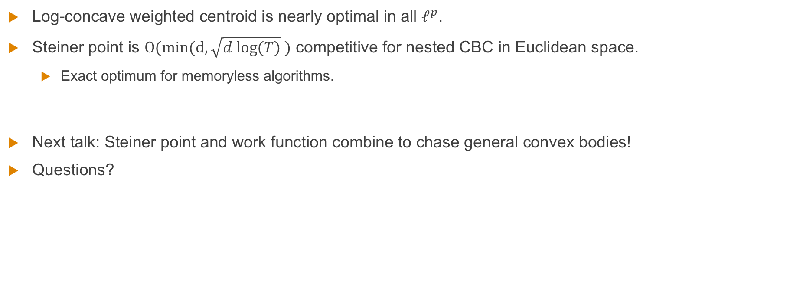
Conclusion
Log-concave weighted centroid is nearly optimal in all $ℓ^{p}$.
Steiner point is $O(\min{(d,\sqrt{d log⁡(T)} })$ competitive for nested CBC in Euclidean space.
Exact optimum for memoryless algorithms.
Next talk: Steiner point and work function combine to chase general convex bodies!
Questions?
Thank you!

Slide 22
References
[ABNPSS 16] Antonios Antoniadis, Neal Barcelo, Michael Hugent, Kirk Pruhs, Kevin Schewior, Michele Scquizzato. Chasing convex bodies and functions. LATIN 2016.
[ABCGL 19] C.J. Argue, Sébastien Bubeck, Michael B. Cohen, Anupam Gupta, and Yin Tat Lee. A nearly-linear bound for chasing nested convex bodies. SODA 2019.
[AGGT 19] C.J. Argue, Anupam Gupta, Guru Guruganesh, Ziye Tang. Chasing convex bodies with linear competitive ratio. SODA 2020.
[CGW 18] Niangjun Chen, Gautam Goel, Adam Wierman. Smoothed Online Convex Optimization in High Dimensions via Online Balanced Descent. 2018
[BBEKU 18] Nikhil Bansal, Martin Bohm, Marek Elias, Grigorios Koumoutsos, Seeun William Umboh. Nested convex bodies are chaseable. SODA 2018.
[BKLLS 20] Sébastien Bubeck, Bo’az Klartag, Yin Tat Lee, Yuanzhi Li, Mark Sellke. Chasing nested convex bodies nearly optimally. SODA 2020.
[BLLS 19] Sébastien Bubeck, Yin Tat Lee, Yuanzhi Li, Mark Sellke. Competitively chasing convex bodies. STOC 2019.
[FL 93] Joel Friedman, Nat Linial. On convex body chasing. Discrete & Computational Geometry 1993.
[GW 19] Gautam Goel, Adam Wierman. An online algorithm for smoothed regression and LQG control. PMLR 2019.
[PY 89] Krzysztof Przesławski and David Yost. Continuity properties of selectors and Michael's theorem. Michigan Mathematics Journal 1989.
[Sch 71] Rolf Schneider. On Steiner points of convex bodies. Israel J Math 1971.
[S 20] Mark Sellke. Chasing convex bodies optimally. SODA 2020.
[Ste 1840] Jakob Steiner. Von dem krümmungs-schwerpuncte ebener curven. Journal für die reine und angewandte Mathematik, 21:33–63, 1840.

