Slide 1
Incentived Exploration with Linear Contexts
Mark Sellke

Slide 2






Motivation: online recommendations
Buy this product
Watch this movie
Dine in this restaurant
Vacation in this resort
Drive this route
See this doctor
Notes:
Our motivation comes from recommender systems. There are many of these everywhere: you can be recommended which movie to watch, which restaurant to dine in, where to go for vacation, which product to buy, which route to drive, and even which doctor to see. The ability to make good recommendations is a big part of the value proposition in all these businesses, and all in all, an important part of the modern internet economy.

Slide 3
Info flow in recommender system
user arrives, needs to choose a product
receives recommendation (& extra info)
chooses a product, leaves feedback
consumes info from prior users
produces info for future users
For common good, user population should balance
exploration: trying out various alternatives to gather info
exploitation: making best choices given current info
Coordination should occur via system recommendations.
Notes:
So, here’s a typical scenario in a recommendation system. A user arrives and needs to choose a product or service among some alternatives. The system gives a recommendation, possibly along with some extra information such as ratings, the user chooses a product and hopefully also leaves feedback.
Crucially, the recommendation relies on feedback from previous users, and the feedback can be used to improve future recommendations. So each user plays a dual role: he is both consumer and producer of information.
In the interest of common good, some users should “explore”: try out various alternatives to gather info which may help future users. Other users should exploit to harvest the fruits of exploration. So the recommendation system will manage this balancing act and everyone will be happy. At least, this is the utopia we’d like to create. However, there is a problem…

Slide 4
Exploration and incentives
Problem: self-interested users (agents) favor exploitation
Under-exploration: some actions explored at sub-optimal rate
For common good, we want to induce some agents to explore.
“External” incentives:
monetary payments / discounts
promise of a higher social status
people’s desire to experiment
Ex: best action remains unexplored if it seems worse initially
prone to selection bias; not always feasible
Notes:
Namely, agents can ignore recommendations. So if a new action is untested but has potential, we’d like to explore it for the common good but no single agent wants to try it first.
There are some potential ways around this. For example, you could offer financial incentives or points for exploration. But in addition to being prone to selection bias, these might not be feasible, e.g. in medical trials for legal and ethical reasons.

Slide 5
Exploration and incentives
Problem: self-interested users (agents) favor exploitation
Under-exploration: some actions explored at sub-optimal rate
For common good, we want to induce some agents to explore.
“External” incentives:
monetary payments / discounts
promise of a higher social status
people’s desire to experiment
Ex: best action remains unexplored if it seems worse initially
prone to selection bias; not always feasible
Approach: create info asymmetry by not revealing full history
Notes:
We will consider a different approach. We will induce exploration by revealing information to the agents selectively to create information asymmetry.

Slide 6
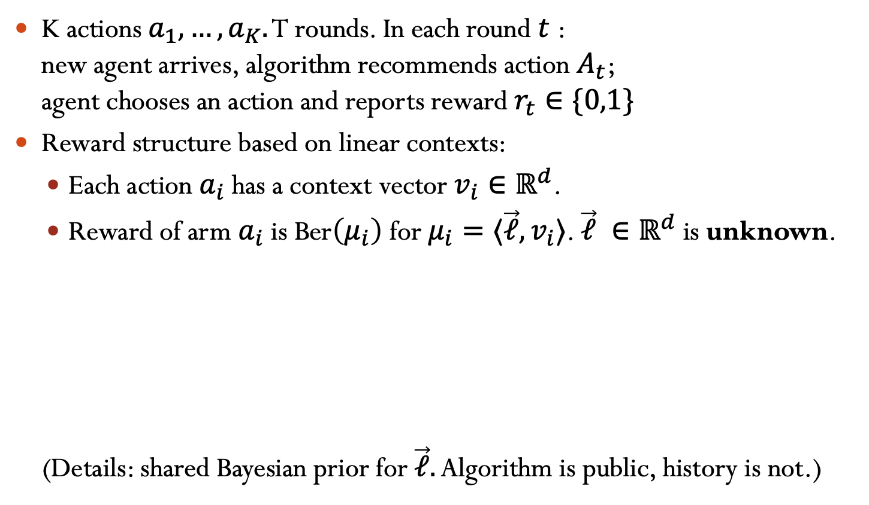
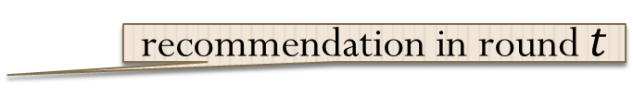
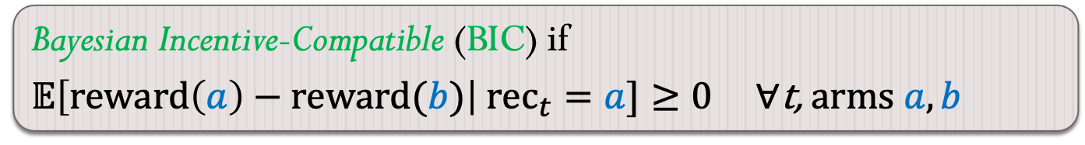
Model: incentivized exploration
K actions $a_{1},…,a_{K}.$ T rounds. In each round $t$ : new agent arrives, algorithm recommends action $A_{t}$; agent chooses an action and reports reward $r_{t}∈\{0,1\}$
Reward structure based on linear contexts:
Each action $a_{i}$ has a context vector $v_{i}∈ℝ^{d}$.
Reward of arm $a_{i}$ is Ber$\left(μ_{i}\right)$ for $μ_{i}=⟨\vec{ℓ},v_{i}⟩$. $\vec{ℓ} ∈ℝ^{d}$ is unknown.
(Details: shared Bayesian prior for $\vec{ℓ}.$ Algorithm is public, history is not.)
Agents follow recommendations ⇒ ordinary linear bandits
Bayesian Incentive-Compatible (BIC) if
$𝔼\left[reward\left(a\right)−reward(b)\right| rec_{t}=a]≥0$ $∀\text{t}\text{,} \text{arm}s a,b$
recommendation in round $t$

Slide 7
Prior work: IE via info asymmetry
Origin: Kremer, Mansour, Perry (EC13 & JPE’14): our model (without context) Che & Horner (`13 & QJE`18): (very) different model
Subsequent work Mansour, Syrgkanis, Slivkins (`15), Papanastasiou, Bimpikis, Savva (`15), Mansour, Syrgkanis, Slivkins, Wu (`16), Bahar, Smorodinsky, Tennenholtz (`16; `19), Immorlica, Mao, Slivkins, Wu (`19; `20), Cohen & Mansour (`19) Simchowitz & Slivkins (`21)
Algorithm design POV: benefits of the BIC property
Reduces need to think about game theory, equilibria
Ensures exploration will benefit every user (on average)

Slide 8
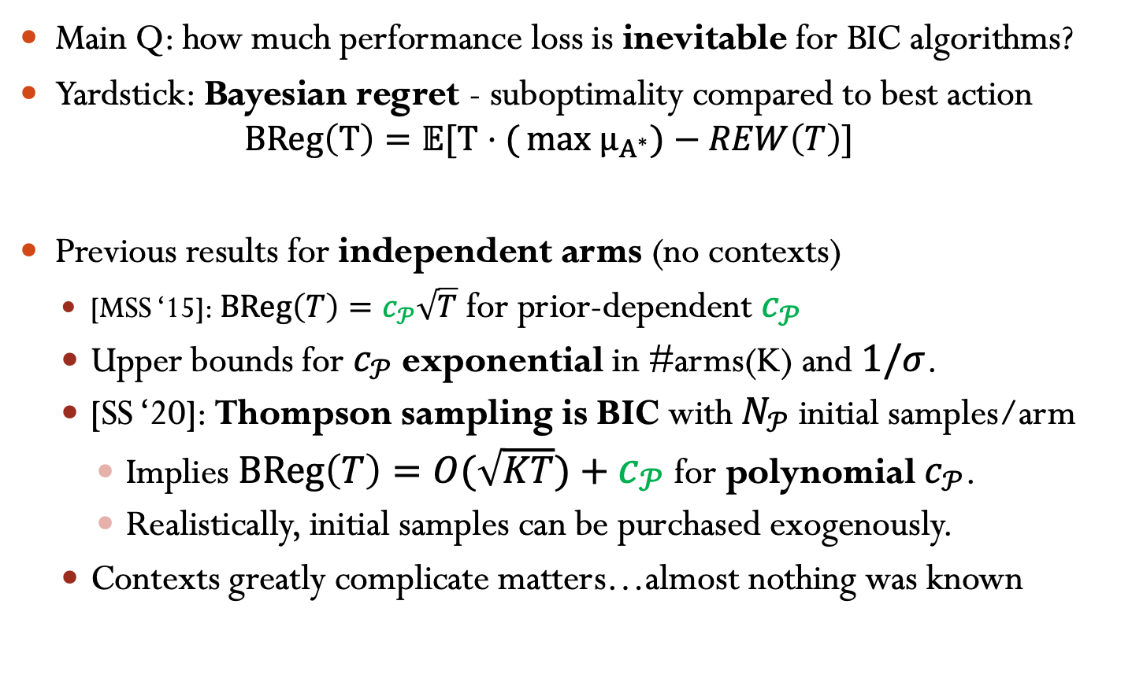
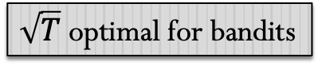
Price Of Incentives (PoI)
Main Q: how much performance loss is inevitable for BIC algorithms?
Yardstick: Bayesian regret - suboptimality compared to best action
$$BReg\left(T\right)=𝔼[T⋅({max μ_{A^{∗}}})−REW\left(T\right)]$$
Previous results for independent arms (no contexts)
[MSS ‘15]: $BReg\left(T\right)=c_{𝒫}\sqrt{T}$ for prior-dependent $c_{𝒫}$
Upper bounds for $c_{𝒫}$ exponential in #arms(K) and $1/σ$.
[SS ‘20]: Thompson sampling is BIC with $N_{𝒫}$initial samples/arm
Implies $BReg\left(T\right)=O(\sqrt{KT})+c_{𝒫}$ for polynomial $c_{𝒫}$.
Realistically, initial samples can be purchased exogenously.
Contexts greatly complicate matters…almost nothing was known
$\sqrt{T}$optimal for bandits

Slide 9
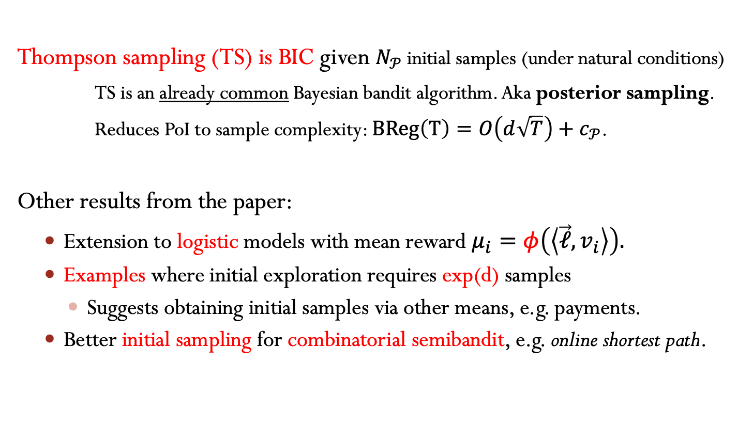
Main Result (Informally):
Thompson sampling (TS) is BIC given $N_{𝒫}$initial samples (under natural conditions)
TS is an already common Bayesian bandit algorithm. Aka posterior sampling.
Reduces PoI to sample complexity: $BReg\left(T\right)=O\left(d\sqrt{T}\right)+$ $c_{𝒫}$.
Other results from the paper:
Extension to logistic models with mean reward $μ_{i}=φ\left(\left\langle \vec{ℓ},v_{i}\right\rangle \right).$
Examples where initial exploration requires exp(d) samples
Suggests obtaining initial samples via other means, e.g. payments.
Better initial sampling for combinatorial semibandit, e.g. online shortest path.

Slide 10
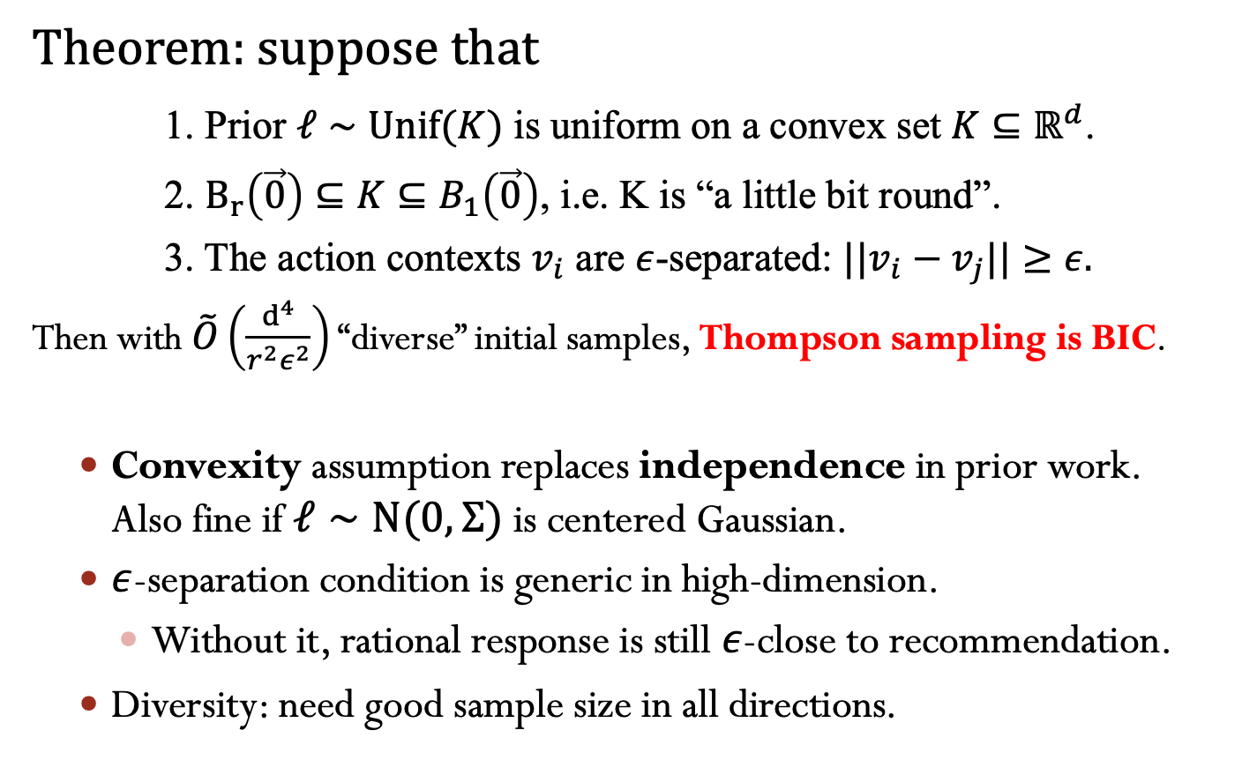
Main Result (formally)
Theorem: suppose that
1. Prior $ℓ∼Unif(K)$ is uniform on a convex set $K⊆ℝ^{d}$.
2. $B_{r}\left(\vec{0}\right)⊆K⊆B_{1}\left(\vec{0}\right)$, i.e. K is “a little bit round”.
3. The action contexts $v_{i}$ are $ε$-separated: $|{|v}_{i}−v_{j}||≥ε.$
Then with $\tilde{O}\left(\frac{d^{4}}{r^{2}ε^{2}}\right)$ “diverse” initial samples, Thompson sampling is BIC.
Convexity assumption replaces independence in prior work. Also fine if $ℓ∼N(0,Σ)$ is centered Gaussian.
$ε$-separation condition is generic in high-dimension.
Without it, rational response is still $ε$-close to recommendation.
Diversity: need good sample size in all directions.

