Slide 1
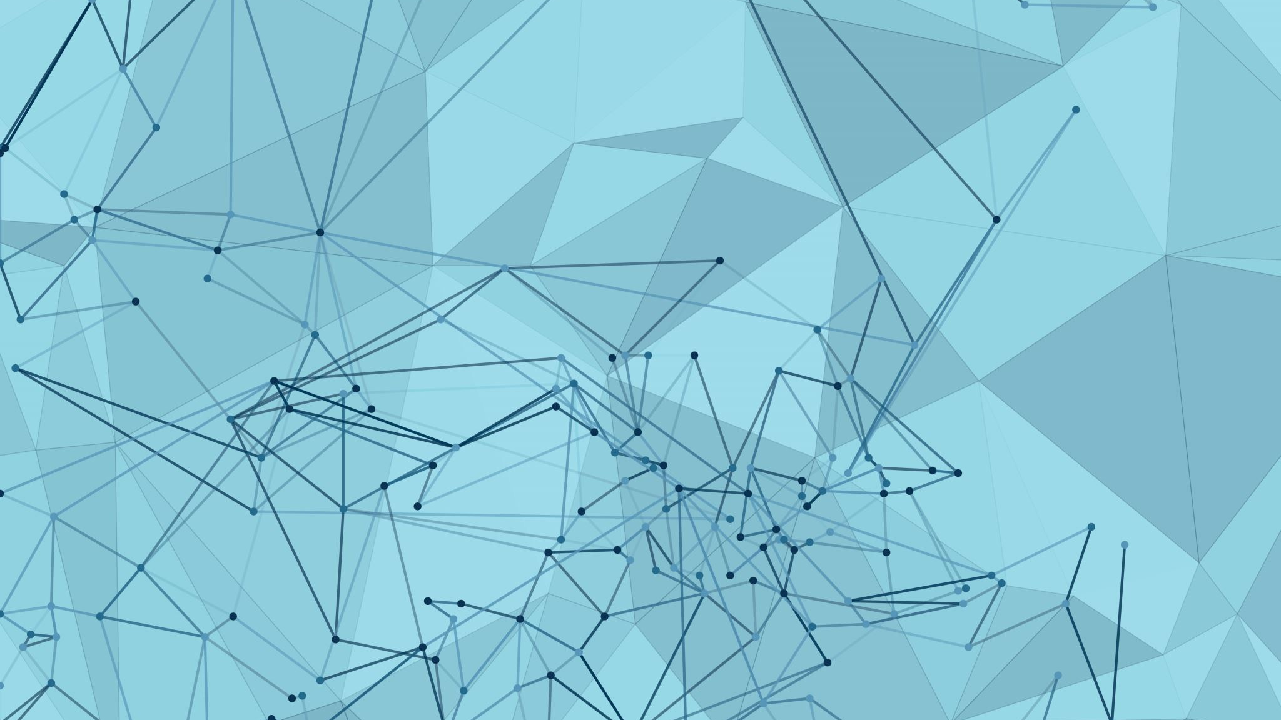
STAT 291
Random High-Dimensional Optimization: Landscapes and Algorithmic Barriers
Lecture 1: Introduction

Slide 2
Today’s Plan
1. Course Logistics
2. Overview of Random Landscapes

Slide 3
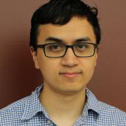
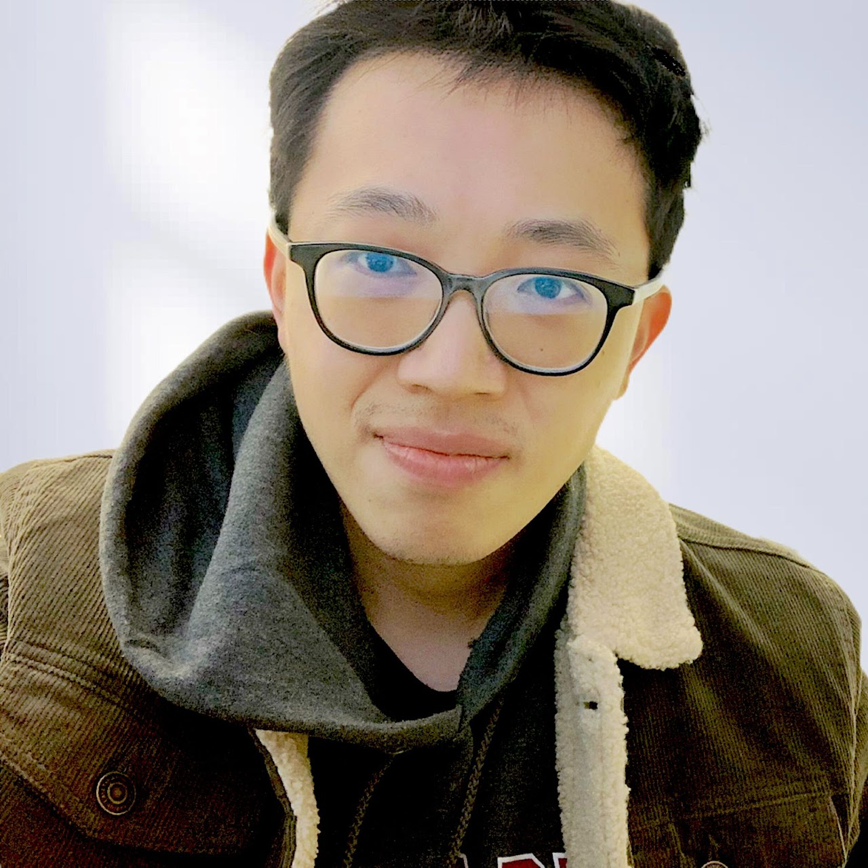
Course Staff and Meeting Times
Instructor: Mark Sellke (msellke@fas.harvard.edu)
Teaching Fellow: Yufan Li (yufan_li@g.harvard.edu)
Lectures: 10:30am-11:45am, TR, SC 309A
Office Hours and Section: fill out survey!
Optional: sign up for short 1-1 chat. Friday morning or next Wednesday afternoon (Jan 26/31)

Slide 4
Coursework
60%: Problem sets (3)
5%: Lecture scribing (2)
35%: Project (1)
0%: Exams (0)

Slide 5
Problem Sets
Three assignments, all due before spring break
HW1: solve 2/4 problems, due Feb 9
Extra credit: do more problems, e.g. ”extra credit problems”
Course survey at the end
1 late day for the semester

Slide 6
Scribing Signups
Scribe two lectures
Sign up sheet will be sent out this afternoon
First-come first serve, but schedule subject to change
Sign up for unclaimed days unless all are taken
Email notes to Yufan and me by the next morning
Latex template is on the course website

Slide 7
Course Project
Students will present their projects at the end of the term. Main options:
Write a survey of 1 or more papers
Conduct original research
List of suggested topics will be posted soon.
Other topics are permitted, just let us know.
Work in groups of 1-3. Choose a topic by end of February.

Slide 8
Pre-Requisites
Required: STAT 210, or a similar probability course
Helpful: concentration inequalities, high-dimensional probability, STAT 212 …
Some references are listed on the course website
Feel free to ask me if you are unsure
Complementary to STAT 217

Slide 9
Today’s Plan
1. Course Logistics
2. Overview of Random Landscapes
Random k-SAT
Random Perceptron
Spin glasses
Tensor PCA

Slide 10
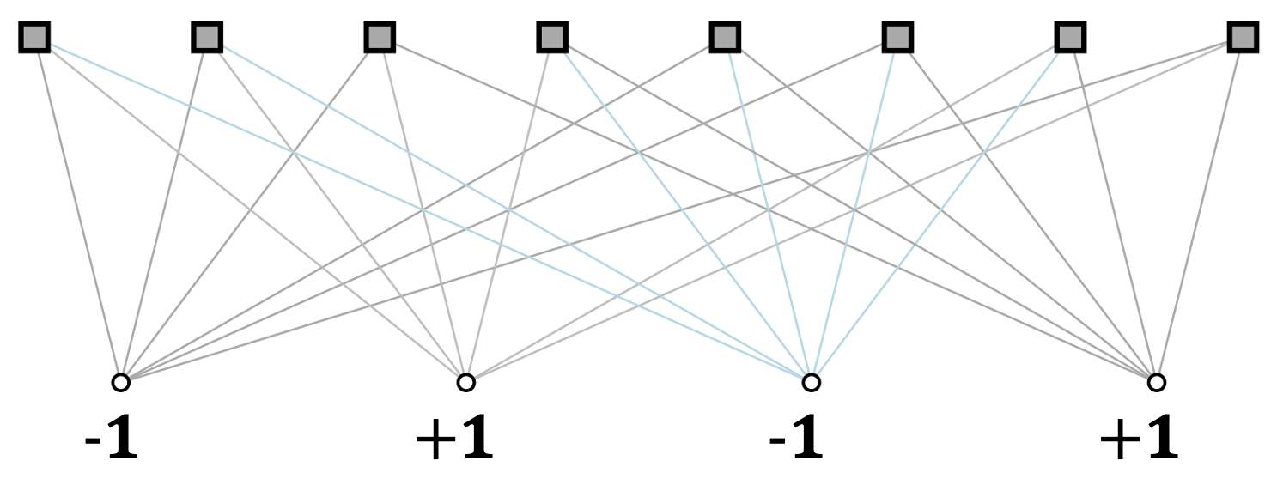





k-SAT
Canonical example of a constraint satisfaction problem (CSP)
M constraints (clauses) on N variables $x_{1},…,x_{N}∈\left\{±1\right\}≃\{T,F\}.$
k-SAT: k variables per clause in disjunctive (OR) form. E.g. k=4:
$$\left\{x_{3}∨\left(¬x_{7}\right)∨\left(¬x_{9}\right)∨x_{17}\right\}.$$
Solutions$(x_{1},…,x_{N})∈{\left\{±1\right\}}^{N}$ must satisfy every clause
For any fixed k≥3, k-SAT is NP-complete in the worst case
Max-Cut, Hamiltonian cycle, …
$$x_{1}$$
$$x_{2}$$
$$x_{3}$$
$$x_{4}$$

Slide 11
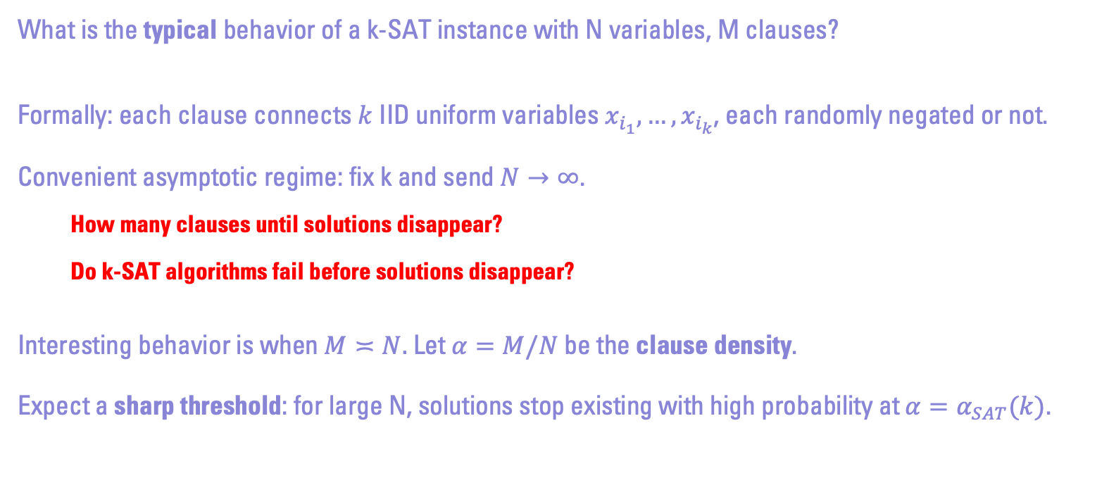
Random k-SAT
What is the typical behavior of a k-SAT instance with N variables, M clauses?
Formally: each clause connects $k$ IID uniform variables $x_{i_{1}},…,x_{i_{k}}$, each randomly negated or not.
Convenient asymptotic regime: fix k and send $N→∞$.
How many clauses until solutions disappear?
Do k-SAT algorithms fail before solutions disappear?
Interesting behavior is when $M≍N.$ Let $α=M/N$ be the clause density.
Expect a sharp threshold: for large N, solutions stop existing with high probability at ${α=α}_{SAT}(k)$.

Slide 12
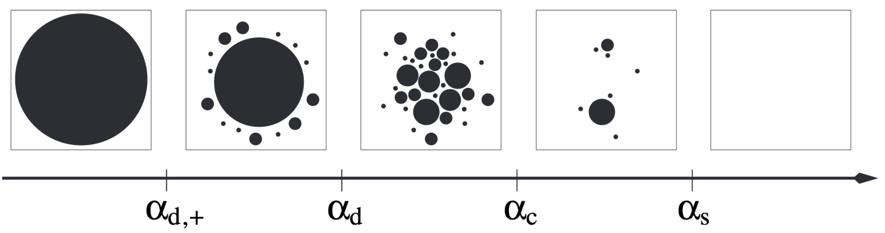
Solution Space of Random k-SAT
Strikingly, multiple structural phase transitions are predicted for the set of solutions:
(Clusters are defined with respect to Hamming distance.)
[Krzakala, Montanari, Ricci-Tersenghi, Zdeborova 2007]

Slide 13
Predicted Phases of Random k-SAT
Predicted phases of random k-SAT:
All solutions in 1 connected component
Most solutions in giant component, few solutions in other small clusters
Many tiny clusters, no giant component (“shattering”)
Many clusters, but the largest 100 contain 90% of solutions (“replica-symmetry breaking”)
No solutions
What do phase transitions mean for efficient k-SAT algorithms?
What if we want to sample a uniform solution?

Slide 14
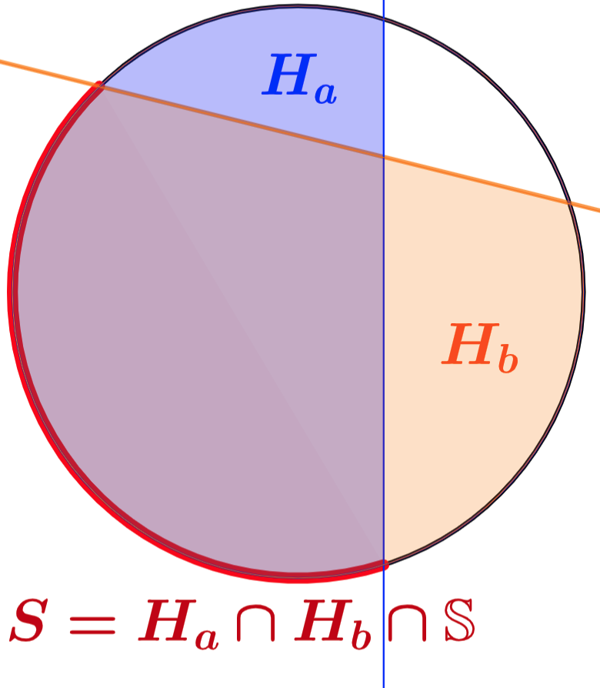

Random Perceptron
k-SAT is an emblematic sparse problem: k=O(1) variables/constraint.
Random perceptron is a dense analog
For $α>0$ and a margin $κ∈ℝ$, intersect $M=αN$ half-spaces:
$$H_{i}=\{σ:\left\langle σ,g_{i}\right\rangle ≥κ\sqrt{N}\} ∀ 1≤i≤M.$$
Here $g_{1},g_{2},…,g_{M}∼N\left(0,I_{N}\right)$ are IID Gaussian vectors.
Require $σ∈{\left\{±1\right\}}^{N}$ (Ising perceptron) or just $||σ||=\sqrt{N}$ (spherical)

Slide 15
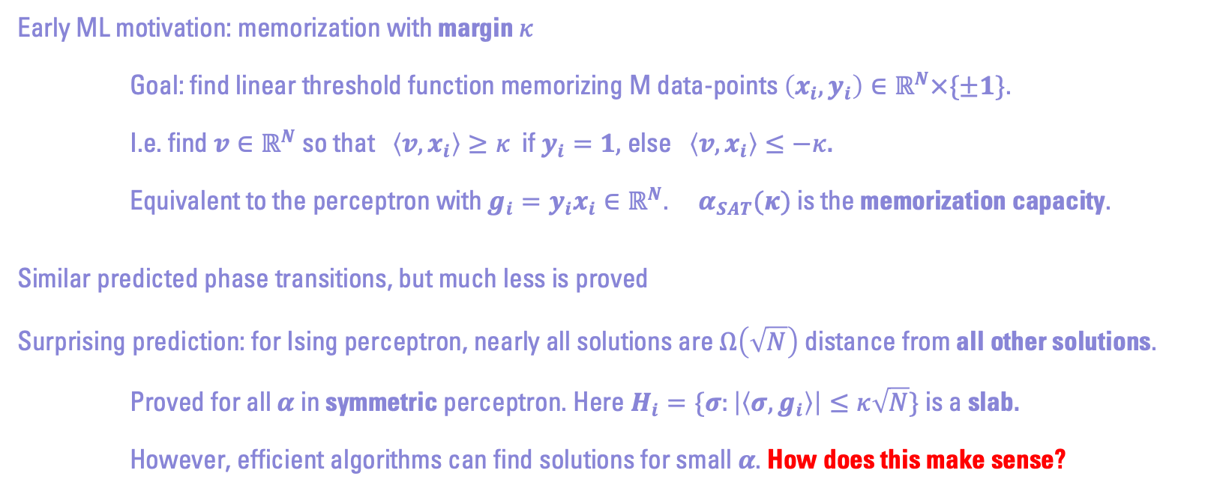
Motivation for Random Perceptron
Early ML motivation: memorization with margin $κ$
Goal: find linear threshold function memorizing M data-points $\left(x_{i},y_{i}\right)∈ℝ^{N}×\{±1\}$.
I.e. find $v∈ℝ^{N}$ so that $\left\langle v,x_{i}\right\rangle ≥κ$ if $y_{i}=1,$ else $\left\langle v,x_{i}\right\rangle ≤−κ$.
Equivalent to the perceptron with $g_{i}={y_{i}x}_{i}∈ℝ^{N}$. $α_{SAT}(κ)$ is the memorization capacity.
Similar predicted phase transitions, but much less is proved
Surprising prediction: for Ising perceptron, nearly all solutions are $Ω\left(\sqrt{N}\right)$ distance from all other solutions.
Proved for all $α$ in symmetric perceptron. Here $H_{i}=\{σ:\left|\left\langle σ,g_{i}\right\rangle \right|≤κ\sqrt{N}\}$ is a slab.
However, efficient algorithms can find solutions for small $α$. How does this make sense?

Slide 16
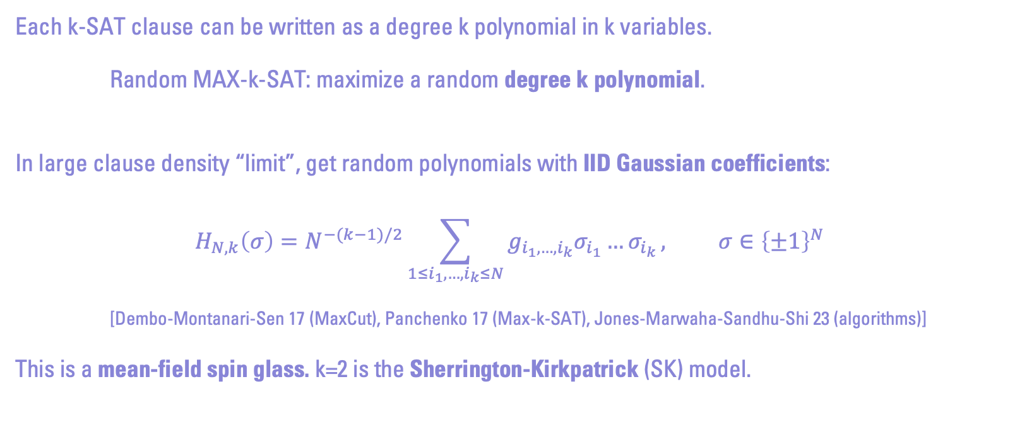
Mean-Field Spin Glasses
Each k-SAT clause can be written as a degree k polynomial in k variables.
Random MAX-k-SAT: maximize a random degree k polynomial.
In large clause density “limit”, get random polynomials with IID Gaussian coefficients:
$$H_{N,k}\left(σ\right)=N^{−(k−1)/2}\sum_{1≤i_{1},…,i_{k}≤N}{g_{i_{1},…,i_{k}}σ_{i_{1}}…σ_{i_{k}}}, σ∈{\left\{±1\right\}}^{N}$$
[Dembo-Montanari-Sen 17 (MaxCut), Panchenko 17 (Max-k-SAT), Jones-Marwaha-Sandhu-Shi 23 (algorithms)]
This is a mean-field spin glass. k=2 is the Sherrington-Kirkpatrick (SK) model.

Slide 17
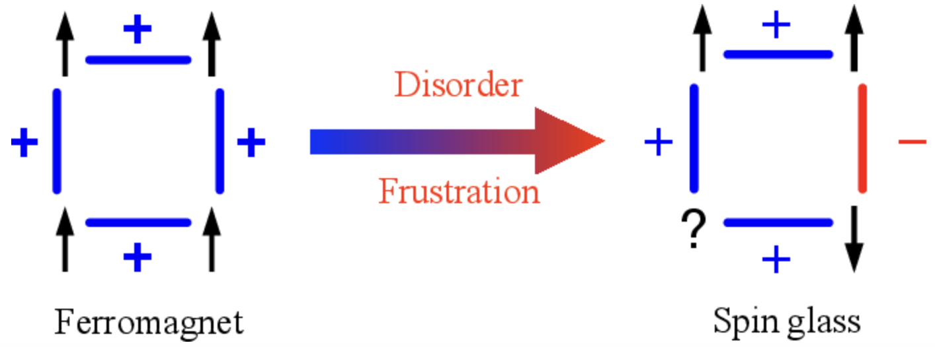
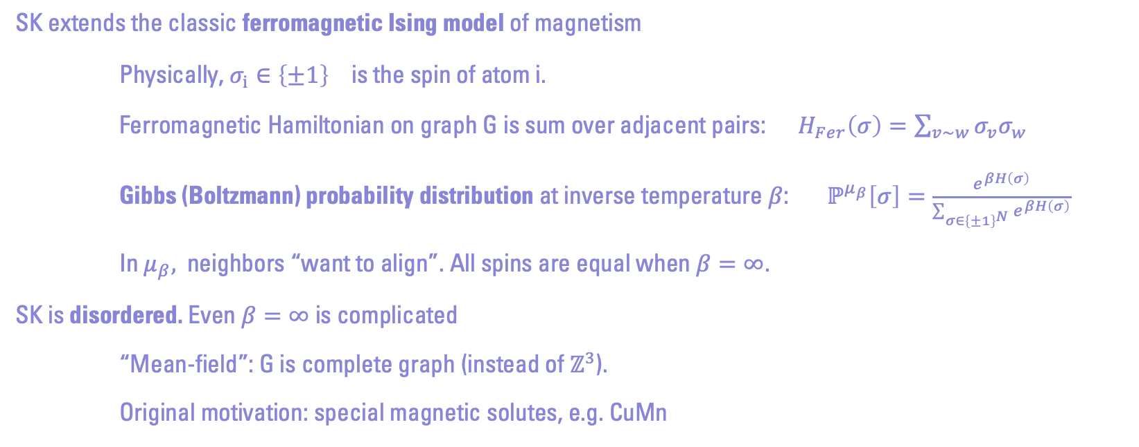
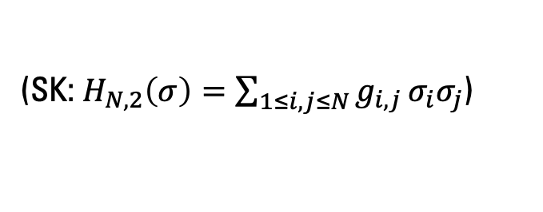
Classic Ising Models
(SK: $H_{N,2}\left(σ\right)=\sum_{1≤i,j≤N}{g_{i,j }σ_{i}σ_{j}}$)
SK extends the classic ferromagnetic Ising model of magnetism
Physically, $σ_{i}∈{\left\{±1\right\}}^{}$is the spin of atom i.
Ferromagnetic Hamiltonian on graph G is sum over adjacent pairs: $H_{Fer}\left(σ\right)=\sum_{v\sim w}{σ_{v}σ_{w}}$
Gibbs (Boltzmann) probability distribution at inverse temperature $β$: $ℙ^{μ_{β}}\left[σ\right]=\frac{e^{βH\left(σ\right)}}{\sum_{σ∈{\left\{±1\right\}}^{N}}{e^{βH\left(σ\right)}}}$
In $μ_{β},$neighbors “want to align”. All spins are equal when $β=∞$.
SK is disordered. Even $β=∞$ is complicated
“Mean-field”: G is complete graph (instead of $ℤ^{3}$).
Original motivation: special magnetic solutes, e.g. CuMn

Slide 18
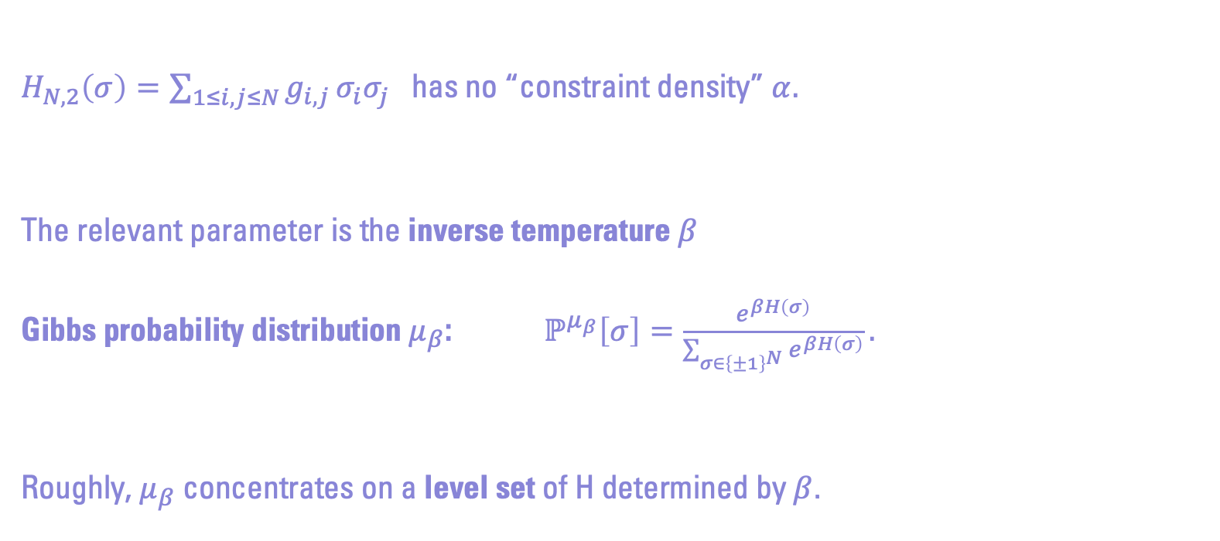
Where is the Phase Transition?
$H_{N,2}\left(σ\right)=\sum_{1≤i,j≤N}{g_{i,j }σ_{i}σ_{j}}$ has no “constraint density” $α.$
The relevant parameter is the inverse temperature $β$
Gibbs probability distribution $μ_{β}$: $ℙ^{μ_{β}}\left[σ\right]=\frac{e^{βH\left(σ\right)}}{\sum_{σ∈{\left\{±1\right\}}^{N}}{e^{βH\left(σ\right)}}}.$
Roughly, $μ_{β}$ concentrates on a level set of H determined by $β$.

Slide 19





Phase Transitions in a Spin Glass
Analogous diagram in $β$:
$$β=0$$
$$β_{d,+}$$
$$β_{d}$$
$$β_{c}$$

Slide 20
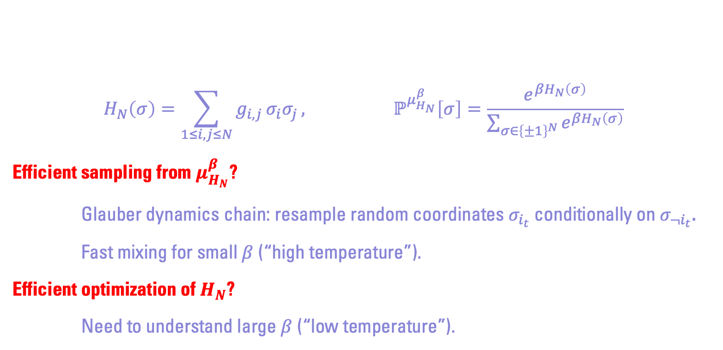
Algorithmic Questions
$$H_{N}\left(σ\right)=\sum_{1≤i,j≤N}{g_{i,j }σ_{i}σ_{j}}, ℙ^{μ_{H_{N}}^{β}}\left[σ\right]=\frac{e^{βH_{N}\left(σ\right)}}{\sum_{σ∈{\left\{±1\right\}}^{N}}{e^{βH_{N}\left(σ\right)}}}$$
Efficient sampling from $μ_{H_{N}}^{β}$?
Glauber dynamics chain: resample random coordinates $σ_{i_{t}}$ conditionally on $σ_{¬i_{t}}$.
Fast mixing for small $β$ (“high temperature”).
Efficient optimization of $H_{N}$?
Need to understand large $β$ (“low temperature”).

Slide 21
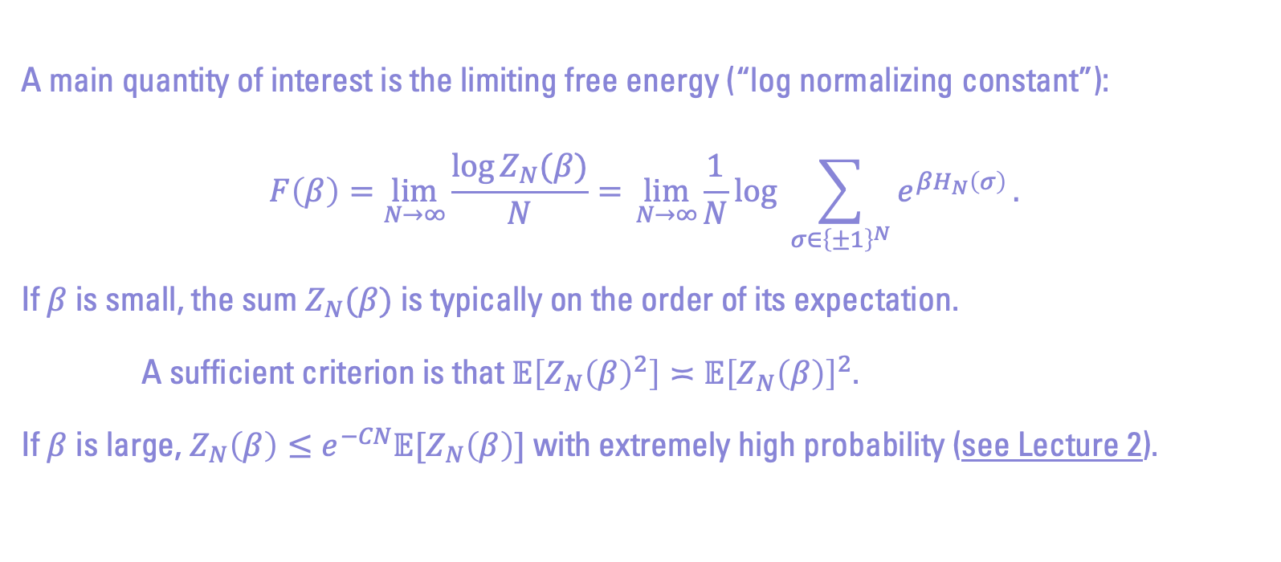
A Bit on Free Energies
A main quantity of interest is the limiting free energy (“log normalizing constant”):
$$F\left(β\right)=\lim_{N→∞}{\frac{\log{Z_{N}(β)}}{N}=} \lim_{N→∞}{\frac{1}{N}\log{\sum_{σ∈{\left\{±1\right\}}^{N}}{e^{βH_{N}\left(σ\right)}}}}.$$
If$β$ is small, the sum $Z_{N}(β)$ is typically on the order of its expectation.
A sufficient criterion is that $𝔼\left[Z_{N}{\left(β\right)}^{2}\right]≍𝔼{\left[Z_{N}\left(β\right)\right]}^{2}$.
If $β$ is large, $Z_{N}\left(β\right)≤e^{−CN}𝔼[Z_{N}\left(β\right)]$ with extremely high probability (see Lecture 2).

Slide 22
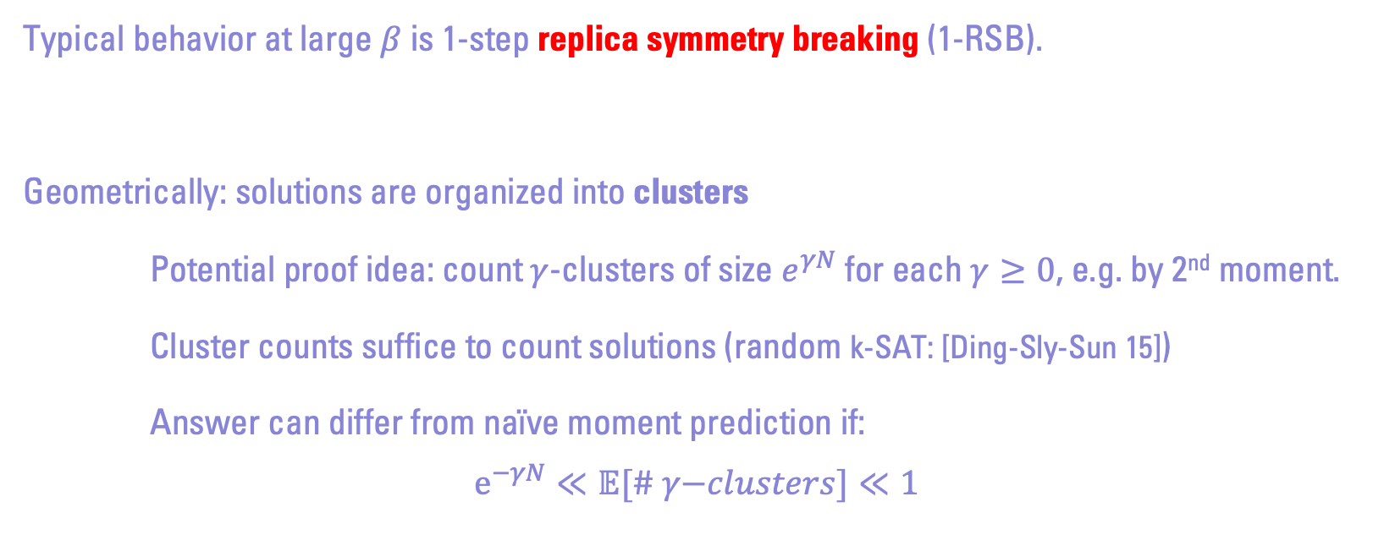
1-RSB Clustering
Typical behavior at large $β$is 1-step replica symmetry breaking (1-RSB).
Geometrically: solutions are organized into clusters
Potential proof idea: count $γ$-clusters of size $e^{γN}$ for each $γ≥0$, e.g. by 2nd moment.
Cluster counts suffice to count solutions (random k-SAT: [Ding-Sly-Sun 15])
Answer can differ from naïve moment prediction if:
$$e^{−γN}≪𝔼[\# γ\text{−}clusters]≪1$$

Slide 23
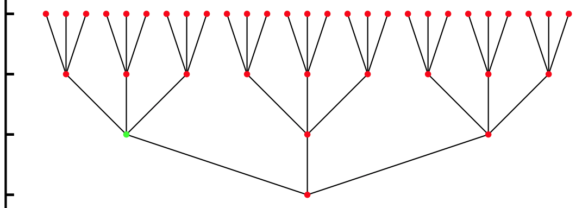
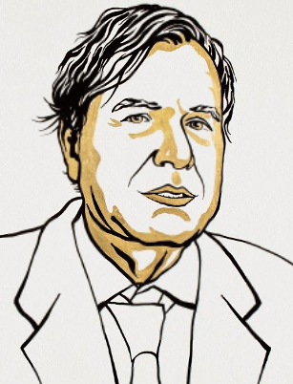

General RSB Ansatz
Other models like SK can have 2-RSB (clusters within clusters), 3-RSB, … even infinite (“full”) RSB.
General formula due to Parisi (1980). Prominently cited in 2021 Nobel Prize.
Parisi formula proved in celebrated work of Talagrand (2006).
Solution
Cluster
Cluste$r^{2}$
…

Slide 24
Today’s Plan
1. Course Logistics
2. Overview of Random Landscapes
Random k-SAT
Random Perceptron
Spherical spin glasses
Tensor PCA

Slide 25
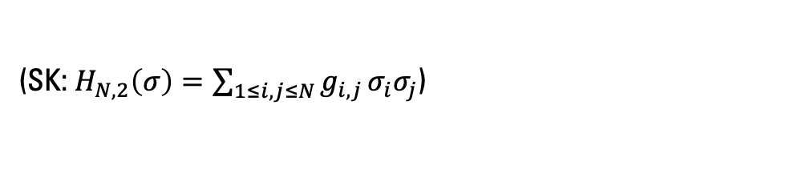
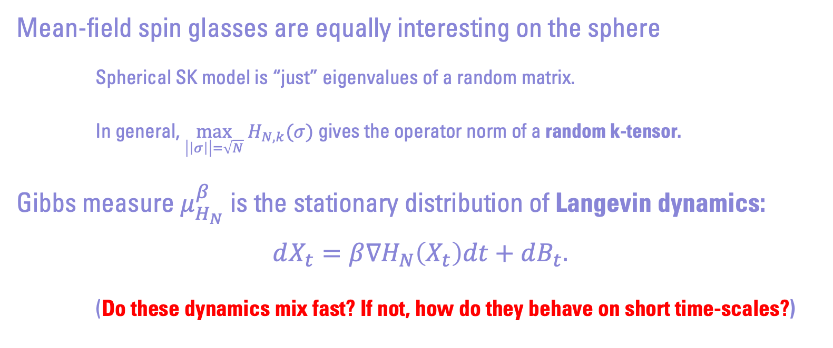
Spherical Spin Glasses
(SK: $H_{N,2}\left(σ\right)=\sum_{1≤i,j≤N}{g_{i,j }σ_{i}σ_{j}}$)
Mean-field spin glasses are equally interesting on the sphere
Spherical SK model is “just” eigenvalues of a random matrix.
In general, $\max_{\left|\left|σ\right|\right|=\sqrt{N}} H_{N,k}(σ)$ gives the operator norm of a random k-tensor.
Gibbs measure $μ_{H_{N}}^{β}$ is the stationary distribution of Langevin dynamics:
$$dX_{t}=β∇H_{N}\left(X_{t}\right)dt+dB_{t}.$$
(Do these dynamics mix fast? If not, how do they behave on short time-scales?)

Slide 26
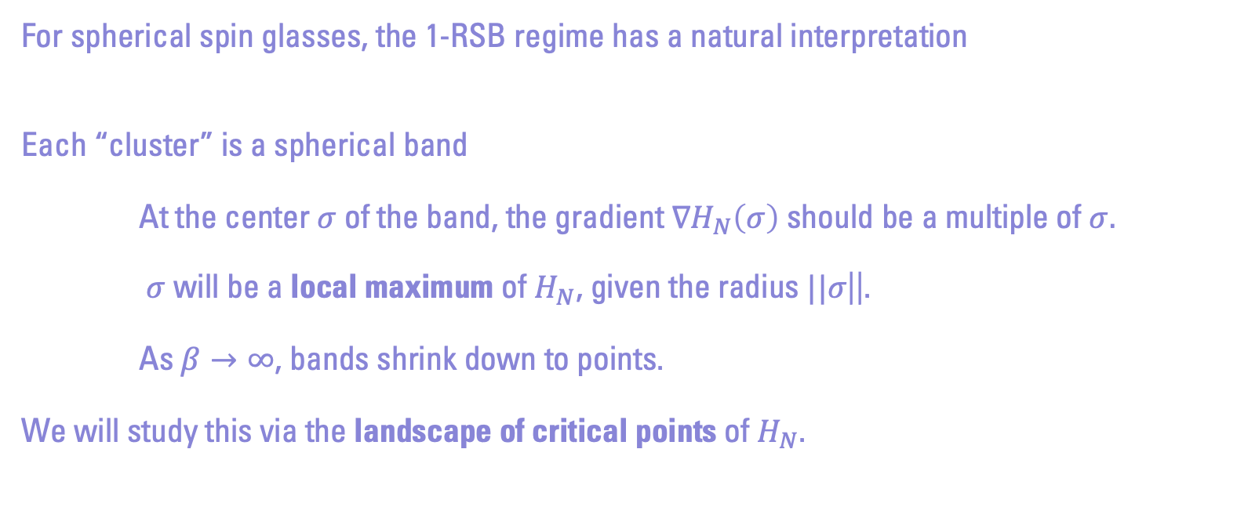
1-RSB Clusters on the Sphere
For spherical spin glasses, the 1-RSB regime has a natural interpretation
Each “cluster” is a spherical band
At the center $σ$ of the band, the gradient $∇H_{N}\left(σ\right)$ should be a multiple of $σ.$
$σ$ will be a local maximum of $H_{N}$, given the radius $||σ$||.
As $β→∞$, bands shrink down to points.
We will study this via the landscape of critical points of $H_{N}$.

Slide 27
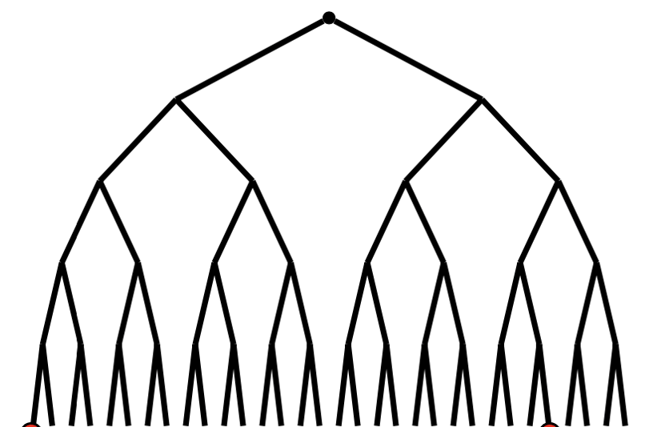
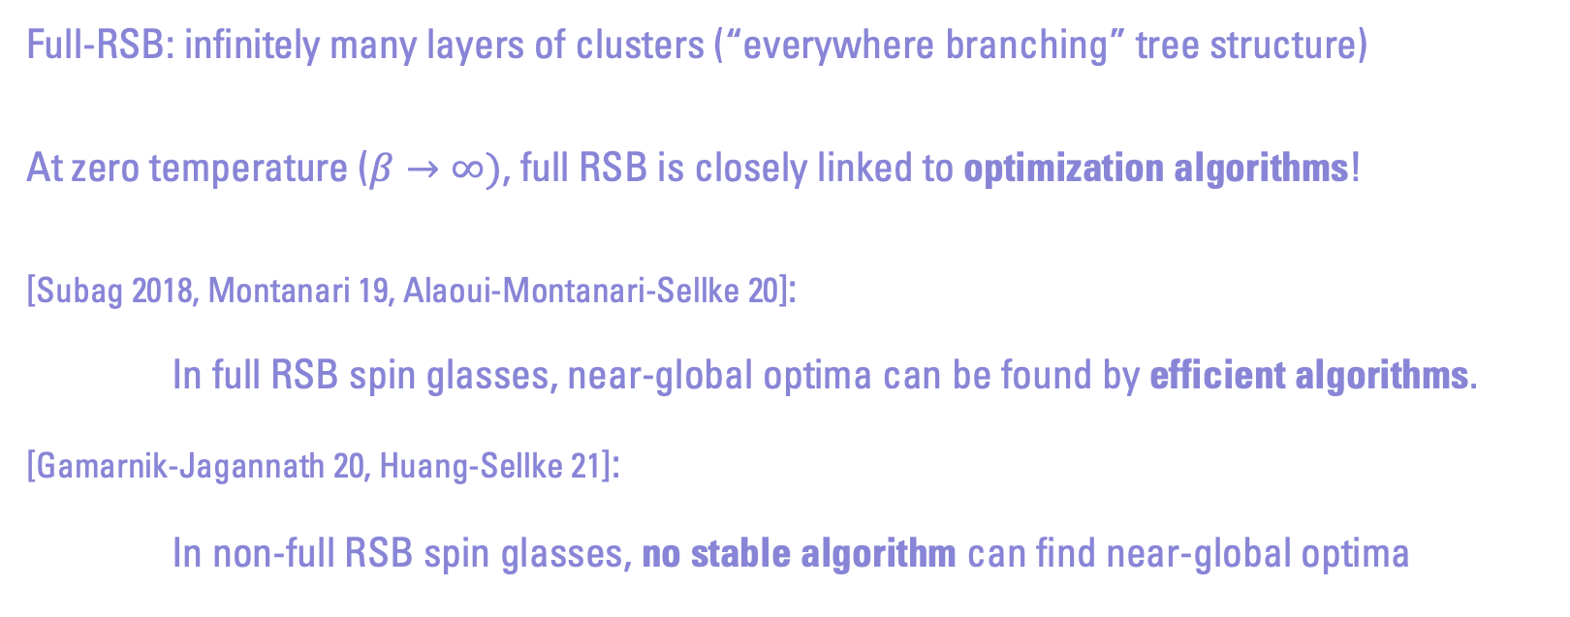
Full-RSB
Full-RSB: infinitely many layers of clusters (“everywhere branching” tree structure)
At zero temperature ($β→∞)$, full RSB is closely linked to optimization algorithms!
[Subag 2018, Montanari 19, Alaoui-Montanari-Sellke 20]:
In full RSB spin glasses, near-global optima can be found by efficient algorithms.
[Gamarnik-Jagannath 20, Huang-Sellke 21]:
In non-full RSB spin glasses, no stable algorithm can find near-global optima

Slide 28
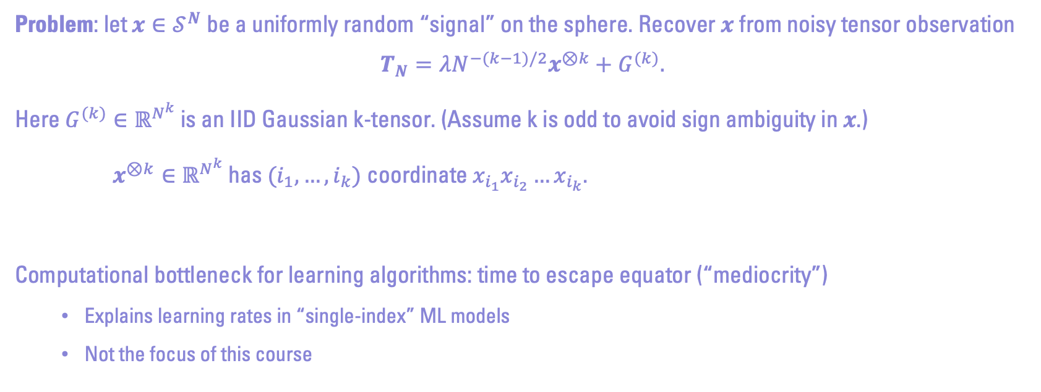
Tensor Principle Component Analysis
Problem: let $x∈𝒮^{N}$ be a uniformly random “signal” on the sphere. Recover $x$ from noisy tensor observation
$$T_{N}=λN^{−(k−1)/2}x^{⊗k}+G^{(k)}.$$
Here $G^{(k)}∈ℝ^{N^{k}}$ is an IID Gaussian k-tensor. (Assume k is odd to avoid sign ambiguity in $x$.)
$x^{⊗k}∈ℝ^{N^{k}}$ has $(i_{1},…,i_{k})$ coordinate $x_{i_{1}}x_{i_{2}}…x_{i_{k}}$.
Computational bottleneck for learning algorithms: time to escape equator (“mediocrity”)
Explains learning rates in “single-index” ML models
Not the focus of this course

Slide 29
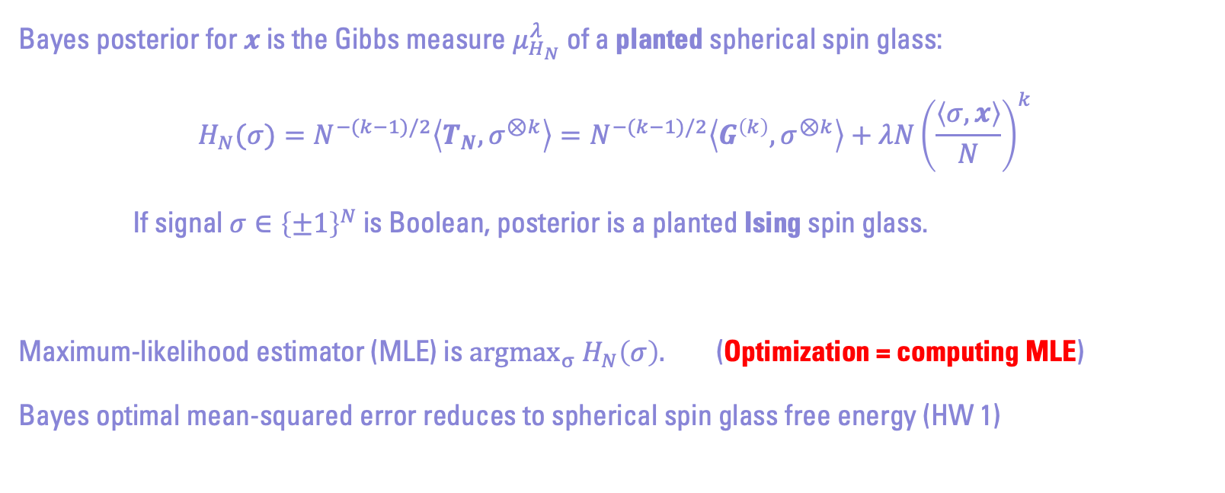
Tensor PCA and Spherical Spin Glasses
Bayes posterior for $x$ is the Gibbs measure $μ_{H_{N}}^{λ}$ of a planted spherical spin glass:
$$H_{N}(σ)=N^{−(k−1)/2}\left\langle T_{N},σ^{⊗k}\right\rangle =N^{−(k−1)/2}\left\langle G^{\left(k\right)},σ^{⊗k}\right\rangle +λN{\left(\frac{\left\langle σ,x\right\rangle }{N}\right)}^{k}$$
If signal${σ∈\left\{±1\right\}}^{N}$ is Boolean, posterior is a planted Ising spin glass.
Maximum-likelihood estimator (MLE) is ${argmax_{σ} H}_{N}\left(σ\right).$ (Optimization = computing MLE)
Bayes optimal mean-squared error reduces to spherical spin glass free energy (HW 1)

Slide 30
Plan for Future Classes
Lectures will focus on spherical spin glasses (or tensor PCA)
Well understood mathematically, clean formulas, several proof techniques available
Emphasis on geometric & algorithmic phenomena
Homework will touch on other models: k-SAT, perceptron,…
Tools: concentration, critical point counting, interpolation, “high-dimensional thinking”
We will NOT use: replica heuristics, approximate message passing, cavity method (see STAT 217)
Final lecture in April: proof outline of the spherical Parisi formula, using methods from class

Slide 31
Today’s Plan
1. Course Logistics
2. Overview of Random Landscapes
3. Bonus: Random XOR-SAT

Slide 32
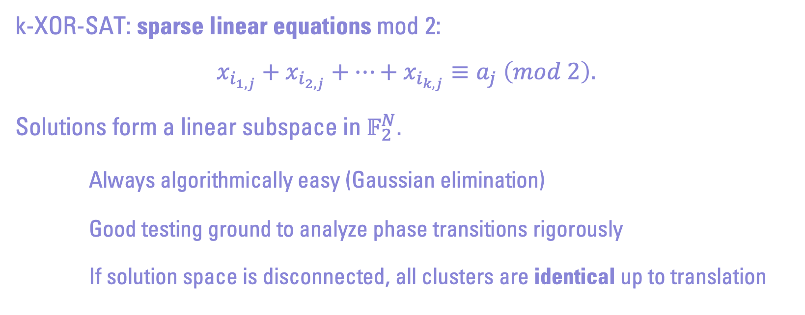
Random XOR-SAT
k-XOR-SAT: sparse linear equations mod 2:
$$x_{i_{1,j}}+x_{i_{2,j}}+…+x_{i_{k,j}}≡a_{j} \left(mod 2\right).$$
Solutions form a linear subspace in $𝔽_{2}^{N}$.
Always algorithmically easy (Gaussian elimination)
Good testing ground to analyze phase transitions rigorously
If solution space is disconnected, all clusters are identical up to translation

Slide 33
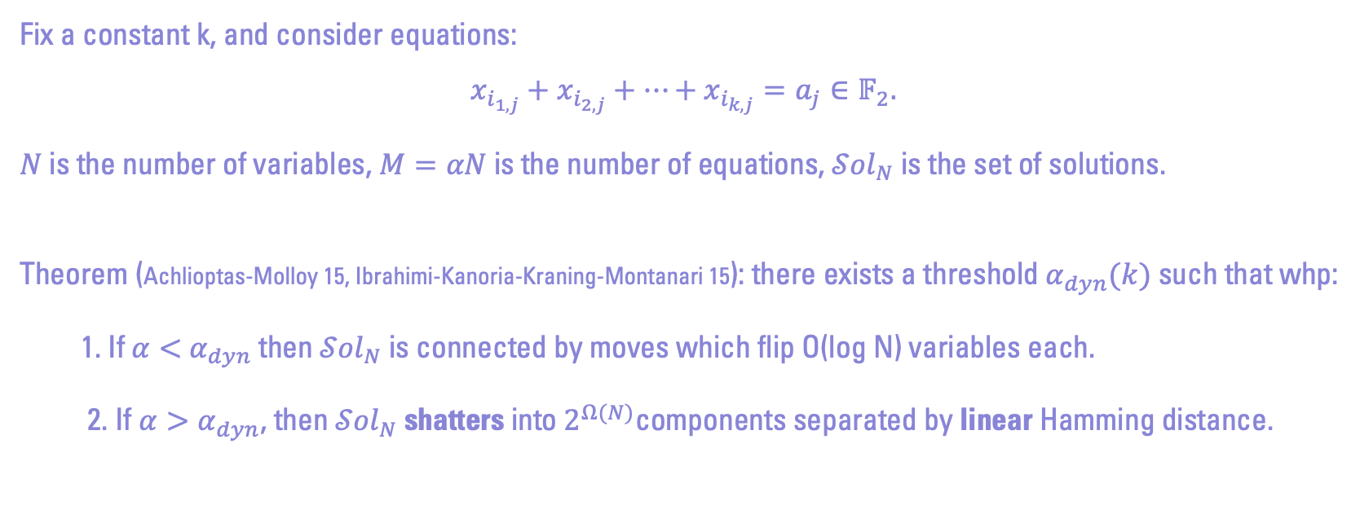
Random XOR-SAT
Fix a constant k, and consider equations:
$$x_{i_{1,j}}+x_{i_{2,j}}+…+x_{i_{k,j}}=a_{j}∈𝔽_{2}.$$
$N$ is the number of variables, $M=αN$ is the number of equations, ${𝒮ol}_{N}$ is the set of solutions.
Theorem (Achlioptas-Molloy 15, Ibrahimi-Kanoria-Kraning-Montanari 15): there exists a threshold $α_{dyn}(k)$ such that whp:
1. If $α<$ $α_{dyn}$ then ${𝒮ol}_{N}$is connected by moves which flip O(log N) variables each.
2. If $α>α_{dyn}$, then ${𝒮ol}_{N}$shatters into $2^{Ω(N)}$components separated by linear Hamming distance.

Slide 34
The 2-Core of Random XOR-SAT

Slide 35
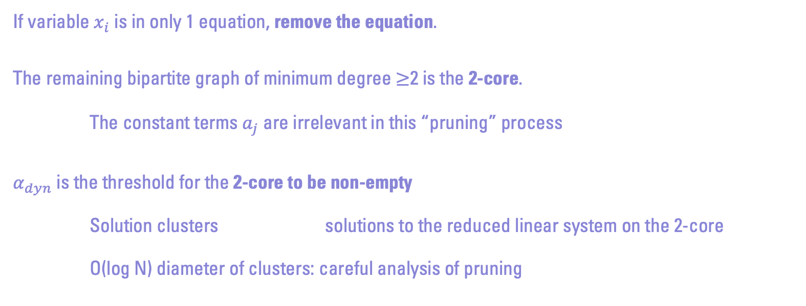
Solutions from the 2-Core
If variable $x_{i}$ is in only 1 equation, remove the equation.
The remaining bipartite graph of minimum degree ≥2 is the 2-core.
The constant terms $a_{j}$ are irrelevant in this “pruning” process
$α_{dyn}$ is the threshold for the 2-core to be non-empty
Solution clusters solutions to the reduced linear system on the 2-core
O(log N) diameter of clusters: careful analysis of pruning

Slide 36
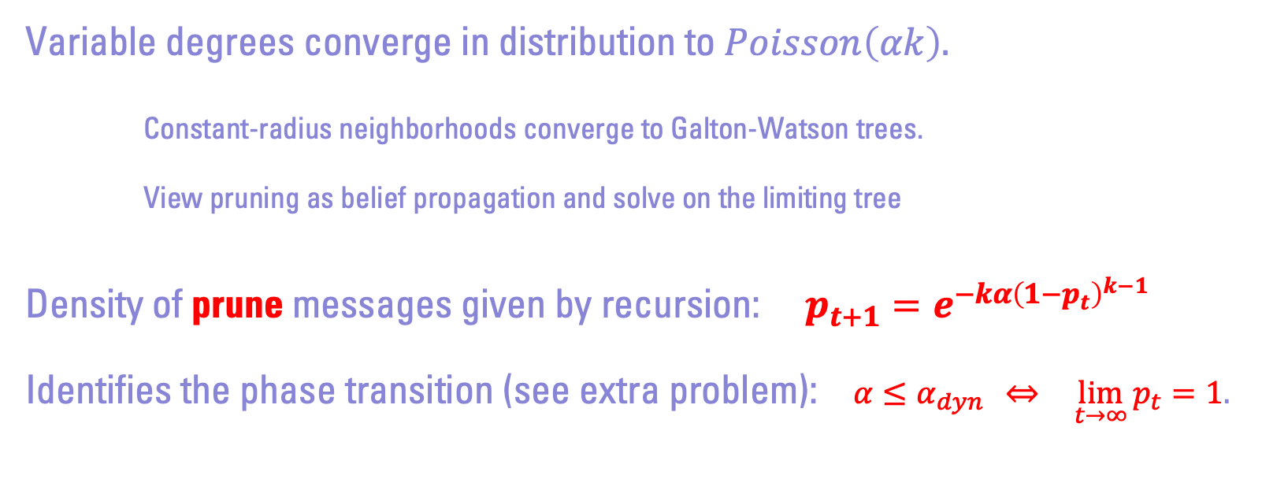
Analysis of 2-Core Pruning
Variable degrees converge in distribution to $Poisson\left(αk\right).$
Constant-radius neighborhoods converge to Galton-Watson trees.
View pruning as belief propagation and solve on the limiting tree
Density of prune messages given by recursion: $p_{t+1}=e^{−kα{\left(1−p_{t}\right)}^{k−1}}$
Identifies the phase transition (see extra problem): $α≤α_{dyn} \text{⇔} \lim_{t→∞}{p_{t}}=1.$

Slide 37
End of First Class!
Sign up later today for:
Scribing (2 lectures)
Short 1-1 meeting on Jan 26 or 31 (optional)
Next class (Jan 25): free energies, 1st and 2nd moments

