Slide 1
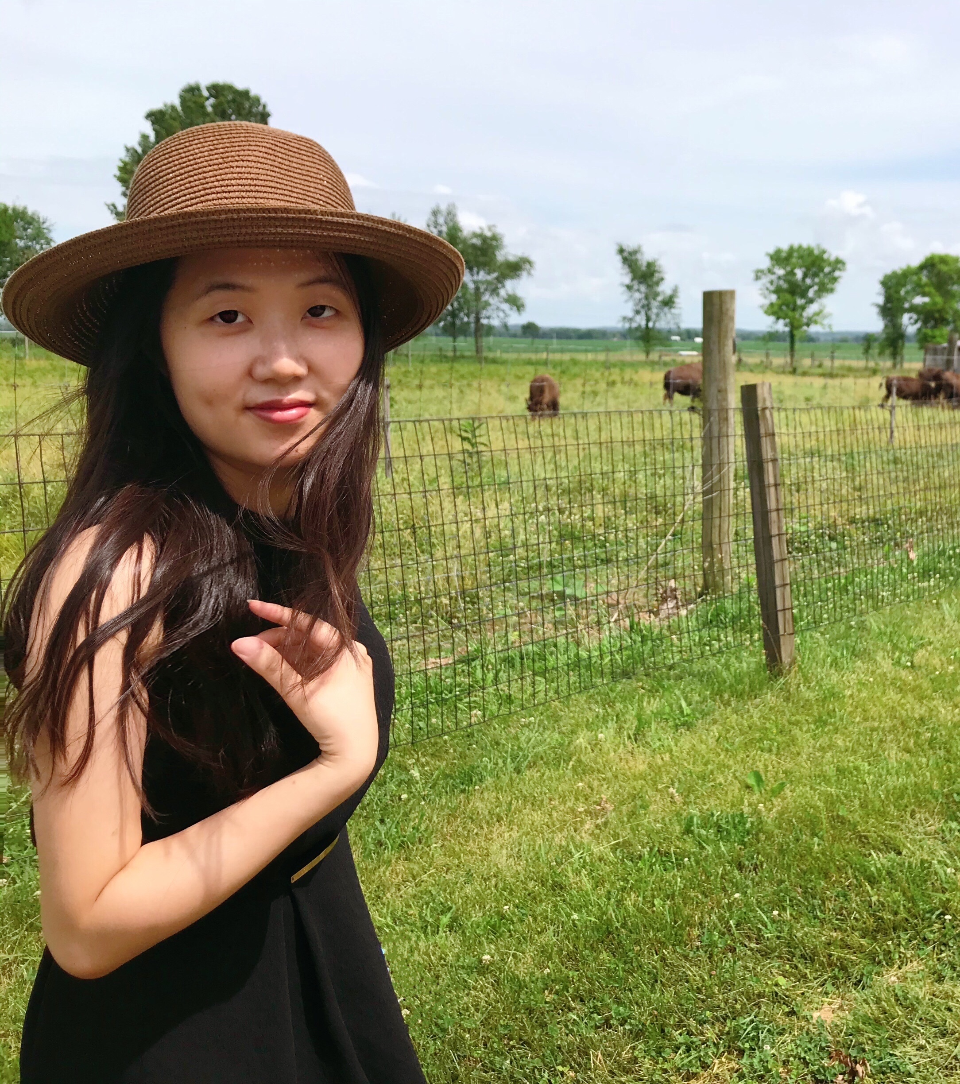
Asymptotically Optimal Pure Exploration for Infinite-Armed Bandits
Mark Sellke (Harvard)
JOINT Work with Evelyn Xiao-Yue Gong (CMU)

Slide 2
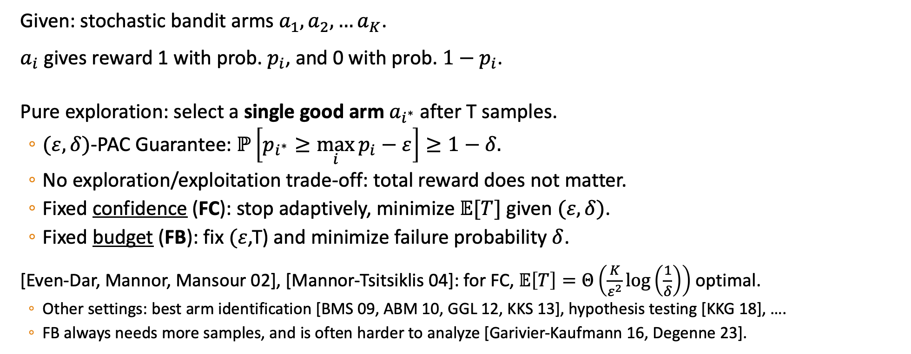
Pure Exploration for K-Armed Bandits
Given: stochastic bandit arms $a_{1},a_{2},…a_{K}$.
$a_{i}$ gives reward 1 with prob. $p_{i}$, and 0 with prob. $1−p_{i}$.
Pure exploration: select a single good arm $a_{i^{∗}}$ after T samples.
  $(ε,δ)$-PAC Guarantee: $ℙ\left[p_{i^{∗}}≥\max_{i}{p_{i}}−ε\right]≥1−δ.$
  No exploration/exploitation trade-off: total reward does not matter.
  Fixed confidence (FC): stop adaptively, minimize $𝔼[T]$ given $(ε,δ)$.
  Fixed budget (FB): fix $(ε$,T) and minimize failure probability $δ$.
[Even-Dar, Mannor, Mansour 02], [Mannor-Tsitsiklis 04]: for FC, $𝔼\left[T\right]=Θ\left(\frac{K}{ε^{2}}\log\left(\frac{1}{δ}\right)\right)$ optimal.
  Other settings: best arm identification [BMS 09, ABM 10, GGL 12, KKS 13], hypothesis testing [KKG 18], ….
  FB always needs more samples, and is often harder to analyze [Garivier-Kaufmann 16, Degenne 23].

Slide 3
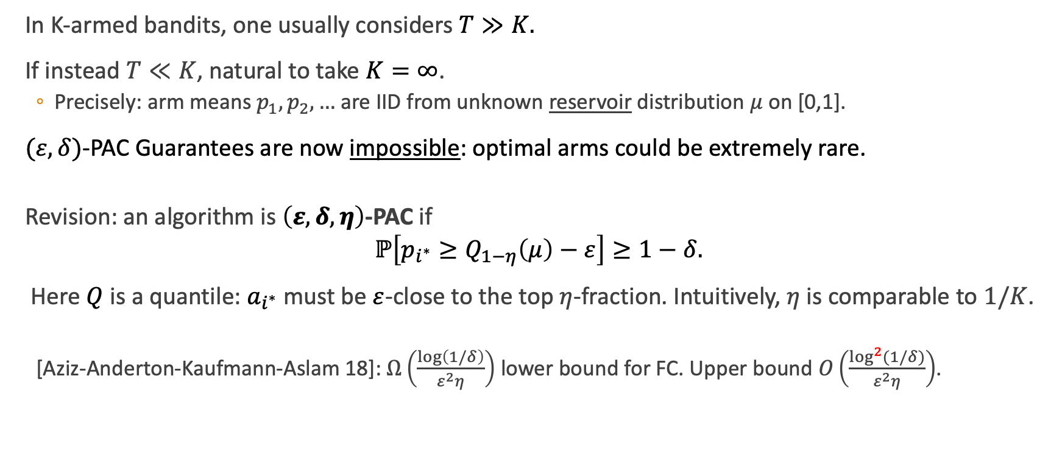
Pure Exploration for Infinite Armed Bandits
In K-armed bandits, one usually considers $T≫K.$
If instead $T≪K$, natural to take $K=∞$.
  Precisely: arm means $p_{1},p_{2},…$ are IID from unknown reservoir distribution $μ$ on [0,1].
$(ε,δ)$-PAC Guarantees are now impossible: optimal arms could be extremely rare.
Revision: an algorithm is $\left(ε,δ,η\right)$-PAC if
$$ℙ\left[p_{i^{∗}}≥Q_{1−η}\left(μ\right)−ε\right]≥1−δ.$$
Here $Q$ is a quantile: $a_{i^{∗}}$ must be $ε$-close to the top $η$-fraction. Intuitively, $η$ is comparable to $1/K$.
  [Aziz-Anderton-Kaufmann-Aslam 18]: $Ω\left(\frac{\log\left(1/δ\right)}{ε^{2}η}\right)$ lower bound for FC. Upper bound $O\left(\frac{\log^{2}{(1/δ)}}{ε^{2}η}\right)$.

Slide 4
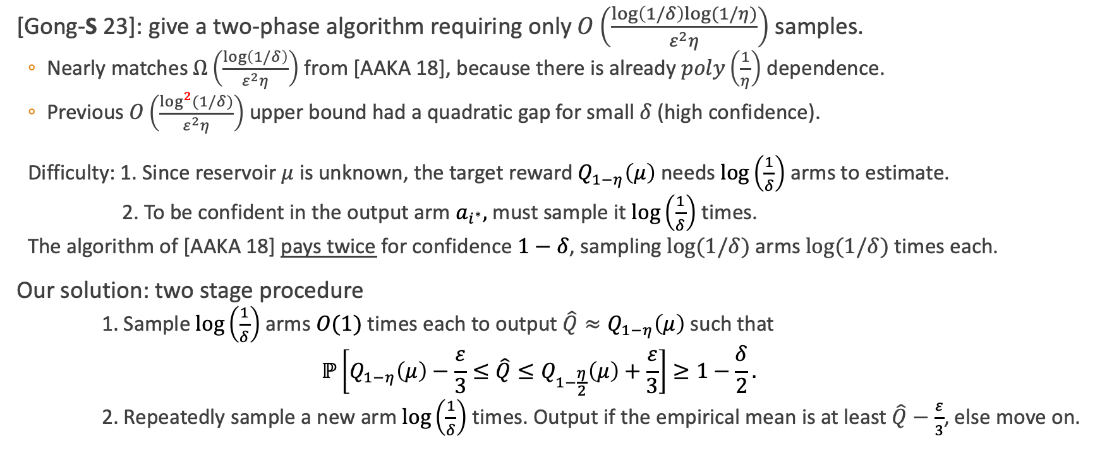
New Results: Fixed Confidence
[Gong-S 23]: give a two-phase algorithm requiring only$O\left(\frac{\log\left(1/δ\right)log⁡(1/η)}{ε^{2}η}\right)$ samples.
  Nearly matches $Ω\left(\frac{\log\left(1/δ\right)}{ε^{2}η}\right)$ from [AAKA 18], because there is already $poly\left(\frac{1}{η}\right)$ dependence.
  Previous $O\left(\frac{\log^{2}{(1/δ)}}{ε^{2}η}\right)$ upper bound had a quadratic gap for small $δ$ (high confidence).
  Difficulty: 1. Since reservoir $μ$ is unknown, the target reward $Q_{1−η}\left(μ\right)$ needs $\log\left(\frac{1}{δ}\right)$ arms to estimate.
  2. To be confident in the output arm $a_{i^{∗}},$ must sample it $\log\left(\frac{1}{δ}\right)$ times.
  The algorithm of [AAKA 18] pays twice for confidence $1−δ$, sampling $log⁡(1/δ)$ arms $log⁡(1/δ)$ times each.
Our solution: two stage procedure
  1. Sample $\log\left(\frac{1}{δ}\right)$ arms $O(1)$ times each to output $\hat{Q}≈Q_{1−η}\left(μ\right)$ such that
  $$ℙ\left[Q_{1−η}\left(μ\right)−\frac{ε}{3}≤\hat{Q}≤Q_{1−\frac{η}{2}}\left(μ\right)+\frac{ε}{3}\right]≥1−\frac{δ}{2}.$$
  2. Repeatedly sample a new arm $\log\left(\frac{1}{δ}\right)$ times. Output if the empirical mean is at least $\hat{Q}−\frac{ε}{3}$, else move on.

Slide 5
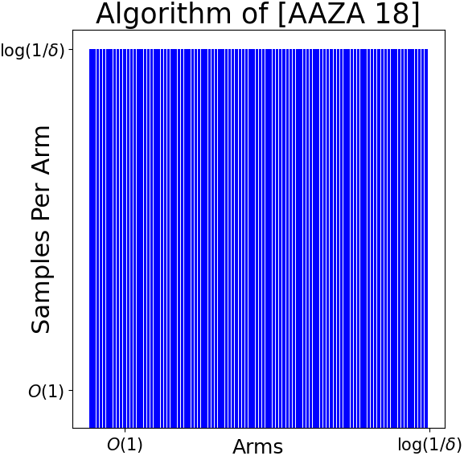
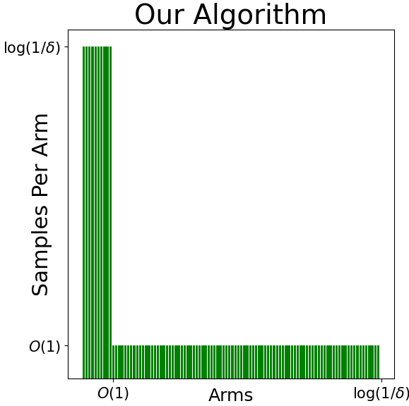
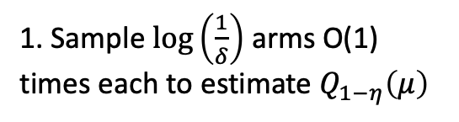
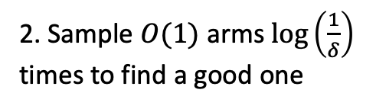
Improved Sample Complexity, Illustrated
2. Sample $O(1)$ arms $\log\left(\frac{1}{δ}\right)$
times to find a good one
1. Sample $\log\left(\frac{1}{δ}\right)$ arms O(1) times each to estimate $Q_{1−η}\left(μ\right)$

Slide 6
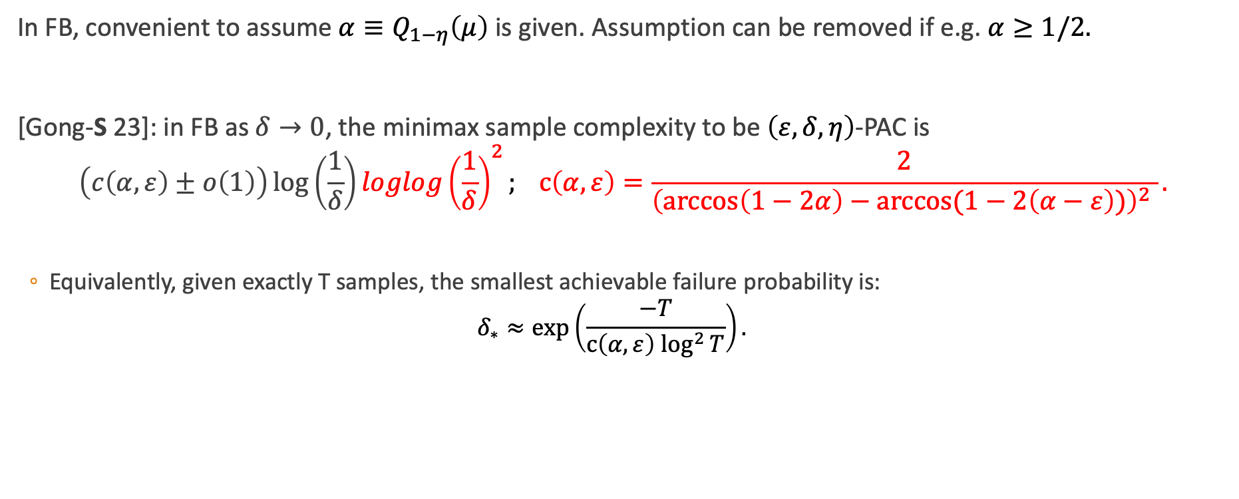
New Result: Fixed Budget
In FB, convenient to assume ${α≡Q}_{1−η}\left(μ\right)$ is given. Assumption can be removed if e.g. $α≥1/2.$
[Gong-S 23]: in FB as $δ→0$, the minimax sample complexity to be $\left(ε,δ,η\right)$-PAC is
$$\left(c\left(α,ε\right)±o\left(1\right)\right)\log\left(\frac{1}{δ}\right)loglog{\left(\frac{1}{δ}\right)}^{2}; c\left(α,ε\right)=\frac{2}{{\left(\arccos\left(1−2α\right)−arccos⁡(1−2\left(α−ε\right))\right)}^{2} }.$$
  Equivalently, given exactly T samples, the smallest achievable failure probability is:
  $$δ_{∗}≈\exp\left(\frac{−T}{{c\left(α,ε\right) log}^{2}{T}}\right).$$

Slide 7
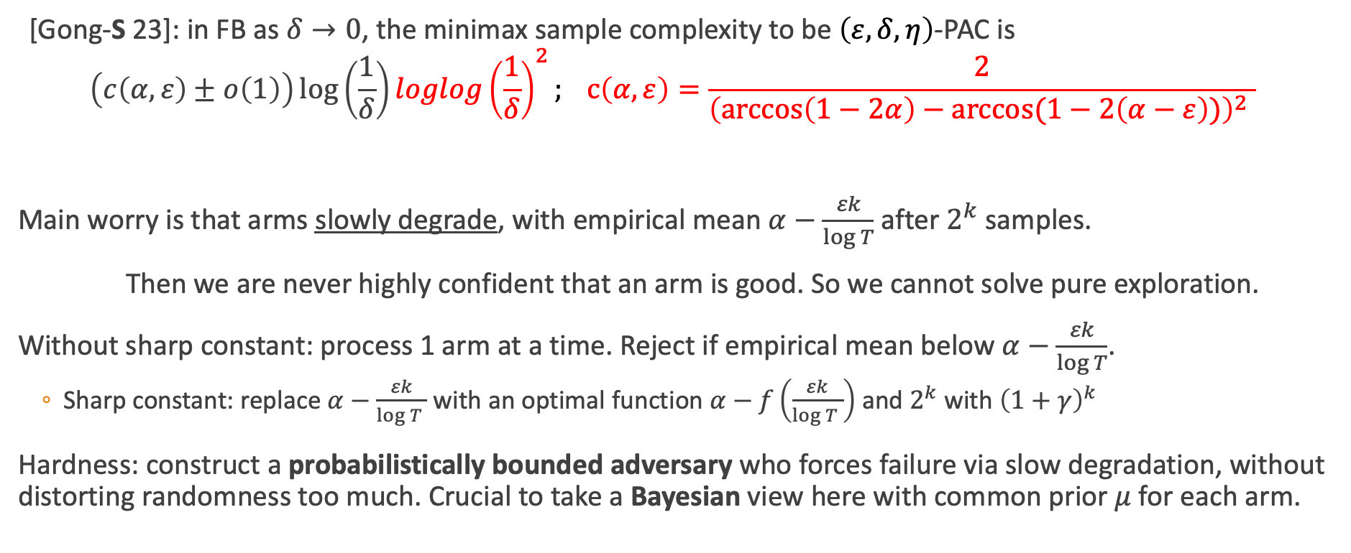
A Few Proof Elements
[Gong-S 23]: in FB as $δ→0$, the minimax sample complexity to be $\left(ε,δ,η\right)$-PAC is
$$\left(c\left(α,ε\right)±o\left(1\right)\right)\log\left(\frac{1}{δ}\right)loglog{\left(\frac{1}{δ}\right)}^{2}; c\left(α,ε\right)=\frac{2}{{\left(\arccos\left(1−2α\right)−arccos⁡(1−2\left(α−ε\right))\right)}^{2} }$$
Main worry is that arms slowly degrade, with empirical mean $α−\frac{εk}{\log{T}}$ after $2^{k}$ samples.
Then we are never highly confident that an arm is good. So we cannot solve pure exploration.
Without sharp constant: process 1 arm at a time. Reject if empirical mean below $α−\frac{εk}{\log{T}}$.
  Sharp constant: replace $α−\frac{εk}{\log{T }}$ with an optimal function $α−f\left(\frac{εk}{\log{T }}\right)$ and${ 2}^{k}$ with ${\left(1+γ\right)}^{k}$
Hardness: construct a probabilistically bounded adversary who forces failure via slow degradation, without distorting randomness too much. Crucial to take a Bayesian view here with common prior $μ$ for each arm.

