Slide 1

Towards Automated
Venture Capital Screening
Author: Mark Shelton
Supervisors: Melinda Hodkiewicz, Tim French
Program: Bachelor of Philosophy (Honours)
Date: 01 June 2017

Slide 2
Background
Venture Capital & Startups

Slide 3









Superannuation Funds
Venture Capital Firms
Startups
Notes:
How does VC funding work? 3-8 year fund lifecycle
NVCA - $50bn in 2015
AVCAL - $232m in 2016

Slide 4

Number of Startups
Profitability / Value Created
UBER FOR CUPCAKES
Pre-Seed
Seed
Series A
Series B
Series C
Series D+
Developmental Stage / Time
Notes:
So why did those companies get VC funding?
Well, they startups are only the tip of the iceberg.

Slide 5
!
!
!
Many investment opportunities
Little information available
Low chance of success
Notes:
Silicon Valley – 20,000 startups

Slide 6
Can we make life easier for VC firms so they can help more startups succeed?

Slide 7

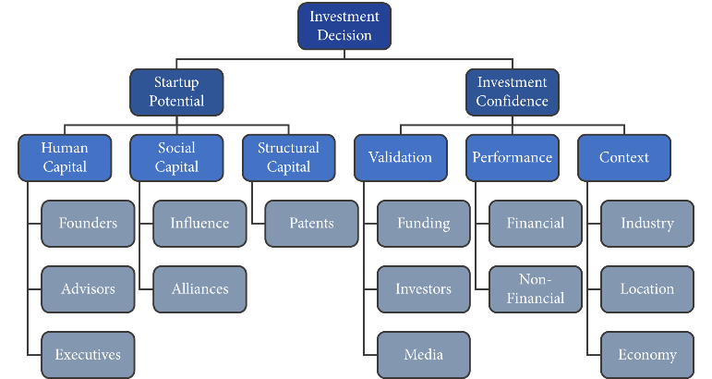
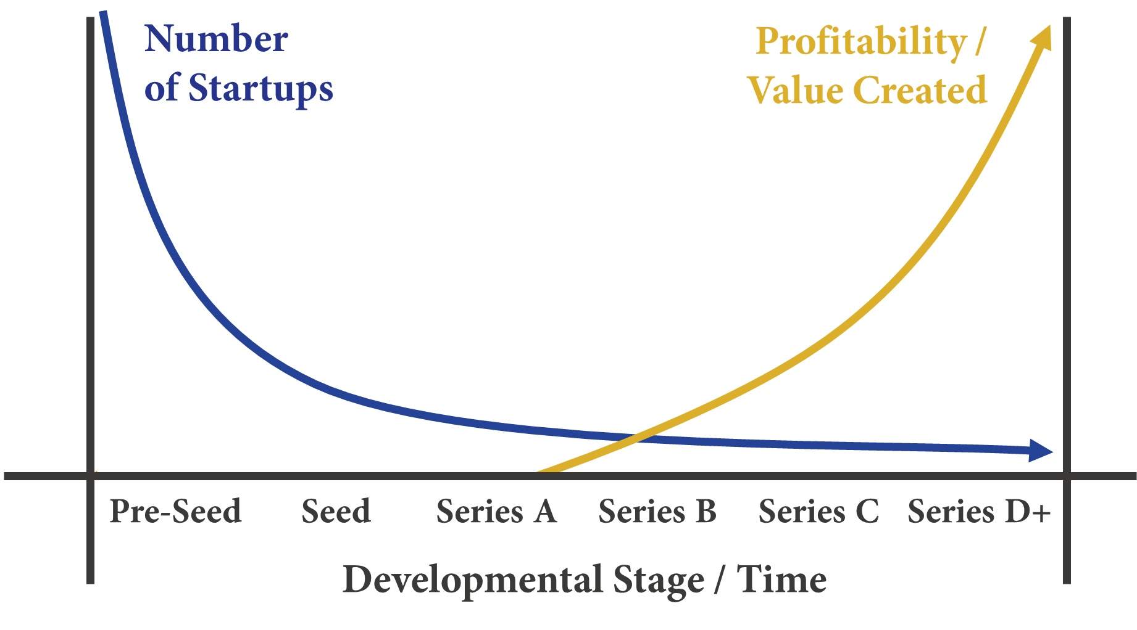
Limitations of techniques in the literature
Small Sample Size
Early-Stage Focus
Narrow Feature Set
Notes:
Small Sample Size – Case Studies, interviews
Early-stage focus – Stone (2014) (UCL) early-stage not possible
Narrow feature set – Xiang (2012) Media coverage features

Slide 8
Investment screening system criteria
Practicality
Minimal user input, saves effort and time
Processes new data in a timely fashion
Robustness
Minimal variance in predictions over time
Adapts to changing data sources over time
Versatility
Highly configurable

Slide 9
This seminar is organised as follows:
0. Background
1. System Design
2. System Performance
3. Model Evaluation
4. Conclusions

Slide 10
System Design

Slide 11
400,000+ Companies
150+ Hyperparameter Combinations
400+ Company Features
7 Classification Algorithms
6 Developmental Stages
5 Target Outcomes
Datasets From 2012-2017
2-4 Year Forecasts

Slide 12
Input
Process
Output
1.
Collect Data
Master Database
2. Prepare Dataset
CrunchBase
Model
PatentsView
3.
Create Pipelines
Dataset
5.
Fit & Predict
System
Configuration
Predictions
Scored Pipelines
4.
Select Pipeline
Best Pipeline

Slide 13
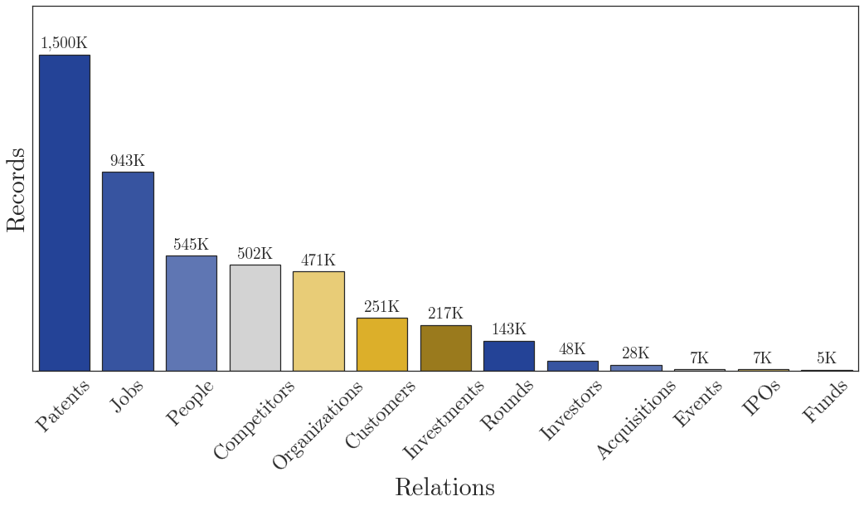


Design: Data Collection
6.555M
Notes:
Data Collection

Slide 14
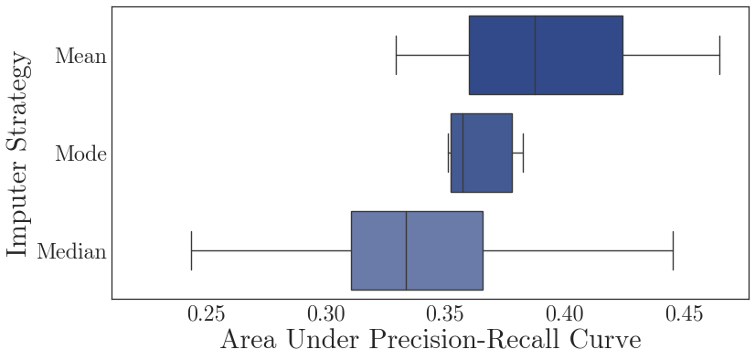
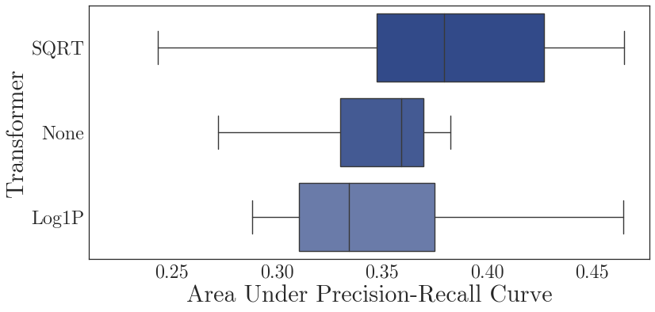
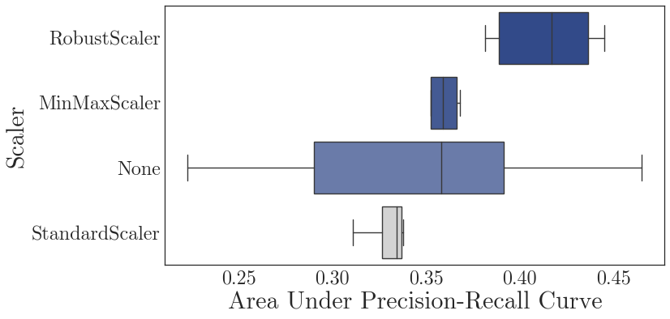
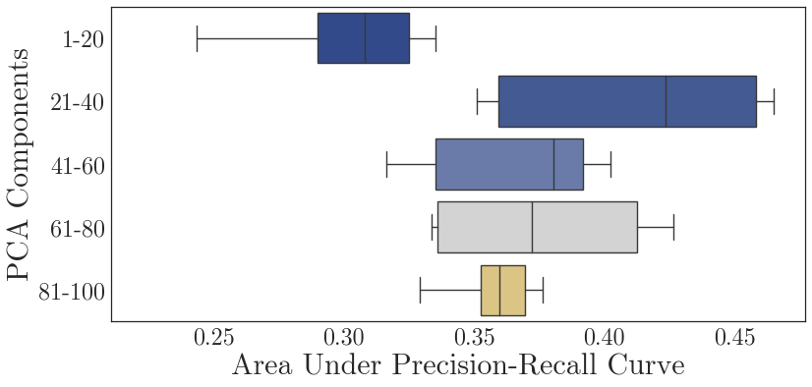
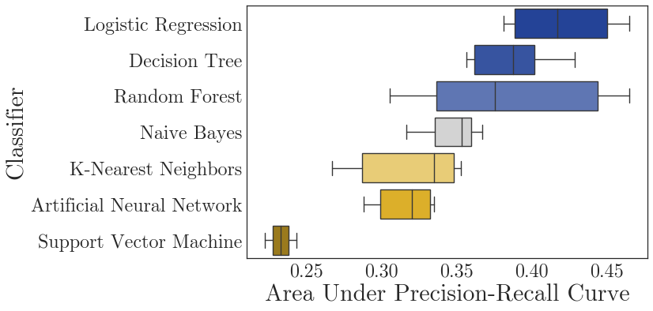

Design: Pipeline Creation
Practicality
Imputer
Transformer
Scaler
Extractor (PCA)
Classifier
Configuration: Forecast Window – 2 Years, Developmental Stages – All, Target Outcome – Acquisition, IPO or Extra Funding.

Slide 15
Design: Pipeline Creation (Classifier)
Practicality
Configuration: Forecast Window – 2 Years, Developmental Stages – All, Target Outcome – Acquisition, IPO or Extra Funding.

Slide 16
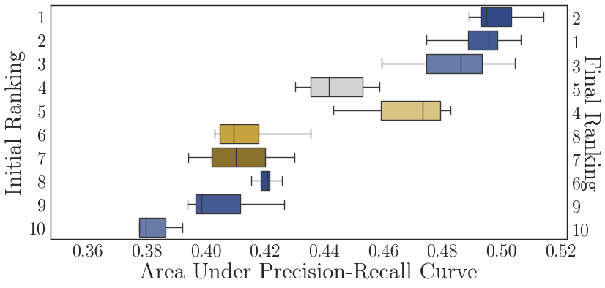
Design: Pipeline Selection
Practicality
Configuration: Forecast Window – 2 Years, Developmental Stages – All, Target Outcome – Acquisition, IPO or Extra Funding.

Slide 17
Design: Time Profile
Practicality
Time Taken
Pipeline Creation
(38.6 hours, 85%)
525 Cycles:
25 Search Iterations
3 Cross-Validated Folds
7 Classification Algorithms
Pipeline Selection
(6 hours, 13%)
75 Cycles:
5 Finalist Pipelines
3 Dataset Slices
3 Cross-Validated Folds
Fit & Make Predictions (1 hour, 2%)
Notes:
So why did those companies get VC funding?
Well, they startups are only the tip of the iceberg.

Slide 18
System Performance

Slide 19
3. Create Pipelines
4.
Select Pipeline
- Training Set Date
- Training Set Size
- Forecast Window
- Developmental Stage
- Target Outcome
Scored Pipelines
Best Pipeline
CrunchBase & PatentsView
2. Prepare Dataset
Fit Model
Apply Model
Score Model
Training Database
Dataset
Model
Predict-ions
Scores
1. Collect Data
2. Prepare Dataset
Test Database
Feature Vector
Outcome Vector

Slide 20
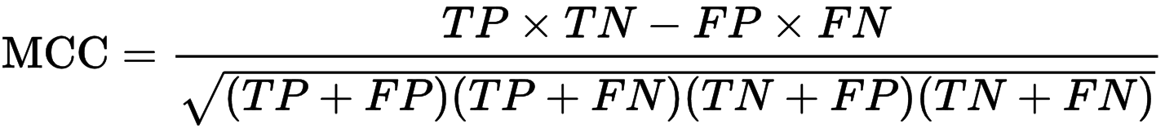
Receiver Operating Characteristic (ROC)
Curve
Precision-Recall (PR) Curve
True Positive Rate
Precision
False Positive Rate
Recall
Matthews Correlation Coefficient (MCC)
F1 Score (Positive)
TP
FN
Precision
FP
TN
Recall
Notes:
Precision = TP / TP + FP
Recall = TP / TP + FN
True Positive Rate = TP / TP + FN
False Positive Rate = FP / FP +TN

Slide 21
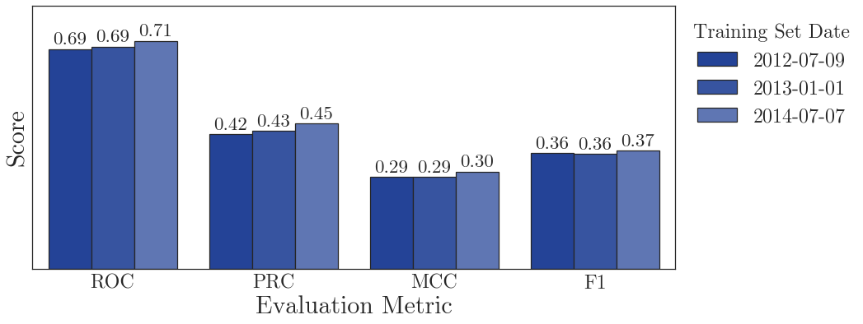
Performance: Training Set Date
Robustness
Configuration: Forecast Window – 2 Years, Developmental Stages – All, Target Outcome – Acquisition, IPO or Extra Funding.
Notes:
The performance of our system is stable when trained on historical datasets from different dates
Experimental configuration: Forecast window 2 years, all companies, Extra Stage outcome

Slide 22
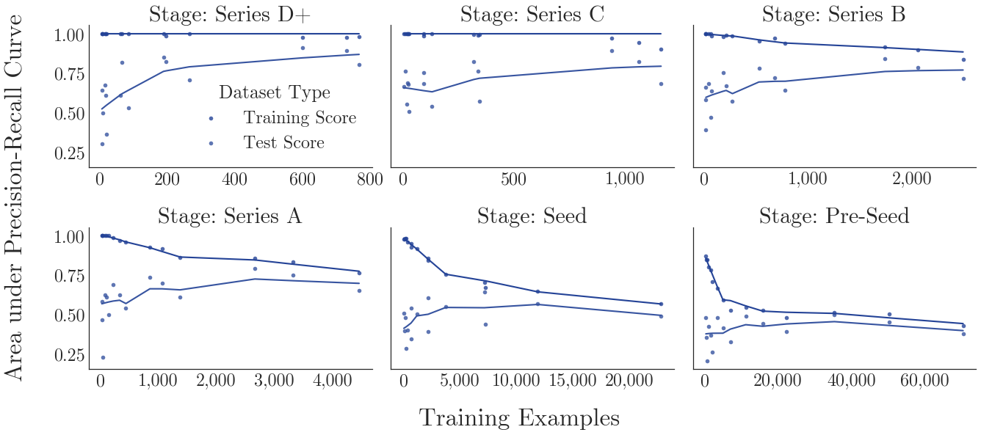
Performance: Training Set Size
Robustness
Configuration: Dataset Slices – 9 (2012-16), Forecast Window – 2-4 Years, Target Outcome – Acquisition, IPO or Extra Funding.

Slide 23
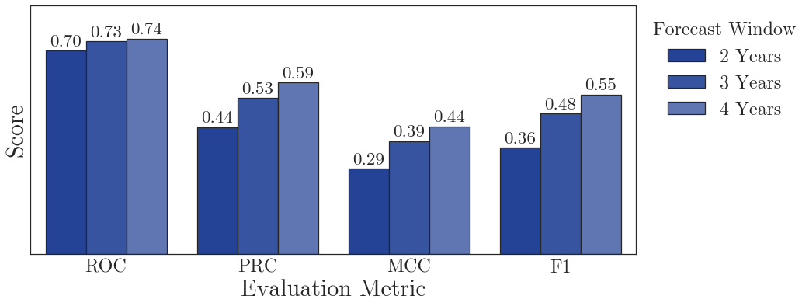
Performance: Forecast Window
Versatility
Configuration: Dataset Slices – 9 (2012-16), Developmental Stages – All, Target Outcome – Acquisition, IPO or Extra Funding.
Notes:
Advisors are more important in earlier stages
Investors become more important in later stages

Slide 24
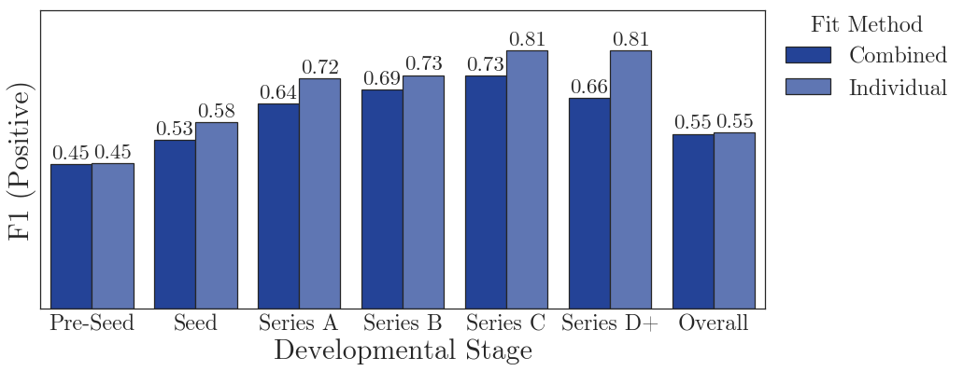
Performance: Developmental Stage
Versatility
Configuration: Dataset Slices – 3, Forecast Window – 4 Years, Target Outcome – Acquisition, IPO or Extra Funding.
Notes:
Advisors are more important in earlier stages
Investors become more important in later stages

Slide 25
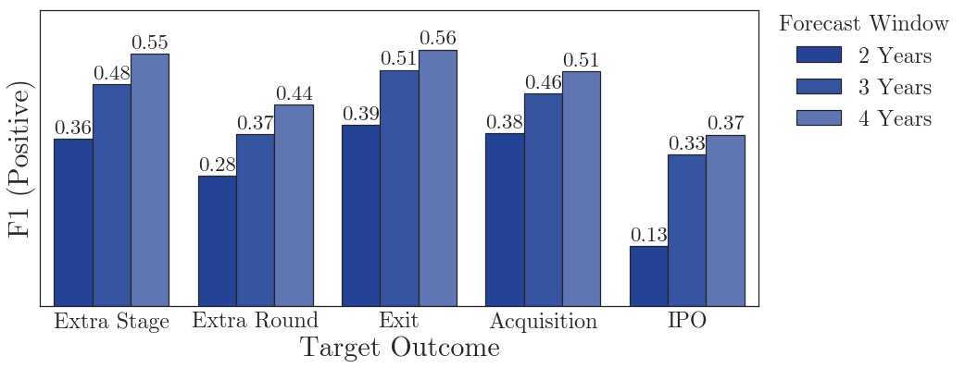
Performance: Target Outcome
Versatility
Configuration: Dataset Slices – 9 (2012-16), Developmental Stages – All.
Notes:
Advisors are more important in earlier stages
Investors become more important in later stages

Slide 26
Performance: Comparison to Literature
Versatility
Beckwith (2016)
Predicting equity crowdfunding success
Best score – F1 (Positive) of 0.33
Stone (2014)
Predicting funding for Pre-Seed companies
Best score – ROC (AUC) of 0.57
Bhat (2011)
Predicting exits for Series C+ companies
Best score – F1 (Positive) of 0.75
Notes:
Compared to previous research
Source: Beckwith, J. Predicting Success in Equity Crowdfunding. Honours Thesis. University of Pennyslvania. 2016.
Stone, T.R. Computational analytics for venture finance. PhD Thesis. University College London. 2014.
Bhat, H.S., and Zaelit, D. Predicting company exits using qualitative data. In Pacfici-Asia Conference on Knowledge Discovery and Data Mining. Springer. 2011, pp. 399-410

Slide 27
Model Evaluation

Slide 28
Investment Decision
Startup Potential
Investment Confidence
Validation
Performance
Context
Human Capital
Social Capital
Structural Capital
Founders
Advisors
Executives
Events
Alliances
Patents
Funding
Investors
Media
Financial
Customers
Industry
Location
Economy
Notes:
How do VC firms make their decisions?

Slide 29
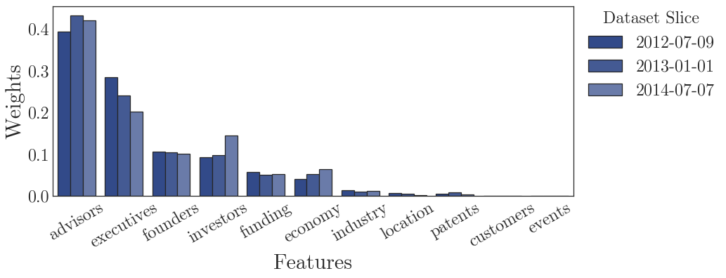
Features: Training Set Dates
Configuration: Forecast Window – 2 Years, Developmental Stages – All, Target Outcome – Acquisition, IPO or Extra Funding.

Slide 30
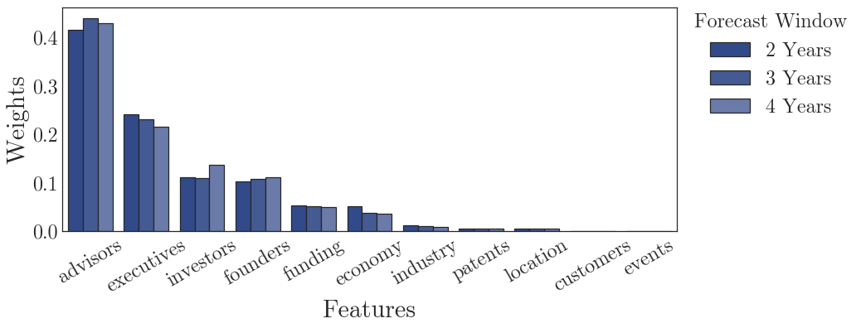
Features: Forecast Window
Configuration: Dataset Slices – 9 (2012-16), Developmental Stages – All, Target Outcome – Acquisition, IPO or Extra Funding.

Slide 31
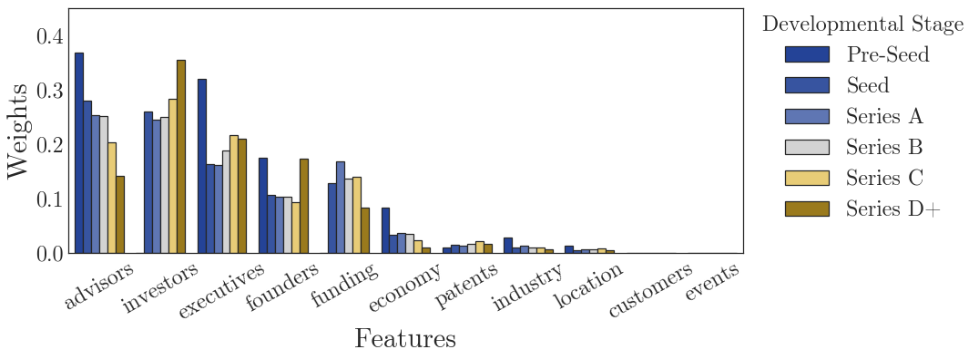
Features: Developmental Stage
Configuration: Dataset Slices – 9 (2012-16), Forecast Window – 2-4 Years, Target Outcome – Acquisition, IPO or Extra Funding.
Notes:
Advisors are more important in earlier stages
Investors become more important in later stages

Slide 32
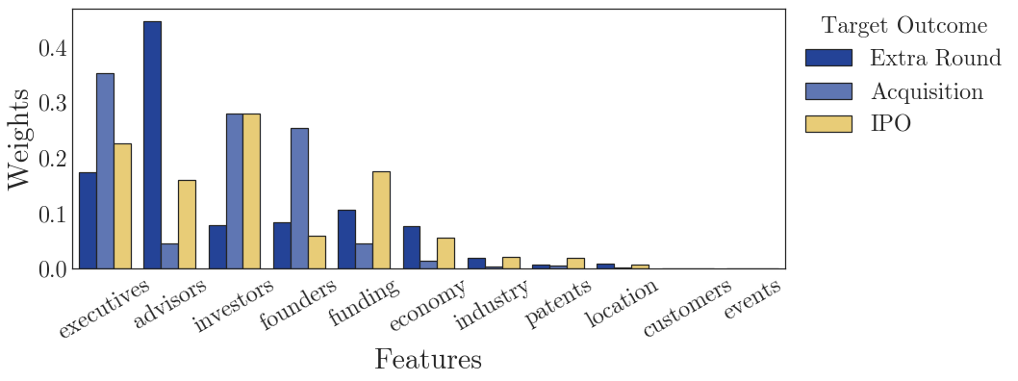
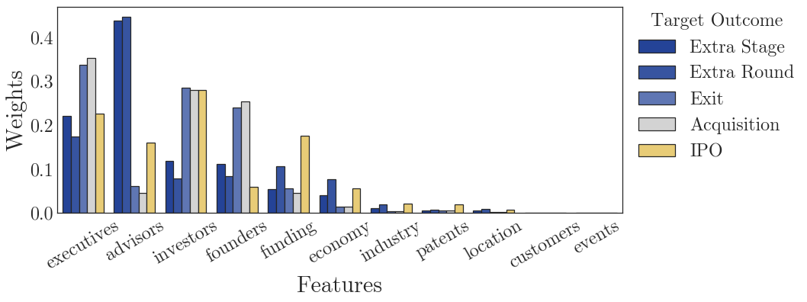
Features: Target Outcome
Configuration: Dataset Slices – 9 (2012-16), Forecast Window – 2-4 Years, Developmental Stages – All.
Notes:
All outcomes are highly predicted by human capital
Investor influence also has a significant role in Exits

Slide 33
Investment Decision
Startup Potential
Investment Confidence
Validation
Performance
Context
Human Capital
Social Capital
Structural Capital
Founders
Advisors
Executives
Influence
Alliances
Patents
Funding
Investors
Media
Financial
Non-Financial
Industry
Location
Economy
Notes:
How do VC firms make their decisions?

Slide 34
Conclusions

Slide 35
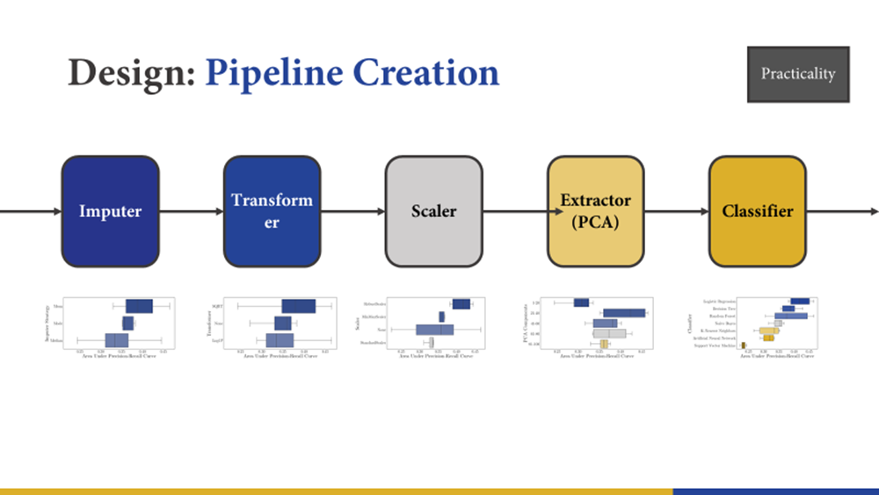
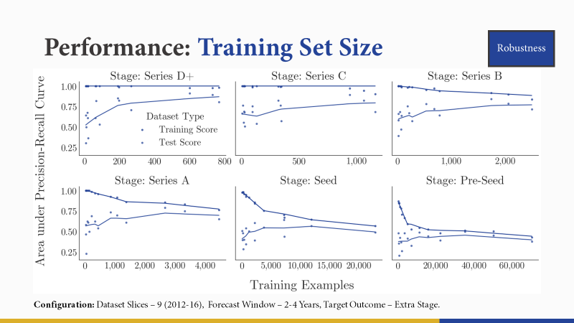
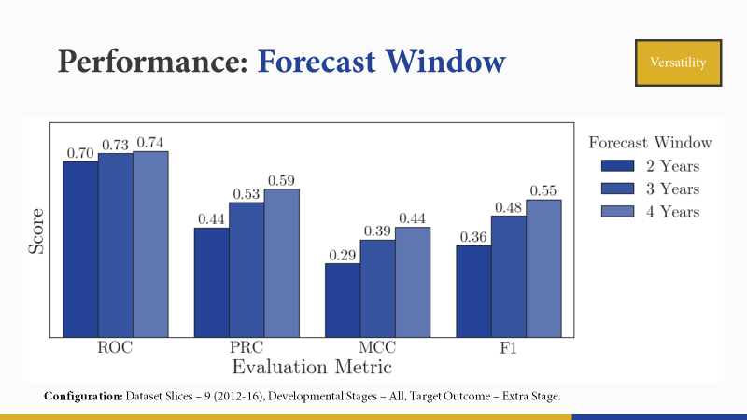
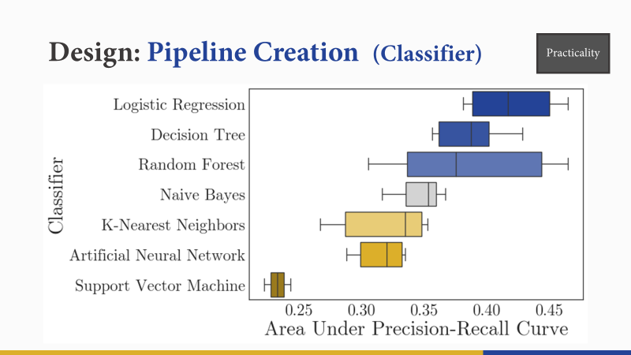
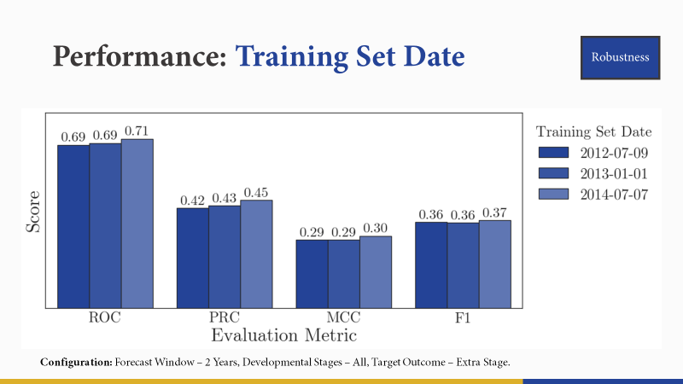
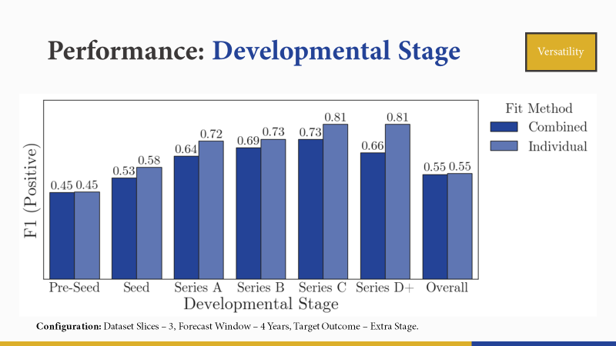
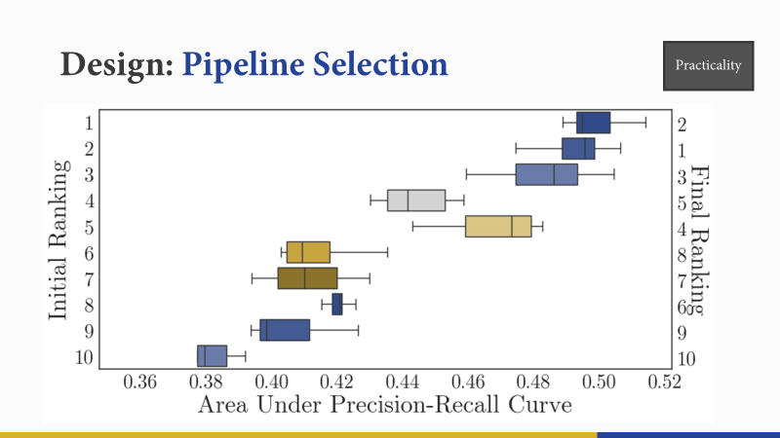
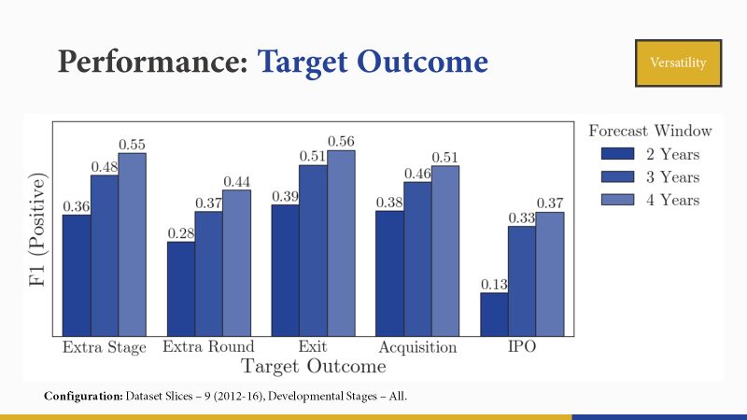
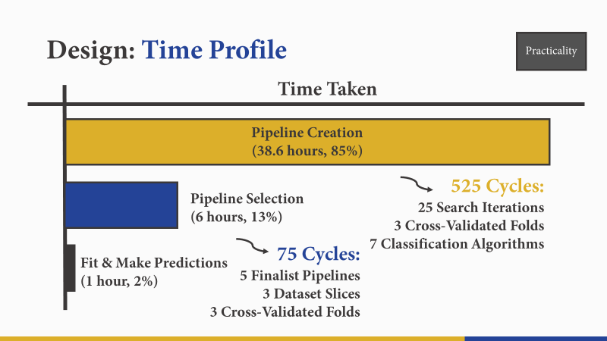
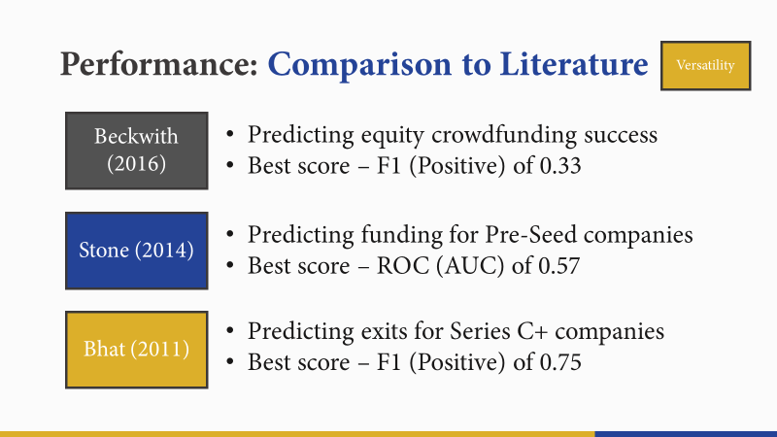
Evaluation of Criteria
Practicality
Robustness
Versatility

Slide 36
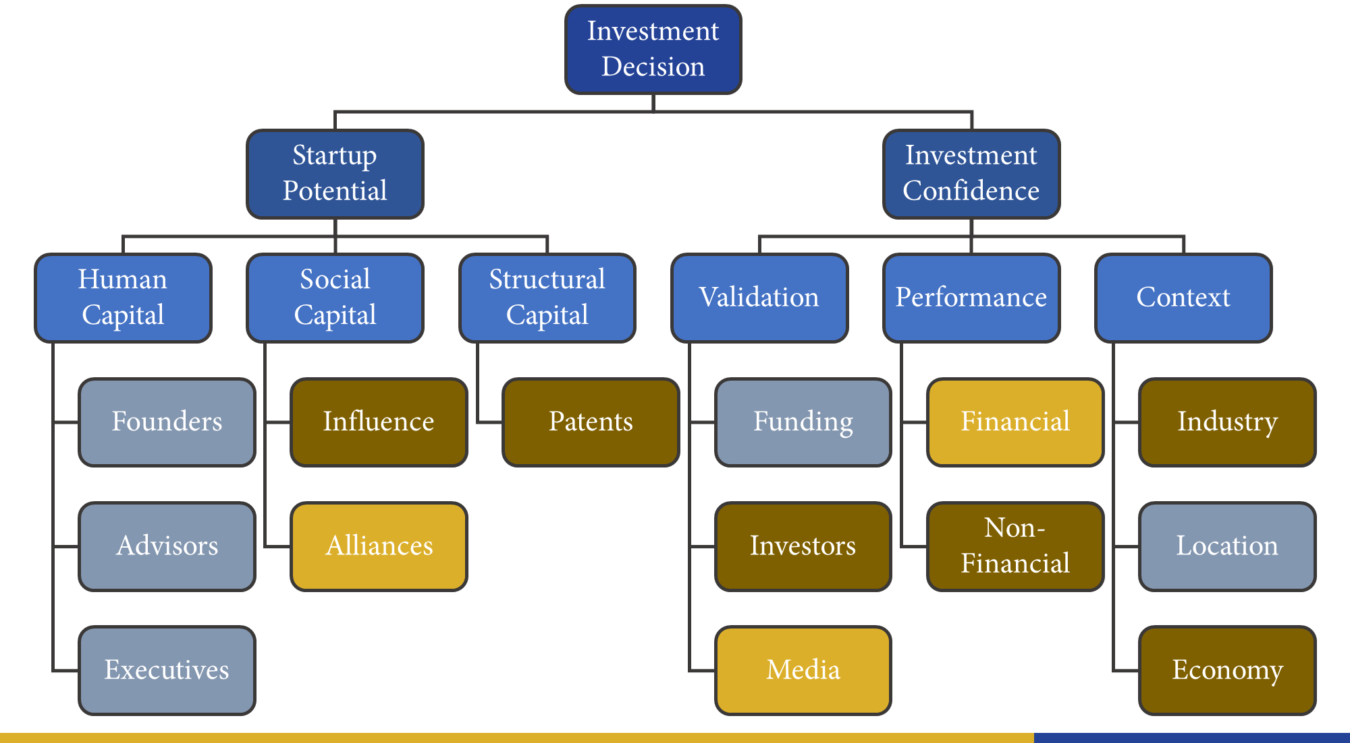
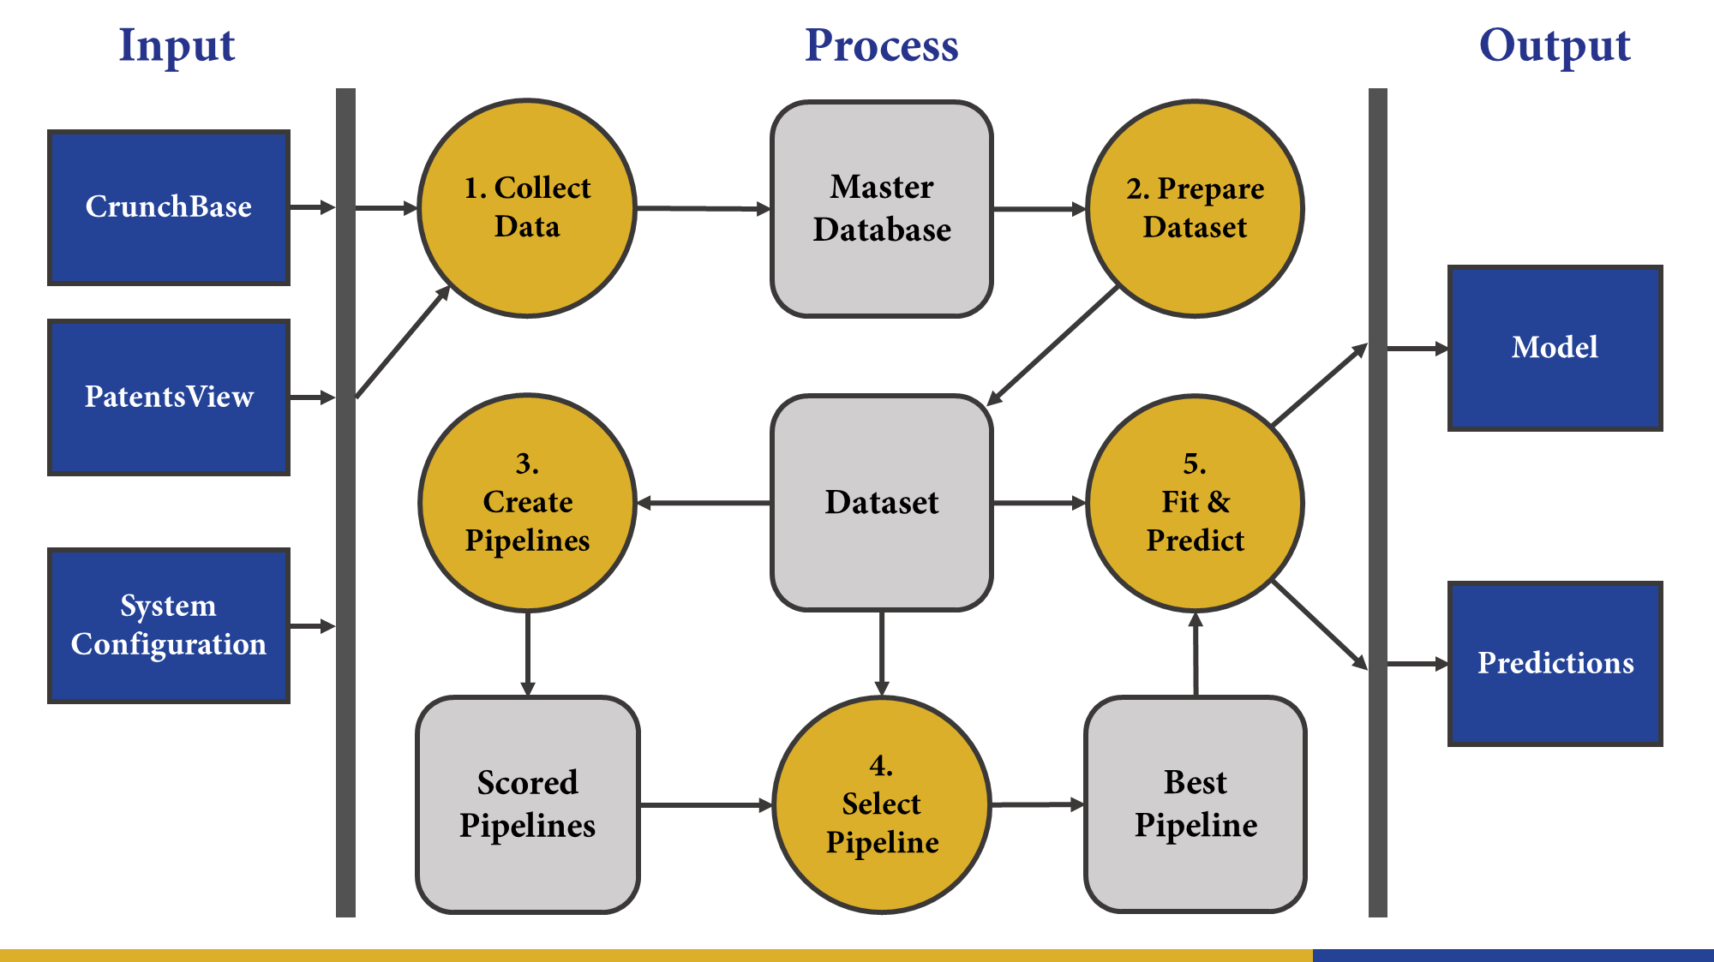
Future Work
Extend Feature Set
Automatic Scheduling & Data Collection
Commercialisation
Notes:
Small Sample Size – Case Studies, interviews
Early-stage focus – Stone (2014) (UCL) early-stage not possible
Narrow feature set – Xiang (2012) Media coverage features

Slide 37
Contributions
A VC investment screening system ready for industry: near-autonomous, adaptable, and leverages public data.
A VC investment screening system performs better or comparable to previous studies across a large domain.
An empirical study of startup performance more comprehensive than any from the literature.

Slide 38
Towards Automated
Venture Capital Screening
Author: Mark Shelton
Supervisors: Melinda Hodkiewicz, Tim French
Program: Bachelor of Philosophy (Honours)
Date: 01 June 2017

Slide 39
Appendices

Slide 40



Notes:
What do all of these companies have in common? They all have:
HIGH LEVERAGE ON LABOUR
DEVELOP INNOVATIVE TECHNOLOGY
RAPID GROWTH IN CUSTOMER-BASE
And they’re all startups backed by Venture Capital firms.

Slide 41
What do venture capitalists think?
“We have not been able to quantify startup potential. We haven't even tried. Although I am sure someone could do it and they might be very successful with it. To us, the ideal founding team is one supremely talented product-oriented founder and one, two, or three strong developers, and nothing else”
Chris Dixon, Andreessen Horowitz
“One of the main activities of good investors is trying to find ‘accurate contrarian theses’ about what make good startups, markets, founders etc. I've seen a few attempts to do it quantitatively but I think those are often flawed because the measurable things are either obvious, irrelevant, or suffer from over-fitting.”
Fred Wilson, Union Square Ventures
Source: Stone (2014), see Bibliography.

Slide 42




Notes:
But not many startups, even those backed by VC firms are successful

Slide 43
Origination & Screening
Opportunity Evaluation
Deal Structuring
Investment Management

Slide 44





Acquired
IPO
Extra Round
Exit
Extra Stage
Notes:
What does success look like?

Slide 45
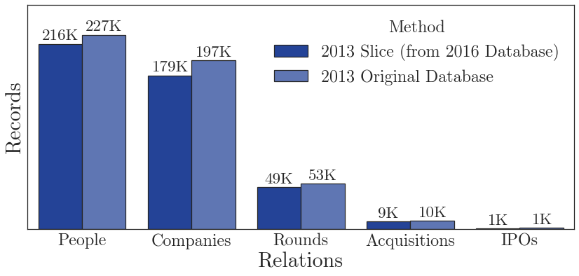
Design: Dataset Preparation

Slide 46




Feature (2013-April)
Age (Years) | 7.4 | 0.6 | 4.3 | 3.8
Funding Raised ($m) | 92.0 | 0.0 | 171.0 | 12.0
Funding Rounds (N) | 8 | 0 | 8 | 4
Developmental Stage | Series D+ | Pre-Seed | Series C | Series A
Predicted Outcome | ✓ | ✗ | ✓ | ✓
Outcome (2017-April)
Funding Raised ($m) | 96.0 | 5.0 | 336.0 | 77.0
Developmental Stage | Series D+ | Series A | Acquired | Series B
Actual Outcome | ✗ | ✓ | ✓ | ✓
Correct Prediction | ✗ | ✗ | ✓ | ✓
Configuration: Dataset Slices – 3, Forecast Window – 4 Years, Target Outcome – Extra Stage.

Slide 47
Bibliography
Beckwith, J. Predicting success in equity crowdfunding. Honours Thesis. University of Pennsylvania. 2016.
Stone, T.R. Computational analytics for venture finance. PhD Thesis. University College London. 2014.
Bhat, H.S., and Zaelit, D. Predicting company exits using qualitative data. In Pacific-Asia Conference on Knowledge Discovery and Data Mining. Springer. 2011, pp. 399-410

