Slide 1
Chapter 4
Calculating the Derivative

Slide 2
Section 4.1
Techniques for Finding
Derivatives

Slide 3


Slide 4


Slide 5


Slide 6


Slide 7
Section 4.2
Derivatives of Products and Quotients

Slide 8


Slide 9
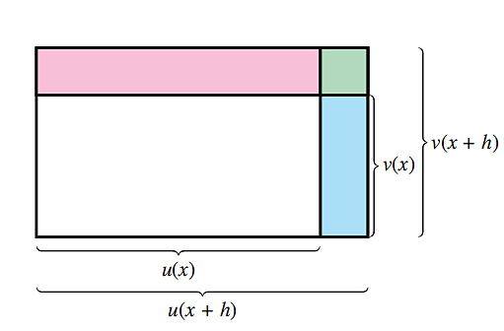
Figure 8

Slide 10
Section 4.3
The Chain Rule

Slide 11


Slide 12
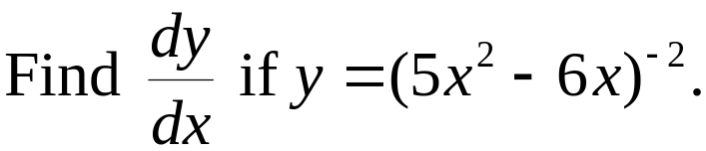
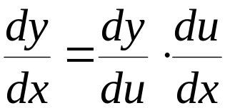



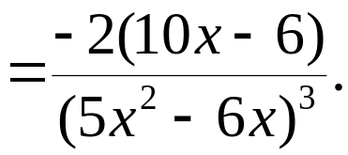
Your Turn 4
Solution:

Slide 13


Slide 14
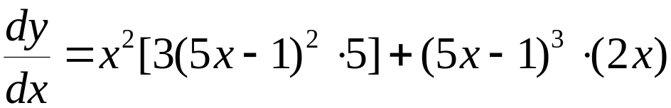

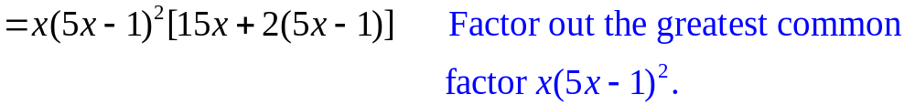


Your Turn 6
Solution:
Now use the product rule and the chain rule.

Slide 15
Section 4.4
Derivatives of Exponential Functions

Slide 16



Slide 17


Slide 18
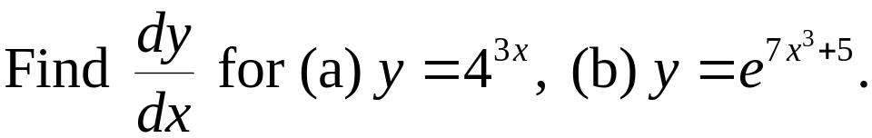
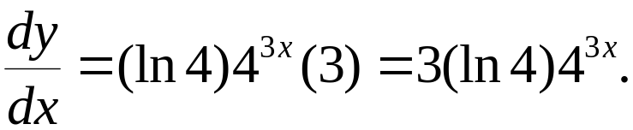
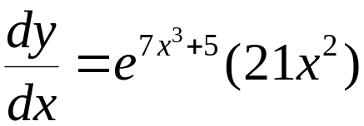

Your Turn 1

Slide 19
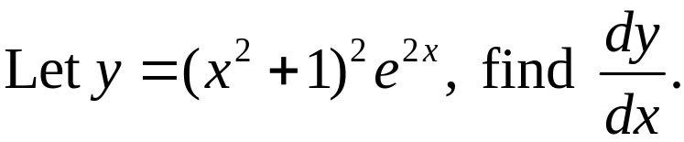
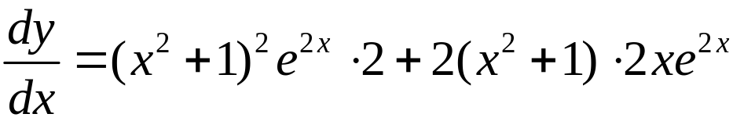

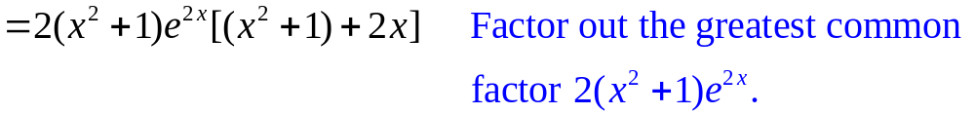


Your Turn 2
Solution: Use the product rule and the chain rule.

Slide 20
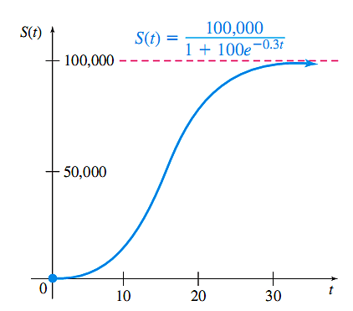
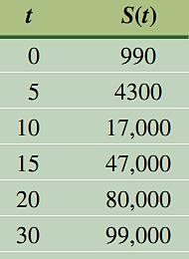
Figure 11

Slide 21
Section 4.5
Derivatives of Logarithmic Functions

Slide 22



Slide 23
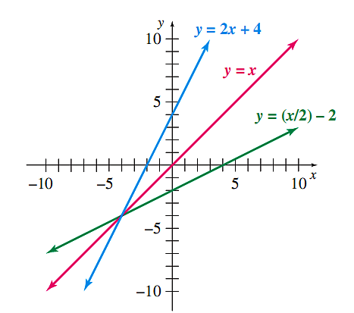
Figure 12

Slide 24
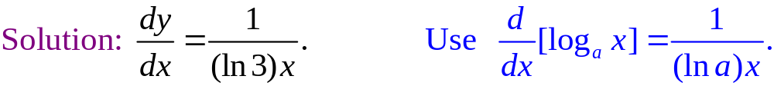
Your Turn 1

Slide 25


Slide 26
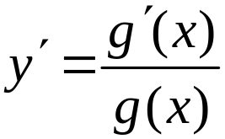
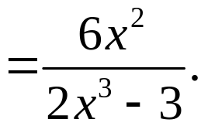
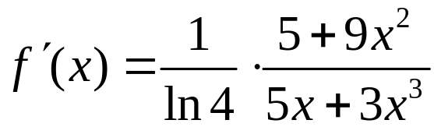
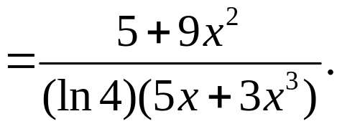
Your Turn 2
Solution (a):
Solution (b):

Slide 27
Chapter 4
Extended Application: Electric Potential
and Electric Field

Slide 28
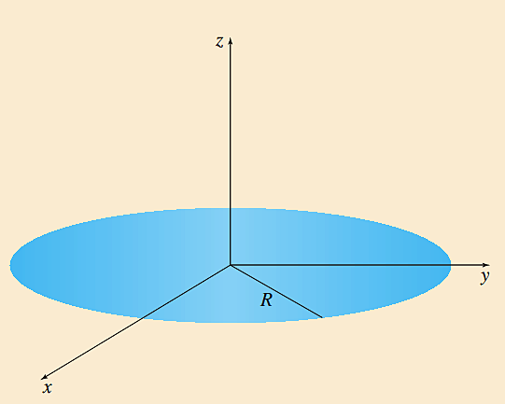
Figure 13

Slide 29
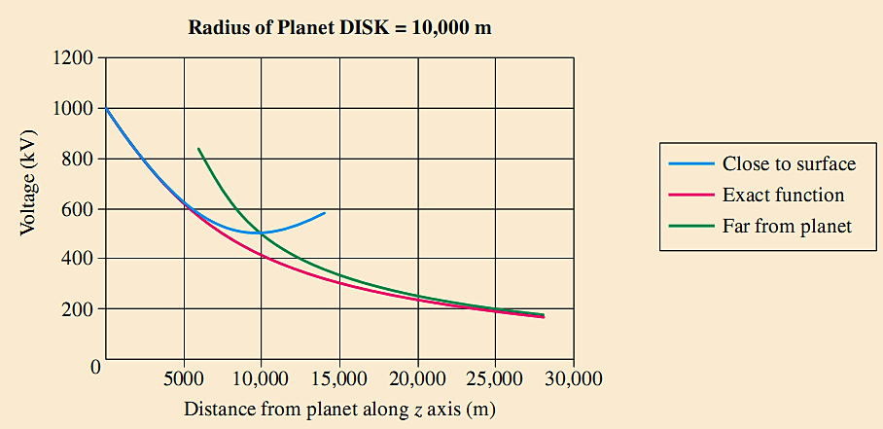
Figure 14

Slide 30
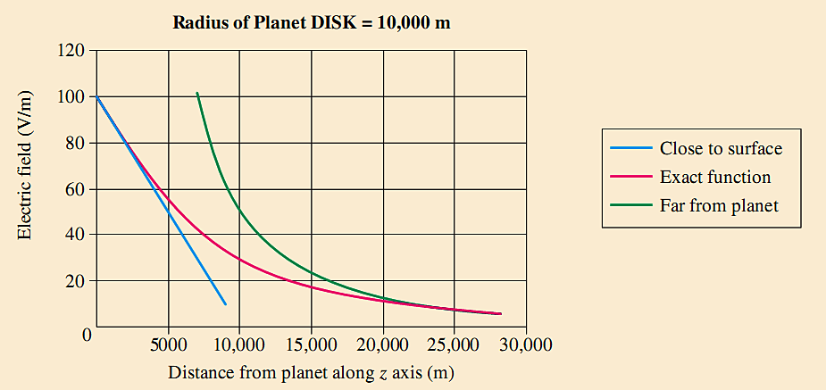
Figure 15

