Slide 1
Chapter 3
The Derivative

Slide 2
Section 3.1
Limits

Slide 3
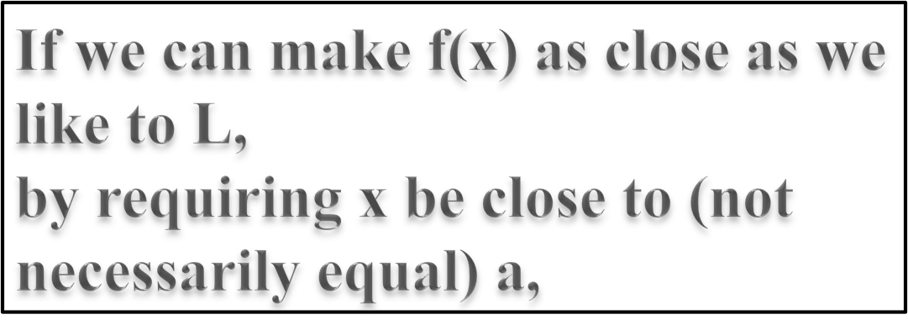
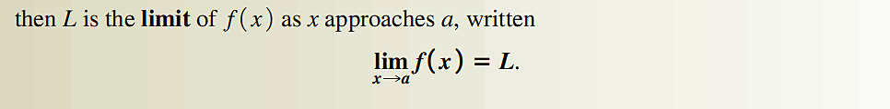

Slide 4
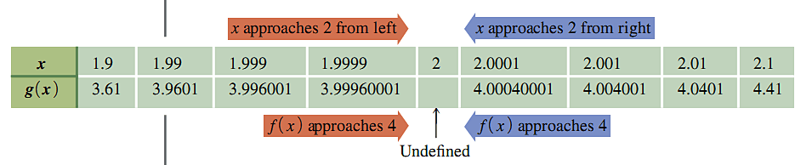
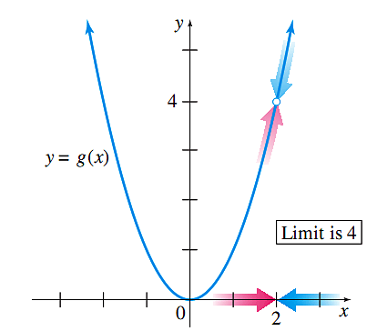
Figure 2

Slide 5
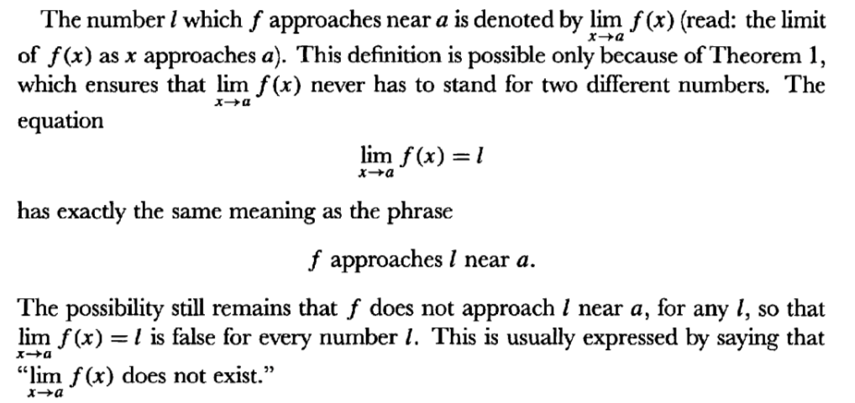
Notation *from Spivak’s Calculus

Slide 6
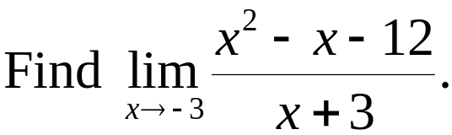
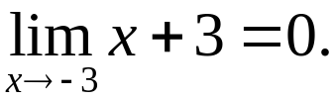
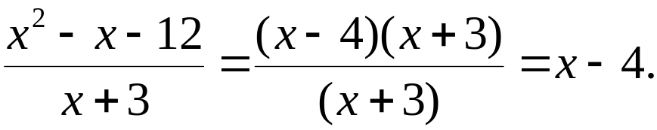
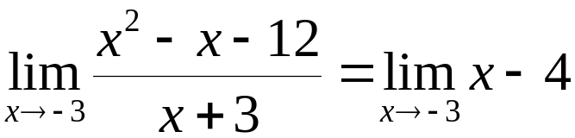

Your Turn
Solution: since
The numerator also approaches 0 as x approaches −3, and 0/0
is meaningless. For x ≠ − 3 we can, however, simplify the
function by rewriting the fraction as
Now

Slide 7
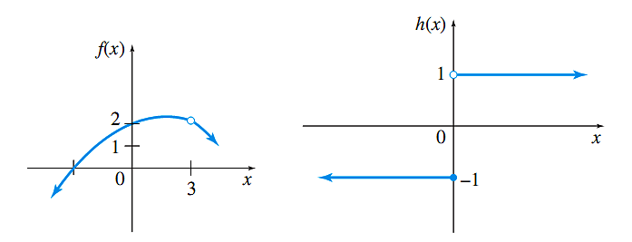
Left and Right

Slide 8
Left and Right
What can you say about lim f(x) as x → 10 if
  lim f(x) as x → 10⁻ (from the left) is 5
  lim f(x) as x → 10⁺ (from the right) is 5 ?

Slide 9
infinity
lim 1/x as x → infinity ?

Slide 10
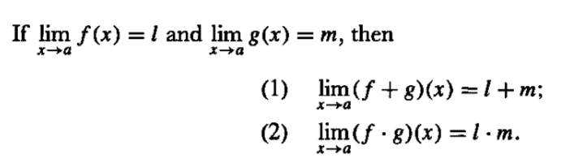
Two Tools with Limits

Slide 11
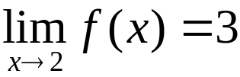
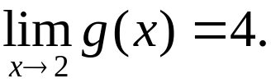
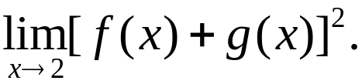
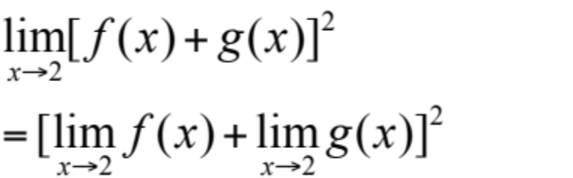


Your Turn 5
Suppose
and
find
Solution:

Slide 12
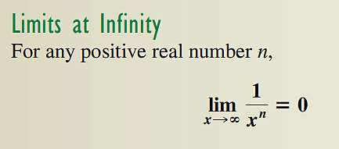

Slide 13
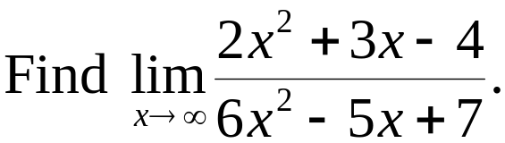
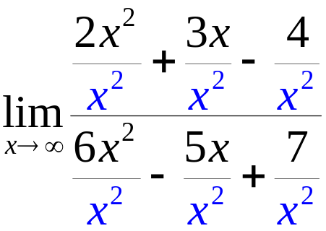
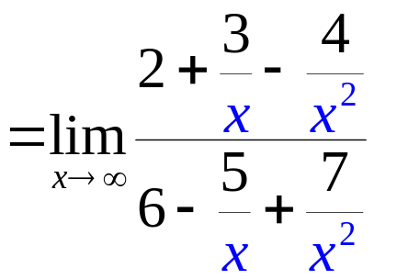
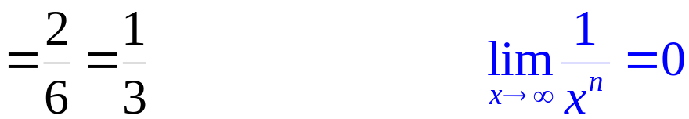
Your Turn 8
Solution: Here, the highest power of x is x², which is used to divide
each term in the numerator and denominator.

Slide 14
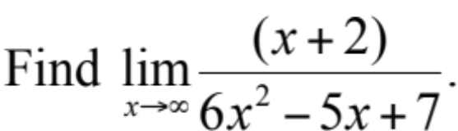
Your Turn

Slide 15
Section 3.2
Continuity

Slide 16
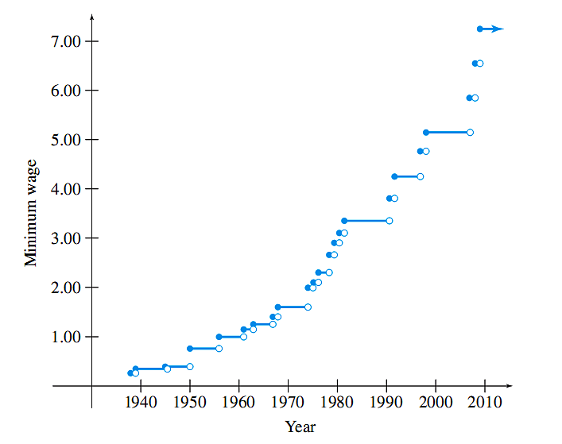
Figure 14

Slide 17
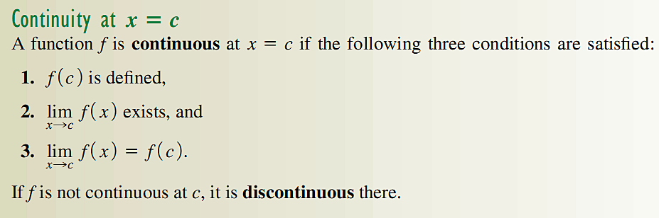

Slide 18
Figure 15 - 16

Slide 19
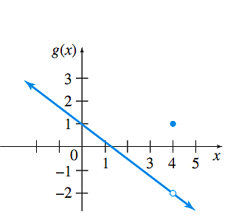
Figure 17

Slide 20
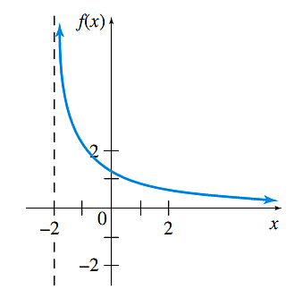
Figure 18

Slide 21
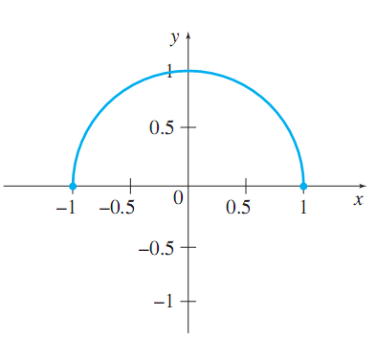
Figure 19

Slide 22
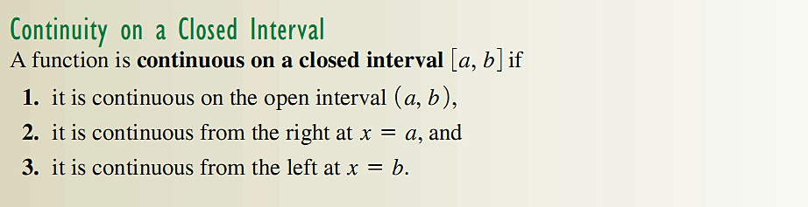

Slide 23
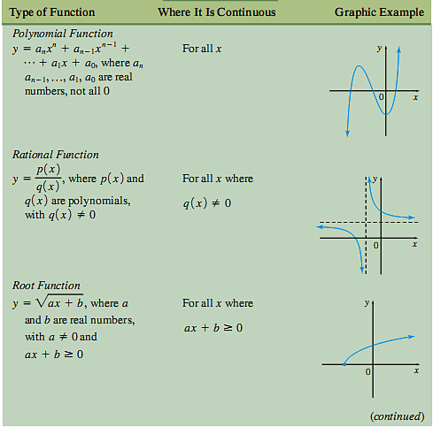

Slide 24
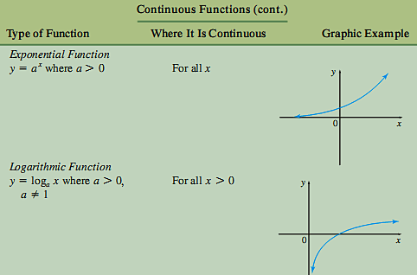

Slide 25

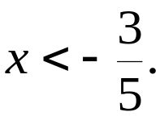
Your Turn 1
Find all values x = a where the function
is discontinuous.
Solution: This root function is discontinuous wherever the
radicand is negative.
There is a discontinuity when 5x + 3 < 0

Slide 26
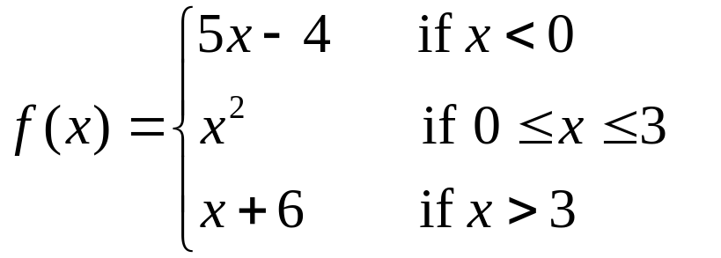
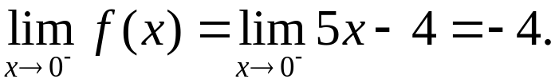
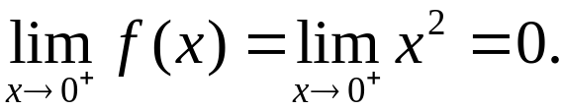
Your Turn 2
Find all values of x where the piecewise function is discontinuous.
Solution: Since each piece of this function is a polynomial, the
only x-values where f might be discontinuous here are 0 and 3.
We investigate at x = 0 first. From the left, where x-values are less
than 0,
From the right, where x-values are greater than 0
Continued

Slide 27
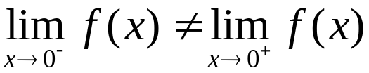
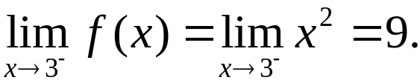
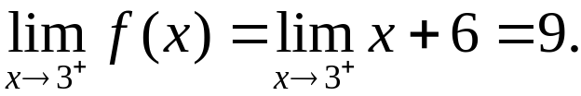

Your Turn 2 Continued
Because
the limit does not exist, so f is discontinuous at x = 0 regardless
of the value of f(0).
Now let us investigate at x = 3.
Thus, f is continuous at x = 3.

Slide 28
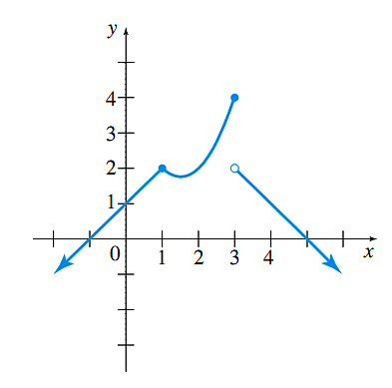
Figure 20

Slide 29
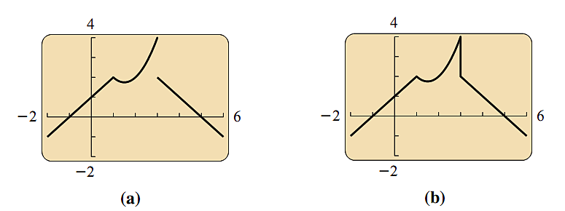
Figure 21

Slide 30
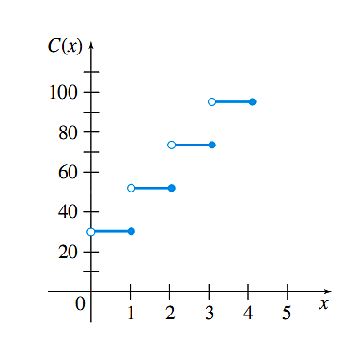
Figure 22

Slide 31
Section 3.3
Rates of Change

Slide 32
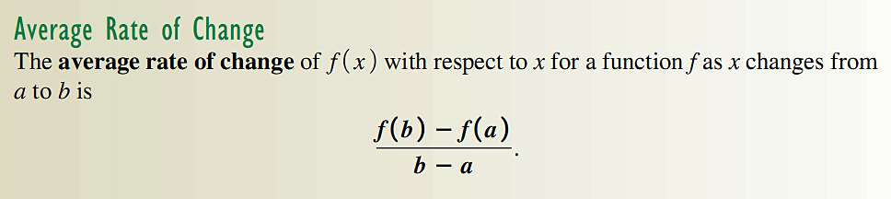

Slide 33
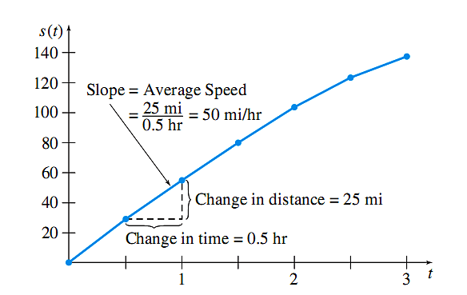
Figure 23

Slide 34
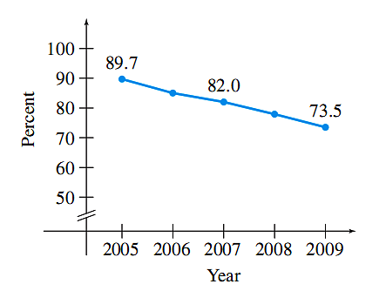
Figure 24

Slide 35
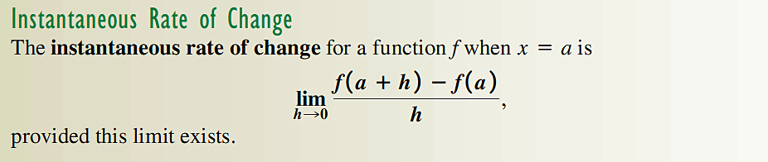

Slide 36
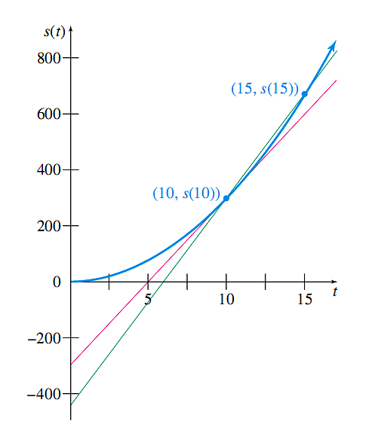
Figure 25

Slide 37
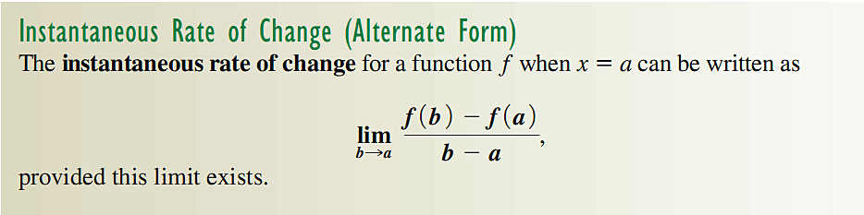

Slide 38
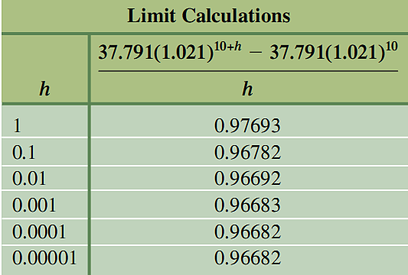
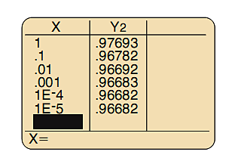
Figure 26

Slide 39
Section 3.4
Definition of the Derivative

Slide 40
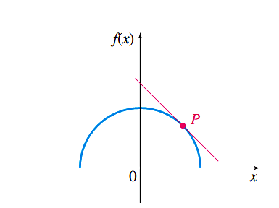
Figure 27

Slide 41
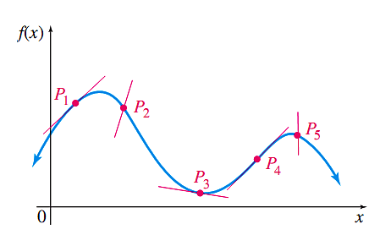
Figure 28

Slide 42
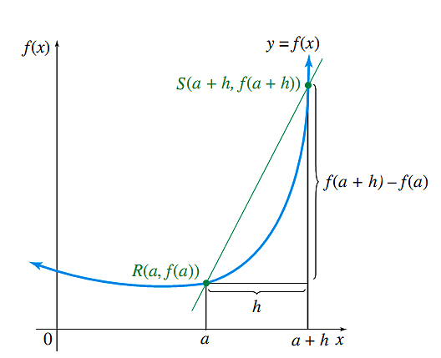
Figure 29

Slide 43

Figure 30

Slide 44


Slide 45

Figure 31

Slide 46

Figure 32

Slide 47

Figure 33 - 34

Slide 48

Figure 35

Slide 49

Figure 36 - 37

Slide 50


Slide 51


Slide 52


Slide 53

Figure 38

Slide 54


Slide 55


Slide 56

Figure 39

Slide 57


Slide 58

Figure 40

Slide 59

Figure 41 - 42

Slide 60

Figure 43

Slide 61


Slide 62

Figure 44

Slide 63
Section 3.5
Graphical Differentiation

Slide 64

Figure 45

Slide 65

Figure 46

Slide 66

Figure 47 - 48

Slide 67

Figure 49

Slide 68

Figure 50

Slide 69

Figure 51

Slide 70

Figure 52

Slide 71

Figure 53

Slide 72

Figure 54

Slide 73
Chapter 3
Extended Application: A Model for
Drugs Administered Intravenously

Slide 74

Figure 55

Slide 75

Figure 56

Slide 76

Figure 57

