Slide 1
Litmus
Helping you thread the eye of the needle
of consistent HTML email rendering

Slide 2
Email Marketing
Marketing channel with a very large potential audience
Segmentation to focus marketing efforts
Personalization and customization
Time sensitive and relevant communications
Wealth of analytical data
User profiles
User behavior
Initiate sales funnel, A/B Testing

Slide 3

Email Marketing Creative
Inconsistent HTML/CSS rendering across clients
Spotty CSS support
Inline CSS
No javascript execution
Design must fit a table layout
Creative crafted to display across as many clients as possible
HTML like it’s 1999

Slide 4
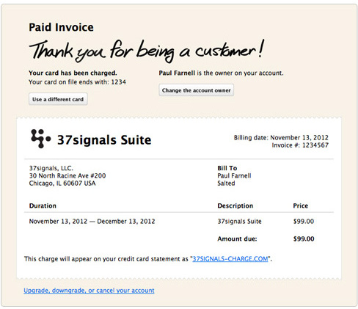
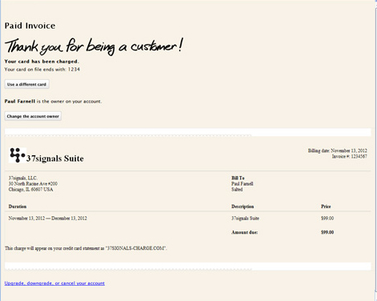

Slide 5
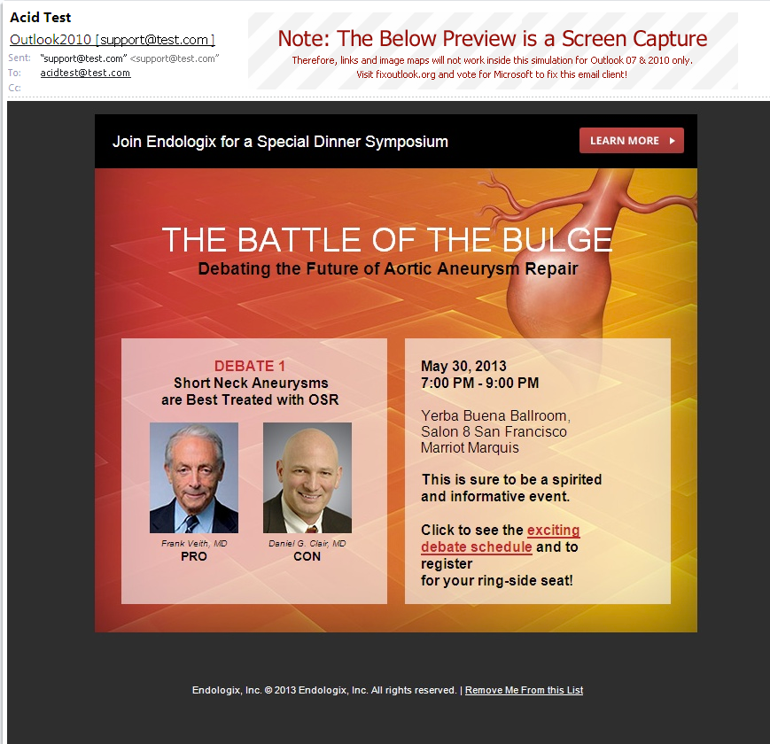
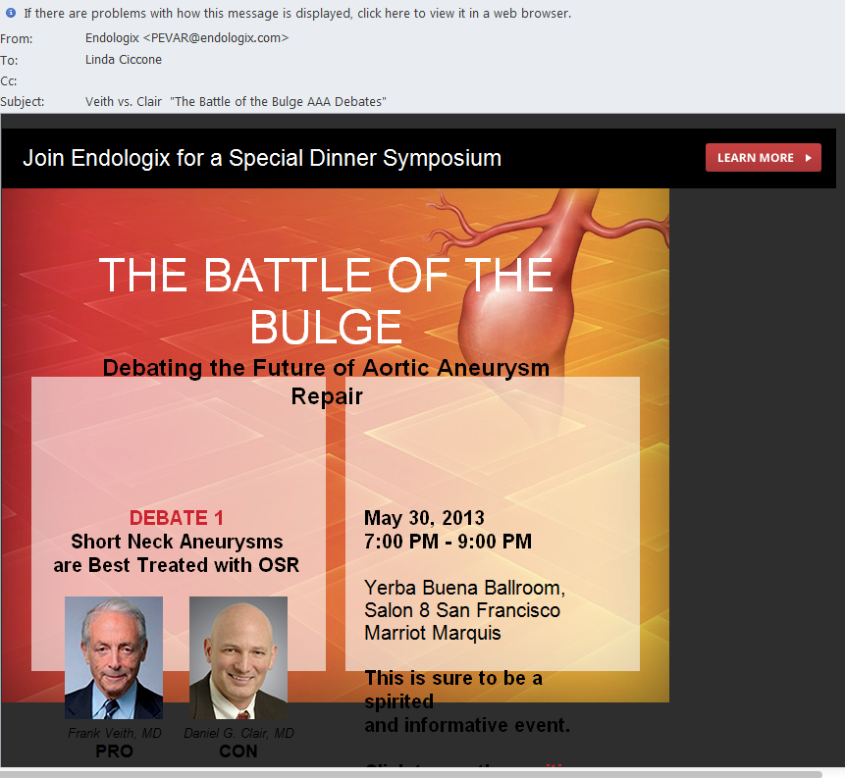

Slide 6
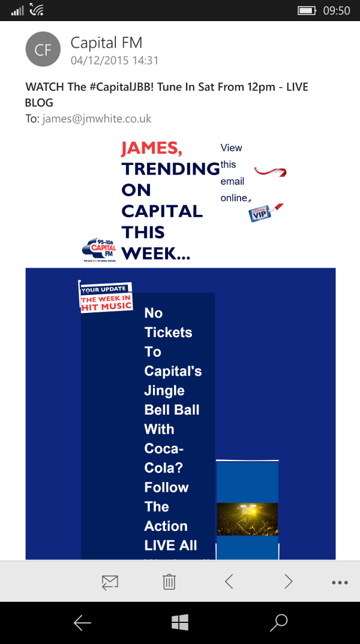
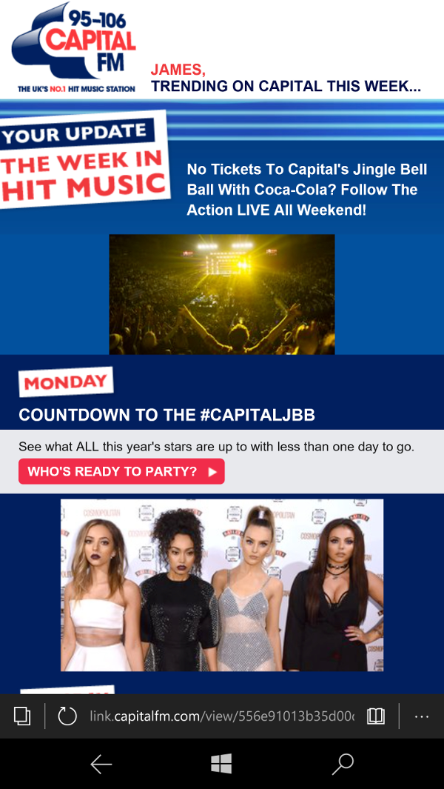

Slide 7

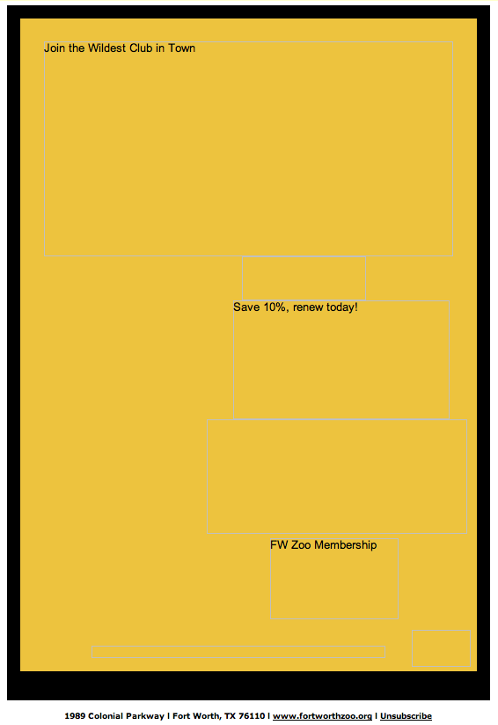
Make Design All Images

Slide 8
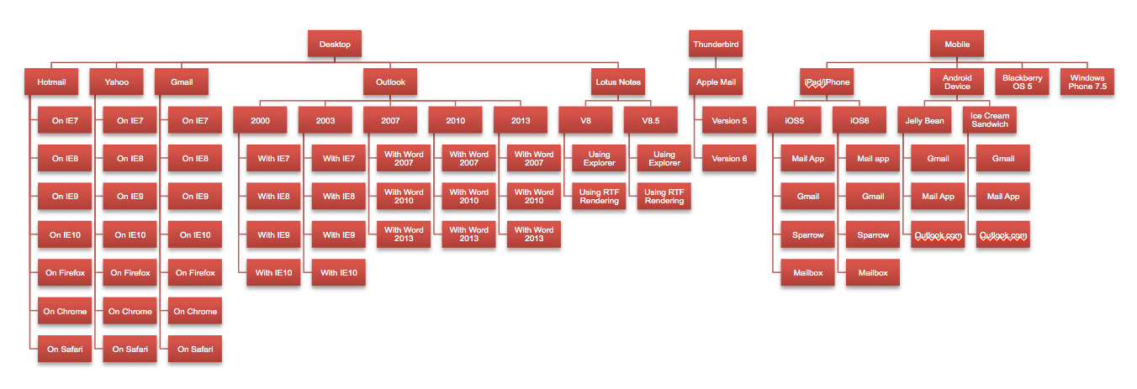
Email clients

Slide 9
Litmus Services
(spit/twist and granny glasses)

Slide 10
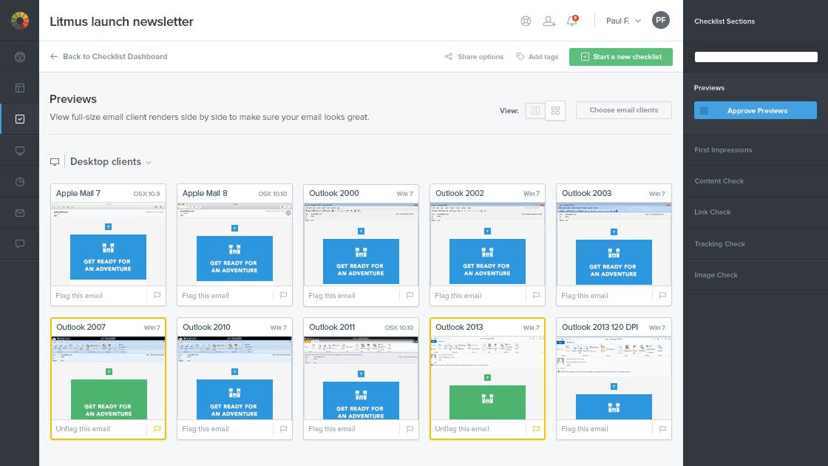
Checklist

Slide 11
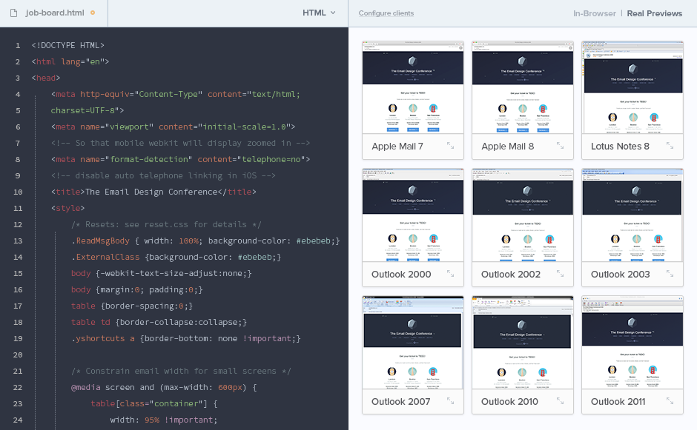
Builder

Slide 12
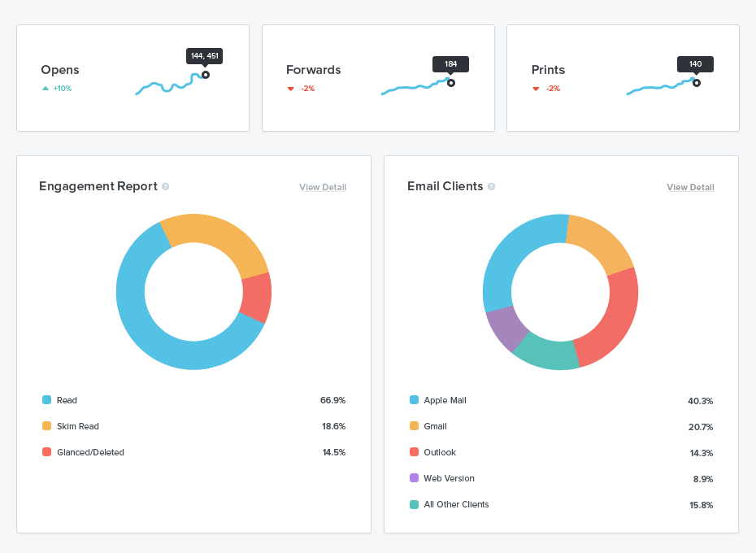
Analytics

Slide 13
Other services
Spam testing
IP reputation analysis
DKIM/SPF verification
Scoring from major spam filters (SpamAssassin, Barracuda, Postini, ISP filters)
Web page testing
Broken image check
Broken link check
Ensure consistency from email to landing
API
Integrate into your workflow or product

Slide 14
Email is your first impression
Get it right!

