Slide 1
COMP 3024
Business Intelligence & Analysis
Final Assignment
Mark Song

Slide 2

Business Proposal

Slide 3

Table of Content
Smoking data
Our solution

Slide 4


Slide 5
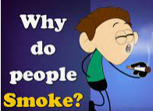
Stress relief
Pleasure
Peer pressure
Addiction
Relaxing
Stay focused
Afraid to quit

Slide 6
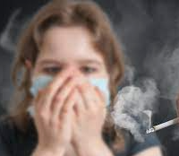
Effects of Smoking and long-term smoker
Tobacco odor and smell
Yellow teeth and gums
Vision problems
Risks of cancers especially in lungs and throat
Heart diseases and failure
Lack of taste
Blood clots
Decreased life expectancy

Slide 7
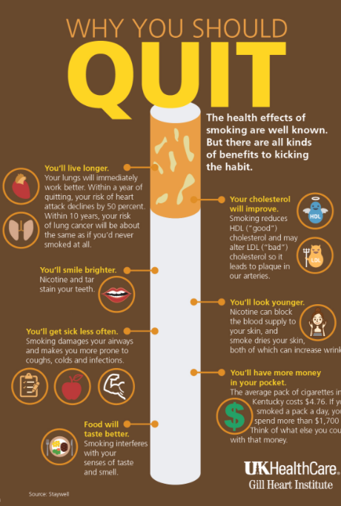
Protects others from second-hand smoking
Decreases the risks of health issues, like cancer rate and diseases rate
Better breathing and lung functionality
Feeling better after fully quitting
Improved sense of taste and smell
Saves money

Slide 8


Main Data
https://ourworldindata.org/
https://www.cdc.gov/

Slide 9


Slide 10
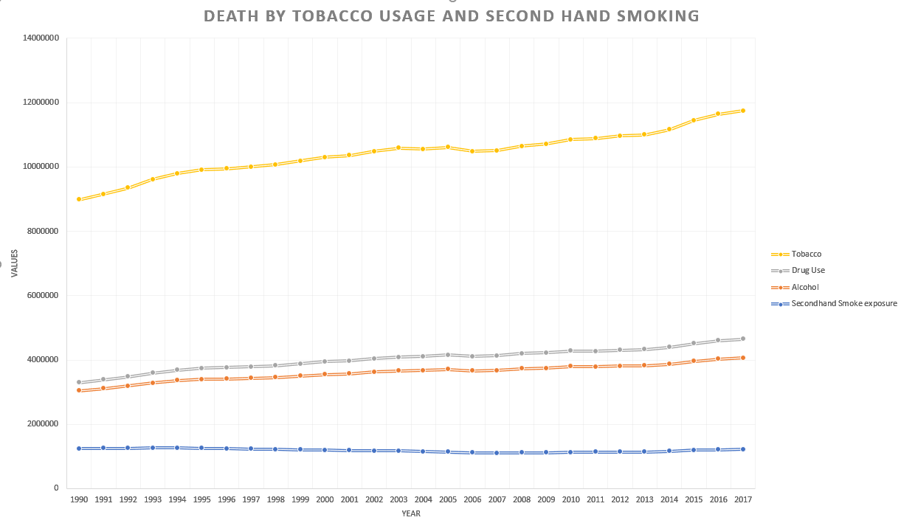

Slide 11


Slide 12
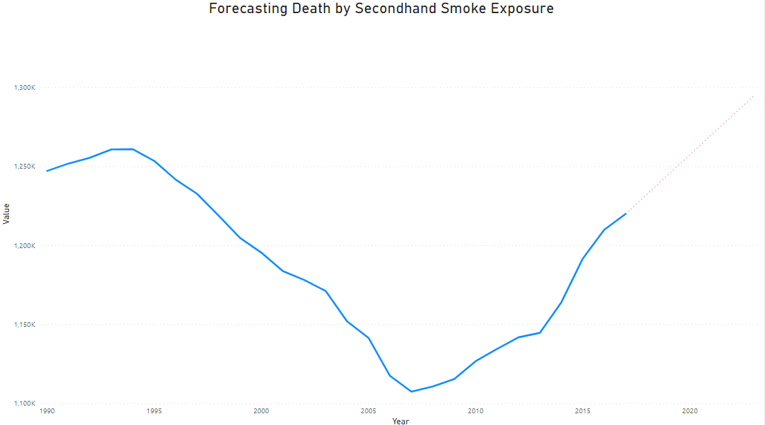

Slide 13
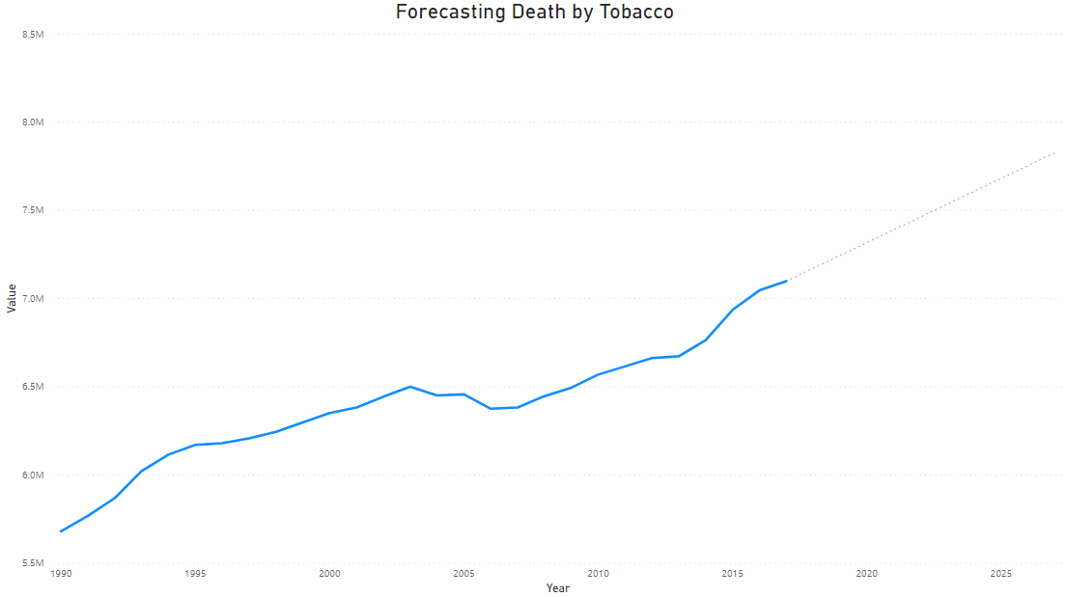

Slide 15

Jupyter Notebook

Slide 16
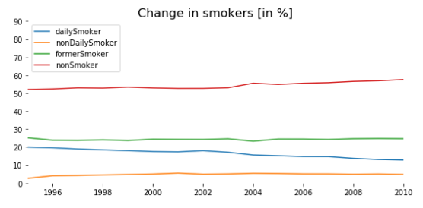

Slide 18
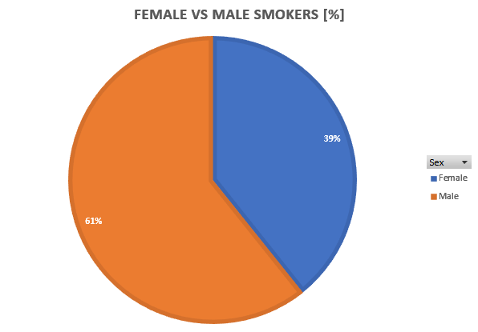
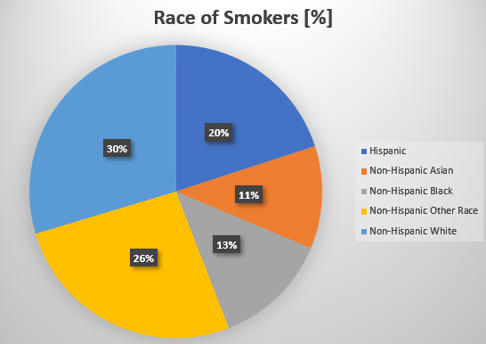
California Secondary School Survey [2015 – 2016]

Slide 19
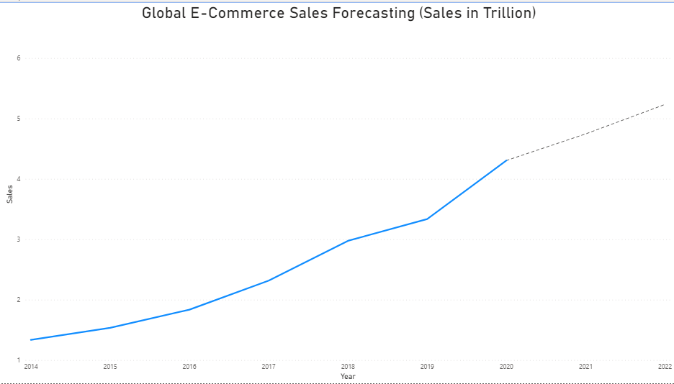

Slide 20
Our Solution….
Application to help quit smoking
Set daily reminders & goal
Daily Exercises
Monthly Reports
Subscription Based

Slide 21


Slide 22
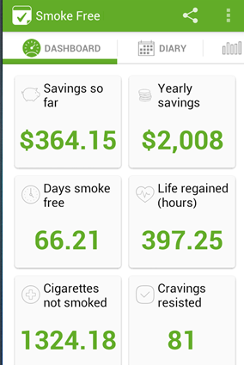



Slide 23





Slide 24

So Why Should You Invest in us?

Slide 25

Thank You

Slide 26
References
https://venngage.com/blog/business-proposal/
https://www.statista.com/statistics/379046/worldwide-retail-e-commerce-sales/
https://www.cdc.gov/tobacco/data_statistics/index.htm
https://data.chhs.ca.gov/dataset/high-school-electronic-smoking-device-and-tobacco-use-prevalence
https://dataverse.scholarsportal.info/dataverse/ICCD;jsessionid=aec8e6b2ce18dce012b8c8cb1acd?q=&types=datasets%3Afiles&sort=nameSort&order=desc&page=1
https://data.bris.ac.uk/data/dataset/299889i8ysm0d21dt3rz63nipg
https://ourworldindata.org/smoking
Video Link

