Slide 1
Setting up a pupil dilation experiment
Robbert van der Mijn/Mark Span
Data Collection and Analysis for Cognitive Neuroscience, 2024-2025

Slide 2
Today
Software installation
Difficult vs. Easy addition experiment (demo)
Design
Structure
Look ahead
☕️
Software installation (help!)

Slide 3
Mental Effort
o
7+1
o
8
o
F/J?
Hypothesis: Pupils are larger for difficult tasks
Quick and dirty demo-experiment
Participants: us
Duration: as short as possible
Number of trials: not informed by power analysis
1500 ms
Fixation
800 ms
problem
1500 ms
Fixation
800 ms
solution
1500 ms
fixation
[rt] ms
response
problem | solution | difficulty | correct
7+1 | 8 | easy | F
3+6 | 10 | easy | J
72+38 | 110 | hard | F
36+84 | 130 | hard | J
… | … | … | …
… | … | … | …

Slide 4
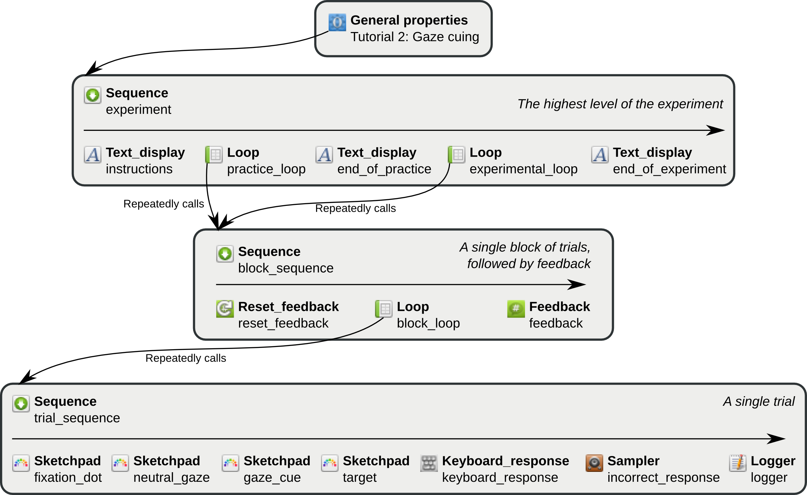
problem | solution | difficulty | correct
7+1 | 8 | easy | F
3+6 | 10 | easy | J
72+38 | 110 | hard | F
36+84 | 130 | hard | J
… | … | … | …
… | … | … | …

Slide 5
Measuring the Pupil
Besides the pupil size, we want to record
When an event takes place
What the event is
Send markers to the eye tracker!
o
7+1
o
8
o
F/K
eyetracker.log('start_phase baseline')
eyetracker.log(‘stop_phase baseline')
eyetracker.log(‘start_phase problem')
eyetracker.log(‘end_phase problem')
eyetracker.log(‘start_phase fixation')
eyetracker.log(‘end_phase fixation')
eyetracker.log(‘start_phase solution')
eyetracker.log(‘end_phase solution')

Slide 6
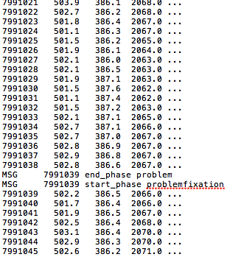
Measuring the Pupil
Millisecond since the tracker started
X
Y
Pupil Size

Slide 7
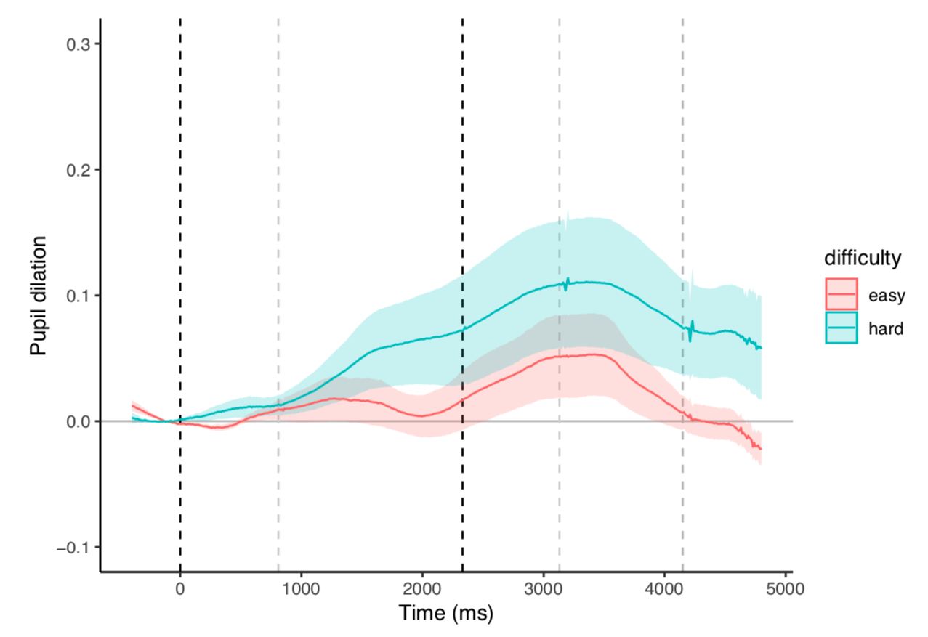
Design
4 practice trials
1 block of 40 trials:
10 Easy Correct
10 Easy Incorrect
10 Difficult Correct
10 Difficult Incorrect
Analysis
Time Lock
Baseline
Average
Visualise
72+38
110
o
7+1
o
8
o
F/K
Average of
2 conditions
Baseline

Slide 8
Considerations
Luminance
Creating equiliminant images can be challenging
Eye movement
Restrict the amount of eye movement (reading long words, scanning a scene)
Task Demands
Is the pp required to do something, or just passively observe?

