Slide 1
Data Collection and Analysis for Cognitive Neuroscience
Practical Introduction

Slide 2
Today
Practical Introduction
Intro Opensesame

Slide 3
Who are we?

Slide 4
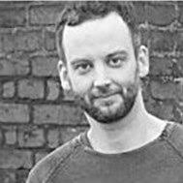
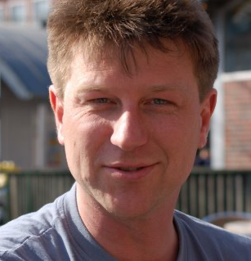
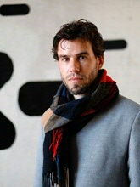
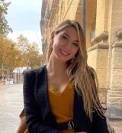
Instructors
Instructors:
Mark Span, Olaf Demigen
Guest Lecturers:
Sebastiaan Mathot and
Ana Vilotijeviç

Slide 5
Who are you?
What is your name, what is your background (e.g., what country are you from)?
What kindled the interest in cognitive neuroscience for you?
What was the topic of your bachelors thesis (maybe a short synopsis?)

Slide 6
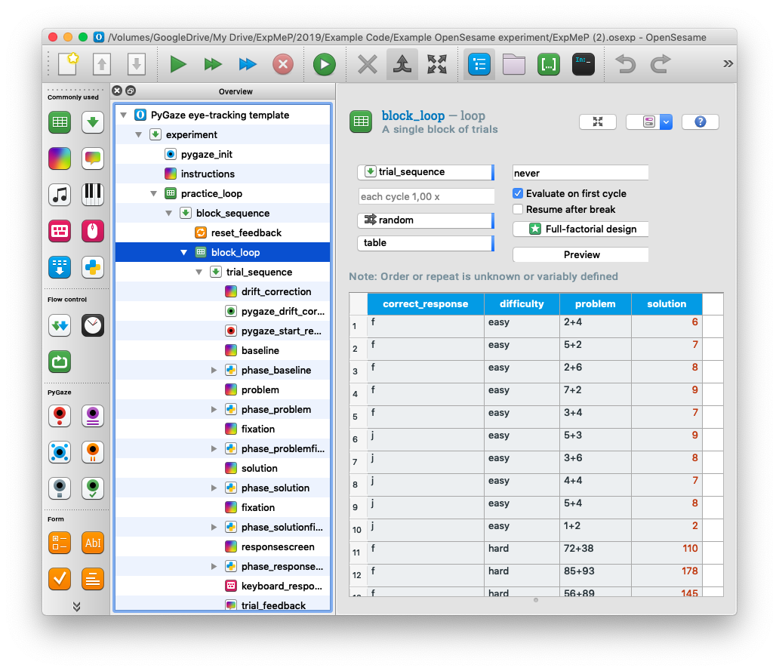
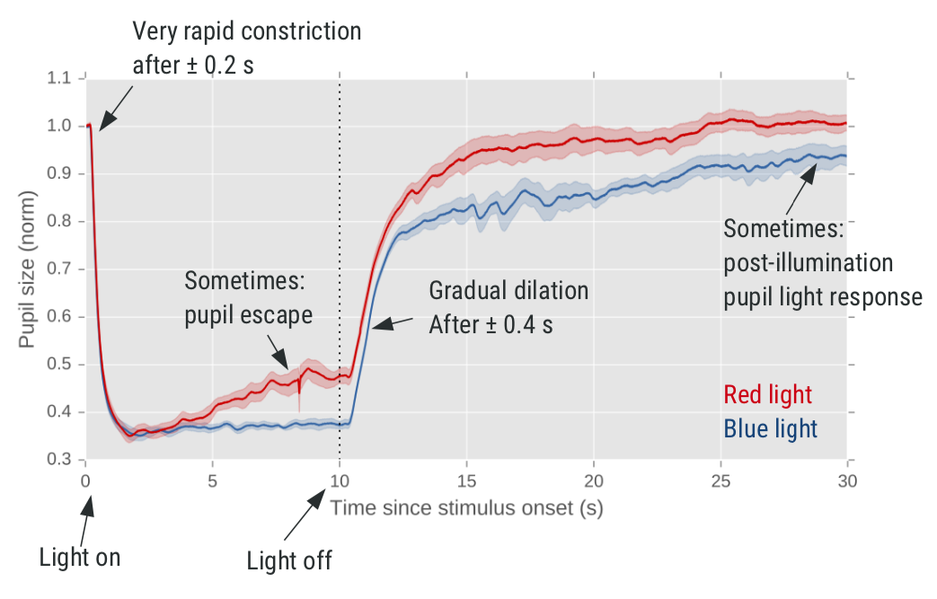
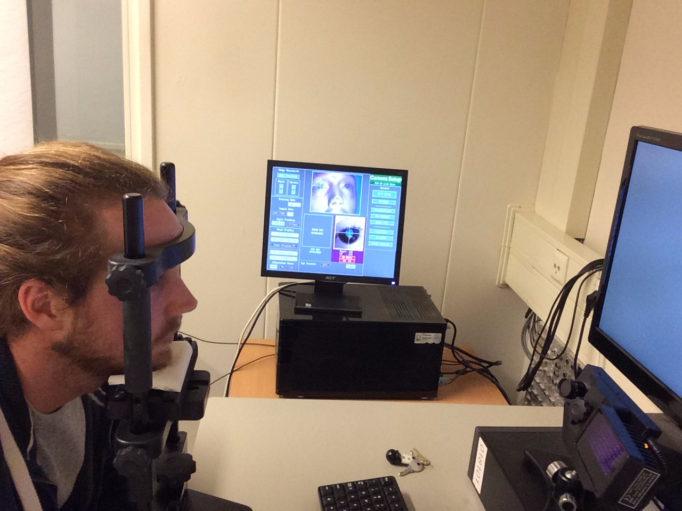
What is the purpose of this course
Build experiment
Collect data from eyetracker
Analyse and report

Slide 7
What we expect of you
Assignment (graded 0 - 4), 20% of final grade
Assig 0: Choose an experiment
Assig 1: Build an experiment with OpenSesame
Assig 2: Programming in Python tutorial
Assig 3: Preprocessing pupil data (Python)
Assig 4: Analysing pupil data (Python)
Assig 5: Presentation
Final paper 80% of final grade
Abstract
Methods
Results

Slide 9
Pupillometry: Psychology, Physiology, and Function
Three types of responses
pupil light response
pupil near response
psychosensory pupil response
How are pupil responses modulated by high-level cognition?

Slide 10
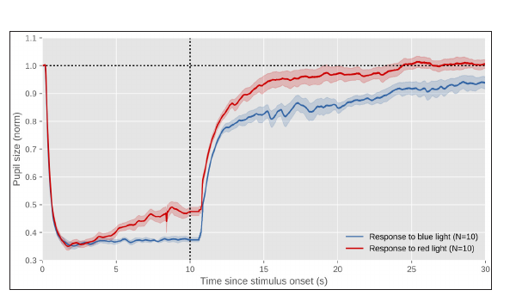
Pupil light response
Cognitive influences
Visual attention/awareness
Eye movement preparation
Subjective interpretation
Mental imagery and word meaning
Working memory
Where is it good for?
Transition bright to dark (not to protect us)
Depth of field & visual acuity

Slide 11
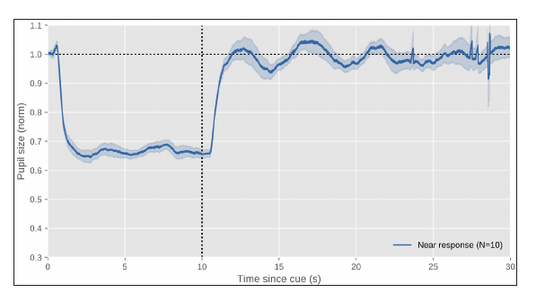
Pupil near response
Cognitive influences (?)
Where is it good for?
Increase depth of field near vision

Slide 12
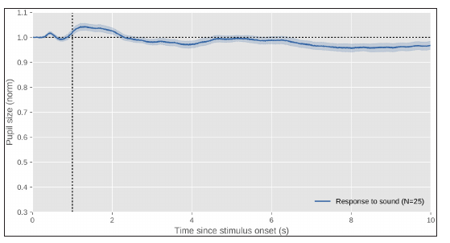
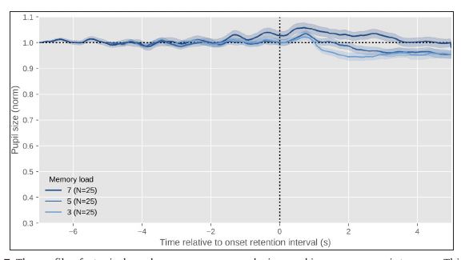
Psychosensory pupil response
Cognitive influences
Sudden events
Mental effort and arousal
Adaptive-gain theory: role of Locus Coeruleus (LC) in regulating behavior
Exploitation: phasic LC activity; more constriction
Exploration: tonic LC activity; more dilation
Where is it good for?
Trade-off visual sensitivity (dilation) and visual acuity (constriction) depends on the situation

