Slide 1




Slide 2
DATA+AI A TUTORIAL WEBSITE: LEARNING DATA ANALYSIS WITH CHATGPT

Slide 3

ASK PREPARE PROCESS
ANALYSE SHARE ACT
PYTHON & LIBRARIES
CHATGPT WORKFLOW
EXAMPLE PROJECT
TEXT, IMAGES & VIDEO

Slide 4
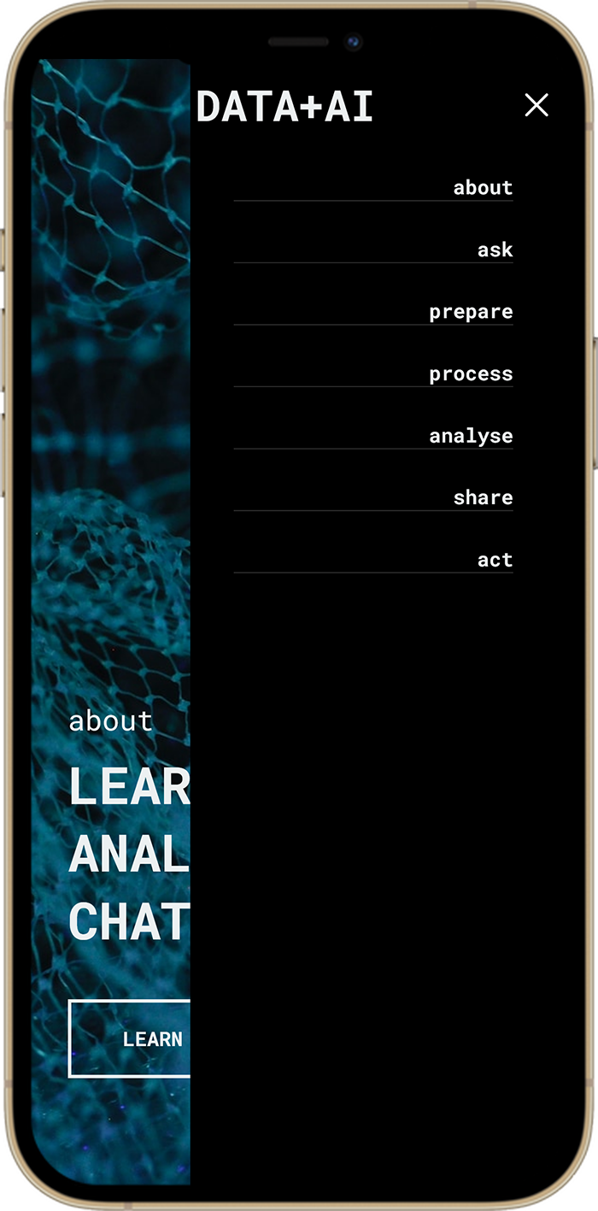
UNIVERSITY STUDENTS
YOUNG PROFESSIONALS
FUNDAMENTAL SKILLS
SELF-STUDY RESOURCE
JUMPING-OFF POINT

Slide 5
TEST UX WEEKS 5-8
NAVIGATION CATEGORIES
CONTENT LAYOUT DESIGN
WIREFRAMES
CODE MOCK-UPS
PEER GROUP A/B TESTING

