Slide 1
Investigating the Feasibility of Indexing Read Sequences and its Potential to Reduce Reference Bias in Variant Calling
研 究 生：周東誼
指 導 教 授：賀保羅 教授

Slide 2
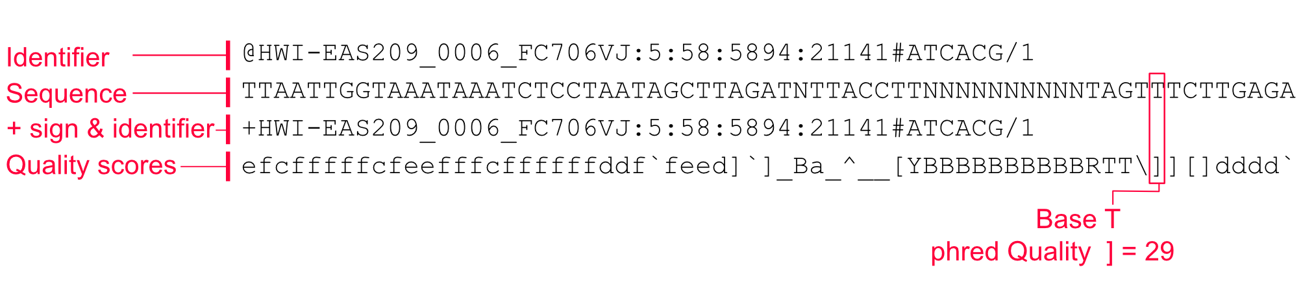
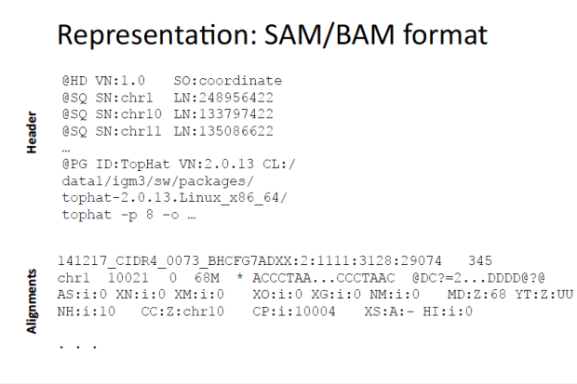
Varaint calling
Variant calling is the process by which we identify variants from sequence data
Carry out whole genome (exome) sequencing to create FASTA/FASTQ files.
Align the sequences to a reference genome, creating BAM files.
Identify where the aligned reads differ from the reference genome and write to a VCF file.
Variant classification
SNP(Single Nucleotide Polymorphism)
Indel(Insertion and Deletion)
SV(Structured Variants)
Notes:
1.1 usually done using Illumina sequencers produce read sequences for 150bp-250bp in length
1.1 fastq has quality score as ASCII characters
2.2 1bp< X <50bp,frequendce is markedly lower than SNP frequency(expect some repetitive region)

Slide 3
Sequence Alignment
Difference: Alignment vs. Mapping
Mapping: Find the approximate origin of a sequence.
Alignment: Find the exact difference between two sequences
Mapping is part of alignment
Mapping
GTGGTGCATCTGTTCTCCCCCGGCGGGAAGTA oqxB_EU370913
Alignment
GTGGTGCATCTGTTCTCCCCCGGCGGGAAGTACGACTCGCTGTATATG ||||||||||||||_||_||___|||_||||||||||||||||||||| GTGGTGCATCTGTTTTCGCCAAACGGTAAGTACGACTCGCTGTATATG

Slide 4
Mapping methods
1. KmerFinder
2. Kraken
3. Kallisto (development)
4. Salmon (development)
5. KMA-Sparse

Slide 5
Alignment methods
1. BLAST
2. Bowtie2
3. BWA-MEM (development)
4. GraphMap (development)
5. MiniMap2
6. KMA
Notes:
Why so many ?
1. We have a lot of different analyzes to carry out. Therefore different assumptions and pathways are taken to perform these tasks.
2. One shoe might fit all, if you cut bits of your feet.
Take home messages
1. Every method has its own assumptions.
2. When you choose a method, you better be sure that your data and hypothesis fits within these assumptions.
3. Most methods have a big variety of settings, which lets you fine tune it to improve predictions or make better use of the computational resources.
4. Read the documentation of your method of choice in order to fulfill #1, #2 and #3.

Slide 6
Reference bias
DNA is fragmented and sequenced.
The sequenced reads are then aligned to a reference genome for the species.
read alignment is performed using a linear reference genome
does not capture the genomic diversity of a population
reads that highly differ from the reference do not map correctly, and are either mapped to the wrong position in the genome or remain unmapped altogether.
Notes:
Incorrect read mapping in turn leads to false negative or false positive variant calls.
Most region suffer little bias,reference bias does have the potential affect downstream analysis

Slide 7
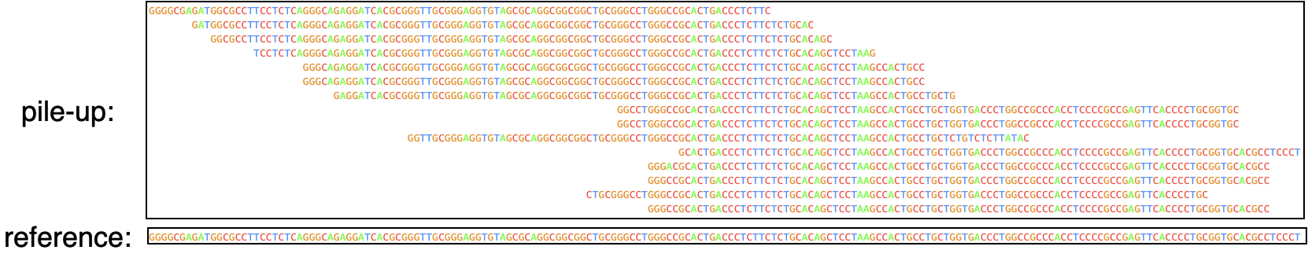
Pile-up
Notes:
First, perform read mapping for all sequencing reads against the reference genome.
Then stack those mapped reads on top of each other in a special kind of multiple alignment often called the “pile-up” with the bottom sequence being the reference genome
A simple way to do variant calling is to simply scan this pile-up multiple alignment looking for columns in which read sequences consistently differ from the reference genome.
Many reads may overlop at the same position,whuch called the pileup

Slide 8

Notes:
Reference bias. When aligned to a linear reference genome, only a small proportion of sample reads containing an insertion (dark blue) are mapped to the correct position.

Slide 9
Variant calling tools
GATK
Platypus
FreeBayes
These method are “heavy” reliance on the pile-up can leads to mistake in repetitive region

Slide 10
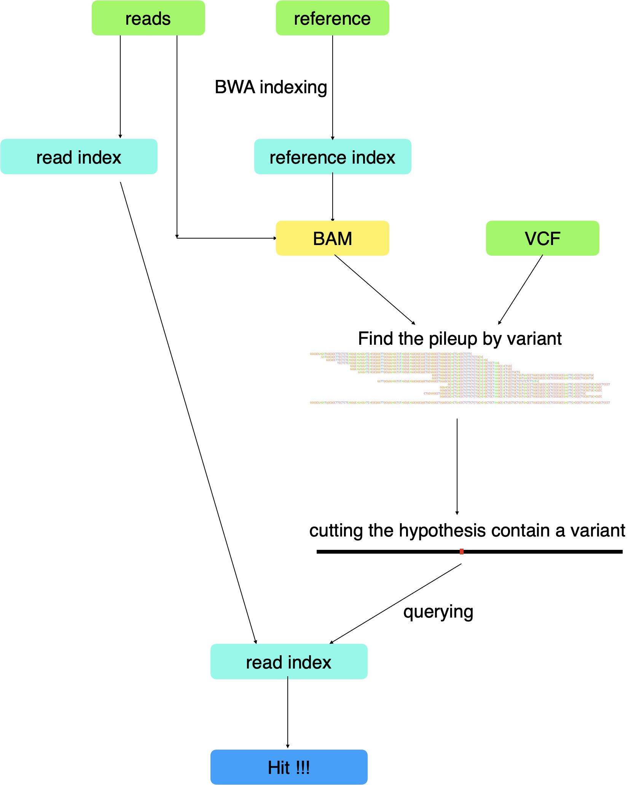
Reduce Reference Bias

Slide 11
Step 1 . map the read on the reference genome
Use BWA-MEM
bwa index ref.fa
bwa mem ref.fa reads.fq > aln-se.sam
samtools view -S -b sample.sam > sample.bam
Notes:
BWA is a software to align the reads on reference sequences based on Burrows–Wheeler Transform (BWT).
Using the FM-index [14] which combines the BWT and suffix array enables the backward search, making querying more efficient

Slide 12
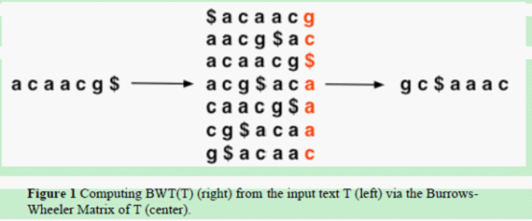
BWA- FM-index
Burrows-Wheeler Matrices(BWT)
Notes:
Core of algorithms are data structures called indexes which contain information about set of sequences(called the text)
Hssh tables
Suffix array

Slide 13
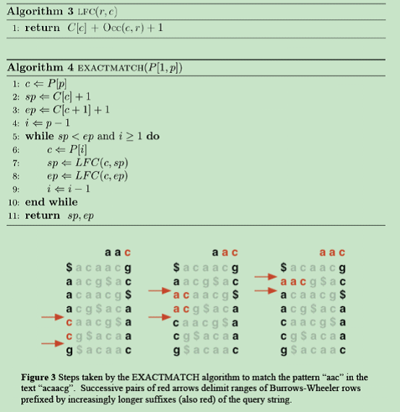

Slide 14
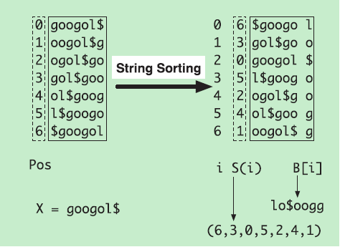

Slide 15
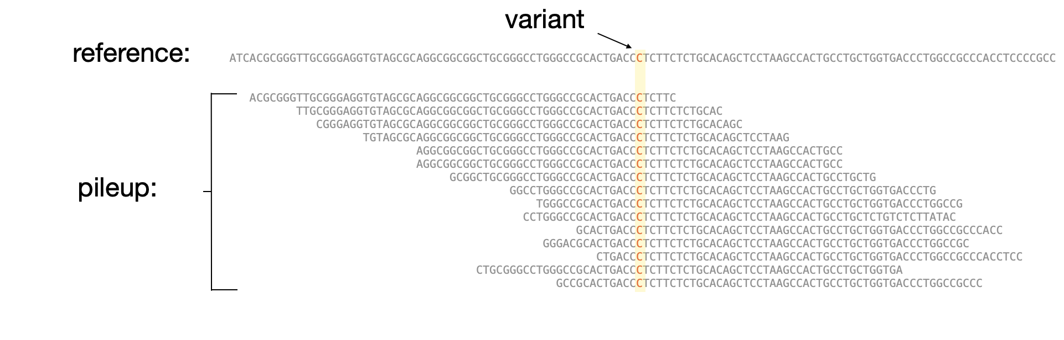
Step2. find the pileup
In the BAM file, we can observe that the reads are mapped to a position of a chromosome. Many reads may overlap at the same position, which is called the pileup.
Notes:
we get the variant position from the VCF file and find the same position on BAM, then we can get some reads which are covered in the position.
HTSlib

Slide 16
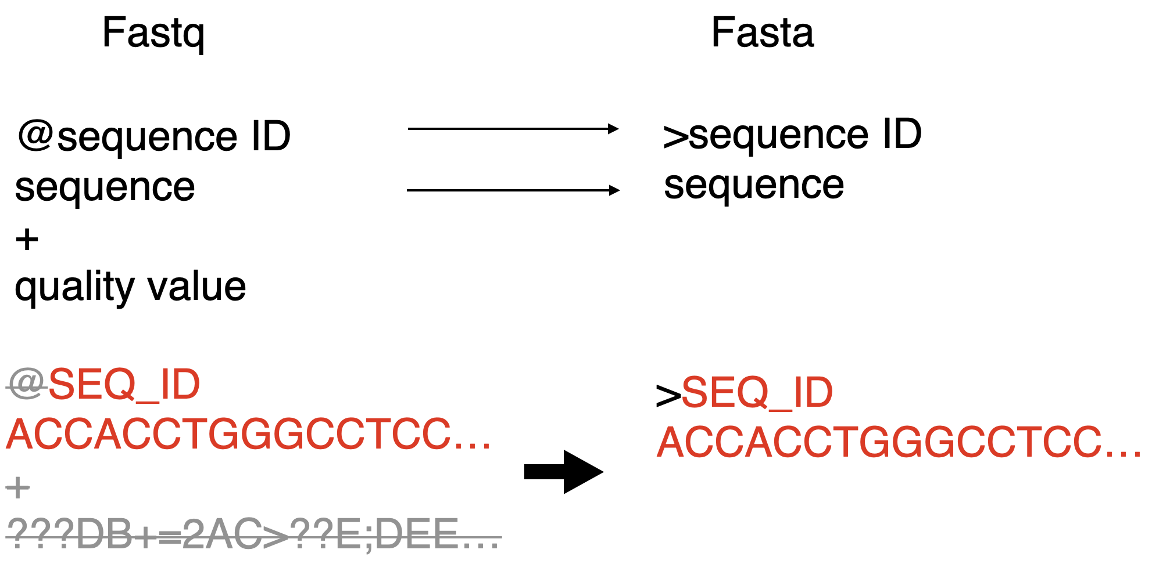
Step3. Read index

Slide 17
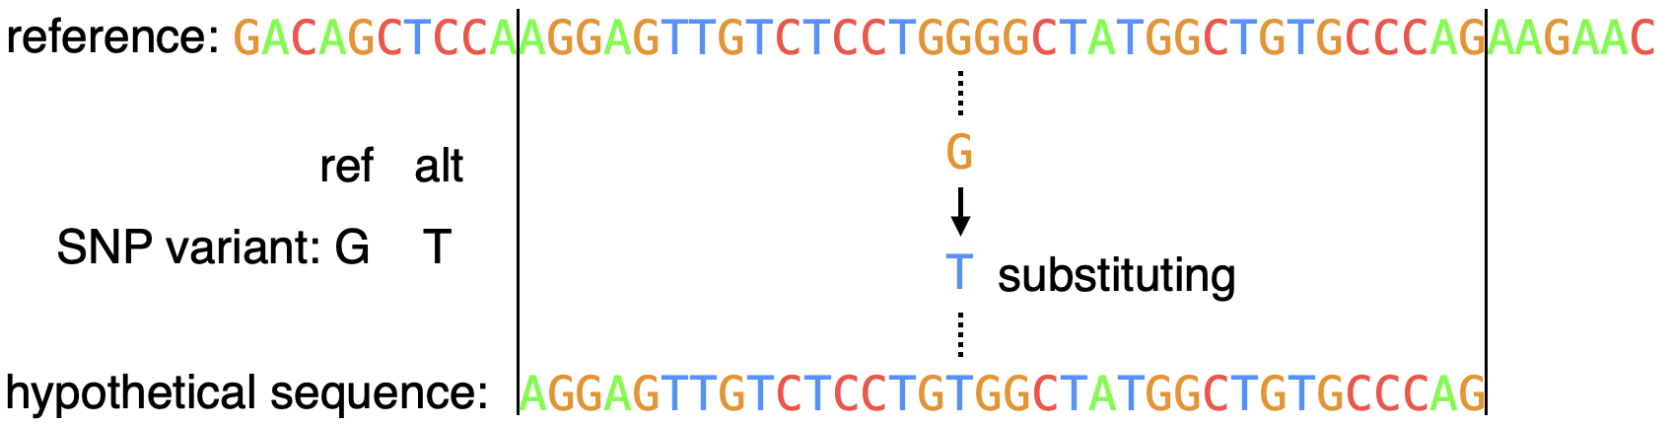
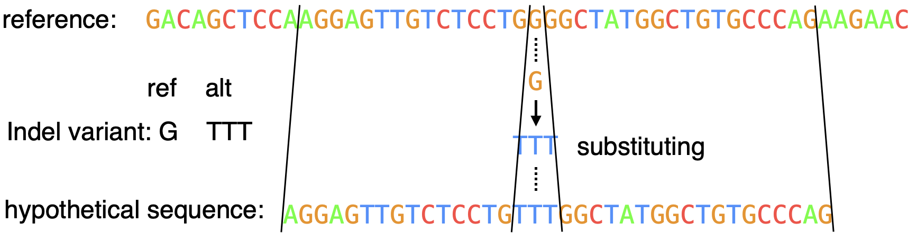
Step4.Hypothetical sequence
1. produce the sequence by editing a region of the reference sequence to include a variant of interest

Slide 18
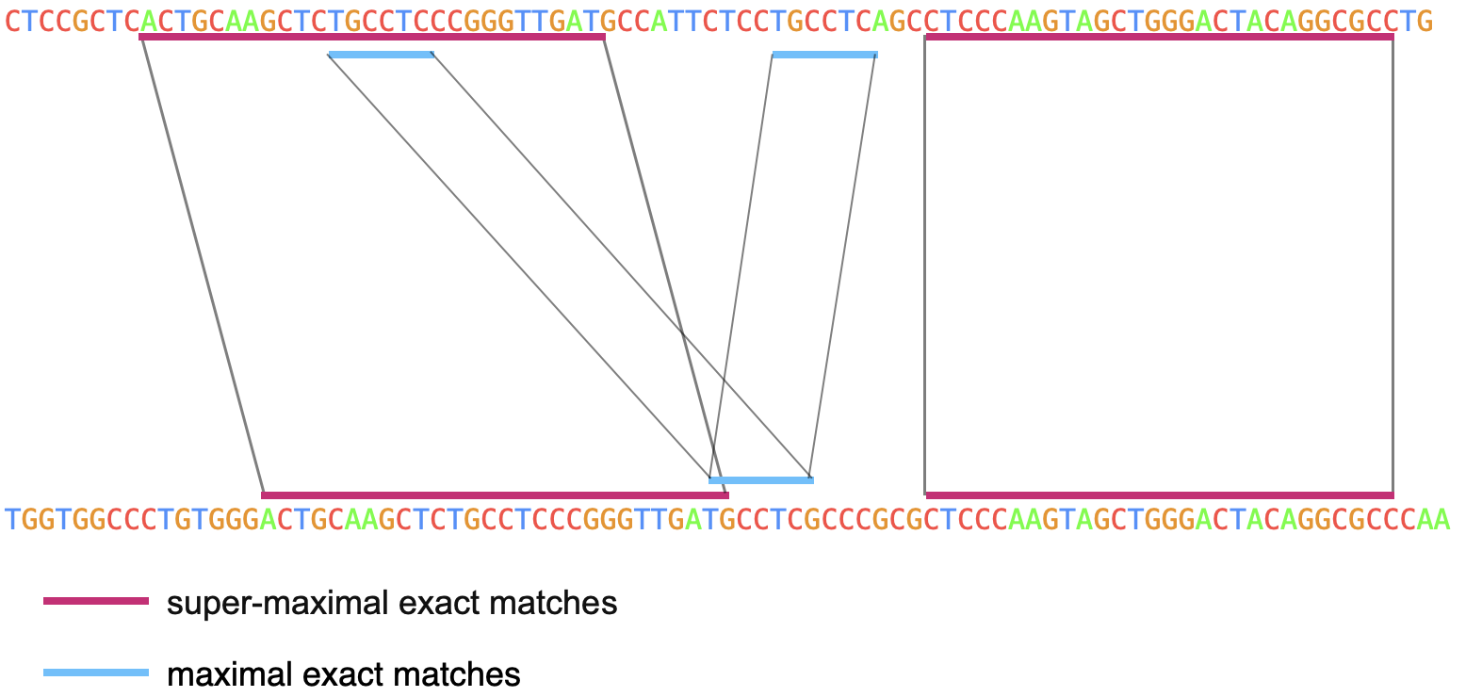
Step4.Hypothetical sequence
2.called BWA function to obtain the position in the indexed text of super-maximal exact matches (SMEMs) to a query.
Notes:
indexed text is the read sequences
Formally, a maximal exact match (MEM) is an exact match that cannot be extended in either direction of the match. An SMEM is a MEM that is not considered in other MEMs on the query sequence
super-maximal exact matches are defined as MEMs that are not contained in another MEM in the read

Slide 19
