Slide 1
Analysis : Four Levels of Validation
CDS505/CCS514-Data Viz. & Viz. Analytics
Notes:
In Munzner’s vis definition she included an important element which many definitions failed to consider i.e. an element of “effectiveness” of the vis idiom. This aspect of vis is often neglected due the complexities of the issues surrounding it. How ones validate that a particular vis idiom is effective? i.e. solving the goal of the target users. As it turns out there are many different aspects to validate, each of which are closely related to one another, hence the complexity. Munzner approaches this through a four levels of validation – the domain/application, the abstraction level (what-why), the vis idiom (how – encoding & interaction), and the algorithm (instantiation of vis idiom at computational level). The first and last levels are two new “steps” added to her vis analysis framework.

Slide 2

Visualization Definition : Revisit & Keywords
“Computer-based visualization systems provide visual representations of datasets designed to help people carry out tasks more effectively” (Munzner)
Data
Visual Encoding
Visualization
Perception
Interaction
Notes:
Explaining step-by-step the “process” of visualization – emphasizing on these three keywords; Revisiting Viz’s def and relating the main keywords – Data (What to visualize), Visual Encoding (the How part) and Interaction (the Why – manipulation tasks to help users slice-&-dice either interacting with visual idiom or with the data to understand or get insight from).
More crucially in this case is the “effectiveness” keyword (the perception part in the above diagram) – which raise a question of “how do we assess this?”

Slide 3
Evaluation of Viz’s Idiom Effectiveness
How do we know how effective a visualization idiom is?
Could we address this issue (measurement) in vis idiom’s design?
Why it is such as a challenging issue to address?
What is a unit of measurement for “effectiveness” that we can agree on?
Notes:
Evaluation of vis idiom effectiveness is a big issue & difficult to address (hence most shy away from addressing it). It is challenging due to many reasons, some of them are highlighted below :
The users (or more generally human) – our perception of “effectiveness” varies based on our experience, knowledge (what we know/don’t know), etc.; hence it is very subjective; it is also relates to our physiological differences – some can perceived colours better than other (cf colour blind), etc.
Various factors in the visual artefacts itself – the domain it is designed for, the data & interaction it supported, the visual encoding (colour, shape, texture, lines, etc) or finally the algorithm/implementation of the specific vis’s idiom
Munzner’s tried to address this issue by systematically “breaking-up” the effectiveness issues in hierarchical layers (inter-dependence).

Slide 4
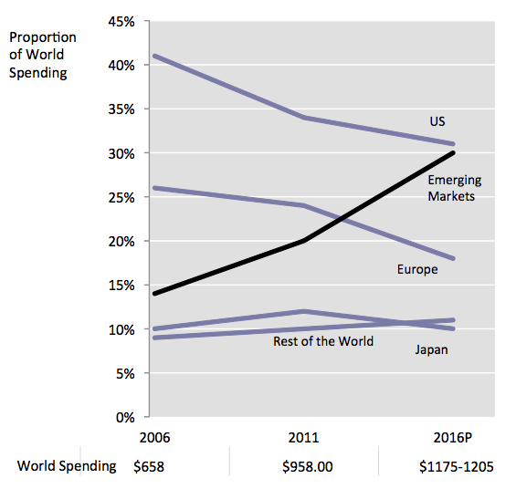
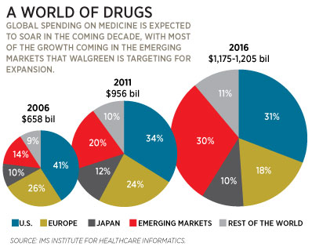
Expanding Circle of Errors
Example taken from: Junk Charts: Expanding circles of error
Notes:
How do you assess the quality of a visualization? How do you know that one visualization is better than another? That's a very important question. So, isn't that subjective? I show visualization to some people and some people like A, whereas some other people like B. Isn't that just about what people like? People have different tastes. Some visual representations are actually much better than others at communicating some information. So, if your goal is to communicate information to somebody else effectively, some visual representations are clearly better because they are easier to interpret, and easier and faster, and more accurate to read.
This is a visual representation that comes from a magazine, and it's titled "A World of Drugs". And here, it's very small dataset, shows how the proportion of different markets in a global spending in drugs changes over time. Going from 2006, and 2011, and 2016, and these are presented by three pie charts, but these pie charts also have different sizes that are meant to represent the growing spending over time, but also how the proportions change over time.
So now, if your goal is to show how the proportions change over time across these markets, that's not a particularly good representation. So, there are a number of issues here. Well, visually, we tend to perceive quantity with the area of the segments. But the quantity that the designer here wants to convey is actually represented with the angle of the pies. So that's one problem. So, we see something that is growing because the area is growing, but the intent is to communicate the information that is actually mapped to the angles of the pies. Another problem is that the angle and the size interfere. So it's very hard to disentangle these two pieces of information. Another problem is that if we want to see how proportions change over time, we have to mentally link these areas across the segments, which are also not aligned, which makes these comparison even harder.

Slide 5
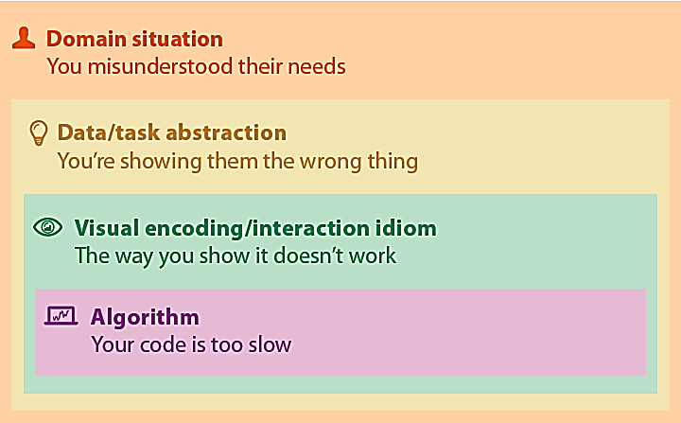
Why Validate?
Too many choices, most of them ineffective
Validation refines design choices based on the feedback
Why it is difficult?
Different ways to get it wrong at each level (user’s requirements, wrong data & task abstraction, incorrect vis idiom, etc.)
Require multi-disciplines validation approaches in different levels
Notes:
Validation is essential to deliver “effectively” vis idiom that fulfil target users goals; it is achieved through a series of feedback gathering at various levels of design framework, through which your vis idiom design is being refined/fine-tuned, hence specialized enough to address “narrower/well-defined” user’s goals. Feedback is gathered through different types of approaches e.g. user’s study to capture essential data/tasks at domain level, interview & survey to get user inputs (domain level), field study observing target users after vis idiom deployment (abstraction level), checklist of “good design criteria” (visual encoding & interaction level) or quantitative measures – system performance, user productivity, etc (at algorithm level). Note that practical validation for all levels is next to impossible due to different types of approaches needed, time consuming and costly.

Slide 6
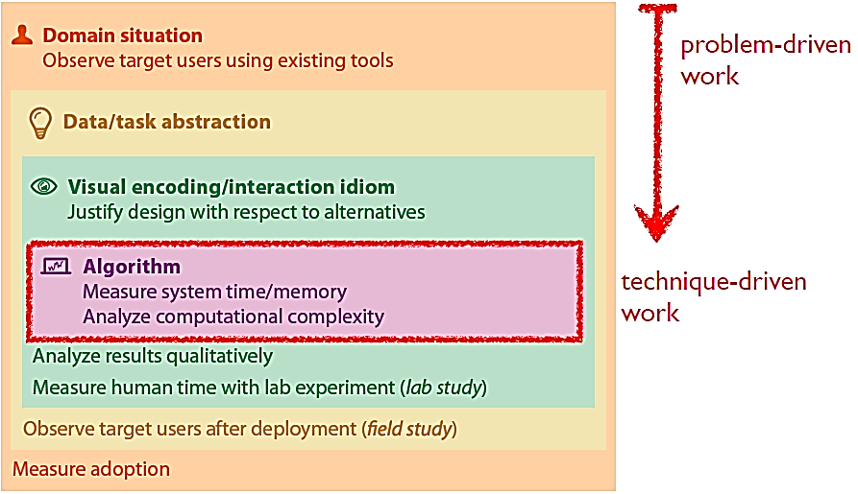




The Big Picture – Nested Model of Vis Design and Validation
Notes:
Figure borrowed from the book. A complete nested model of vis design and validation – it highlighted that validation followed different approaches for each level – coming from different area of studies or field e.g. anthropology/ethnography, design (creative arts/media), CS, HCI, cognitive psychology; play crucial roles in creating “an effective” vis.
The strategy to approach design and/or validation is either problem-driven (top-down) or technique-driven (bottom-up) or a mixture of both. Which one is more “natural”?; if you’re tasked to address users problem, naturally you would approach it from the top through the implementation stage, which is logical, meaningful to update progress & also to do validation at each stage. But if you aim is says to “improve” existing (specific viz’s idiom), perhaps it is too slow or users want to enhance current viz’s idiom, it is than natural to start with the current artefact.

Slide 7
Design Choices Validation
Activity 4.1 : Validating your design
Imagine you’re designing a solution to fulfill target’s user goals (in your respective field).
Think individually what would you do/use to check/validate whether your choices are correct.
Take turn to explain validation approach(es) in your field
Explain to the class your points either individually or consensus as a pair

Slide 8
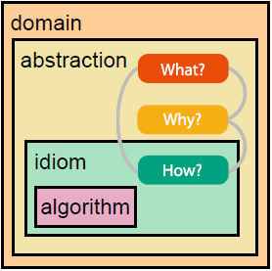
Analysis Framework : Four Levels, Three Questions
Domain situation – who are the target users?
Abstraction – translate from specifics of domain to vocabulary of vis
What is shown? data abstraction
Why is the user looking at it? task abstraction
Idiom – how it is shown?
Visual encoding idiom : how to draw?
Interaction idiom: how to manipulate?
Algorithm – efficient computation
Notes:
Revisiting the analysis framework (what-why-how), but now with the additional two more layers to complete the framework. The outer layer (new - domain or application level) “encloses” the entire problem domain and thus dictates the overall vis design choices; Abstraction layers (what-why) mapped domain specifics “terms/vocab” to domain independent vocab; vis idiom (how level) specify approach to visual encoding & interaction; finally the lowest most level (new), algorithm instantiates idioms into its computational form.

Slide 9
Domain Situation (Design Level 1)
All about target user’s requirements (specifics) :
Explanation in domain vocabs : data, tasks, existing workflow, narrower or broad-based target users
The goal here is to identify the needs of target users
Methods used : interview, observations, specific research study of target’s users; explore the data, draw/prototype
Difficulties in identifying user needs :
Users do not know what their needs (in the context of vis)
Users unable to articulate their needs for vis
“what they says is different from what they do” with their data
Incomplete picture; common tasks dominate rarer ones, where most of the complexities lie (hence the need for vis)
Outcomes of situation block :
a series of questions or actions your users want to carry out with this data.
Notes:
Goal here is to identify user’s requirements – understanding what they do (tasks) with the data; often explained in the terminology specific to the domain (hence very constrained point-of-view).
Understanding who are your target users and what problems they need to solve with (their) data.
Outcome of this step: a series of questions or actions your users want to carry out with this data.
One of the best approach to study what the mind is thinking and what the user’s eventually do (the tasks) is to look for the “errors/flaws” they make.

Slide 10
Task and Data Abstraction (Design Level 2)
The goal here is to map domain-specific task & data description (from level 1) to a generic representation. Why?
Abstract data blocks are designed (contrast to identified as in domain situation) – so it is an active creative design process.
Crucial issue to consider is whether to derive new data type that would support vis idiom that address user’s goals (effective solution)
E.g. transforming quantitative temperature data (given) into categorical (derived) type (freezing cold,cool,mild,warm,hot,boiling hot) which later mapped into colour visual representation (dark blue, blue, light blue, …)
The nested model explicitly exposing this abstraction stage, hence forces an informed justifications to be made in design choices for data & tasks
Outcomes of Task-Data Abstraction block : identified tasks block and designed data abstraction block
Notes:
Abstraction (as discussed in last lecture) allows us to generalize a problem and helps us to see/find similarities (in/of data & tasks) across domains – by hiding details; and thus we can learn or borrow good effective data & tasks from other highly successful domains (or conversely avoid pitfalls) in our design choices of why vis tool is needed or what data is suitable/shown.
Transforming given data/dataset is crucial element in design choice in the process to get better vis idiom that support user’s goals – and this process is made explicit. That is every design choice is to be justified rather than implicitly assumed (by-passed/shortcut).
Classic example is addressing the problem of “lost in hyperspace” in early web vis idiom; most implicitly assume (lacking evidence to justify their choices) that “showing a visual representation of the topological structure of web’s hyperlink connectivity graph” would address this problem – it turns out the graph incurred additional cognitive load for the user rather than reducing it.
After domain situation you need to understand what needs to be visualized for what tasks.
If you fail here it means you are not showing the right things and/or supporting the right operations.

Slide 11
Case Study : PLUS Traffic Tweeters
PLUS provides tweet updates about traffic conditions on their North-South Expressways (NSE)
Visit this site to see the tweets : https://twitter.com/plustrafik?lang=en
You have been approached by PLUS to design visualization idioms to improve its tweets displays which need improvement ...
Identify the common language/vocabs use in their tweets
Extract the data, possible tasks (if any), workflow or anything from twitter’s site that will help you in your understanding of PLUS’s Domain
As the users of NSE & PLUS’s traffic tweets, list down “things/issues/functions” that you’ve with the current “displays/interface” … the opposite of this is what would you like PLUS to provide for YOU as their customer

Slide 12
Visual Encoding & Interaction (Level 3)
The goal is to design vis idiom from abstract data block guided by abstract tasks (output of level 2)
Two main concerns :
Visual encoding : how to draw
Interaction : how to manipulate
Idiom blocks are designed – active creative decision making
Quite challenging tasks as there are many design options even for static; enormously huge for dynamic manipulation scenarios
Luckily, design choices are heavily constrained by data & task blocks abstraction :
Checklist of good/bad design options (if it exist – experts opinions)
Effectiveness are mainly judged against human visual perception & memory
Notes:
Idiom is distinct possible approach for visual encoding & interaction. Due to the nested nature of design model, design decisions made here are heavily influenced by abstraction blocks choices. Which also means that “errors” in design choices are inherited & accumulated – this can only lead to difficulty in pinpointing the “source” of design error (if such “error” make sense).
Though design choices for visual encoding and interaction could be independent from one another; in practice often they are closely intertwined to one another.
The design here could mean you’re coming up with new/novel vis idioms – new idea of visual encoding and interaction (which has the implication that you have to design the algorithm as well) or you came up with new design by combining, integrating, mixing/hybridizing existing vis idioms to match the users’ goals – another word for this is adoption.
You need to design effective visual representations and interactions for the data and tasks identified.
This is where you need to know how to get rid of poor matches and ideate good designs.

Slide 13
Algorithm (Level 4)
The goal is to design (or choose) algorithm that efficiently handle visual encoding & interaction idioms i.e. computational issues
Many alternatives which differs in term of visual quality, execution speed, memory requirement, accuracy (approximation or exact match) – issue to consider how well it instantiated the visual encoding & interaction idioms
Example : three types of direct volume rendering algorithms to choose from visualizing 3D CT-scan or MRI data.
Notes:
Algorithm – a detailed procedure that allows a computer to automatically carry out a desired goal (classic CS definition). In the context of nested model, algorithm blocks are instantiation of vis idiom into computational form (implementation). Therefore, the main issues of concern are computational rather than human visual perception – how fast is the image generated, sharp/clear visual depictions, support many colour, high-resolution etc.
Implementation level details can complicate the selection process e.g. programming language, graphics library, OS, hardware, etc.

Slide 14
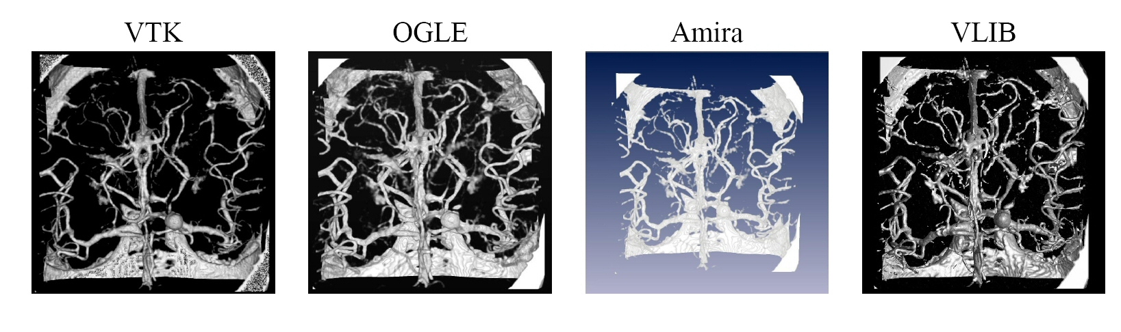
Comparison of Ray Casting and Texture Approaches
Ray casting
Texture-based
Texture-based
Ray casting
http://www.cora.nwra.com/Ogle/
http://www.amiravis.com
http://vg.swan.ac.uk/vlib
Notes:
This example show outputs from two types of direct volume rendering (DVR) algorithms – ray casting & texture mapping; from 4 different implementations (open source – VTK & VLIB, commercial – OGLE & Amira). Notice differences in term of output’s quality; ray casting tend to produce shaper results, more realistic (with depth cueing information – shading & highlight), whereas texture-based is less realistic. In contrast, ray-tracing is time consuming whereas texture-based is relatively fast (especially with hardware support texture mapping).

Slide 15
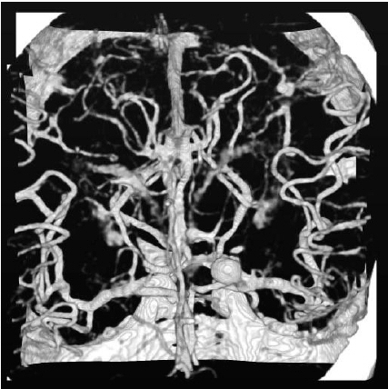
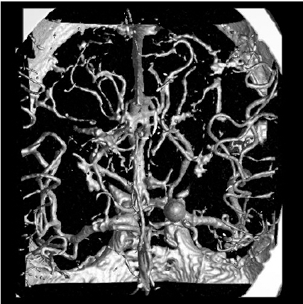
Close Up
Ogle: texture-based
Vlib: ray casting
Notes:
Close up views show clear differences between ray-casting and texture-based. As noted earlier, texture-based output appears “blocky” (due to the texture’s image projection on either 2D or 3D polygons), lacking in depth cues (not bad for 3D texture). Contrast this with ray-casting, output looks realistic with good depth cues support

Slide 16
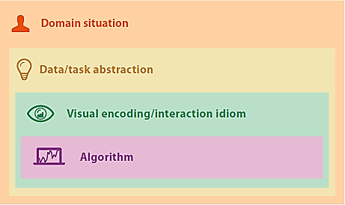
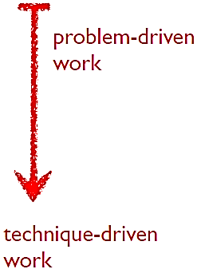
Approaches to Design
Top-Down
Bottom-Up
Top-Down : starts with user’s goals and work through 4 design levels to create a solution that addresses user’s goals effectively
Selecting existing vis idioms (cf designing new ones)
Challenges lies in abstraction level (mapping domain-specific to generic reps)
Bottom-Up : start with ideas on NEW vis idioms & algorithm; analyse existing idioms to improve computational efficiency (algorithm), coming up with new vis idiom design addressing specific gaps, etc.
Notes:
In top-down approach, the main issues are (i) understanding user’s needs (identify the right problems – data & task used) and (ii) translating that domain-specific needs to an abstraction of data & task. Hence, it is logical the downstream design activities (level 3 – 4) are mainly revolving around selecting/choosing suitable vis idioms (encoding + interaction) & algorithms to effectively solve user’s goals. This is not to entirely disqualify the possibility in bottom-up approach where a new design of vis idioms & algorithms are needed, especially in cases where existing idioms are not suitable/efficient to address the user’s goals. In terms of skill set (knowledge of expertise), top down approach stresses more on design ability or design expertise, not so much on the technical abilities which are crucial for new vis idiom & algorithm’s design.
Bottom-up approach is typical for improving existing vis idiom either its computational efficiency (speed, time, memory) or alternative encoding & interaction that provide better cognitive visual perception supports. Often, it ignores the target user’s goals for addressing specific problem (at domain level) BUT it addresses the user’s computational efficiency concerns.
Irrespective where we start the design process, the 4 levels design model allows visiting to other’s levels, refining the design choices in those levels and this can be done in iterative fashion.

Slide 17
Revisiting Validation – its Pitfalls/Threats
Validation – test if you’ve designed the
right solution (at every design level)
Checking your design decision using the same 4 levels model
Distinct fundamental design decision errors at each level :
Wrong Problem : Vis Designer misunderstood target’s user needs
Wrong Abstraction : Vis Designer showing target’s user the wrong thing.
Wrong Idiom : The way Vis Designer show the thing that does not work
Wrong Algorithm : Vis Designer code is too slow
Notes:
See the side note (in a box) on pg. 75 in the textbook, Munzner justified her choices of the terms ‘threat’ (which sound scary & intimidating) and ‘validation’.
So there are many ways to get your design decisions wrong, and at each level your errors exhibit different set of fundamental design requirement. The 4-level model, helps us to “systematically” consider all of these errors at each of the step through a set of well established validation approaches ranging from cognitive psychology, HCI, User’s studies to technical quantitative validation as in computational aspect.

Slide 18
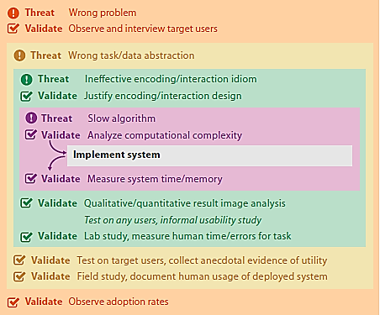
Validation Approaches - Overview
Immediate Approach :
Validation done at a level independent from other levels (no dependency)
Down-Stream Approach :
Validation at a level only possible when a complete instantiation of vis idiom is available i.e. need results from upper levels
Notes:
First, notice the validation is nested !! Which could only add to the complexity of the validation process. An immediate validation approach is only possible in a few cases such as at algorithm’s level – when all the upstream design choices are made, hence a “complete” solution description are available for algorithm design (and implementation). At best, immediate validation approach only offer localize feedback (incomplete). In most cases, down-stream validation is the only viable validation approaches. The problems with down-stream approach are many and of variety in nature; in fact it is next to impossible to characterize these problems. Since there are many levels involved, ones face with a problem on exactly pinpointing where is the source of the errors – as noted earlier, the nested nature of the model allows inherited errors to be accumulated which often exposed as symptoms in the final instantiation while hiding the real/core errors. What choice do we have?
Rapid prototyping models such as Agile or Lean development approaches may help alleviate or reduce some of the problems.

Slide 19

Domain Validation Approaches
Mischaracterized target’s user problems (incorrect problem)
Field study – observe & interview user’s in their work environment; or contextualize inquiry (interrupt to probe more details about the nature of the work).
Is this immediate or down-stream validation approach?
Adoption rate study – observe/report the rate at which the solution has been adopted by the target user in their working environment.
What are the merits and/or the possible flaws of these validation approaches?

Slide 20

Abstraction Validation Approaches
How do you validate abstraction concept?
The challenge is that our designed data & identified task abstraction blocks do not solve the characterized problems of target’s user.
E.g. says you’ve decided to use network dataset and the associated network’s data manipulation operations for the task. How do you validate these abstraction design choices?
Two down-stream approaches :
Test on target’s users, collect anecdotal evidence of utility e.g. insight found
Field study, observe & document human usage of deployed system look for behavior changes
Are there more direct immediate validation approach for abstraction blocks?
Notes:
It seems, this is the hardest level to validate (bearing in mind that it is also the hardest part to design), due to its ‘abstract’ nature. Unlike, physical models which abstracting some physical underlying phenomena e.g. weather forecasting models where we could refer to well established scientific theories in the field, and then we can formalize the model with mathematical or logic formulation, which we can then theoretically validate such model. Is there equivalent of this validation approach for our data & task abstraction blocks?
The fundamental issue is the central role played by the target’s user i.e. human in the loop (refer to Munzner’s vis definition); which requires validation to focus on the part of user’s qualitative (or quantitative) satisfaction levels. That is we’re validating indirect qualities (or otherwise errors) exhibited by our choices of data & task abstraction. For instance, in the lab test, we could have measure the time user took to work with our network dataset and/or later interact with the data to accomplish certain tasks – longer time, not effective??

Slide 21
Idiom Validation Approaches
The threat is that the chosen idioms are NOT effective at communicating the desired abstraction to the target’s users
Immediate approach : Justify encoding/interaction design principles
Checklist , heuristics evaluation and expert review
Guard against violating well-known guideline for vis idiom design
Down-stream approaches :
Lab study : measure human time/errors for task, mouse movements, clicking actions, eye tracking movements (quant); users preferences & reflection (qualitative).
Presentation & qualitative discussion on results : active focus discussion between designer & users pointing out the desirable properties or flaws in the vis idiom results (typically for specific usage scenario)
Qualitative/Quantitative results image analysis (quality metrics) : number of edges crossing, edges bends in network node-link visual encoding
Notes:
So it become measure for effectiveness in two forms – qualitative and quantitative; immediate approaches seemed to focus on qualitative measure relying on past findings of good design criteria prepared by the experts. The degree on which these qualitative effect, effectiveness measures are addressed is not clear, so it become as a checklist exercises to fulfill good practices discovered in the past, which may not be relevant in today’s effectiveness requirements. Says for instance, the dynamic nature of data or streaming in today’s scenario may require a different set of checklist to be considered.
A more objective validation measures are those from down-stream validation approaches where quantitative metrics can show some interesting feedback on the effectiveness of vis idiom designs.

Slide 22
Algorithm Validation Approaches
The threats :
Is the designed algorithm suboptimal in terms of time & memory performance
Algorithm incorrectness – poor algorithm design or implementation problems (bugs)
Immediate approach : Theoretical complexity analysis of the algorithm e.g. Big-Oh notation
Down-stream approaches :
Experimental : execute the implemented algo. on some benchmark dataset to evaluate its computational performance e.g. time, memory, scalability, etc.
Implicitly done via peer reviewing the results presented in the papers (for validating algo. incorrectness)
Notes:
Validation at this level is common for CS field – complexity analysis via Big-Oh notation (theoretical analysis & validation), other down-stream approaches validate real algorithm performance (its implementation) such as wall-clock time & memory performance; scalability – size of dataset used which relates to some benchmark/standard reference dataset

Slide 23
A Simple Example – Algorithm Incorrectness
This table shows the observed oxygen levels in the flue gas, when coal undergoes combustion in a furnace
TIME (mins)
0
2
4
10
28
30
32
OXYGEN (%)
20.8
8.8
4.2
0.5
3.9
6.2
9.6
User would like to investigate if there is any correlation between these two variables; what kind of correlation?. Can you design a believable vis idiom to address user’s needs?
Notes:
A hypothetical case to prompt students understanding on the algorithm incorrectness

Slide 24
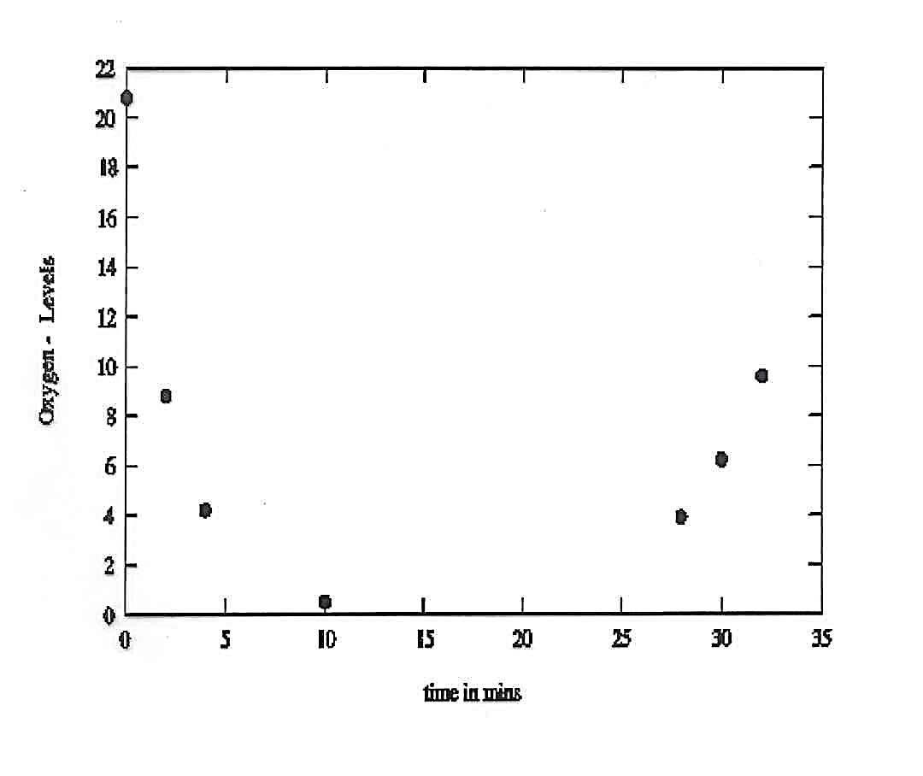
Visualizing the Data – Scattered Plot
but is this what we want to see?

Slide 25
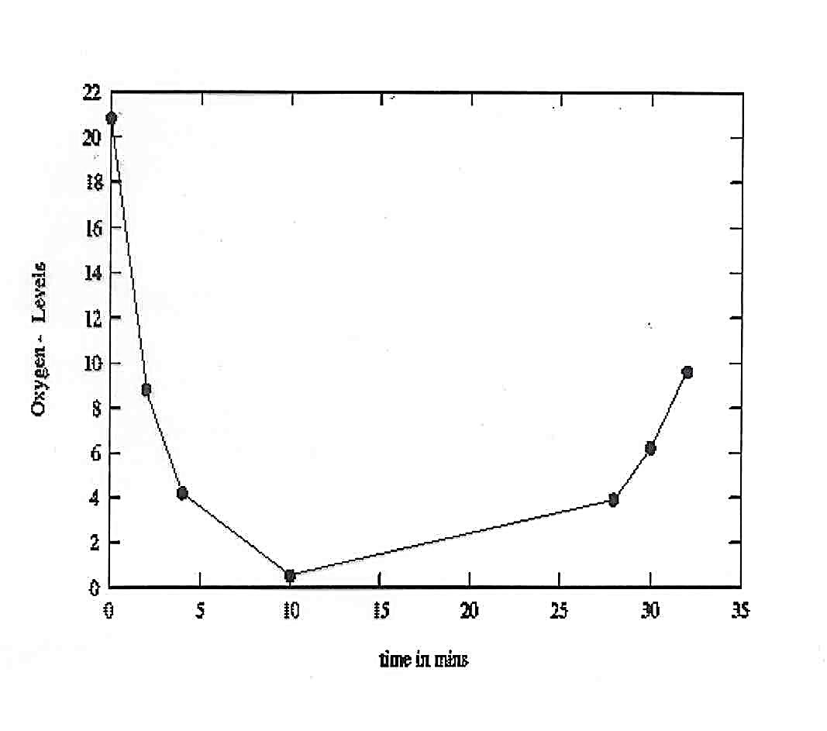
Estimating behaviour between the data - but is this believable?
Visualizing the Data – Line Plot

Slide 26
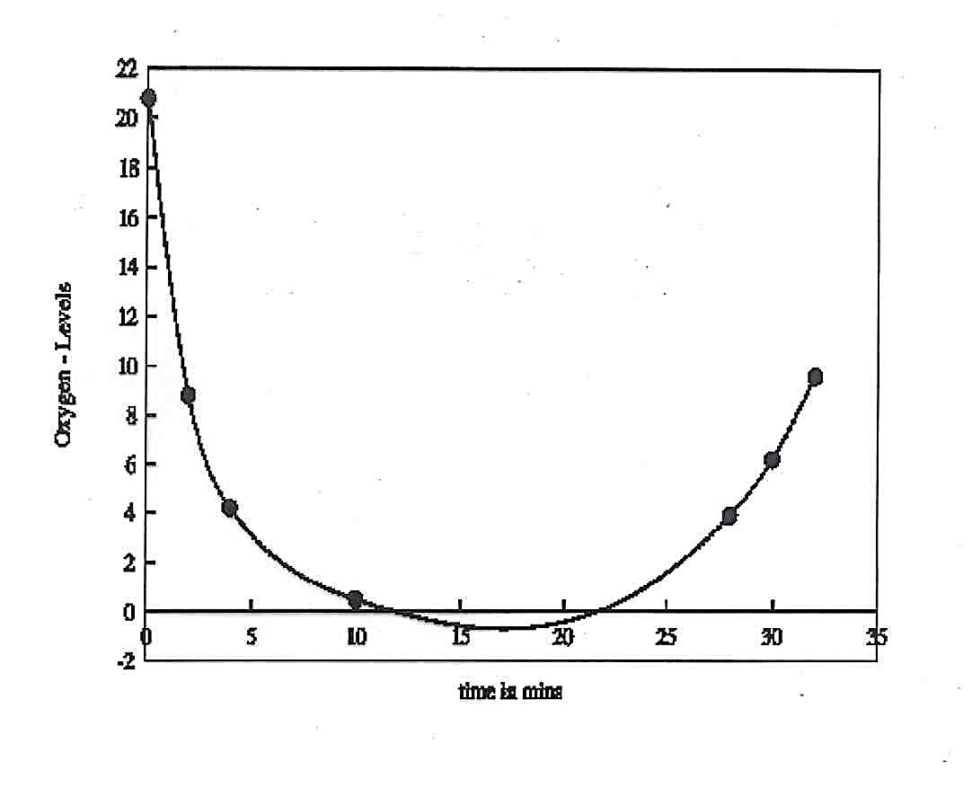
Now it looks believable… but something is wrong
Visualizing the Data – Curve Plot

Slide 27
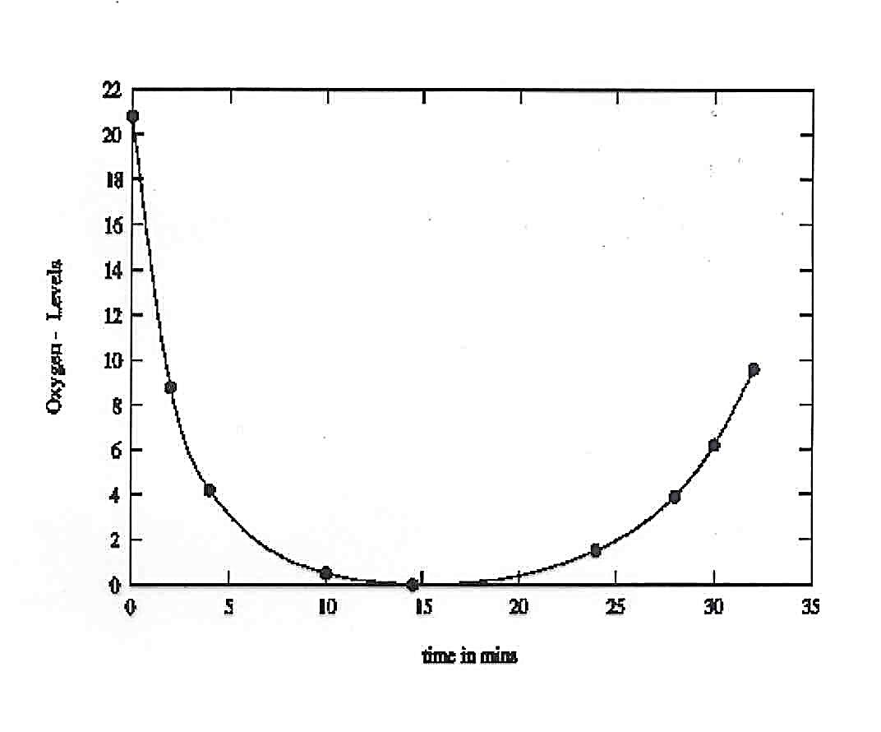
At least this is credible..
Visualizing the Data – Constrained Curve Plot

Slide 28
What Have We Learnt?
It is not only the data that we wish to visualize - it is also the bits inbetween!
The data are samples from some underlying ‘field’ which we wish to understand
First step is to create from the data a ‘best’ estimate of the underlying field - we shall call this a MODEL
This needs to be done with care and may need guidance from the scientist
The process of fitting a continuous curve (or surface, or volume) through given data is known as INTERPOLATION

Slide 29
Validation Examples
Genealogical Graphs
MatrixExplorer
Flow Maps
LiveRAC
LinLog
Sizing the Horizon
Notes:
Read the discussion in each example, relates how the various validation methods (at several levels) are addressed in the paper. This is really good exercise for you to get good idea on how to evaluate visualization’s paper. Note that the discussion reframe the paper’s contents in term of the 4 Analysis levels.
These examples and their discussions provide good reference for your Assignment 1 – which you’ve to analyze a visualization system.

Slide 30
Summary
The four nested levels of vis design that also facilitate for addressing validation at each level
Specific design issues to consider at each level, their dependency and iterative nature of design choices between levels
Specific validation threats at each level and the validation approaches should be chosen accordingly
The nested model explicitly separates the vis design problem into levels in order to guide validation according to the unique threats at each level – to avoid mismatch

