Slide 1
PUBLISHED BY THE AGENTICS FOUNDATION
The OIA Reference Model
A structural reference for the design, deployment, and governance of enterprise intelligent systems.
By Mark Templeton
Version 0.5 · 2026

Slide 2
WHY THIS MATTERS NOW
Reference architectures matter most when the technology is moving faster than the organisations deploying it.
We are in such a moment now.
Enterprise intelligent systems — agents, models, and automation that increasingly do real work alongside human teams — are arriving inside our companies before the architectural vocabulary to govern them has stabilised.
Boards are asking strategic questions their management teams cannot yet answer in structural terms. CIOs are committing capital before the architecture is drawn. CISOs are defending against threat surfaces existing frameworks do not name.
AGENTICS FOUNDATION · THE OIA REFERENCE MODEL · V0.5
[ supporting company slot ]

Slide 3
PART ONE
The OIA Reference Model
The structural shape of enterprise intelligent systems.

Slide 4
SECTION 2 OF THE REFERENCE PAPER
Three properties define enterprise intelligent systems.
PERSISTENCE
AUTONOMY
CONSEQUENCE
Intelligent systems maintain state across interactions.
Intelligent systems act with degrees of autonomy past applications could not.
Outputs and actions whose correctness must be demonstrable, against current threat reality.
A conversation continues across sessions. An agent's knowledge of the organisation accumulates. A model's behaviour reflects its training history. Persistence is not optional — it is what makes the system useful, and what makes it harder to govern.
They take multi-step actions. They invoke tools. They make decisions inside scopes of authority that humans did not pre-approve case-by-case. They can act faster than humans can supervise them in the moment.
A patched library, a swapped model, a new jailbreak — each changes correctness mid-flight. Architectural posture is time-bound. Consequence is governed continuously, not at release.
Layers 8 & 3
Layer 7
All seven cross-layer spans
AGENTICS FOUNDATION · THE OIA REFERENCE MODEL · V0.5
[ supporting company slot ]

Slide 5
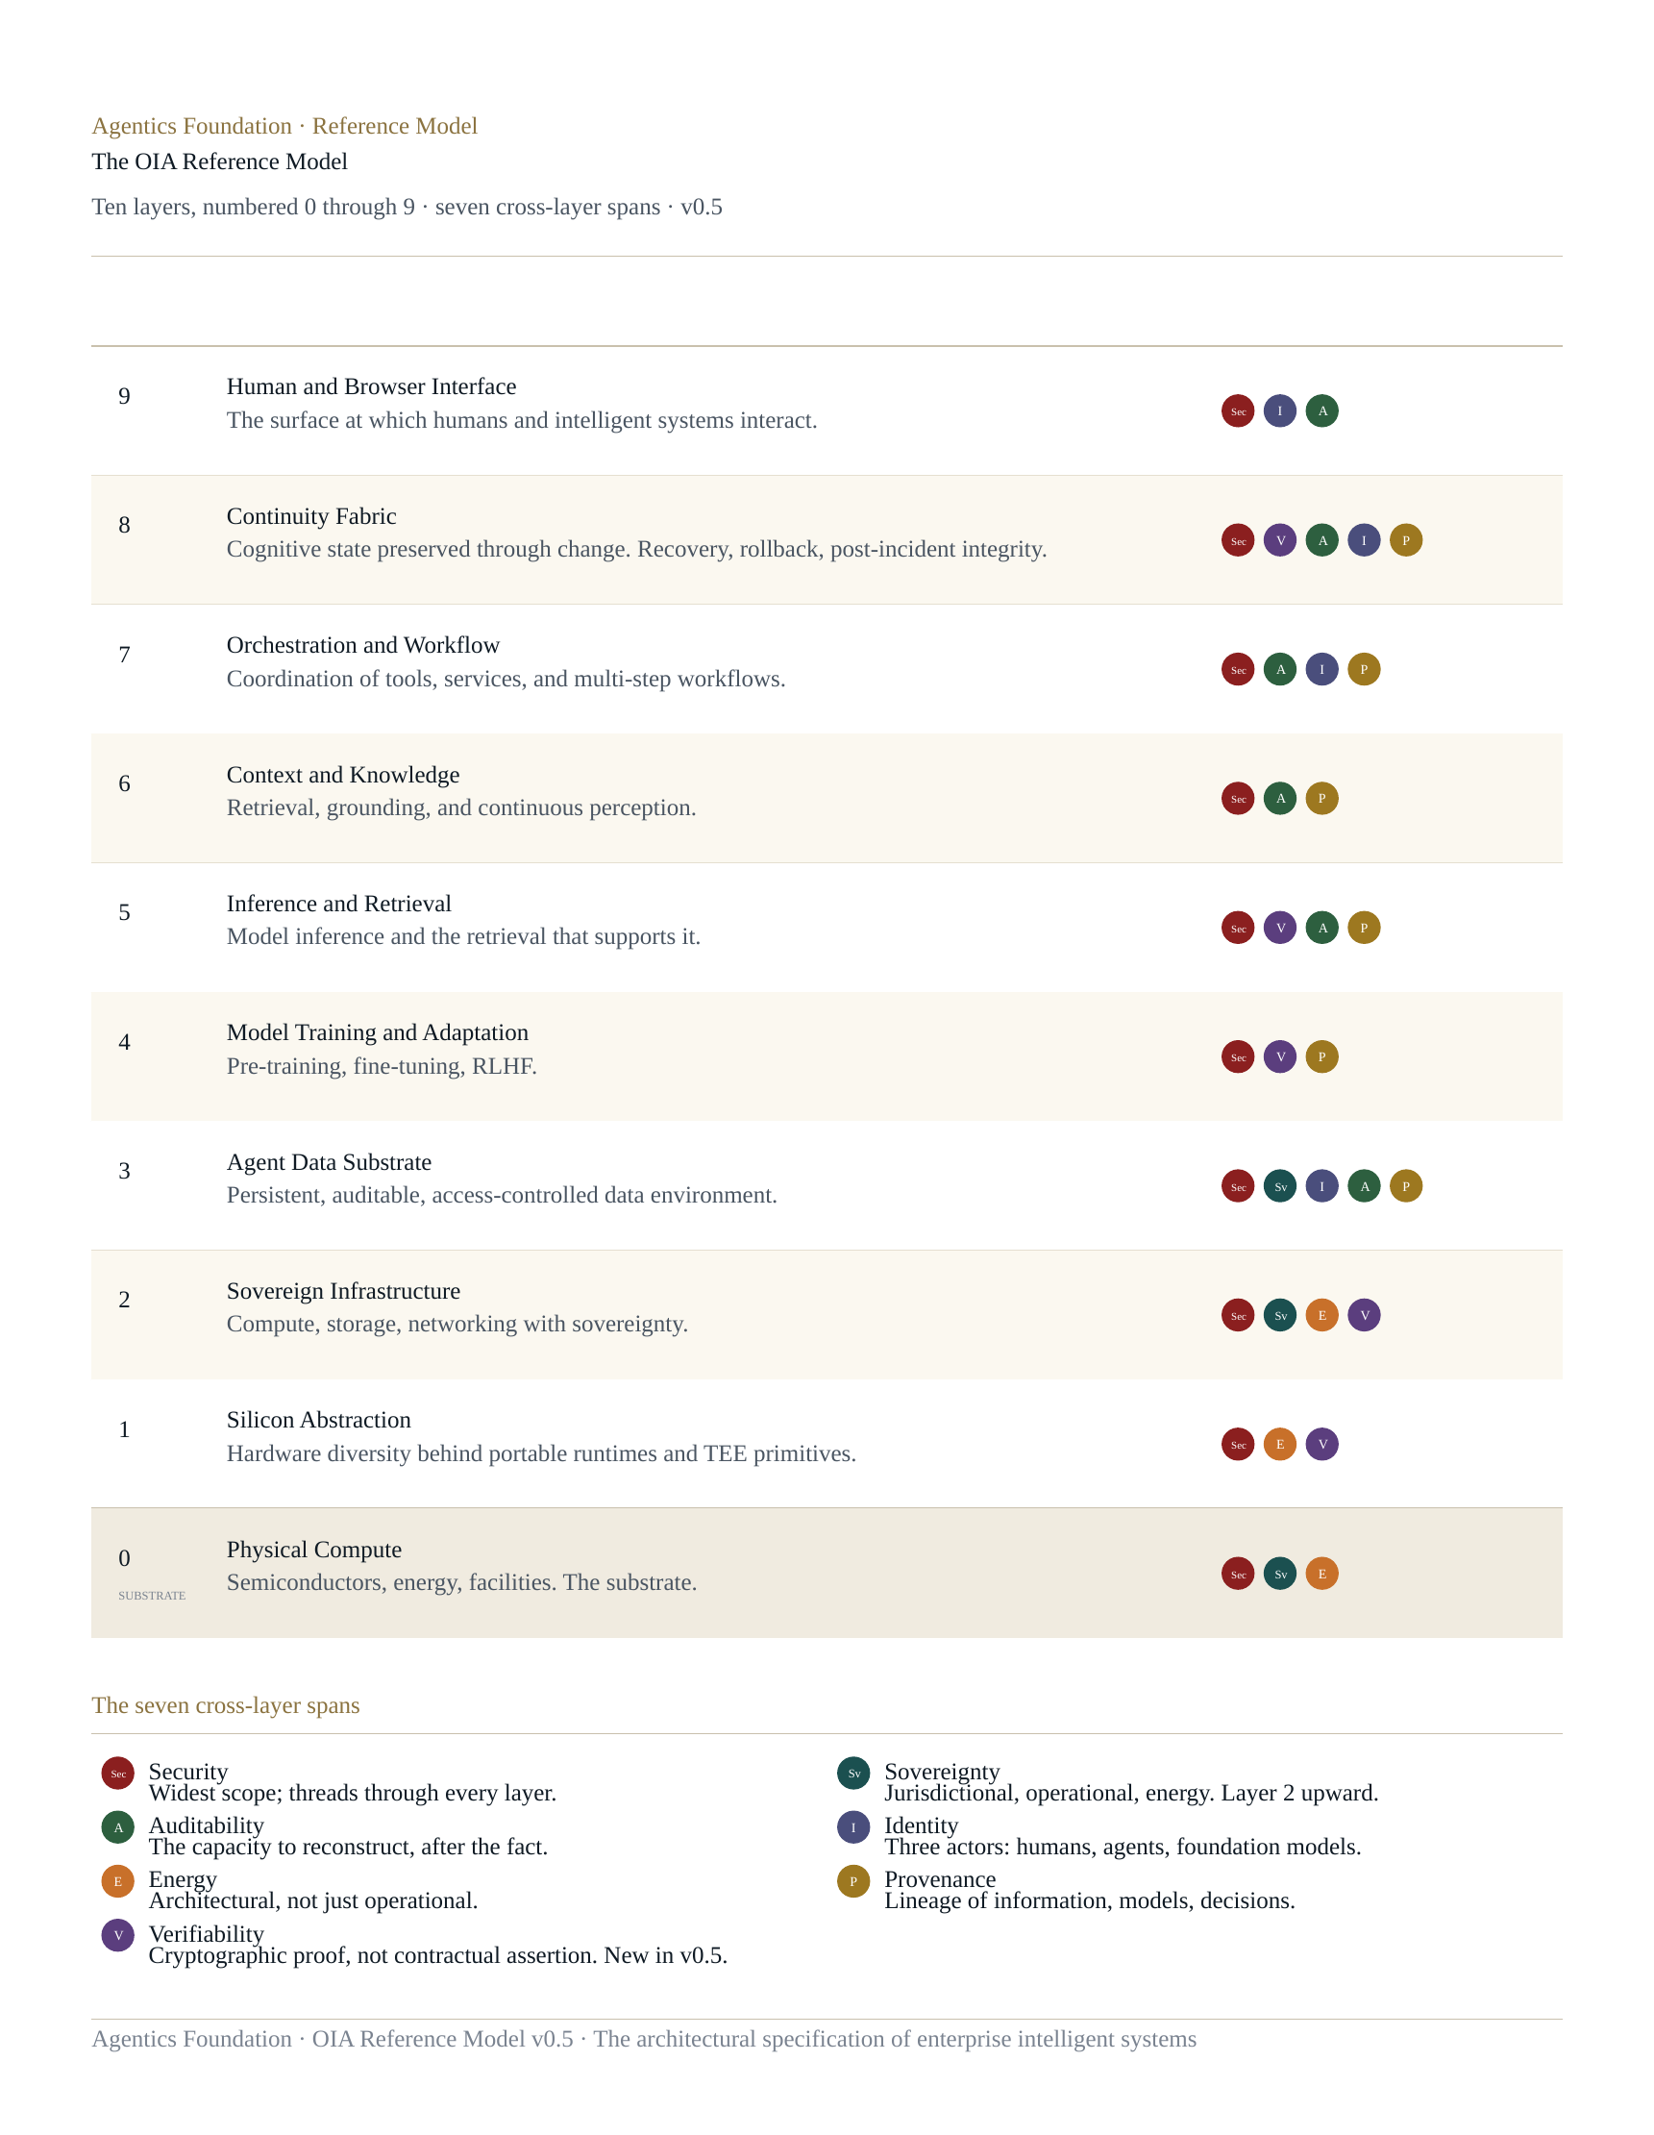
THE ARCHITECTURE IN ONE FRAME
Ten layers, numbered 0 through 9. Seven cross-layer spans.
Layer 0 is the physical substrate.
Layers 1–9 are the architectural stack.
Two layers hold state: Layer 3 (substrate) and Layer 8 (fabric). The pairing is asymmetric — substrate below, fabric above the operational stack — and architecturally deliberate.
Seven spans thread vertically: Security, Sovereignty, Auditability, Identity, Energy, Provenance, and — new in v0.5 — Verifiability.
AGENTICS FOUNDATION · THE OIA REFERENCE MODEL · V0.5
[ supporting company slot ]

Slide 6
LAYER 8 — THE ARCHITECTURAL CENTREPIECE
The Continuity Fabric is the layer the rest of the architecture is paired against.
Cognitive state preserved through change. Recovery, rollback, post-incident integrity.
No agent framework, model provider, or orchestration platform can be allowed to own the enterprise's cognitive state — because all of them will eventually change.
Layer 8 is the layer most consistently identified across audiences as the gap the existing technology stack does not yet fill:
• CISOs feel it as recovery and rollback gap.
• CIOs feel it as state-coherence gap across agent frameworks.
• Boards feel it as audit-chain integrity gap.
One layer. Three different audience readings. The same architectural absence.
AGENTICS FOUNDATION · THE OIA REFERENCE MODEL · V0.5
[ supporting company slot ]

Slide 7
THE CONNECTIVE TISSUE ACROSS THE ARCHITECTURE
Seven cross-layer spans thread through the model.
Security
Widest scope. Threads through every layer.
Sovereignty
Three dimensions: jurisdictional, operational, energy.
Auditability
The capacity to reconstruct, after the fact.
Identity
Three actors: humans, agents, foundation models.
Energy
Architectural, not just operational.
Provenance
Lineage of information, models, decisions, actions.
Verifiability
Cryptographic proof, not contractual assertion. New in v0.5.
AGENTICS FOUNDATION · THE OIA REFERENCE MODEL · V0.5
[ supporting company slot ]

Slide 8
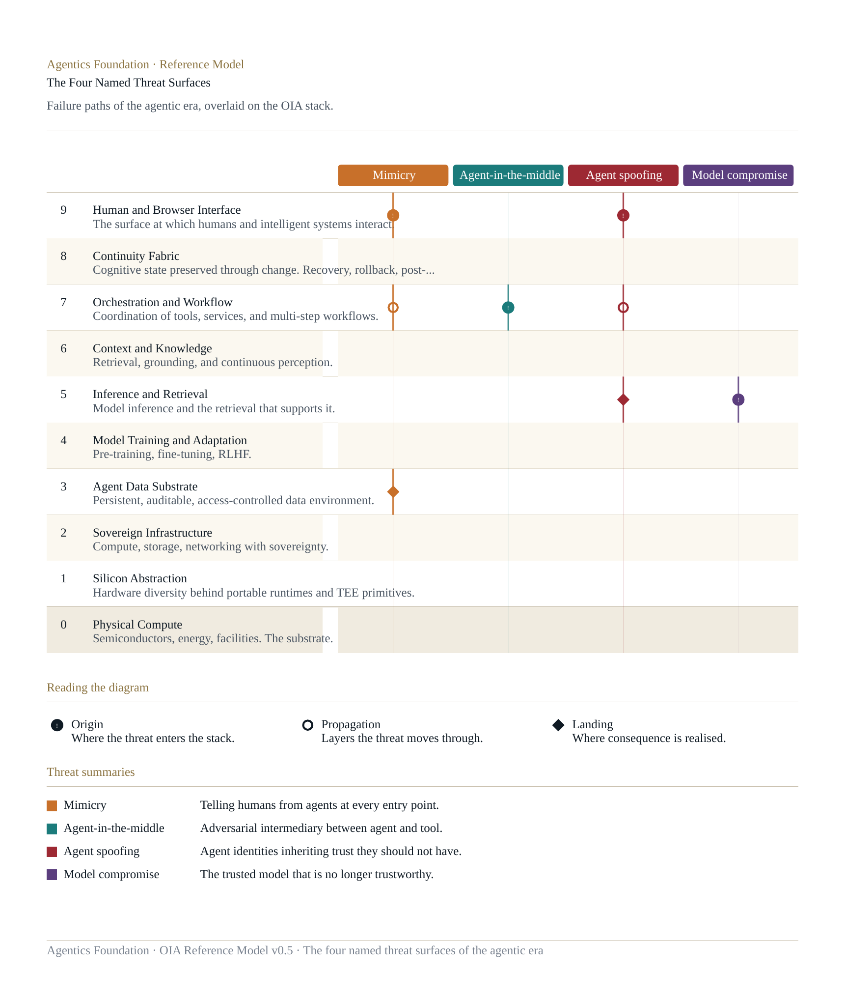
THE AGENTIC ERA THREAT SURFACES
Four named threats land inside the operational stack — not at the perimeter.
Mimicry
Telling humans from agents — and AI from real people — at every entry point.
Agent-in-the-middle
Adversarial intermediary between agent and tool. The agentic SSL strip.
Agent spoofing
Agent identities inheriting trust they should not have.
Model compromise
The trusted model that is no longer trustworthy. Weight swap, alignment drift, jailbreak.
AGENTICS FOUNDATION · THE OIA REFERENCE MODEL · V0.5
[ supporting company slot ]

Slide 9
PART TWO
The OIA Lens System
How the architecture reaches the executives accountable for AI.

Slide 10
THE ARCHITECTURE ALONE IS NOT ENOUGH
Reference architectures become foundational only when audiences can find themselves in them.
The OIA is intentionally neutral. Vendor-neutral. Audience-neutral. That neutrality is what gives the architecture its durability.
It also creates a problem.
Most executives accountable for AI do not work from structural specifications. They work from their own frameworks, their regulatory environment, the questions on their desk this quarter.
Without translation, the OIA risks being filed as a security document by the first CISO who picks it up — or as a strategy paper that never reaches the engineers who must build to it.
The Lens System is the translation.
AGENTICS FOUNDATION · THE OIA REFERENCE MODEL · V0.5
[ supporting company slot ]

Slide 11
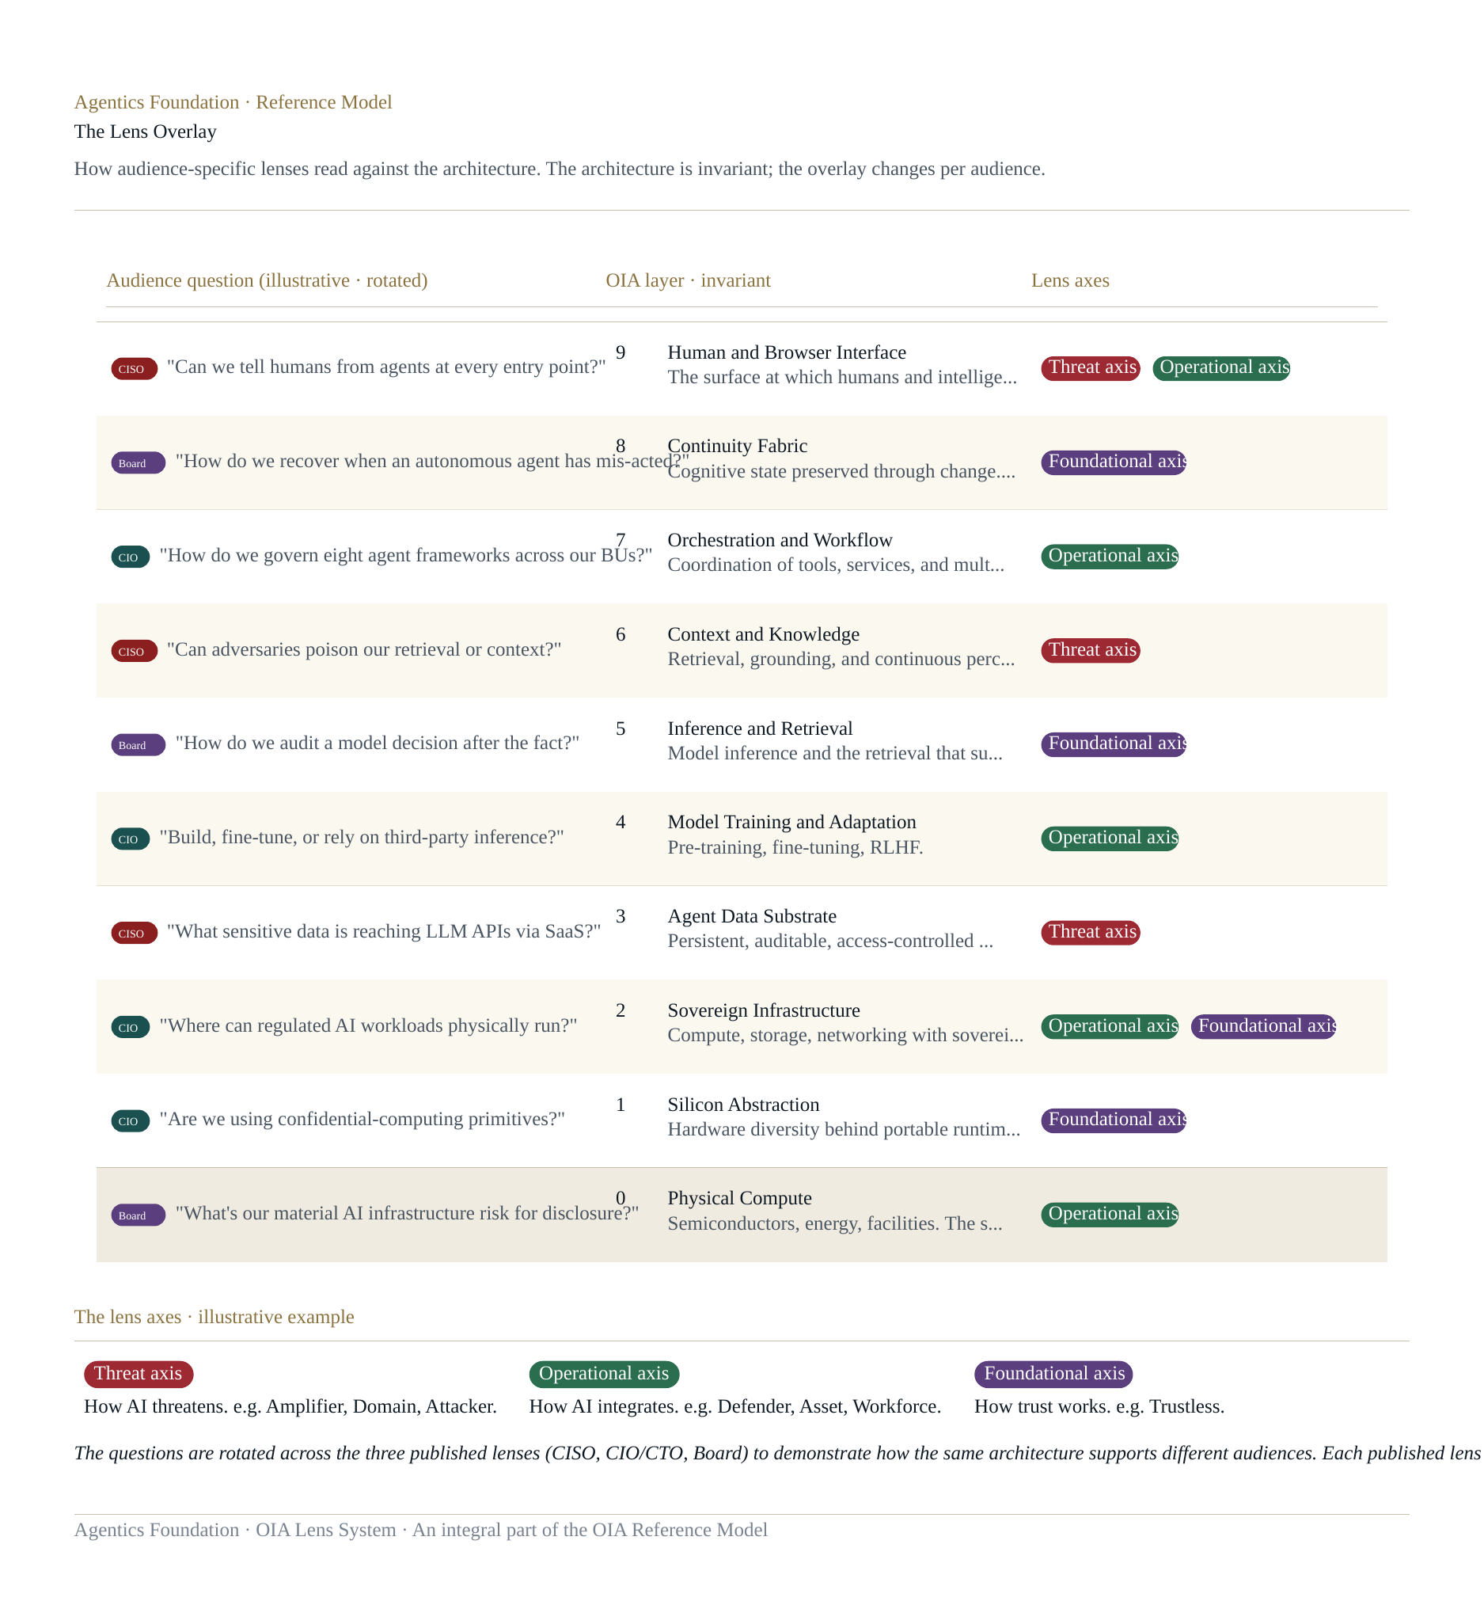
HOW A LENS MAP WORKS
The architecture is invariant. The overlay changes per audience.
AGENTICS FOUNDATION · THE OIA REFERENCE MODEL · V0.5
[ supporting company slot ]

Slide 12
THREE LENSES PUBLISHED WITH V0.5
One architecture. Three audiences. Each in their own language.
THE SECURITY ORGANISATION
THE TECHNOLOGY ORGANISATION
DIRECTORS, RISK COMMITTEES, CROS
The CISO Lens
The CIO/CTO Lens
The Board & Risk Lens
Calibrated to the threat surfaces, frameworks, and planning questions of CISOs in 2026. Three actors to govern: humans, agents, and the foundation models themselves.
Calibrated to the conversations about coherence, capital allocation, vendor concentration, and architectural debt that the technology executive is having now.
Calibrated to accountability and exposure. Treats the cross-layer spans as primary, the layers as substrate. Built to support the conversations directors are actually having.
FRAMEWORK ANCHORS
FRAMEWORK ANCHORS
FRAMEWORK ANCHORS
NIST CSF · NIST AI RMF · MITRE ATLAS · MITRE D3FEND · OWASP LLM · CCC
TOGAF · ITIL · FinOps · ISO/IEC 42001 · platform engineering · SRE
NIST AI RMF · ISO/IEC 42001 · EU AI Act · SEC disclosure · fiduciary frameworks
AGENTICS FOUNDATION · THE OIA REFERENCE MODEL · V0.5
[ supporting company slot ]

Slide 13
WHAT THE LENS WORK REVEALS ABOUT THE ARCHITECTURE
An architecture that holds its shape across audiences is drawn against the structural shape of the problem.
Different audiences foreground different layers. The architecture supports all of them — without distortion.
• Security audience reads Layers 9, 7, 5, 3 as primary.
• Technology audience reads Layers 0–2 as primary, with Layer 8 as the unowned territory.
• Governance audience reads the cross-layer spans as primary, the layers as substrate.
None of these readings distorts the architecture. None requires it to be redrawn to fit.
The Lens Maps are not the proof of the architecture.
The audiences finding themselves on the page is the proof.
AGENTICS FOUNDATION · THE OIA REFERENCE MODEL · V0.5
[ supporting company slot ]

Slide 14
WHAT COMES NEXT
The lens roster grows as practitioner engagement supports it.
PUBLISHED IN V0.5
ANTICIPATED
• The CISO Lens
• The CIO/CTO Lens
• The Board and Risk Lens
• The CFO Lens — capital allocation, unit economics
• The General Counsel Lens — liability, regulatory exposure
• The CHRO Lens — agents as workforce, governance
Other lenses are possible — chief data officer, regulated-industry, public-sector, line-of-business.
The Foundation will publish lenses for any audience where the work meets the discipline of the approach. Practitioners with deep audience expertise are invited to contribute proposals.
AGENTICS FOUNDATION · THE OIA REFERENCE MODEL · V0.5
[ supporting company slot ]

Slide 15
PART THREE
What This Means for You
Engaging with the OIA across the executive team.

Slide 16
THE BODY OF WORK AT V0.5
Five artifacts. One coherent release.
OIA Reference Paper
The architectural specification in full. ~40 pages. The authoritative reference.
OIA Lens System
Three audience-specific Lens Maps. CISO, CIO/CTO, Board and Risk.
OIA Visual Reference
Three diagrams that render the architecture and its applications visually.
OIA Body of Work Framing
Reading guide and overview. Where to start by role.
Thought Leadership Deck
This presentation. Calibrated to board and executive audiences.
AGENTICS FOUNDATION · THE OIA REFERENCE MODEL · V0.5
[ supporting company slot ]

Slide 17
HOW TO ENGAGE BY ROLE
Different roles. Different entry points. Same architecture.
CISO
The CISO Lens, then Reference Paper §15 (threats) and §14 (spans).
CIO / CTO
The CIO/CTO Lens, then Reference Paper layer chapters most acute to current planning.
Board, Risk Committee, CRO
The Board and Risk Lens, then Reference Paper §14 (spans) and §17 (open questions).
CEO and Operating Executives
This deck. Then the Foreword, Introduction, and Closing of the Reference Paper.
Practitioners and Contributors
Everything. The full Reference Paper, all Lenses, and the Architecture Lock.
AGENTICS FOUNDATION · THE OIA REFERENCE MODEL · V0.5
[ supporting company slot ]

Slide 18
WHAT THE MODEL DELIBERATELY DOES NOT YET CLOSE
The open questions are where the work concentrates next.
Layer 8 — Continuity Fabric.
Continuity primitives that work across agent frameworks. Witness-chain implementations at scale. The most architecturally consequential gap in the present technology stack.
Layer 7 — Agent identity at architectural scope.
Onboarding, scope assignment, behavioural baselining, offboarding. The MCP security architecture as it matures.
Layer 5 — Continuous model trust scoring.
Foundation models as actors whose trustworthiness is dynamic and must be governed dynamically.
Verifiability span.
Whether trust verified rather than asserted becomes an enterprise default — or remains a regulated-workload specialty.
AGENTICS FOUNDATION · THE OIA REFERENCE MODEL · V0.5
[ supporting company slot ]

Slide 19
CLOSING
Reference architectures earn their place when the people who must apply them can find their work in the language.
The OIA Reference Model is meant to be foundational. Foundational means open — to the audiences that will use it, to the practitioners who will refine it, and to the technological progress that will keep changing what enterprise intelligence can do.
The Foundation invites you to read the architecture. Read the Lens that fits your role. Push back on what does not fit. Tell us what is missing.
We will keep developing the model. The body of work will keep growing.
AGENTICS FOUNDATION · THE OIA REFERENCE MODEL · V0.5
[ supporting company slot ]

Slide 20
WITH THANKS
Acknowledgments
The OIA Reference Model is the product of many minds. The architecture builds on the agentic infrastructure thinking of Reuven Cohen. The pressure-testing and practitioner perspectives came from John McKinley, Greg Lavender, and the CISO colleagues who took the time to read drafts.
The customer and partner perspectives that grounded the architecture in real deployment came from friends at:
Arista Networks · Nutanix · Proofpoint · Reltio · Thoma Bravo · ACIUM
— each contributing technological insights, customer perspectives, and the sage advice that comes from people who have actually had to ship enterprise software at scale. The model is better for all of it.
AGENTICS FOUNDATION · THE OIA REFERENCE MODEL · V0.5
[ supporting company slot ]

Slide 21
PUBLISHED BY THE AGENTICS FOUNDATION
Discussion
The OIA Reference Model · v0.5 · 2026

