Slide 1
What is Bootstrap ?
It is a CSS framework
By default Responsive code
CSS classes + HTML + JavaScript + Jquery
It is a collection of readymade CSS classes
Bootstrap is developed by ?
- Twitter
What is Framework ?
Framework means ready made code/program with extra features
What is Library ?
Means ready made code/program

Slide 2
What is Framework ?
(Library + Some Extra Features)
With the help of frameworks we can speed up our development process.
fname
Who can read & transfer this data?
- JavaScript
lname
pass
Submit
First.html

Slide 3
## JavaScript ------- > jquery (Library)
** .css
Bootstrap
(Framework)
** .js
jquery
Popper.js
If you want to use Bootstrap we have to download jquery library

Slide 4
# If you want to create dynamic web pages minimum required 3 technologies.
>> HTML + CSS + JS
# JavaScript – JS is a programming Language
(Object Oriented & Scripting Language)
# JavaScript can communicate with the server
# If you want to use jquery lib while development need to download jquery lib.

Slide 5
Download BootStrap
Create folder name -
bootstrap
Open browser
Search BootStrap download
Download Compiled CSS & JS
Unzip download to the bootstrap folder
Jquery.com/download
Unpkg.com/popper.js

Slide 6
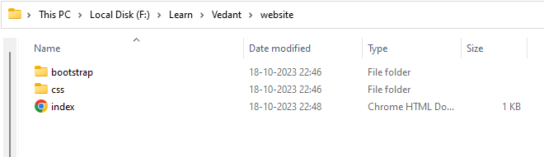
Folder Structure
Project/Website/Application Name

Slide 7
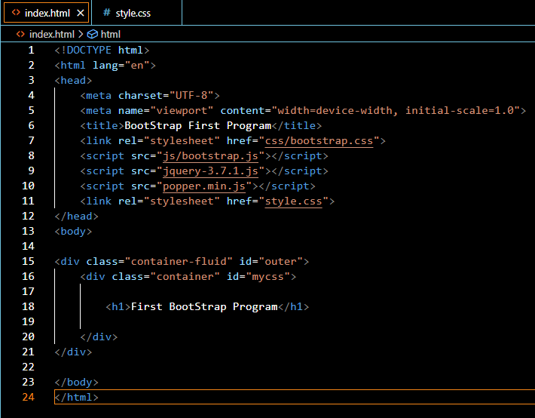

Slide 8
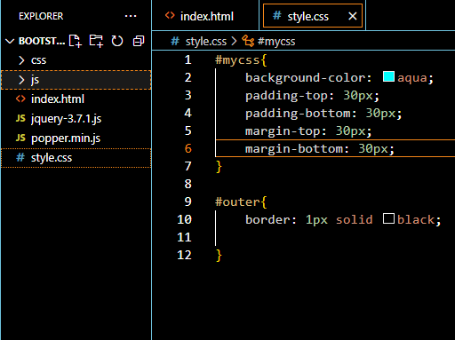

Slide 9
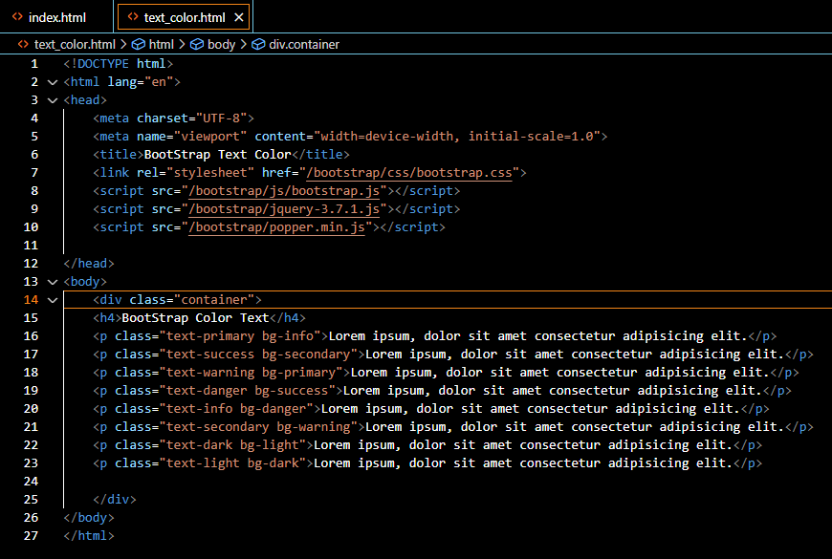

Slide 10
BootStrap Classes –
Container
Container-fluid
Text-color
Background-color
Text-color
text-primary
Text-success
Text-warning
Text-danger
Text-info
Text-secondary
Text-dark
Text-light
Text-mute
Background-color
bg-primary
bg-success
bg-warning
bg-danger
bg-info
bg-secondary
bg-dark
bg-light
bg-mute

Slide 11
Want to use bootstrap ?
bootstrap.css
Bootsrap.js
Jquery.js
Popper.min.js
library

Slide 12
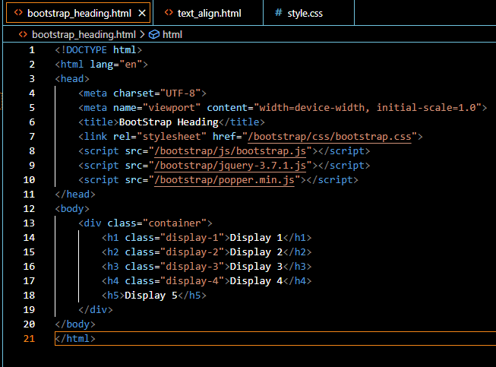

Slide 13
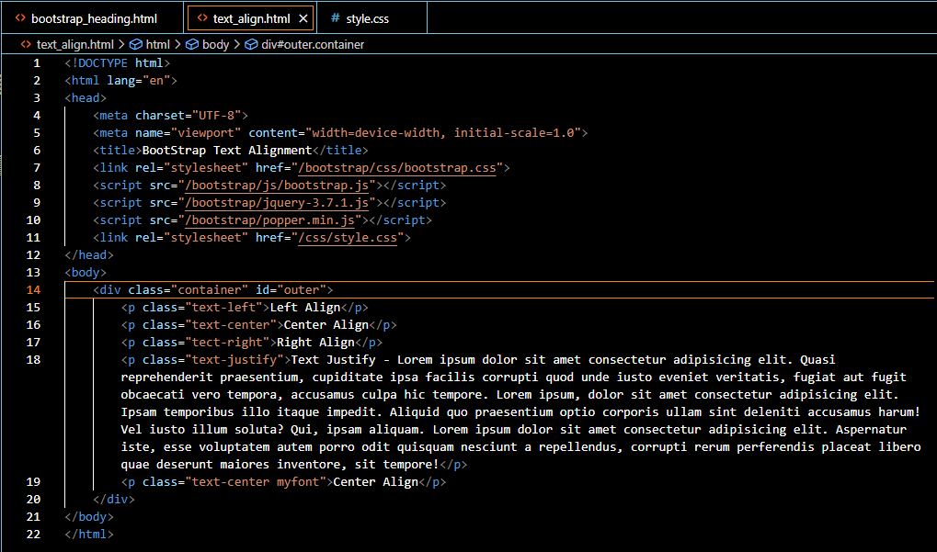

Slide 14
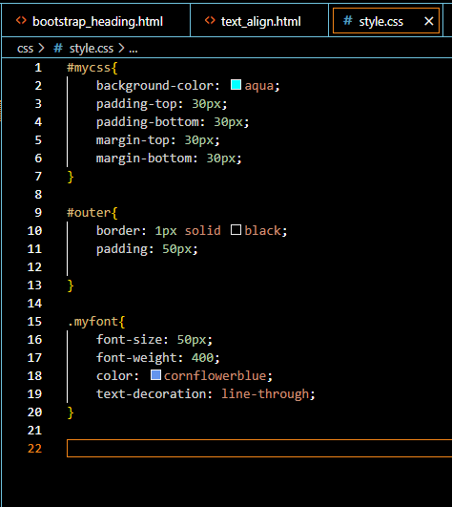

Slide 15
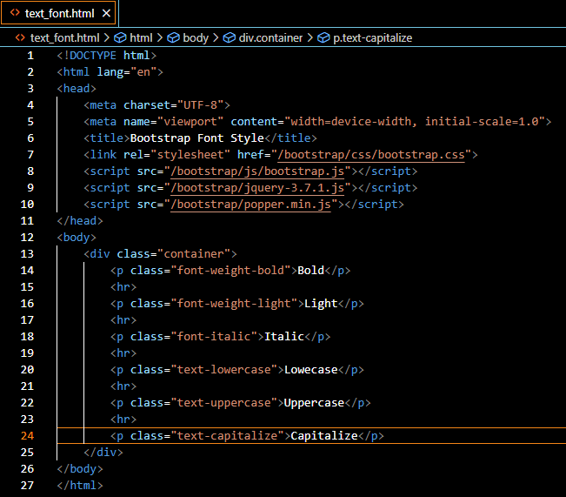
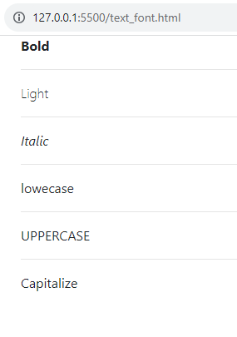
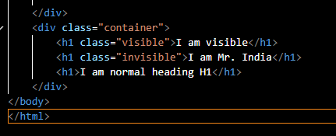

Slide 16


Logo
Home About Contact
Banner
Fsudbfuidbfuud fiuhf fu dif fbdufuidb fdfui dsfuisdgfi dusifuidsufsiudgfui dsuif iud ufiuduf giudgfiudf gdsfgdugf uidgfg iudg fugdifg iusd gfu gdsui gfiusd giufg iudg fiu dgiufg diugf iud gfiug siuf duif
Footer

Slide 17

Grid
System

Slide 18
1 | 1 | 1 | 1 | 1 | 1 | 1 | 1 | 1 | 1 | 1 | 1
4 | 4 | 4
3 | 6 | 3

Slide 19
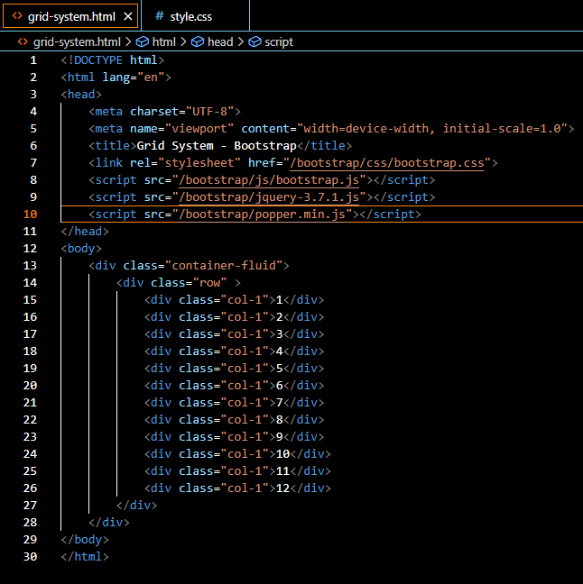

Slide 20
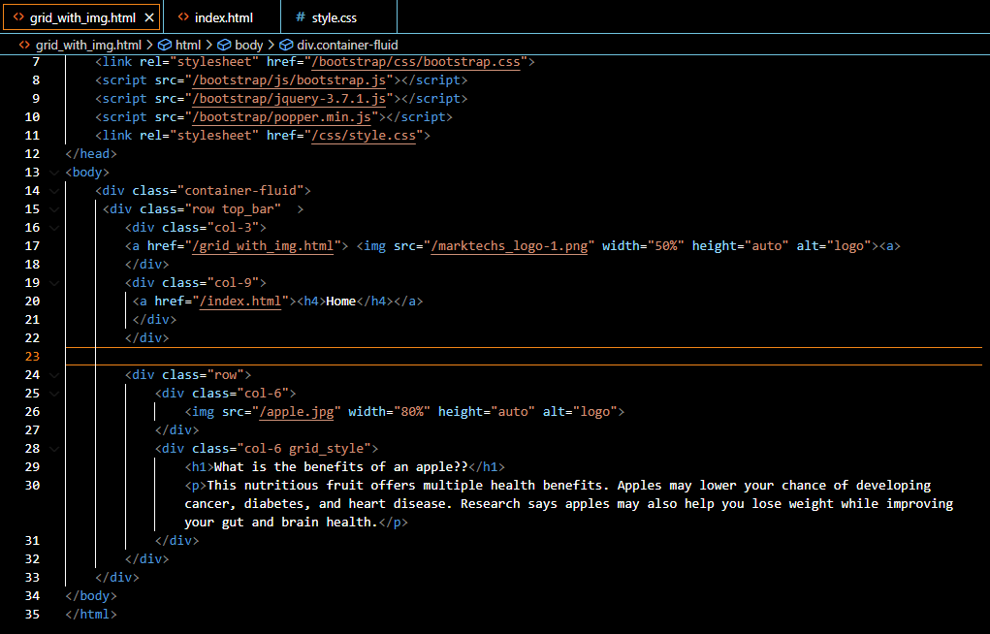
1

Slide 21
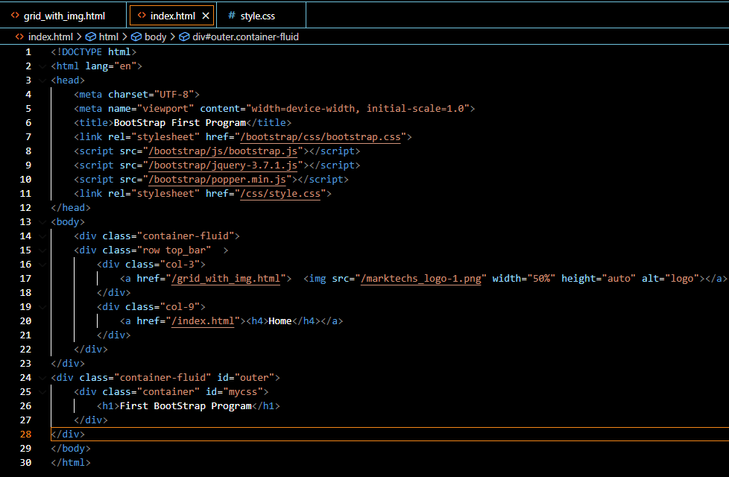
2

Slide 22
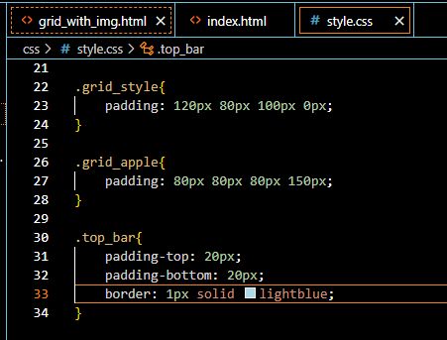

Slide 23
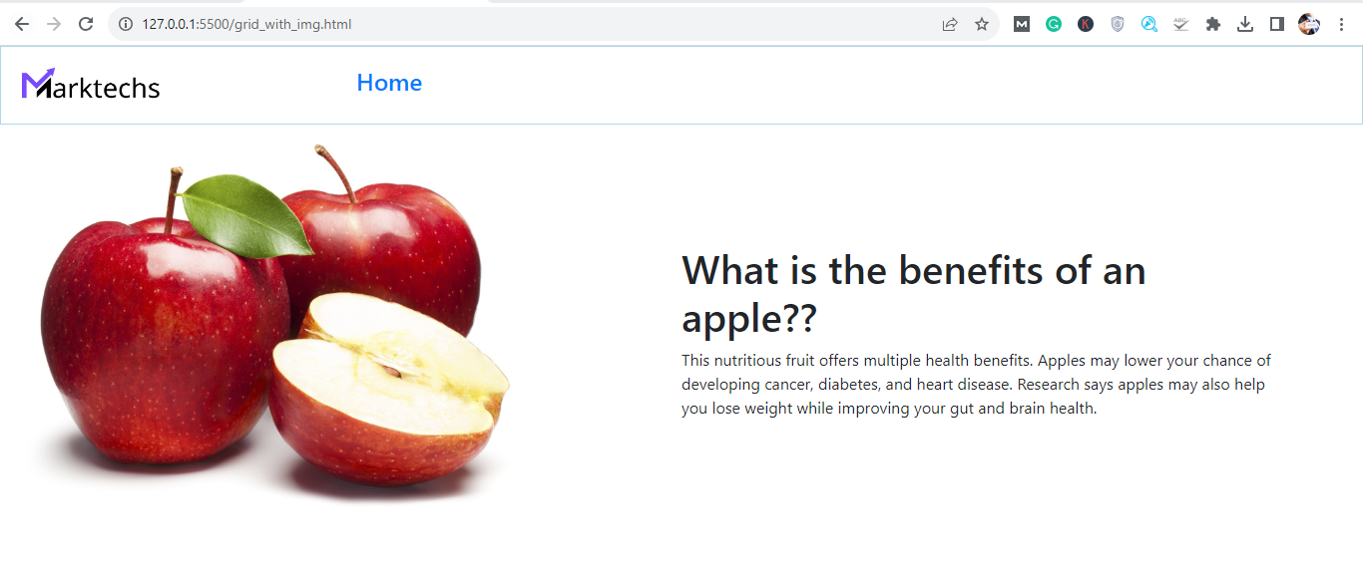

Slide 24
Adjust Width by Device
sm - Small Device
md - Medium Device
lg - Large Device
xl - Extra Large Device

Slide 25
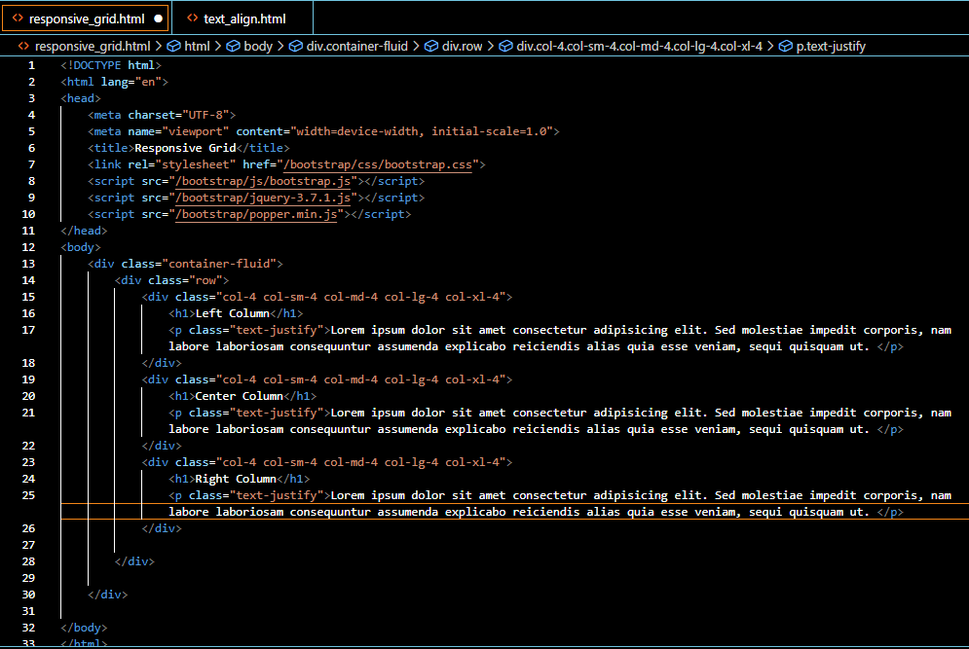

Slide 26
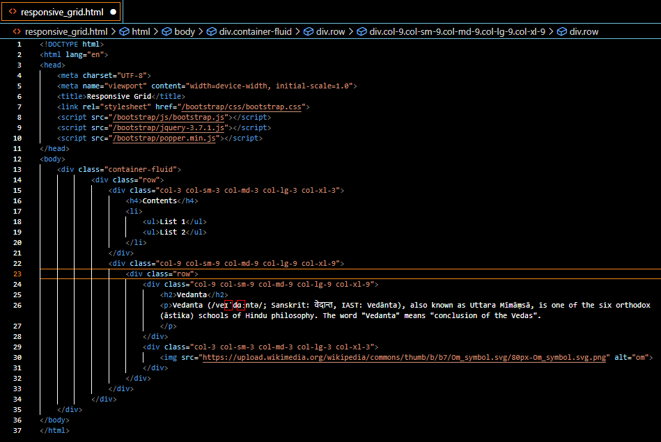

Slide 27
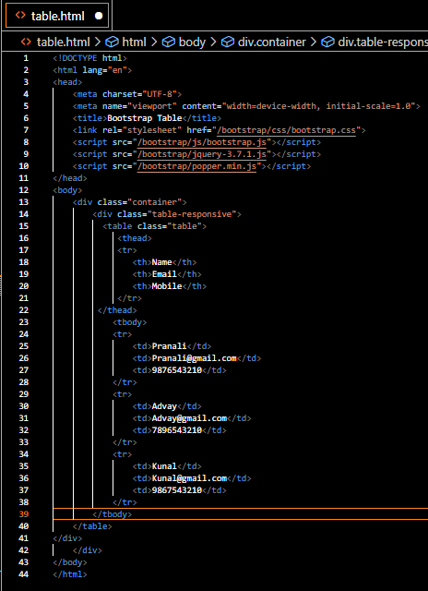

Slide 28
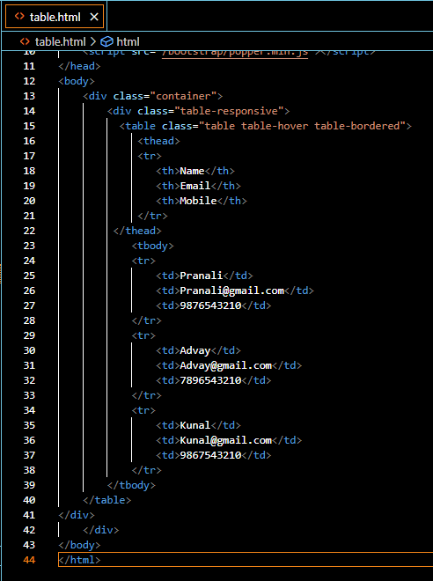

Slide 29
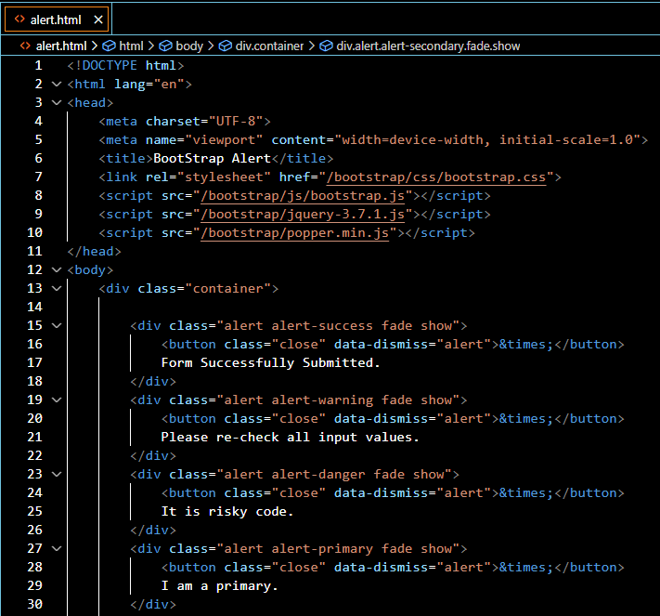
BootStrap Alert

Slide 30
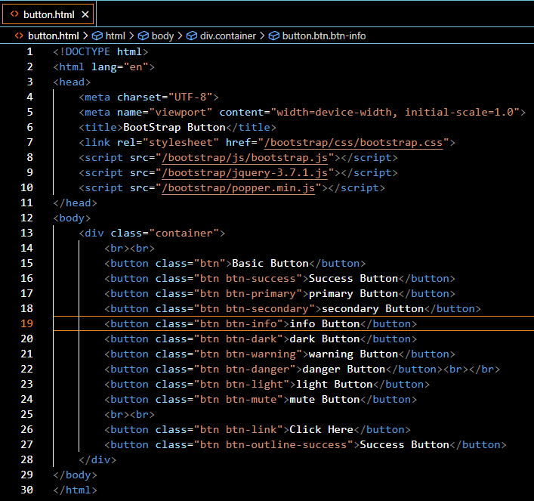

Slide 31
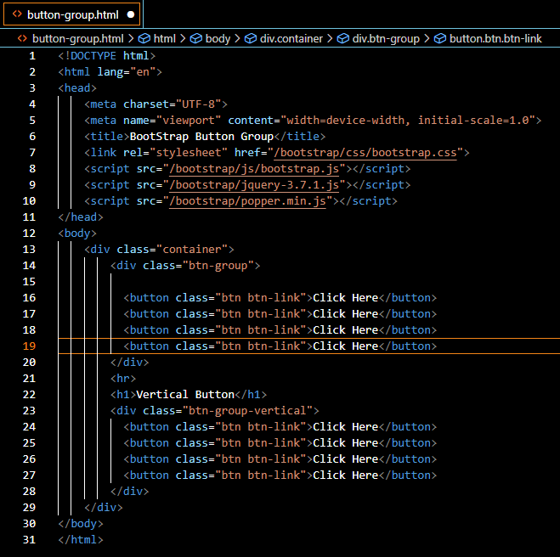

Slide 32
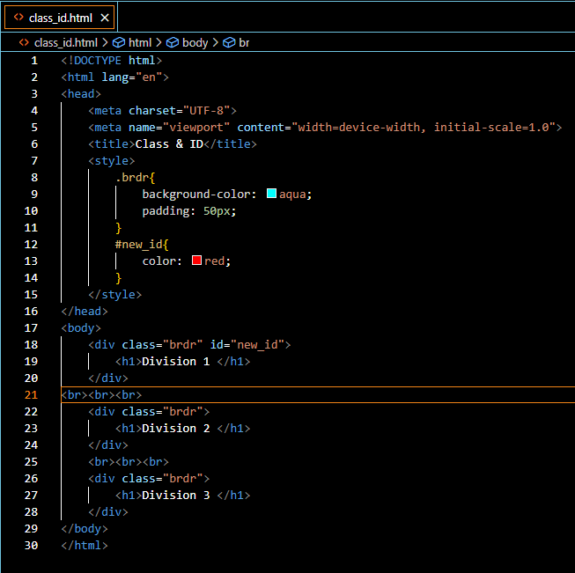
Difference between CLASS and ID

