Slide 1


BRISTOL
CITY YOUTH
COUNCIL
Young People Stand
Young People Vote
Young People Represent

Slide 2
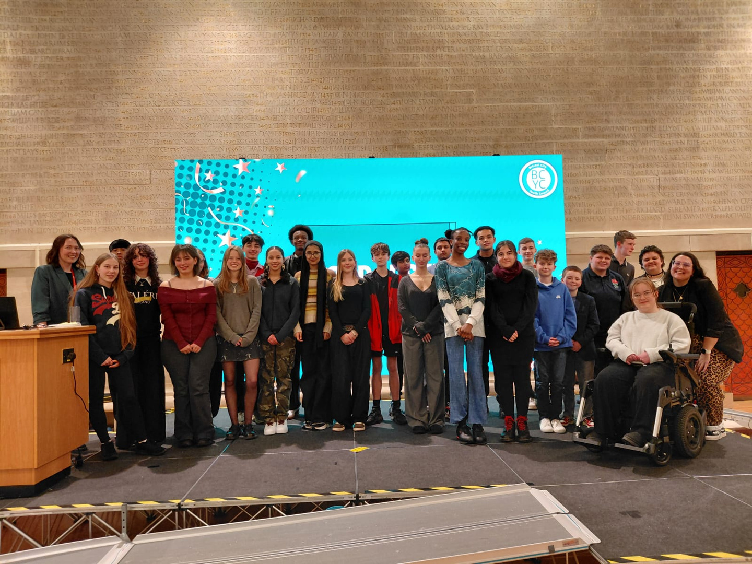
What is Bristol City Youth Council?
The main aim of the Bristol City Youth Council is to advocate, represent and champion the voices of young people across Bristol.
We ask that young people commit around 2 - 3 hours a week over the two year term of office but this can vary depending on whether they have a role.

Slide 3

Who are the Bristol City Youth Council?
Elected
Area
Equality
6 x area co-optees identified through Family Help and other services.
2 from each area.
5 x equality groups identified:
  Listening Partnership
  Children in Care
  Integrate UK
  Young Carers
  Freedom (OTR)
6 x North
6 x South
6 x East Central
29 Youth Councillors in total
Notes:
Bristol City Youth Council is a group of 29 elected young people voted in by young people from across Bristol. Broken down into 3 areas: North, South and East Central.​
Youth Councillors are elected for a 2 year term
This Youth Council will be in term from 2026-2028
18 young people are elected through the
Bristol Youth Elections in schools and youth organisations.
6 young people are elected locally in their areas.
5 young people are elected through their equality groups.

Slide 4
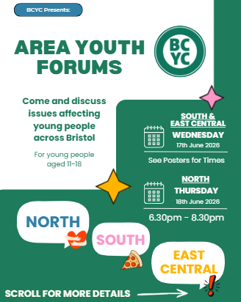
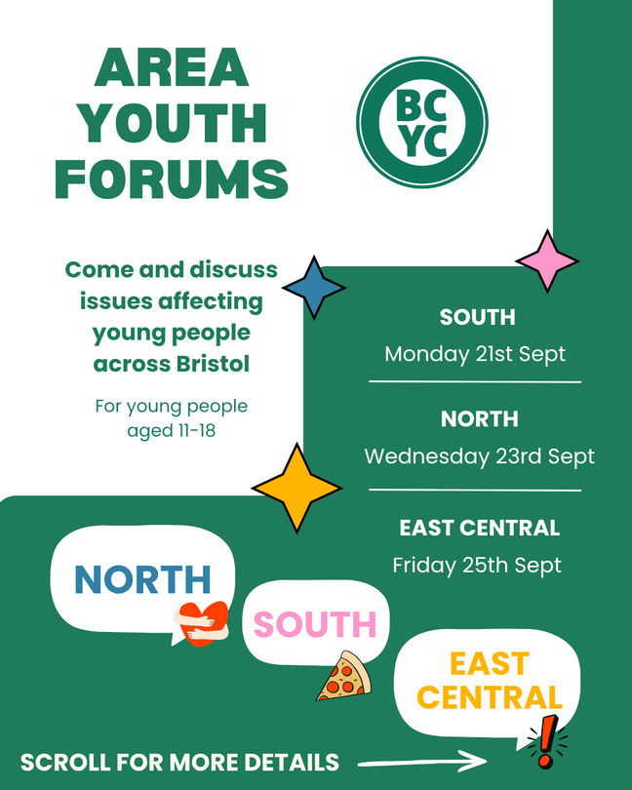
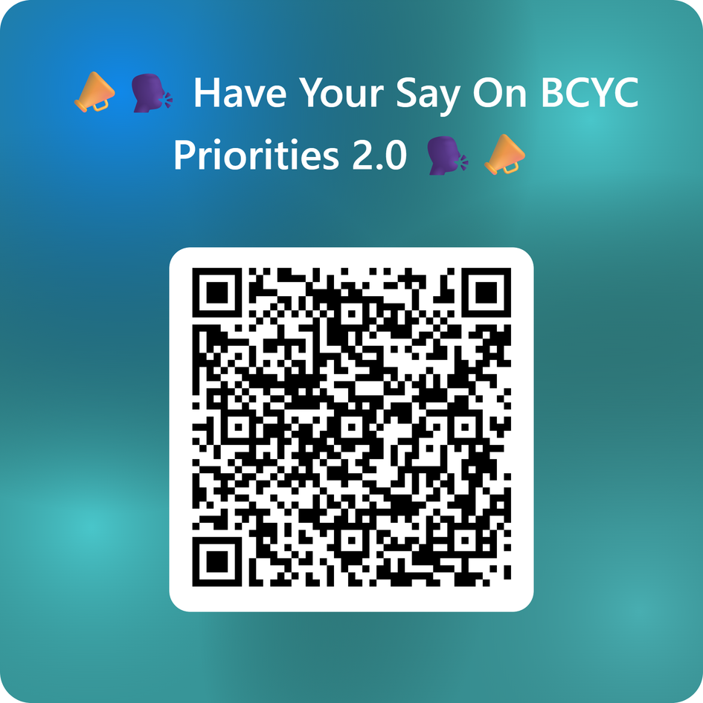
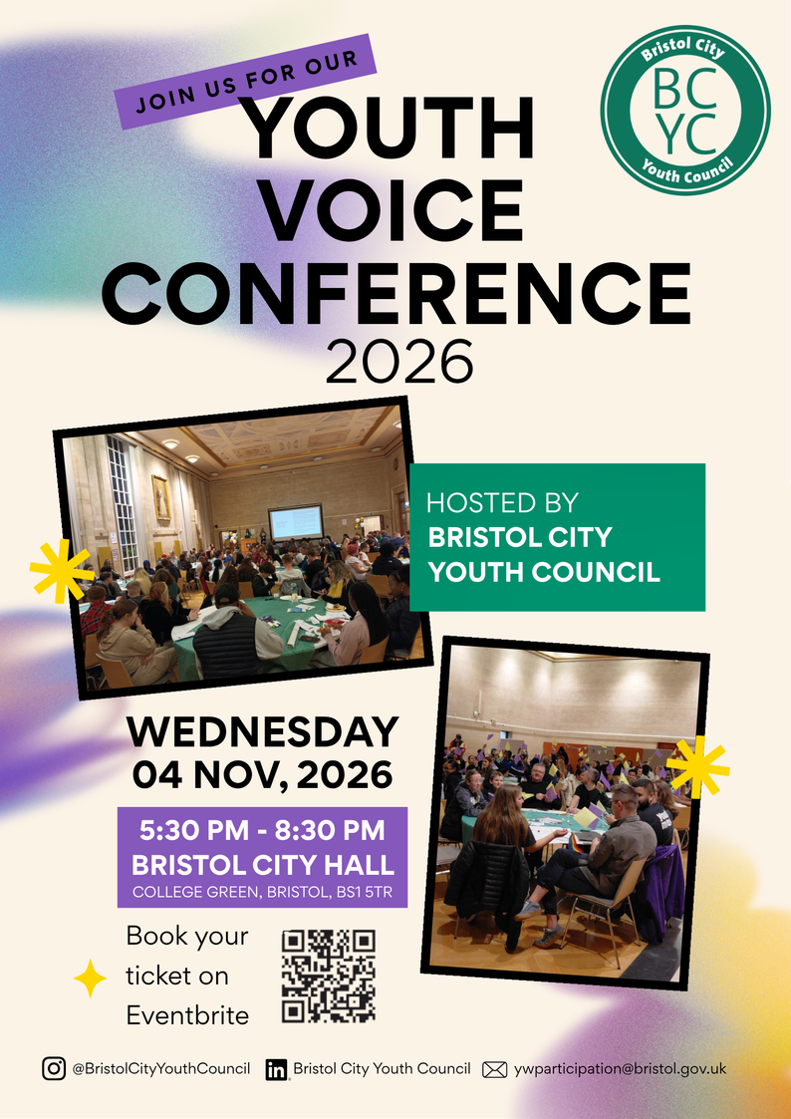
The Ways BCYC gather the voice of Young People

Slide 5
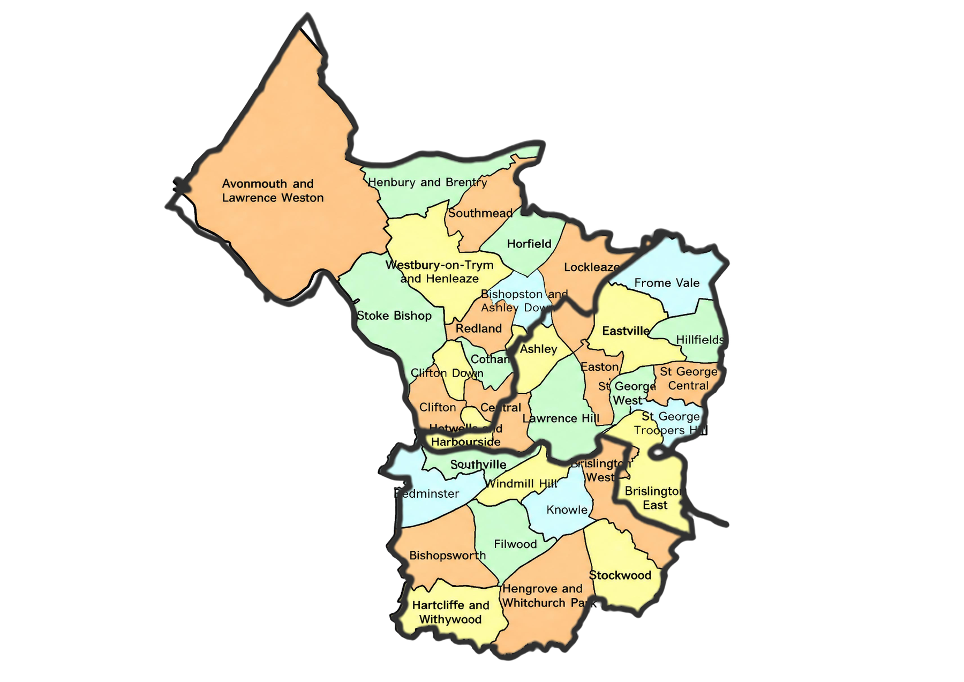
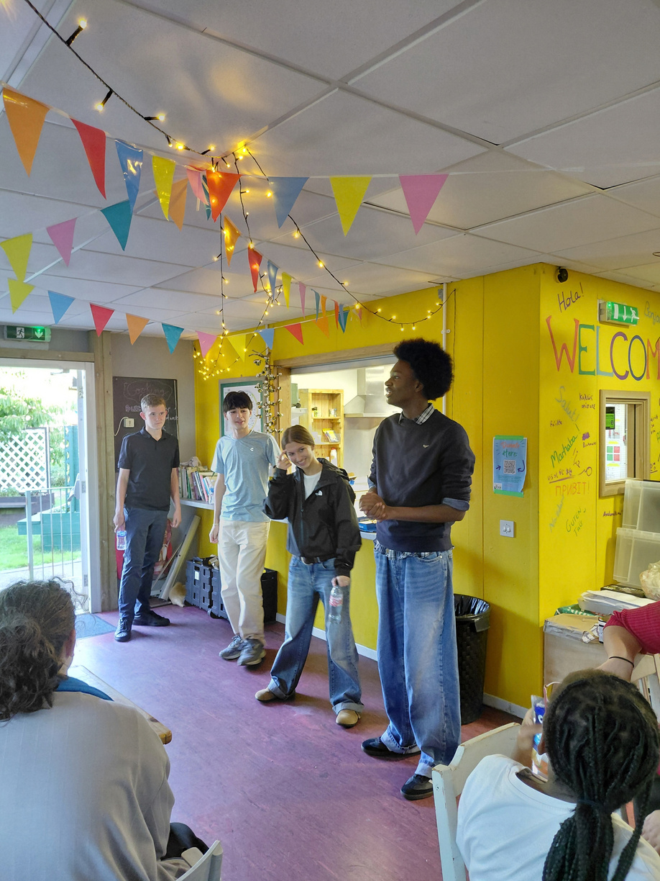
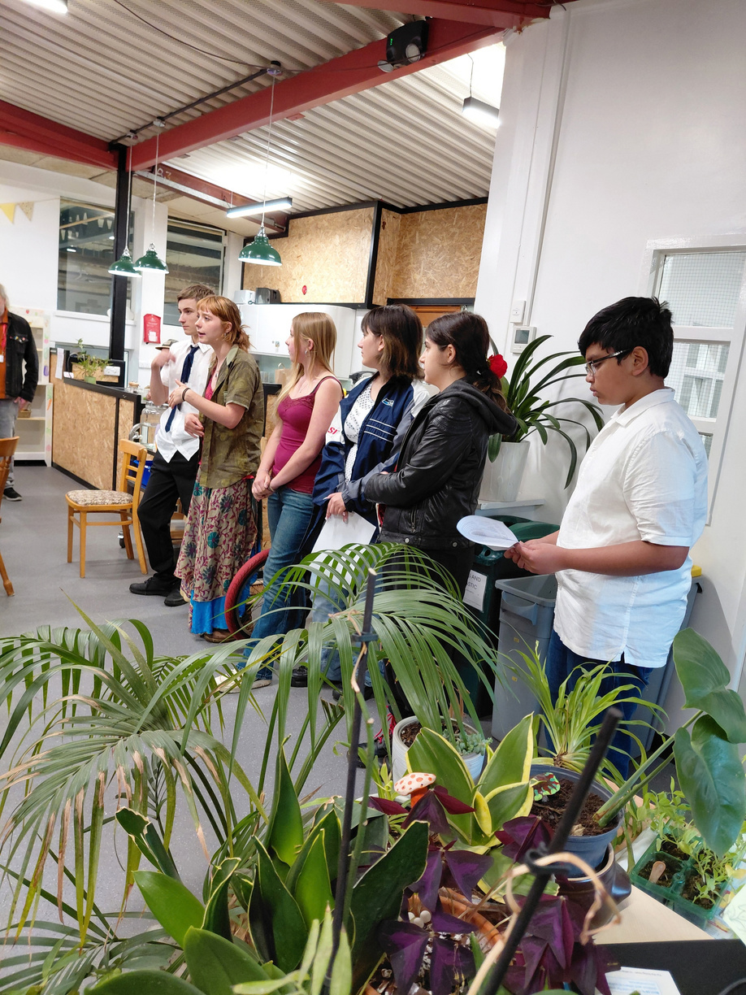
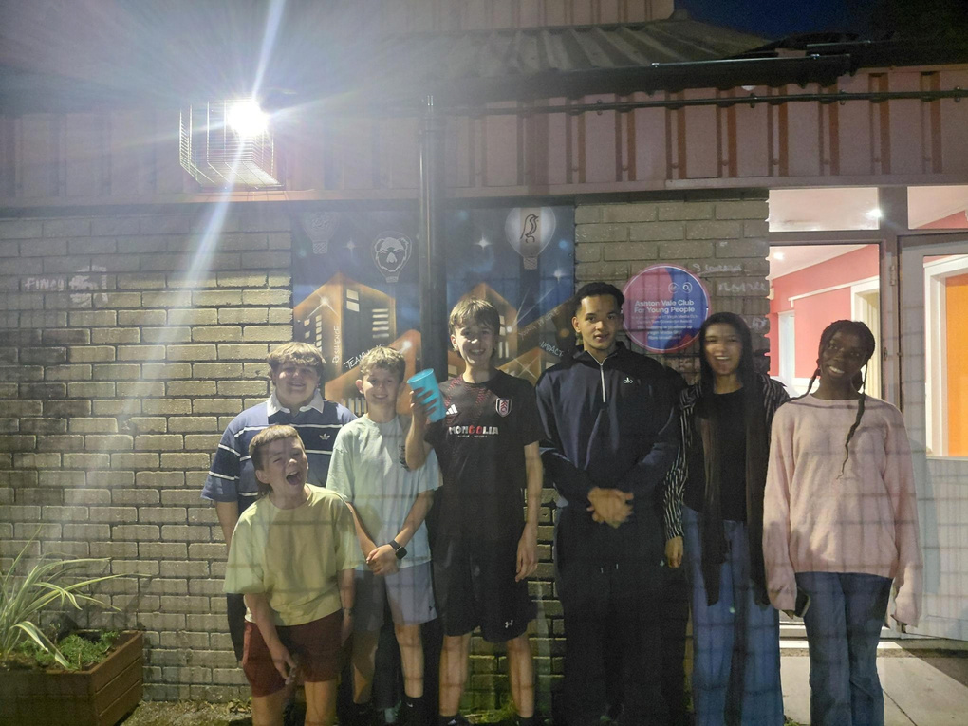
Area Youth Forums

Slide 6
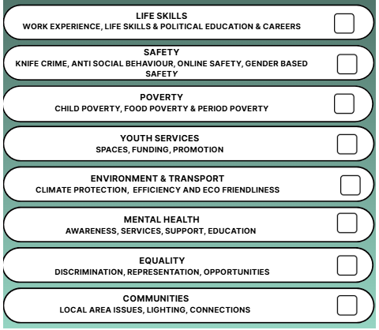
Priorities 2026 - 2028
At the Youth Voice Conference 2025, the young people who attended voted for the priorities that the current Youth Council are focusing on.
This list was made by the previous Youth Council, who worked through all the feedback and information they had collected from Area Youth Forums and looking at national priorities for young people to create this list of options.

Slide 7
Safety Priority
Themes identified by young people:
Violence, cyberbullying, night time safety, knife crime, intimidation, drugs, schools, law, youth voice, discrimination & harassment
“Young girls or teenage girls are never safe in the city!”
“Gang violence”
“Travelling in the dark”
“Walking in the street, as you don't know who is out there that is dangerous.”
“It seems more normalised for young people to carry knives around with them, because they feel the need to protect themselves. This gets dangerous, because knives are then used maliciously, whether that's to protect themselves or just try and impress their friends.”

Slide 8
Mental Health Priority
Themes identified by young people:
Awareness, social media, NHS & council support, symptoms & conditions, schools, home & belonging
“[Mental health services] takes ages. There is so many people that need it and just not enough support to help everyone at the same time”
“Not enough support for certain mental health conditions and it might feel scary to reach out”
“Social media seems to be a problem that harms children's mental health, there should be more things to do outside of school so people aren't constantly on social media.”
“In general teenagers usually have some sh*t going on as we literally have hormones racing through our bodies . But also one issue is that when we tell people our concerns about our mental health, adults say it doesn't count because we are just kids.”

Slide 9
Equality & Discrimination Priority
Themes identified by young people:
Online discrimination, racism, disability, gender & identity, faith & belief
“Right wing ideology and the rise of the manosphere!”
“Not enough education on equality (more teaching on history of migration, ways to show equality etc) and also more community events for people to meet more people”
“Online is where most discrimination takes place. Not so much in person as people are more scared to do it and online is like a safety barrier and they feel they can get away with it. More sanctions should be imposed on online hate”

Slide 10
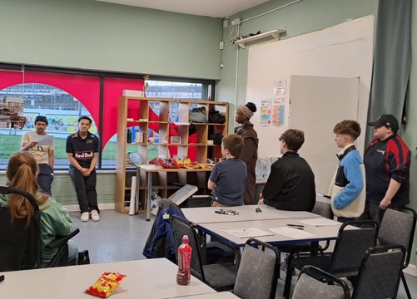
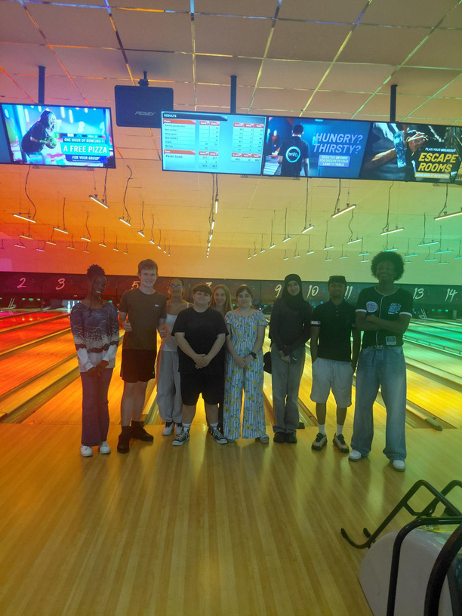
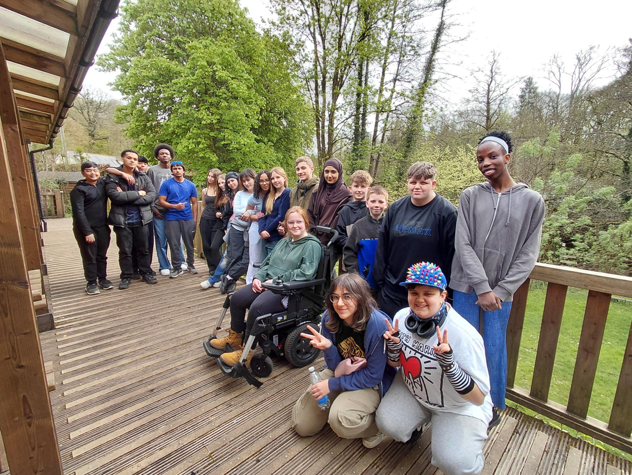
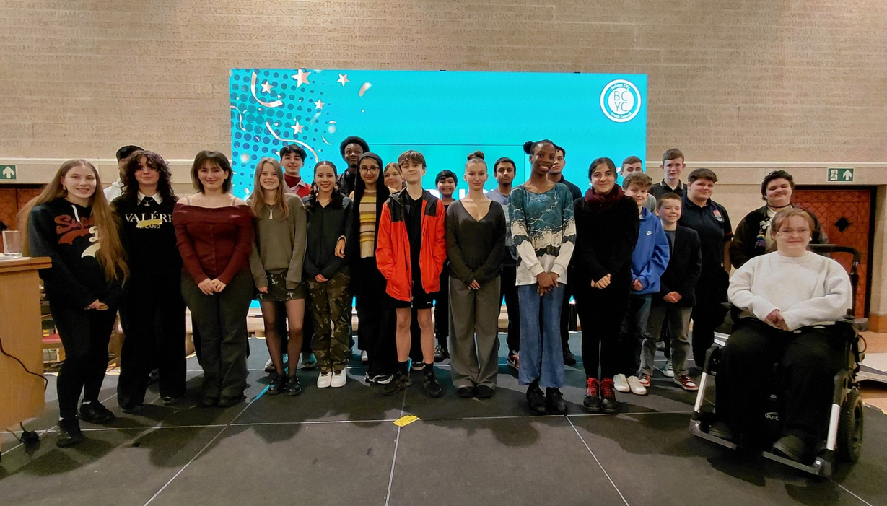
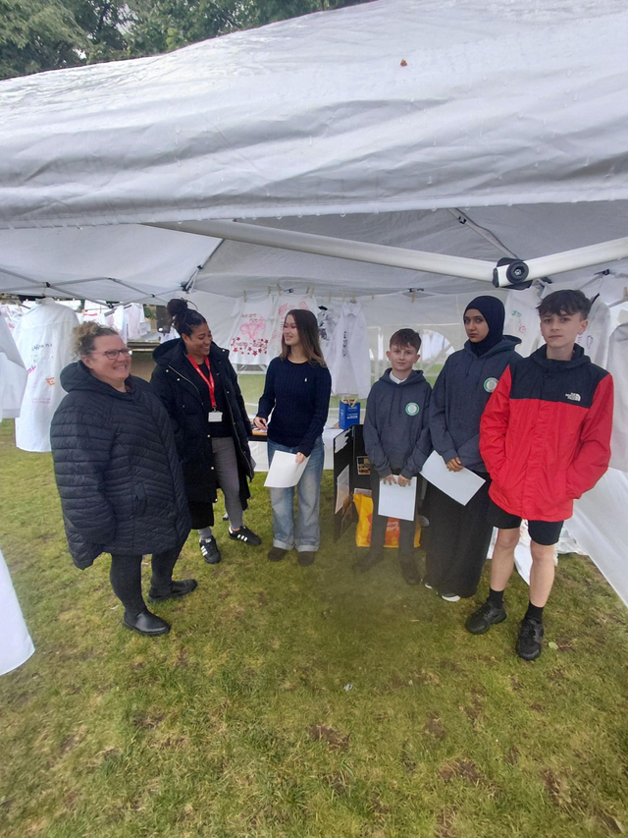
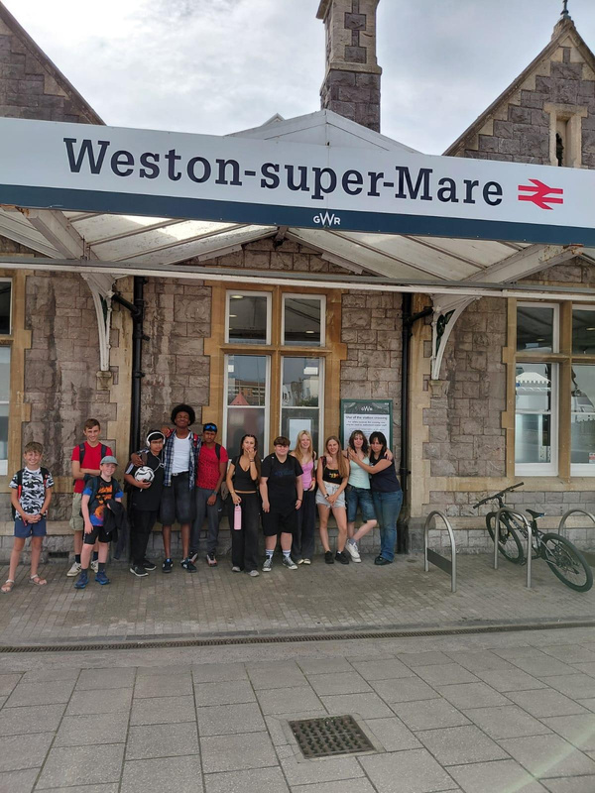
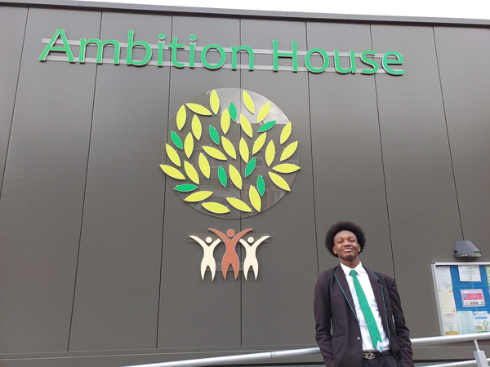
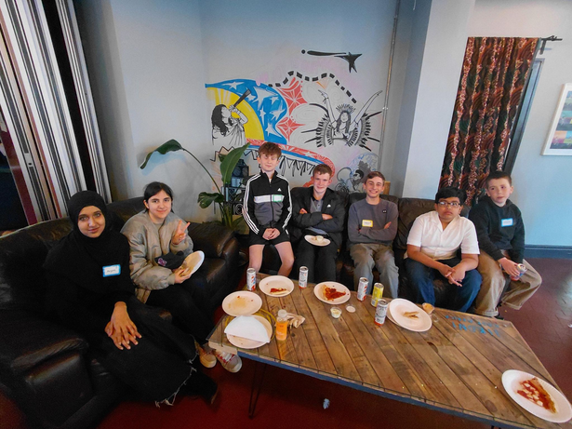
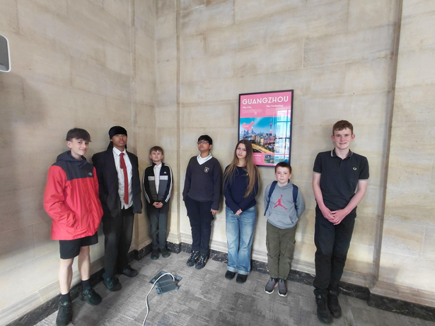
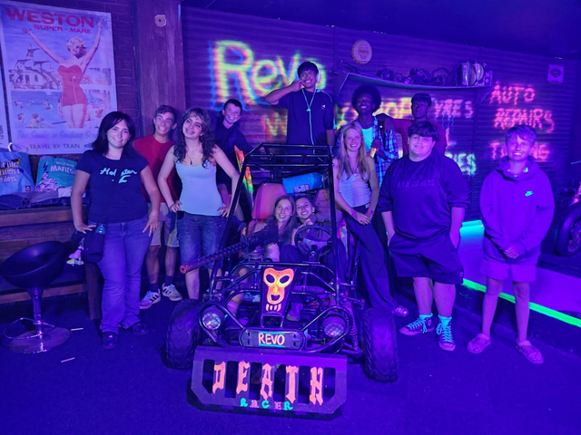
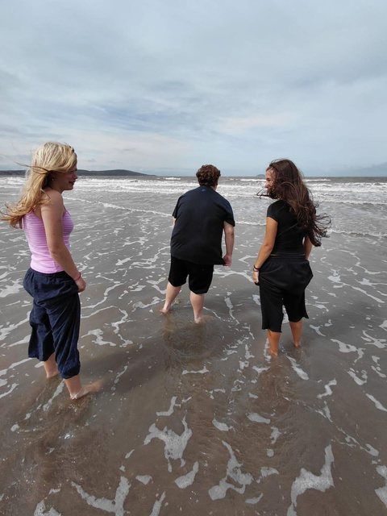
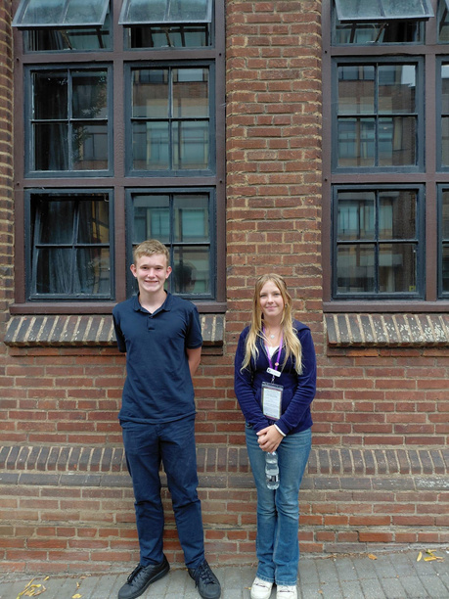
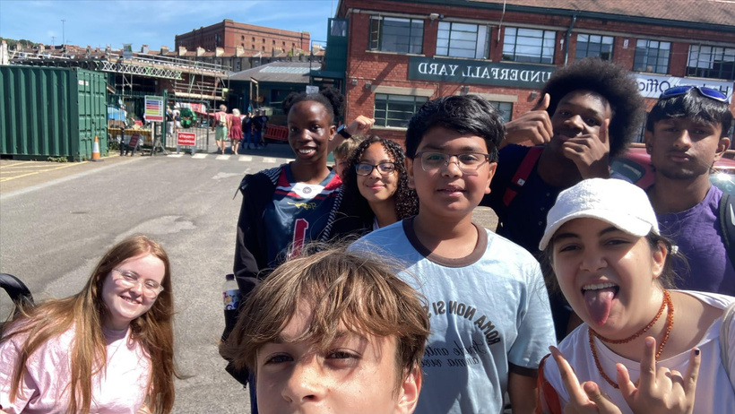
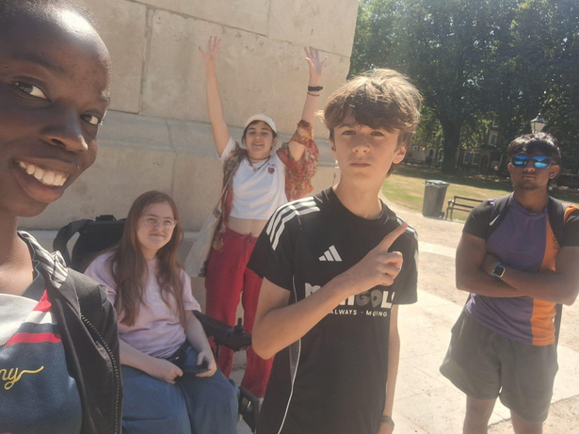
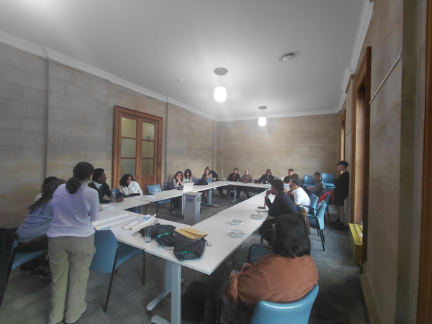
Youth Work

Slide 11
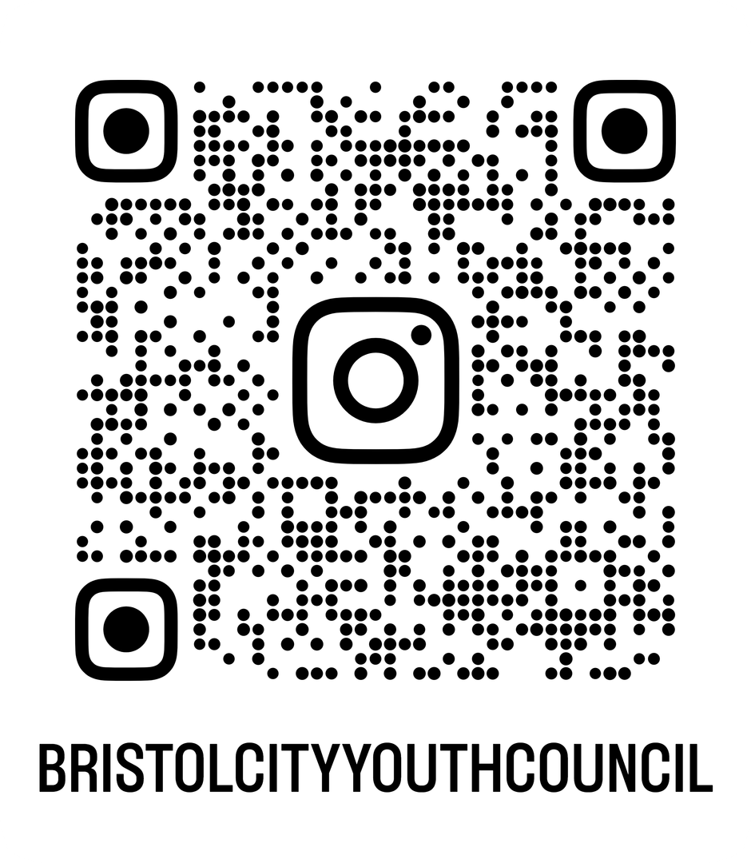
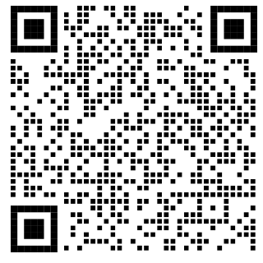
Keep updated with BCYC
LinkedIn

Slide 12

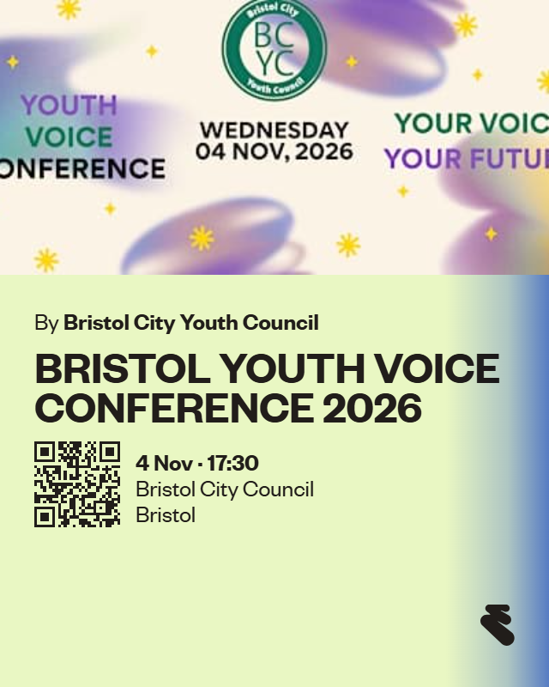
Youth Voice Conference 2026

Slide 13
What are you guys up to?
Round Table Discussion:
What issues are important to the young people you’re working with?
What projects are you working on related to those issues/what young people have highlighted?
Are there common themes across Bristol?

