Slide 1
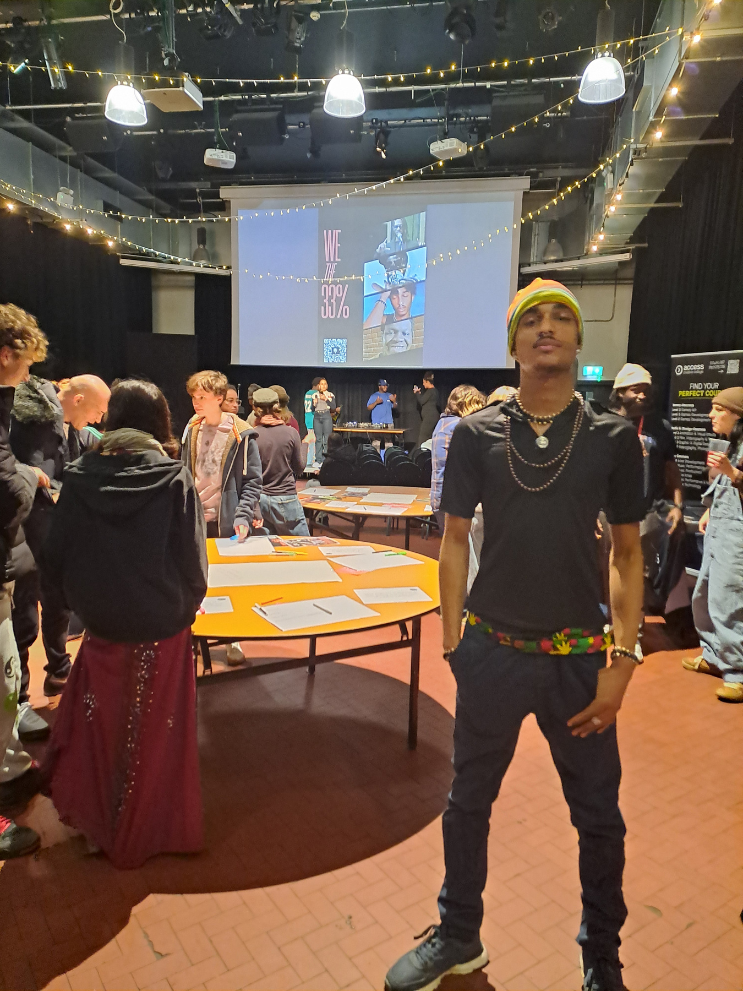

Reduced funding for youth work
Digital youth voice
A pilot programme to develop a digital youth platform for young people by young people

Slide 2
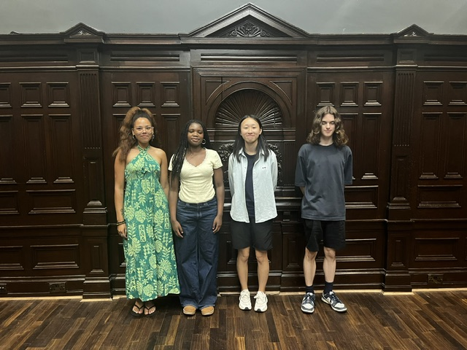
The Team
Content Coordinator – Elle Placide
Content Coordinators
Jackson (16yrs) Written long form
Gracie (17yrs) Podcaster and documenter
Wing (22yrs) Animator and website designer
Currently supported by Digital Youth Voice Coordinator and Marketing team at CYN.
Guided by Steering group
Platform for the whole youth sector

Slide 3
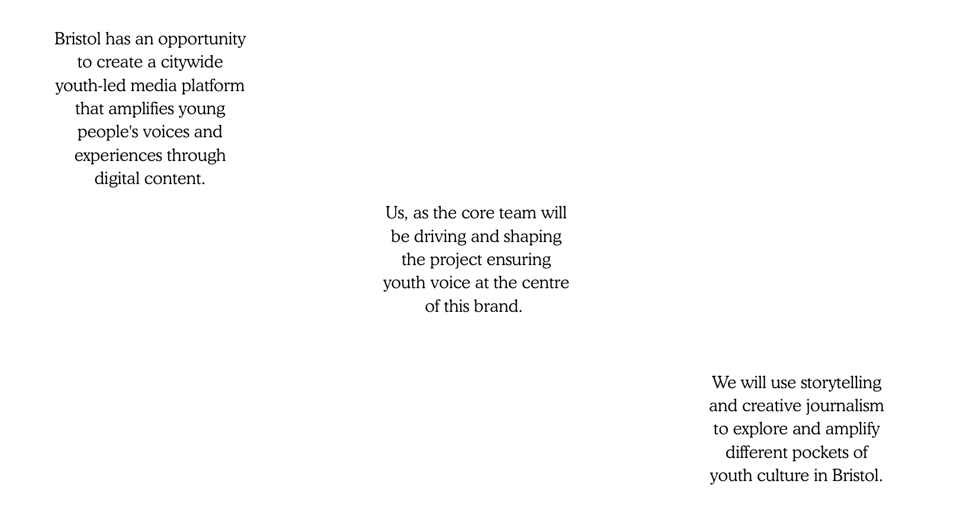

Slide 4
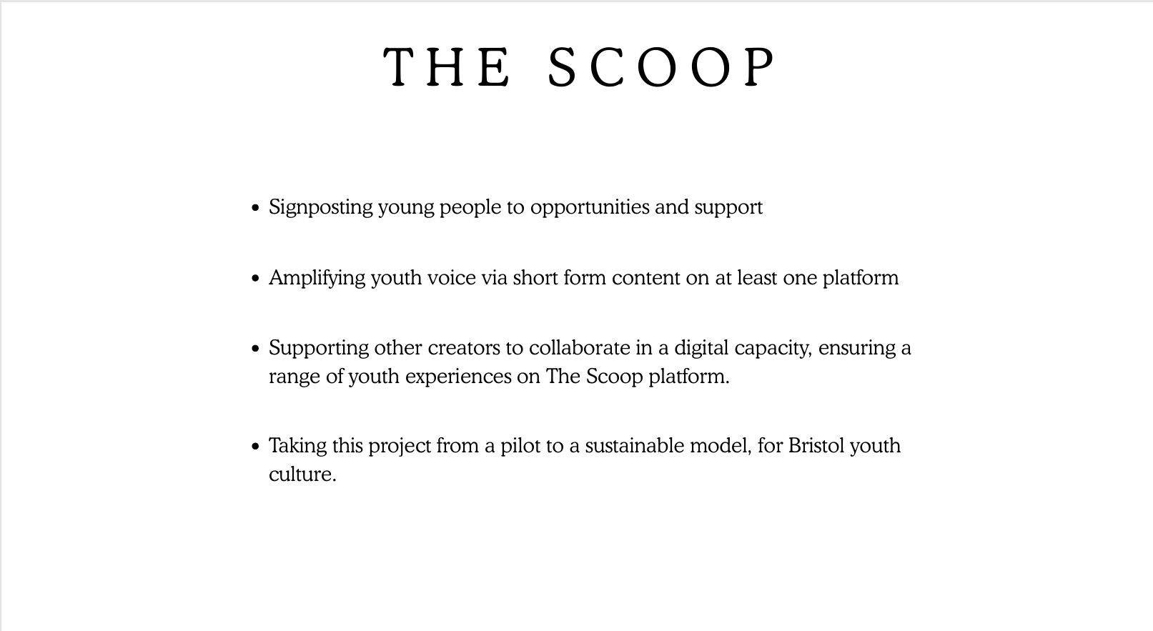

Slide 5


Slide 6


Slide 7

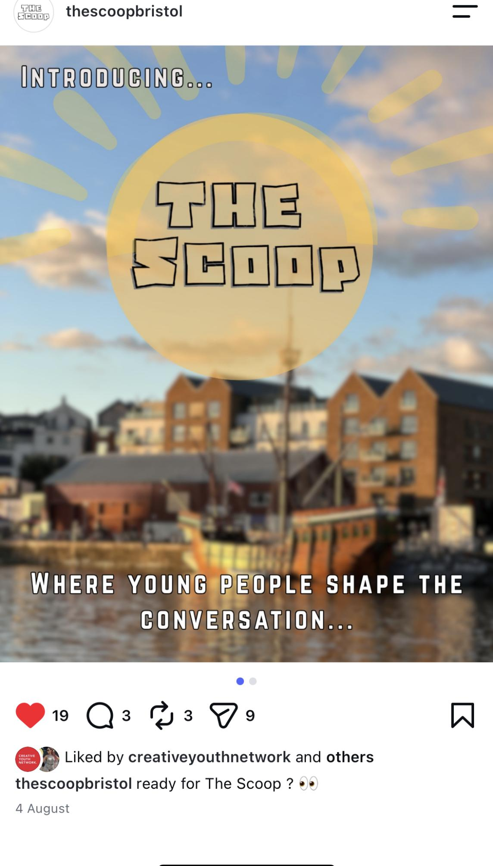
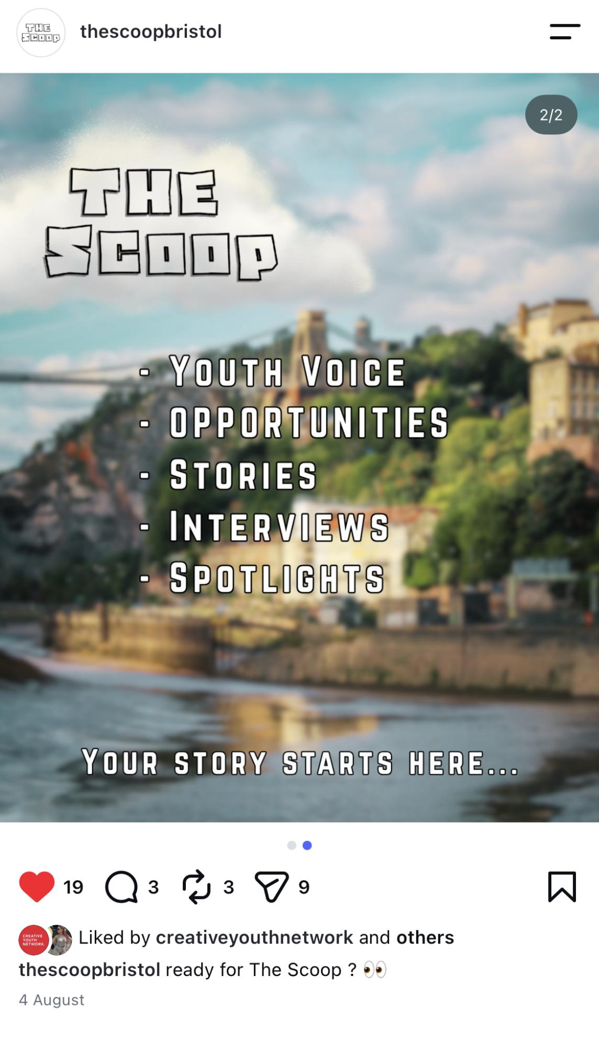
Digital Youth Voice
Platform
‘The Scoop’
Instagram launched (currently at 78 folllowers), youtube channel and website up and running by the end of September to host content.
First pieces of longform being released in September focusing on Education, Employment and Training from our Content Editor and all 3 content creators: an animation, written blog and interview vlog.
How The Education System Fails Neurodivergent Students - The Scoop - Bristol Play and Youth Alliance
4 x commissions scheduled and in progress to bring in other young people's voices with a focus on: the experience of young carers, trans awareness, a Romanian young person looking at Heritage through folklore, and a female creative events collective.

Slide 8
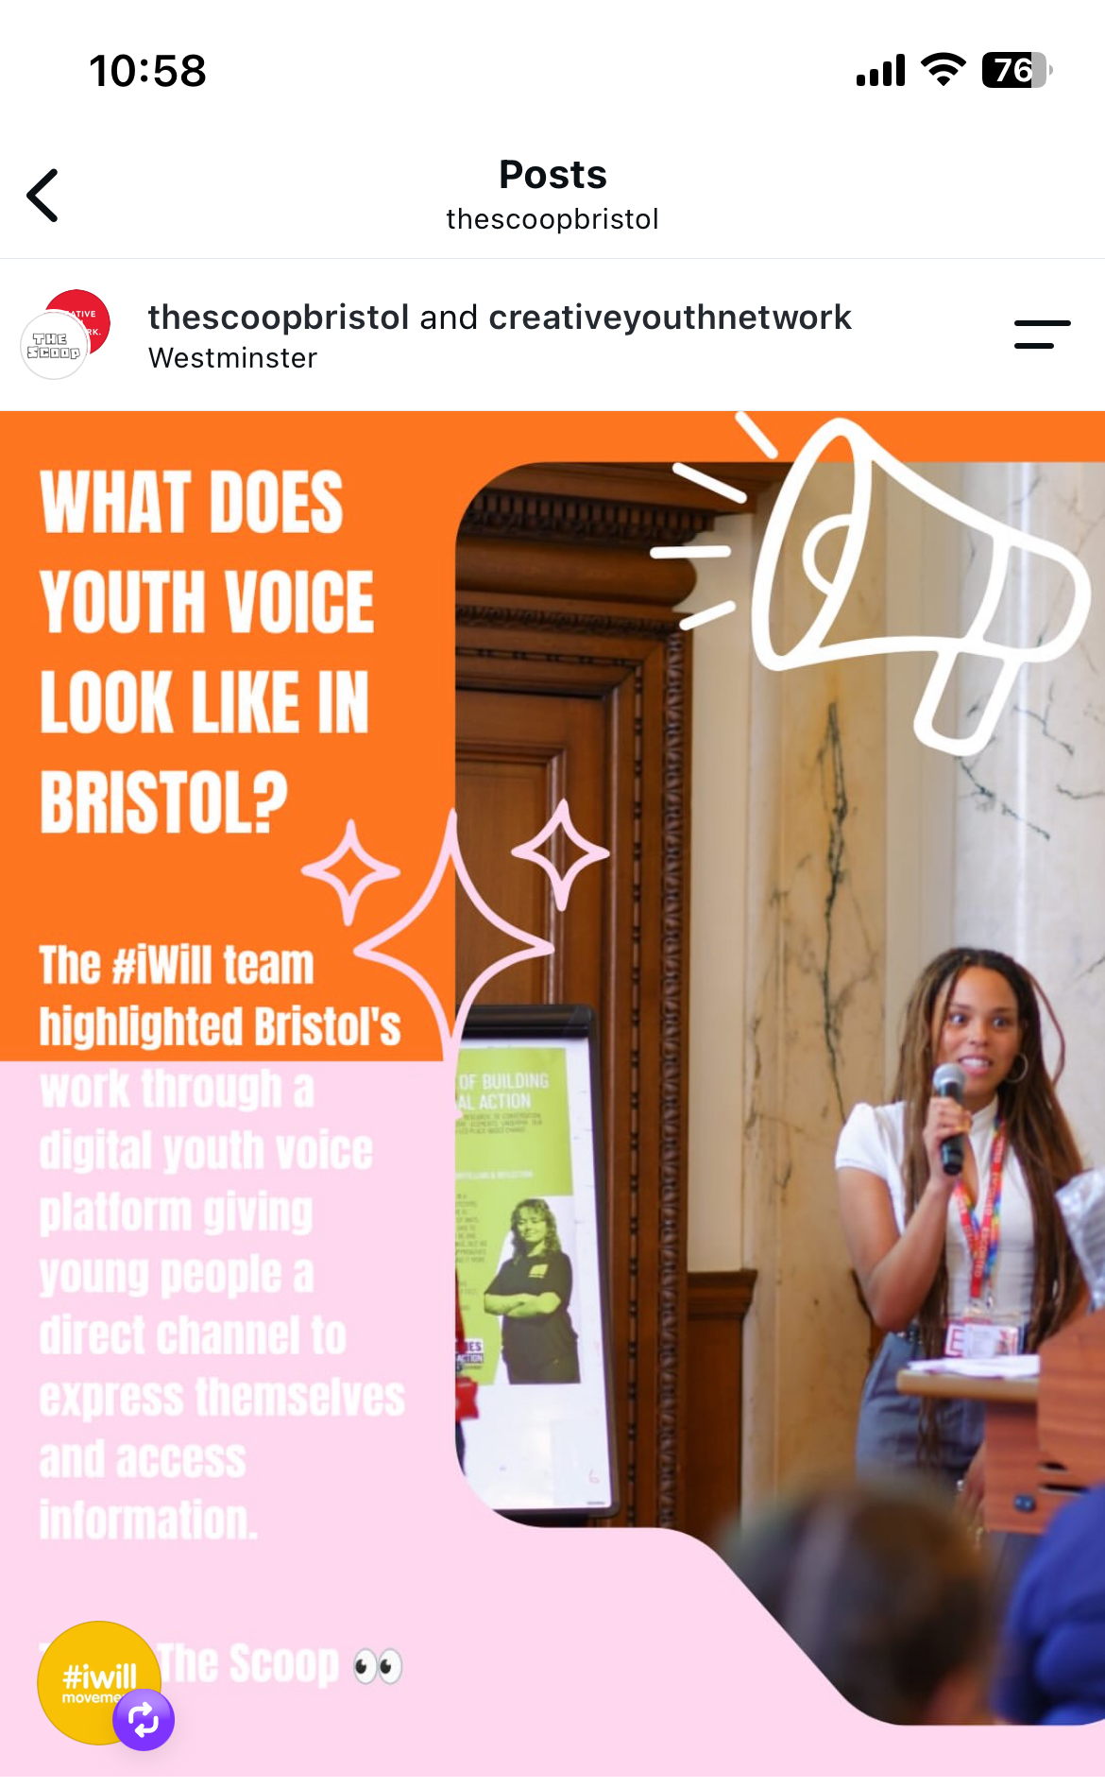
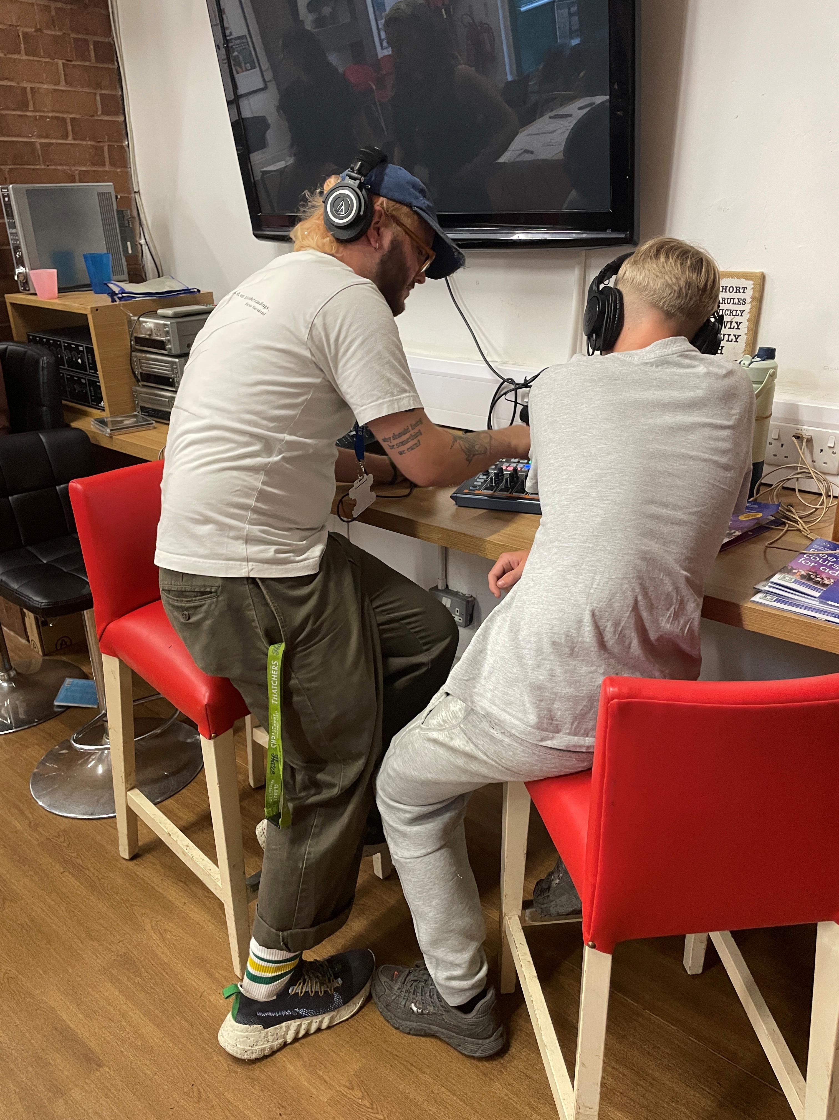
Upskilling Change Makers
Influencing change:
The Scoop's Content Editor from the Scoop - Elle Placide - went to the #iwill national meet up event in London https://www.instagram.com/p/DdZP0boEXay/?utm_source=ig_web_copy_link&stkn=MzRlODBiNWFlZA==
Elle is also hosting an event at the Station showing the Postcodes film with Q and A
Training and Mentoring:
Partnership to produce podcasts with radiostation Noods and Ujima in progress and likely to start in October.
Training with People’s Media over the Summer – story telling and ethics.
In house training ongoing from the Youth Voice and Comms Team at CYN.
Conversations with magazine Crack on offering some training on repurposing content.

Slide 9
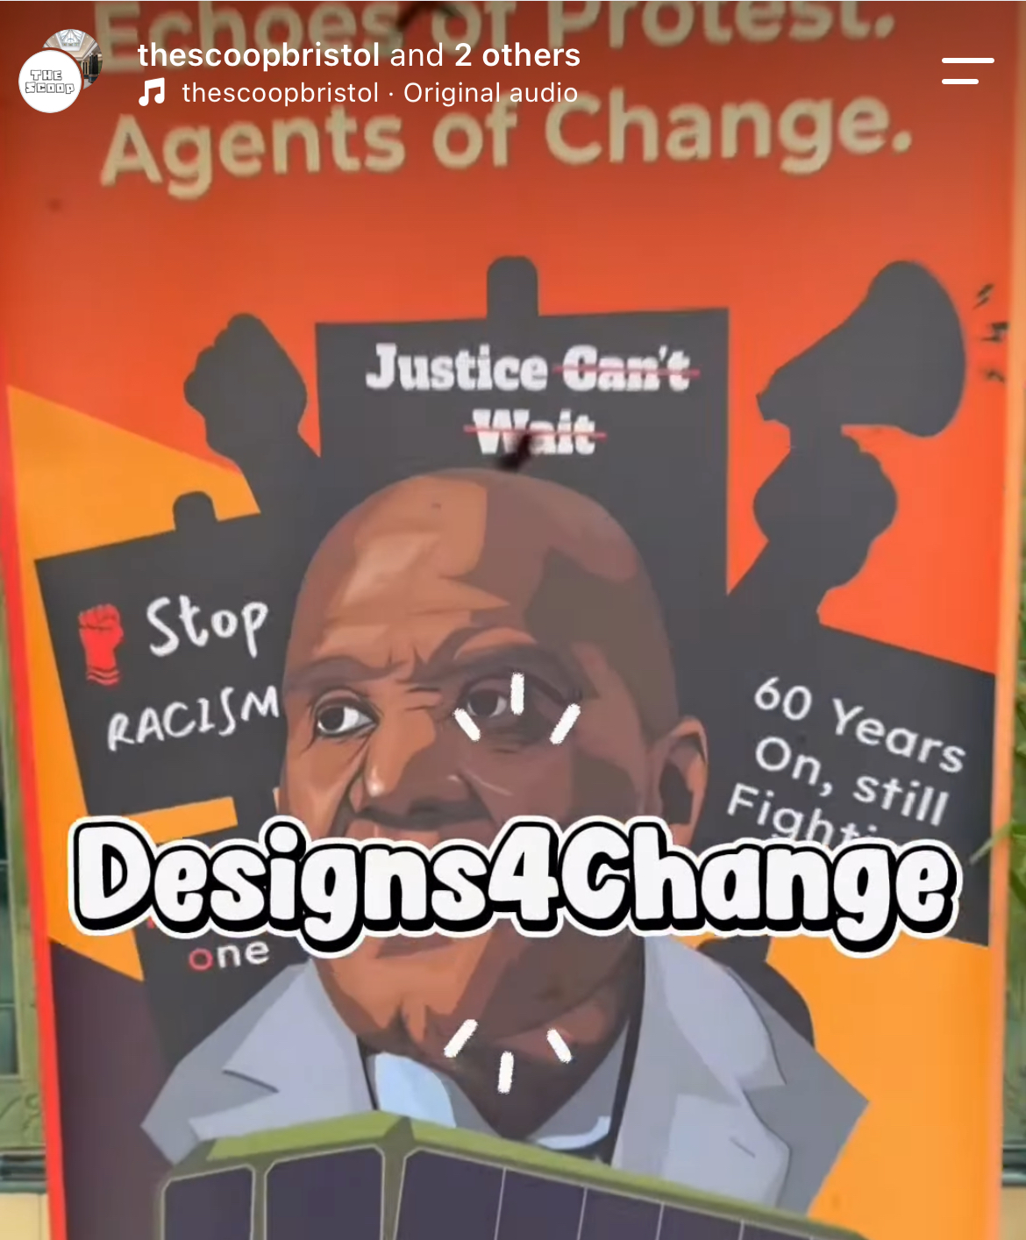
Digital Youth Voice Micro Commissions
Micro Commissions
Invitation to support young people to apply for a micro commission of £500
Brief: to create a long form piece of content on an issue or subject important to them
Rolling deadlines – applications reviewed every 2 weeks
Steering Group
Invitation to join the Monthly Digital Youth Voice Steering group
Opportunities for training and networking.

Slide 10
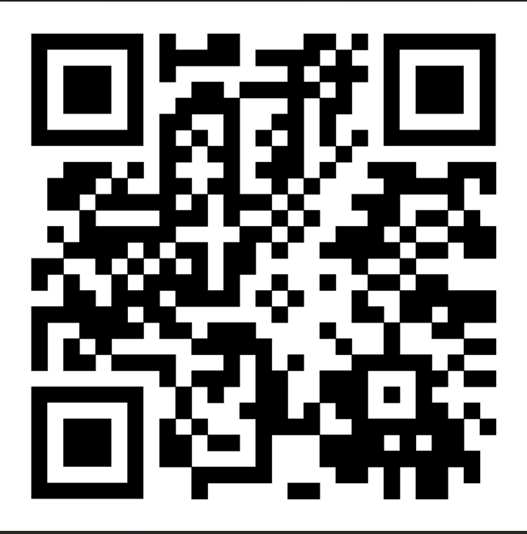
TO APPLY SCAN THE QR CODE

Slide 11
Round Table Discussion
How do we use and share the information we are hearing from young people?
How do we make sure young people are meaningfully involved, rather than simply consulted?

