Slide 1
Applied Research Laboratories
Group f15e4
Heena narottam, ryan spiegelman, and marcus cruz

Slide 2
Data Models
Concept to reality

Slide 3
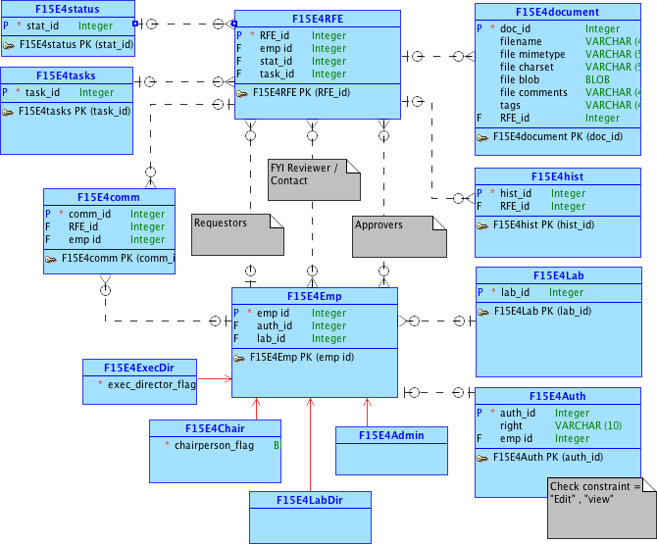
Notes:
conceptual

Slide 4
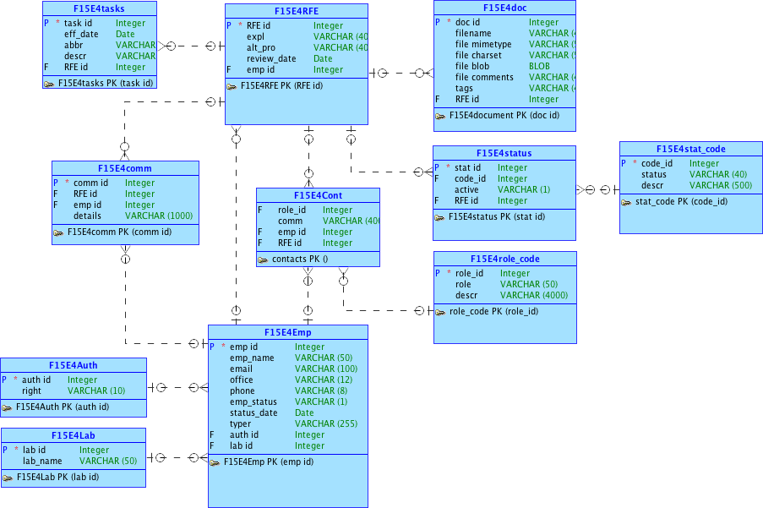
Notes:
logical

Slide 5
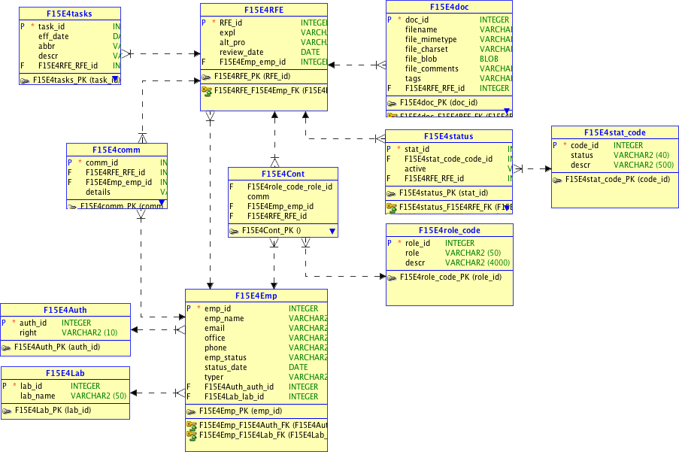
Notes:
Relational

Slide 6
Our Application
Applied research laboratory proposal

Slide 9
Animal Database
Apex mobile application

Slide 10
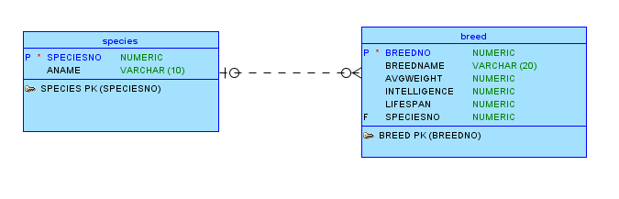
Conceptual Model
Notes:
Conceptual model

Slide 11
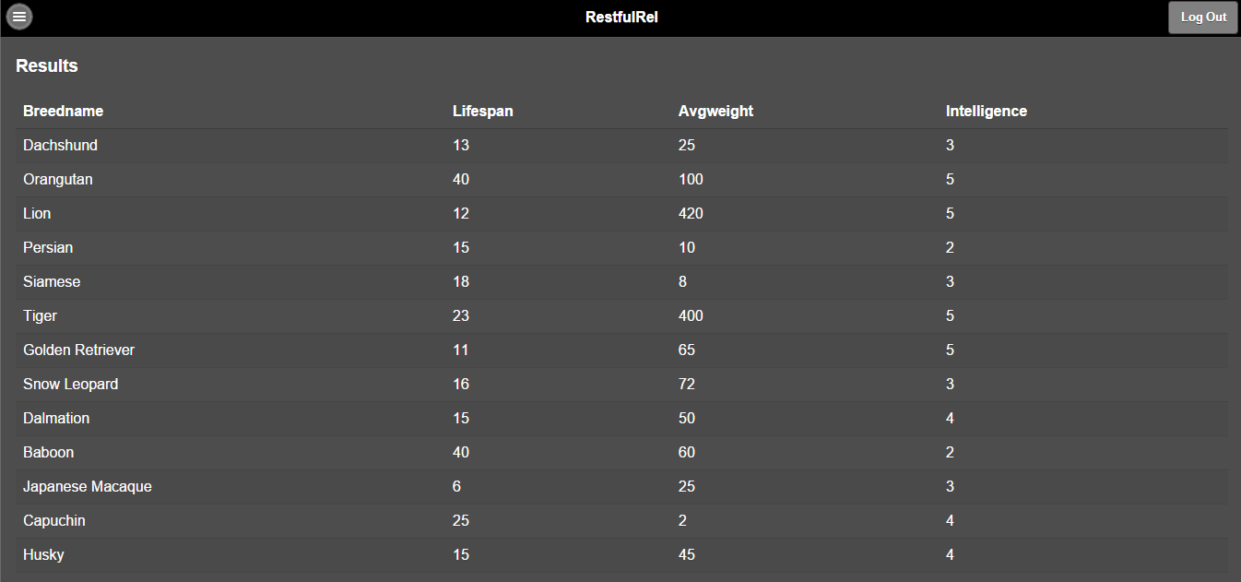
Mobile Application
Notes:
Description of part 2 with a few representative screenshots

Slide 12
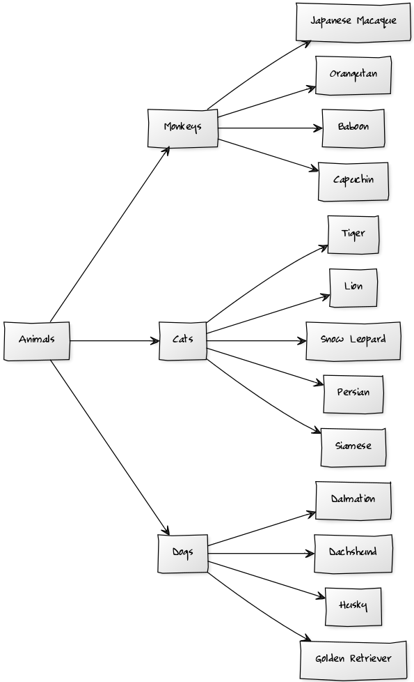
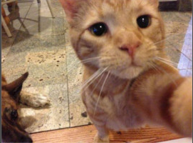

Slide 13
Notes:
Pointer to our git repository
- saved version of our data models
- ddl files
- Dml file with insert statements
Separate SQL file with pl/sql statements
Export of arl application
Readme file with URLS to apex applications
Part 2 ddl file
Export of part 2 apex application
Presentation documents

