Slide 1
Applied research labs app
MARCUS CRUZ, HEENA NAROTTAM, RYAN SPIEGELMAN
CS 347, PROJECT REVIEW. Group E4.

Slide 2
Conceptual model
General Overview

Slide 3
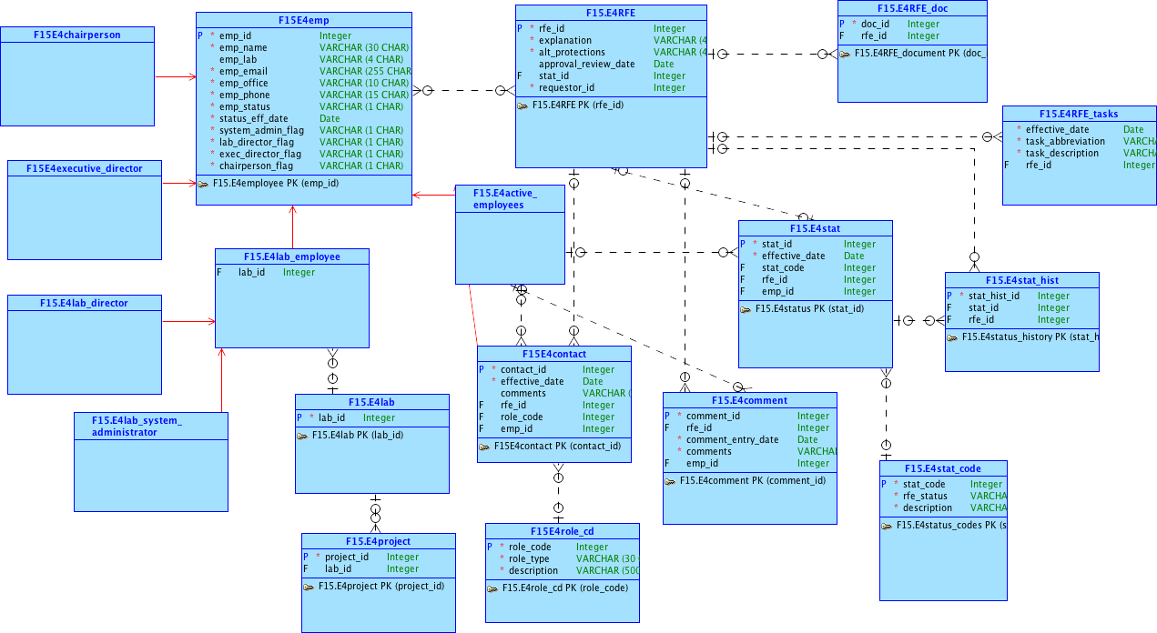

Slide 4
Logical model
Database Structure

Slide 5
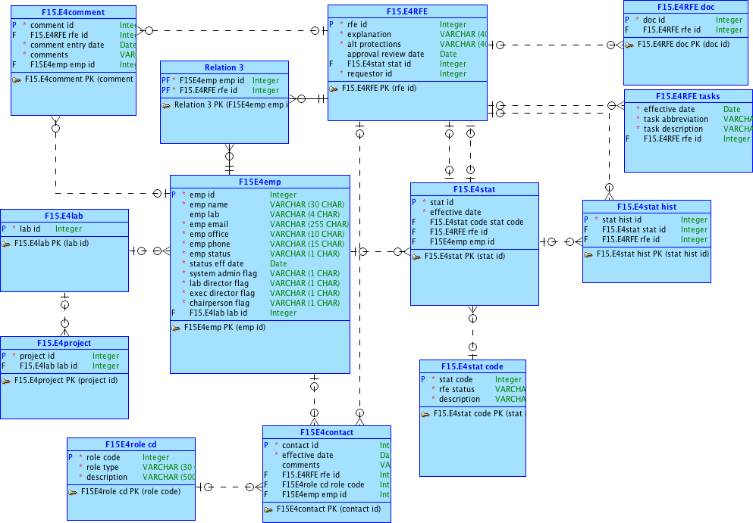

Slide 6
QUESTIONS FOR CUSTOMER
Can a lab employee be associated with more than one lab?
Can a lab project be associated with more than one lab?
Can a lab employee be associated with more than one lab?
What is the purpose of status history?
Do we have to limit names to 30 characters? How definite are the field limits?
How many tasks can be assigned to a single RFE? What is their purpose, etc.?
Should higher ranked employees have privileges of lower ranked employees? (E.g. setting approval statuses)

Slide 7
APEX Prototype Application
Pages to add employees, create new RFE
Create new Labs, create new Projects, create new Tasks
Delete Restricted, Update-ONLY
Responsive Design

