Slide 1
HTTP Redirect Attack
Robert Christensen, Phil Lundrigan, Mark Thueson

Slide 2
Introduction to problem
Related work
Demo
Proposed solutions

Slide 3
Adversary Model
Compromised middle node
Compromised access point
ARP Cache poisoning
etc.
Middle node has access to all traffic coming and going

Slide 4
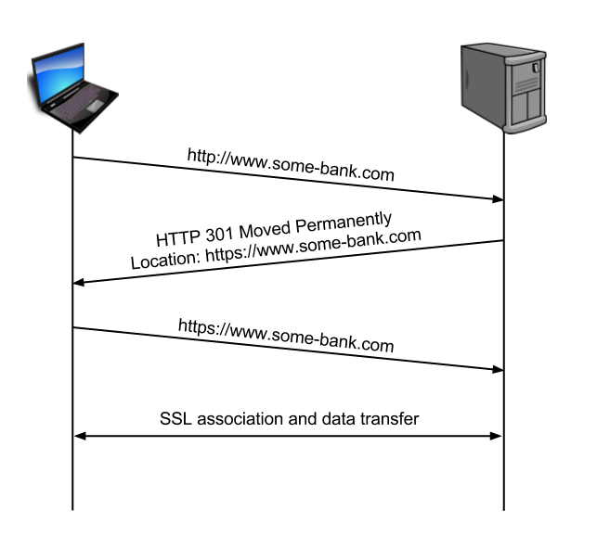

Slide 5
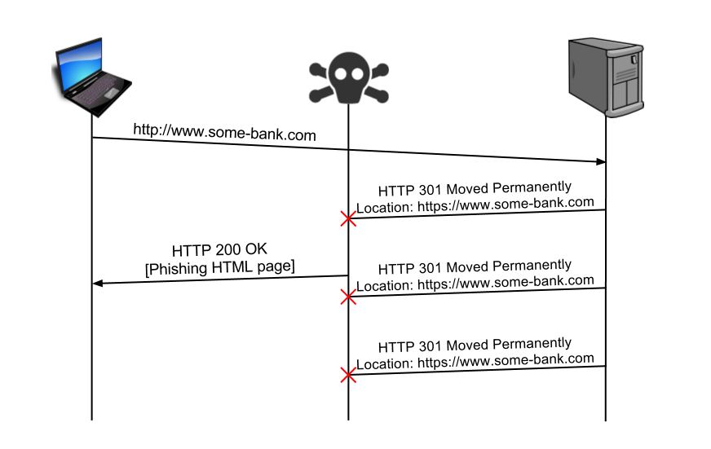

Slide 6
Related Work
Usually involve redirects with location changed to homograph-similar sites
Tools like sslstrip demonstrate this
Controversy about if redirects are bad practice

Slide 7
Demo
Notes:
Show working version
show in wireshark
Show redirect version
show old and new payload
show in wireshark

Slide 8
Solutions
Notes:
Browser fix the problem
not scalable
out of sync
top level domains
Change authentication process
one time passwords
Change network architecture

Slide 9
Network Architecture Fix
IPsec
Content Centric Networking
Proposed architectural fixes discussed in class

Slide 10
One Time Passwords
Implementation
Issues
Using a secondary trusted association (cell phone), send a one time password to user
Requires a secondary trusted association
Requires addition time and effort

Slide 11
Browser Level Fix
Implementation
Issues
Keep list of HTTPS websites
Automatically changes HTTP request to HTTPS request for initial connection
Removes need for redirect packet
Not scalable
Browser out of sync with real Internet

Slide 12
Transport layer needs to be secure!

Slide 13
Questions

