Slide 1


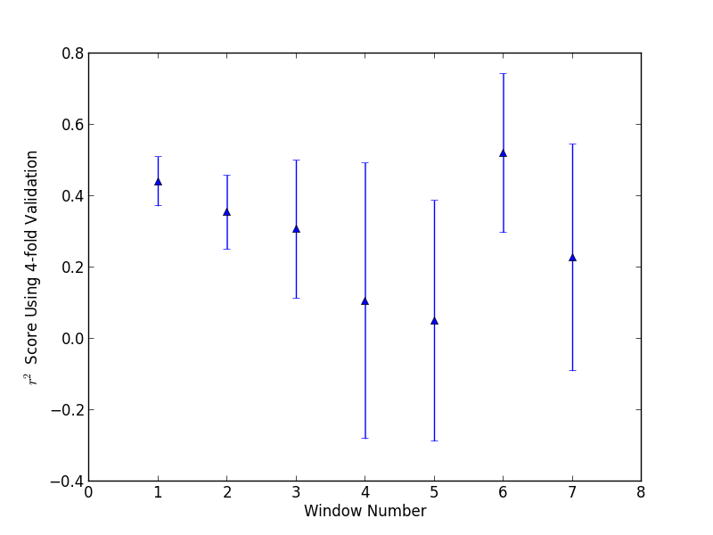
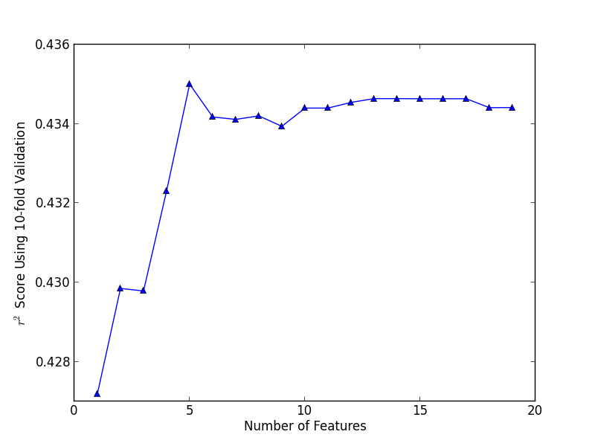
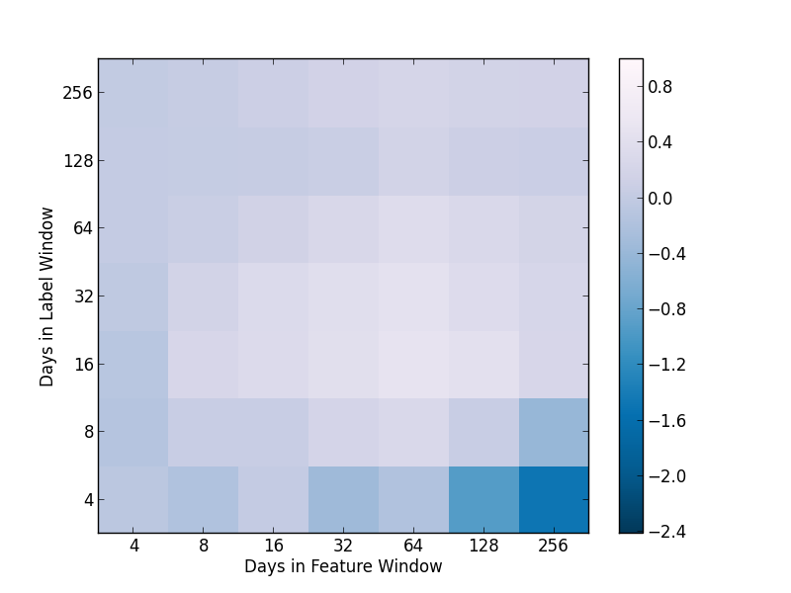
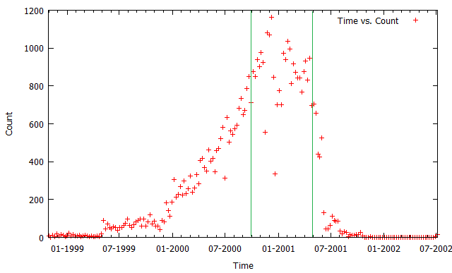
Future Link Regression Using Supervised Learning on Graph Topology
Adam Goldberg, Jonathan Hung, Mark Ulrich
Problem Statement
Features
Feature Selection
Machine Learning & Results
We investigate the problem of link regression, which predicts link weights based on snapshots of a weighted network. In our case, edge weight is the number of emails sent between two nodes. Formally, we want to create a regression function f(X), where X = (n₁, n₂, f₁ , f₂, f₃) is a pair of nodes n₁, n₂, features f_{1,} f₂ on one node each, and features f₃ that depend on both n₁ and n₂. This input comes from a window of size Δ_{x,} from time t to t+ Δ_{x}. The output is the number of emails between n₁ and n₂ during time t+ Δ_{x} + Δ_{y} for some number of days Δ_{y}.
We examined graph topology attributes for single nodes and pairs, as well as natural language processing features.
PageRank
Rooted PageRank
Node Degree
Node Volume
PropFlow
Adamic Adar
Number of Common Neighbors
Jaccard Coefficient
Target Value for previous window
We computed the F-score of each feature by running univariate linear regression tests formed from each feature and orthogonalize it and our data and compute cross-correlation between it and our data.
Feature | F-score
TargetValue | 2.936e6
DeliverSum | 2.825e6
DeliverDataSum | 1.839e6
LinesSum | 1.758e6
RequestSum | 1.246e6
SentSum | 8.330e5
MeetSum | 2.504e5
PropFlow | 9.644e4
Rooted PageRank | 6.592e4
DeliverMean | 3.946e4
LinesMean | 3.455e4
SentMean | 3.451e4
CommitSum | 1.487e4
JPageRank | 6.858e3
ProposeSum | 4.490e3
IVolume | 7.980e2
CommonNeighbor | 7.764e2
JDegree | 5.595e2
Jaccard Coefficient | 2.818e2
IDegree | 1.032e2
JVolume | 7.603e1
DeliverDataMean | 9.915e3
RequestMean | 3.335e3
MeetMean | 6.198e2
CommitMean | 1.959e2
IPageRank | 1.520e1
ProposeMean | 0.000e-5
We computed linear regression R² values by for each month from 2000 to May 2001. The negative R² values indicate our problem is non-linear.
R² values based on number of features used. Best results at 11 features.
Our methodology was to run k-fold cross validation with a standard k of 10. We constructed three baseline systems, predicting always 0, always the mean, and always the TargetValue, respectively. We optimized with forward feature selection.
NLP Features
Data
We needed to combine email-level NLP features to pairs of nodes, so we took sums of and averages of each feature on a per-pair basis.
Indicator on Request in {0,1}
Indicator on Commit in {0,1}
Indicator on Deliver in {0,1}
Indicator on DeliverData in {0,1}
Indicator on Propose in {0,1}
Indicator on Meet in {0,1}
Sentiment Score in [-1,1]
Email Length (lines)
Our data is a collection of emails sent to and from a set of 150 Enron employees from 1998 to 2002. After preprocessing, we have 7475 email addresses and 50098 emails. Our data is concentrated between 10/2000 and 05/2001, so we use that time period to construct a network.
Left: Feature and label size against accuracy (30 day windows)
We created multiple non-parametric and parametric systems, and for each computed the optimal set of features by F-score. Our results are in the table below, after parameter tuning (when relevant).
Method | Mean Base | Zero Base | Ridge Base | Ridge NLP | Ridge Graph | Ridge Best
R² (avg) | -0.0002 | -0.0002 | 0.4163 | 0.4538 | 0.4596 | 0.4856
R² (σ²) | 0.0002 | 0.0001 | 0.1439 | 0.0681 | 0.0982 | 0.0418
Email class | Percent of emails
Request | 22.5%
Deliver | 74.7%
Commit | 1.1%
Proposal | 0.2%
Meet | 0.7%
DeliverData | 31.2%
Conclusion & Future Work
Our network appears to follow a power law distribution with α = 2.1 and approximately the mean node out degree is 6.7. In our regression, approximately 1% of node pairs have a nonzero target.
Our predictions work best when we combine graph topology features and NLP features. However, work can be done for more features, such as burstiness (groupings) of messages. We could also use deep learning models or ensemble learning, as well as dimensionality reduction to shrink our feature space.

