Slide 1
Steps Used (Evolving Approach)
Identify possible inputs
Find overview website for each input
Find most useful website for each input
Download dataset for each input
Parse dataset manually
Integrate dataset into visualization
Integrate dataset into input database

Slide 2
1. Identify possible inputs
“Deepest Dive Under Antarctica Reveals a Shockingly Vibrant World”
“Upwelling currents bring cold nutrient-rich waters from the ocean bottom to the surface”
“Sharks are the most electrically sensitive animals known, responding to DC fields as low as 5 nV/cm”
“Sharks are widely thought to use the earth's magnetic field for navigation but most evidence for this putative compass sense is circumstantial.”
“They CAN detect blood a considerable distance away - 400-500 yards”
“They react especially to [sounds] produced by sick or wounded animals, … over a distance of several hundred meters.”

Slide 3
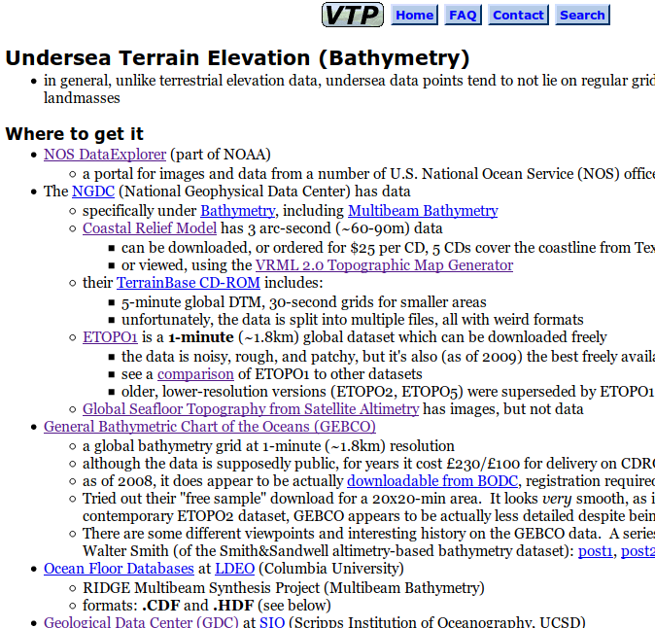
2. Overview website for each input
http://vterrain.org/Elevation/Bathy/

Slide 4
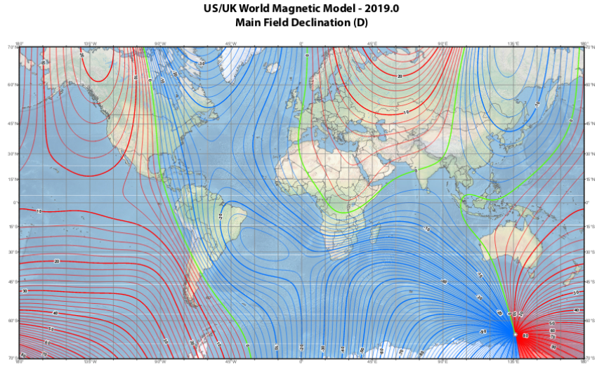
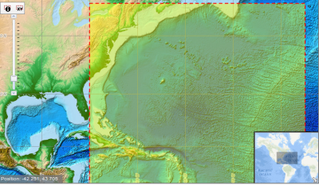
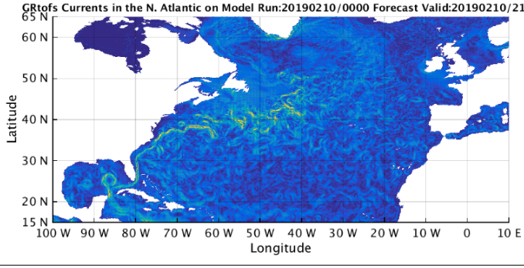
3. Useful website for each input
https://www.ngdc.noaa.gov/geomag/WMM/data/WMM2015/WMM2015v2_D_MERC.pdf
https://maps.ngdc.noaa.gov/viewers/wcs-client/
https://ocean.weather.gov/Loops/ocean_guidance.php?model=Global_RTOFS&area=Natl&plot=currents&day=1&loop=1

Slide 5
4. Download dataset
Format?
  CSV (comma separated values)
  TSV (tab separated values)
  NetCDF
  GeoTIFF
Python tools support all of these formats
  I used all of the above except GeoTIFF for this project

Slide 6
5. Parse dataset manually
Assumes you have installed tools like
  pip install matplotlib, numpy, pandas, scipy
Example – for ‘nc’ netcdf file google search gives
from scipy.io import netcdf
f = netcdf.netcdf_file (‘file’, ‘r’)
for v in f.variables:
print (v)
lat = f.variables [‘lat’]
print (lat.shape)
CSV, TSV and NetCDF code is very similar

Slide 7
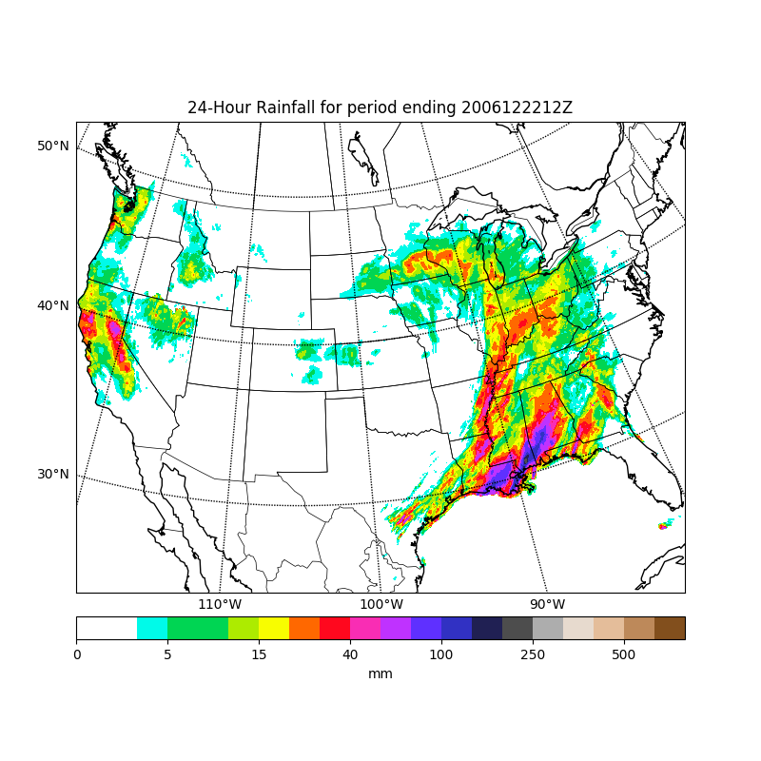
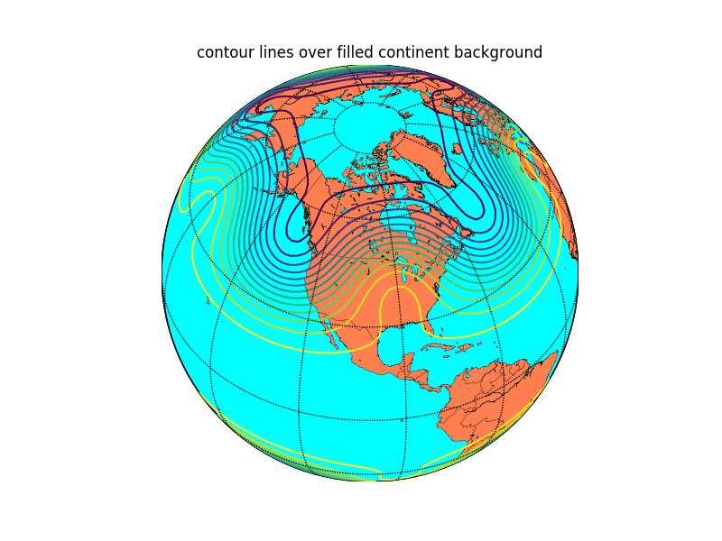
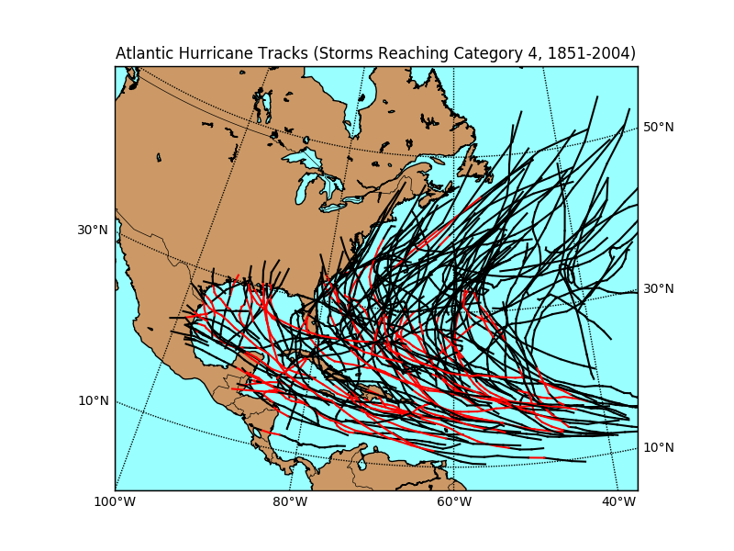
6. Integrate into visualization (1/3)
“Liberate” code found by search on “XXX examples”
Example: https://matplotlib.org / basemap/users / examples.html

Slide 8
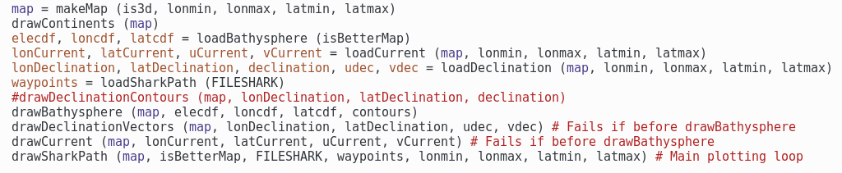
6. Integrate into visualization (2/3)
github.com/markummitchell/ai-on-the-beach/SharkPathGallagher.py

Slide 9
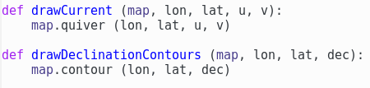
6. Integrate into visualization (3/3)
Low level code snippets
Video pseudo code snippet
for row in waypoints:
if row[date] is different from previous
output graphics as png file “###.png”
if row[id] was seen before
draw line from old waypoint to new waypoint
save waypoint as old waypoint for id
ffmpeg -i %03d.png -o video.mp4

Slide 10
7. Integrate into AI-on-the-Beach dataset
Coordinate
Ask Smitesh?

