Slide 1
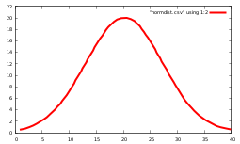
Image File
Data File
Import
Engauge
Define coordinates
Place points
Export
1,
2,
3,
4,
.
16
25
36
49
.
Save
(optional)
011100101001
101010101110
011010100011
10101
Open
(optional)
DIG File

