Slide 1
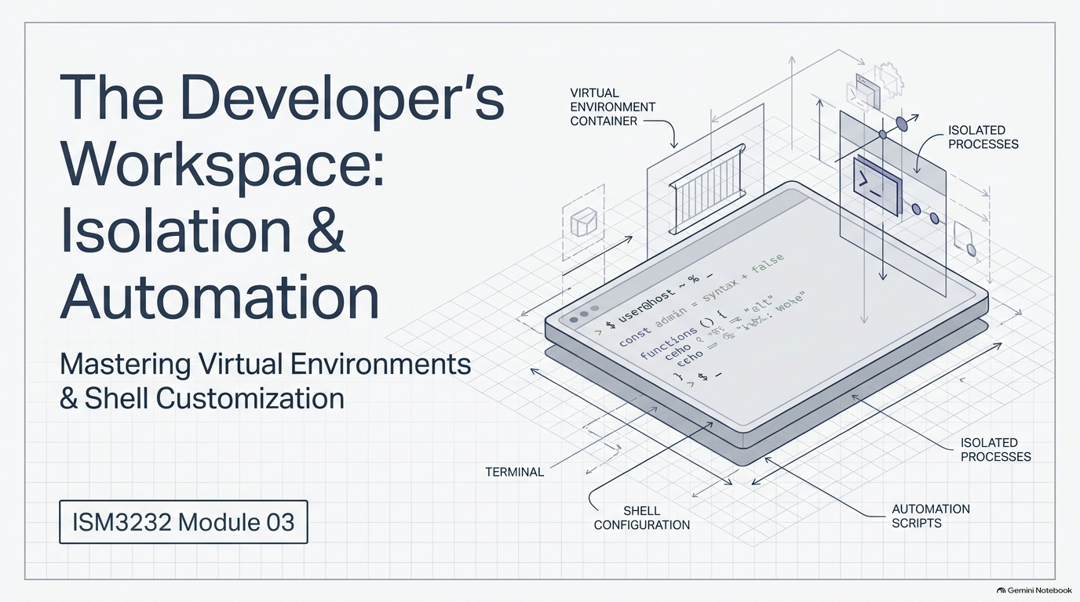
Notes:
SLIDE 1 — INTRO
TEACHING GOAL: frame the whole lab before anyone touches the keyboard. A venv gives true, provable isolation per project; .zshrc habits (aliases + functions) become permanent, global developer tooling that carries across the entire semester.
SAY: "Lab 3 — virtual environments and shell customization. Here's the mental model before we type anything: a venv is a private room for each project. Activate it and you walk in — every package you install stacks up on that room's shelves. Deactivate and you walk out — other projects are completely unaffected. Let's build one."
SLIDE NOTES
The diagram's labeled zones (virtual environment container, isolated processes, terminal, shell configuration, automation scripts) preview the lab's four parts: Part 1 venv workflow, Part 2 .gitignore, Part 3 .zshrc aliases/functions, Part 4 practice + deactivate.

Slide 2
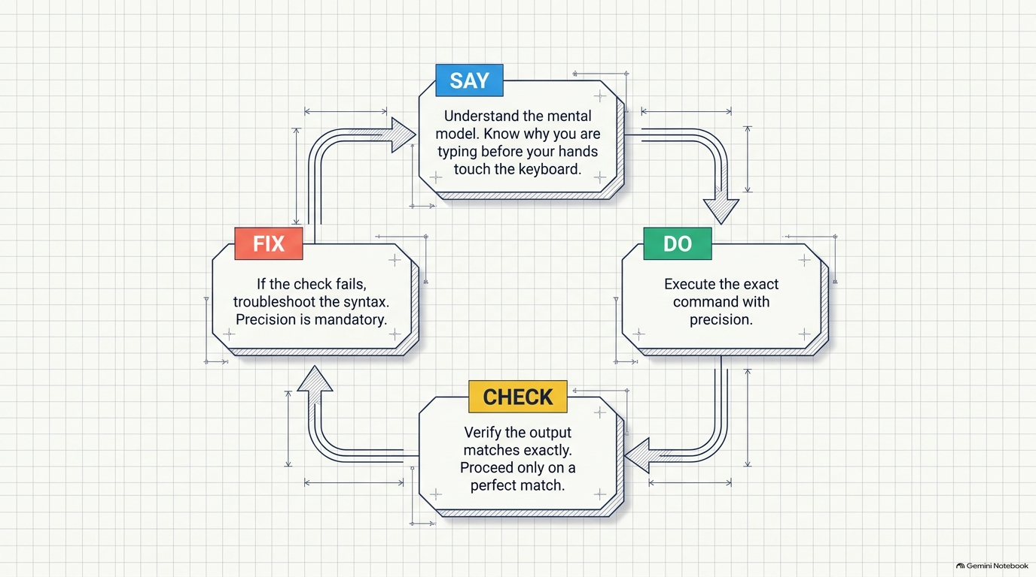
Notes:
SLIDE 2
TEACHING GOAL: establish the working rhythm for every remaining step in this lab, and every lab for the rest of the semester — SAY the mental model before typing, DO the exact command with precision, CHECK that the output matches exactly, and if it doesn't, FIX the syntax before moving on. Never proceed past a mismatch.
This is the same How to Use This Script pattern from the top of the script, restated visually: 'Execute the exact command with precision' and 'Verify the output matches exactly — proceed only on a perfect match.' Set this expectation explicitly now since the rest of the lab is dense with commands.

Slide 3
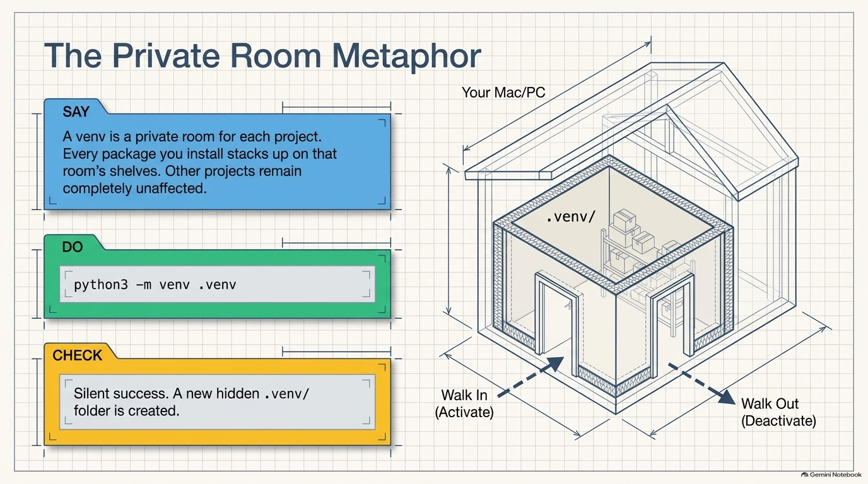
Notes:
SLIDE 3 — Step 1 — Create the venv
TEACHING GOAL: land the private-room metaphor visually, then immediately make it concrete with the one command that creates the room.
SAY: "One command creates the whole isolated environment as a folder called .venv."
DO:
cd ~/ism3232/module02_zsh
python3 -m venv .venv
CHECK: No output on success, and a new hidden .venv/ folder now exists — confirm with ls -la (the leading dot means plain ls won't show it).

Slide 4
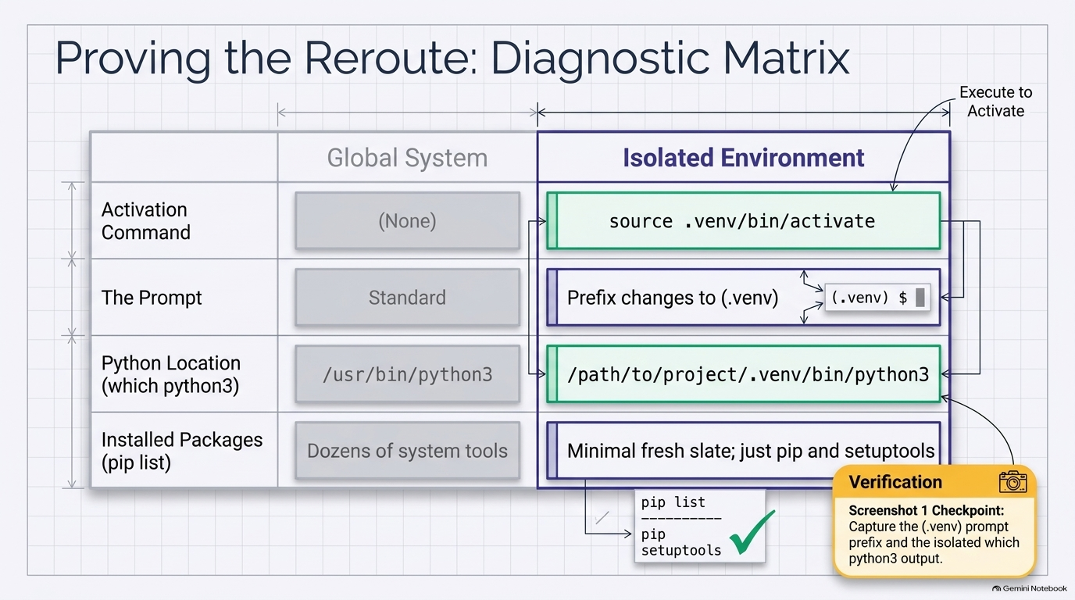
Notes:
SLIDE 4 — Step 2 — Activate it
TEACHING GOAL: prove the isolation is real and provable, not just a prompt-prefix cosmetic — walk every row of this Global System vs. Isolated Environment table live.
Step 2 — Activate it
SAY: "Activating doesn't install anything — it just tells the shell 'use this room's Python from now on.'"
DO:
source .venv/bin/activate
CHECK: Your prompt now shows a (.venv) prefix:
(.venv) yourname@machine module02_zsh %
FIX: If you don't see (.venv), confirm you ran the command from inside module02_zsh and that .venv/bin/activate exists via ls .venv/bin.
Step 3 — Confirm which Python is active
SAY: "Let's prove the isolation is real, not just cosmetic — which python3 binary is actually running now?"
DO:
which python3
CHECK:
/Users/yourname/ism3232/module02_zsh/.venv/bin/python3
It points inside .venv, not at the system Python — that's isolation working.
Step 4 — Check installed packages
SAY: "A fresh venv starts almost empty — let's see."
DO:
pip list
CHECK:
Package Version
---------- -------
pip 24.x
Just pip itself (and maybe setuptools) — nothing else yet.
Screenshot 1 checkpoint
SAY: "Screenshot 1 — the (.venv) prefix in the prompt, plus the which python3 output."
Step 7 — Verify isolation from a second terminal
SAY: "The real test: open a brand-new terminal tab — do not activate the venv in it — and check the same two things."
DO: In a new terminal tab (venv not activated):
which python3
pip list
CHECK:
/usr/bin/python3
and a pip list that does not include pytest or ruff.
This confirms the venv only affects the terminal session where you activated it — that's what "isolated" means in practice. Switch back to your original, activated terminal before continuing.
SLIDE NOTES
Fold in Step 7 here as the deeper proof of isolation, right after this table: open a brand-new terminal tab, do NOT activate the venv in it, then run which python3 (expect /usr/bin/python3, the system Python) and pip list (should NOT include pytest or ruff once installed in Step 5).

Slide 5
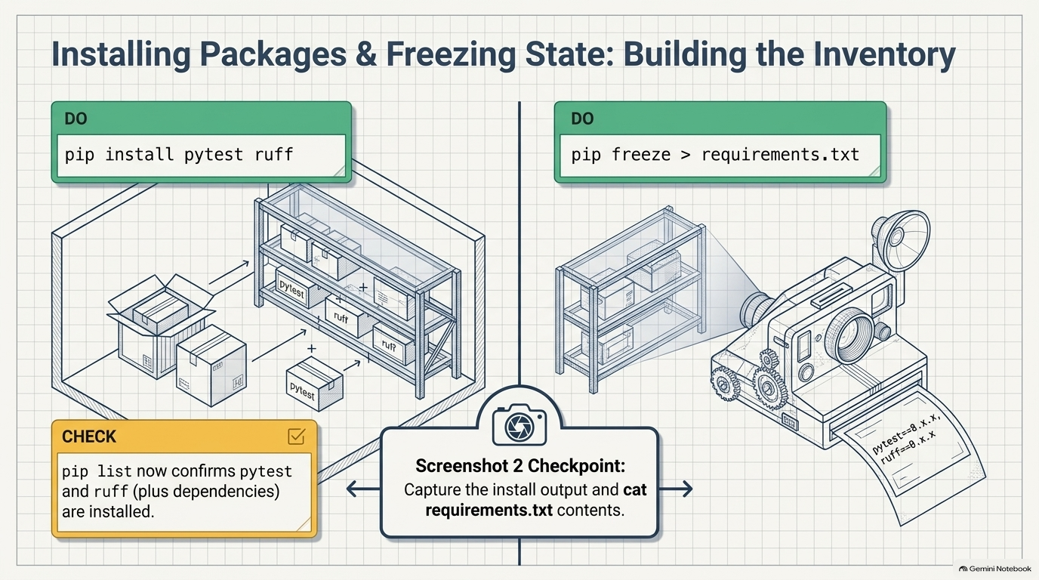
Notes:
SLIDE 5 — Step 5 — Install packages
TEACHING GOAL: install the two tools this whole course depends on, then capture the exact versions so the environment is reproducible by anyone, including future-you.
Step 5 — Install packages
SAY: "Now we furnish the room — installing the two tools this course uses everywhere: pytest for testing, ruff for linting."
DO:
pip install pytest ruff
pip list
CHECK: The second pip list now includes both:
pytest 8.x.x
ruff 0.x.x
plus their dependencies.
Step 6 — Freeze requirements
SAY: "pip freeze writes down every installed package and its exact version, so anyone — including future you — can rebuild this exact environment."
DO:
pip freeze > requirements.txt
cat requirements.txt
CHECK: File contents list pytest==8.x.x, ruff==0.x.x, and their dependencies, each pinned to an exact version number.
Screenshot 2 checkpoint
SAY: "Screenshot 2 — the pip install output and cat requirements.txt output."

Slide 6
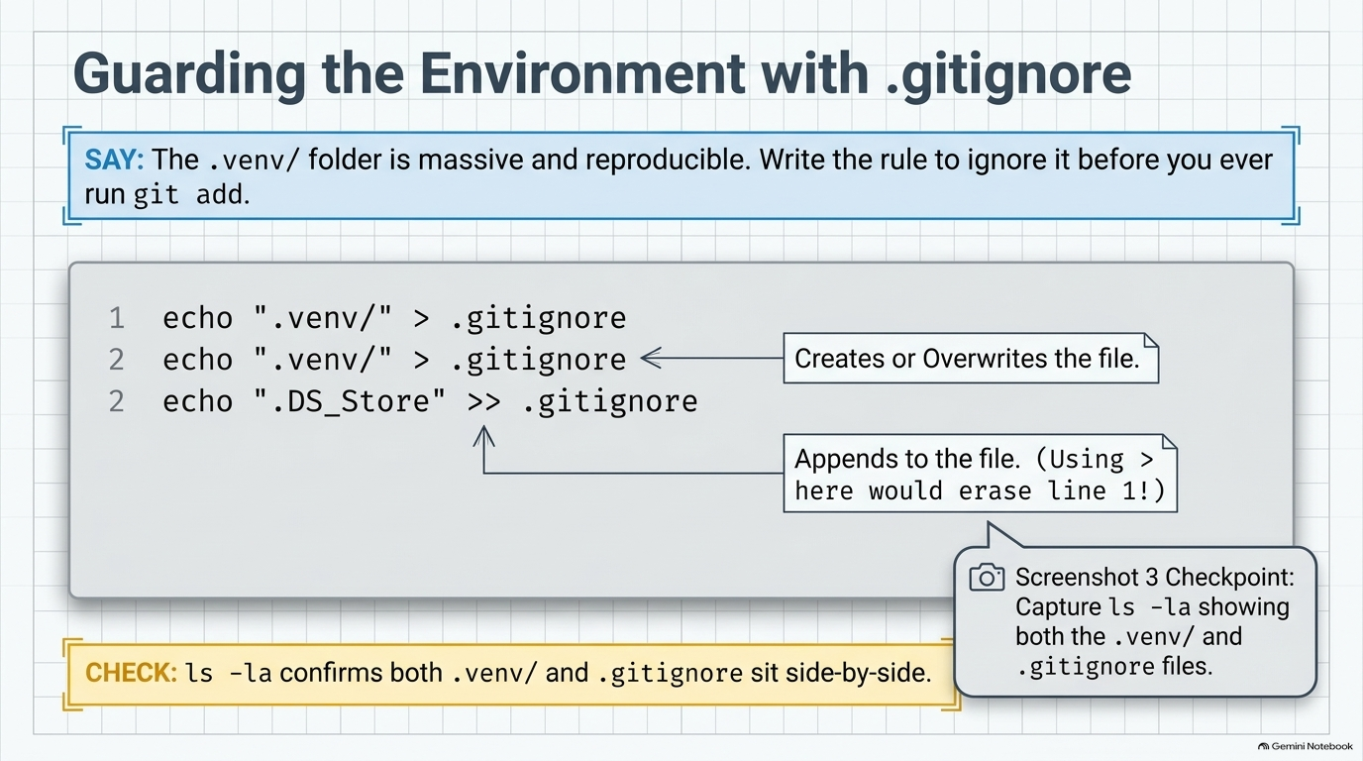
Notes:
SLIDE 6 — Step 8 — Write .gitignore line by line
TEACHING GOAL: protect the repo from ever committing the (large, fully reproducible) .venv/ folder, and get the > vs >> distinction exactly right before students start using it habitually.
Step 8 — Write .gitignore line by line
SAY: "The .venv/ folder can be hundreds of megabytes and is entirely reproducible from requirements.txt — it should never be committed to Git. Let's write the rule before we ever run git add."
DO:
cd ~/ism3232/module02_zsh
echo '.venv/' > .gitignore
echo '__pycache__/' >> .gitignore
echo '*.pyc' >> .gitignore
cat .gitignore
CHECK:
.venv/
__pycache__/
*.pyc
Note the first line used > (create/overwrite) and the next two used >> (append) — using > again on lines 2 or 3 would have erased line 1.
Step 9 — Confirm both files exist
SAY: "One more check — both the environment and the ignore rule for it should be sitting side by side."
DO:
ls -la
CHECK: Output includes both .venv and .gitignore in the listing (along with requirements.txt from Step 6).
Screenshot 3 checkpoint
SAY: "Screenshot 3 — ls -la showing both .venv/ and .gitignore."
SLIDE NOTES
Note on the graphic: the illustration's own example text (a repeated .venv/ line plus .DS_Store) is just placeholder art from the deck generator — teach the ACTUAL three lines from the script above, not the literal text shown on the slide. Use the graphic only to land the underlying lesson: the first line must use > (create/overwrite), and every line after it must use >> (append) — using > again on line 2 or 3 would silently erase line 1.

Slide 7
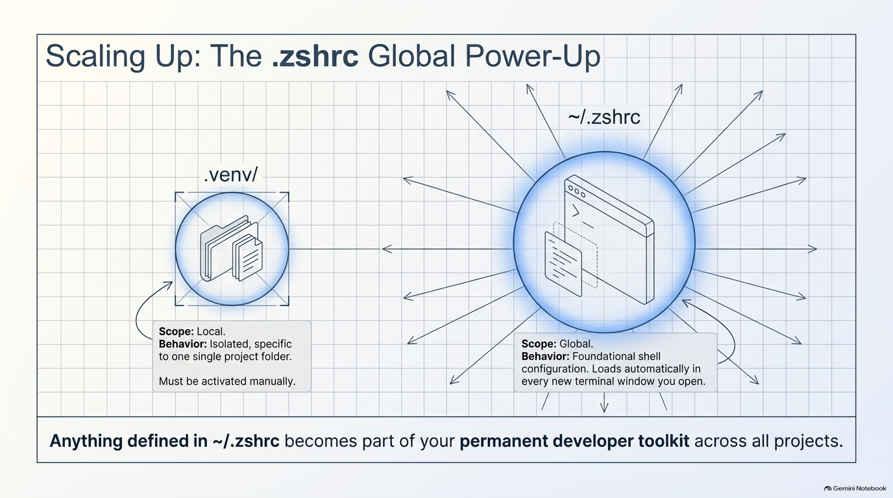
Notes:
SLIDE 7
TEACHING GOAL: make the scope contrast explicit before touching .zshrc — .venv/ is LOCAL (must be activated manually, isolated to one project folder), while ~/.zshrc is GLOBAL (loads automatically in every new terminal window, becomes part of the permanent developer toolkit across every project).
SAY (bridge line): "Now we customize the shell itself. .zshrc runs every time you open a new terminal — anything defined here is available everywhere, in every project." Emphasize the slide's closing line out loud: anything defined in ~/.zshrc becomes part of your permanent developer toolkit across all projects, not just this one.

Slide 8
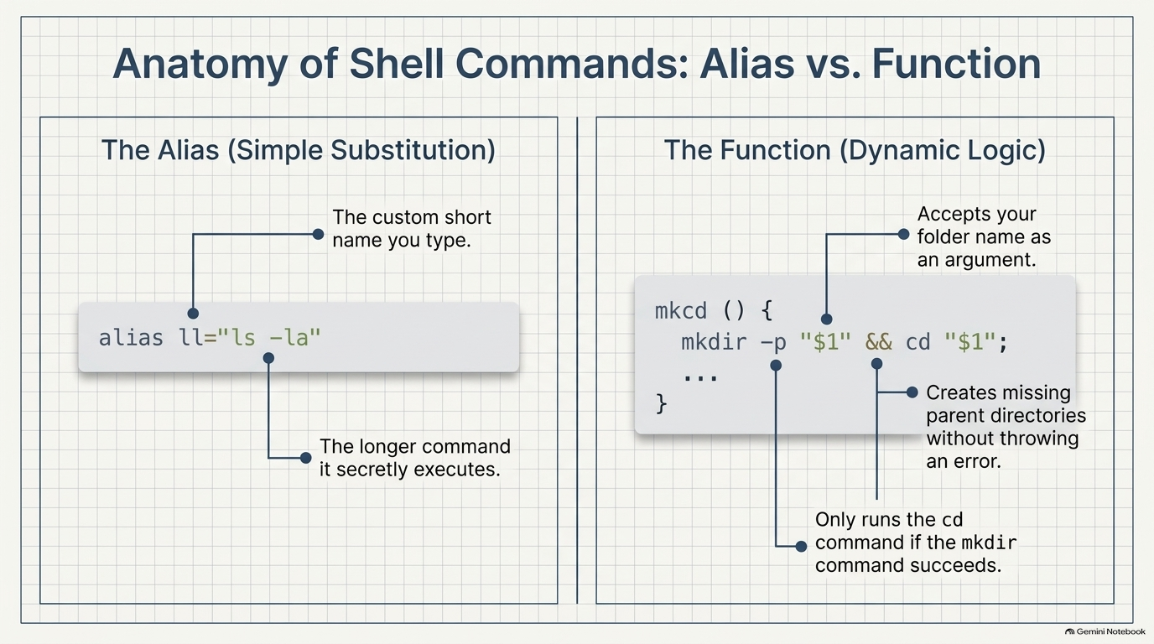
Notes:
SLIDE 8 — Step 10 — Open .zshrc and add the required aliases
TEACHING GOAL: distinguish a simple alias (pure text substitution, no logic) from a shell function (accepts an argument, runs real logic) before students add nine of the former and one of the latter.
Step 10 — Open .zshrc and add the required aliases
SAY: "Now we customize the shell itself. .zshrc runs every time you open a new terminal — anything defined here is available everywhere, in every project."
DO:
code ~/.zshrc
Add these lines at the end of the file — do not delete anything already there:
# ISM3232 required aliases
alias ll='ls -la'
alias c='clear'
alias py='python3'
alias gs='git status'
alias ga='git add .'
alias gcmsg='git commit -m'
alias gp='git push'
alias gl='git log --oneline'
alias tree2='tree -L 2'
CHECK: Nine alias lines are now in ~/.zshrc, each mapping a short name to a longer command you'll type constantly this semester.
Step 11 — Add the mkcd function
SAY: "One more addition — a shell function, not just an alias, because it needs to take an argument: a folder name."
DO: Directly below the aliases:
# Required shell function
mkcd() { mkdir -p "$1" && cd "$1" }
Save the file.
CHECK: Read the function back on camera: "mkcd takes one argument, $1, makes that directory — including any missing parent folders because of -p — and if that succeeds, changes into it. One command instead of two."
SLIDE NOTES
Reference the left half of this slide: an alias is just the custom short name pointing at the longer command it secretly executes.
This matches the right half of the slide exactly: accepts the folder name as an argument, -p creates missing parents without erroring, && only runs cd if mkdir succeeds.

Slide 9
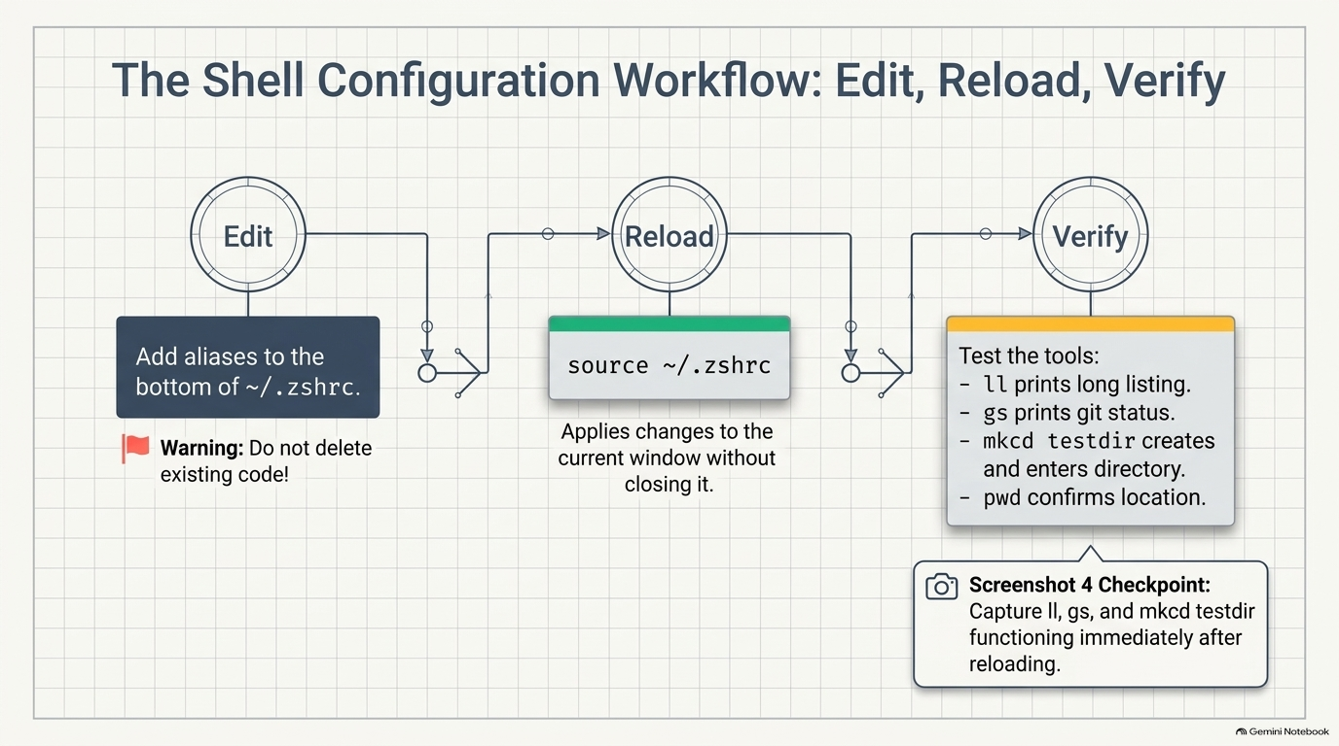
Notes:
SLIDE 9 — Step 12 — Reload and test every alias
TEACHING GOAL: close the edit-reload-verify loop — config changes in .zshrc are inert until the shell is told to re-read the file.
Step 12 — Reload and test every alias
SAY: "New config in .zshrc doesn't apply automatically to an already-open terminal — we have to reload it."
DO:
source ~/.zshrc
ll
gs
mkcd testdir
pwd
CHECK:
• ll prints a long listing (same as ls -la)
• gs prints git status output for the current repo (or "not a git repository" if you're outside one — either confirms the alias works)
• mkcd testdir produces no output but changes directory
• pwd confirms you're now inside testdir:
/Users/yourname/ism3232/module02_zsh/testdir
FIX: If source ~/.zshrc throws a syntax error, check for a missing quote or brace on the mkcd line — the braces { } must both be present with a space after {.
Screenshot 4 checkpoint
SAY: "Screenshot 4 — ll, gs, and mkcd all working, right after source ~/.zshrc."
SLIDE NOTES
"New config in .zshrc doesn't apply automatically to an already-open terminal — we have to reload it." Reinforce the slide's warning flag: do not delete existing code when editing ~/.zshrc, only add to the bottom.

Slide 10
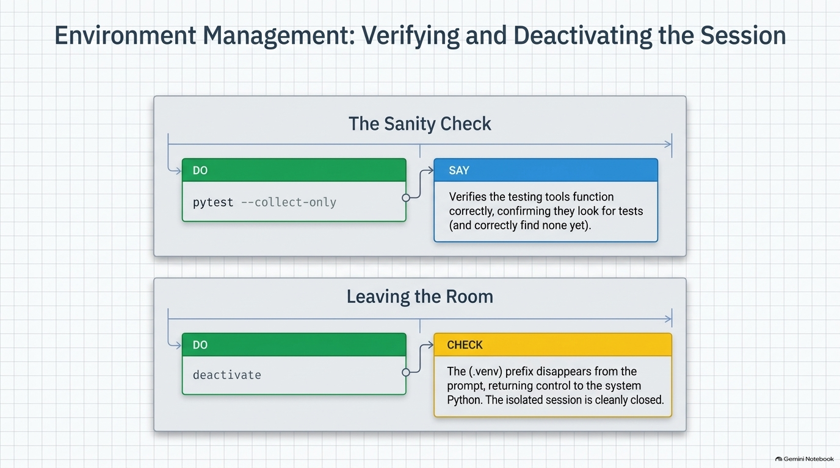
Notes:
SLIDE 10 — Step 13 — Quick pytest sanity check, then deactivate
TEACHING GOAL: confirm the testing tool itself works correctly (finds zero tests, since none exist yet) before leaving the venv cleanly.
SAY: "Before we leave the venv, one quick test that the tooling itself works, even with zero test files yet."
DO:
cd ~/ism3232/module02_zsh
source .venv/bin/activate
pytest --collect-only
CHECK:
no tests found
(or similar language — pytest confirming it looked and found nothing yet, which is correct since we haven't written test files).
Now leave the room:
deactivate
which python3
CHECK:
/usr/bin/python3
Back to the system Python, and the (.venv) prefix is gone from the prompt.

Slide 11
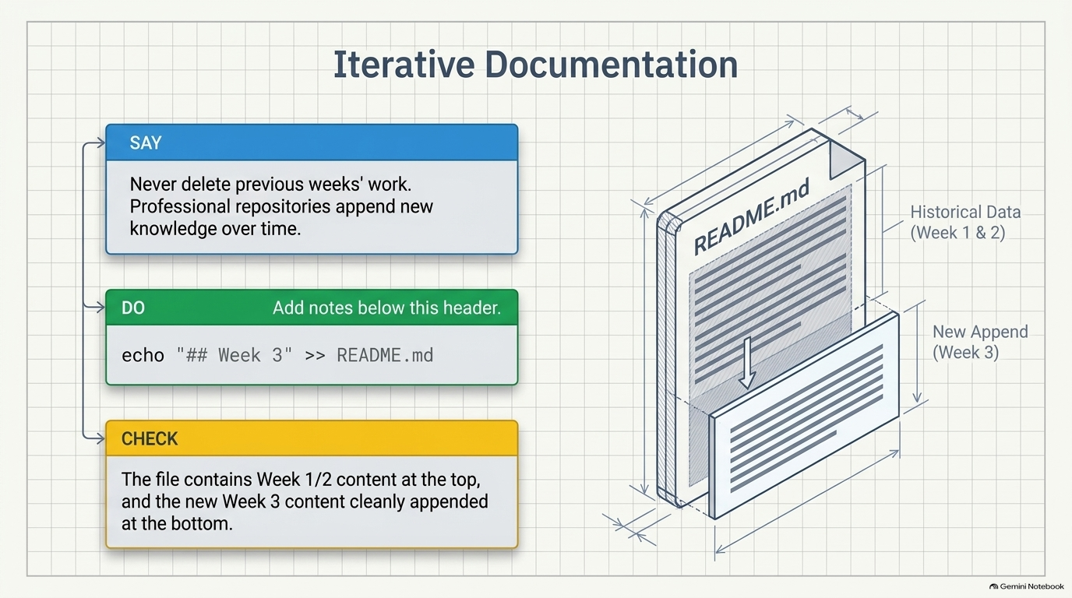
Notes:
SLIDE 11 — Step 14 — Add the Week 3 README section
TEACHING GOAL: build the habit of a living, append-only README that accumulates across the whole semester rather than being overwritten week to week.
SAY: "Same README from last week, one more section appended — never delete previous weeks' work."
DO:
cd ~/ism3232/module02_zsh
code README.md
Add:
## Week 3: Virtual Environments and .zshrc
- `python3 -m venv .venv` — creates an isolated environment
- `source .venv/bin/activate` — activates it (shows `(.venv)` in prompt)
- `pip install <package>` — installs into the active venv only
- `pip freeze > requirements.txt` — records exact installed versions
- `deactivate` — leaves the venv, returns to system Python
- 9 required aliases and `mkcd` added to `~/.zshrc`
CHECK: README.md now has two sections — the Week 1/2 content from before, plus this new ## Week 3 heading — nothing earlier was overwritten.
SLIDE NOTES
Reinforce the graphic's framing: Week 1 & 2 content is historical data at the top of the file, Week 3 is a clean new append at the bottom.

Slide 12
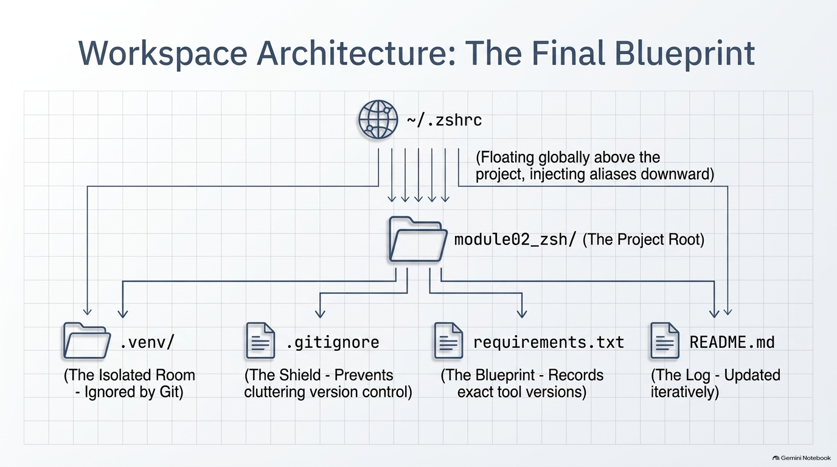
Notes:
SLIDE 12
TEACHING GOAL: pull every artifact from this lab into one mental map before the checklist — use this as a closing recap, and consider asking students to explain each arrow out loud.
Walk the diagram top to bottom: ~/.zshrc floats globally above every project, injecting the nine aliases and the mkcd function downward into every folder — including module02_zsh, the project root for this lab. Inside that root sit four artifacts: .venv/ (the isolated room, ignored by Git), .gitignore (the shield that keeps .venv/ out of version control), requirements.txt (the blueprint recording exact tool versions via pip freeze), and README.md (the log, updated iteratively — Week 1/2 plus this week's new Week 3 section).
This is the moment to connect every prior slide: the private-room metaphor (slide 3), the isolation proof (slide 4), pip freeze (slide 5), .gitignore (slide 6), the local-vs-global scope contrast (slide 7), and the README habit (slide 11) all collapse into this one picture.

Slide 13
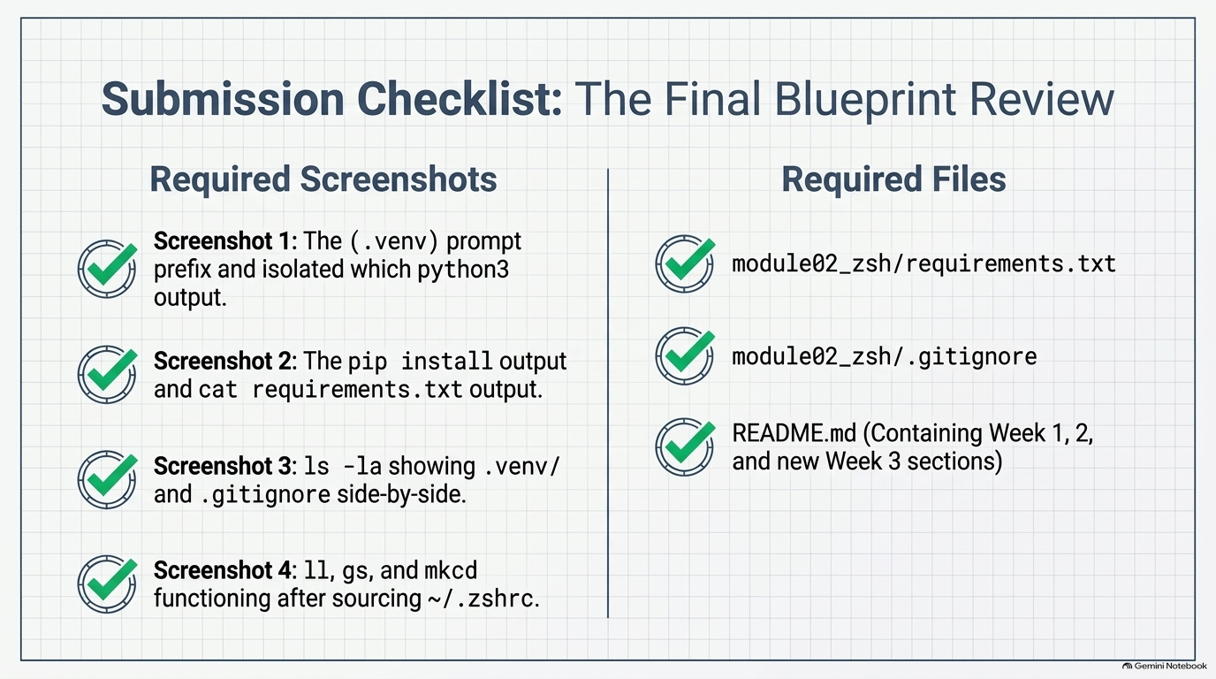
Notes:
SLIDE 13 — SUBMISSION CHECKLIST
• [ ] Screenshot 1: (.venv) prompt and which python3 output
• [ ] Screenshot 2: pip install output and cat requirements.txt
• [ ] Screenshot 3: ls -la showing .venv/ and .gitignore
• [ ] Screenshot 4: ll, gs, and mkcd working after source ~/.zshrc
• [ ] module02_zsh/requirements.txt uploaded
• [ ] module02_zsh/.gitignore uploaded
• [ ] README.md with Week 3 section added, uploaded
• [ ] Submitted to Canvas
SLIDE NOTES
Walk this checklist live before anyone uploads to Canvas — don't just read it, have students actually locate each item on their own screen.
Required screenshots: Screenshot 1 — the (.venv) prompt prefix and which python3 output. Screenshot 3 — ls -la showing .venv/ and .gitignore side-by-side. Screenshot 4 — ll, gs, and mkcd all working immediately after source ~/.zshrc.
Required files: module02_zsh/requirements.txt uploaded; module02_zsh/.gitignore uploaded; README.md containing the Week 1, Week 2, and new Week 3 sections uploaded. Confirm the whole set is submitted to Canvas before ending the session.

