Slide 1
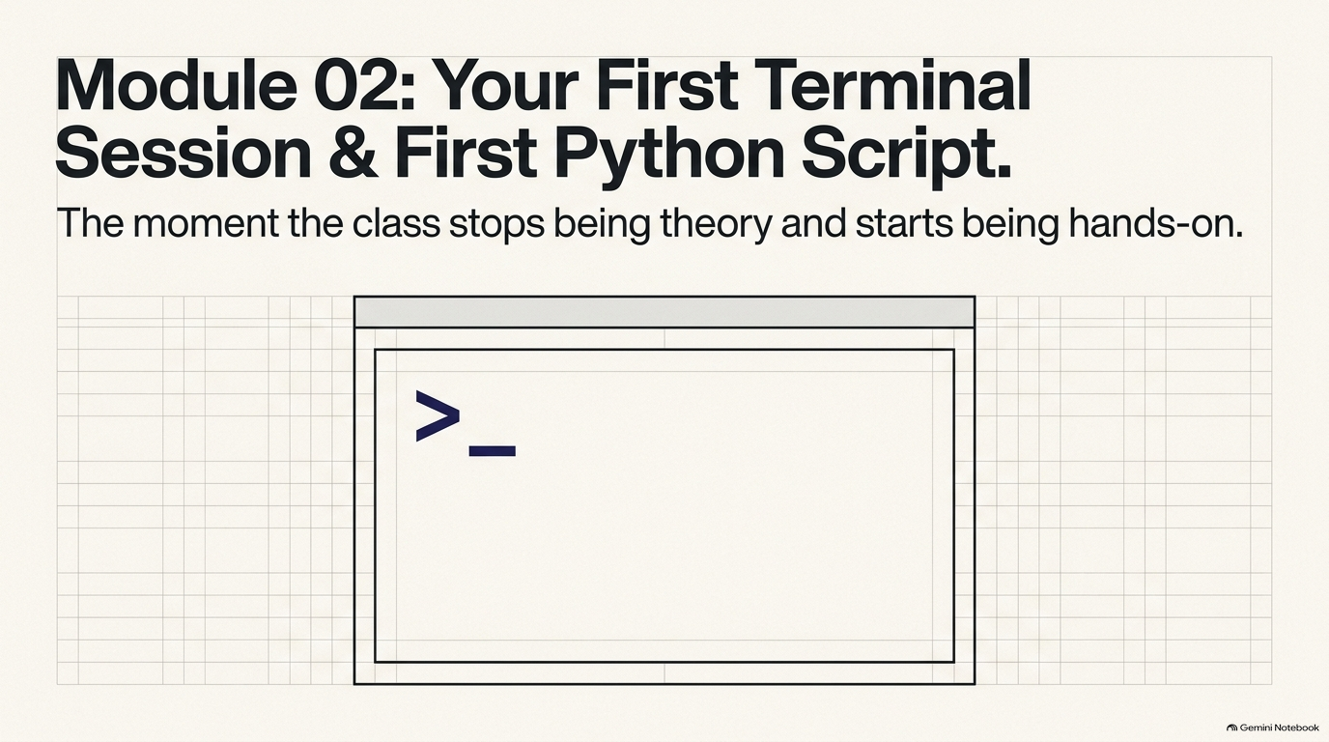
Notes:
SLIDE 1 — INTRO
SAY: "Lab 2 — your first terminal session and your first Python script. This is the moment the class stops being theory and starts being hands-on. Every command I run, I'm going to show you the exact expected output before moving to the next one — that's the habit to build starting today."
SLIDE NOTES
Open by saying: "This is the moment the class stops being theory and starts being hands-on."
Frame the whole session before typing a single command: every command run gets shown with its exact expected output before moving to the next one — that habit starts today and continues for the rest of the semester.
Today's arc: four warm-up terminal commands, verifying Python and pip are installed, writing and running two versions of hello.py, deliberately breaking the script to read two different real error messages (NameError and SyntaxError), and finally running a script from the wrong folder to see why paths matter.
By the end, students should be comfortable navigating and executing code entirely from the terminal, with no GUI.

Slide 2
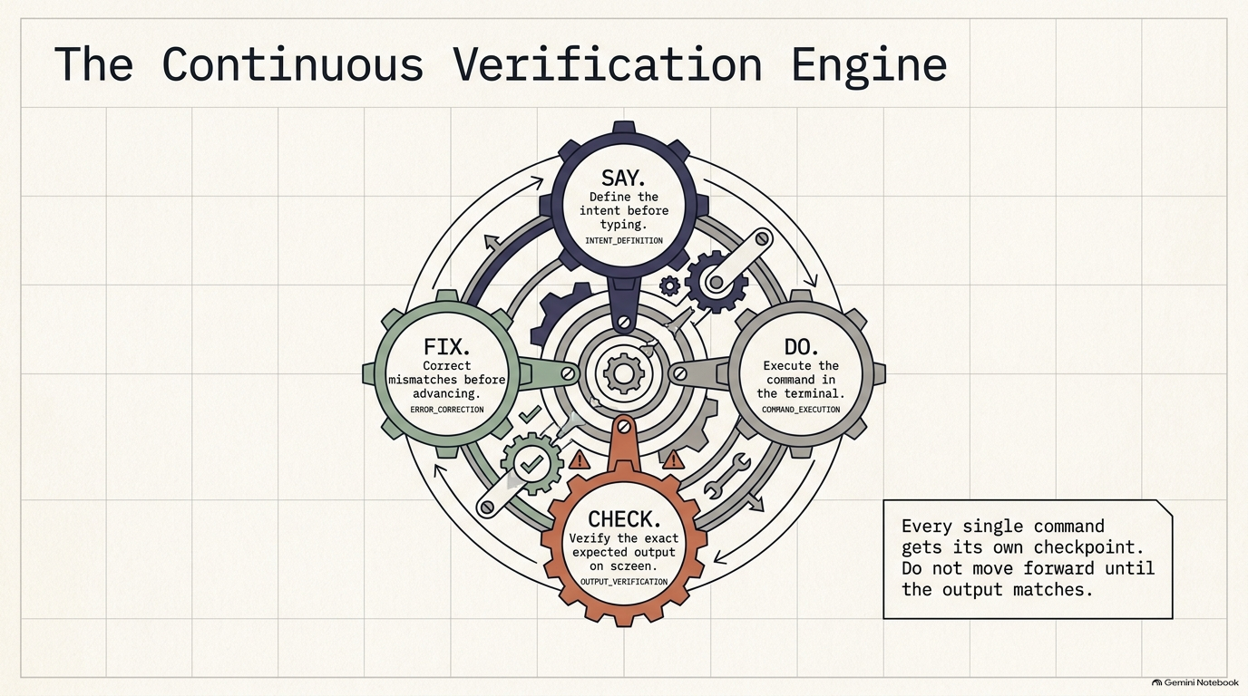
Notes:
SLIDE 2
This is the operating loop for every exercise today, and for every lab this semester: SAY it (define the intent out loud before typing anything), DO it (execute the exact command in the terminal), CHECK it (verify the exact expected output on screen — not "close enough", exact), and FIX it if it doesn't match before advancing.
Say explicitly: every single command gets its own checkpoint — do not move to the next command until the output matches what's expected.
This is most students' first time typing real commands into a terminal, so this checkpoint habit is what prevents a small typo from snowballing into a confusing failure three steps later.

Slide 3
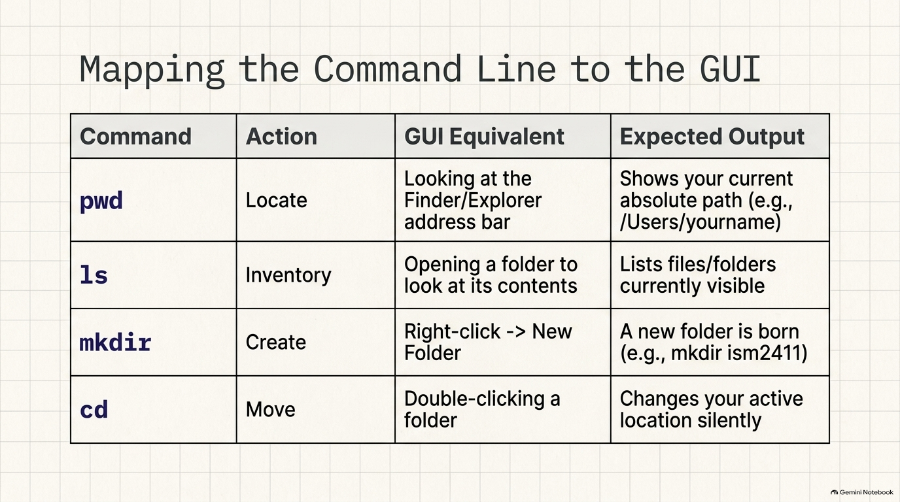
Notes:
SLIDE 3 — EXERCISE 1 — Terminal Warm-Up
SAY: "Four commands: where am I, what's here, make a new folder, move into it."
DO:
pwd
ls
mkdir ism2411
cd ism2411
pwd
CHECK: The first pwd shows your current location (e.g., /Users/yourname). ls lists whatever's already there. After mkdir ism2411 and cd ism2411, the second pwd shows the full path ending in /ism2411:
/Users/yourname/ism2411
FIX: If the second pwd doesn't end in /ism2411, confirm cd ism2411 didn't error — a common typo is capitalization (ISM2411 vs ism2411), and folder names are case-sensitive on Mac/Linux.
SLIDE NOTES
Map each command to the GUI action students already know: pwd = looking at the Finder/Explorer address bar (Locate); ls = opening a folder to see its contents (Inventory); mkdir = right-click → New Folder (Create); cd = double-clicking into a folder (Move) — except cd changes your location silently, with no visual confirmation, which is exactly why it's always followed by pwd.

Slide 4
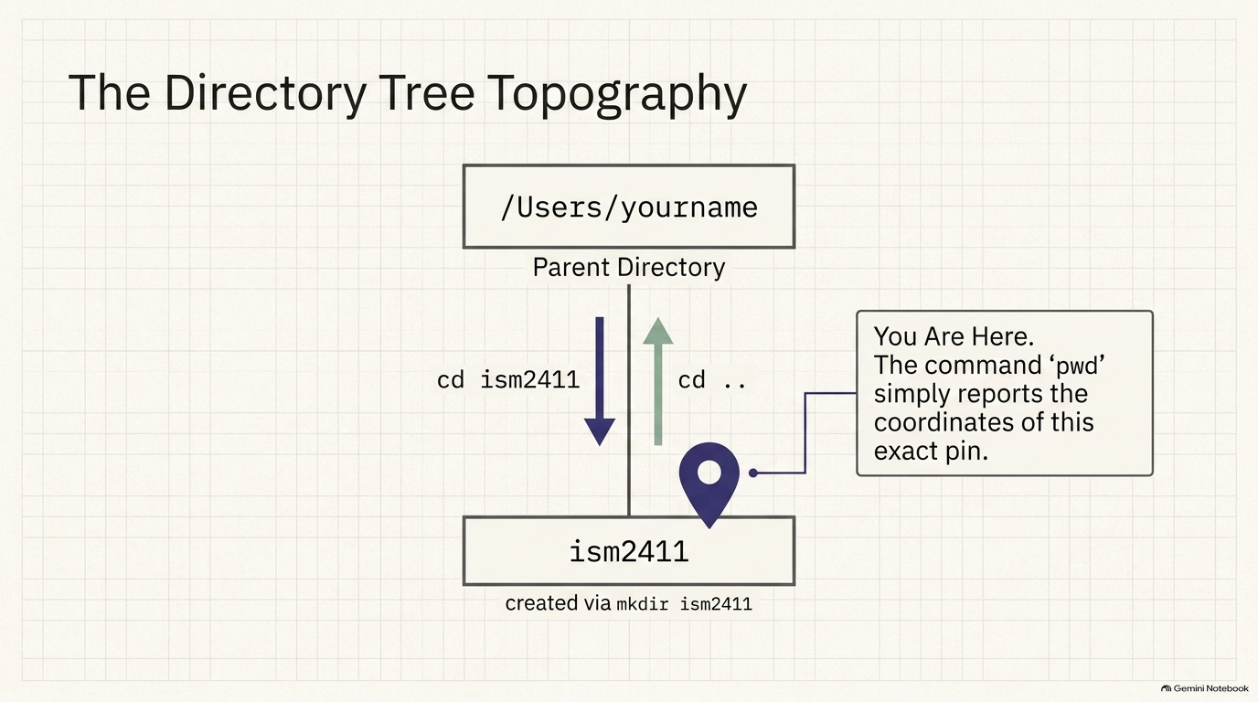
Notes:
SLIDE 4
Supporting concept slide for the cd/pwd mental model underlying both Exercise 1 and Exercise 4.
Visualize the filesystem as a tree: /Users/yourname is the parent directory; ism2411 (created via mkdir ism2411) sits one level below it. cd ism2411 moves the "you are here" pin down into that folder; cd .. moves it back up to the parent.
Say explicitly: pwd does not move you anywhere — it only reports the coordinates of the pin exactly where it already is.
Students should leave this slide with a literal mental picture of themselves as a pin moving up and down a tree, not an abstract idea of "paths".

Slide 5
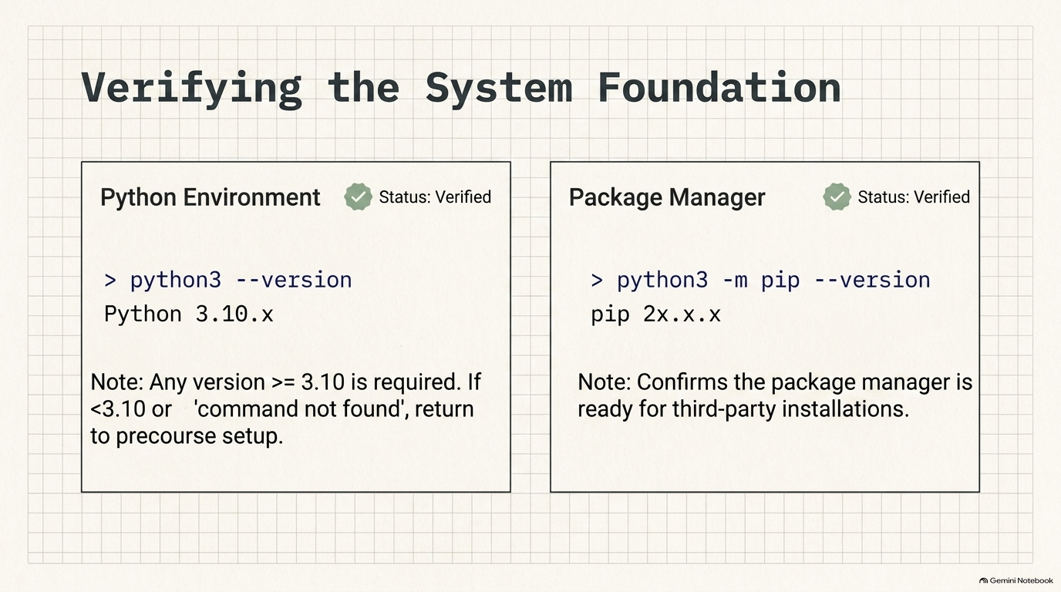
Notes:
SLIDE 5 — EXERCISE 2 — Verify Python
SAY: "Before writing any code, confirm the tools are actually there."
DO:
python3 --version
pip3 --version
CHECK:
Python 3.11.4
pip 23.x.x from ... (python 3.11)
Any Python 3.10 or higher is fine.
FIX: If you see a version below 3.10, or command not found, go back to the precourse setup page and reinstall Python 3 before continuing.
SLIDE NOTES
if the version shown is below 3.10, or the terminal says "command not found", send the student back to the precourse setup page to reinstall Python 3 before continuing — every later exercise depends on this working.

Slide 6
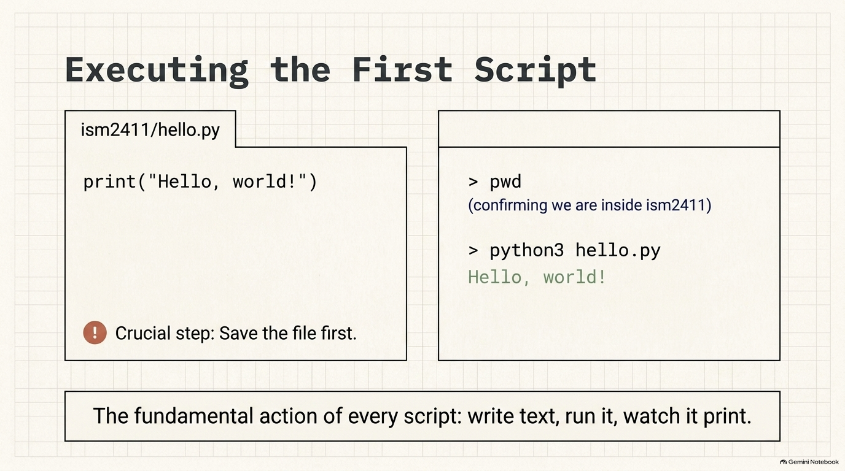
Notes:
SLIDE 6 — EXERCISE 3 — Write hello.py
SAY: "Your first Python file — one line, but it's the same fundamental action every script this semester will use: write text, run it, watch it print."
DO: In VS Code, create hello.py in your ism2411 folder:
print("Hello, ISM2411!")
Save it, then in the terminal, from the same folder:
python3 hello.py
CHECK:
Hello, ISM2411!
FIX: If nothing prints, confirm you saved the file first, and that you're running the command from inside the same folder where hello.py lives — check with pwd.

Slide 7
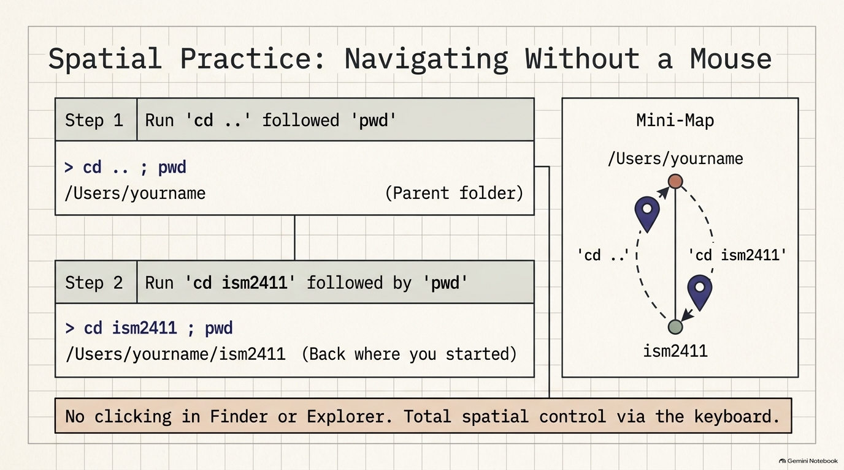
Notes:
SLIDE 7 — EXERCISE 4 — Path Practice
SAY: "Now practice moving between folders using only the terminal — no clicking in Finder or Explorer."
DO:
cd ..
pwd
cd ism2411
pwd
CHECK: The first pwd shows the parent of ism2411 (e.g., /Users/yourname). The second pwd shows /Users/yourname/ism2411 again — back where you started.
SLIDE NOTES
cd .., pwd, cd ism2411, pwd — shown on the slide as two combined steps (cd .. ; pwd, then cd ism2411 ; pwd).
Walk the mini-map on the slide as a literal picture of the round trip: the pin goes up to the parent on cd .., then back down into ism2411. Reinforce: zero mouse involvement — total spatial control via the keyboard alone.

Slide 8
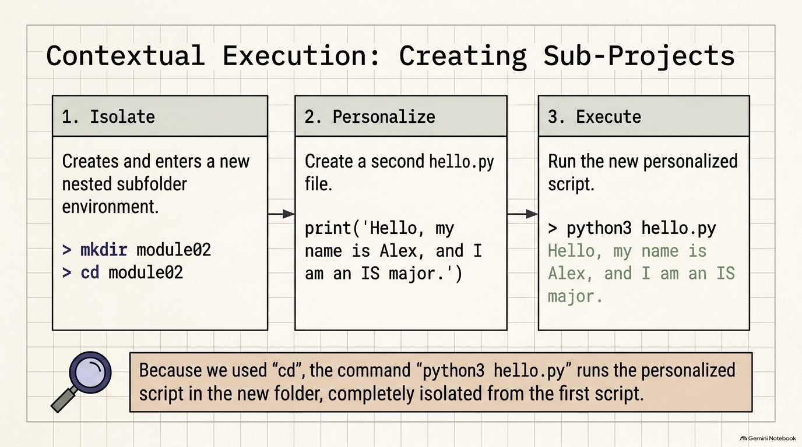
Notes:
SLIDE 8 — EXERCISE 5 — Make a Sub-Project
SAY: "A second script, in its own subfolder, personalized instead of generic."
DO:
mkdir module02
cd module02
Create a second hello.py here:
print("Alex Chen — Finance major")
(Replace with your own name and major.)
python3 hello.py
CHECK:
Alex Chen — Finance major
(Your own name and major will print instead.)
SLIDE NOTES
DO, live, following the three steps on the slide — Isolate: mkdir module02, cd module02 (creates and enters a brand-new nested subfolder).
Point out the callout at the bottom of the slide: because they cd'd into module02 first, python3 hello.py runs the personalized script in the new folder, completely isolated from the first hello.py in ism2411 — same filename, two different files, because they live in two different folders.

Slide 9
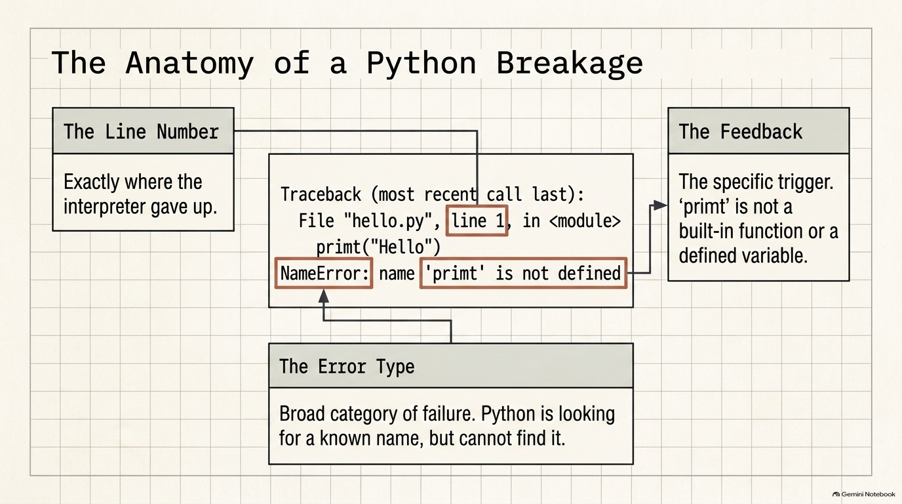
Notes:
SLIDE 9 — EXERCISE 6 — Deliberate Error Experiment
SAY: "Now break it on purpose — reading error messages is a skill, and the only way to build it is to see real ones and read them carefully instead of panicking."
DO: In hello.py, change print to primt (a typo):
primt("Alex Chen — Finance major")
Run it:
python3 hello.py
CHECK:
Traceback (most recent call last):
File "hello.py", line 1, in <module>
primt("Alex Chen — Finance major")
NameError: name 'primt' is not defined
SAY: "Write down three things: (a) the line number — line 1. (b) the error type — NameError. (c) what it's telling you — Python has no idea what primt means, because it's not a built-in function or anything you defined; it's expecting a name it recognizes, and primt isn't one."
SLIDE NOTES
Walk the anatomy exactly as diagrammed: the line number (line 1, exactly where the interpreter gave up), the error type (NameError — Python was looking for a known name and couldn't find one), and the feedback (the specific trigger: 'primt' is not a built-in function or anything defined).
Have students write down all three pieces before moving on — that's the reading-comprehension habit this exercise builds.

Slide 10
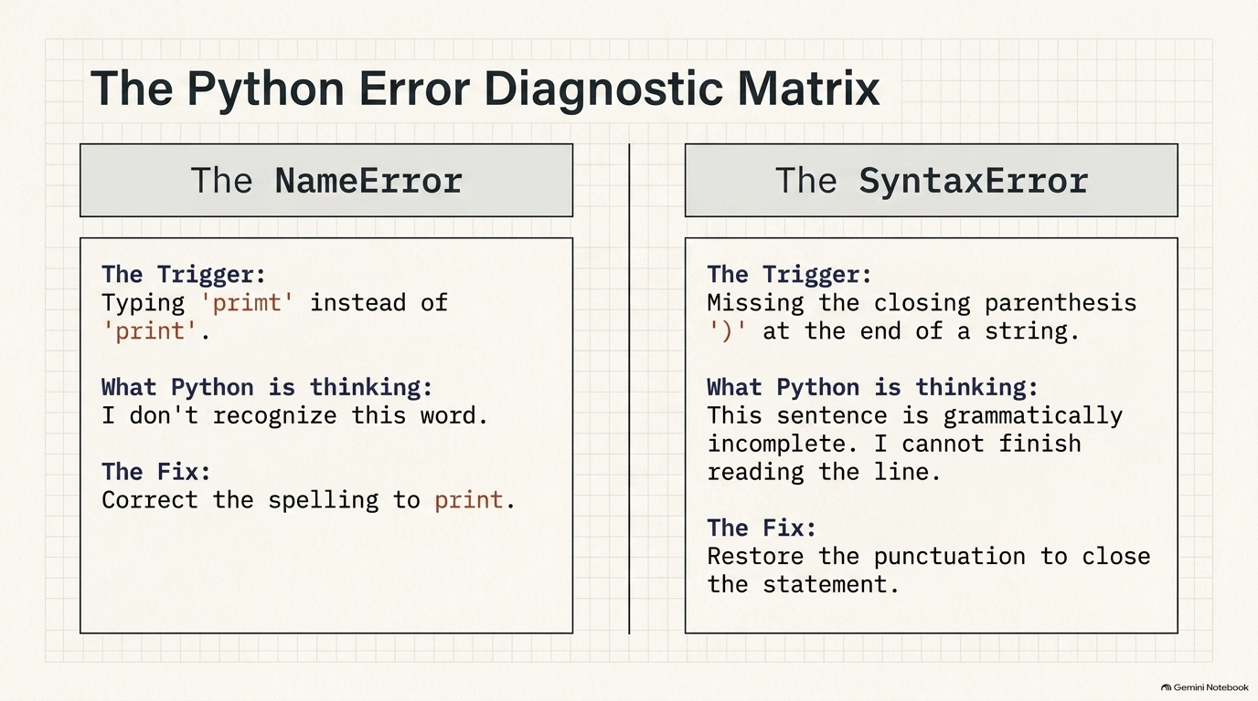
Notes:
SLIDE 10 — EXERCISE 6 — Deliberate Error Experiment
Now try a different typo — remove the closing parenthesis:
print("Alex Chen — Finance major"
python3 hello.py
CHECK:
File "hello.py", line 1
print("Alex Chen — Finance major"
^
SyntaxError: '(' was never closed (Python 3.10+; older versions print: SyntaxError: unexpected EOF while parsing)
A completely different error type — SyntaxError instead of NameError — because this time Python couldn't even finish reading the line; the missing ) means the statement is grammatically incomplete, not just referencing an unknown name.
FIX: Restore both fixes — primt back to print, and the closing ) back in place. Run once more to confirm it's back to printing cleanly.

Slide 11
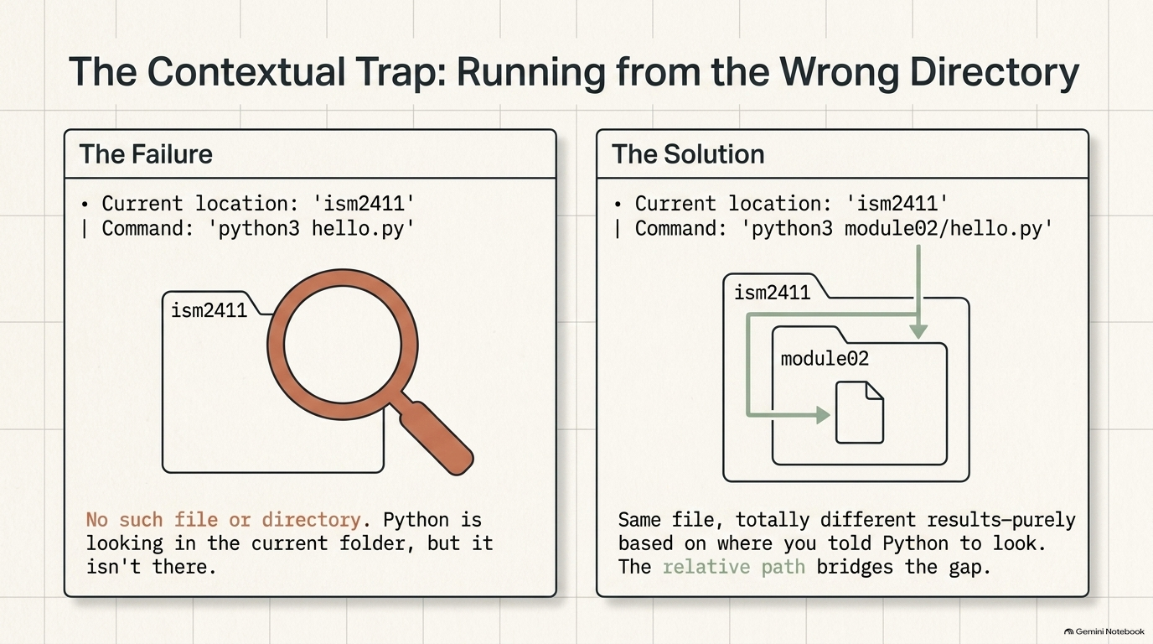
Notes:
SLIDE 11 — EXERCISE 7 — Run from the Wrong Directory
SAY: "One more experiment, and this is the single most common early mistake: running a script from the wrong folder."
DO:
cd ..
python3 hello.py
CHECK:
python3: can't open file 'hello.py': [Errno 2] No such file or directory
SAY: "Read that carefully — Python isn't complaining about your code at all. It's saying it looked for hello.py in the current folder and it simply isn't there, because you're now one level up, in ism2411, not module02 where the file actually lives."
Now run it with the correct relative path:
python3 module02/hello.py
CHECK:
Alex Chen — Finance major
SAY: "Same file, same content, two totally different results — purely based on where you told Python to look. module02/hello.py tells it: go into module02, then find hello.py there. This is exactly why pwd before running anything is such a useful habit."

Slide 12
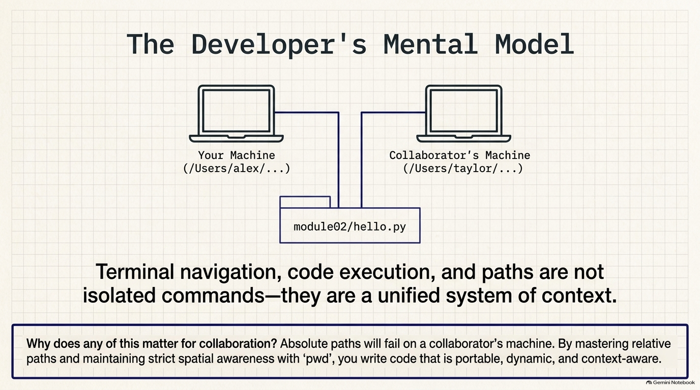
Notes:
SLIDE 12
Synthesis slide tying the lab together before the reflection questions.
Say: terminal navigation, code execution, and file paths are not three separate skills — they're one unified system of context; where you are determines what a bare filename like hello.py even means.
Use the two-laptop diagram to set up Reflection Question 3 directly: absolute paths (like /Users/alex/...) are tied to one specific machine and simply will not exist on a collaborator's machine (like /Users/taylor/...); relative paths (like module02/hello.py, from Exercise 7) are portable because they describe a location relative to wherever the project folder is, on any machine.
This is the bridge from "I can run my own code" to "I can hand my code to someone else and it still works."

Slide 13
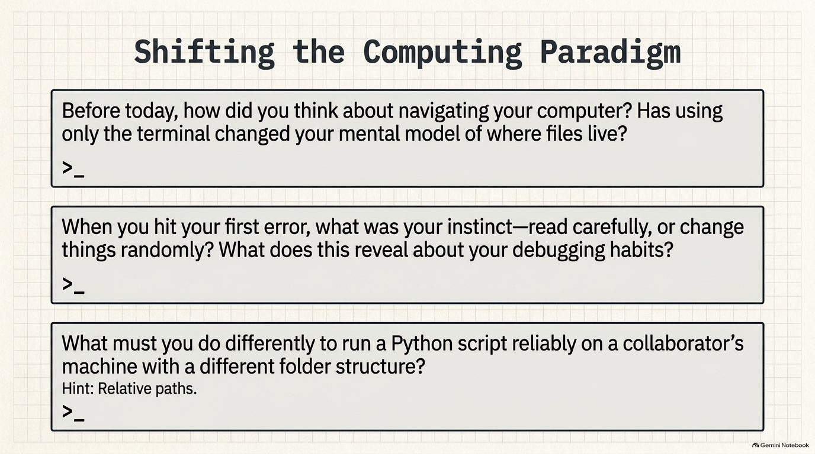
Notes:
SLIDE 13 — REFLECTION QUESTIONS
DO: Answer honestly, in your own words:
1. Before today, how did you think about navigating your computer? Has using only the terminal — no GUI — changed your mental model of where files live?
2. When you hit your first error in Exercise 6, what was your instinct — read the message carefully, or start changing things randomly? What does that tell you about your current debugging habits?
3. What would you need to do differently to run a Python script reliably on a collaborator's machine — someone with a different username and a different folder structure?
CHECK: Question 3 is worth pausing on: the honest answer involves relative paths (from Exercise 7) instead of paths hardcoded to your specific username, since /Users/alex/... won't exist on your collaborator's machine at all.
SLIDE NOTES
Reflection Questions — have students answer honestly, in their own words; there's no single correct answer as long as it's genuine.
Before today, how did you think about navigating your computer, and has using only the terminal — no GUI — changed your mental model of where files actually live?
When you hit your first error in Exercise 6, was your instinct to read the message carefully or to start changing things randomly — what does that reveal about your current debugging habits?
What would you need to do differently to run this Python script reliably on a collaborator's machine, with a different username and folder structure? Hint on the slide: relative paths.

Slide 14
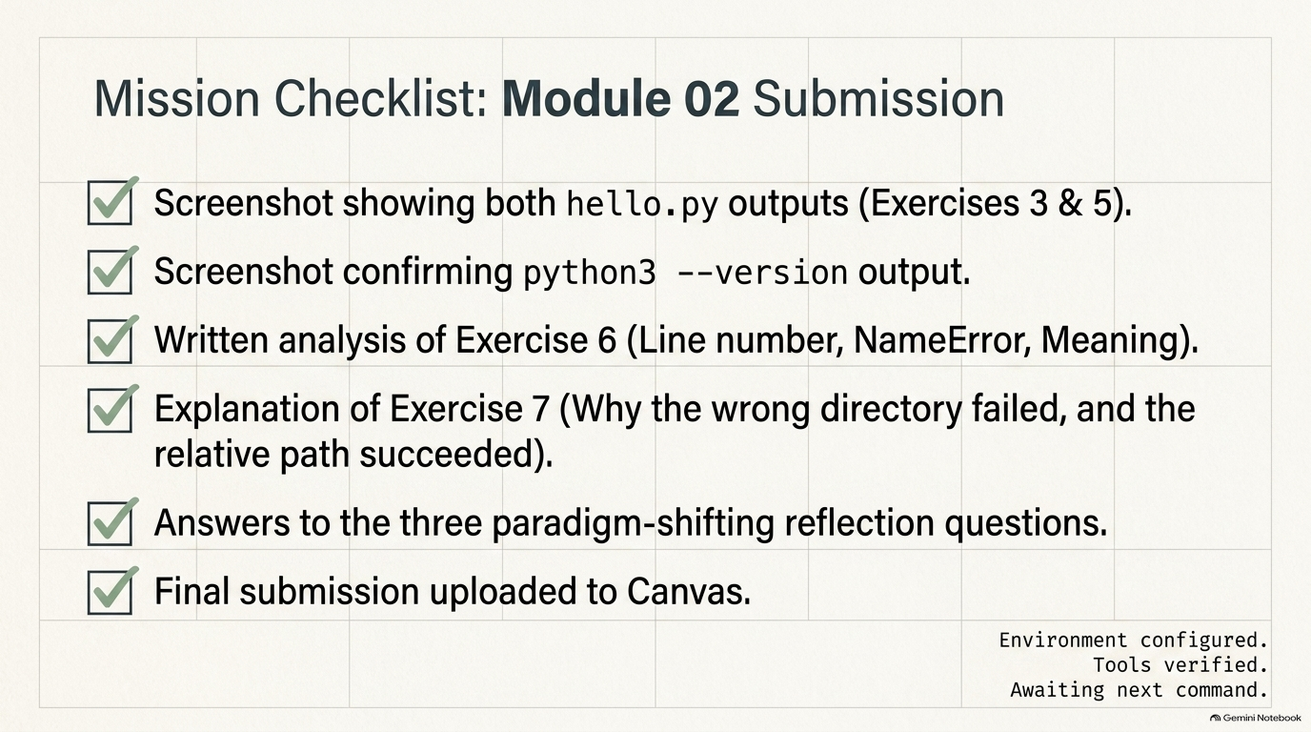
Notes:
SLIDE 14 — SUBMISSION CHECKLIST
• [ ] Screenshot(s) of the terminal, in this order: (1) python3 --version output, (2) hello.py printing Hello, ISM2411! (Exercise 3), (3) module02/hello.py printing your name and major (Exercise 5), (4) the "No such file or directory" error from Exercise 7 followed by the successful run using the relative path
• [ ] The terminal prompt and command you typed are visible above each output, not just the output itself
• [ ] File named module02_notes.txt containing: (a) the error type and line number from Exercise 6, in your own words, and (b) 1–2 sentences explaining why the first attempt in Exercise 7 failed and the second succeeded
• [ ] Three reflection questions answered honestly
• [ ] Submitted to Canvas
SLIDE NOTES
Submission checklist — walk every line before students upload to Canvas.
Terminal screenshots, in order, showing: (1) python3 --version output, (2) hello.py printing Hello, ISM2411! from Exercise 3, (3) the personalized module02/hello.py output from Exercise 5, and (4) the "No such file or directory" error from Exercise 7 immediately followed by the successful run using the relative path. The prompt/command must be visible above each output, not just the raw output alone.
A plain text file named exactly module02_notes.txt containing: (a) the error type and line number from Exercise 6 in their own words, and (b) one to two sentences explaining why the first attempt in Exercise 7 failed and the second succeeded. Emphasize the exact filename — graders check for that literal name.
All three reflection questions answered honestly, then the whole thing submitted to Canvas.

