Slide 1
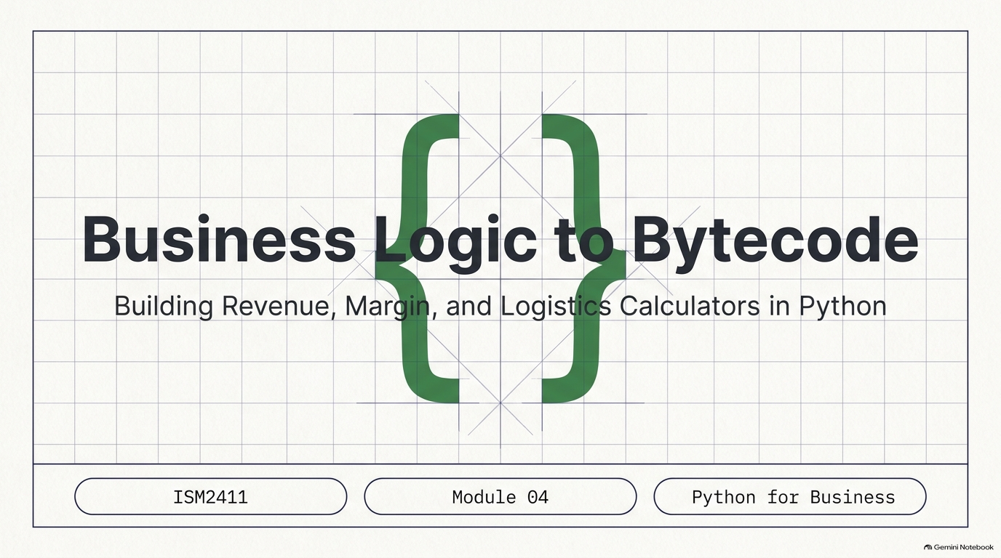
Notes:
SLIDE 1 — INTRO
SAY: "Lab 4 — revenue, margin, and a discount calculator. Today's operators — arithmetic, comparison, logical — are the building blocks of every business rule you'll ever encode: is this over budget, does this qualify for a discount, which of two options is better. All of it starts here."
SLIDE NOTES
Title slide — "Business Logic to Bytecode: Building Revenue, Margin, and Logistics Calculators in Python." ISM2411 Module 04.
Everything students build today lands in one file, calculator.py, with a `# --- Exercise N ---` comment marking each section — that is the exact submission format required on Canvas.

Slide 2
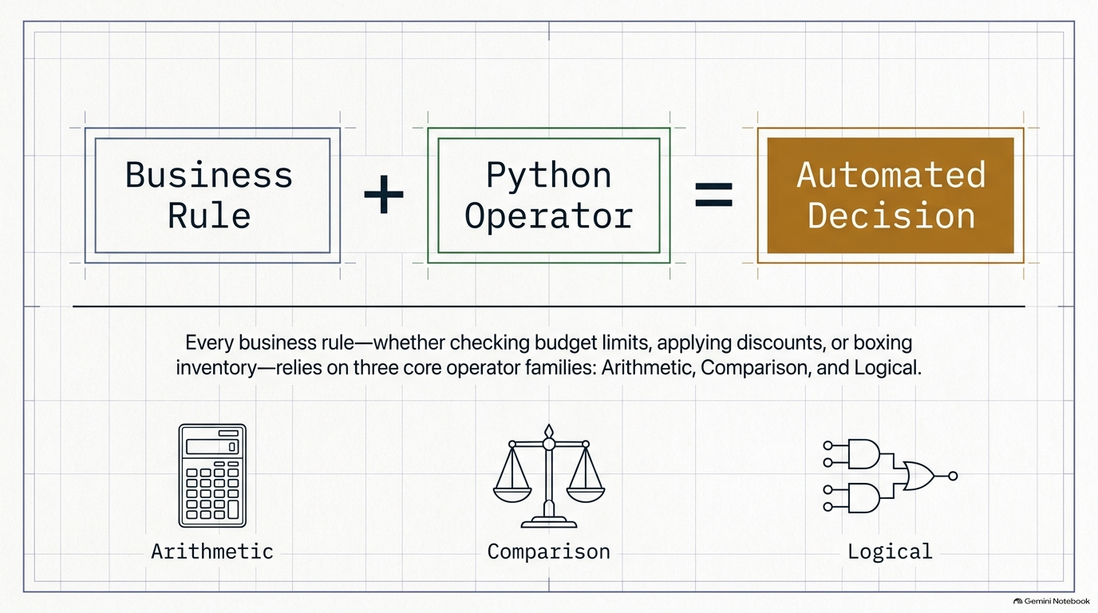
Notes:
SLIDE 2
Framing slide: Business Rule + Python Operator = Automated Decision, with the three operator families shown as icons — Arithmetic (calculator), Comparison (balance scale), Logical (AND/OR gate).
SAY: "Every business rule — whether checking budget limits, applying discounts, or boxing inventory — relies on three core operator families: Arithmetic, Comparison, and Logical. By the end of this lab you will have used all three inside one working calculator.py."
Use this as the through-line for the whole session: Exercises 1 and 2 are Arithmetic (revenue, margin). Exercise 3 is Comparison (>). Exercise 4 is Logical (and). Exercise 5 introduces a second arithmetic family — //, and % — that Exercise 7 puts to real use. Exercise 6 combines everything into one interactive tool.

Slide 3
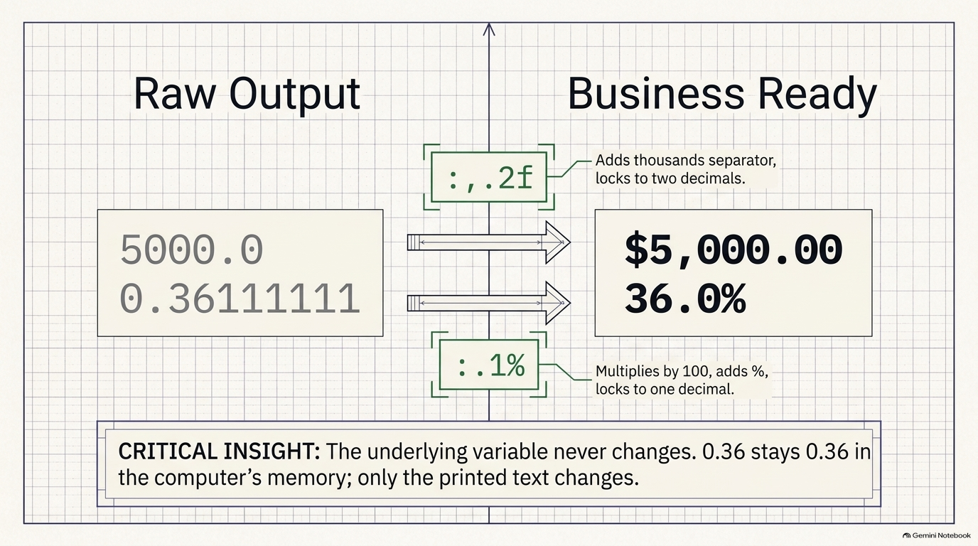
Notes:
SLIDE 3 — EXERCISE 1 — Revenue
EXERCISE 1 — Revenue
SAY: "The simplest possible business formula — price times quantity — formatted for a human to read."
DO:
# --- Exercise 1 ---
price = 50
quantity = 12
revenue = price * quantity
print(f"Revenue: ${revenue:,.2f}")
python3 calculator.py
CHECK:
Revenue: $600.00
:,.2f does two things at once: adds thousands separators (not visible yet at $600, but it will matter soon) and forces exactly two decimal places.
EXERCISE 2 — Margin
SAY: "Margin — the same formula from last week's product card, now formatted with the % format spec instead of computing a percentage by hand."
DO:
# --- Exercise 2 ---
cost = 32
price = 50
margin = (price - cost) / price
print(f"Margin: {margin:.1%}")
python3 calculator.py
CHECK:
Margin: 36.0%
SAY: "Notice margin itself is 0.36, a plain decimal fraction — the .1% format spec is what multiplies it by 100 and appends the % sign for display. The underlying variable never actually becomes 36.0; only the printed text does."
SLIDE NOTES
"Margin — the same formula from last week's product card, now formatted with the `%` format spec instead of computing a percentage by hand."
DO: cost = 32, price = 50, margin = (price - cost) / price, print(f"Margin: {margin:.1%}").
CRITICAL INSIGHT on the slide: the underlying `margin` variable is still the plain decimal fraction 0.36111111 — the `.1%` format spec is what multiplies it by 100, rounds to one decimal, and appends the % sign for display. The variable in memory never actually becomes 36.0; only the printed text changes. Make sure students say this back to you before moving on.

Slide 4
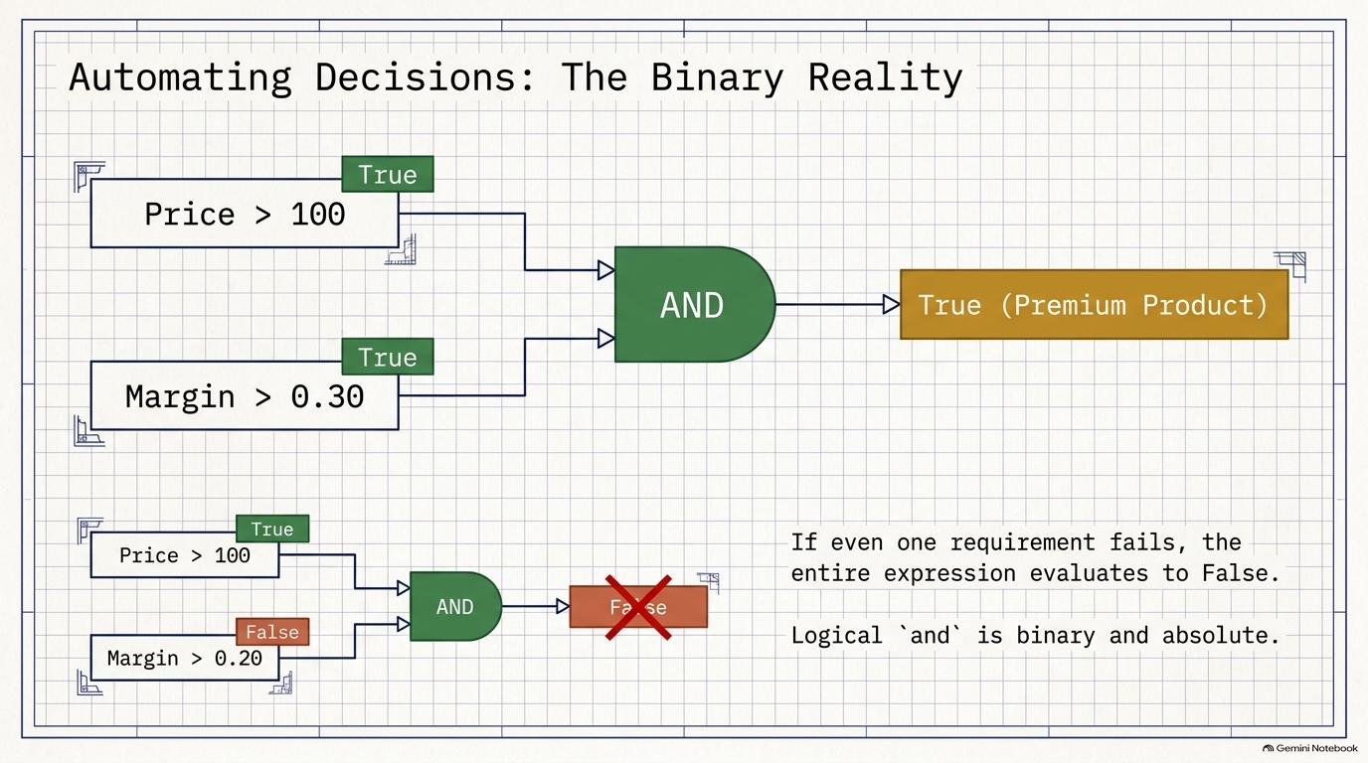
Notes:
SLIDE 4 — EXERCISE 3 — Two Products
EXERCISE 3 — Two Products
SAY: "Now a comparison — which of two products has the better margin? Store the answer as a boolean, not just print it as a sentence."
DO:
# --- Exercise 3 ---
price_a, cost_a = 50, 32
price_b, cost_b = 80, 60
margin_a = (price_a - cost_a) / price_a
margin_b = (price_b - cost_b) / price_b
product_a_wins = margin_a > margin_b
print(f"Product A margin: {margin_a:.1%}")
print(f"Product B margin: {margin_b:.1%}")
print(f"Product A wins: {product_a_wins}")
python3 calculator.py
CHECK:
Product A margin: 36.0%
Product B margin: 25.0%
Product A wins: True
Confirm by hand: Product B's margin is (80-60)/80 = 0.25, lower than A's 0.36 — so margin_a > margin_b correctly evaluates to True.
EXERCISE 4 — Logical Combo
SAY: "Now combine two conditions with and — a product only counts as 'premium' if both the price is high enough and the margin is good enough."
DO:
# --- Exercise 4 ---
price = 150
margin = 0.35
is_premium = price > 100 and margin > 0.3
print(f"is_premium = {is_premium}")
python3 calculator.py
CHECK:
is_premium = True
SAY: "Now change the values so only one condition holds — say the margin drops to 0.2 while the price stays at 150."
DO:
price = 150
margin = 0.2
is_premium = price > 100 and margin > 0.3
print(f"is_premium = {is_premium}")
CHECK:
is_premium = False
Even though price > 100 is still True, and requires both sides to be True — one failing condition is enough to make the whole expression False.
SLIDE NOTES
Exercise 3 does not get its own slide — cover it verbally here before moving into the AND-logic diagram for Exercise 4.
Slide content — "Automating Decisions: The Binary Reality" — is Exercise 4.
CHECK: "is_premium = True" — matches the top half of the diagram (Price > 100 → True, Margin > 0.30 → True, AND → True (Premium Product)).
DO (second run, shown in the bottom half of the diagram): change margin to 0.2 while price stays at 150 — is_premium = price > 100 and margin > 0.3.
SAY: "Even though `price > 100` is still True, `and` requires BOTH sides to be True — one failing condition is enough to make the whole expression False." Point at the crossed-out False box and the callout text: "If even one requirement fails, the entire expression evaluates to False.

Slide 5
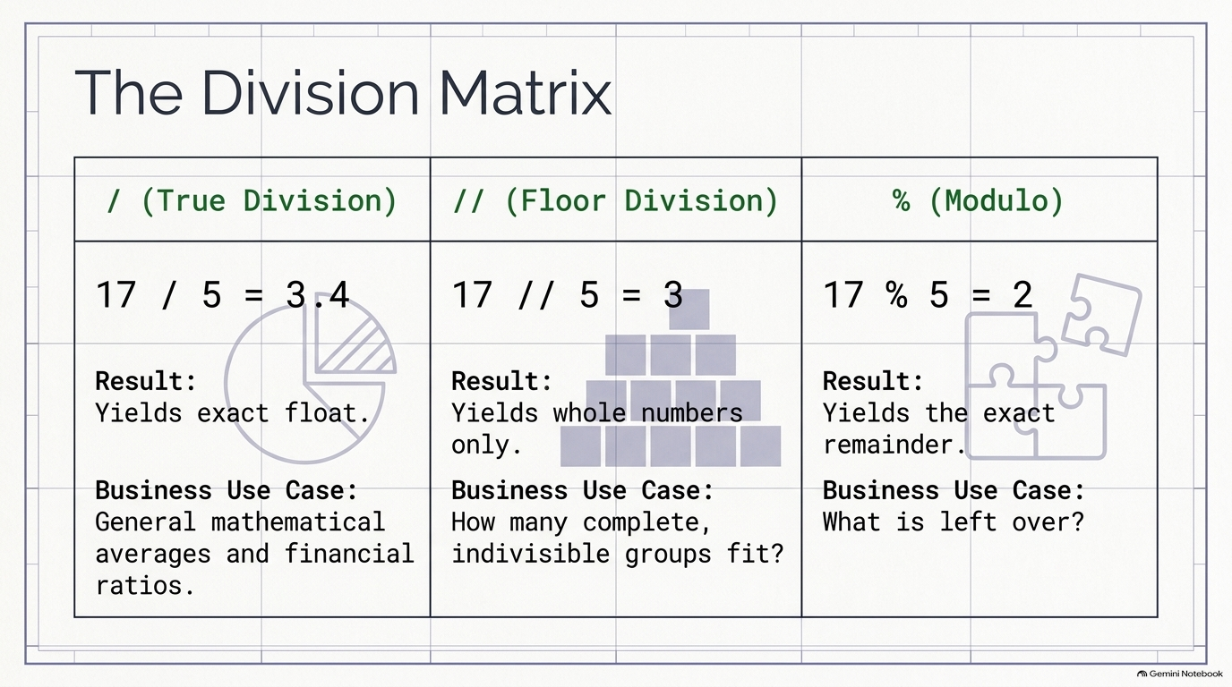
Notes:
SLIDE 5 — EXERCISE 5 — Common-Mistake Check
SAY: "Before running anything, predict out loud what each of these three produces — then check yourself."
DO: Predict, then run:
# --- Exercise 5 ---
print(17 / 5)
print(17 // 5)
print(17 % 5)
python3 calculator.py
CHECK:
3.4
3
2
SAY: "/ is true division — always returns a float, 3.4. // is floor division — drops everything after the decimal, keeping just the whole number, 3. % is modulo — the remainder after floor division, 2, because 3 × 5 = 15 and 17 − 15 = 2. In business terms: // answers 'how many complete groups fit,' and % answers 'what's left over that doesn't fill a complete group' — you'll use exactly that pairing in Exercise 7."
SLIDE NOTES
The Division Matrix — side-by-side comparison of / (true division), // (floor division), and % (modulo), each with 17 and 5 as the worked example.
Tie it to the slide's "Business Use Case" row for each operator: `/` → general mathematical averages and financial ratios; `//` → how many complete, indivisible groups fit; `%` → what is left over. Land the transition line explicitly: "In business terms, `//` answers 'how many complete groups fit,' and `%` answers 'what's left over that doesn't fill a complete group' — you'll use exactly that pairing in Exercise 7," which is the next slide.

Slide 6
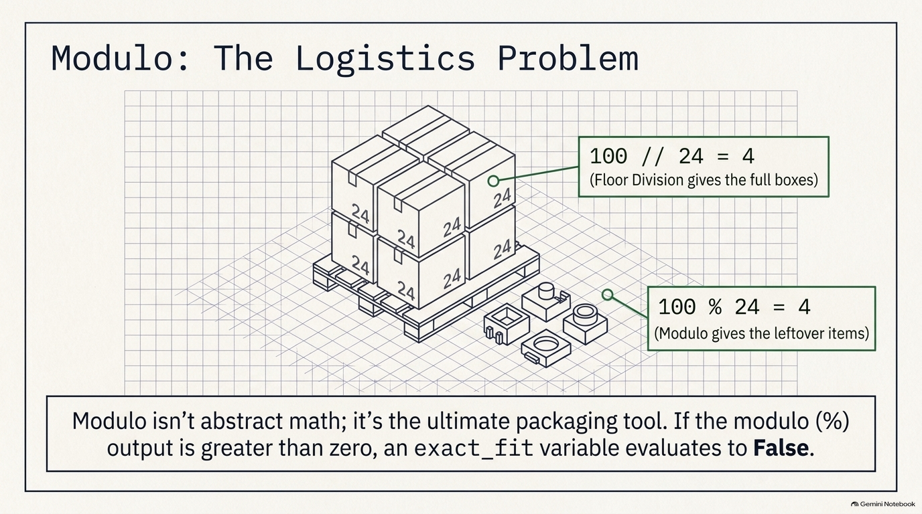
Notes:
SLIDE 6 — EXERCISE 7 — Packaging Problem
SAY: "A logistics problem — how many full boxes, and how many loose items are left — using exactly the // and % pairing from Exercise 5."
DO:
# --- Exercise 7 ---
BOX_SIZE = 24
items_ordered = int(input("Number of items ordered: "))
full_boxes = items_ordered // BOX_SIZE
loose_items = items_ordered % BOX_SIZE
exact_fit = loose_items == 0
print(f"Full boxes: {full_boxes}")
print(f"Loose items: {loose_items}")
print(f"Exact fit: {exact_fit}")
python3 calculator.py
Enter 100.
CHECK:
Number of items ordered: 100
Full boxes: 4
Loose items: 4
Exact fit: False
Confirm: 100 // 24 = 4 (since 4 × 24 = 96), 100 % 24 = 4 (the leftover), and since the remainder isn't zero, exact_fit is False.
SLIDE NOTES
Modulo: The Logistics Problem — a pallet of boxes (each holding 24 items) illustrating 100 // 24 = 4 full boxes and 100 % 24 = 4 leftover items.
"A logistics problem — how many full boxes, and how many loose items are left — using exactly the `//` and `%` pairing from Exercise 5."
DO: BOX_SIZE = 24; items_ordered = int(input("Number of items ordered: ")); full_boxes = items_ordered // BOX_SIZE; loose_items = items_ordered % BOX_SIZE; exact_fit = loose_items == 0; print the three values.
Confirm out loud: 100 // 24 = 4 (since 4 × 24 = 96), 100 % 24 = 4 (the leftover), and since the remainder is not zero, exact_fit is False — exactly matching the slide's callouts and its closing line: "Modulo isn't abstract math; it's the ultimate packaging tool.

Slide 7
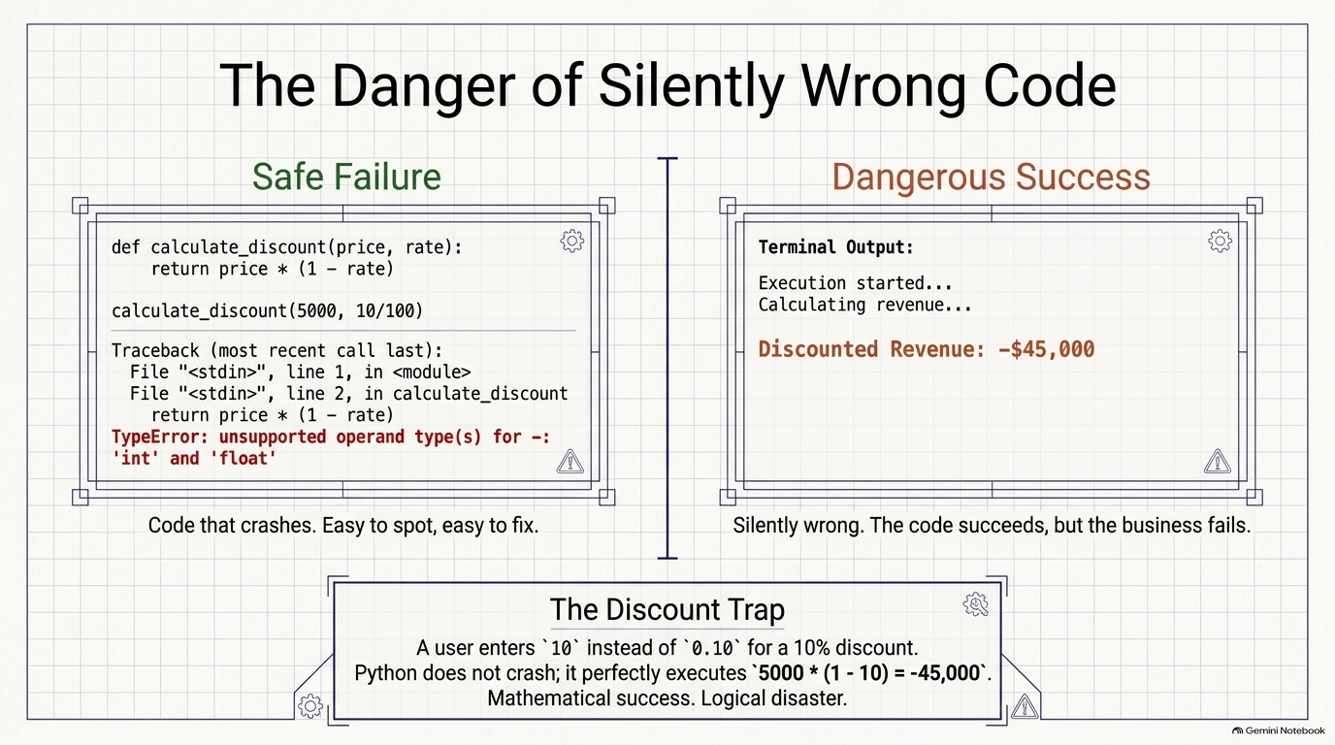
Notes:
SLIDE 7 — EXERCISE 6 — Full Pricing Calculator
FIX: If your discounted revenue is way too small (or negative), you likely forgot to divide discount_pct by 100 — using 10 directly instead of 0.10 would compute 5000 × (1 - 10) = 5000 × -9 = -45,000, a silently wrong but not crashing answer. That's the trap Reflection Question 1 asks about.
SLIDE NOTES
The Danger of Silently Wrong Code — "Safe Failure" (a TypeError traceback that crashes immediately) contrasted with "Dangerous Success" (code that runs fine but silently prints "Discounted Revenue: -$45,000"), plus a boxed callout: "The Discount Trap."
This is the FIX for Exercise 6, and it is the heart of Reflection Question 1.
"On the left, code that crashes — easy to spot, easy to fix, because Python tells you immediately with a TypeError. That silence is exactly why this kind of bug is dangerous in real business code — nothing on screen tells you it's wrong unless you already know what the right answer should look like."
Bridge directly into Reflection Question 1: "In Exercise 6, what would happen if you forgot to divide the discount percentage by 100 — used 10 instead of 0.10? Describe the error this causes — does Python crash, or does it produce a wrong answer silently?" The expected answer is exactly what this slide shows: Python does NOT crash — it silently computes a wildly wrong, often negative, discounted revenue.

Slide 8
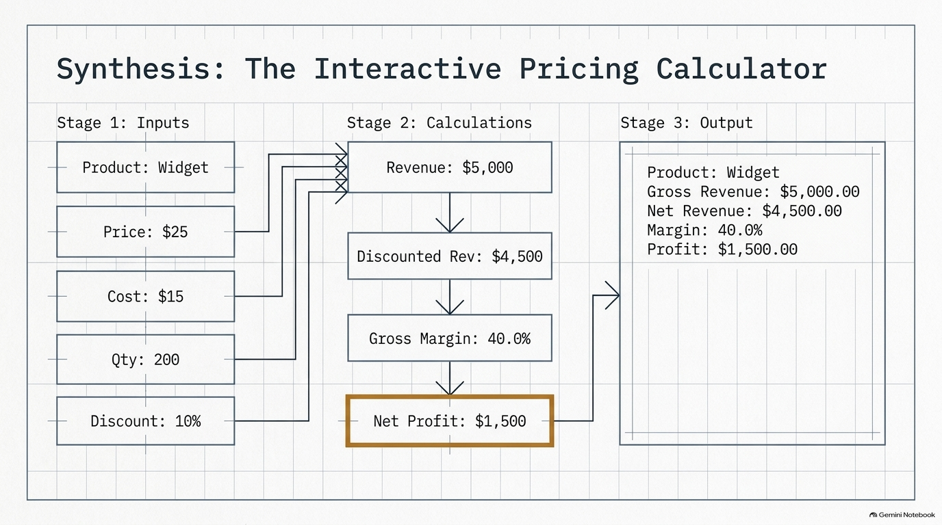
Notes:
SLIDE 8 — EXERCISE 6 — Full Pricing Calculator
SAY: "Now the real tool — five inputs from the user, four calculations, a five-line formatted report."
DO:
# --- Exercise 6 ---
name = input("Product name: ")
retail_price = float(input("Retail price: "))
unit_cost = float(input("Unit cost: "))
quantity_sold = int(input("Quantity sold: "))
discount_pct = float(input("Discount percent (e.g., 10 for 10%): "))
revenue = retail_price * quantity_sold
discounted_revenue = revenue * (1 - discount_pct / 100)
gross_margin = (retail_price - unit_cost) / retail_price
net_profit = discounted_revenue - (unit_cost * quantity_sold)
print(f"Product: {name}")
print(f"Revenue: ${revenue:,.2f}")
print(f"Discounted Revenue: ${discounted_revenue:,.2f}")
print(f"Gross Margin: {gross_margin:.1%}")
print(f"Net Profit: ${net_profit:,.2f}")
python3 calculator.py
Enter: Widget, 25, 15, 200, 10.
CHECK:
Product name: Widget
Retail price: 25
Unit cost: 15
Quantity sold: 200
Discount percent (e.g., 10 for 10%): 10
Product: Widget
Revenue: $5,000.00
Discounted Revenue: $4,500.00
Gross Margin: 40.0%
Net Profit: $1,500.00
SAY: "Trace it: revenue is 25 × 200 = 5,000. Discounted revenue applies the 10% discount: 5,000 × 0.90 = 4,500. Gross margin is (25-15)/25 = 40.0%. Net profit subtracts total cost from discounted revenue: 4,500 − (15 × 200) = 4,500 − 3,000 = 1,500."
FIX: If your discounted revenue is way too small (or negative), you likely forgot to divide discount_pct by 100 — using 10 directly instead of 0.10 would compute 5000 × (1 - 10) = 5000 × -9 = -45,000, a silently wrong but not crashing answer. That's the trap Reflection Question 1 asks about.
SLIDE NOTES
Synthesis: The Interactive Pricing Calculator — a three-stage pipeline diagram: Stage 1 Inputs (Product: Widget, Price: $25, Cost: $15, Qty: 200, Discount: 10%) → Stage 2 Calculations (Revenue → Discounted Rev → Gross Margin → Net Profit, highlighted) → Stage 3 Output (the full formatted report).
Run and enter exactly: Widget, 25, 15, 200, 10 (matching every value shown on this slide).
Net profit subtracts total cost from discounted revenue: 4,500 − (15 × 200) = 4,500 − 3,000 = 1,500." Walk the room to make sure every student's terminal matches this exact output before moving on — this is the slide right before the discount-trap FIX slide, so flag that a wrong discount_pct entry is the most likely thing to break this exact chain.

Slide 9
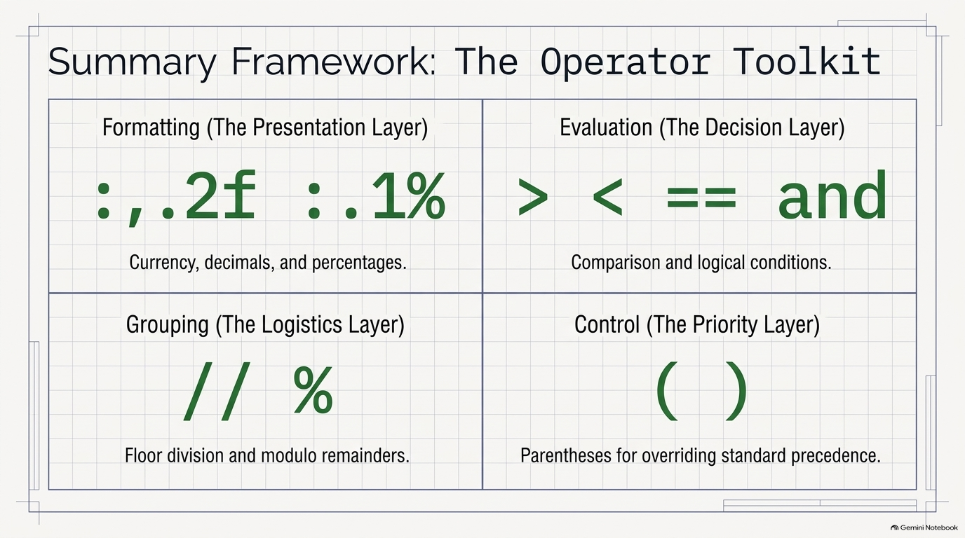
Notes:
SLIDE 9
Summary Framework: The Operator Toolkit — a 2×2 grid: Formatting (`:,.2f` `:.1%`) = the presentation layer; Evaluation (`> < == and`) = the decision layer; Grouping (`// %`) = the logistics layer; Control (`( )`) = the priority layer, i.e. parentheses for overriding standard precedence.
Use this as the lab's recap before the checklist. Walk all four quadrants and tie each back to an exercise students just finished: Formatting → Exercises 1, 2, and 6 (currency, decimals, percentages via `:,.2f` and `:.1%`). Evaluation → Exercises 3 and 4 (comparison operators and the logical `and`). Grouping → Exercises 5 and 7 (`//` and `%` for floor division and remainders). Control → parentheses for precedence — this one is not covered by a dedicated exercise this week, so mention it briefly as a forward-looking concept (operator precedence matters whenever you mix these families in one expression) rather than walking a worked example.
SAY (wrap-up line): "Four layers, one toolkit: formatting makes numbers readable, evaluation makes decisions, grouping solves logistics problems, and parentheses make sure Python evaluates your business rule the way you actually mean it." Transition into the submission checklist next.

Slide 10
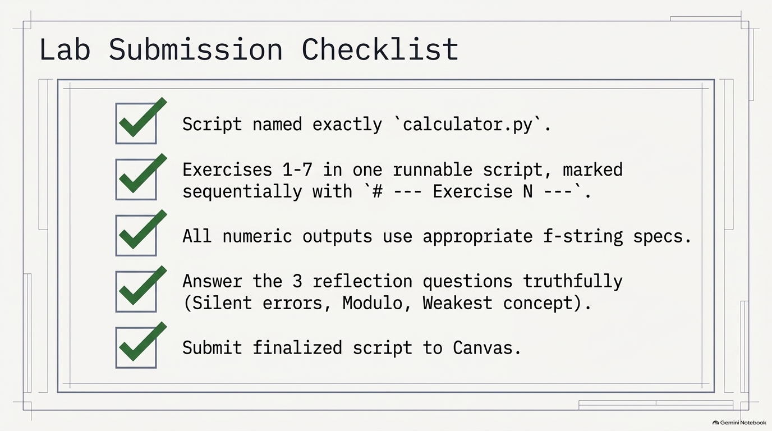
Notes:
SLIDE 10 — REFLECTION QUESTIONS
REFLECTION QUESTIONS
DO: Answer honestly:
1. In Exercise 6, what would happen if you forgot to divide the discount percentage by 100 — used 10 instead of 0.10? Describe the error this causes — does Python crash, or does it produce a wrong answer silently?
2. The modulo operator (%) might seem obscure, but Exercise 7 shows it solving a real logistics problem. Describe another business scenario where you'd need to know both "how many full groups" and "how many are left over."
3. Looking back at Modules 01–04, you've gone from "what is a computer" to writing a working pricing calculator that handles user input and produces formatted financial output. What concept from these four modules do you feel least confident about, and what would help you strengthen it?
CHECK: Question 1's answer should be specific: Python does not crash — it silently computes a wildly wrong (often negative) discounted revenue. That silence is precisely why this kind of bug is dangerous in real business code.
SUBMISSION CHECKLIST
• [ ] calculator.py — filename matches exactly, lowercase
• [ ] All exercises 1–7 present as one runnable script
• [ ] Each exercise marked with a # --- Exercise N --- comment
• [ ] All numeric output uses appropriate f-string format specs (:,.2f, :.1%, etc.)
• [ ] Three reflection questions answered honestly
• [ ] Submitted to Canvas
SLIDE NOTES
Lab Submission Checklist — five checked items: script named exactly calculator.py; Exercises 1–7 in one runnable script marked sequentially with `# --- Exercise N ---`; all numeric outputs use appropriate f-string format specs; answer the 3 reflection questions truthfully (Silent errors, Modulo, Weakest concept); submit finalized script to Canvas.
Walk the checklist item by item exactly as shown: (1) calculator.py — filename matches exactly, lowercase. (2) All exercises 1–7 present as one runnable script. (3) Each exercise marked with a `# --- Exercise N ---` comment. (4) All numeric output uses appropriate f-string format specs (`:,.2f`, `:.1%`, etc.) — spot-check that students did not hardcode formatted strings by hand. (5) Three reflection questions answered honestly. (6) Submitted to Canvas.
Describe the error this causes — does Python crash, or does it produce a wrong answer silently?" — this is the "Silent errors" checklist item; the expected answer is the discount-trap slide from earlier: no crash, silently wrong negative revenue.

