Slide 1
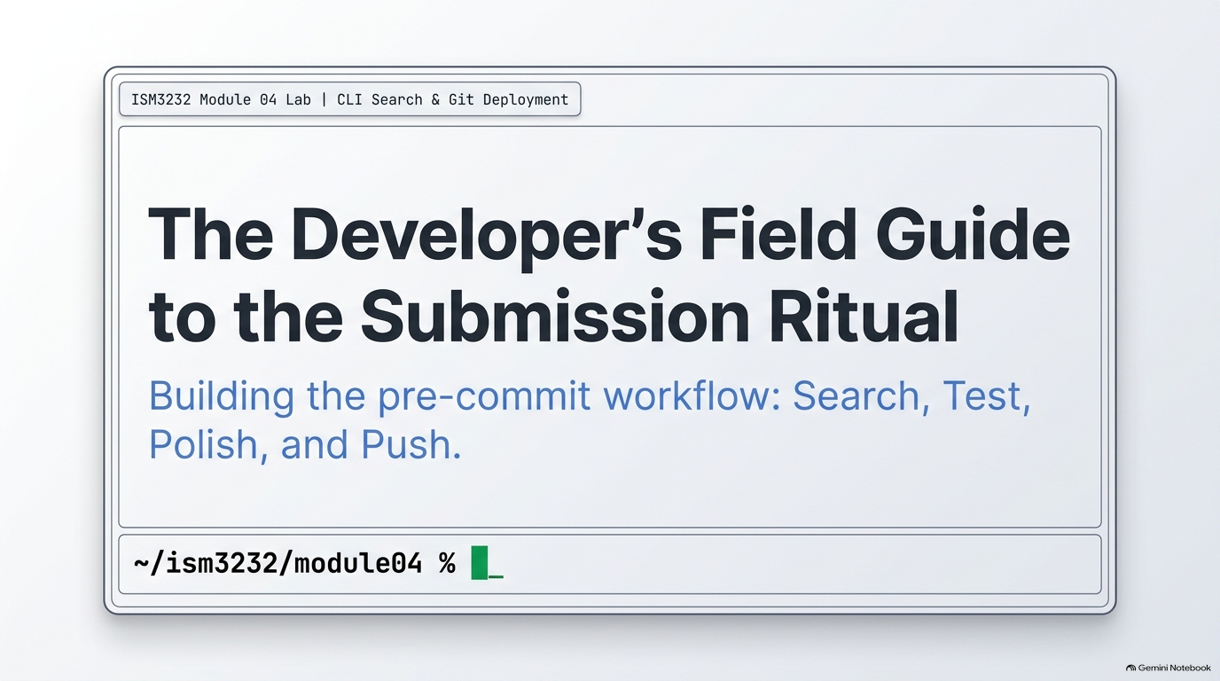
Notes:
SLIDE 1 — INTRO
SAY: "Lab 4 — search tools, the submission ritual, and Git. This is the single most important lab in Unit 1. The ritual we build today — format, lint, test, commit, push — is required before every major assignment for the rest of the semester. Instructors check your Git log. A missing ruff or pytest step is visible there, so we're building the habit correctly, right now, on camera."
SLIDE NOTES
Welcome to Lab 4: search tools, the submission ritual, and Git. Today you'll search a codebase with ripgrep, find, and tree; write and pass three pytest tests; run the full pre-submission ritual; and push to GitHub for the first time. Have your terminal open in ~/ism3232 and follow along, typing each command yourself rather than pasting. (Video runtime ~12 min.)

Slide 2
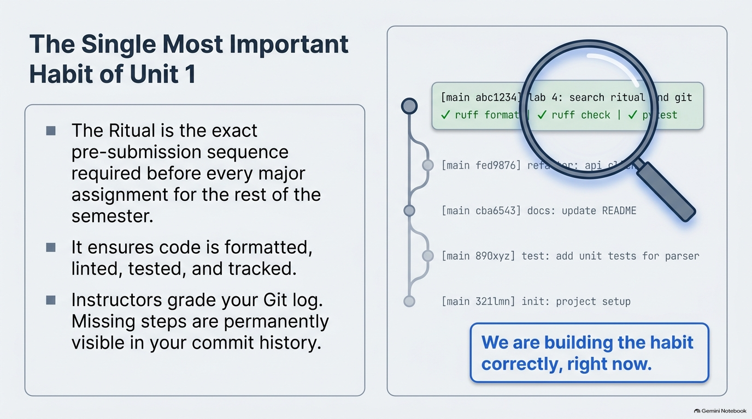
Notes:
SLIDE 2
This is the single most important habit of Unit 1. The ritual is the exact sequence we run before every major assignment for the rest of the semester: format, lint, test, commit, push. Point at the commit graph: your Git log is a permanent record, and instructors read it. A skipped ruff or pytest step is visible there. So we are building the habit correctly, right now, on camera. Set expectations: descriptive commit messages are graded from here on.

Slide 3
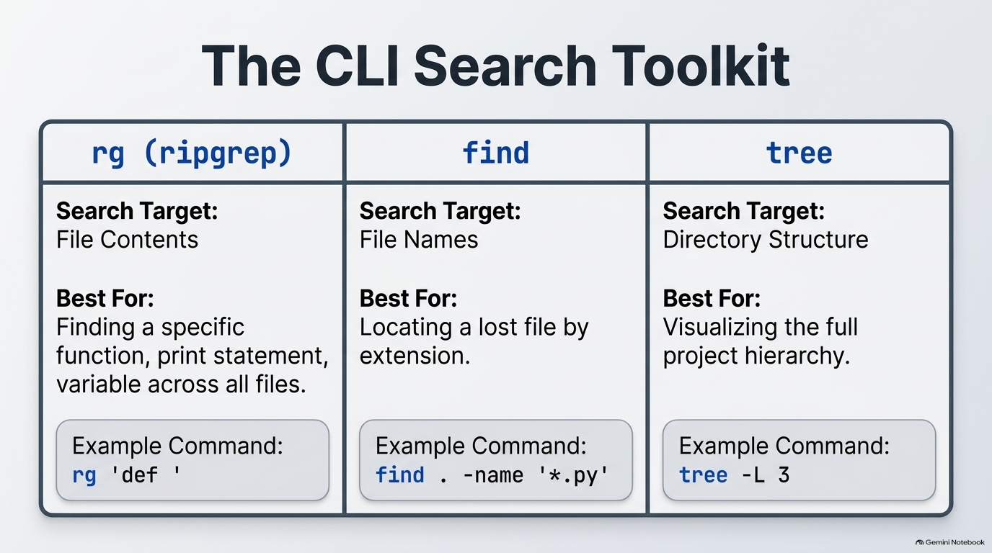
Notes:
SLIDE 3 — Step 1 — Search file contents with ripgrep
Step 1 — Search file contents with ripgrep
SAY: "rg — ripgrep — searches inside every file's contents, fast. Let's find every print statement across the whole course folder."
DO:
cd ~/ism3232
rg 'print'
CHECK: A list of file paths and line numbers, each showing a line containing print — for example, the two print() lines from module01_setup/hello_ism3232.py.
FIX: If rg: command not found, install it — macOS: brew install ripgrep; Ubuntu: sudo apt install ripgrep.
Step 2 — Search for function definitions
SAY: "Now every function definition in the whole project, in one command."
DO:
rg 'def '
CHECK: Lines like module02_zsh/tests/test_week4.py:2:def test_always_passes(): — file, line number, and the matching line itself.
SLIDE NOTES
Three tools, three different questions. rg (ripgrep) searches file contents: use it to find a function, a print statement, a variable across every file. find searches file names: use it to locate a file by name or extension. tree shows directory structure: use it to see the whole project at a glance. Each has an example command at the bottom of its column. Note: if rg is not found, install with brew install ripgrep (macOS) or sudo apt install ripgrep (Ubuntu).

Slide 4
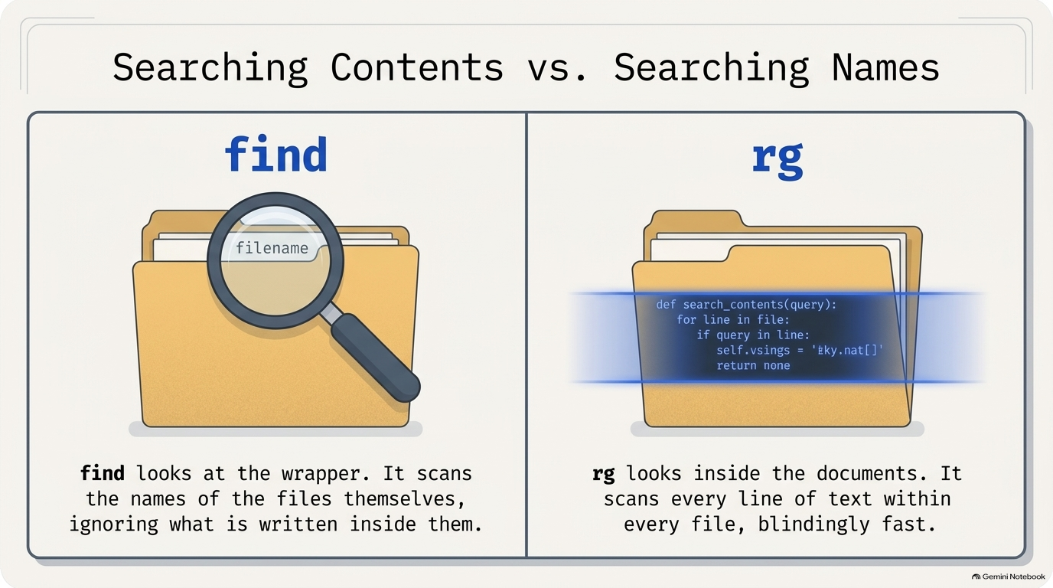
Notes:
SLIDE 4 — Step 4 — Search by filename with find
SAY: "rg searches file contents. find searches file names. Three quick examples."
DO:
find . -name '*.py'
find . -name '*.md'
find . -name '*.txt'
CHECK: Three separate lists — every .py file, every .md file, every .txt file in the current tree, each printed with its relative path (e.g. ./module01_setup/hello_ism3232.py).
SLIDE NOTES
The key distinction to land: find looks at the wrapper, the names of files, and ignores what is written inside. rg looks inside the documents, scanning every line of every file, extremely fast. Students often reach for the wrong one. Ask: "If I want every file ending in .py, which tool?" (find.) "If I want every place I wrote def?" (rg).

Slide 5
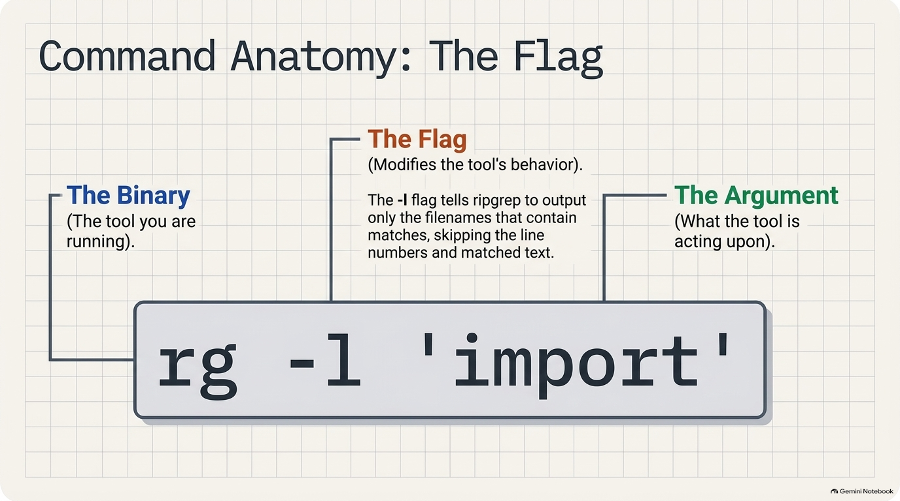
Notes:
SLIDE 5 — Step 3 — List just the matching filenames
Step 3 — List just the matching filenames
SAY: "Sometimes you don't want to see every matching line — just which files contain a match. That's the -l flag."
DO:
rg -l 'import'
CHECK: A short list of filenames only — no line numbers, no matched text, just paths.
Step 5 — Visualize with tree
SAY: "And one more look at the whole structure, three levels deep this time — deeper than the -L 2 we used in Week 2."
DO:
tree -L 3
CHECK: The full ism3232/ tree, now showing files inside module01_setup, module02_zsh, etc. — not just the folder names.
Screenshot 1 checkpoint
SAY: "Screenshot 1 — at least two rg commands and their output, plus the tree -L 3 output."
SLIDE NOTES
Anatomy of a command: the binary is the tool you're running (rg), the flag modifies its behavior (-l), and the argument is what the tool acts on ('import'). Here -l tells ripgrep to print only the filenames that contain a match, skipping line numbers and matched text. Useful when you only care which files, not which lines.

Slide 6
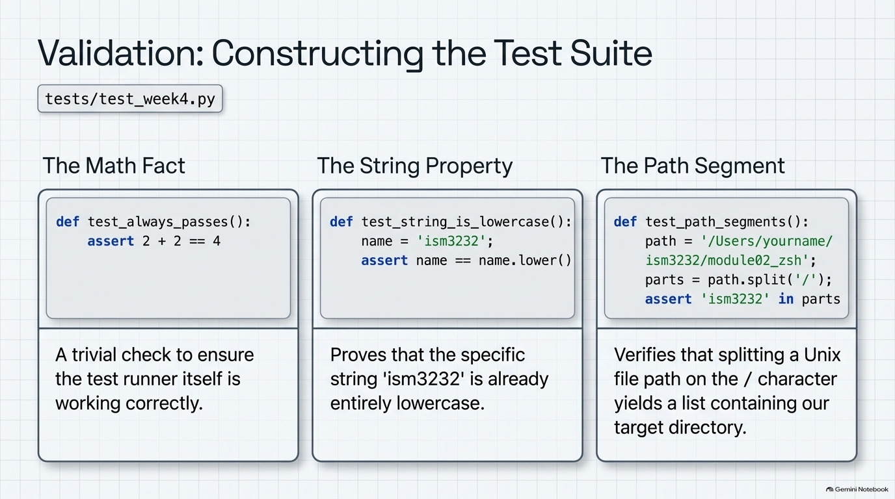
Notes:
SLIDE 6 — Step 6 — Set up the tests folder
Step 6 — Set up the tests folder
SAY: "We're adding real tests to module02_zsh now. Activate the venv first — pytest lives inside it, remember."
DO:
cd ~/ism3232/module02_zsh
source .venv/bin/activate
mkdir -p tests
touch tests/__init__.py tests/test_week4.py
code tests/test_week4.py
CHECK: Prompt shows (.venv), and ls tests/ shows two files: __init__.py and test_week4.py.
Step 7 — Type all three tests
SAY: "Three tests, each checking something different — a pure math fact, a string property, and a path-splitting operation. Type them in, don't paste."
DO:
# tests/test_week4.py
def test_always_passes():
assert 2 + 2 == 4
def test_string_is_lowercase():
name = 'ism3232'
assert name == name.lower()
def test_path_segments():
path = '/Users/yourname/ism3232/module02_zsh'
parts = path.split('/')
assert 'ism3232' in parts
CHECK: Read each test out loud before running it: "Test one — trivially, 2 plus 2 is 4. Test two — 'ism3232' is already all lowercase, so it equals its own .lower(). Test three — splitting that path on / gives a list of segments, and 'ism3232' must be one of them."
SLIDE NOTES
Now we add real tests to module02_zsh. First activate the venv, because pytest lives inside it: cd ~/ism3232/module02_zsh, source .venv/bin/activate, mkdir -p tests, touch tests/__init__.py tests/test_week4.py, code tests/test_week4.py. Check for the (.venv) prompt and two files in tests/.
Test one, the math fact, is a sanity check that the test runner itself works. Test two, the string property: 'ism3232' equals its own .lower(). Test three, the path segment: splitting the path on '/' gives a list, and 'ism3232' must be in it. Have students read each test aloud before running. Type them, don't paste.

Slide 7
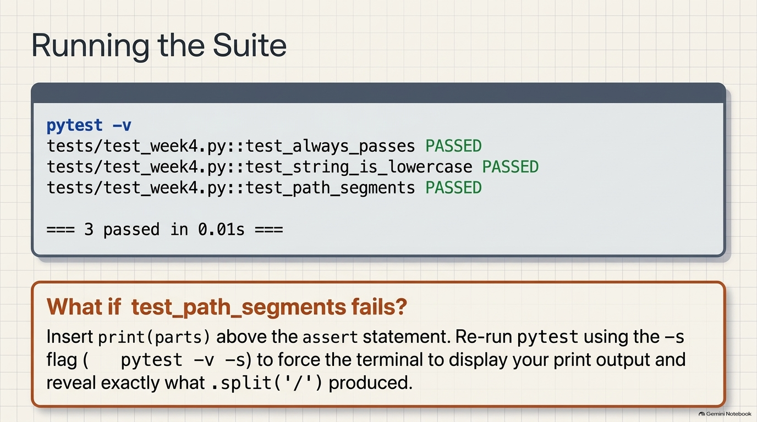
Notes:
SLIDE 7 — Step 8 — Run pytest and confirm all three pass
SAY: "Moment of truth — run it."
DO:
pytest -v
CHECK:
tests/test_week4.py::test_always_passes PASSED
tests/test_week4.py::test_string_is_lowercase PASSED
tests/test_week4.py::test_path_segments PASSED
======================== 3 passed in 0.01s ========================
FIX: If test_path_segments fails, print the actual parts list with a debug print(parts) above the assert and re-run with pytest -v -s (the -s flag lets print() output show) to see exactly what .split('/') produced.
SLIDE NOTES
Moment of truth: run pytest -v. Expect all three PASSED and a summary line "3 passed in 0.01s".
If test_path_segments fails: add print(parts) above the assert and re-run with pytest -v -s. The -s flag lets print output show in the terminal, so you can see exactly what .split('/') produced. Common cause: a typo in the path string. Fix it before moving on; we never proceed on a red suite.

Slide 8
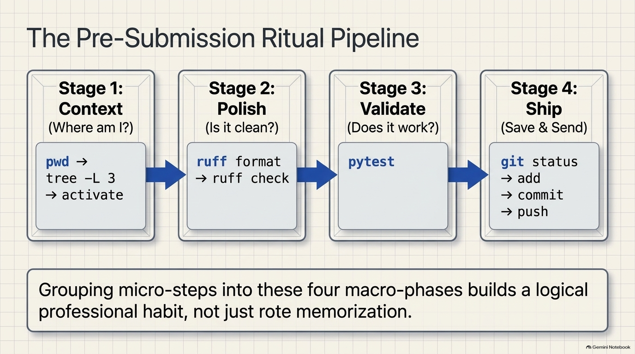
Notes:
SLIDE 8
Here is the ritual, grouped into four macro-phases so it becomes a professional habit, not rote memorization. Stage 1, Context: where am I? (pwd, tree -L 3, activate). Stage 2, Polish: is it clean? (ruff format, ruff check). Stage 3, Validate: does it work? (pytest). Stage 4, Ship: save and send (git status, add, commit, push). Ten steps, always in this order. Next four slides walk through each stage; we will then run all of it in the terminal.

Slide 9
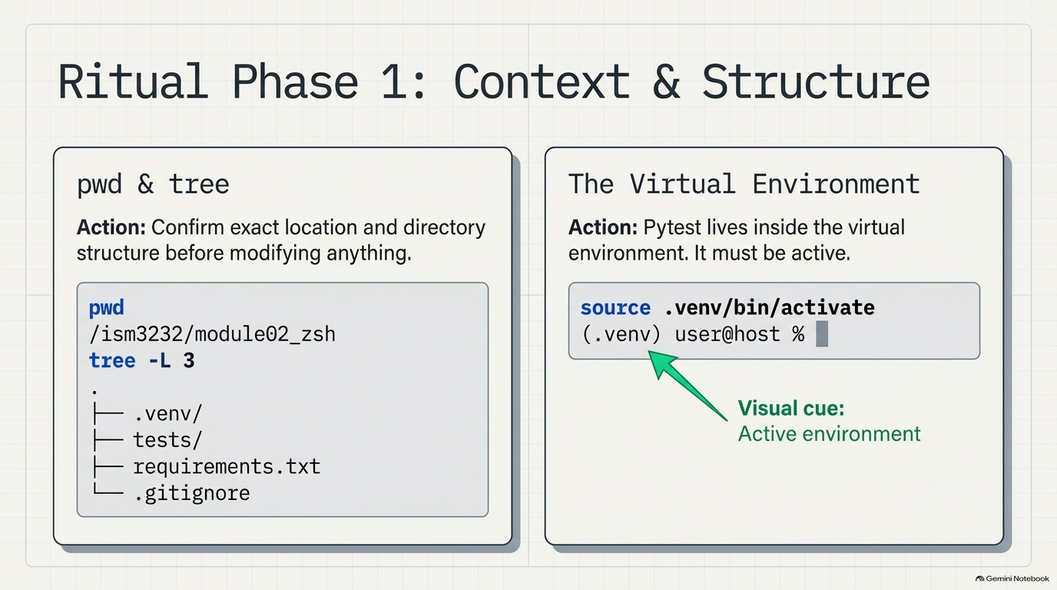
Notes:
SLIDE 9 — Step 9a — Confirm location
Step 9a — Confirm location
DO:
pwd
CHECK:
/Users/yourname/ism3232/module02_zsh
Step 9b — Confirm structure
DO:
tree -L 3
CHECK: Full structure including .venv/, tests/, requirements.txt, .gitignore — a snapshot of exactly what exists before you touch Git.
Step 9c — Activate the venv
DO:
source .venv/bin/activate
CHECK: (.venv) prefix appears in the prompt.
SLIDE NOTES
Run pwd to confirm your exact location (expect /Users/yourname/ism3232/module02_zsh), then tree -L 3 to snapshot what exists before you touch Git: .venv/, tests/, requirements.txt, .gitignore. Then source .venv/bin/activate. The visual cue is the (.venv) prefix on the prompt. Without it, pytest and ruff may not be found. Students who skip this step are the ones who commit from the wrong folder.

Slide 10
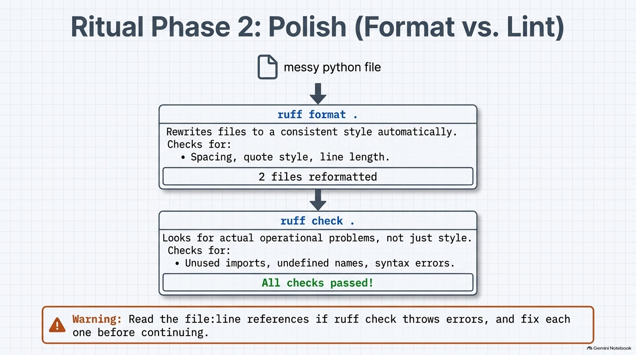
Notes:
SLIDE 10 — Step 9d — Format the code
Step 9d — Format the code
SAY: "ruff format rewrites your files to a consistent style automatically — spacing, quote style, line length."
DO:
ruff format .
CHECK:
2 files reformatted, 1 file left unchanged
(Exact counts vary — the key output is that it ran without error.)
Step 9e — Lint the code
SAY: "ruff check looks for actual problems — unused imports, undefined names — not just style."
DO:
ruff check .
CHECK:
All checks passed!
FIX: If it lists errors instead, read the file:line references and fix each one before continuing — do not commit with lint errors present.
SLIDE NOTES
Stage 2 splits into two different jobs. ruff format . rewrites files to a consistent style automatically: spacing, quote style, line length. Expect something like "2 files reformatted, 1 file left unchanged"; exact counts vary, the key is no error. ruff check . looks for actual problems: unused imports, undefined names, syntax errors. Expect "All checks passed!". Warning callout: if it lists errors, read the file:line references and fix each one before continuing. Format is style; lint is correctness.

Slide 11
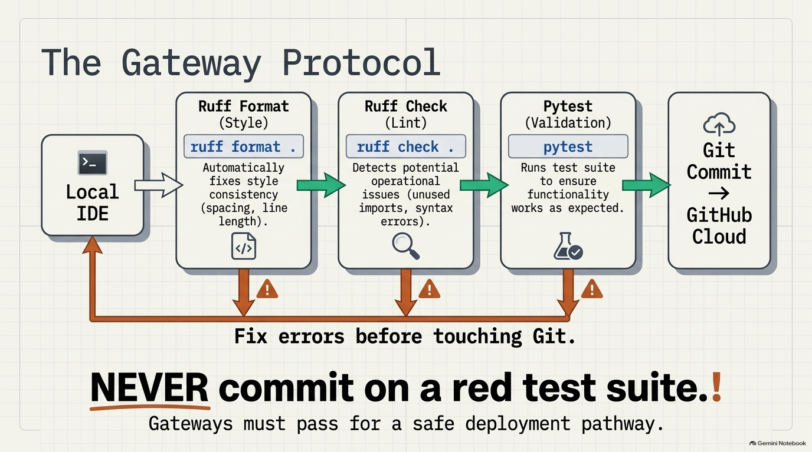
Notes:
SLIDE 11
The gateway protocol: code flows left to right through three gates before it reaches Git. Ruff format, then ruff check, then pytest. If any gate fails, the red arrows loop you back to your editor: fix errors before touching Git. The bold rule at the bottom is non-negotiable: NEVER commit on a red test suite. Gateways must pass for a safe deployment pathway. Pause here and let it sink in before running Stages 3 and 4.

Slide 12
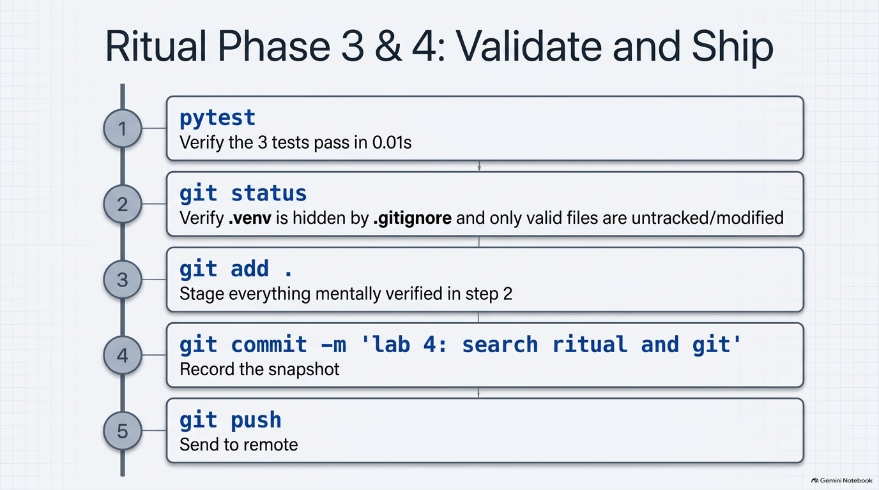
Notes:
SLIDE 12 — Step 9f — Run the tests
Step 9f — Run the tests
DO:
pytest
CHECK:
3 passed in 0.01s
FIX: If anything fails here, stop — go back and fix it before touching Git. Never commit on a red test suite.
Step 9g — Check git status
DO:
git status
CHECK: A list of untracked/modified files — tests/, any reformatted files, etc. — none of them should be .venv/ (that's what your Week 3 .gitignore prevents).
Step 9h — Stage everything
DO:
git add .
CHECK: No output. Re-run git status mentally in your head — everything just staged should now show green/staged in a follow-up git status if you want to double check.
Step 9i — Commit with a descriptive message
DO:
git commit -m 'lab 4: search ritual and git'
CHECK:
[main abc1234] lab 4: search ritual and git
4 files changed, 32 insertions(+)
Step 9j — Push
DO:
git push
CHECK: Output ending in something like main -> main with no errors. (If this is your very first push, see Part 4 below first — you need a remote configured before push works.)
Ritual complete when: ruff check returns no errors, pytest returns all passed, and git status says "nothing to commit" right after the push.
Screenshot 2 checkpoint
SAY: "Screenshot 2 — the entire ritual, from pwd through git push, visible in one terminal session."
SLIDE NOTES
Stages 3 and 4, run in order. 1) pytest: expect "3 passed in 0.01s". 2) git status: confirm .venv/ does NOT appear (your Week 3 .gitignore hides it) and only valid files are untracked or modified. 3) git add . stages everything you just verified. 4) git commit -m 'lab 4: search ritual and git' records the snapshot; expect [main abc1234] with a files-changed summary. 5) git push sends it to the remote. Ritual complete when ruff check is clean, pytest passes, and git status says nothing to commit right after the push. If push fails because no remote exists, that's the next slide.

Slide 13
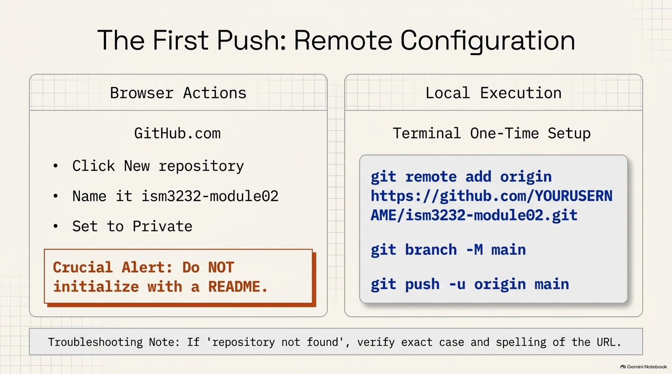
Notes:
SLIDE 13 — Step 10 — Create the GitHub repo and connect it
SAY: "If Step 9j just failed because there's no remote yet, here's the one-time setup."
DO: On github.com: New repository → name it ism3232-module02 → set Private → do not initialize with a README. Then back in the terminal:
git remote add origin https://github.com/YOURUSERNAME/ism3232-module02.git
git branch -M main
git push -u origin main
CHECK: Push output shows your objects being uploaded and ending with a line establishing main tracks origin/main.
FIX: If you get "repository not found," double check the URL matches exactly what GitHub showed you after creating the repo — case and spelling both matter.
SLIDE NOTES
One-time setup, split in two halves. In the browser on GitHub.com: New repository, name it ism3232-module02, set it to Private, and crucially do NOT initialize with a README (that creates a conflicting history). Then in the terminal: git remote add origin https://github.com/YOURUSERNAME/ism3232-module02.git, git branch -M main, git push -u origin main. Expect objects uploading and a line saying main tracks origin/main. Troubleshooting: "repository not found" almost always means the URL doesn't match exactly; case and spelling both matter.

Slide 14
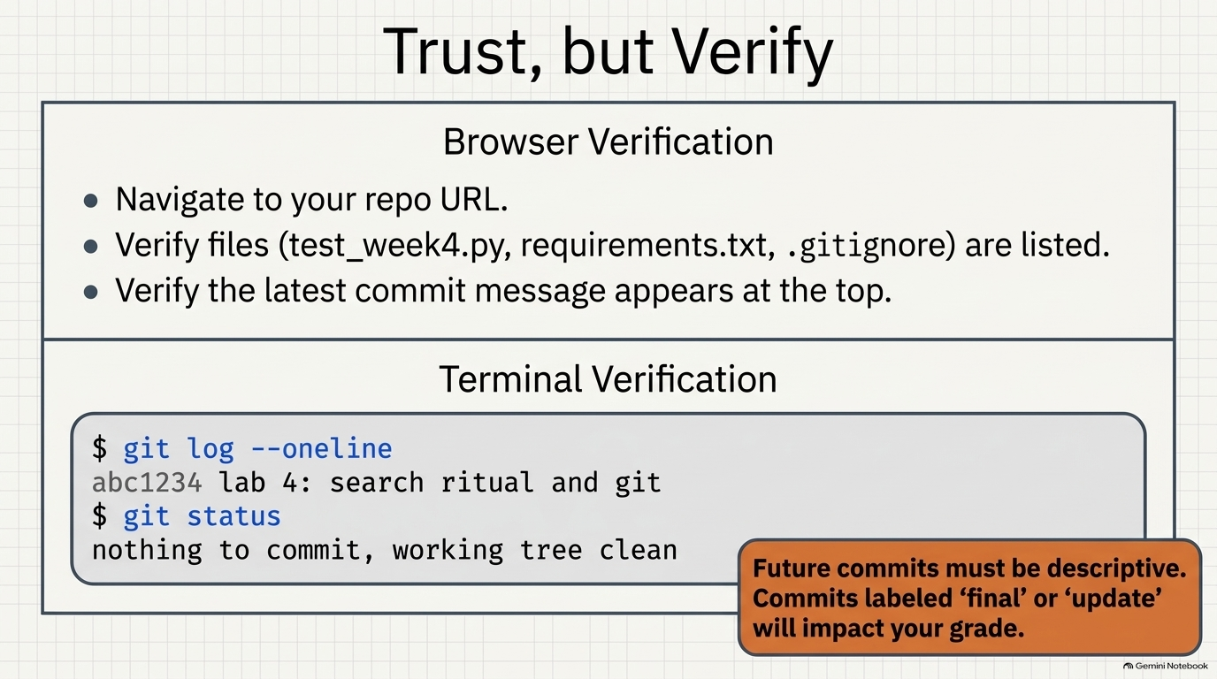
Notes:
SLIDE 14 — Step 11 — Verify on GitHub.com
Step 11 — Verify on GitHub.com
SAY: "Don't trust the terminal alone — open the actual repository page in a browser."
DO: Navigate to https://github.com/YOURUSERNAME/ism3232-module02 in Chrome.
CHECK: Your files — tests/test_week4.py, requirements.txt, .gitignore, README.md — are all listed, and the latest commit message (lab 4: search ritual and git) shows at the top.
Screenshot 3 checkpoint
SAY: "Screenshot 3 — your GitHub repository page, showing the committed files."
Step 12 — Verify the commit log
SAY: "One last check — the commit history itself, because this log is part of your grade."
DO:
git log --oneline
git status
CHECK:
abc1234 lab 4: search ritual and git
and
nothing to commit, working tree clean
FIX: If your commit message just says "final" or "update," rewrite future commits to be descriptive — that's explicitly graded from here forward.
SLIDE NOTES
Trust, but verify. Don't rely on the terminal alone. In the browser, open your repo URL, confirm test_week4.py, requirements.txt, and .gitignore are listed, and that your latest commit message appears at the top.
In the terminal, run git log --oneline (expect abc1234 lab 4: search ritual and git) and git status (expect "nothing to commit, working tree clean"). Emphasize the orange callout: this log is part of your grade. Commits labeled "final" or "update" will hurt it from now on.

Slide 15
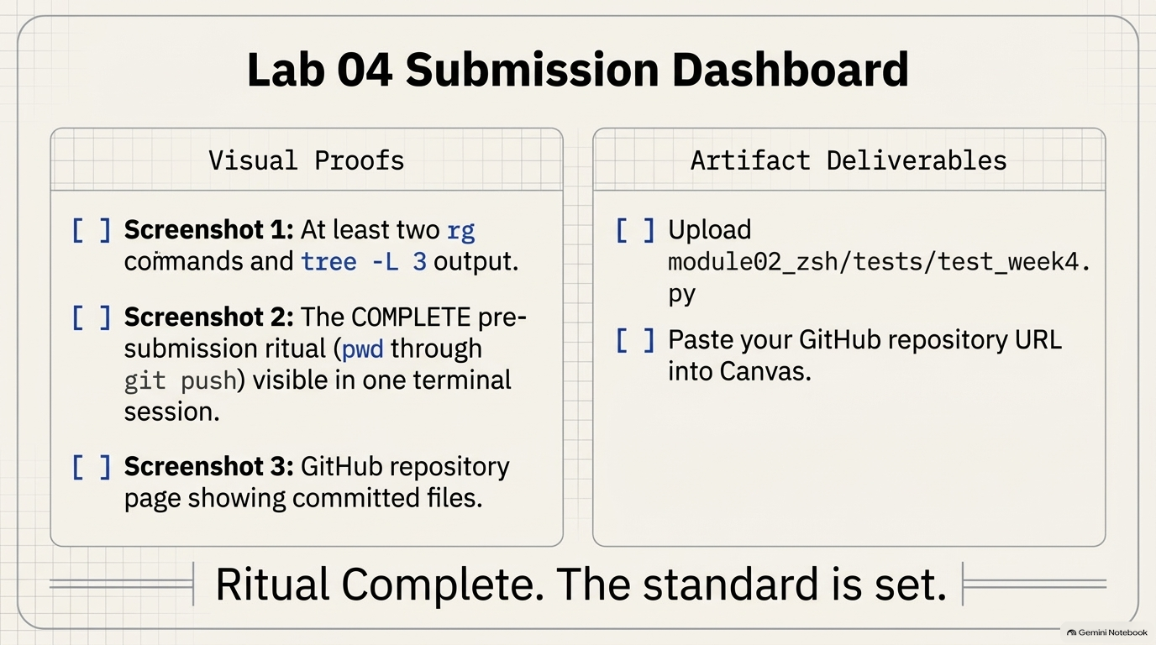
Notes:
SLIDE 15 — SUBMISSION CHECKLIST
• [ ] Screenshot 1: two rg commands and tree -L 3 output
• [ ] Screenshot 2: the complete pre-submission ritual — all steps in one terminal session
• [ ] Screenshot 3: your GitHub repository page showing committed files
• [ ] module02_zsh/tests/test_week4.py uploaded
• [ ] Your GitHub repository URL pasted into the Canvas text box
SLIDE NOTES
Visual proofs: Screenshot 1 (two rg commands plus tree -L 3), Screenshot 2 (the complete ritual, pwd through git push, in one terminal session), Screenshot 3 (your GitHub repo page with files). Deliverables: upload module02_zsh/tests/test_week4.py, and paste your GitHub repository URL into the Canvas text box. Close with: the ritual is now your standard for every major assignment. The standard is set.

