Slide 1
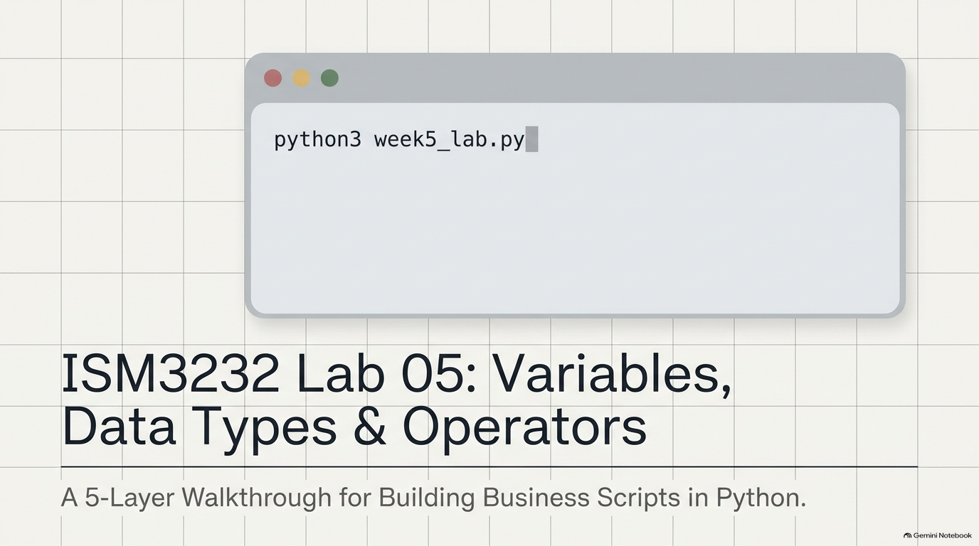
Notes:
SLIDE 1 — INTRO
LAB GUIDE — EXACT CODE AND EXPECTED OUTPUT
SAY: "Lab 5 — variables, data types, and operators. Full class period, one script, built up in five layers: raw data, calculations, user input, tests, and the ritual. I'm building a purchase-request script — pick whatever business domain you like, the mechanics are identical."
SPOKEN SCRIPT
Welcome, everybody. Get your laptops open, with a terminal and VS Code ready.
Today is Lab 5: Variables, Data Types, and Operators. The subtitle says it well: a five-layer walkthrough for building business scripts in Python.
The picture is a terminal with one command in it: python3 week5_lab.py. By the end of today, that one command will run a small business program that you built and tested yourself, and that you can push to GitHub.
We are going to build one script. It's a purchase-request script, the kind of thing an employee fills out before buying equipment. I'll use a laptop as my example. You may pick any business domain you like, a coffee shop, a gym, an inventory system. The mechanics are identical, so pick something that interests you, and put a comment at the top of your file saying which domain you picked.
Let me show you the plan for the class.

Slide 2
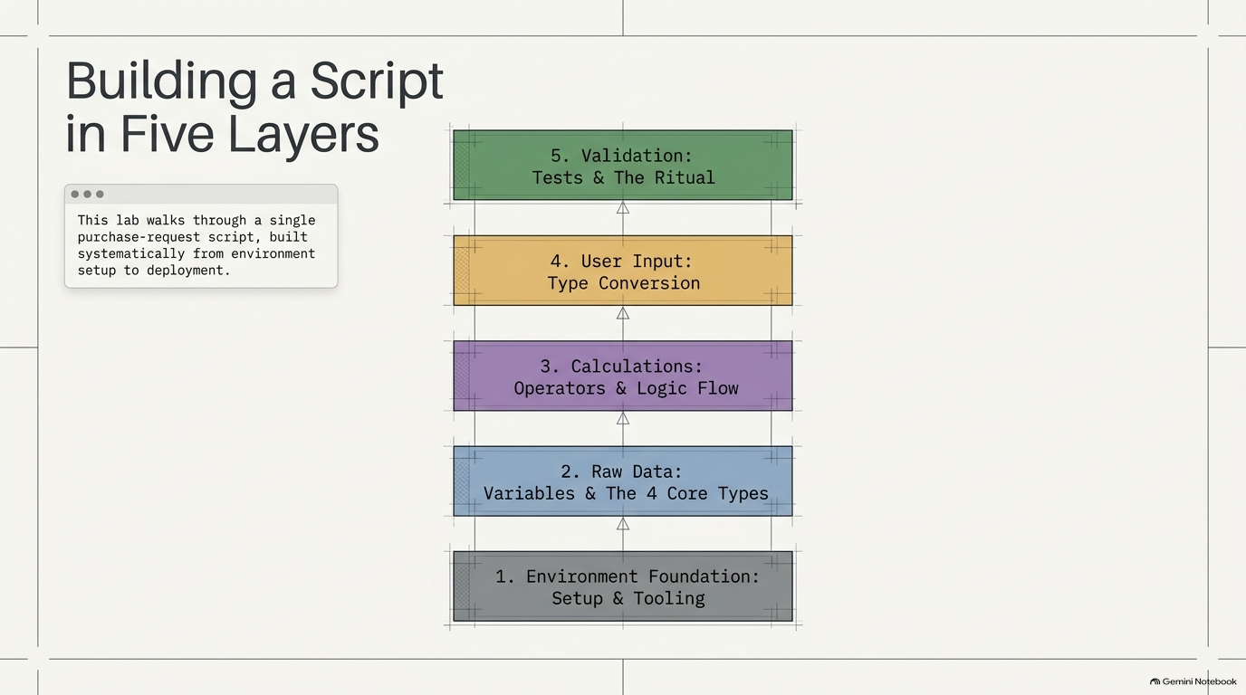
Notes:
SLIDE 2 — BUILDING A SCRIPT IN FIVE LAYERS
SPOKEN SCRIPT
Here is the map for today. Read it from the bottom up, because that's the order we build in. It's like a building: you can't put in the top floor until the foundation is there.
Layer 1, at the bottom, gray: the environment foundation. Setup and tooling. A fresh virtual environment, our packages, and a .gitignore.
Layer 2, blue: raw data. Variables and the four core data types.
Layer 3, purple: calculations. Operators and logic flow. Subtotal, tax, total, and a yes-or-no approval flag.
Layer 4, yellow: user input and type conversion. This is where the famous bug lives.
Layer 5, green, at the top: validation. Tests, and the ritual that gets your work onto GitHub.
The little box says, "This lab walks through a single purchase-request script, built systematically from environment setup to deployment." Emphasize "single." We are not writing five programs. It's one file, and each layer adds to it.
One more thing: you are collecting three screenshots today for your submission: the formatted summary, the input prompt output, and the green pytest run, and I'll announce each one as we reach it, marked with a camera icon on the slides.
The rhythm today is: I say it, I do it, we check the exact output, and if it doesn't match, we fix it. Don't run ahead of me, and don't skip the check. Ready? Layer 1.

Slide 3
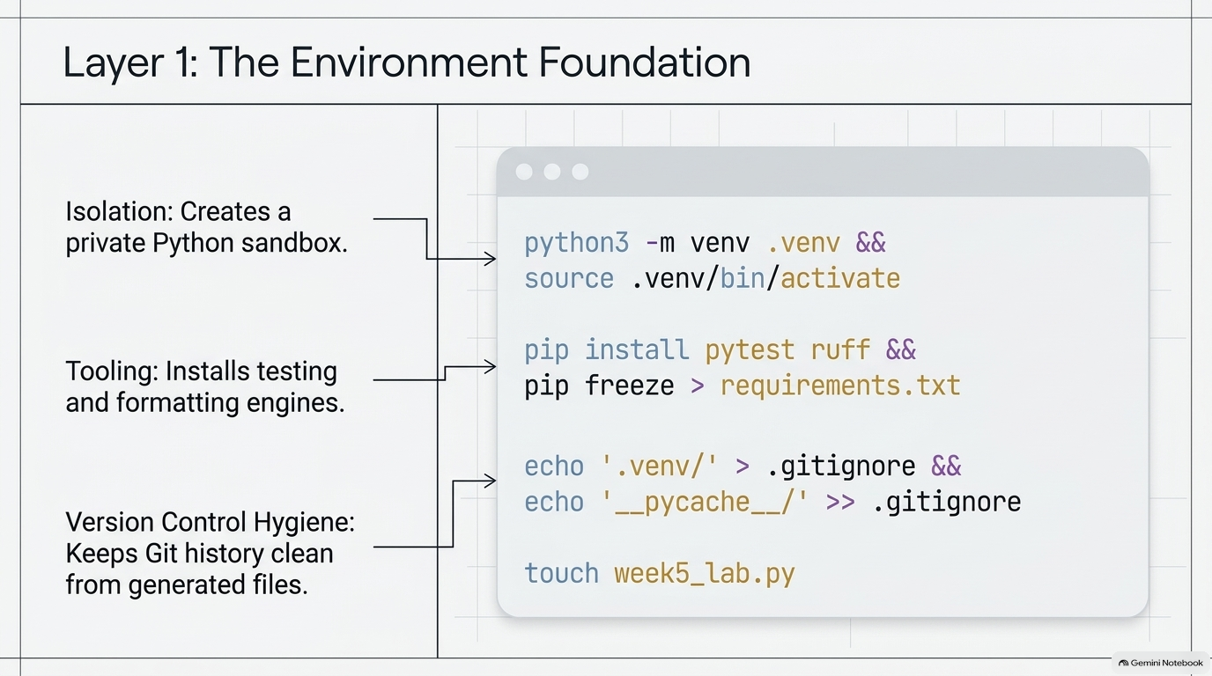
Notes:
SLIDE 3 — Step 1 — Fresh project setup
LAB GUIDE — EXACT CODE AND EXPECTED OUTPUT
SAY: "New module, so new venv — same five commands as Week 3, now muscle memory."
DO:
cd ~/ism3232/module04_programming
python3 -m venv .venv && source .venv/bin/activate
pip install pytest ruff && pip freeze > requirements.txt
echo '.venv/' > .gitignore && echo '__pycache__/' >> .gitignore
touch week5_lab.py && code week5_lab.py
CHECK: Prompt shows (.venv); ls -la shows .venv/, .gitignore, requirements.txt, and the new empty week5_lab.py.
SPOKEN SCRIPT
New module, so a new virtual environment. This is the same set of commands as Week 3, so it should be starting to feel like muscle memory.
The slide has three callouts on the left. Isolation, which creates a private Python sandbox. Tooling, which installs testing and formatting engines. And version control hygiene, which keeps your Git history clean from generated files.
Let's take the commands one at a time, and please run them as I do.
[DO]
First, change into your module folder. On the lab page the path is shown as ~/ism3232/module04_programming. Use whichever folder your lab page tells you to use.
Command one: "python3 -m venv .venv && source .venv/bin/activate". The first half creates a folder called .venv, a private copy of Python for this project. The second half turns it on. The double ampersand means "run the second command only if the first one worked."
Look at your prompt. You should see (.venv) at the start of the line. If you don't, stop and tell me. Everything after this depends on it. Why does it matter? Because anything we install now goes into this project only, and can't collide with something else on your machine.
Command two: "pip install pytest ruff && pip freeze > requirements.txt". pytest is our testing tool. ruff is a formatter and a checker that catches style problems. And "pip freeze" writes down the exact versions we installed into requirements.txt, so anybody can rebuild your setup.
Command three: "echo '.venv/' > .gitignore && echo '__pycache__/' >> .gitignore". Watch the arrows. One arrow creates the file, and two arrows add to it. Why do we do this? Because the .venv folder has thousands of files and it should never be uploaded to GitHub, and __pycache__ is junk Python creates automatically. .gitignore tells Git to leave them alone.
Command four: "touch week5_lab.py && code week5_lab.py". This creates the empty file and opens it in VS Code.
[CHECK]
Run "ls -la". You should see .venv, .gitignore, requirements.txt, and your new empty week5_lab.py. The (.venv) should still be on your prompt.
If "code" isn't recognized, open the file from VS Code manually, and tell me afterward so we can fix the shell command.
Everyone has all four files? Great. That's the foundation. Now the data.

Slide 4
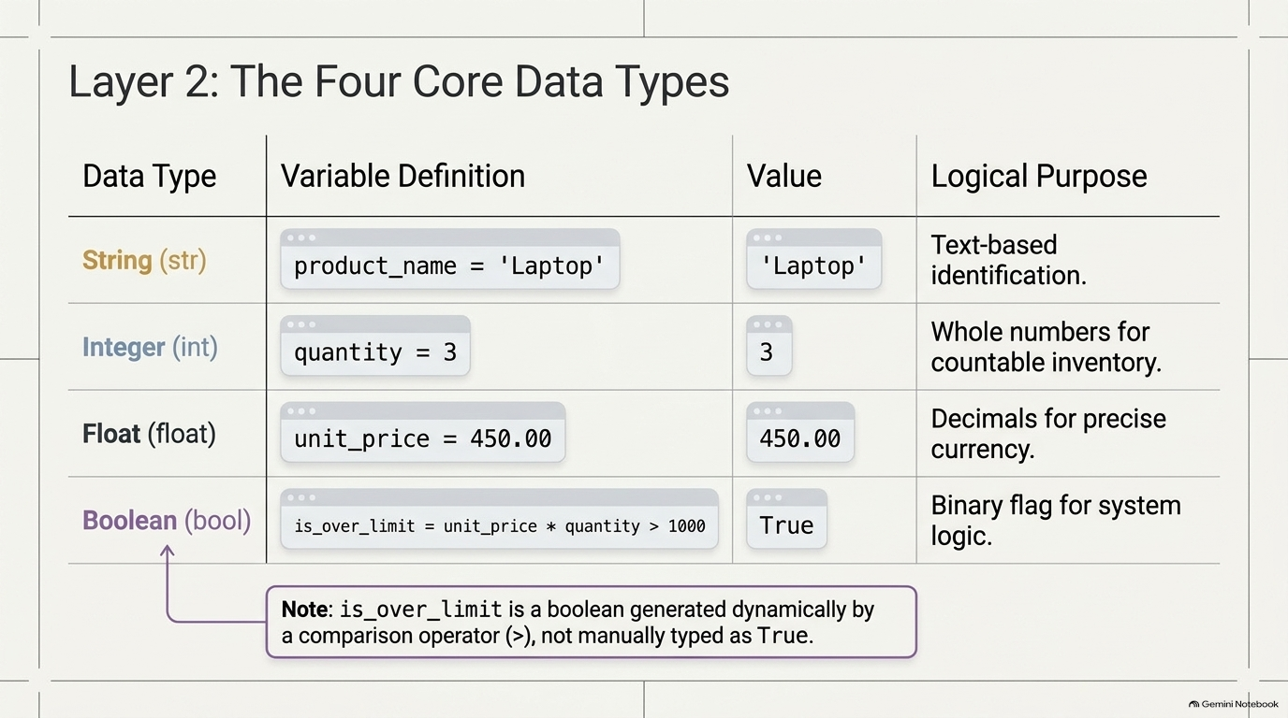
Notes:
SLIDE 4 — Step 2 — Write the four core variables
LAB GUIDE — EXACT CODE AND EXPECTED OUTPUT
SAY: "Four data types, four variables, one for each: a string, another string, an integer, a float, and a boolean built from a comparison."
DO:
# week5_lab.py
# Author: [Your Name]
# Business domain: [describe your scenario]
product_name = 'Laptop'
status = 'Pending'
quantity = 3
unit_price = 450.00
is_over_limit = unit_price * quantity > 1000
print(type(product_name), type(quantity), type(unit_price), type(is_over_limit))
CHECK: Read each variable's type out loud before running: "product_name and status — strings. quantity — int. unit_price — float. is_over_limit — a bool, because it's the result of a comparison, not a value I typed directly."
SPOKEN SCRIPT
Layer 2. This table is the heart of today's first half. Four data types. Four variables. Each with a purpose.
Go down the rows.
String, abbreviated str. Our variable is product_name equals 'Laptop'. Purpose: text-based identification. Anything in quotes is a string.
Integer, int. quantity equals 3. Whole numbers, for countable things like inventory. No decimal point.
Float. unit_price equals 450.00. A number with a decimal point. Purpose on the slide: decimals for precise currency. (If someone asks about money and floats, say honestly that real financial software uses a special decimal type to avoid rounding drift, but a float is the right tool for this lab.)
Boolean, bool. is_over_limit equals unit_price times quantity is greater than 1000. It can only be True or False.
Now the note at the bottom, and please don't skip this. is_over_limit is a boolean generated dynamically by a comparison operator, not manually typed as True. This is subtle. I never typed the word True. Python calculated 450 times 3, got 1,350, compared it to 1,000, and the answer to that question is a boolean. Comparisons produce booleans.
[DO]
In week5_lab.py, type the header comments first: "# week5_lab.py", "# Author:" and your name, "# Business domain:" and a description of your scenario.
Then type the five lines: product_name equals 'Laptop'. status equals 'Pending'. quantity equals 3. unit_price equals 450.00. is_over_limit equals unit_price times quantity greater than 1000. Yes, that's five lines for four types, because we have two strings. Line the equals signs up if you like, as on the lab page. It's not required, but it makes the file easy to read.
Type carefully, with matching quotes. Single quote to single quote.
Then the last line: print(type(product_name), type(quantity), type(unit_price), type(is_over_limit)).
Before you run it, do what I'm about to do. Say each type out loud, before Python tells you. product_name, string. quantity, int. unit_price, float. And is_over_limit... bool, because it is the result of a comparison. Predict, then verify. That habit will save you hours.
Now run it.

Slide 5
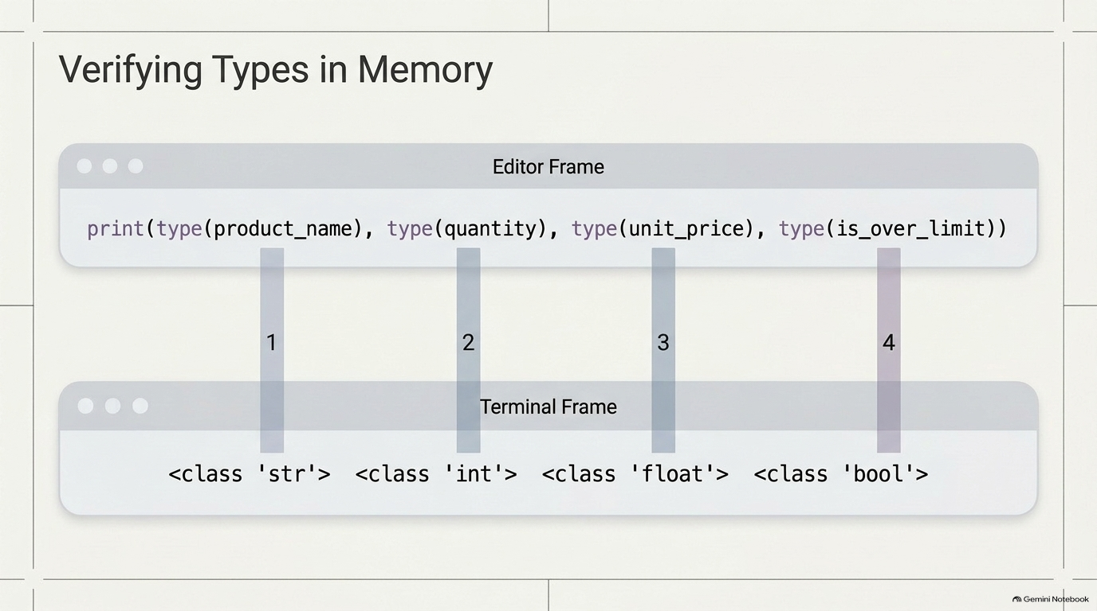
Notes:
SLIDE 5 — Step 3 — Run and confirm all four types
LAB GUIDE — EXACT CODE AND EXPECTED OUTPUT
DO:
python3 week5_lab.py
CHECK:
<class 'str'> <class 'int'> <class 'float'> <class 'bool'>
Four distinct type names, in the order the variables were passed to print().
FIX: If you see a SyntaxError, check that both string values use matching quote characters ('Laptop' not 'Laptop").
SPOKEN SCRIPT
Now run it: python3 week5_lab.py.
The slide shows the editor on top, the terminal on the bottom, and four connecting bars numbered one through four. The point: the first thing in the print statement maps to the first thing in the output, and so on. Order in, order out.
[CHECK]
You should see: <class 'str'> <class 'int'> <class 'float'> <class 'bool'>. Four different type names, in this order.
Match them up. Bar one: product_name, str. Bar two: quantity, int. Bar three: unit_price, float. Bar four: is_over_limit, bool. If that's what you see, you've verified the four data types.
The habit here is important. type() is a debugging tool. When something behaves strangely in Python, your first question should be, "What type is this really?" We'll see exactly why in about ten minutes.
[FIX, if needed]
If you get a SyntaxError, the number one cause is mismatched quotes: an opening single quote and a closing double quote, like 'Laptop". Fix them so the quote characters match. The second cause is a missing parenthesis in the print line. Read the error message from the bottom up. It usually names the line.
Thumbs up when you have four type names. Good. On to calculations.

Slide 6
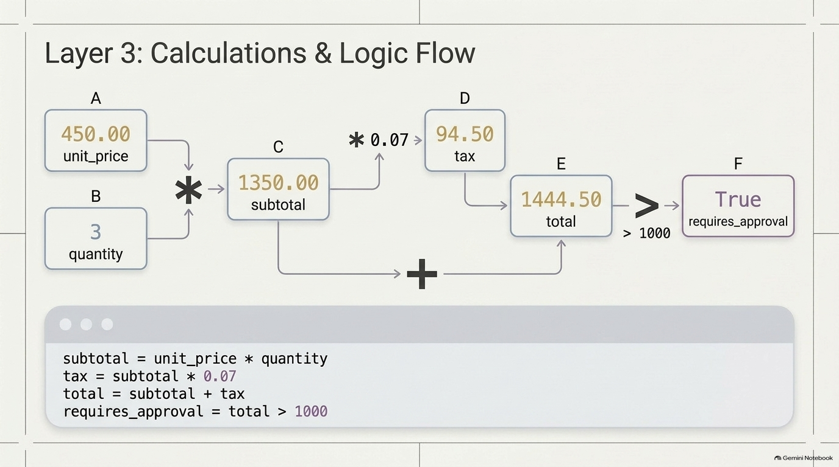
Notes:
SLIDE 6 — Step 4 — Add the calculations
LAB GUIDE — EXACT CODE AND EXPECTED OUTPUT
SAY: "Now the arithmetic — subtotal, a 7% tax, and the total — plus a boolean that flags whether this needs manager approval."
DO: Append to week5_lab.py:
subtotal = unit_price * quantity
tax = subtotal * 0.07
total = subtotal + tax
requires_approval = total > 1000
CHECK: Say the math out loud before running: "Subtotal is 450 times 3 — 1,350. Tax is 7% of that — 94.50. Total is 1,444.50. Since that's over 1,000, requires_approval should come out True."
SPOKEN SCRIPT
Layer 3. Now that we have data, we can do arithmetic with it.
This diagram is a data-flow chart, so let's trace it like a wiring diagram. A is unit_price, 450. B is quantity, 3. Multiply them, that's the star, and you get C, subtotal, 1,350. Then a branch: multiply the subtotal by 0.07, and you get D, the tax, 94.50. Then add the subtotal and the tax, the plus sign at the bottom, and you get E, the total, 1,444.50. Finally, compare the total to 1,000, and you get F, requires_approval, which is True.
Every variable is calculated from earlier ones. That's the essence of a script: a chain of small, understandable steps.
[DO]
Below your earlier code, type four lines. subtotal equals unit_price times quantity. tax equals subtotal times 0.07. total equals subtotal plus tax. requires_approval equals total greater than 1000.
The 0.07 is a seven percent tax rate written as a decimal. Multiplication is the star, not an x. Do not use a dollar sign inside a variable name. Python will complain.
Before running anything, say the math out loud like this: "Subtotal is 450 times 3, that's 1,350. Tax is 7 percent of that, 94.50. Total is 1,444.50. And because that's over 1,000, requires_approval should come out True."
Why say it first? Because if you can predict the output, you understand the code. If your prediction is wrong, you've found something to learn before it becomes a bug.
We are not printing these yet. Let's do that next, and make it look professional.

Slide 7
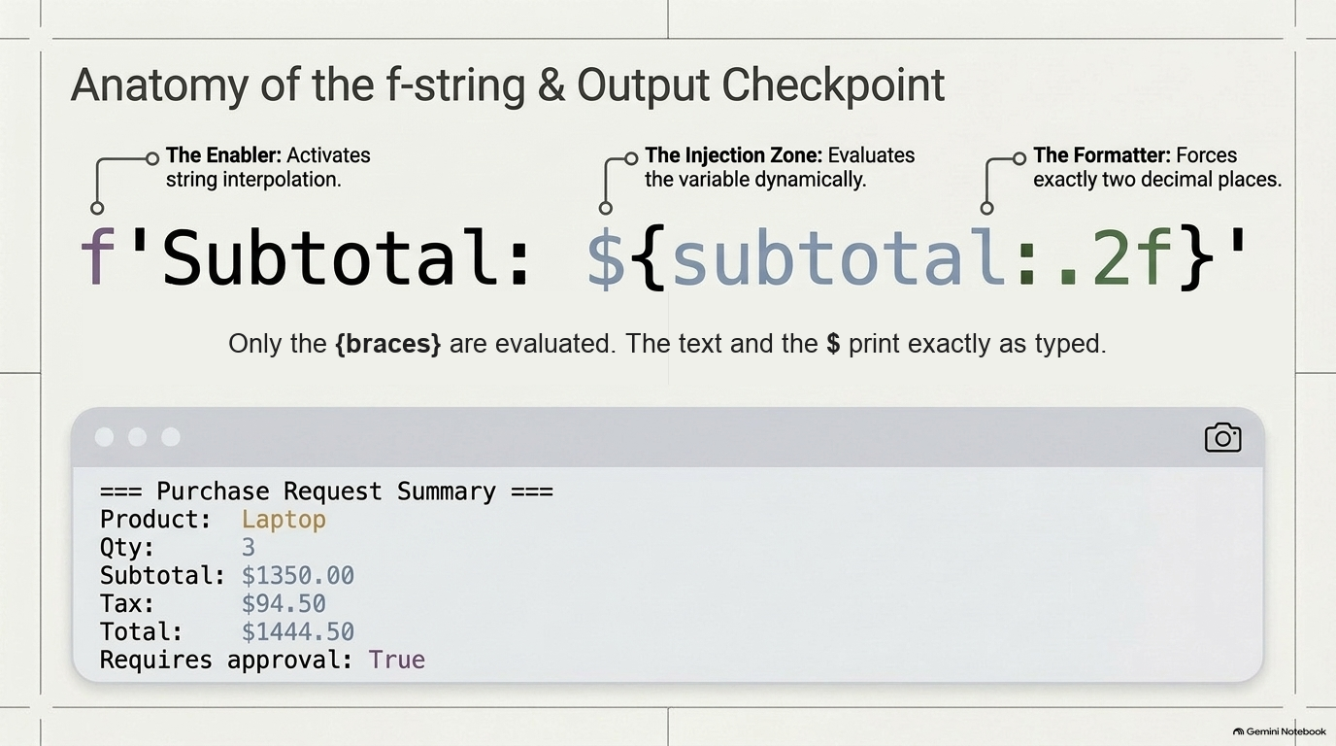
Notes:
SLIDE 7 — Step 5 — Print the formatted summary
LAB GUIDE — EXACT CODE AND EXPECTED OUTPUT
Step 5 — Print the formatted summary
SAY: "Now format it for a human to read — f-strings, with :.2f to force exactly two decimal places on every dollar amount."
DO:
print('=== Purchase Request Summary ===')
print(f'Product: {product_name}')
print(f'Qty: {quantity}')
print(f'Subtotal: ${subtotal:.2f}')
print(f'Tax: ${tax:.2f}')
print(f'Total: ${total:.2f}')
print(f'Requires approval: {requires_approval}')
CHECK:
=== Purchase Request Summary ===
Product: Laptop
Qty: 3
Subtotal: $1350.00
Tax: $94.50
Total: $1444.50
Requires approval: True
Confirm the dollar amounts match the math you said out loud in Step 4.
Screenshot 1 checkpoint
SAY: "Screenshot 1 — the formatted business summary output."
SPOKEN SCRIPT
Now we present the numbers to a human being. That's what an f-string is for.
Look at the big line in the middle: f'Subtotal: ${subtotal:.2f}'. Let's take it apart in three pieces, using the callouts.
The f in front of the quote, the Enabler, tells Python: this string has variables inside it. Without the f, Python prints the curly braces literally, and you'd see the word subtotal instead of a number. That is a very common mistake.
The curly braces are the injection zone. Whatever is inside gets evaluated and dropped into the string. Notice the dollar sign sits outside the braces. It's just a plain character, so it prints literally as a dollar sign. The line under the string on the slide says exactly that: only the braces are evaluated, and everything else prints as typed.
And the :.2f, the Formatter, is the part after the colon. It means, show this as a float with exactly two decimal places. So 94.5 prints as 94.50, the way money should look.
[DO]
Type the seven print lines. First: print('=== Purchase Request Summary ==='). Then f-strings for Product, Qty, Subtotal, Tax, Total, and Requires approval. Use spaces after the labels so the values line up, as on the lab page. Dollar amounts get :.2f. Product and quantity and the approval flag don't need it.
Run it.
[CHECK]
Your output should read: Purchase Request Summary header. Product: Laptop. Qty: 3. Subtotal: $1350.00. Tax: $94.50. Total: $1444.50. Requires approval: True.
Compare that to the math we said out loud a minute ago. 1,350. 94.50. 1,444.50. They match, so our code and our reasoning agree.
If you see the curly braces printed on the screen, you forgot the f. If you see NameError, check the spelling of your variable against the one you defined.
[SCREENSHOT 1 - CHECKPOINT]
The camera icon on the terminal on the slide is the cue. This is Screenshot 1: the formatted business summary. Take it now. Your full terminal output should be visible, including the header line. Save it somewhere you can find it, because you'll upload all three at the end.
Ready for input? Next layer.

Slide 8
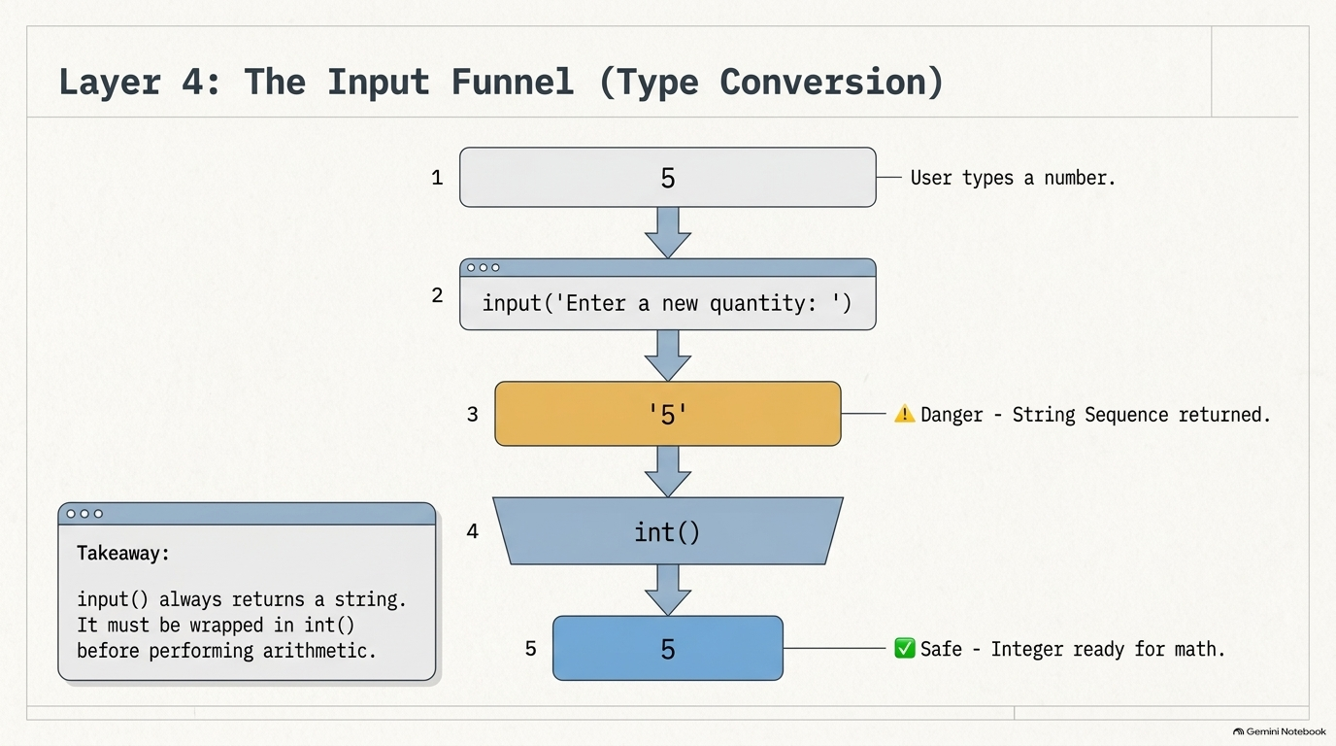
Notes:
SLIDE 8 — Step 6 — Add input() with int() conversion
LAB GUIDE — EXACT CODE AND EXPECTED OUTPUT
SAY: "Now let the user change the quantity at runtime. The critical detail: input() always returns a string, so we wrap it in int() immediately."
DO: Append:
user_qty = int(input('Enter a new quantity: '))
new_total = unit_price * user_qty * 1.07
print(f'New total for {user_qty} units: ${new_total:.2f}')
print(f'Requires approval: {new_total > 1000}')
DO:
python3 week5_lab.py
Type 5 when prompted.
CHECK:
Enter a new quantity: 5
New total for 5 units: $2407.50
Requires approval: True
SPOKEN SCRIPT
Layer 4. So far everything is hard-coded. Now we let a user type something in. Follow the funnel from top to bottom, numbered one to five.
Step 1: the user types a number, the digit 5. Step 2: our code calls input() with the prompt "Enter a new quantity:". Step 3, and this is the yellow warning box: what comes back is not the number 5. It's the string '5', a piece of text that happens to look like a number. The slide flags it: Danger, string sequence returned. Step 4: the int() function, the funnel, converts text to a whole number. Step 5: now it's the integer 5, safe, ready for math.
The takeaway box says it best: input() always returns a string. It must be wrapped in int() before performing arithmetic.
Say that out loud with me: input always returns a string.
If you forget everything else from today, keep that. It applies to every program that reads from a keyboard, forever.
[DO]
Append these lines. user_qty equals int(input('Enter a new quantity: ')). Then new_total equals unit_price times user_qty times 1.07. Multiplying by 1.07 is a shortcut for adding 7 percent tax in one step. Then two prints: an f-string, 'New total for {user_qty} units: ${new_total:.2f}', and an f-string 'Requires approval: {new_total > 1000}'.
Notice we can put an expression, new_total greater than 1000, straight inside the curly braces. Python evaluates it and prints True or False.
Run the script. Everything from before prints again, and then it stops and waits with a blinking cursor. That pause is input() waiting for you. Type 5 and press Enter.
[CHECK]
Enter a new quantity: 5. New total for 5 units: $2407.50. Requires approval: True.
Verify the math: 450 times 5 is 2,250. Times 1.07 is 2,407.50. Correct.
Now, I want to show you what happens when we don't do this right. That's next.

Slide 9
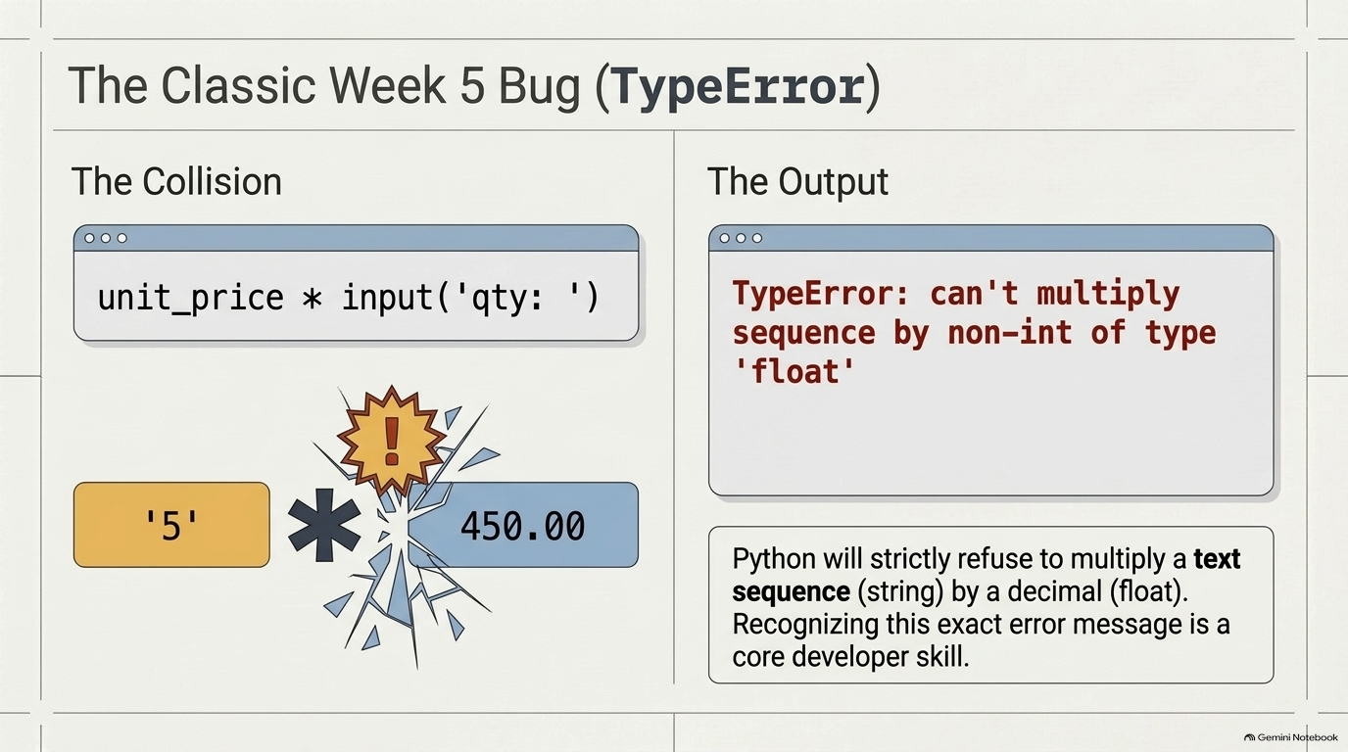
Notes:
SLIDE 9 — Step 7 — Deliberately break it — the classic Week 5 bug
LAB GUIDE — EXACT CODE AND EXPECTED OUTPUT
SAY: "Now let's cause the single most common bug in this lab, on purpose, so you recognize it instantly when it happens by accident. Temporarily remove the int() wrapper."
DO: In a scratch line (don't keep this in your final file), try:
unit_price * input('qty: ')
CHECK:
TypeError: can't multiply sequence by non-int of type 'float'
FIX: "input() returned a string — a sequence of characters — and Python won't multiply a string by a float. That's exactly why Step 6 wraps it in int(). Delete this scratch line and confirm your real week5_lab.py still has the int(input(...)) version from Step 6."
SPOKEN SCRIPT
Now we're going to break our code on purpose. Why? Because the first time most people see this error is at 11 p.m. when it's an emergency. I'd rather you meet it here, in daylight, so you recognize it instantly.
Left side of the slide, "The Collision." A float, 450.00, and a string, '5', are about to be multiplied. The star in the middle is exploding. Python cannot do that.
[DO]
Do not edit your real int(input(...)) line. Instead, add a scratch line at the bottom of the file, or open a Python prompt, and type: unit_price * input('qty: '). Run it. Type 5 when it asks.
[CHECK]
On the right of the slide, "The Output," you should see: TypeError: can't multiply sequence by non-int of type 'float'.
Let's decode that sentence, because error messages are written in a language you can learn. "Sequence" is Python's word for a string, a sequence of characters. "Non-int of type float" refers to the 450.00. Python is saying: I can multiply a string by a whole number, that just repeats it, so '5' times 3 gives '555'. But I can't multiply a string by a decimal. That makes no sense.
The box at the bottom says it plainly: Python will strictly refuse to multiply a text sequence by a decimal. Recognizing this exact error message is a core developer skill.
The fix, which you already wrote in Step 6, is wrapping input in int(). The input returns text, int() turns it into a number, and everything works.
[FIX, very important]
Delete the scratch line now. Confirm that your real file still has int(input('Enter a new quantity: ')). If you leave the broken line in, your script crashes and your submission is broken. Run the script once more to be sure it works cleanly.
Let me see hands: everyone got the TypeError? And everyone deleted the scratch line? Good.

Slide 10
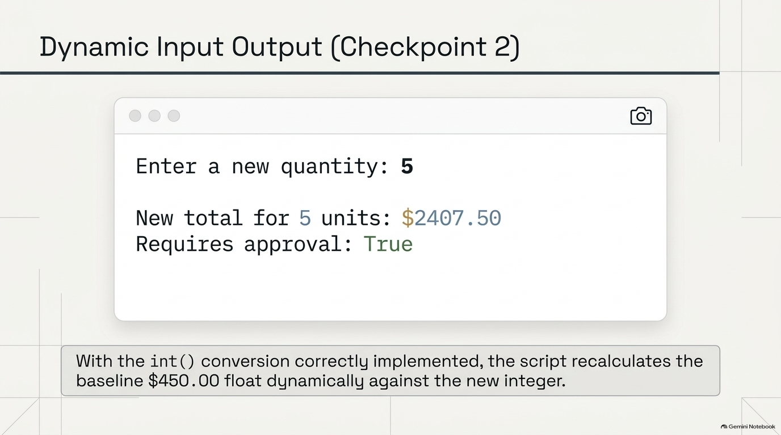
Notes:
SLIDE 10 — Screenshot 2 checkpoint
LAB GUIDE — EXACT CODE AND EXPECTED OUTPUT
SAY: "Screenshot 2 — the complete output including the input prompt and result from Step 6."
SPOKEN SCRIPT
This is Screenshot 2. Take a moment and run your real, corrected script one more time.
What should your screenshot show? The slide has it: the prompt "Enter a new quantity:" with the 5 you typed, then "New total for 5 units: $2407.50," and "Requires approval: True." The camera icon in the corner is your cue.
The caption at the bottom is worth reading. With the int() conversion correctly implemented, the script recalculates the baseline 450 dollar float dynamically against the new integer. In plain words: the script now responds to what a person types, instead of only using numbers we hard-coded.
Make sure the screenshot includes the input prompt line, not just the results. The grader wants to see that you actually entered a value. Also, be sure that it's the corrected version, not the TypeError.
Take Screenshot 2 now and save it next to the first one. I'll give you 30 seconds.
[PAUSE about 30 seconds.]
Next layer: tests.

Slide 11
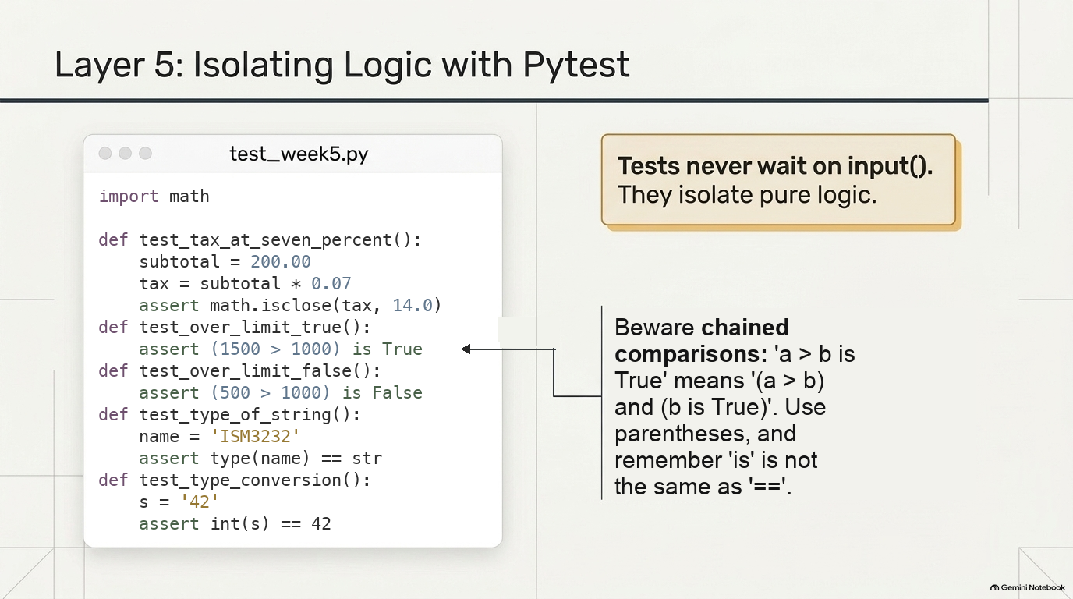
Notes:
SLIDE 11 — Step 8 — Write all five tests
LAB GUIDE — EXACT CODE AND EXPECTED OUTPUT
SAY: "Five tests, each isolating one piece of logic from the script — none of them depend on input(), because tests should never wait on a human typing something."
DO:
mkdir -p tests && touch tests/__init__.py tests/test_week5.py
code tests/test_week5.py
import math
def test_tax_at_seven_percent():
subtotal = 200.00
tax = subtotal * 0.07
assert math.isclose(tax, 14.0)
def test_over_limit_true():
assert (1500 > 1000) is True
def test_over_limit_false():
assert (500 > 1000) is False
def test_type_of_string():
name = 'ISM3232'
assert type(name) == str
def test_type_conversion():
s = '42'
assert int(s) == 42
CHECK: Read two lines closely on camera. First, test_tax_at_seven_percent: "I use math.isclose instead of == because 200.00 * 0.07 is actually 14.000000000000002 in floating point — computers can't store 0.07 exactly, so never compare a computed decimal with ==." Second, test_over_limit_true: "The parentheses matter. Without them, 1500 > 1000 is True is a chained comparison — Python reads it as 1500 > 1000 and 1000 is True, and 1000 is True is False, so the test would fail even though 1500 really is greater than 1000. Parenthesize the comparison so it's evaluated first, then checked against True. Also worth knowing: is is not the same as ==."
SPOKEN SCRIPT
[INSTRUCTOR NOTE - not spoken. The slide, the student lab page (week05_lab.html), and the video script now show the corrected tests: math.isclose(tax, 14.0) with "import math", and parenthesized comparisons. As originally written, three of the five fail (200.00 * 0.07 is 14.000000000000002, and "1500 > 1000 is True" is a chained comparison that evaluates False). The instructor guide (instructor_notes/ism3232/lab_w05.md) still has you type the as-given version live so students hit the failures and diagnose them. Use whichever flow you prefer; if you run the live-debug version, this slide is the "after" picture.]
Final layer. Everything so far, we checked by eye. We ran the script, read the output, and decided whether it looked right. That doesn't scale. Tests let the computer do the checking, every time, in a fraction of a second.
Look at the slide. The file on the left is tests/test_week5.py. Five small functions, and each one's name starts with test_. That's how pytest finds them. Each function contains an assert, a statement that says, "this must be true." If the assert is true, the test passes. If it's false, the test fails.
The yellow box makes the key design point: tests never wait on input(). They isolate pure logic. Imagine running your tests and having the computer freeze, waiting for someone to type a number. A test has to run by itself. That's why our tests re-create the little pieces of logic and don't call the input line.
[DO]
Create the folder and the files: "mkdir -p tests && touch tests/__init__.py tests/test_week5.py", and then "code tests/test_week5.py".
Walk through the five tests.
Test one, test_tax_at_seven_percent. Subtotal is 200, tax is subtotal times 0.07, and we assert it equals 14. This checks our tax math. Notice the slide uses math.isclose, and there's an import math at the top of the file. Floating-point numbers can't represent 0.07 exactly, so 200 times 0.07 actually comes out as 14.000000000000002, and a plain double equals would fail. The lesson: never compare computed floats with exact equality. isclose checks that two numbers are equal within a tiny tolerance.
Test two, test_over_limit_true. Assert that 1500 is greater than 1000. And test three, test_over_limit_false, asserts 500 is not greater than 1000. These check the boolean comparisons. Now the box on the right of the slide, "Beware chained comparisons." Python treats "a > b is True" as a chain: "a > b" AND "b is True". Since "1000 is True" is False, the unparenthesized version would fail even though 1500 really is greater than 1000. That's why the slide wraps the comparison in parentheses, so it's evaluated first and then checked. And remember, "is" is not the same as "==".
Test four, test_type_of_string. name equals 'ISM3232', and assert type(name) equals str. That reuses the type() habit from earlier.
Test five, test_type_conversion. s equals '42', and assert int(s) equals 42. This proves the conversion behavior that fixed our TypeError.
Type them carefully, and don't forget the import math line at the very top. Each function needs the word def, the parentheses, a colon, and an indented body. Two blank lines between functions keeps ruff happy.
Everyone has five functions? Now we run them.

Slide 12
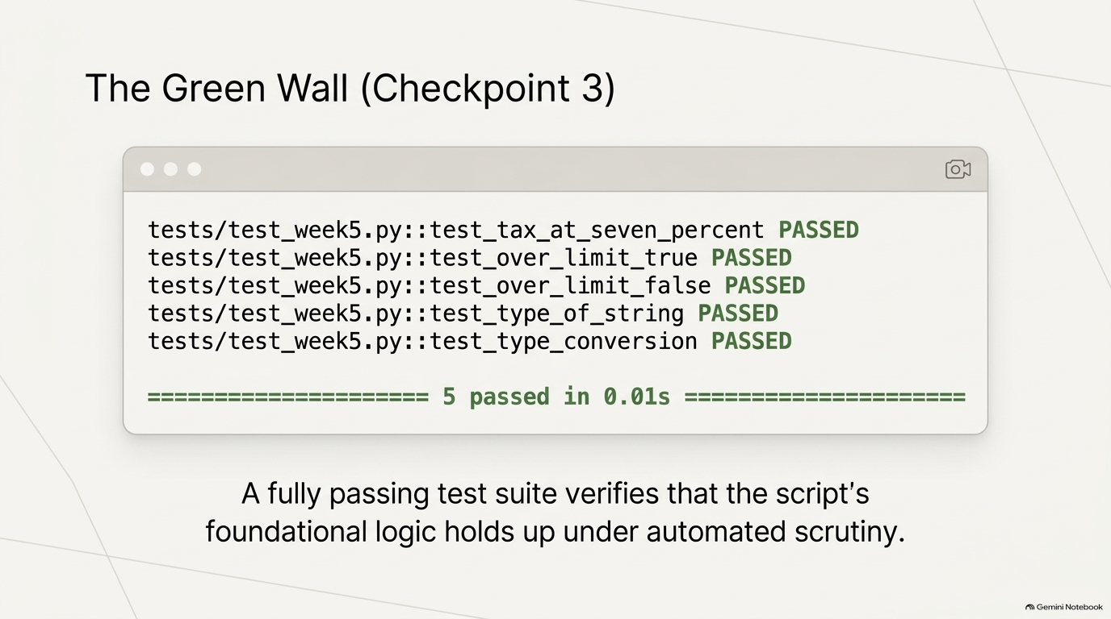
Notes:
SLIDE 12 — Step 9 — Run pytest and confirm all green
LAB GUIDE — EXACT CODE AND EXPECTED OUTPUT
Step 9 — Run pytest and confirm all green
DO:
pytest -v
CHECK:
tests/test_week5.py::test_tax_at_seven_percent PASSED
tests/test_week5.py::test_over_limit_true PASSED
tests/test_week5.py::test_over_limit_false PASSED
tests/test_week5.py::test_type_of_string PASSED
tests/test_week5.py::test_type_conversion PASSED
======================== 5 passed in 0.01s ========================
Screenshot 3 checkpoint
SAY: "Screenshot 3 — pytest -v with all five tests green."
SPOKEN SCRIPT
In your terminal, make sure you're in the project folder, at the top, not inside tests. Then run: pytest -v. The -v means verbose, so it prints one line per test.
[CHECK]
The goal, shown on the slide, is "the green wall": five lines, each ending in PASSED, and the bottom line reading "5 passed in 0.01s." Test names in order: test_tax_at_seven_percent, test_over_limit_true, test_over_limit_false, test_type_of_string, test_type_conversion.
[If any test shows FAILED, this is a teachable moment. Say:] "A red F is not a disaster, it's the tool doing its job. Read the assertion output. Pytest shows you both sides of the failed comparison. Check that you typed the tests exactly as on the previous slide, with the import math at the top, math.isclose on the tax, and the parentheses around the comparisons. Fix the line and run it again."
Read the last line of the slide: "A fully passing test suite verifies that the script's foundational logic holds up under automated scrutiny." Why do we care? Because next month, when you change the tax rate or add a feature, you run one command and immediately know whether you broke something.
[SCREENSHOT 3 - CHECKPOINT]
The camera icon again. Screenshot 3 is the pytest -v output with all five tests green. It has to show all five test names and the "5 passed" line. Don't crop the summary. If yours has red in it, don't take the screenshot yet. Fix it first.
Take it now and check that you have three screenshots in total. Then we'll ship it.

Slide 13
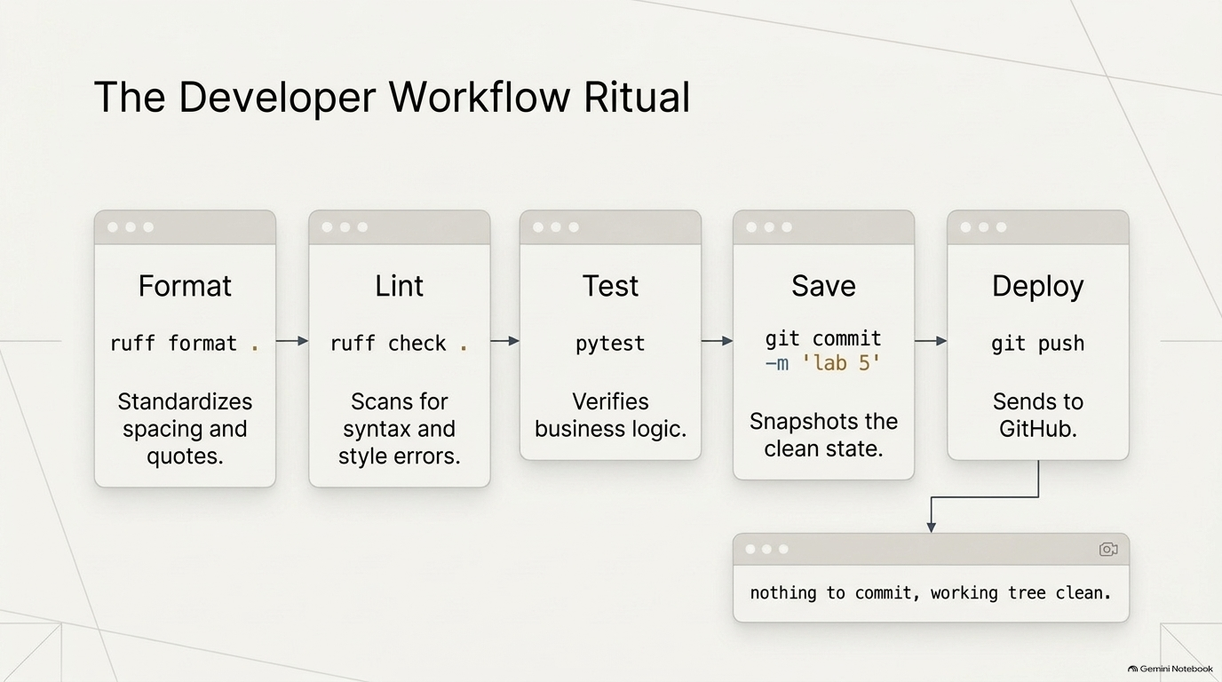
Notes:
SLIDE 13 — Step 10 — Run the full ritual
LAB GUIDE — EXACT CODE AND EXPECTED OUTPUT
SAY: "Same ten-step ritual from Week 4, now on this module."
DO:
ruff format .
ruff check .
pytest
git status
git add .
git commit -m 'lab 5: variables types operators'
git push
CHECK: ruff check reports no errors, pytest shows 5 passed, and git push completes without error. Follow with git status — it should say "nothing to commit, working tree clean."
SPOKEN SCRIPT
We're at the last step. This is the ritual you've been building since Week 4, and by now you should almost be able to do it without looking. The slide shows five boxes, left to right.
Format: "ruff format ." The dot means "this whole folder." It standardizes spacing and quotes, so your code looks consistent.
Lint: "ruff check ." It scans for syntax and style errors. Think of it as a spell-checker for code.
Test: "pytest." It verifies your business logic. Here we want to see "5 passed."
Save: git commit with the message 'lab 5'. It snapshots the clean state. The commit message has to include "lab 5." That's a checklist item.
Deploy: "git push." It sends everything to GitHub.
The order matters. Format first, so lint doesn't complain about spacing. Lint before test, so obvious mistakes are caught first. Test before commit, so you never save broken work.
[DO]
Type the commands one at a time. "ruff format ." and then "ruff check ." Then "pytest." Then "git status" to see what's about to be saved. You should see week5_lab.py, the tests folder, requirements.txt, and .gitignore, and you should NOT see .venv. If .venv is listed, your .gitignore is wrong, so stop and let me know.
Then "git add ." and "git commit -m 'lab 5: variables types operators'". Then "git push."
[CHECK]
ruff check reports no errors. pytest shows 5 passed. git push finishes without an error. Then run "git status" one more time. The message in the box at the bottom right of the slide is what you want: "nothing to commit, working tree clean."
If git push is rejected or asks for a login, raise your hand. That is nearly always an authentication or a branch issue, and I'll come to you.
Go ahead and finish the ritual now.

Slide 14
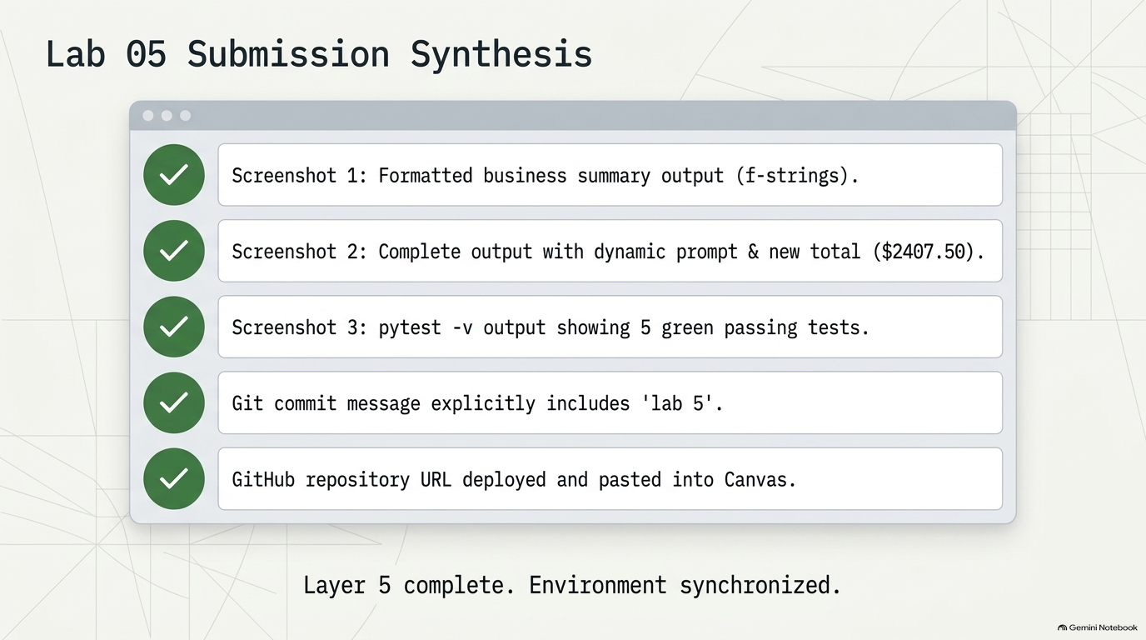
Notes:
SLIDE 14 — SUBMISSION CHECKLIST
LAB GUIDE — EXACT CODE AND EXPECTED OUTPUT
• [ ] Screenshot 1: formatted business summary output
• [ ] Screenshot 2: complete output including the input prompt
• [ ] Screenshot 3: pytest -v with all five tests green
• [ ] Git commit message includes "lab 5"
• [ ] GitHub repository URL pasted into Canvas
SPOKEN SCRIPT
Last slide. This is everything you need to turn in, so let's confirm the five items.
Screenshot 1: the formatted business summary output, the f-string report.
Screenshot 2: the complete output with the dynamic prompt and the new total, $2407.50, meaning you typed 5 and it came back correctly.
Screenshot 3: pytest -v showing five green passing tests.
Item four: your Git commit message includes "lab 5." Go look at it with "git log --oneline", and check it's there.
Item five: your GitHub repository URL pasted into Canvas. Open your repo in the browser first and make sure your newest files show up, week5_lab.py and the tests folder. Then copy the URL from the address bar, not from the terminal, and paste it into the Canvas submission.
The bottom line says "Layer 5 complete. Environment synchronized." Let's recap what you did today, because it's a lot. You made a clean environment. You used four data types. You did arithmetic and formatted it. You took user input and handled the string trap. You wrote automated tests. And you shipped it with a professional workflow.
If any of your three screenshots is missing, it's not too late, so go back and re-run whatever you need. I'll be walking around. Stay for questions, and thank you all, good work today.

