Slide 1
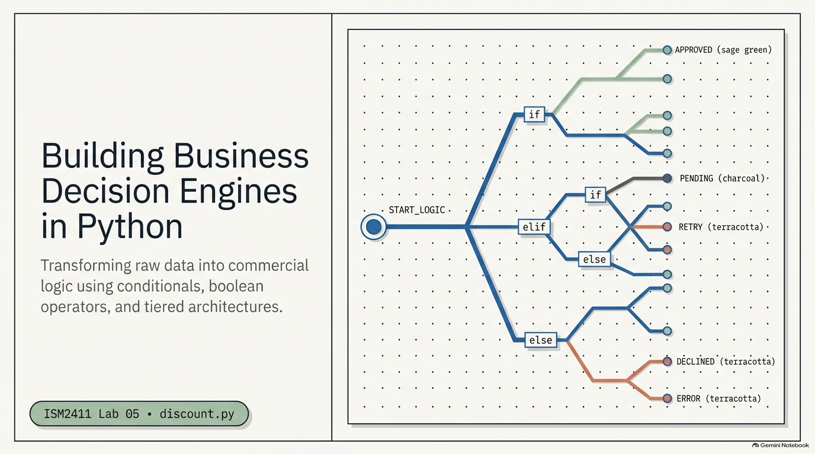
Notes:
SLIDE 1 — INTRO
LAB GUIDE — EXACT CODE AND EXPECTED OUTPUT
SAY: "Lab 5 — the tiered discount calculator. This is the lab where if/elif/else stops being an abstract syntax lesson and becomes actual business decision logic — the same shape as tax brackets, shipping tiers, and loyalty programs you interact with every day."
SPOKEN SCRIPT
Good [morning/afternoon], everybody. Go ahead and get settled, open your terminal and your code editor, and let's get started.
Today is Lab 5. The title on the screen is "Building Business Decision Engines in Python." That sounds fancy, so let me translate it. A decision engine is just a program that looks at some data and decides what to do about it. Does this customer get a discount? Does this order need a manager's signature? Is this transaction suspicious? Businesses make those calls millions of times a day, and today you are going to write the code that makes them.
Look at the picture on the right. Everything starts at START_LOGIC on the left, and then the path splits: if, elif, else. Every path ends at an outcome: approved, pending, retry, declined, error. That branching tree is the whole lab. By the end of class you will have built one.
Everything today goes into one file called discount.py. Please create it now, lowercase, exactly that spelling, because the filename is on your submission checklist and a misspelled filename is the most avoidable way to lose points today.
[PAUSE until everyone has an empty discount.py open.]
Let's start with why this matters.

Slide 2
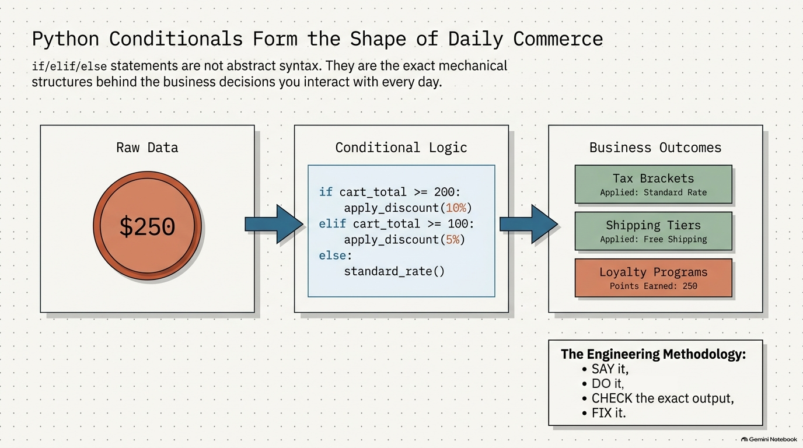
Notes:
SLIDE 2 — CONDITIONALS FORM THE SHAPE OF DAILY COMMERCE
SPOKEN SCRIPT
Read the title with me: "Python Conditionals Form the Shape of Daily Commerce." I want you to stop thinking of if, elif, and else as syntax you memorize for an exam. They are the mechanical structure behind decisions you run into every single day.
Walk left to right across the diagram. On the left is raw data, a cart total of 250 dollars. That number by itself does nothing. In the middle is the conditional logic: if the cart total is at least 200, apply a discount; elif it's at least 100, apply a 5 percent discount; else, standard rate. On the right are the business outcomes: tax brackets, shipping tiers, loyalty programs. The arrows matter. Data goes in, logic decides, and a business outcome comes out.
Ask the room: "Where have you seen this this week?" Take two or three answers. Likely ones are free shipping over a certain amount, a streaming plan that changes at a certain number of screens, or a tax bracket. Tell them: "Every one of those is an if/elif/else somebody wrote."
Now the box in the bottom right, the engineering methodology. This is how we will work all lab, and it is the same rhythm as the earlier labs. Say it, do it, check it, fix it. I explain what we are about to do. I do it and you do it alongside me. Then we check the exact output against what the lab says it should be. And if it doesn't match, we fix it before we move on. Do not skip the check step. If your output says 10 percent and mine says 10 percent, we are in the same place. If it doesn't match, raise your hand right then, not after five more exercises.
Any questions before we write code? Good. Exercise 1.

Slide 3
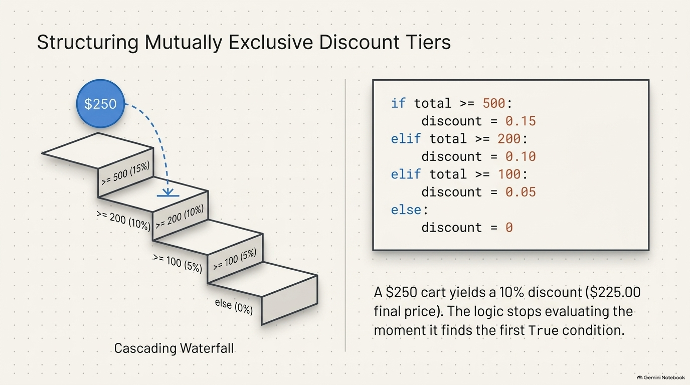
Notes:
SLIDE 3 — EXERCISE 1 — Discount Tiers
LAB GUIDE — EXACT CODE AND EXPECTED OUTPUT
SAY: "Four tiers, checked from highest threshold to lowest — order matters here, and we'll see why in a second."
DO: Starting from the given scaffold:
total = float(input("Enter cart total: $"))
# Add your if/elif/else here
discount = 0 # replace with correct logic
final = total * (1 - discount)
print(f"Discount: {discount*100:.0f}%")
Fill in the logic:
total = float(input("Enter cart total: $"))
if total >= 500:
discount = 0.15
elif total >= 200:
discount = 0.10
elif total >= 100:
discount = 0.05
else:
discount = 0
final = total * (1 - discount)
print(f"Discount: {discount*100:.0f}%")
print(f"Final price: ${final:,.2f}")
python3 discount.py
Enter 250.
CHECK:
Enter cart total: $250
Discount: 10%
Final price: $225.00
SAY: "Trace it: 250 fails the >= 500 check, but passes >= 200 — so elif stops right there at 10%, never even checking the >= 100 branch. That's exactly why the order is highest-threshold-first: if you checked >= 100 first, a $250 cart would incorrectly stop at the 5% tier instead of reaching the 10% one."
SPOKEN SCRIPT
This is Exercise 1, the discount tier ladder. Four tiers. Total of 500 or more gets 15 percent. 200 or more gets 10 percent. 100 or more gets 5 percent. Under 100 gets nothing.
Look at the staircase on the left. The 250 dollar ball drops in at the top. It is checked against the top step first, "greater than or equal to 500," and that's a no. So it falls to the next step, "greater than or equal to 200," and that's a yes. The dashed arrow shows it landing there, and it stops. It never touches the 100 step. That is what the caption is telling you: the logic stops evaluating the moment it finds the first true condition.
[DO - type along while they follow]
Start with the scaffold from the lab page. Line one: total equals float of input, with the prompt "Enter cart total: dollar sign." Notice we wrap input in float, because input always gives us text, and we need a number.
Now write the ladder. "if total >= 500:" indent, "discount = 0.15". "elif total >= 200:" indent, "discount = 0.10". "elif total >= 100:" indent, "discount = 0.05". "else:" indent, "discount = 0".
Watch the colons and the indentation. Every one of those lines ends in a colon, and every body is indented four spaces. If Python throws an IndentationError or a SyntaxError, that is the first place to look.
Below the ladder: "final = total * (1 - discount)". Then two prints: an f-string showing the discount as a percentage, "discount times 100" with ":.0f", and one showing the final price with ":,.2f".
Save it and run it: python3 discount.py. When it asks, type 250.
[CHECK]
You should see: Discount: 10%, and then Final price: $225.00.
Say it out loud with me, a trace: 250 fails the "at least 500" test. It passes "at least 200." So the elif chain stops right there at 10 percent. 250 times 0.90 is 225.
If yours says 5 percent, you likely wrote the tiers in the wrong order. If yours says 0, check that your comparisons use greater-than-or-equal and not a typo like "=>". Raise your hand if you're stuck.
Before we go on, I want you to test one more: run it again with 500. Because we used "at least," exactly 500 lands in the 15 percent tier. Boundaries are where business rules go wrong, so always test the edge.
[PAUSE for everyone to confirm 10% / $225.00.]
Next slide: why the order matters so much.

Slide 4
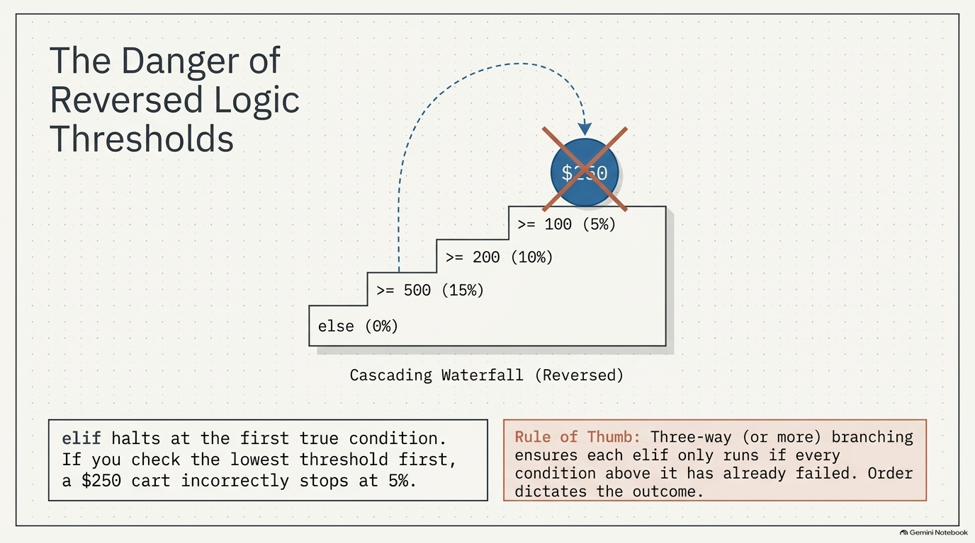
Notes:
SLIDE 4 — THE DANGER OF REVERSED LOGIC THRESHOLDS
SPOKEN SCRIPT
This slide is the most important idea of the first half of the lab, so I want your full attention.
What you're looking at is the same staircase, flipped. The tiers are stacked with the lowest threshold, 100 dollars and 5 percent, at the top. Now watch the 250 dollar cart. It hits "at least 100" first. That is true. And so Python stops there. The big red X on the ball is what happens to your customer: they were owed 10 percent and they got 5.
Read the box on the bottom left with me: "elif halts at the first true condition. If you check the lowest threshold first, a 250 dollar cart incorrectly stops at 5 percent."
Here's the thing I want you to notice. Nothing crashed. No error. Python did exactly what you told it to. The program ran cleanly and gave the wrong answer, and those are the most dangerous bugs, because nobody knows to look for them. In a real company that is a customer being overcharged, or a company giving away margin.
Now the red box, the rule of thumb: "Three-way or more branching ensures each elif only runs if every condition above it has already failed. Order dictates the outcome."
Say it back to yourself in plain English: by the time you reach an elif, you already know everything above it was false. That is what lets a chain of conditions stay short.
Practical rule for today: when the conditions are thresholds, order them from most restrictive to least restrictive. Highest first for greater-than checks.
Quick check for understanding. Ask: "If I reversed my code, what would a 600 dollar cart get?" Wait for someone to say 5 percent. "Right, it would pass 'at least 100' and stop."
Good. Exercise 2.

Slide 5
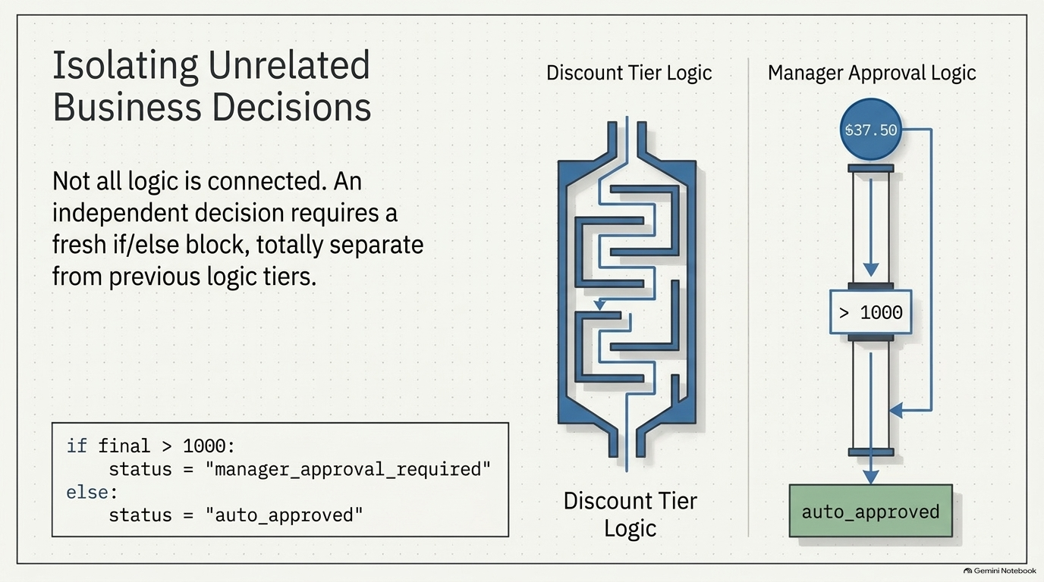
Notes:
SLIDE 5 — EXERCISE 2 — Approval Flag
LAB GUIDE — EXACT CODE AND EXPECTED OUTPUT
SAY: "A second, independent decision — nothing to do with the discount tier, just a threshold on the final price."
DO:
if final > 1000:
status = "manager_approval_required"
else:
status = "auto_approved"
print(f"Status: {status}")
python3 discount.py
Enter 637.50 as the cart total directly this time, or trace it through from a total that produces final = 637.50.
CHECK:
Status: auto_approved
637.50 doesn't exceed 1000, so it auto-approves.
SPOKEN SCRIPT
Exercise 2 is short but it teaches a design habit. Read the sentence on the left: "Not all logic is connected. An independent decision requires a fresh if/else block, totally separate from previous logic tiers."
Look at the two diagrams. On the left is the discount tier logic, drawn as a maze, all those branches we just built. On the right is the manager approval logic, and it is a straight pipe. A number comes in, it hits one question, "is it over 1000?", and it goes one of two ways. The number on the slide, 37.50, is just a placeholder for the picture. Ours will be different.
The point: approval has nothing to do with which discount tier you were in. It only asks about the final price. So we do not tack it onto the ladder. We write a brand new if/else underneath, at the same indentation level as the first block.
[DO]
Under your f-string prints, type: "if final > 1000:" indent, status equals "manager_approval_required". "else:" indent, status equals "auto_approved". Then print an f-string: "Status: {status}".
Notice we use greater-than, not greater-than-or-equal. Exactly 1000 dollars is auto-approved. That's a business rule, and the difference is a single character.
To test it, we want the final price to be 637.50. The easiest way is to temporarily set final equal to 637.50 on the line right above this if statement, or work backwards to a cart total that produces it. Either is fine. Run it.
[CHECK]
Status: auto_approved. Because 637.50 does not exceed 1000.
For extra credit, change final to 1200 and run it again. You should get manager_approval_required. Change it back after.
One heads-up: a later exercise recalculates final, so don't be surprised if it changes value as the file grows. That is expected.
Lesson to keep: one decision, one block. When two rules are independent, keep them independent. It makes each one easy to read and easy to change later.

Slide 6
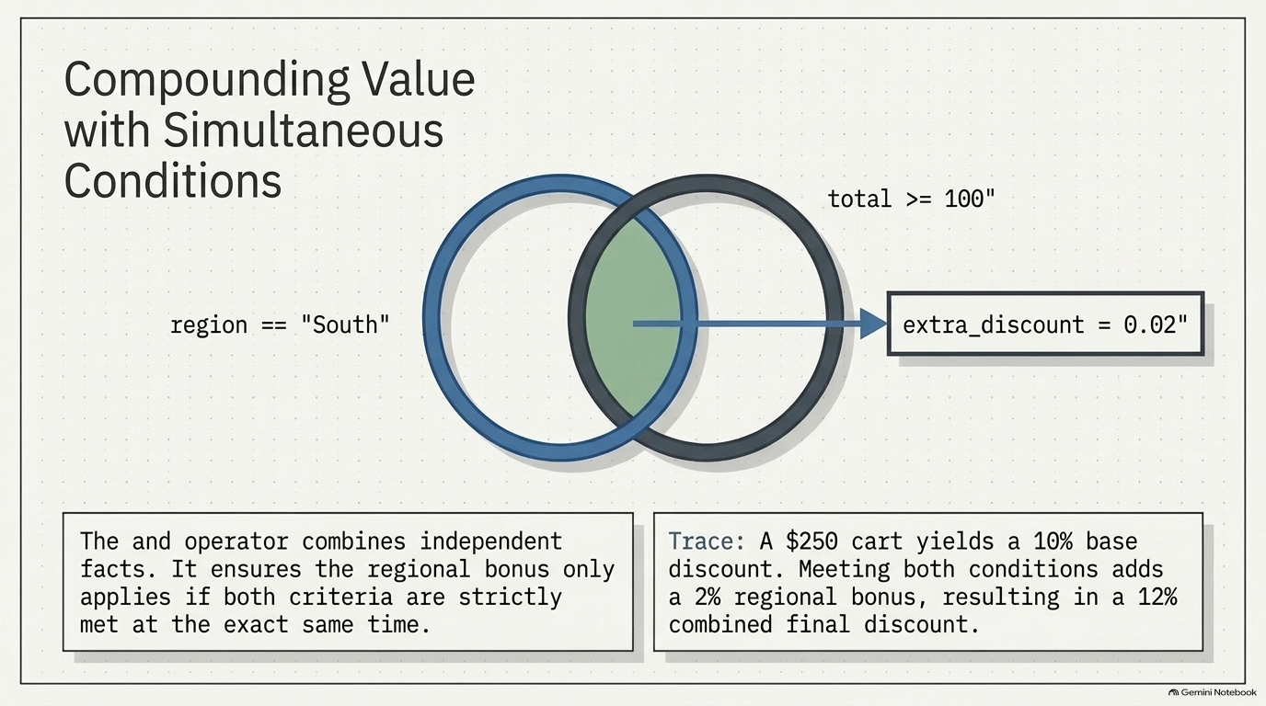
Notes:
SLIDE 6 — EXERCISE 3 — Combine Conditions
LAB GUIDE — EXACT CODE AND EXPECTED OUTPUT
SAY: "Now a regional bonus, layered on top of the tier discount — and this is where and combines two separate facts into one condition."
DO:
region = "South"
extra_discount = 0
if region == "South" and total >= 100:
extra_discount = 0.02
print("Region bonus applied: additional 2% off")
final_discount = discount + extra_discount
final = total * (1 - final_discount)
print(f"Final discount: {final_discount*100:.0f}%")
print(f"Final price: ${final:,.2f}")
python3 discount.py
Enter 250 as the total, with region = "South".
CHECK:
Region bonus applied: additional 2% off
Final discount: 12%
Final price: $220.00
SAY: "Trace it: tier discount from Exercise 1 was 10% for a $250 cart. The region bonus adds 2%, since both region == \"South\" and total >= 100 are true — 12% combined. 250 × (1 - 0.12) = 250 × 0.88 = 220.00."
SPOKEN SCRIPT
Exercise 3. We're adding a regional bonus on top of the tier discount. Customers in the South who spend at least 100 dollars get an extra 2 percent off.
Look at the diagram. Two circles overlap. The left circle is "region equals South." The right circle is "total at least 100." The green sliver in the middle where they overlap is the only place the extra discount gets awarded. That is exactly what the word "and" does. Both facts have to be true at the same time.
Read the box on the bottom left: "The and operator combines independent facts. It ensures the regional bonus only applies if both criteria are strictly met at the exact same time."
[DO]
First, near the top of the section, create the variable: region equals "South", with a capital S. Case matters. A lowercase "south" would not equal "South", so type it exactly.
Then set extra_discount equal to 0 as a default. That matters: we always want the variable to exist, even when the bonus does not apply.
Then: "if region == "South" and total >= 100:" indent, extra_discount equals 0.02, and a print, "Region bonus applied: additional 2% off".
Now combine: final_discount equals discount plus extra_discount. Recalculate final equals total times one minus final_discount. Then print the final discount as a percentage and the final price.
Slow down on one thing: it is two equals signs for comparison and one equals sign for assignment. The single most common typo in this lab is writing one equals sign inside the if.
Run it with 250.
[CHECK]
Region bonus applied: additional 2% off. Final discount: 12%. Final price: $220.00.
The trace is on the slide: 250 earns 10 percent from the tier. Both bonus conditions are true, so we add 2 percent. 12 percent total. 250 times 0.88 is exactly 220.
Test the other direction too. Change region to "North" and run again. The bonus line should not print, and you should be back to 10 percent and 225. Proving that the bonus does not fire is just as important as proving that it does.
Questions? Good.

Slide 7
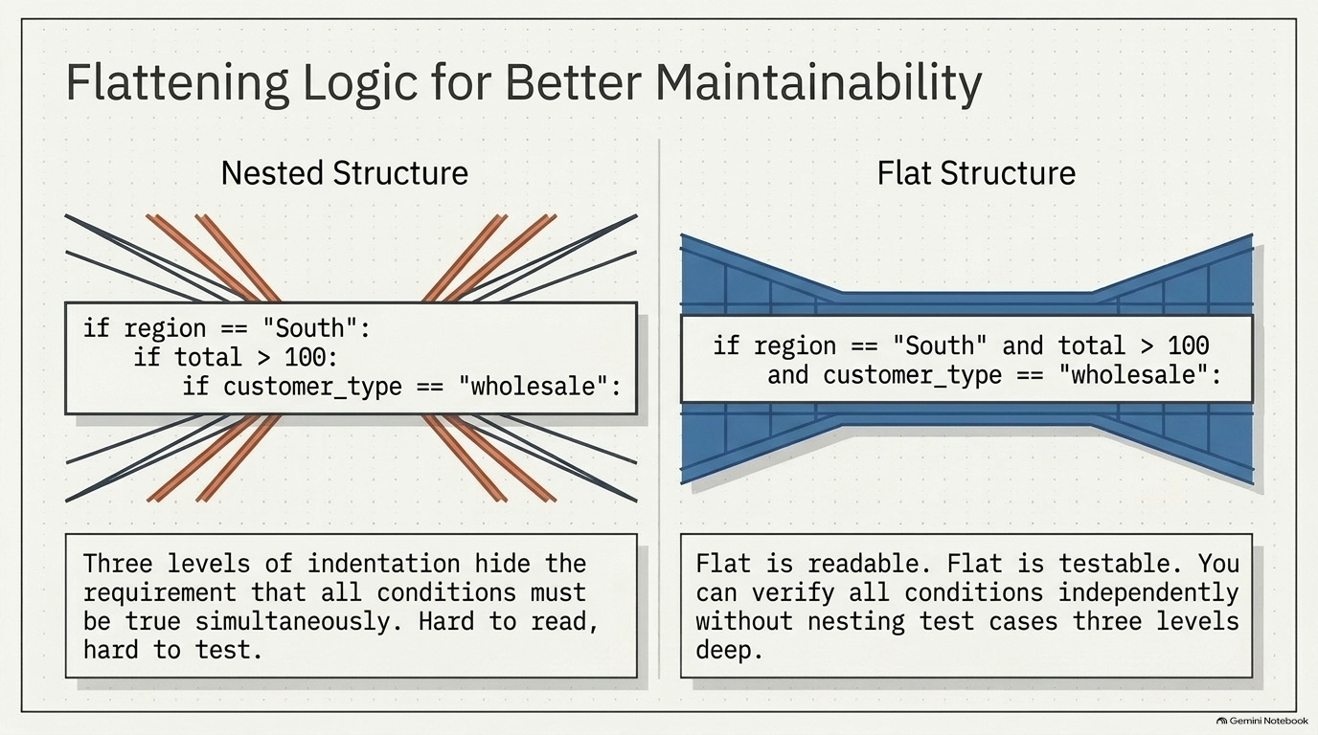
Notes:
SLIDE 7 — EXERCISE 4 — Refactor a Nested If
LAB GUIDE — EXACT CODE AND EXPECTED OUTPUT
SAY: "Now a code-quality exercise — the same logic, written two different ways, and one of them is clearly easier to read."
DO: Start with the nested version:
# Nested version — the one to rewrite
if region == "South":
if total > 100:
if customer_type == "wholesale":
extra_discount = 0.03
Rewrite it flat, using and:
# Flat version
if region == "South" and total > 100 and customer_type == "wholesale":
extra_discount = 0.03
# Flat is easier to read and test: all three conditions are visible on one line,
# and you can test each condition independently without needing to nest
# test cases three levels deep to reach the code that actually runs.
CHECK: Run both versions with region = "South", total = 150, customer_type = "wholesale" — confirm both produce extra_discount = 0.03. They're logically identical; only the readability differs. That's the lesson: three levels of indentation hide the fact that all three conditions must be true simultaneously, while the flat and chain makes that requirement visible at a glance.
SPOKEN SCRIPT
Exercise 4 is a different kind of exercise. There is no new Python syntax here. This one is about writing code that other people, and you in six months, can read.
Look at the left side of the slide. Nested structure. Three if statements, each indented inside the last: region is South, then total over 100, then customer type is wholesale. The slide draws it as a tangle of crossed lines, and that's fair. To find the line that actually does the work, your eye has to climb down three levels, and you have to remember that all three conditions above it must be true.
The right side is the flat version. One line: "if region == South and total > 100 and customer_type == wholesale". It's drawn as a clean bridge. Same logic, same result, but every requirement is visible in one glance.
[DO]
Type the nested version first so we all have it. Then, below it or commented out, write the flat version with and between all three conditions. Set up test values so both can run: region equals "South", total equals 150, customer_type equals "wholesale". Give extra_discount equals 0.03 in the body.
Add a comment above the flat version in your own words explaining why it's better. The lab requires that comment, and it is on your submission checklist. Something like: "Flat is easier to read and test because all three conditions are visible on one line."
[CHECK]
Run both versions with those test values. Both should set extra_discount to 0.03. They are logically identical. The only difference is how easy they are to read.
Now read the two boxes on the slide. Left: "Three levels of indentation hide the requirement that all conditions must be true simultaneously. Hard to read, hard to test." Right: "Flat is readable. Flat is testable. You can verify all conditions independently without nesting test cases three levels deep."
Say that testable point in plain English: with nesting, to test the innermost line you have to build a test case that satisfies all three levels. With the flat version, you change one value at a time and see which condition breaks it.
Small note: this exercise uses total greater than 100, not greater-than-or-equal like Exercise 3. It's a different rule, so read the condition carefully.
Next: three bands.

Slide 8
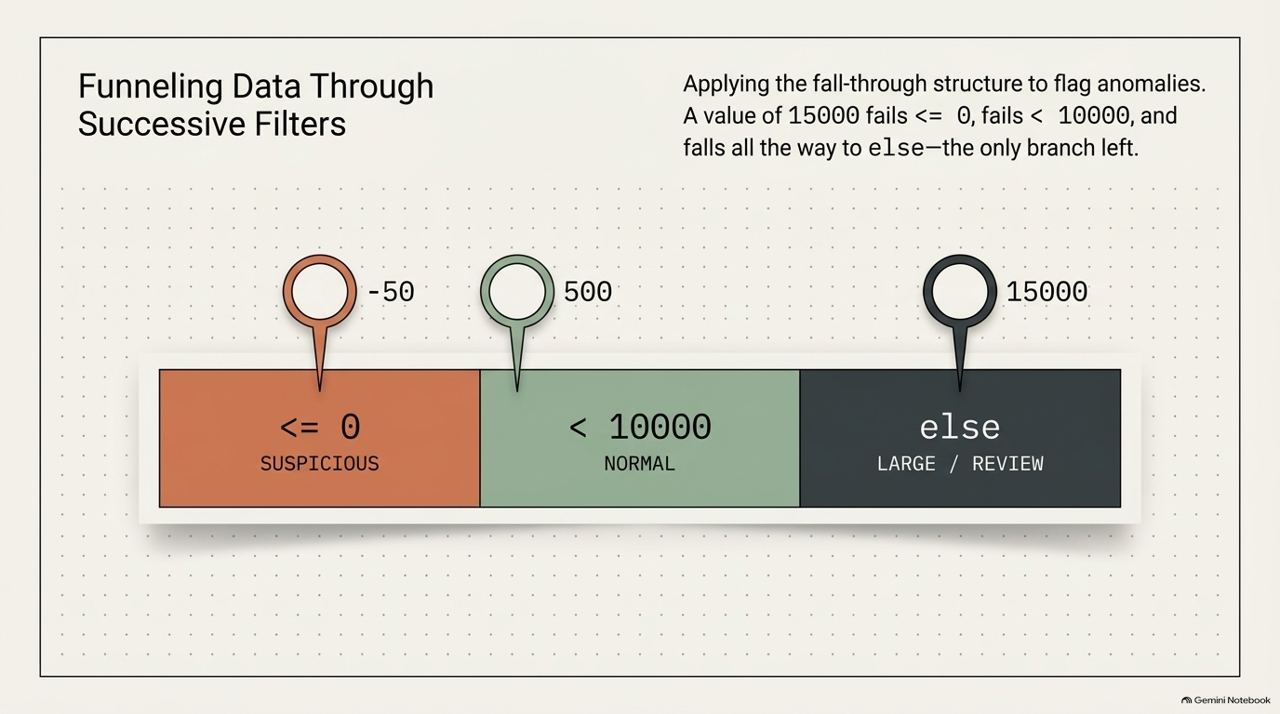
Notes:
SLIDE 8 — EXERCISE 5 — Anomaly Flagging
LAB GUIDE — EXACT CODE AND EXPECTED OUTPUT
SAY: "Three bands this time, not two — and notice the order again matters, same as Exercise 1."
DO:
amount = -50 # test with -50, then 500, then 15000
if amount <= 0:
print("SUSPICIOUS")
elif amount < 10000:
print("NORMAL")
else:
print("LARGE — REVIEW REQUIRED")
python3 discount.py
Run it three times, changing amount each time to -50, then 500, then 15000.
CHECK:
-50 → SUSPICIOUS
500 → NORMAL
15000 → LARGE — REVIEW REQUIRED
SAY: "For amount = 15000: it fails <= 0, fails < 10000, so it falls all the way to else — the only branch left. That's the pattern with three-way branching: each elif only runs if every condition above it already failed."
SPOKEN SCRIPT
Exercise 5. This time we're flagging anomalies in transaction amounts, and there are three bands, not two.
Look at the bar. Left band, orange: less than or equal to 0, SUSPICIOUS. Middle band, green: less than 10,000, NORMAL. Right band, dark: everything else, LARGE, REVIEW REQUIRED. The three pins are our three test values: negative 50, 500, and 15,000.
And notice, the order matters again, same lesson as Exercise 1. Read the text at the top right: a value of 15,000 fails "less than or equal to 0," fails "less than 10,000," and falls all the way through to else, the only branch left.
Why do we flag zero and negative amounts? In real payment systems a negative purchase amount or a zero-dollar charge is a classic red flag, a data-entry error or an attempt to exploit a refund bug. So the very first thing we check is whether the number is even valid.
[DO]
Type: amount equals negative 50. Then "if amount <= 0:" indent, print "SUSPICIOUS". "elif amount < 10000:" indent, print "NORMAL". "else:" indent, print "LARGE — REVIEW REQUIRED".
Run it three times. First with negative 50. Then edit the value to 500 and run again. Then 15000 and run again.
[CHECK]
Negative 50 gives SUSPICIOUS. 500 gives NORMAL. 15000 gives LARGE, REVIEW REQUIRED.
Here's the logic to say out loud. Each elif only runs if everything above it already failed. So when we reach the "less than 10,000" line we already know the amount is greater than zero. We do not need to write "greater than 0 and less than 10,000". The structure carries that knowledge for us. That's why chains stay short and readable.
Boundary question for the room: "What does exactly 10,000 give you?" Let them work it out. Answer: it fails "less than 10,000," so it falls to else and gets LARGE. And exactly zero? It's SUSPICIOUS, because of the "less than or equal to." Whether those are the right business rules is a decision for the business, but you should always know which way your code breaks the tie.
On to the last exercise.

Slide 9
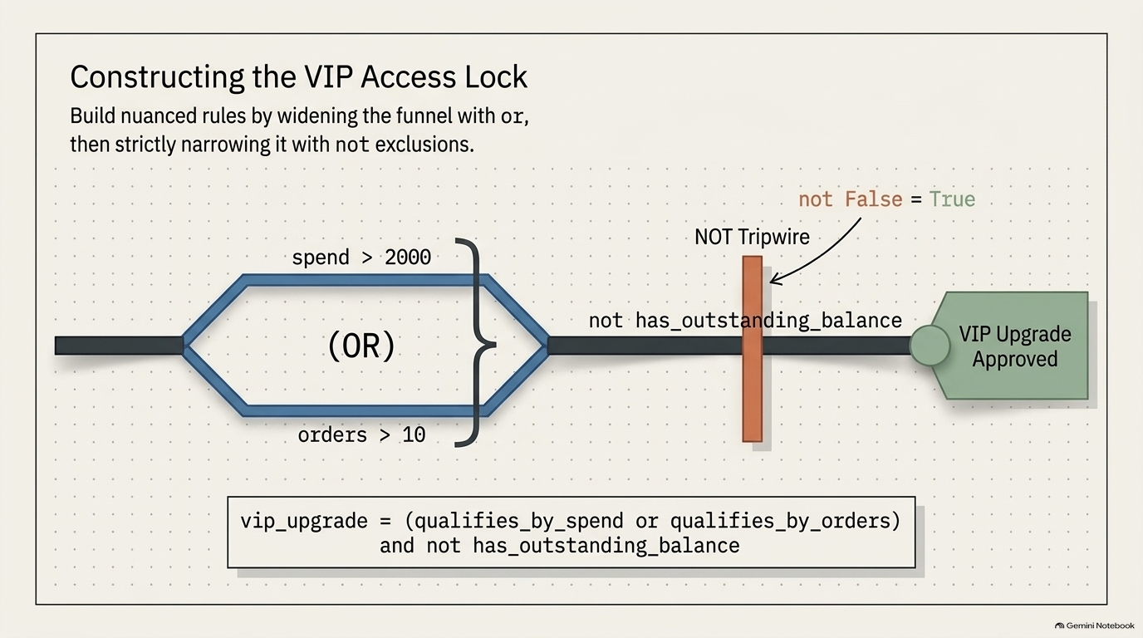
Notes:
SLIDE 9 — EXERCISE 6 — Boolean Logic
LAB GUIDE — EXACT CODE AND EXPECTED OUTPUT
SAY: "One condition built from or, then narrowed with not — a two-part business rule."
DO:
total_spent_this_year = 2500
orders_this_year = 6
has_outstanding_balance = False
qualifies_by_spend = total_spent_this_year > 2000
qualifies_by_orders = orders_this_year > 10
vip_upgrade = (qualifies_by_spend or qualifies_by_orders) and not has_outstanding_balance
print(f"VIP upgrade: {vip_upgrade}")
python3 discount.py
CHECK:
VIP upgrade: True
SAY: "Trace it: spend of $2,500 clears $2,000, so qualifies_by_spend is True — that alone is enough for the or to be True, regardless of the order count. Then not has_outstanding_balance — since there's no outstanding balance, not False is True, and True and True gives the final True. Now flip has_outstanding_balance to True and re-run — even with the same spend and order numbers, the customer no longer qualifies."
SPOKEN SCRIPT
Exercise 6 is the final coding exercise: building a VIP upgrade rule out of or, and, and not.
Follow the picture from the left. The pipe splits into two lanes that reconnect: spend greater than 2000, or orders greater than 10. That is the "or" section, the wide funnel. Either lane gets you through. Then the pipe reaches an orange gate, the NOT tripwire. It reads: "not has_outstanding_balance". If the customer owes us money, the gate is closed, and nobody gets to the VIP Upgrade Approved tag on the right no matter how much they've spent. The small label above the gate says "not False equals True," and that is exactly how it opens.
So the slide's title summarizes the technique: widen with or, then narrow with not.
[DO]
Set up three inputs. total_spent_this_year equals 2500. orders_this_year equals 6. has_outstanding_balance equals False, with a capital F.
Then break the rule into named pieces. qualifies_by_spend equals total_spent_this_year greater than 2000. qualifies_by_orders equals orders_this_year greater than 10. Naming the pieces is deliberate. Compare it to one giant line: named pieces read like a sentence.
Then the final rule, exactly as on the slide: vip_upgrade equals, open parenthesis, qualifies_by_spend or qualifies_by_orders, close parenthesis, and not has_outstanding_balance. Do not skip the parentheses. Without them, and binds tighter than or, and you'd get a different rule than the one we meant. Print an f-string: "VIP upgrade: {vip_upgrade}".
[CHECK]
VIP upgrade: True.
Trace it out loud. Spend is 2500, which clears 2000, so qualifies_by_spend is True. Orders is only 6, so that one's False. But True or False is True. Then has_outstanding_balance is False, so "not False" is True. True and True is True. The customer qualifies.
Now the experiment. Change has_outstanding_balance to True and run it again. Same spend, same orders, but now not True is False, so the whole thing is False. Someone tell me why. Right: the gate closed.
Also try spend of 1000 and orders of 12. It should still be True through the other lane.
Two minutes for everyone to run those experiments, then we'll pull back and reflect.

Slide 10
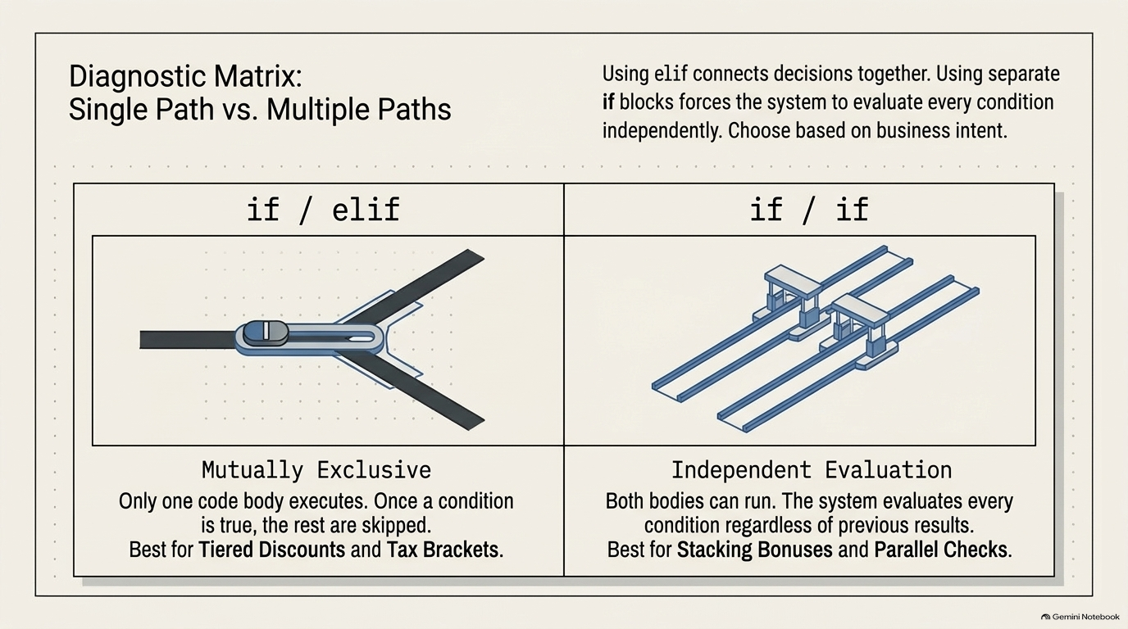
Notes:
SLIDE 10 — DIAGNOSTIC MATRIX: SINGLE PATH VS. MULTIPLE PATHS
SPOKEN SCRIPT
This slide connects to Reflection Question 2, so let's spend a moment here before you answer it on your own.
Two columns. On the left, if/elif: one track that splits and you only ever go down one branch. Mutually exclusive. Once a condition is true, the rest are skipped. That's what we used for tiered discounts and tax brackets, where a customer belongs in exactly one tier.
On the right, if/if: separate parallel tracks, each with its own gate. Independent evaluation. Every condition is checked no matter what happened before, and more than one body can run. That's the right tool for stacking bonuses or running parallel checks, like the regional bonus we wrote.
Here is a concrete example so it sticks. Suppose I write two separate if statements, not elif: "if total >= 200: discount = 0.10" and then "if total >= 100: discount = 0.05". A 250 dollar cart passes both. Both bodies run. The second one overwrites the first, and the customer ends up at 5 percent. That is the reversed-logic bug from earlier, arrived at by a different road.
Now, the question in the reflection: what's the difference between "if total > 100 and total < 500" and two separate if statements checking each condition? Here's the honest answer to share. With "and" inside one if, the body runs only when both conditions are true at once. With two separate ifs, each one is evaluated on its own, and each body runs if its own condition is true, so the two bodies can each run separately when only one condition holds. They are related, but they are not automatically interchangeable. The right choice depends on whether you want one combined decision or two independent ones.
Ask: "For each of these, elif or separate if? A shipping tier. A coupon that stacks with a sale. A tax bracket." Expected: elif, separate if, elif.
You'll write this up in your reflection answers, in your own words.

Slide 11
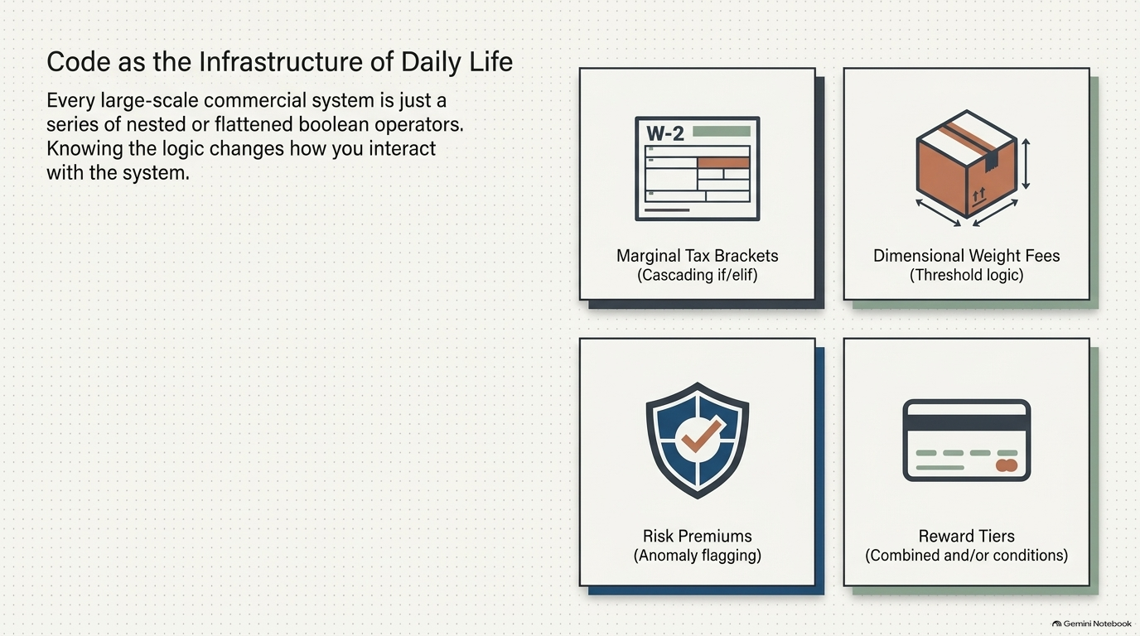
Notes:
SLIDE 11 — CODE AS THE INFRASTRUCTURE OF DAILY LIFE
SPOKEN SCRIPT
Let's zoom out. Read the sentence on the left: "Every large-scale commercial system is just a series of nested or flattened boolean operators. Knowing the logic changes how you interact with the system."
Four tiles, four real systems, and each one is something you built a piece of today.
Top left: marginal tax brackets. That's the cascading if/elif ladder, just like Exercise 1. Top right: dimensional weight fees for shipping, which are threshold logic, where the price jumps when a package crosses a size or weight line. Bottom left: risk premiums and anomaly flagging, the three-band check from Exercise 5. Bottom right: reward tiers and credit card rewards, which are combined and/or conditions, like our VIP upgrade.
This is Reflection Question 3. Take a moment and ask the class: "Where do you run into tiered conditional logic in your own life, and does knowing Python change how you think about it?" Take two or three responses. Push a little. For example, if someone says free shipping over 35 dollars, ask: "What's the condition? What happens at exactly 35?" Get them thinking in boundaries.
Point to make: when you see a company make a strange decision, like a price that jumps at an odd threshold, there is probably an if statement behind it, and a person decided where to put the line. Now you can read those systems, and one day, you will write them.
Now let's make sure you can turn this in.

Slide 12
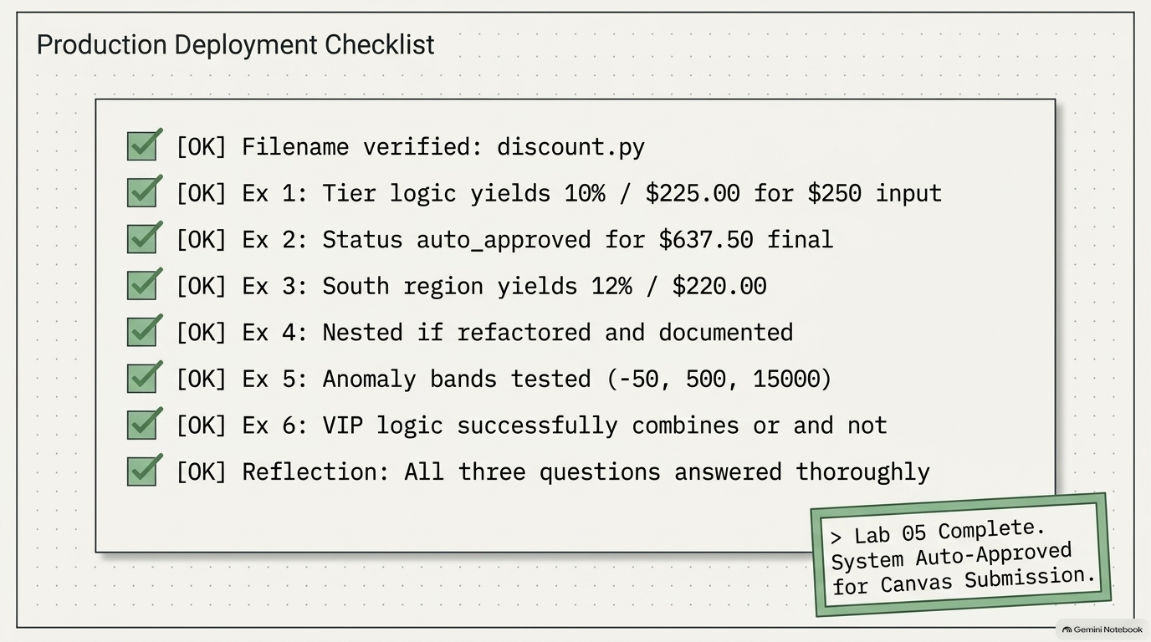
Notes:
SLIDE 12 — REFLECTION QUESTIONS
LAB GUIDE — EXACT CODE AND EXPECTED OUTPUT
REFLECTION QUESTIONS
DO: Answer honestly:
1. Without looking at your code, can you explain in plain English what happens to order_total = 350 as it passes through your discount tier logic? Trace it step by step.
2. What is the difference between if total > 100 and total < 500: and two separate if statements checking each condition? Would both produce the same result? Why or why not?
3. Where in your day-to-day life do you encounter systems that use tiered conditional logic? (Think: tax brackets, shipping fees, insurance premiums, credit card rewards.) How does knowing Python conditionals change how you think about those systems?
CHECK: Question 2's honest answer: two separate if statements (not elif) would both evaluate independently and both run their bodies if both conditions are true, whereas and inside a single if requires both conditions simultaneously to run the body even once — they're related but not automatically interchangeable, and the right choice depends on whether you want one combined decision or two independent ones.
SUBMISSION CHECKLIST
• [ ] discount.py — filename matches exactly, lowercase
• [ ] Exercise 1: correct tier logic, tested with total = 250 giving 10% / $225.00
• [ ] Exercise 2: approval flag correct for final = 637.50
• [ ] Exercise 3: South-region bonus tested, giving 12% / $220.00
• [ ] Exercise 4: nested if flattened, with a comment explaining why it's easier to read
• [ ] Exercise 5: all three anomaly bands tested with -50, 500, 15000
• [ ] Exercise 6: VIP logic using both or and not
• [ ] Three reflection questions answered honestly
• [ ] Submitted to Canvas
SPOKEN SCRIPT
Last slide. This is your submission checklist, and I'd like you to go through it line by line against your own file, not against my screen.
One: the filename is discount.py, lowercase, matches exactly.
Exercise 1: tier logic gives 10 percent and 225.00 for an input of 250.
Exercise 2: the status is auto_approved for a final price of 637.50.
Exercise 3: South region gives 12 percent and 220.00.
Exercise 4: the nested if is flattened, and you wrote a comment explaining why the flat version is easier to read. Check that comment is really in there. It's the item people forget.
Exercise 5: all three anomaly bands tested, with negative 50, 500, and 15000. Run all three, not just one.
Exercise 6: the VIP logic uses both or and not.
And Reflection: all three questions answered honestly, in your own words. Trace the 350 dollar order step by step, explain the "and" versus two separate ifs question, and give a real-life example of tiered logic.
The stamp in the corner says "Lab 05 Complete. System Auto-Approved for Canvas Submission." That's the goal, and notice it's the same kind of if/else you just wrote.
Before you leave: run the file top to bottom one last time and make sure it runs without an error. Then submit discount.py to Canvas.
If you're stuck, stay and I will come around. Thank you all, and see you next class.

