Slide 1
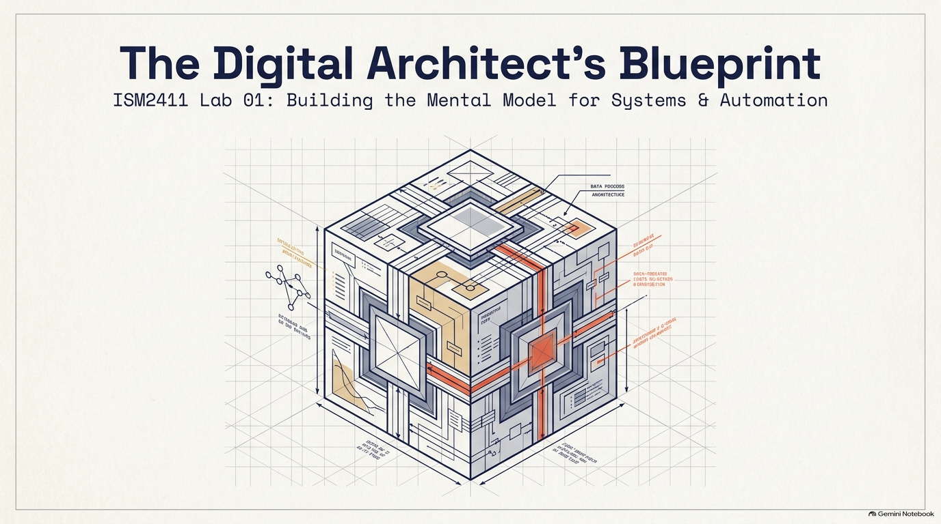
Notes:
SLIDE 1
TITLE — The Digital Architect's Blueprint (Lab 01)
This is the opening slide for Lab 1. There is no code in this lab at all — say that explicitly up front so students don't go looking for a script to write. Set the frame: "Lab 1 — computer vocabulary and a file system tour. No Python today. Before you write a single line of code, you need a rock-solid mental model of what a file actually is, where it lives, and how the computer finds it. Everything for the rest of the semester assumes this is second nature." The blueprint graphic (an isometric cube of interlocking systems) is a visual metaphor for the semester ahead — file systems, hardware, and automation are the load-bearing structure everything else in ISM2411 gets built on top of. Don't over-explain the diagram itself; it's a mood-setter, not content to teach line by line.

Slide 2
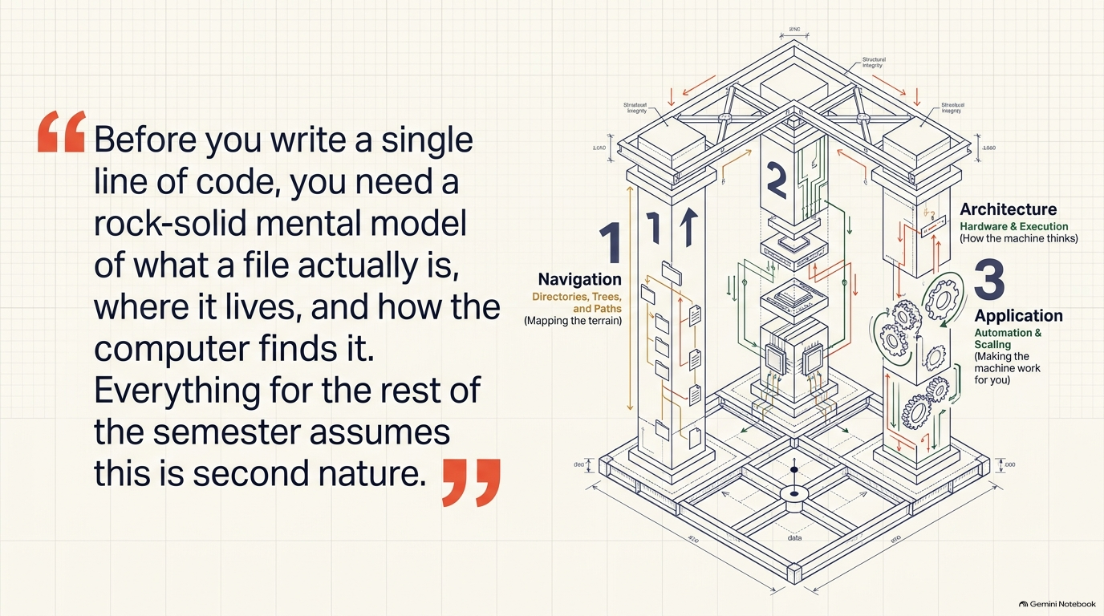
Notes:
SLIDE 2 — INTRO
SAY: "Lab 1 — computer vocabulary and a file system tour. No Python today. Before you write a single line of code, you need a rock-solid mental model of what a file actually is, where it lives, and how the computer finds it. Everything for the rest of the semester assumes this is second nature."
SLIDE NOTES
This slide delivers the SAY line from the Intro verbatim as the pull-quote on the left: "Before you write a single line of code, you need a rock-solid mental model of what a file actually is, where it lives, and how the computer finds it. Everything for the rest of the semester assumes this is second nature." Read it exactly as written — it's the thesis of the whole lab.
The three-layer diagram on the right previews the lab's structure and is worth narrating explicitly
1 — Navigation (directories, trees, and paths — "mapping the terrain") covers Exercises 1, 2, and 5: tracing a real path, building the ism2411 project folder, and drawing/traversing a directory tree. 2 — Architecture (hardware & execution — "how the machine thinks") covers Exercise 3's vocabulary (CPU, RAM, Storage, Program, Interpreter) and Exercise 6's RAM-vs-storage scenarios. 3 — Application (automation & scaling — "making the machine work for you") covers Exercise 4's automation reflection and previews why the rest of the semester exists at all: turning manual Excel friction into scripts. Telling students this three-part shape up front gives them a map for why the exercises are ordered the way they are.

Slide 3
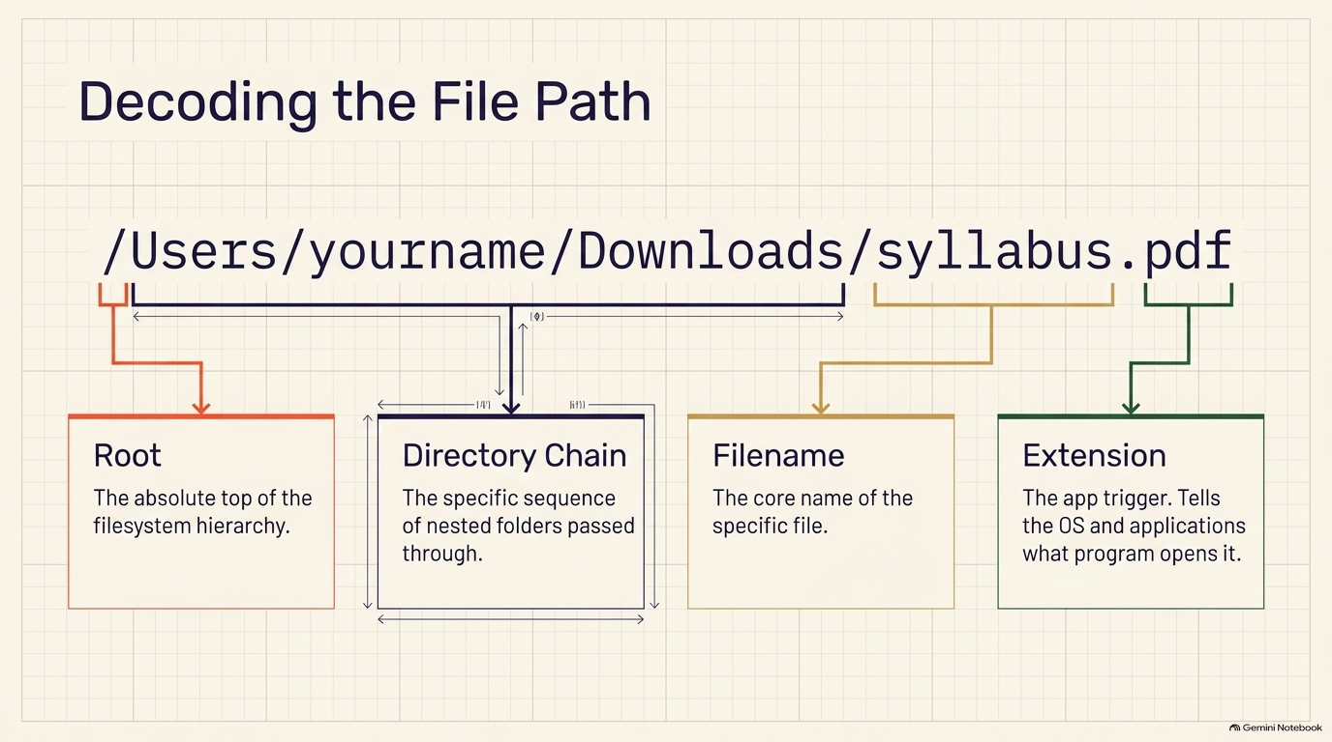
Notes:
SLIDE 3 — EXERCISE 1 — Trace a Real File Path
SAY: "This one uses your actual machine, not a hypothetical example."
DO: Open Finder (Mac) or File Explorer (Windows). Navigate to your Downloads folder, pick any file, right-click it, and choose Properties (Windows) or Get Info (Mac). Copy the full path shown there. For example:
/Users/yourname/Downloads/syllabus.pdf
Break it into its four labeled parts:
• Root: / (the very top of the whole filesystem)
• Directory chain: Users/yourname/Downloads/ (the sequence of folders you pass through)
• Filename: syllabus
• Extension: .pdf (tells the OS and applications what kind of file this is, and which program should open it)
CHECK: Your written answer should look like a fully labeled path — for example: "Root: /. Directory chain: Users → yourname → Downloads. Filename: syllabus. Extension: .pdf." That matches the lab's expected output: a written-out path with each component labeled.
SLIDE NOTES
The slide's example path, /Users/yourname/Downloads/syllabus.pdf, is exactly the worked example from the script — walk through how it decomposes into the four labeled parts shown on screen: Root (/ — the absolute top of the filesystem hierarchy), Directory Chain (Users/yourname/Downloads/ — the specific sequence of nested folders passed through), Filename (syllabus — the core name of the file), and Extension (.pdf — the app trigger that tells the OS and applications what program should open it).

Slide 4
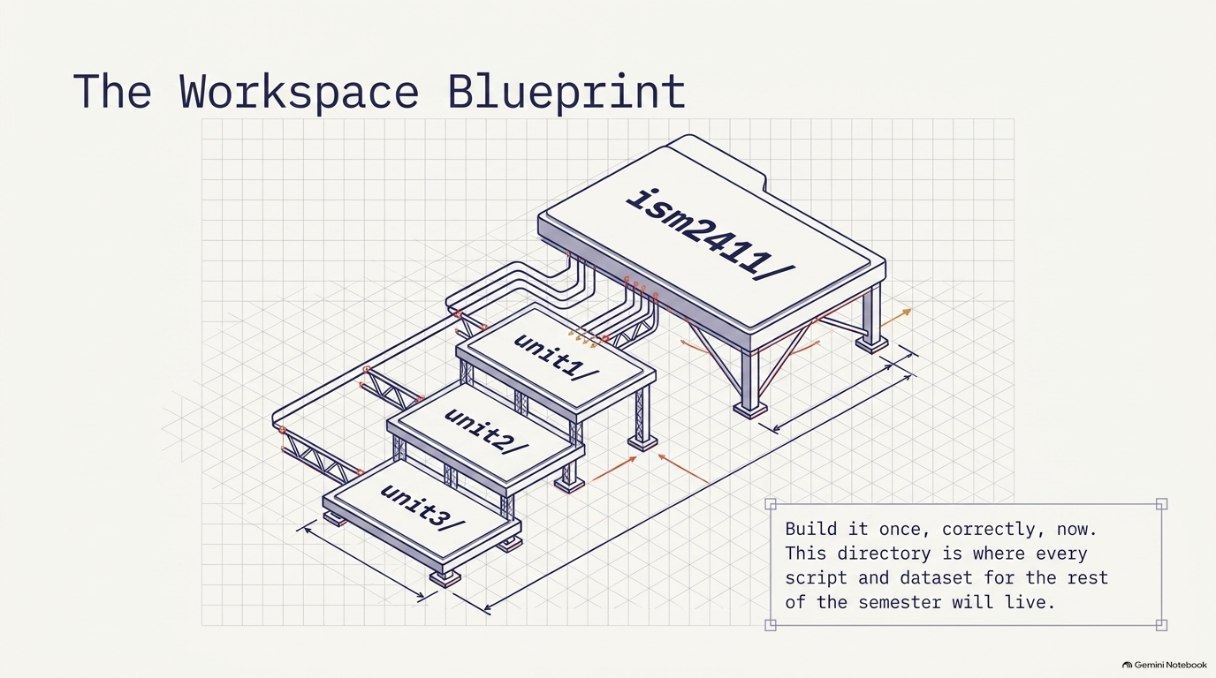
Notes:
SLIDE 4 — EXERCISE 2 — Map Your Project Folder
SAY: "This folder is where every assignment for the rest of the semester lives — build it once, correctly, now."
DO: On your machine, create a folder called ism2411 wherever you keep schoolwork. Inside it, create one subfolder per unit:
ism2411/
├── unit1/
├── unit2/
├── unit3/
└── ...
CHECK: Open Finder/Explorer and confirm you can see the ism2411 folder with its numbered unitN subfolders inside — that's the lab's expected output: "folder structure visible in Finder/Explorer."
SLIDE NOTES
"This folder is where every assignment for the rest of the semester lives — build it once, correctly, now."
DO: have students create a folder called ism2411 wherever they keep schoolwork, then create one subfolder per unit inside it — unit1/, unit2/, unit3/, and so on, exactly as shown in the blueprint graphic (the ism2411/ platform with unit1/, unit2/, unit3/ nested beneath it). Emphasize the callout text on the slide: "Build it once, correctly, now.

Slide 5
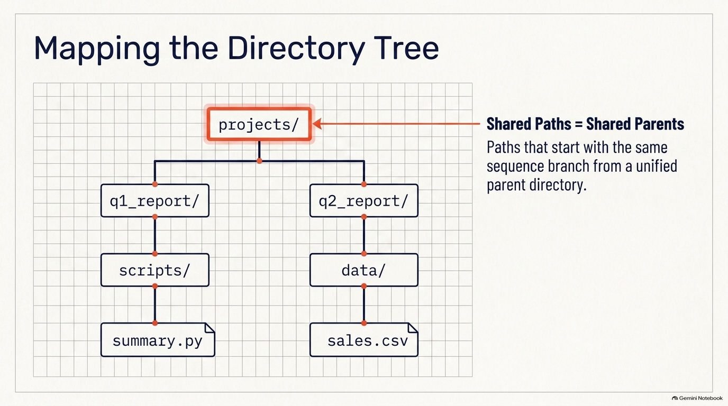
Notes:
SLIDE 5 — EXERCISE 5 — Draw the Directory Tree
SAY: "Now the reverse direction from Exercise 1 — given paths, draw the tree they imply."
DO: Given these three paths:
/home/alice/projects/q1_report/data/sales.csv
/home/alice/projects/q1_report/scripts/summary.py
/home/alice/projects/q2_report/data/sales.csv
Draw the tree, merging shared folders and branching where paths diverge:
/home/alice/projects/
├── q1_report/
│ ├── data/
│ │ └── sales.csv
│ └── scripts/
│ └── summary.py
└── q2_report/
└── data/
└── sales.csv
CHECK: Notice q1_report and q2_report both branch off the same projects/ folder — that's the key insight this exercise tests: shared path prefixes mean shared parent folders. Now write one relative path from scripts/summary.py to q2_report/data/sales.csv:
../../q2_report/data/sales.csv
Read it out loud: "Starting in scripts/, .. goes up to q1_report/, a second .. goes up to projects/, then back down into q2_report/data/sales.csv." That's the lab's expected output: a tree diagram plus that exact relative path.
SLIDE NOTES
This slide's diagram is exactly that tree, condensed to the shared projects/ root: q1_report/ branching into scripts/summary.py, and q2_report/ branching into data/sales.csv (the callout box on the right names the key insight — "Shared Paths = Shared Parents": paths that start with the same sequence branch from a unified parent directory).

Slide 6
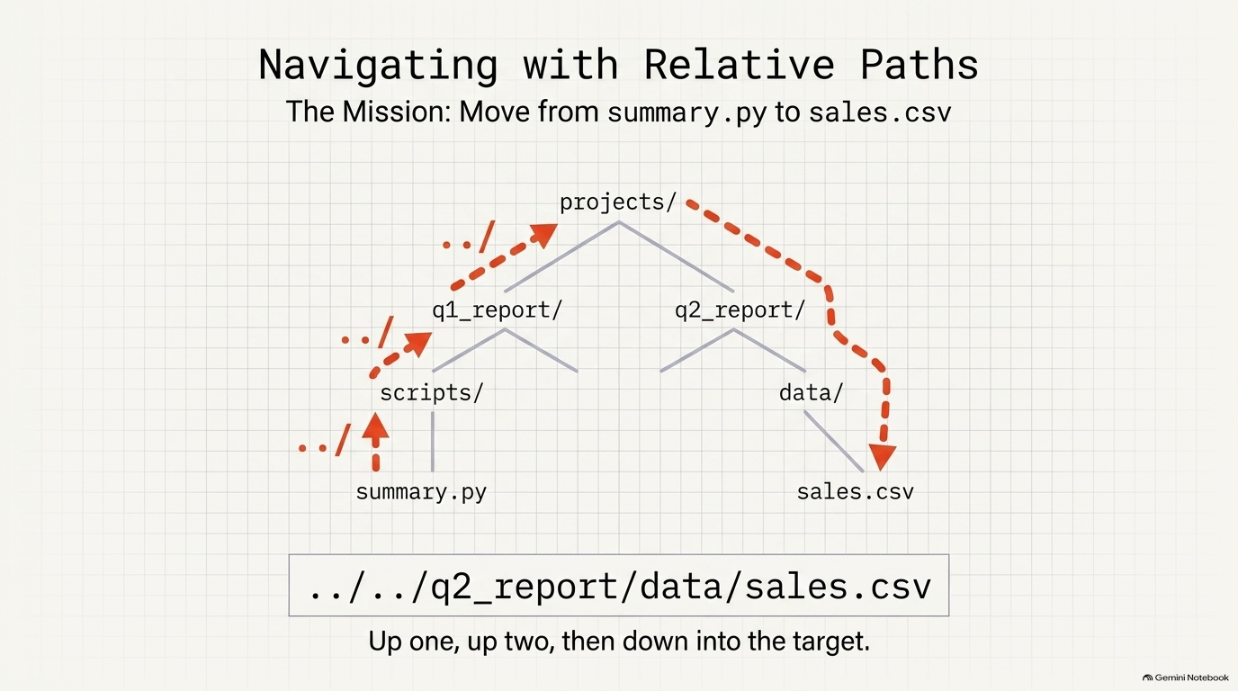
Notes:
SLIDE 6 — EXERCISE 5 — Draw the Directory Tree
CHECK: Notice q1_report and q2_report both branch off the same projects/ folder — that's the key insight this exercise tests: shared path prefixes mean shared parent folders. Now write one relative path from scripts/summary.py to q2_report/data/sales.csv:
../../q2_report/data/sales.csv
Read it out loud: "Starting in scripts/, .. goes up to q1_report/, a second .. goes up to projects/, then back down into q2_report/data/sales.csv." That's the lab's expected output: a tree diagram plus that exact relative path.
SLIDE NOTES
This slide continues Exercise 5's
CHECK step: writing one relative path from scripts/summary.py to q2_report/data/sales.csv. Walk the dotted-arrow path shown on screen exactly as the script narrates it: "Starting in scripts/, .. goes up to q1_report/, a second .. goes up to projects/, then back down into q2_report/data/sales.csv." The correct relative path is ../../q2_report/data/sales.csv, shown boxed at the bottom of the slide with the plain-language gloss "Up one, up two, then down into the target." This is the lab's expected output for Exercise 5 overall: a tree diagram plus this exact relative path. Common student mistake to watch for: forgetting that each .. moves up exactly one directory level, so going from a file two levels deep back to a sibling branch requires two ..'s before descending again — count the levels out loud with them if anyone gets tripped up.

Slide 7
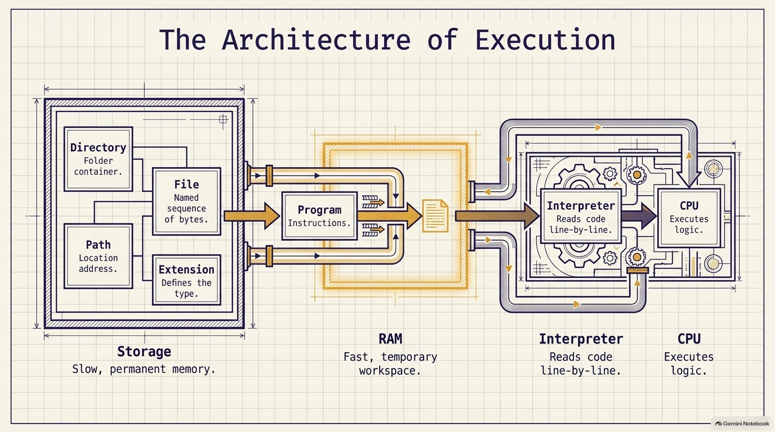
Notes:
SLIDE 7 — EXERCISE 3 — Vocabulary Check
SAY: "Nine terms, one sentence each, in your own words — not copied from the reading. I'll give you the one-sentence version for each; rewrite them in your own phrasing before submitting."
DO:
• CPU — the chip that executes your program's instructions, one at a time.
• RAM — fast, temporary memory where running programs and open files live; it clears when the computer shuts down.
• Storage — slower, permanent memory where files live even when the computer is off.
• File — a named sequence of bytes stored on disk.
• Directory — a container for files and other directories; also called a folder.
• Path — the full address of a file within the directory hierarchy.
• Extension — the suffix after the dot in a filename (like .pdf or .py) that tells the OS and applications what kind of file it is.
• Program — a set of instructions that tells the computer what to do.
• Interpreter — the program that reads and executes another program's instructions, one line at a time (Python code specifically, for this course).
CHECK: Nine one-sentence definitions, written in your own words — the lab's expected output. Read each one back out loud: if it sounds identical to a textbook sentence, rewrite it in your own phrasing.
SLIDE NOTES
I'll give you the one-sentence version for each; rewrite them in your own phrasing before submitting." This diagram ("The Architecture of Execution") is a visual aid tying the vocabulary together as one data flow rather than nine disconnected flashcards: Storage (slow, permanent memory) holds Directories, Files, Paths, and Extensions at rest; a Program's instructions get pulled into RAM (fast, temporary workspace) to run; the Interpreter reads that code line-by-line and hands logic to the CPU to execute.

Slide 8
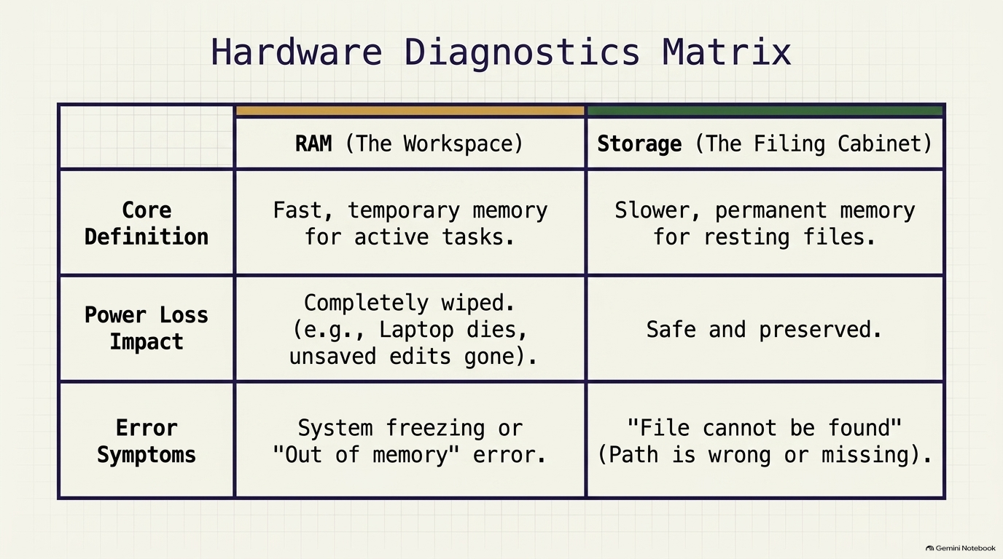
Notes:
SLIDE 8 — EXERCISE 6 — RAM vs. Storage Scenarios
SAY: "Three scenarios, and for each one: is this a RAM problem, a storage problem, or something else?"
DO:
(a) You edited a spreadsheet for an hour and your laptop died. When you restart, your changes are gone. — This is a RAM problem: your unsaved edits existed only in fast, temporary memory. Since you never saved (wrote them to storage), losing power erased them completely.
(b) You try to open a CSV file and get an error saying the file cannot be found. — This is a storage problem: either the file's path is wrong, or the file itself doesn't exist where you're looking — nothing to do with RAM at all.
(c) Your Python script is running slowly when processing a 2 GB file. — This is a storage I/O or RAM capacity problem: reading 2 GB off disk takes real time, and if your machine doesn't have enough RAM to hold the whole file while processing it, the OS has to shuffle data back and forth between RAM and storage, which is much slower than RAM alone.
CHECK: Your three answers should match: (a) RAM — changes not saved to storage; (b) storage — file path wrong or file missing; (c) storage I/O or RAM capacity. That's the lab's expected output.
SLIDE NOTES
"Three scenarios, and for each one: is this a RAM problem, a storage problem, or something else?" This Hardware Diagnostics Matrix slide is the reference table students should mentally run each scenario against — it contrasts RAM ("The Workspace": fast, temporary memory for active tasks; completely wiped on power loss; symptoms are system freezing or an "out of memory" error) against Storage ("The Filing Cabinet": slower, permanent memory for resting files; safe and preserved through power loss; symptoms are a "file cannot be found" error from a wrong or missing path).

Slide 9
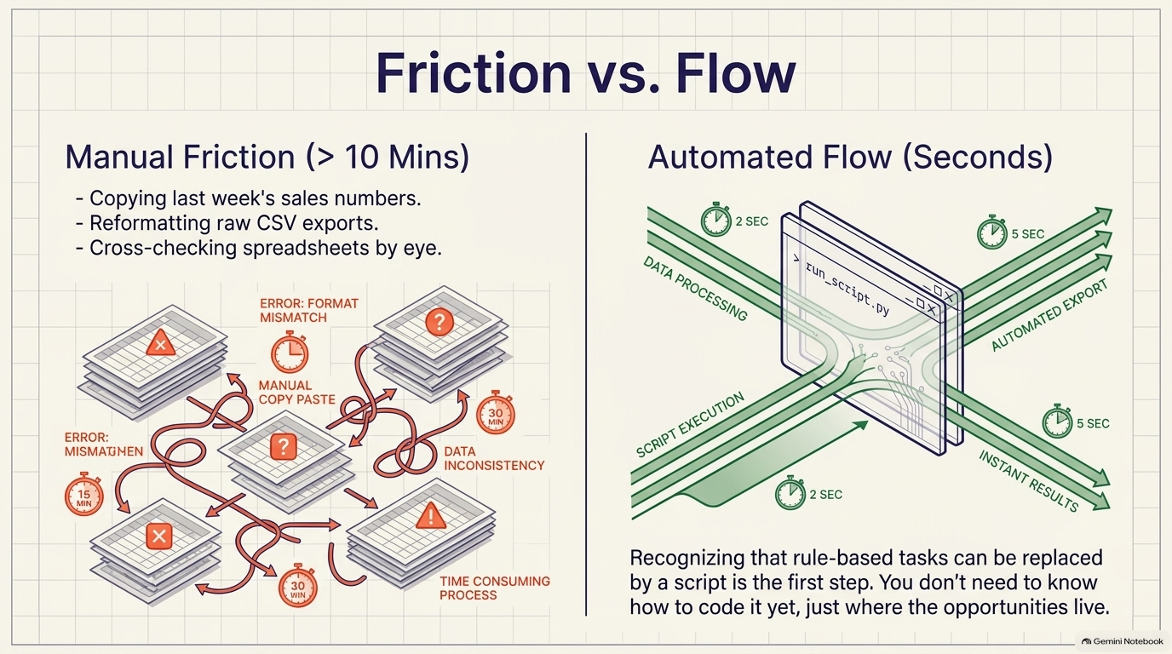
Notes:
SLIDE 9 — EXERCISE 4 — Automation Reflection
SAY: "Discuss this one in pairs if you're in class — the goal is spotting opportunities, not solving them yet."
DO: Name three things you currently do in Excel that take more than 10 minutes. For example:
1. Manually copying last week's sales numbers into a summary tab every Monday morning.
2. Reformatting a CSV export from another system so the columns match your template.
3. Cross-checking two spreadsheets by eye to find rows that don't match.
For each, ask: could a program that runs in a few seconds do this instead?
CHECK: Three tasks described, each with a brief explanation of why it could (or couldn't yet) be automated — the lab's expected output. You are not expected to know how to automate it yet — only to recognize that it could be.
SLIDE NOTES
Flow" slide makes the contrast visceral: the left side shows the tangled, error-prone manual process (format mismatches, mismatched data, 15–30 minute delays stacking up) versus the right side's automated flow, where data processing, script execution, and export each complete in just a few seconds. Reinforce the slide's callout text: "Recognizing that rule-based tasks can be replaced by a script is the first step.

Slide 10
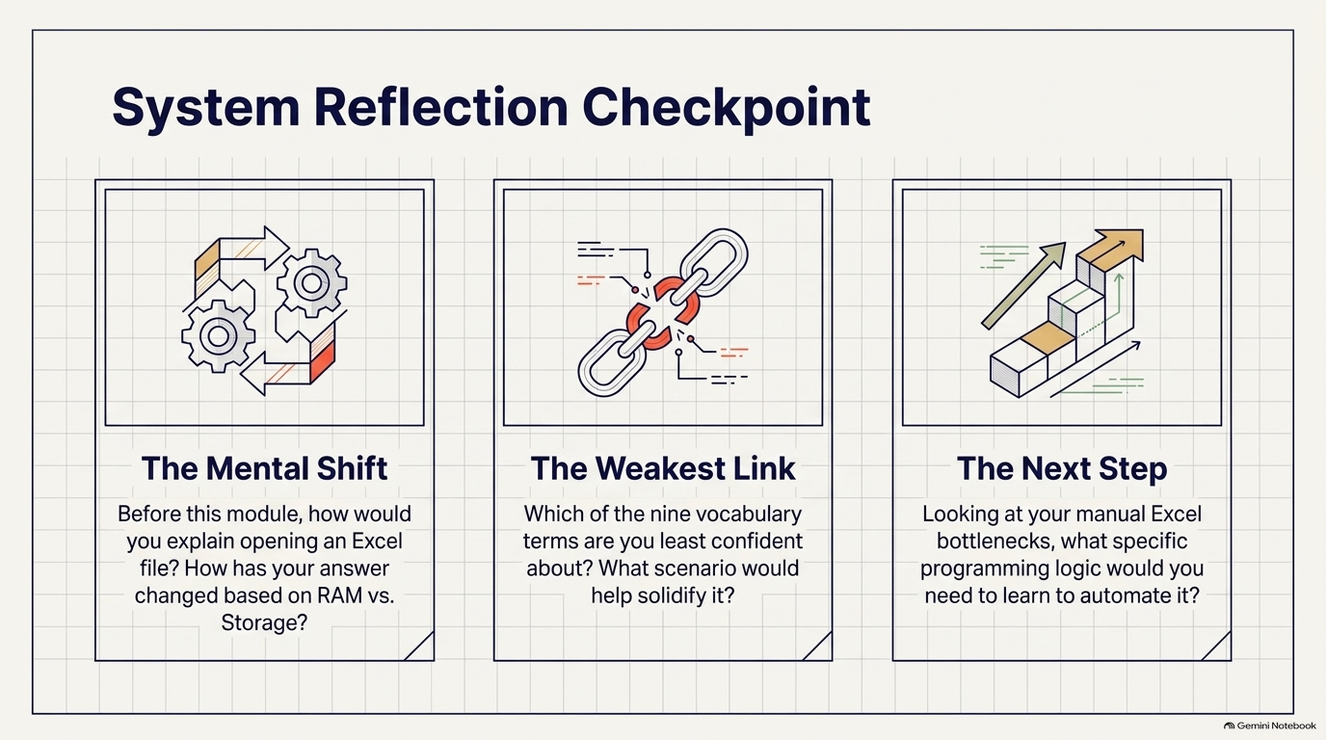
Notes:
SLIDE 10 — REFLECTION QUESTIONS
SAY: "Three self-assessment questions — no code, just honest reflection before you submit."
DO: Answer, in your own words:
1. Before this module, how would you have explained what happens when you open an Excel file? How has your answer changed?
2. Which of the nine vocabulary terms from Exercise 3 are you least confident about? What would help you solidify that concept?
3. The business discussion (Exercise 4) asked about tasks you could automate. What would you need to learn — beyond this module — to actually build that automation?
CHECK: Each answer is a few honest sentences, not a restatement of the definitions — this is where you notice which concepts didn't quite stick yet, before the course moves on.
SLIDE NOTES
"Three self-assessment questions — no code, just honest reflection before you submit." This "System Reflection Checkpoint" slide presents the three questions as three cards: "The Mental Shift" — before this module, how would you have explained opening an Excel file, and how has your answer changed based on RAM vs.

Slide 11
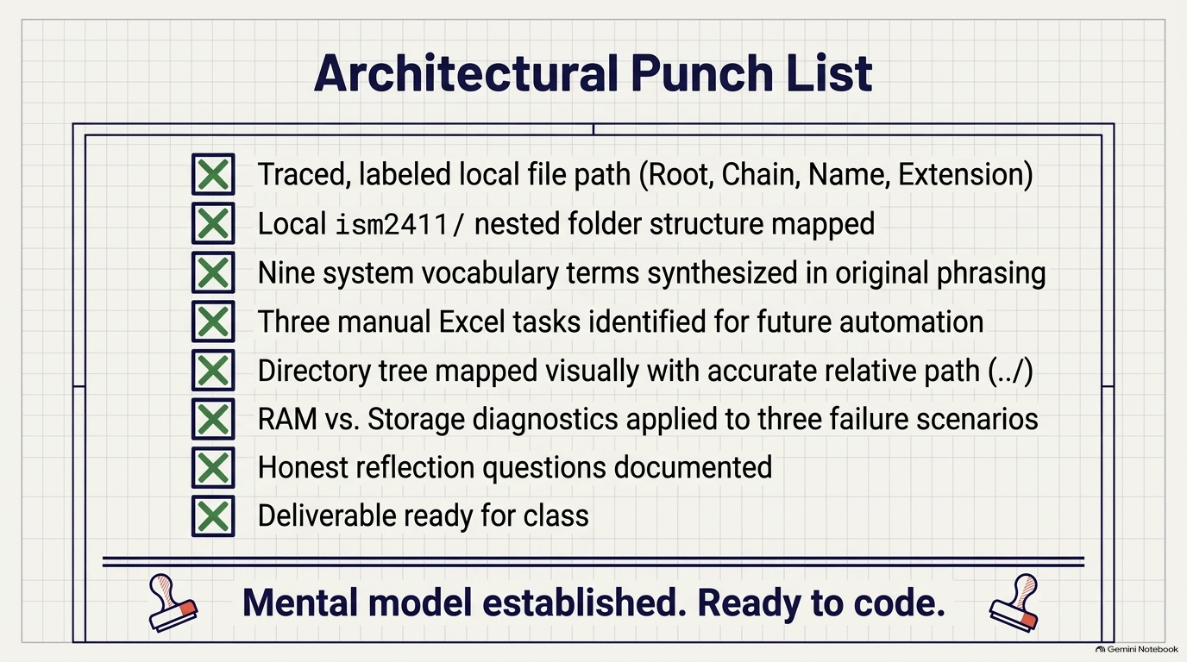
Notes:
SLIDE 11 — SUBMISSION CHECKLIST
SAY: "One text file plus one screenshot to Canvas — no code yet, but the deliverable is still specific about what it wants."
• [ ] One file named exactly module01_lab.txt (or .md)
• [ ] Exercise 1: the full file path traced, with root, directory chain, filename, and extension each labeled
• [ ] Exercise 3: all nine vocabulary definitions, in your own words
• [ ] Exercise 4: the three automation examples and whether each could be automated
• [ ] Exercise 5: the directory tree drawn out in text (indentation is fine) and the one relative path
• [ ] Exercise 6: the RAM-vs-storage explanation for scenarios (a), (b), and (c)
• [ ] Answers to all 3 Self-Assessment Questions
• [ ] One screenshot of Finder/Explorer showing the ism2411/ folder expanded with unit1/, unit2/, etc. visible (from Exercise 2)
SLIDE NOTES
"One text file plus one screenshot to Canvas — no code yet, but the deliverable is still specific about what it wants." This "Architectural Punch List" slide is the visual checklist — walk it item by item before students submit: one file named exactly module01_lab.txt (or .md); Exercise 1's full file path traced with root, directory chain, filename, and extension each labeled; Exercise 3's all nine vocabulary definitions in the student's own words; Exercise 4's three automation examples with whether each could be automated; Exercise 5's directory tree drawn out in text (indentation is fine) plus the one relative path; Exercise 6's RAM-vs-storage explanation for scenarios (a), (b), and (c); answers to all three Self-Assessment Questions; and one screenshot of Finder/Explorer showing the ism2411/ folder expanded with unit1/, unit2/, etc. visible, from Exercise 2. Close on the slide's own line: "Mental model established.

