Slide 1
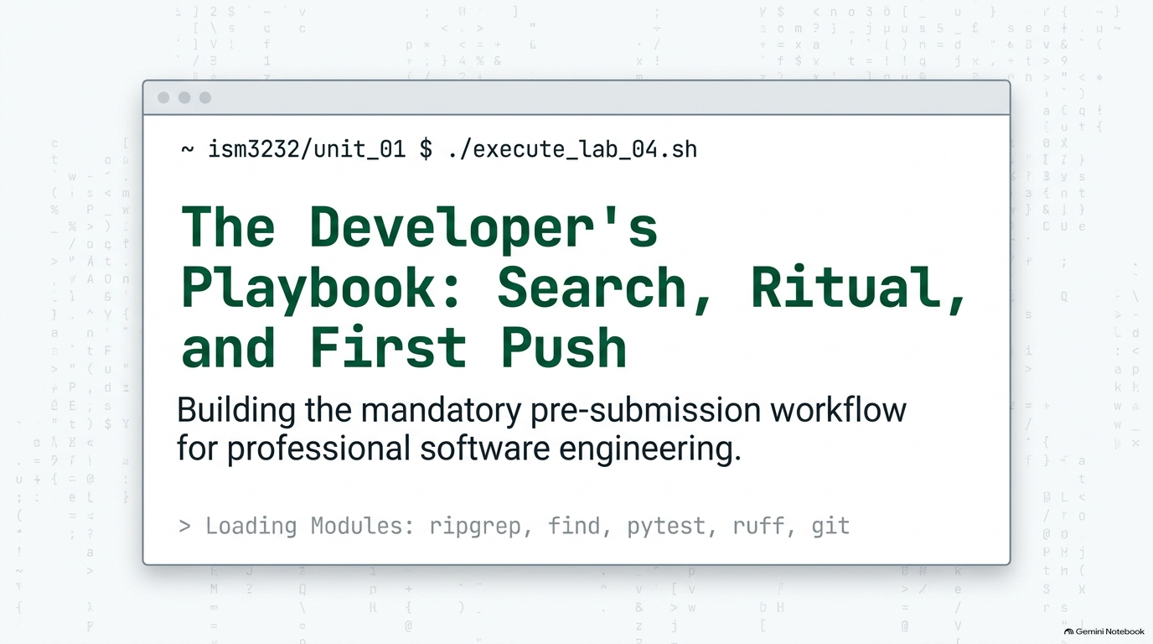
Notes:
SLIDE 1 — INTRO
TEACHING GOAL: set the stakes before touching the keyboard — this is the single most important lab of Unit 1 because everything built today becomes mandatory for every remaining assignment.
SAY: "Lab 4 — search tools, the submission ritual, and Git. This is the single most important lab in Unit 1. The ritual we build today — format, lint, test, commit, push — is required before every major assignment for the rest of the semester. Instructors check your Git log. A missing ruff or pytest step is visible there, so we're building the habit correctly, right now, on camera."
SLIDE NOTES
The slide's 'Loading Modules' line (ripgrep, find, pytest, ruff, git) previews exactly the five tools this lab touches, in the order they're used. Land on the idea that today is less about new syntax and more about a professional workflow habit that will be graded every week from here on.

Slide 2
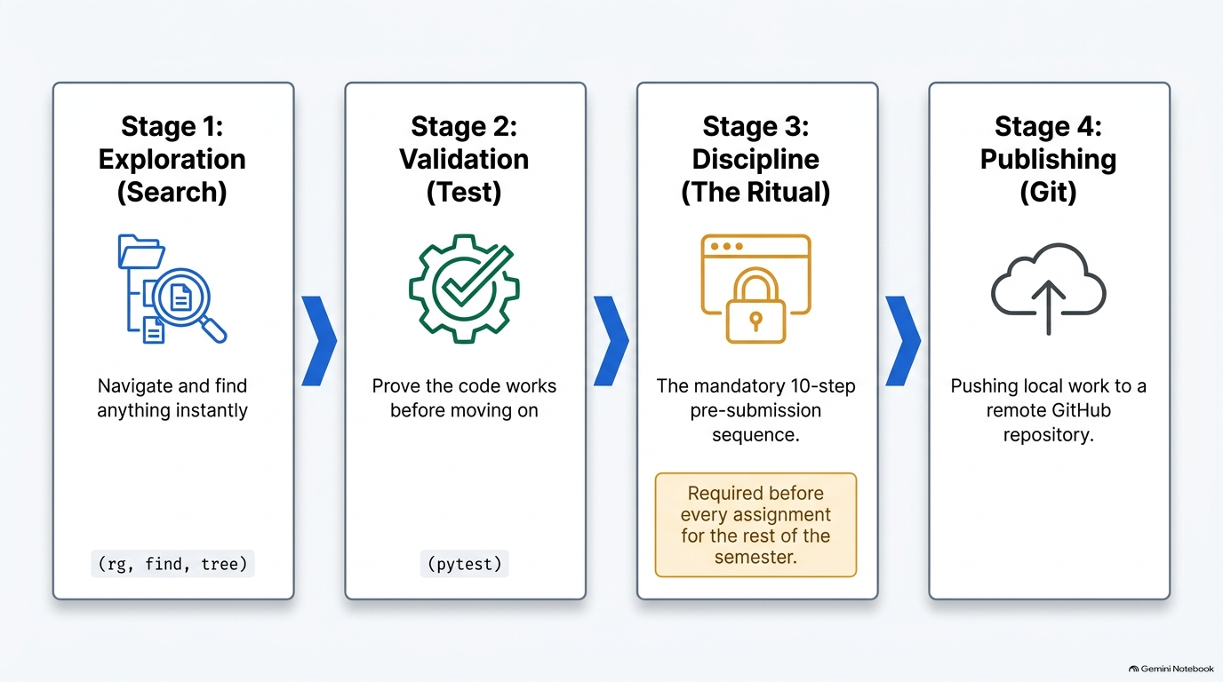
Notes:
SLIDE 2
ROADMAP. This card mirrors the lab's four parts exactly: Part 1 Search Tools (Exploration), Part 2 Write a Test File (Validation), Part 3 Pre-Submission Ritual (Discipline), Part 4 First GitHub Push (Publishing).
SAY: preview the arc out loud before diving in — "We're going to search a codebase instantly, prove our code works with tests, run the exact same 10-step ritual you'll run every week for the rest of the semester, and then publish that work to GitHub for the first time."
Call out the highlighted callout under Stage 3: 'Required before every assignment for the rest of the semester.' This is the single most important sentence on the slide — make sure students hear it, not just read it. It directly sets up the ritual's non-negotiable status covered in Part 3.

Slide 3
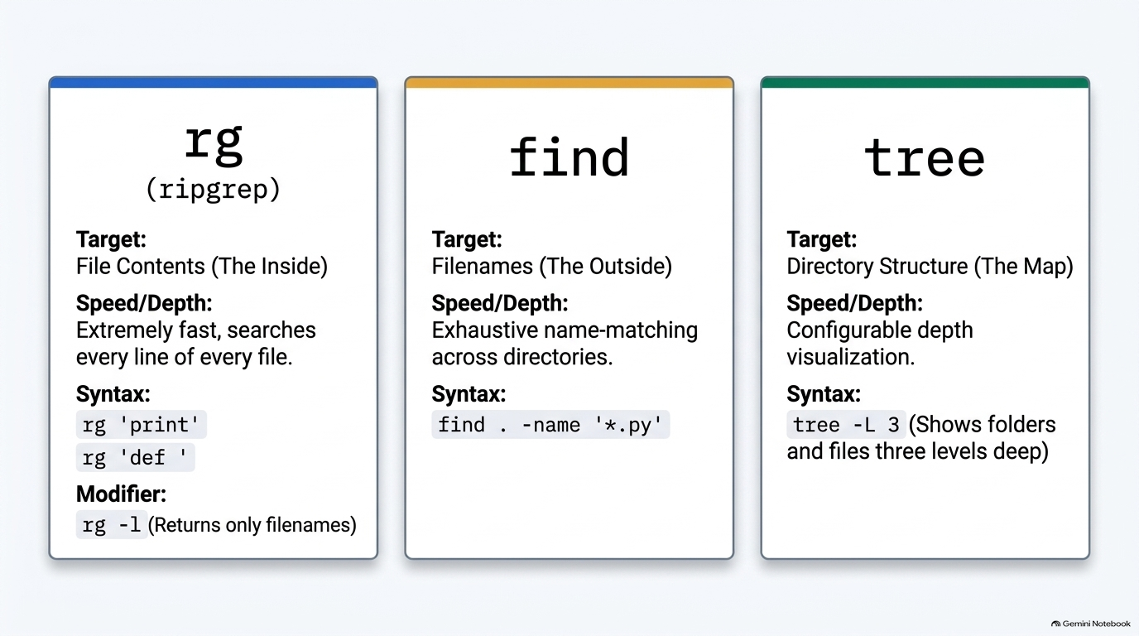
Notes:
SLIDE 3
CONCEPT CARD — rg vs. find vs. tree. Teaching goal: establish the mental distinction between the three search tools before running a single command, so students choose the right tool by target, not by memorized syntax.
SAY (rg, Step 1): "rg — ripgrep — searches inside every file's contents, fast. Let's find every print statement across the whole course folder."
SAY (find, Step 4): "rg searches file contents. find searches file names."
SAY (tree, Step 5): "And one more look at the whole structure, three levels deep this time — deeper than the -L 2 we used in Week 2."
The 'Modifier: rg -l' line on the rg card is Step 3 from the script: "Sometimes you don't want to see every matching line — just which files contain a match. That's the -l flag."
DO on this step: rg -l 'import'.
CHECK: a short list of filenames only — no line numbers, no matched text, just paths. Mention this modifier explicitly even though the next slide's live demo doesn't re-run it.
Reinforce the three-way split verbally: rg = contents (The Inside), find = filenames (The Outside), tree = structure (The Map). This framing is what students should retain, not the exact flags.

Slide 4
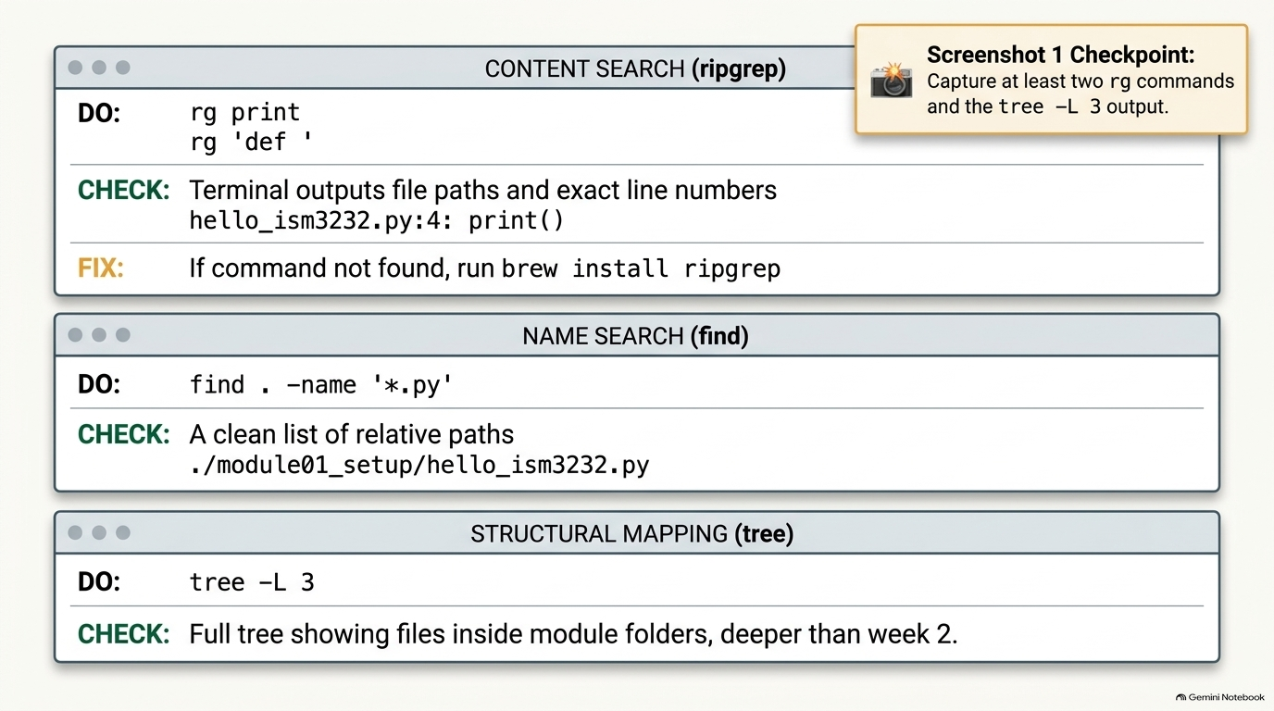
Notes:
SLIDE 4 — Step 1 — Search file contents with ripgrep
Step 1 — Search file contents with ripgrep
SAY: "rg — ripgrep — searches inside every file's contents, fast. Let's find every print statement across the whole course folder."
DO:
cd ~/ism3232
rg 'print'
CHECK: A list of file paths and line numbers, each showing a line containing print — for example, the two print() lines from module01_setup/hello_ism3232.py.
FIX: If rg: command not found, install it — macOS: brew install ripgrep; Ubuntu: sudo apt install ripgrep.
Step 2 — Search for function definitions
SAY: "Now every function definition in the whole project, in one command."
DO:
rg 'def '
CHECK: Lines like module02_zsh/tests/test_week4.py:2:def test_always_passes(): — file, line number, and the matching line itself.
Step 3 — List just the matching filenames
SAY: "Sometimes you don't want to see every matching line — just which files contain a match. That's the -l flag."
DO:
rg -l 'import'
CHECK: A short list of filenames only — no line numbers, no matched text, just paths.
Step 4 — Search by filename with find
SAY: "rg searches file contents. find searches file names. Three quick examples."
DO:
find . -name '*.py'
find . -name '*.md'
find . -name '*.txt'
CHECK: Three separate lists — every .py file, every .md file, every .txt file in the current tree, each printed with its relative path (e.g. ./module01_setup/hello_ism3232.py).
Step 5 — Visualize with tree
SAY: "And one more look at the whole structure, three levels deep this time — deeper than the -L 2 we used in Week 2."
DO:
tree -L 3
CHECK: The full ism3232/ tree, now showing files inside module01_setup, module02_zsh, etc. — not just the folder names.
Screenshot 1 checkpoint
SAY: "Screenshot 1 — at least two rg commands and their output, plus the tree -L 3 output."
SLIDE NOTES
This covers Steps 1, 2, 4, and 5 from Part 1.

Slide 5
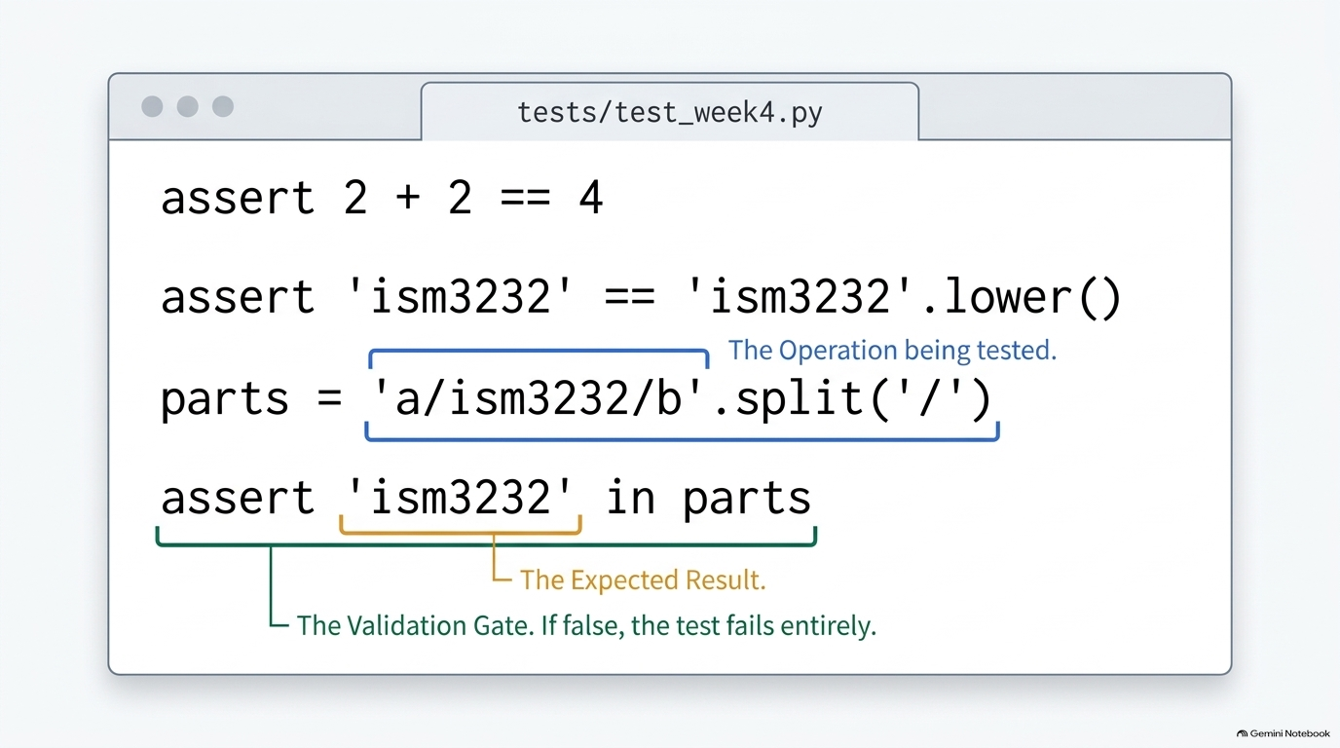
Notes:
SLIDE 5 — Step 6 — Set up the tests folder
Step 6 — Set up the tests folder
SAY: "We're adding real tests to module02_zsh now. Activate the venv first — pytest lives inside it, remember."
DO:
cd ~/ism3232/module02_zsh
source .venv/bin/activate
mkdir -p tests
touch tests/__init__.py tests/test_week4.py
code tests/test_week4.py
CHECK: Prompt shows (.venv), and ls tests/ shows two files: __init__.py and test_week4.py.
Step 7 — Type all three tests
SAY: "Three tests, each checking something different — a pure math fact, a string property, and a path-splitting operation. Type them in, don't paste."
DO:
# tests/test_week4.py
def test_always_passes():
assert 2 + 2 == 4
def test_string_is_lowercase():
name = 'ism3232'
assert name == name.lower()
def test_path_segments():
path = '/Users/yourname/ism3232/module02_zsh'
parts = path.split('/')
assert 'ism3232' in parts
CHECK: Read each test out loud before running it: "Test one — trivially, 2 plus 2 is 4. Test two — 'ism3232' is already all lowercase, so it equals its own .lower(). Test three — splitting that path on / gives a list of segments, and 'ism3232' must be one of them."
SLIDE NOTES
Have students type this in, not paste it.
Test three — splitting a path string on '/' produces a list of segments, and 'ism3232' must be one of those segments — this is the operation the slide's diagram highlights with the blue/orange/green brackets: the operation being tested, the expected result, and the validation gate that fails the whole test if the assertion is false.
Point at the diagram's callouts directly while narrating: the blue bracket is the operation under test (.split('/')), the orange bracket is the expected result ('ism3232' in parts), and the green bracket is the validation gate — if that assert is False, the test fails outright, with no partial credit.

Slide 6
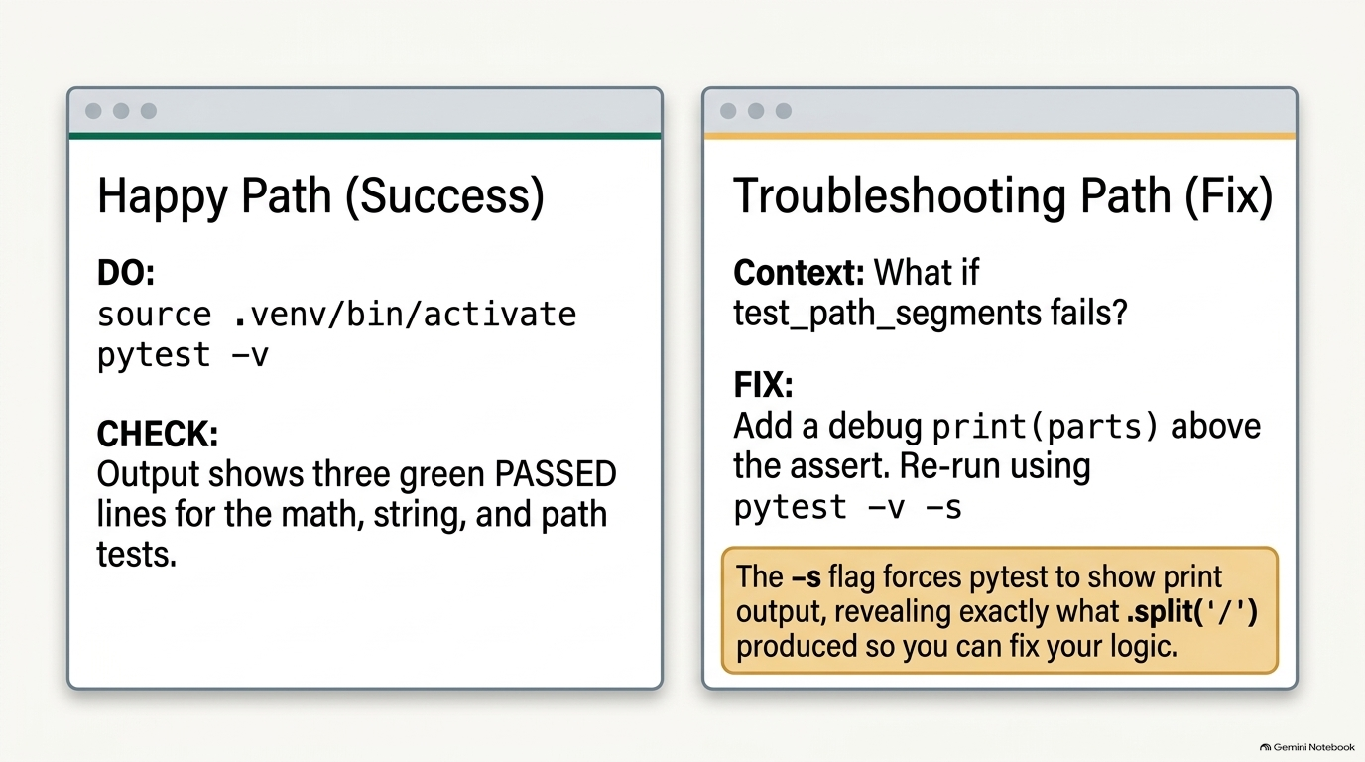
Notes:
SLIDE 6 — Step 8 — Run pytest and confirm all three pass
SAY: "Moment of truth — run it."
DO:
pytest -v
CHECK:
tests/test_week4.py::test_always_passes PASSED
tests/test_week4.py::test_string_is_lowercase PASSED
tests/test_week4.py::test_path_segments PASSED
======================== 3 passed in 0.01s ========================
FIX: If test_path_segments fails, print the actual parts list with a debug print(parts) above the assert and re-run with pytest -v -s (the -s flag lets print() output show) to see exactly what .split('/') produced.
SLIDE NOTES
This is the one moment in the lab where debugging technique (not just running commands) is explicitly taught — slow down here if any student's tests aren't all green, since nothing later in the ritual should proceed on a red test suite.

Slide 7
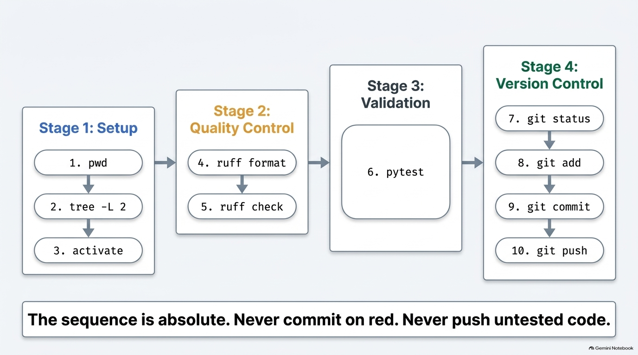
Notes:
SLIDE 7
TRANSITION INTO PART 3 — Pre-Submission Ritual.
SAY: "Here is the ritual. Ten steps, always in this order, for the rest of the semester. I'm going to run every single one and show you the checkpoint for each before moving to the next."
Walk the four-stage grouping shown on the diagram exactly as it maps to the ten steps: Stage 1 Setup — 1. pwd, 2. tree -L 2 (the script says tree -L 3 for the check on this step; either depth is acceptable, the point is confirming the full structure before touching Git), 3. activate. Stage 2 Quality Control — 4. ruff format, 5. ruff check. Stage 3 Validation — 6. pytest. Stage 4 Version Control — 7. git status, 8. git add, 9. git commit, 10. git push.
Land the bottom banner as a rule, not a suggestion: "The sequence is absolute. Never commit on red. Never push untested code." This is the same rule stated in the script's FIX notes for Steps 9e and 9f — lint errors and failing tests both block forward progress in the ritual, no exceptions.

Slide 8
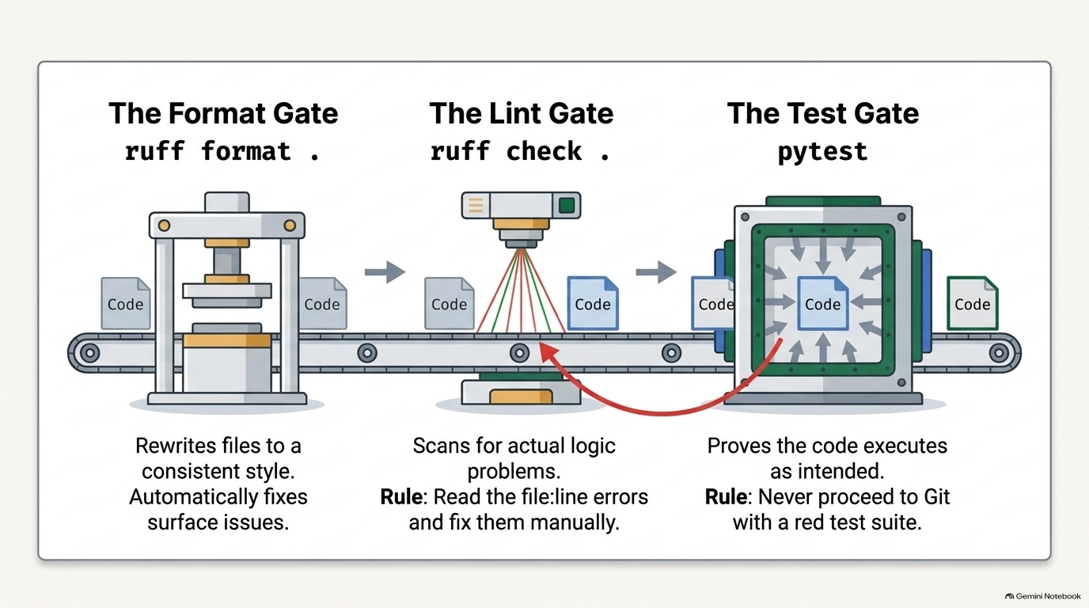
Notes:
SLIDE 8 — Step 9d — Format the code
Step 9d — Format the code
SAY: "ruff format rewrites your files to a consistent style automatically — spacing, quote style, line length."
DO:
ruff format .
CHECK:
2 files reformatted, 1 file left unchanged
(Exact counts vary — the key output is that it ran without error.)
Step 9e — Lint the code
SAY: "ruff check looks for actual problems — unused imports, undefined names — not just style."
DO:
ruff check .
CHECK:
All checks passed!
FIX: If it lists errors instead, read the file:line references and fix each one before continuing — do not commit with lint errors present.
Step 9f — Run the tests
DO:
pytest
CHECK:
3 passed in 0.01s
FIX: If anything fails here, stop — go back and fix it before touching Git. Never commit on a red test suite.
SLIDE NOTES
LIVE DEMO — Steps 9d, 9e, 9f, the three quality gates that sit in the middle of the ritual (after activate, before Git).
Emphasize the diagram's visual: each gate physically reshapes/inspects the code block before it's allowed to pass through to the next stage — that's the right mental model for why order matters.

Slide 9
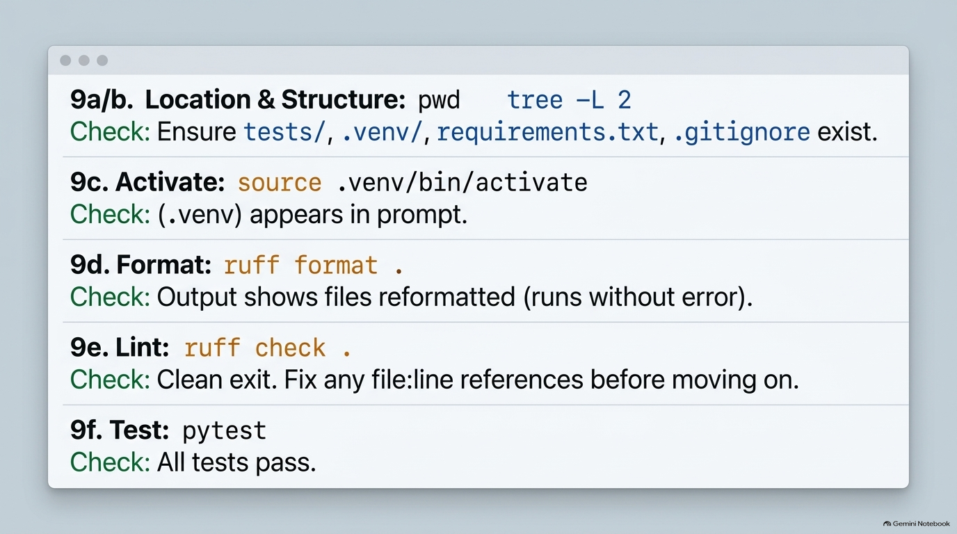
Notes:
SLIDE 9 — Step 9a — Confirm location
Step 9a — Confirm location
DO:
pwd
CHECK:
/Users/yourname/ism3232/module02_zsh
Step 9b — Confirm structure
DO:
tree -L 3
CHECK: Full structure including .venv/, tests/, requirements.txt, .gitignore — a snapshot of exactly what exists before you touch Git.
Step 9c — Activate the venv
DO:
source .venv/bin/activate
CHECK: (.venv) prefix appears in the prompt.
Step 9d — Format the code
SAY: "ruff format rewrites your files to a consistent style automatically — spacing, quote style, line length."
DO:
ruff format .
CHECK:
2 files reformatted, 1 file left unchanged
(Exact counts vary — the key output is that it ran without error.)
Step 9e — Lint the code
SAY: "ruff check looks for actual problems — unused imports, undefined names — not just style."
DO:
ruff check .
CHECK:
All checks passed!
FIX: If it lists errors instead, read the file:line references and fix each one before continuing — do not commit with lint errors present.
Step 9f — Run the tests
DO:
pytest
CHECK:
3 passed in 0.01s
FIX: If anything fails here, stop — go back and fix it before touching Git. Never commit on a red test suite.
SLIDE NOTES
LIVE DEMO — the first six ritual steps, run one at a time, each with its own visible checkpoint before moving to the next.
9a/9b — Location & Structure.
Reiterate: this is the last checkpoint before Git is touched at all — nothing in Stage 4 should run until this line is green.

Slide 10
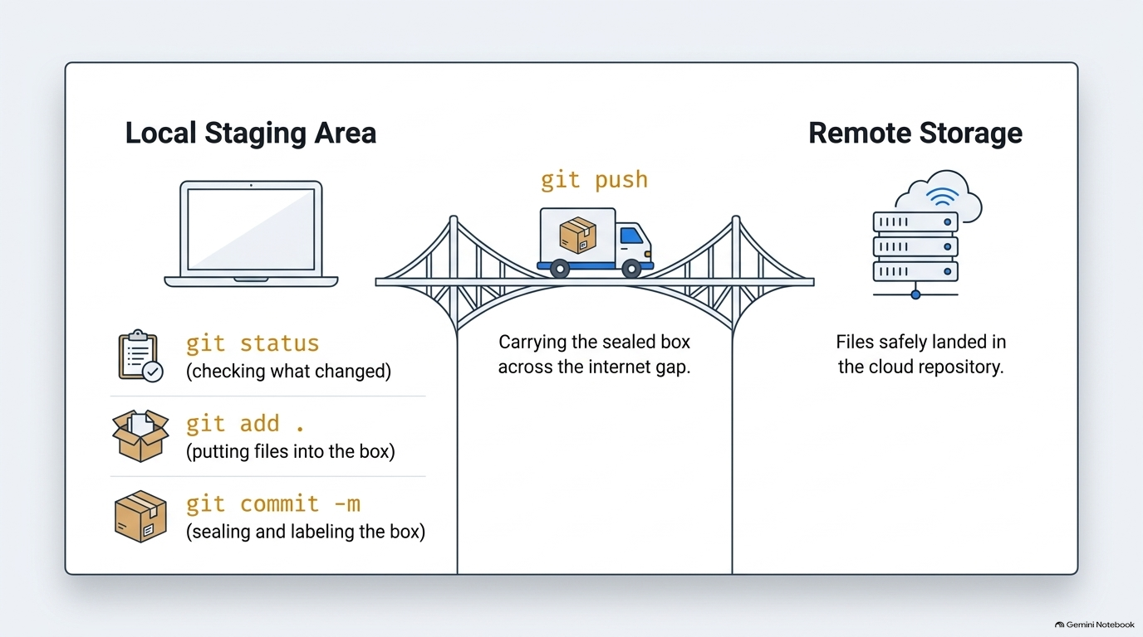
Notes:
SLIDE 10
CONCEPT — the Git half of the ritual as a mental model, bridging into Steps 9g–9j. Teaching goal: give students a physical metaphor for git status / git add / git commit / git push before running them live, since these four commands are the part of the ritual students most often run out of order.
Narrate the metaphor directly off the diagram: your laptop is the Local Staging Area. git status is checking what's changed — walking around the room and noting what's out of place. git add . is putting files into the box — nothing is sent anywhere yet, it's just gathered and marked ready. git commit -m '...' is sealing and labeling that box — a permanent, named snapshot in your local history. git push is the truck carrying the sealed box across the bridge — the internet gap — to Remote Storage, where the files land safely in the cloud repository (GitHub).
Emphasize the order encoded in the metaphor: you cannot push a box that was never sealed (committed), and you cannot seal a box that was never packed (added) — the four steps are strictly sequential, which is exactly why the ritual lists them in this order every time.

Slide 11
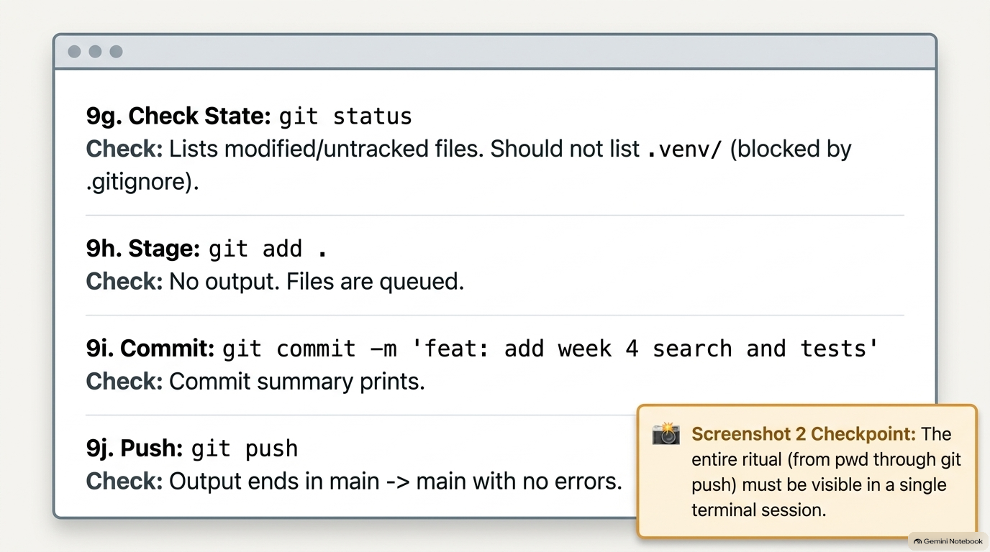
Notes:
SLIDE 11 — Step 9g — Check git status
Step 9g — Check git status
DO:
git status
CHECK: A list of untracked/modified files — tests/, any reformatted files, etc. — none of them should be .venv/ (that's what your Week 3 .gitignore prevents).
Step 9h — Stage everything
DO:
git add .
CHECK: No output. Re-run git status mentally in your head — everything just staged should now show green/staged in a follow-up git status if you want to double check.
Step 9i — Commit with a descriptive message
DO:
git commit -m 'lab 4: search ritual and git'
CHECK:
[main abc1234] lab 4: search ritual and git
4 files changed, 32 insertions(+)
Step 9j — Push
DO:
git push
CHECK: Output ending in something like main -> main with no errors. (If this is your very first push, see Part 4 below first — you need a remote configured before push works.)
Ritual complete when: ruff check returns no errors, pytest returns all passed, and git status says "nothing to commit" right after the push.
Screenshot 2 checkpoint
SAY: "Screenshot 2 — the entire ritual, from pwd through git push, visible in one terminal session."
SLIDE NOTES
9g — Check State.
DO: git commit -m '<a descriptive message>' (the slide's example is 'feat: add week 4 search and tests'; the script's example is 'lab 4: search ritual and git' — either style is fine as long as the message is descriptive, not generic).
If this is the student's very first push and it fails because there's no remote yet, that's expected — the next slide covers the one-time GitHub setup that fixes it.

Slide 12
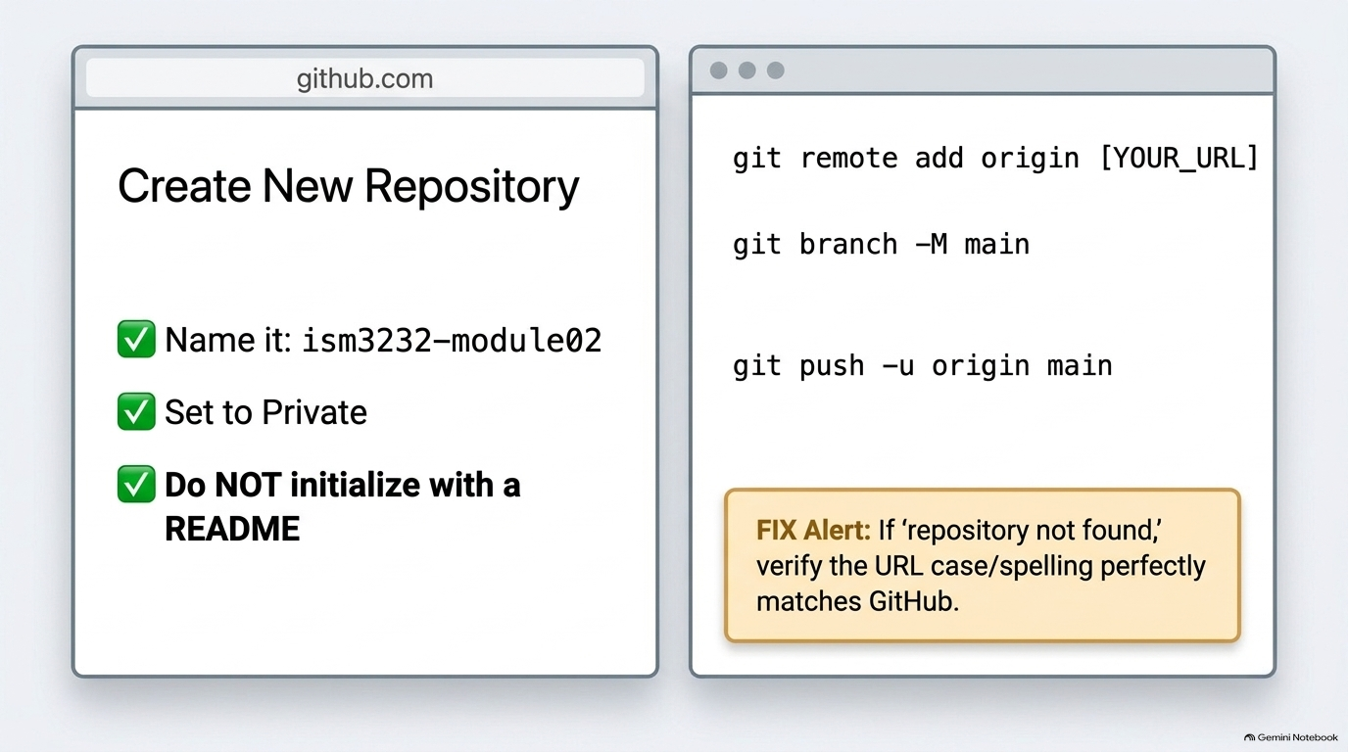
Notes:
SLIDE 12 — Step 10 — Create the GitHub repo and connect it
SAY: "If Step 9j just failed because there's no remote yet, here's the one-time setup."
DO: On github.com: New repository → name it ism3232-module02 → set Private → do not initialize with a README. Then back in the terminal:
git remote add origin https://github.com/YOURUSERNAME/ism3232-module02.git
git branch -M main
git push -u origin main
CHECK: Push output shows your objects being uploaded and ending with a line establishing main tracks origin/main.
FIX: If you get "repository not found," double check the URL matches exactly what GitHub showed you after creating the repo — case and spelling both matter.
SLIDE NOTES
LIVE DEMO — Step 10, the one-time GitHub setup, only needed if the git push in the previous slide failed because there's no remote configured yet.

Slide 13
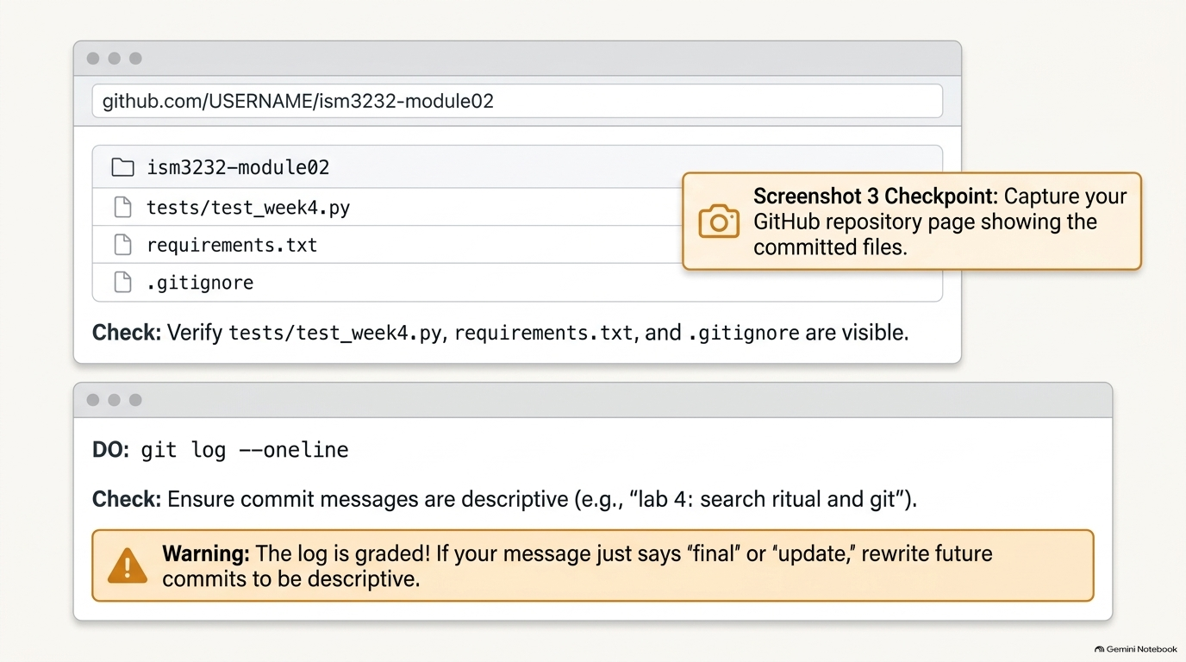
Notes:
SLIDE 13 — Step 11 — Verify on GitHub.com
Step 11 — Verify on GitHub.com
SAY: "Don't trust the terminal alone — open the actual repository page in a browser."
DO: Navigate to https://github.com/YOURUSERNAME/ism3232-module02 in Chrome.
CHECK: Your files — tests/test_week4.py, requirements.txt, .gitignore, README.md — are all listed, and the latest commit message (lab 4: search ritual and git) shows at the top.
Screenshot 3 checkpoint
SAY: "Screenshot 3 — your GitHub repository page, showing the committed files."
Step 12 — Verify the commit log
SAY: "One last check — the commit history itself, because this log is part of your grade."
DO:
git log --oneline
git status
CHECK:
abc1234 lab 4: search ritual and git
and
nothing to commit, working tree clean
FIX: If your commit message just says "final" or "update," rewrite future commits to be descriptive — that's explicitly graded from here forward.
SLIDE NOTES
LIVE DEMO — Step 11 (verify on GitHub.com) plus Screenshot 3, then Step 12 (verify the commit log).
the log shows the descriptive commit message (e.g. 'lab 4: search ritual and git'), and git status reports 'nothing to commit, working tree clean.'
FIX: if a past commit message just says 'final' or 'update,' tell students to rewrite FUTURE commits to be descriptive — that's explicitly graded from this lab forward, exactly as the warning banner on this slide states.

Slide 14
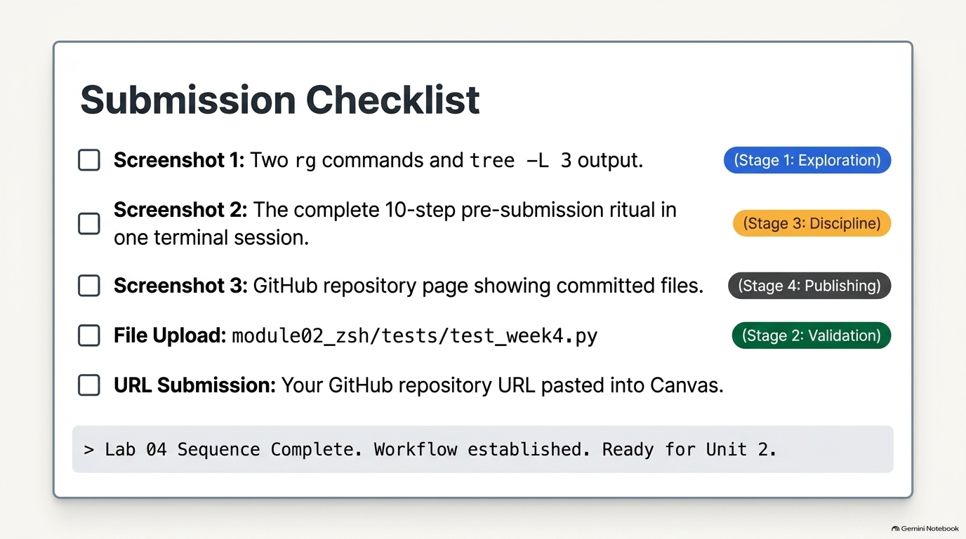
Notes:
SLIDE 14 — SUBMISSION CHECKLIST
• [ ] Screenshot 1: two rg commands and tree -L 3 output
• [ ] Screenshot 2: the complete pre-submission ritual — all steps in one terminal session
• [ ] Screenshot 3: your GitHub repository page showing committed files
• [ ] module02_zsh/tests/test_week4.py uploaded
• [ ] Your GitHub repository URL pasted into the Canvas text box
SLIDE NOTES
WRAP-UP — Submission Checklist. Walk every item before letting students upload to Canvas, mapped to the stage that produced it:
[ ] Screenshot 1 — two rg commands and tree -L 3 output (Stage 1: Exploration).
[ ] Screenshot 2 — the complete pre-submission ritual, all ten steps in one terminal session (Stage 3: Discipline).
[ ] Screenshot 3 — the GitHub repository page showing committed files (Stage 4: Publishing).
[ ] File upload — module02_zsh/tests/test_week4.py (Stage 2: Validation).
[ ] URL submission — the student's GitHub repository URL pasted into the Canvas text box.
Close on the framing from the slide's terminal-style footer: 'Lab 04 Sequence Complete. Workflow established. Ready for Unit 2.' Reinforce verbally that this exact ten-step ritual — not just today's content — is what carries forward into every remaining assignment this semester.

